Slide 1
Analysis of Poly- and Perfluoroalkyl Substances in Drinking Water across CA, MA and MI
Samarth Suresh, MS ENVE
samarthsuresh@gatech.edu

Slide 2
What is PFAS?
PFAS are a group of manufactured chemicals that have been used in industry and consumer products since the 1940s because of their useful properties.
PFAS break down very slowly and can build up in people, animals, and the environment over time.
Found in –
Drinking water
Fire extinguishing foam
Food
Manufacturing or chemical production facilities that produce or use PFAS – Chemical, Textile, Electronics
Personal care products
Food packaging
PFOA Perfluorooctanoic acid
PFOS Perfluorooctanesulfonic acid

Slide 3
What we don’t fully understand about PFAS yet
EPA's researchers and partners across the country are working hard to answer critical questions about PFAS:
How to better and more efficiently detect and measure PFAS in our air, water, soil, and fish and wildlife
How much people are exposed to PFAS
How harmful PFAS are to people and the environment
How to remove PFAS from drinking water
How to manage and dispose of PFAS

Slide 4
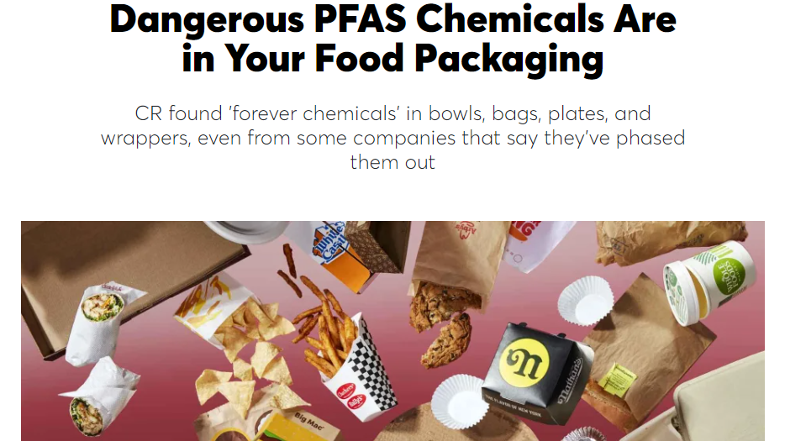
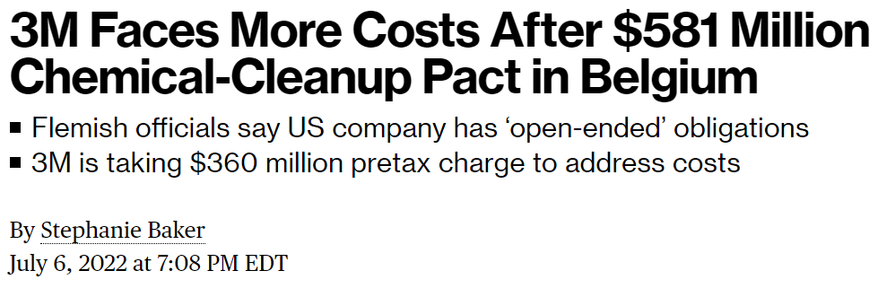

Slide 5
EPA’s Drinking Water Health Advisories for PFOA and PFOS
Compound | Proposed Maximum Contaminant Level Goals (MCLG, Non-Enforceable) | Proposed MCL (enforceable levels)
PFOA | Zero | 4 ng/L
PFOS | Zero | 4 ng/L
PFNA | 1.0 (unitless) Hazard Index | 1.0 (unitless) Hazard Index
PFHxS
PFBS
HFPO-DA (GenX Chemicals)

Slide 6
Data Analysis
Descriptive Statistical Analysis –
Mean Bar Graph
Boxplots
Pattern Identification Analysis –
Regression Analysis (Supervised Learning)
K-Mean Clustering (Unsupervised Learning)
Gaussian Mixture Models (Supervised Learning)
Quality of Clusters – Silhouette Scores
Notes:
Silhouette Scores can be used to check the quality or validate the Gaussian Mixture Models (GMMs). Silhouette Scores measure the quality of clustering in terms of how well-separated clusters are. A higher Silhouette Score indicates that the data points are well-clustered and separated from each other. Therefore, higher Silhouette Scores imply better quality GMMs.

Slide 7
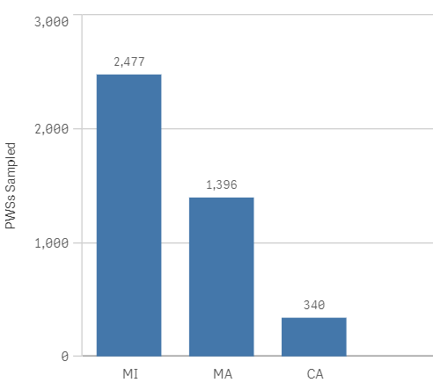
Dataset
Drinking Water Samples for Public Water Systems (PWSs)

Slide 8
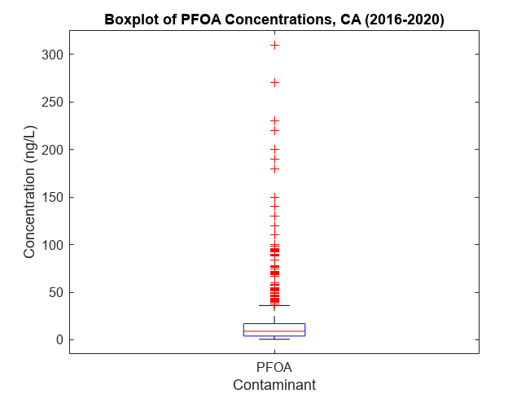
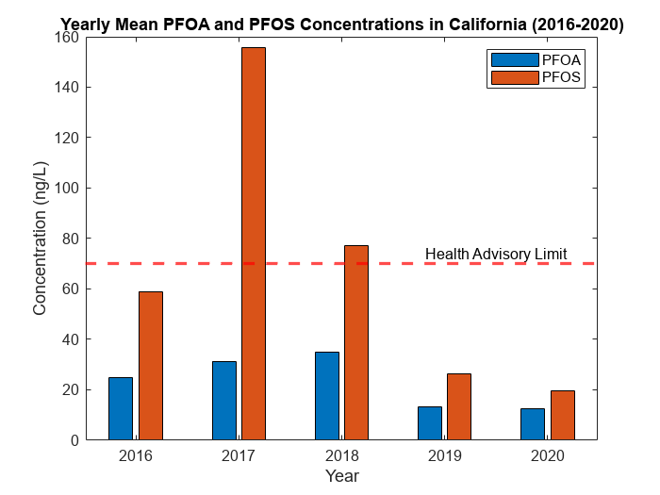
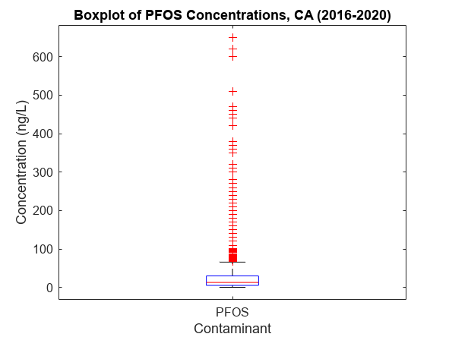
California

Slide 9
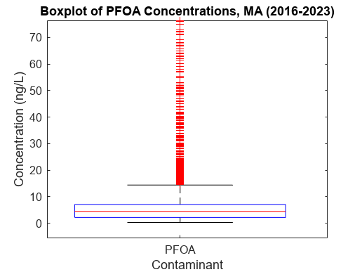
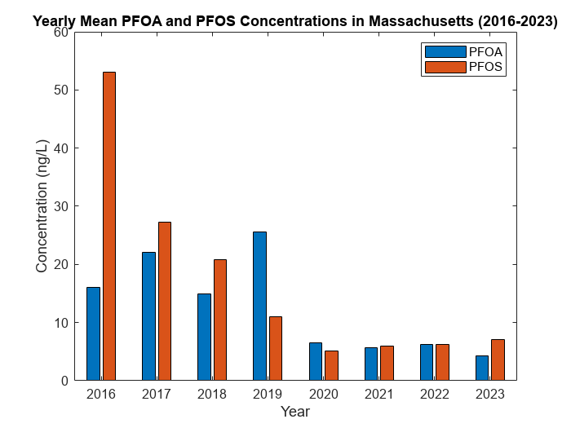
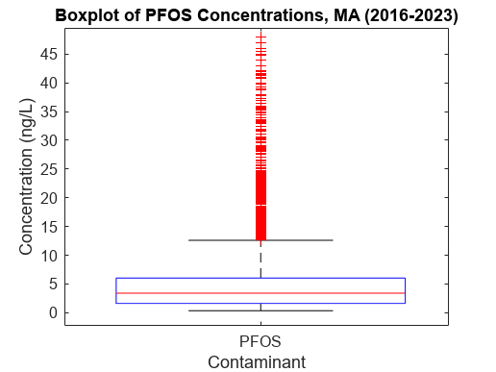
Massachusetts

Slide 10
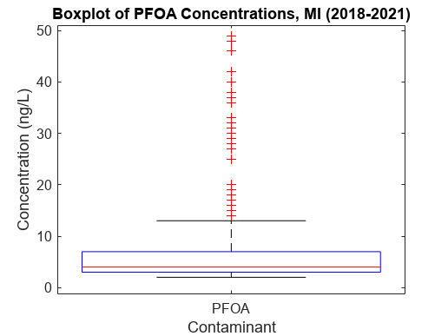
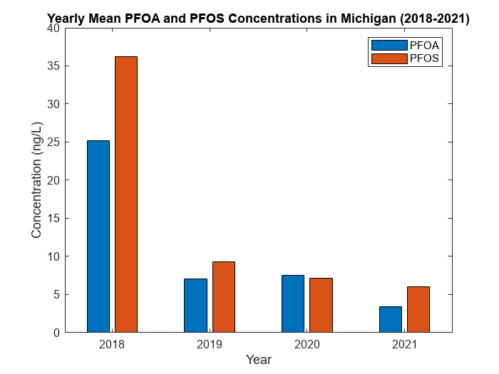
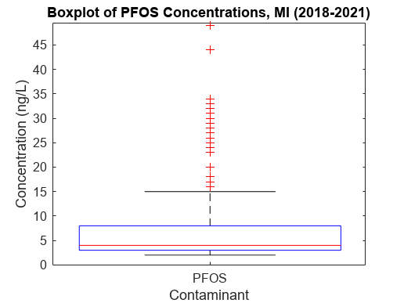
Michigan

Slide 11
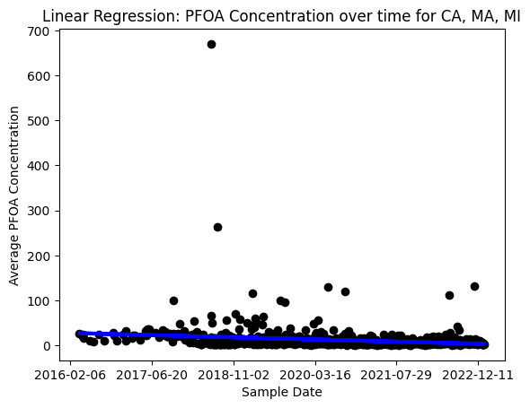
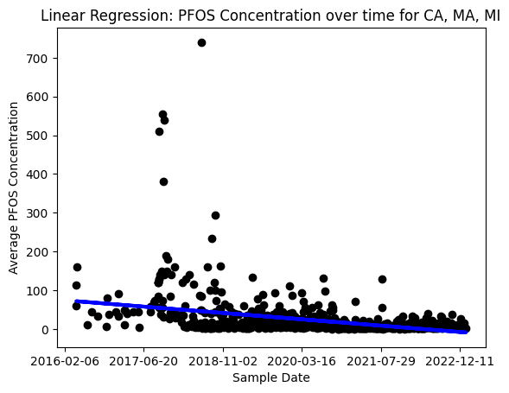
Linear Regression
R-Squared: 0.078
R-Squared: 0.21
Notes:
In this case, we can use linear regression to model the relationship between the concentration of contaminants (y-axis) and the years (x-axis).
The goal is to find the line of best fit that minimizes the sum of the squared differences between the observed values and the predicted values.

Slide 12
k-Means Clustering Analysis
K-Means Clustering is a method of grouping data points into ‘K-clusters’ based on their similarity.
It starts with randomly placing K centroids, calculates the distance of each point to these centroids, and assigns each point to the nearest centroid.
Updates the centroids by taking the mean of the points in each cluster and repeats until convergence.
Quality Tested using –
1. Davies Bouldin’s Index
2. Silhouette Score
Silhouette Score: Silhouette Score measures how well each data point fits its assigned cluster, while also taking into account how well it fits into other clusters. The score ranges from -1 to 1, with higher scores indicating better clustering quality.
Davies-Bouldin Index: The Davies-Bouldin Index is a metric that quantifies the degree of separation between clusters. A lower score indicates better clustering quality.
Notes:
Silhouette Score: Silhouette Score measures how well each data point fits its assigned cluster, while also taking into account how well it fits into other clusters. The score ranges from -1 to 1, with higher scores indicating better clustering quality.
Davies-Bouldin Index: The Davies-Bouldin Index is a metric that quantifies the degree of separation between clusters. A lower score indicates better clustering quality.

Slide 13
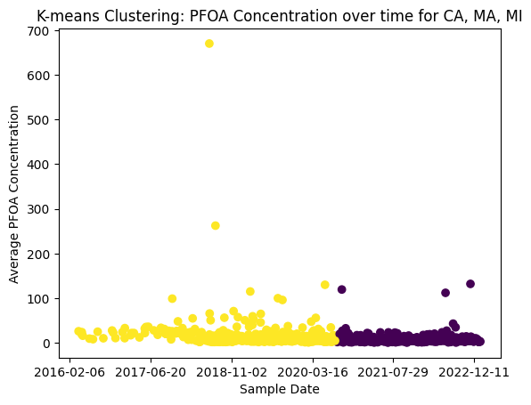
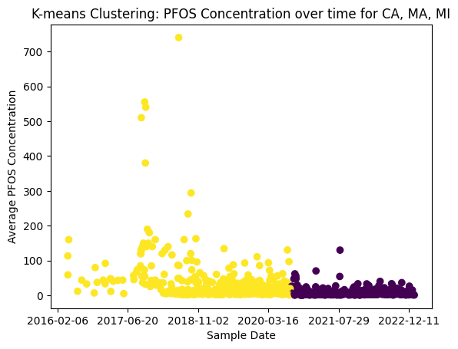
k-Means Clustering Analysis
Davies Bouldin Index: 0.5334
Silhouette Score: 0.5958
Davies Bouldin Index: 0.5433
Silhouette Score: 0.5888
Notes:
Silhouette Score: Silhouette Score measures how well each data point fits its assigned cluster, while also taking into account how well it fits into other clusters. The score ranges from -1 to 1, with higher scores indicating better clustering quality.
Davies-Bouldin Index: The Davies-Bouldin Index is a metric that quantifies the degree of separation between clusters. A lower score indicates better clustering quality.

Slide 14
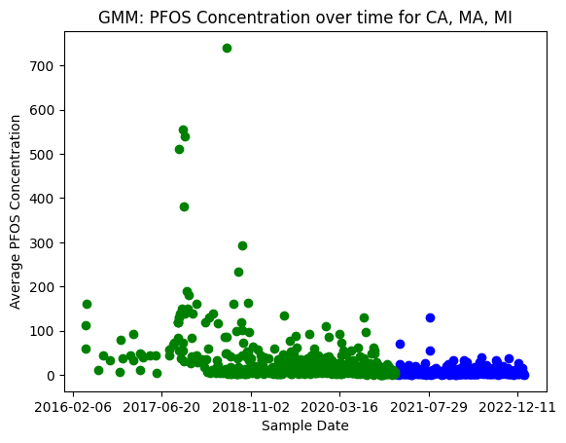
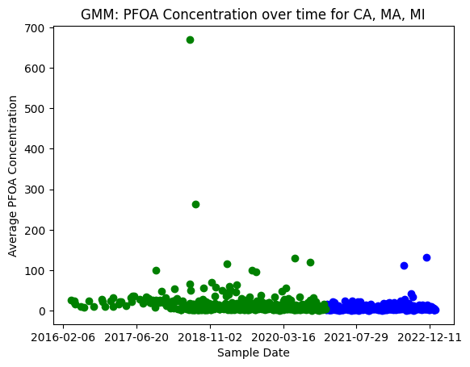
Gaussian Mixture Models
Gaussian Mixture Models (GMM) is a probabilistic model for representing normally distributed subpopulations within an overall population.
The goal of GMM is to estimate the parameters of the underlying Gaussian distributions that best fit the observed data.
Notes:
The Gaussian Mixture Model (GMM) algorithm works as follows:
Given a set of data points, we first assume that the data points are generated by a mixture of Gaussian distributions.
The algorithm starts by randomly initializing the means and covariance matrices of the Gaussian distributions.
In the E-step, we calculate the probability of each data point belonging to each Gaussian distribution based on the current estimates of the mean and covariance matrices.
In the M-step, we update the mean and covariance matrices of each Gaussian distribution based on the probabilities calculated in the E-step.
We repeat the E-step and M-step until convergence is achieved or a maximum number of iterations is reached.
The final output of the algorithm is the set of mean and covariance matrices that best represent the data.

Slide 15
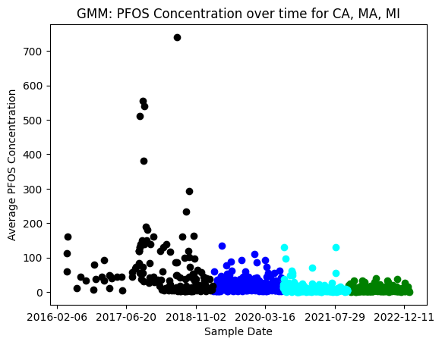
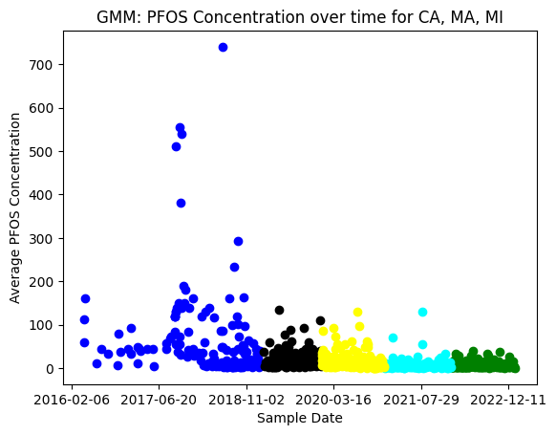
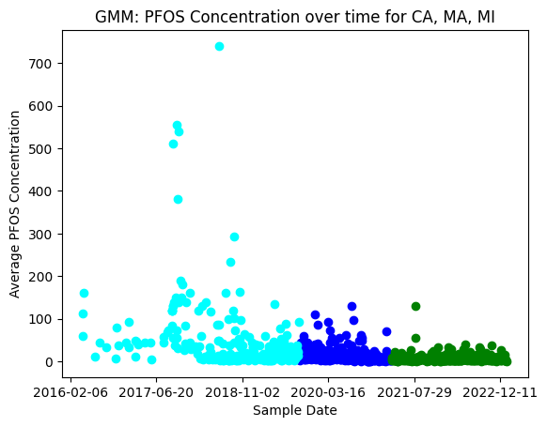
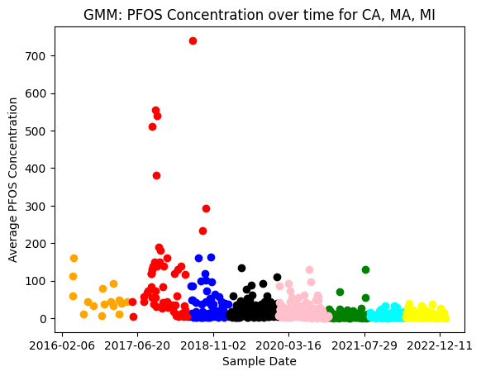
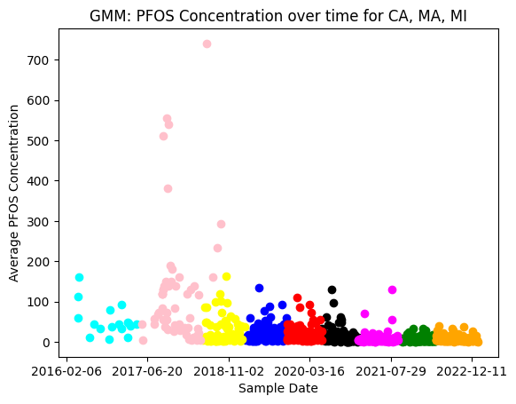
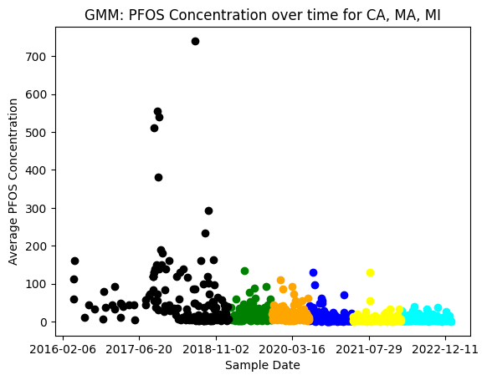
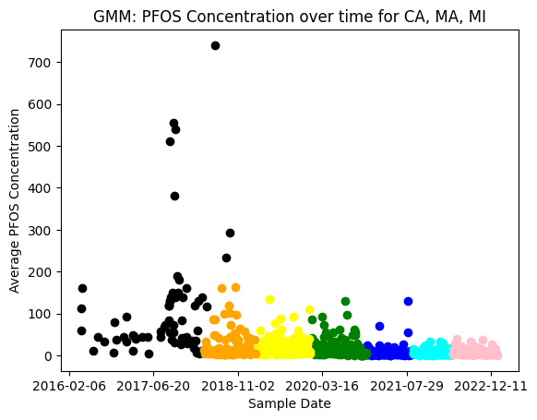
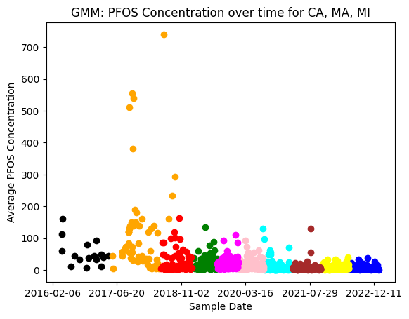
GMMs (PFOS) Quality Analysis – Clustering

Slide 16
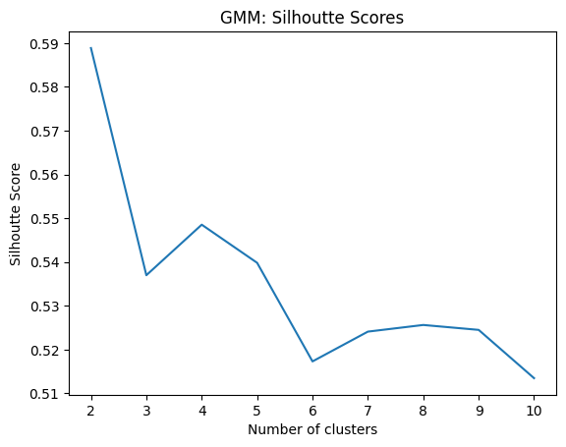
GMMs (PFOS) Quality Analysis - Silhouette Scores

Slide 17
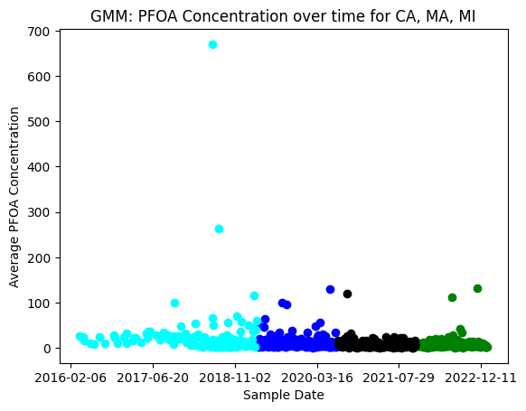
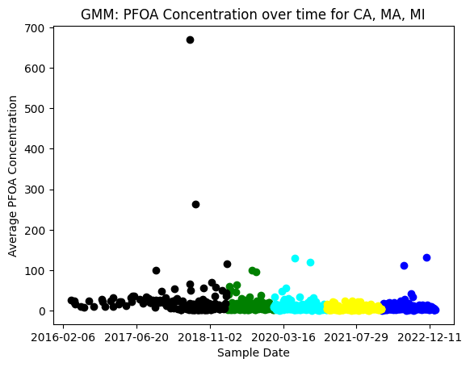
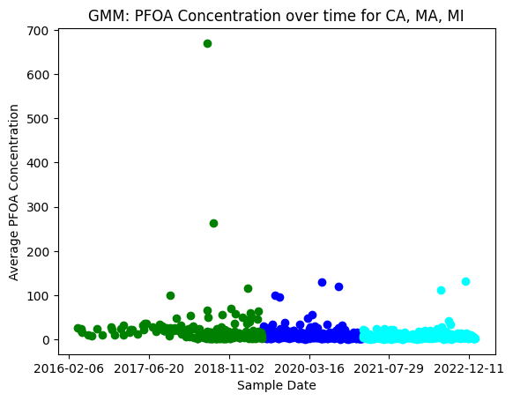
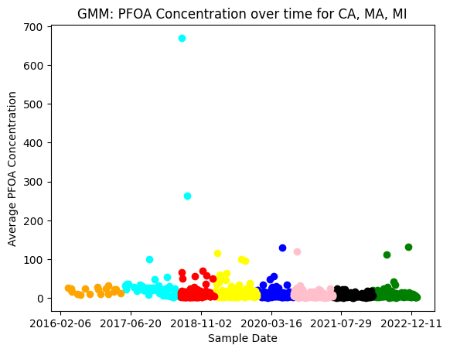
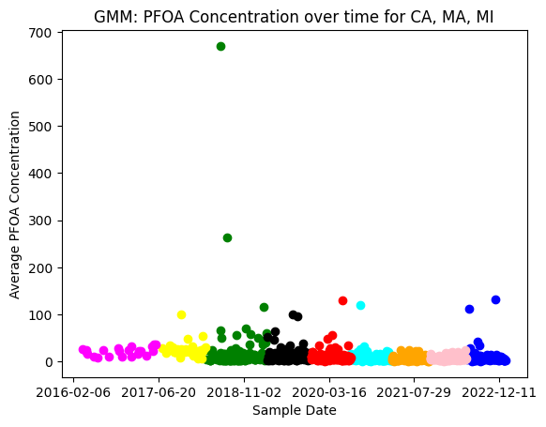
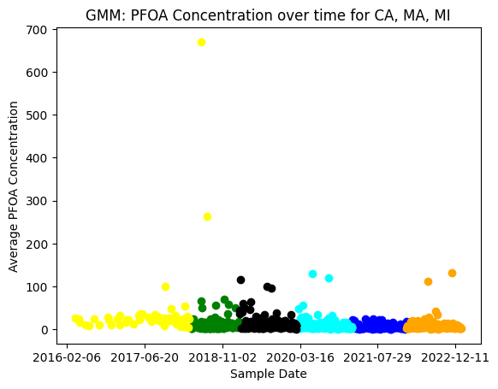
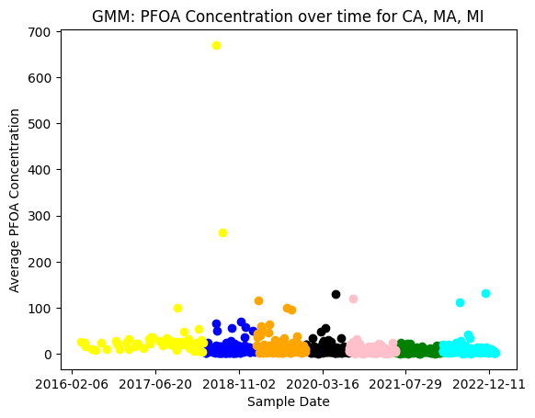
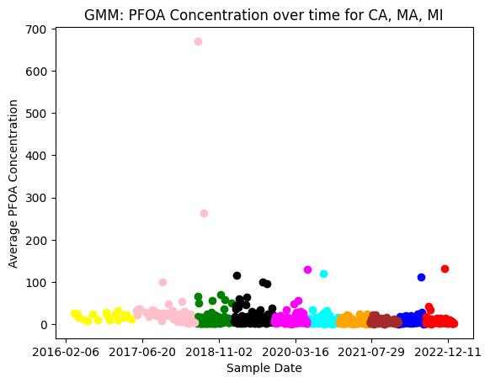
GMMs (PFOA) Quality Analysis – Clustering

Slide 18
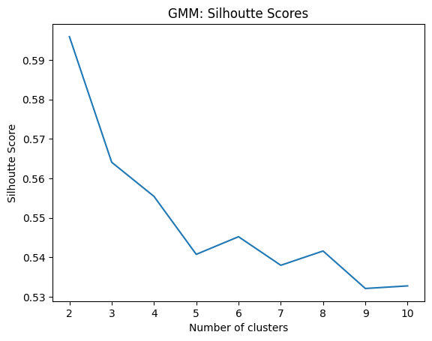
GMMs (PFOA) Quality Analysis - Silhouette Scores

Slide 19
Gaussian Matrix Models Analysis STATEWISE

Slide 20
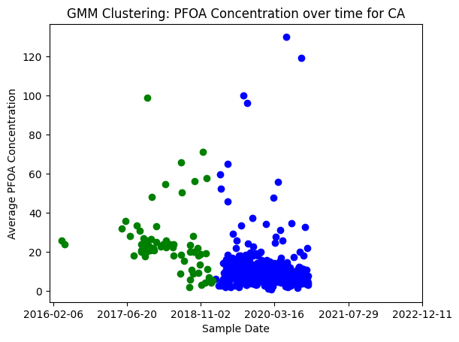
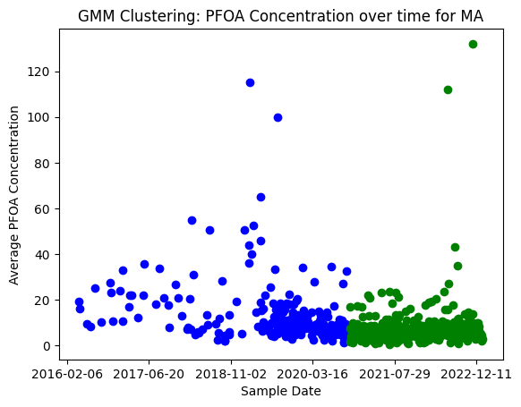
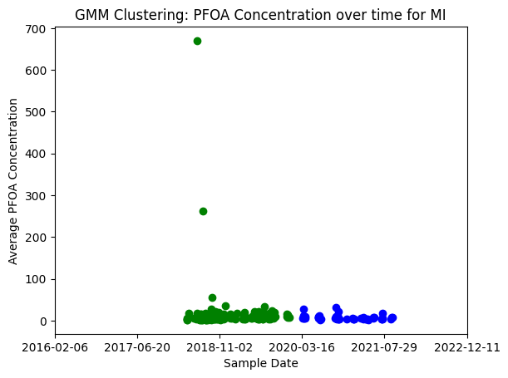
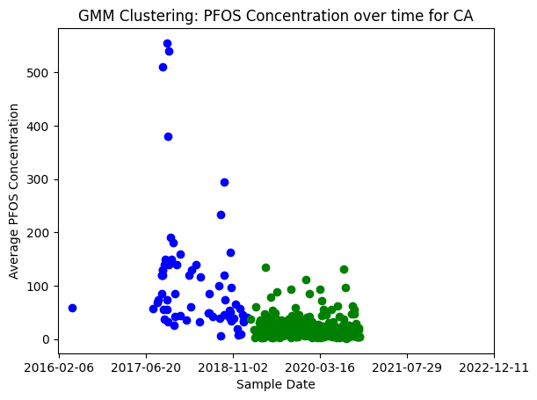
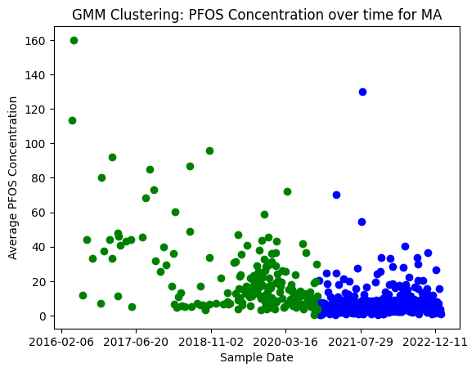
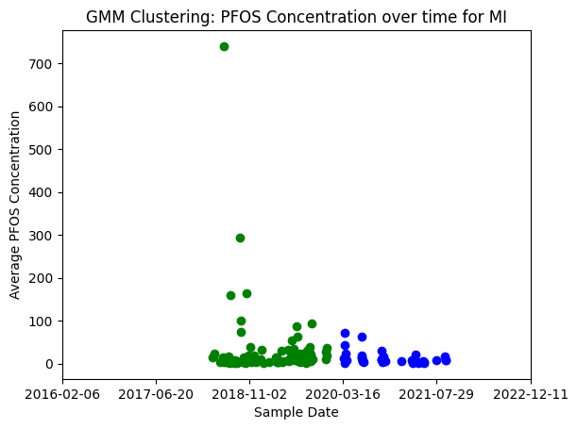

Slide 21
What does all this signify?
The GMMs cluster pattern are partitioning at the 2019 Corona virus pandemic mark signifying the decrease in presence of PFOA & PFOS in drinking water (with exceptions)
Conc. of CA & MA >> MI – Likely because of PFA manufacturing industrial exposure
Linear Regression – Unlikely with the PFA dataset since no feature variables associated apart from concentration. Are there any other water quality variables that can be correlated to the conc.?

Slide 22
Future Works
Polynomial Regression
In-depth descriptive analysis of dataset
Expand to other states for broader comparison
Explore feature variables for correlation analysis
Look into other PFA contaminants – short chained and long chain
PFA concentrations in Wastewater (data?)
PFA concentrations in Biosolids (data?)

Slide 23
References
https://www.epa.gov/sdwa/and-polyfluoroalkyl-substances-pfas
https://awsedap.epa.gov/public/extensions/PFAS_Tools/PFAS_Tools.html
https://en.wikipedia.org/wiki/Perfluorooctanesulfonic_acid
https://en.wikipedia.org/wiki/Perfluorooctanoic_acid
https://www.ewg.org/research/update-mapping-expanding-pfas-crisis
https://www.aquasana.com/info/cities-with-pfoa-pfas-contamination-pd.html#:~:text=Michigan%20has%20the%20highest%20levels,and%201%2C100%20ppt%20of%20PFOA.%E2%80%9D
https://www.michigan.gov/pfasresponse/drinking-water/statewide-survey
https://www.atsdr.cdc.gov/pfas/health-effects/overview.html
https://scikit-learn.org/stable/

Slide 24
Analysis of Poly- and Perfluoroalkyl Substances in Drinking Water across CA, MA and MI
Questions?
Samarth Suresh, MS ENVE
samarthsuresh@gatech.edu

