Slide 1
Analyzing Attendance Data from a Local Small Business
Matthew Adams

Slide 2
Background
Produhktiv is a local small business specializing in online learning
Goal is to analyze attendance data for patterns in time and demographics

Slide 3
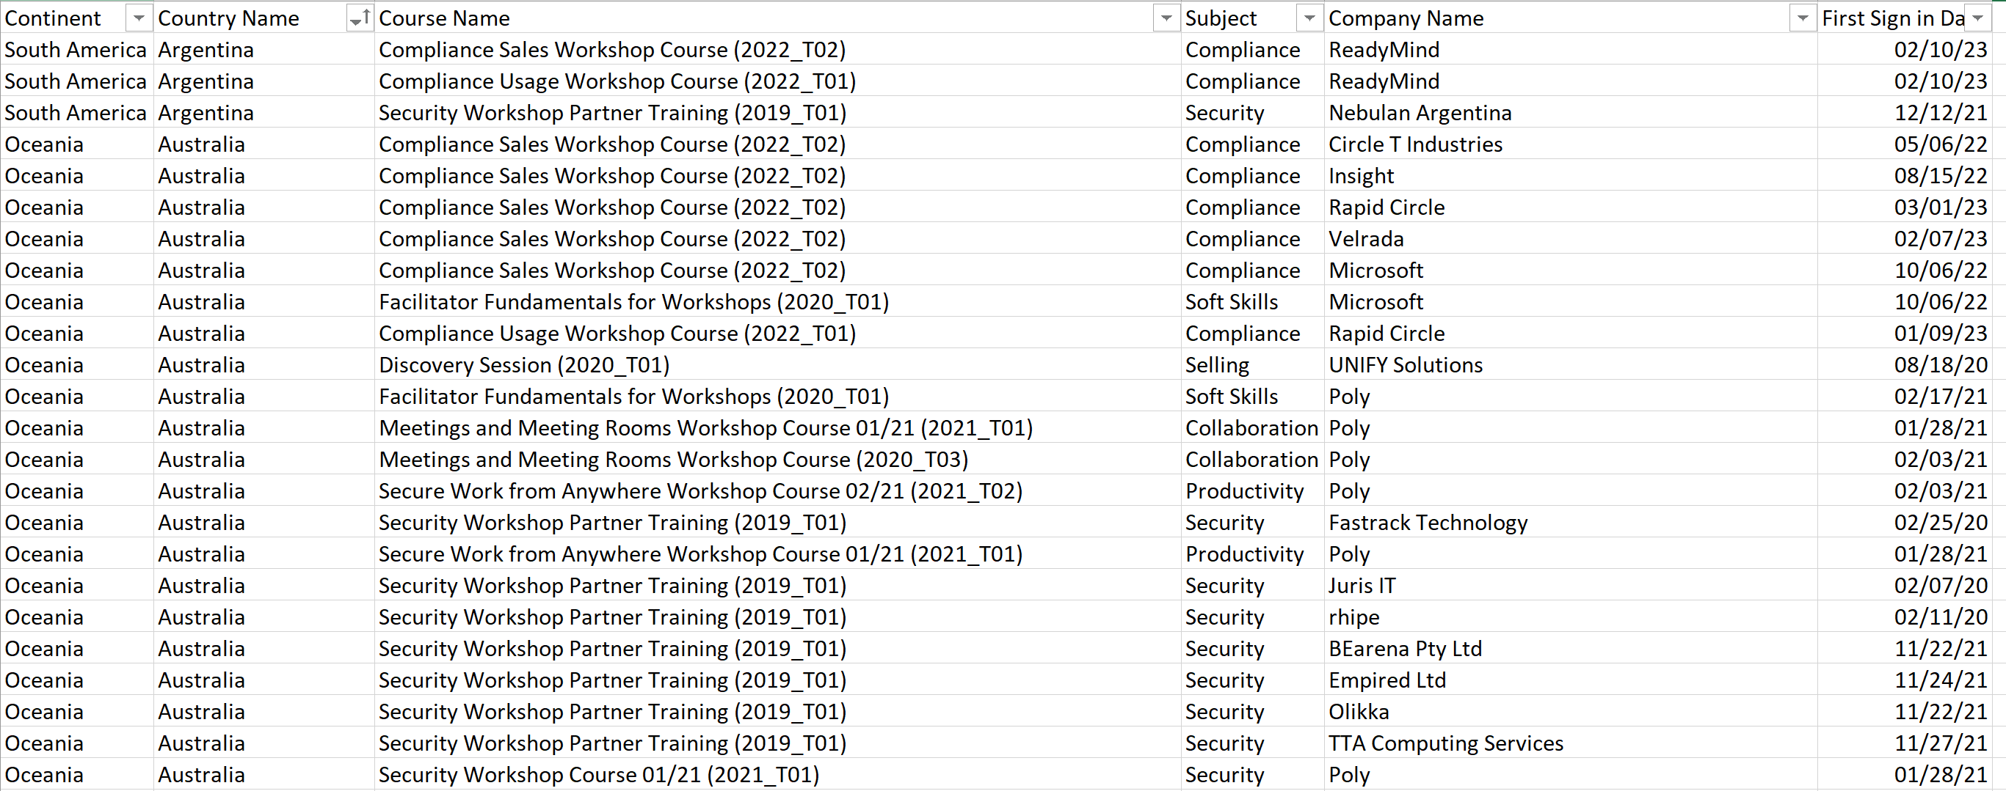
Data
Data from Produhktiv covers all online courses they have run from 2019-present
Provides country and company of learner, the course name, and the date the learner started the course
Over 2,700 learners across over 150 courses
6 continents and 80 countries represented

Slide 4
Test 1: The Covid Years

Slide 5
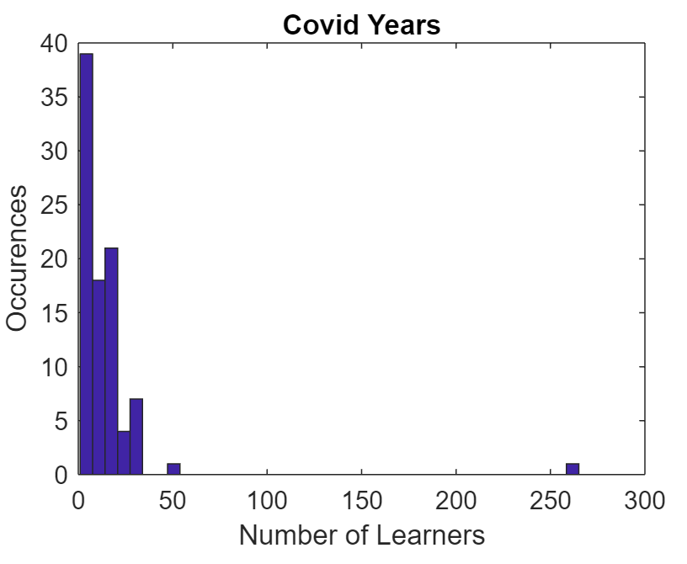
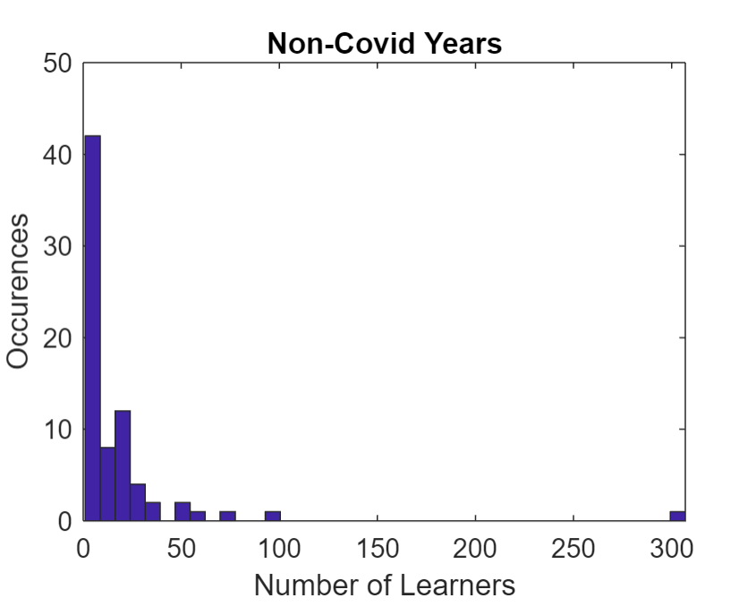
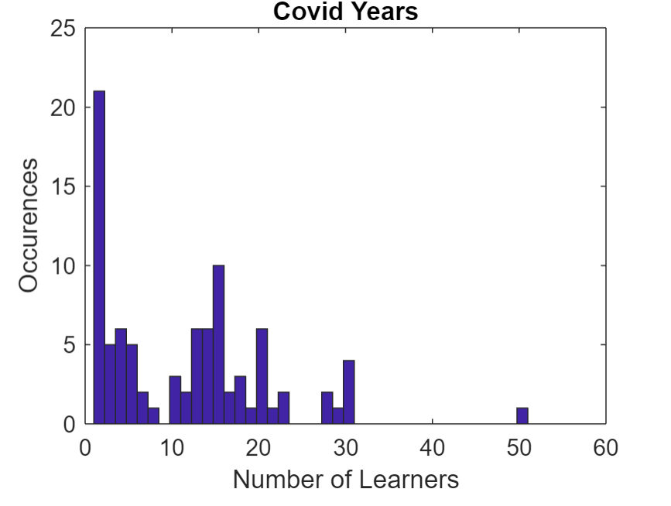
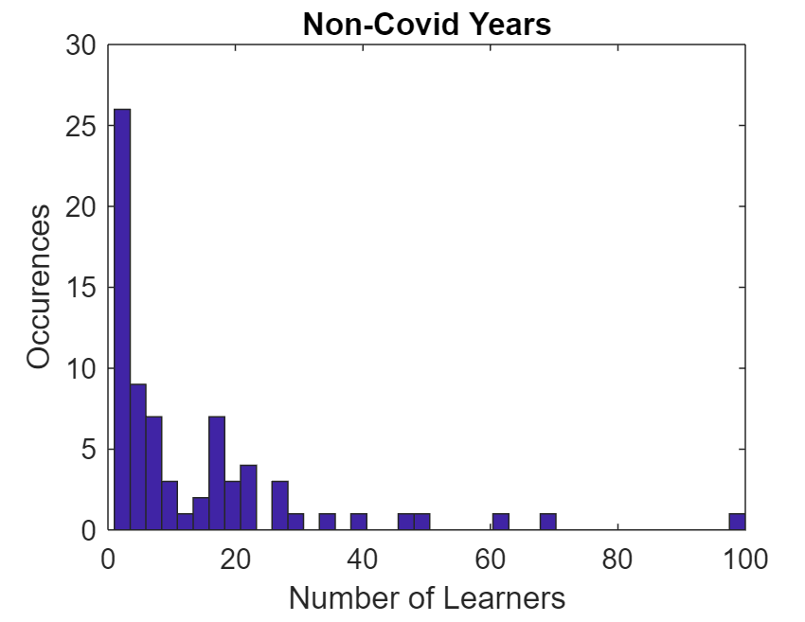
Did Covid significantly impact business?
Looked at average number of learners per course over covid (2020-2021) and non-covid (2019,2022-present) years
Use a 2-tailed t test with 95% CI to determine if there is a significant difference in the means

Slide 6
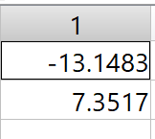
Results
T test failed to reject the null hypothesis, no significant difference between the means
The good news: Covid didn’t significantly affect business!

Slide 7
Test 2: Monthly Attendance

Slide 8
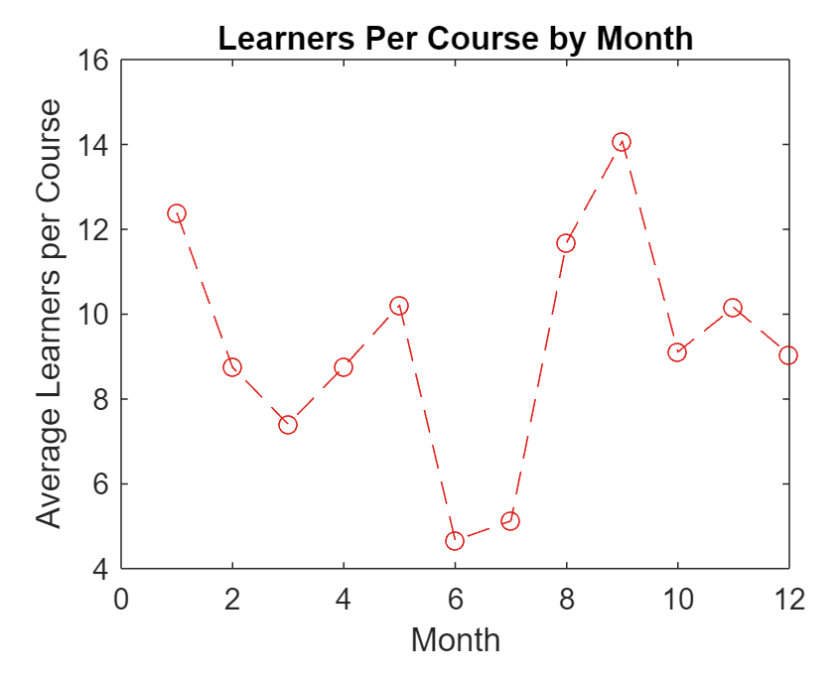
Do any months offer significantly better or worse attendance?
Looked at average number of learners per course over each month of the year
Compared month to month data as well as months to the total average
Use a 2 tailed t test with 95% CI

Slide 9
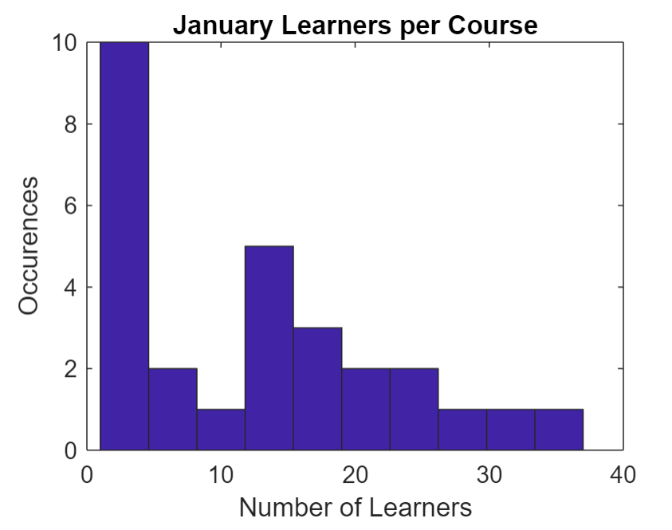
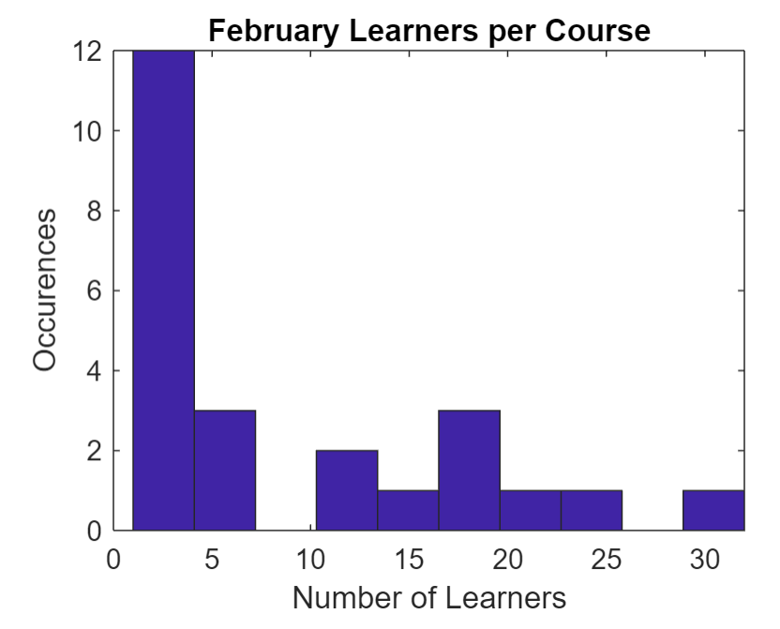
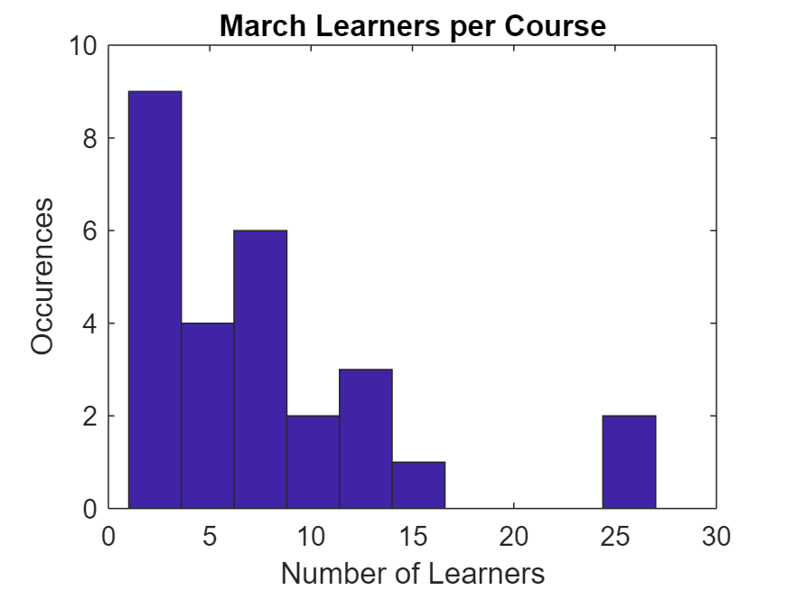
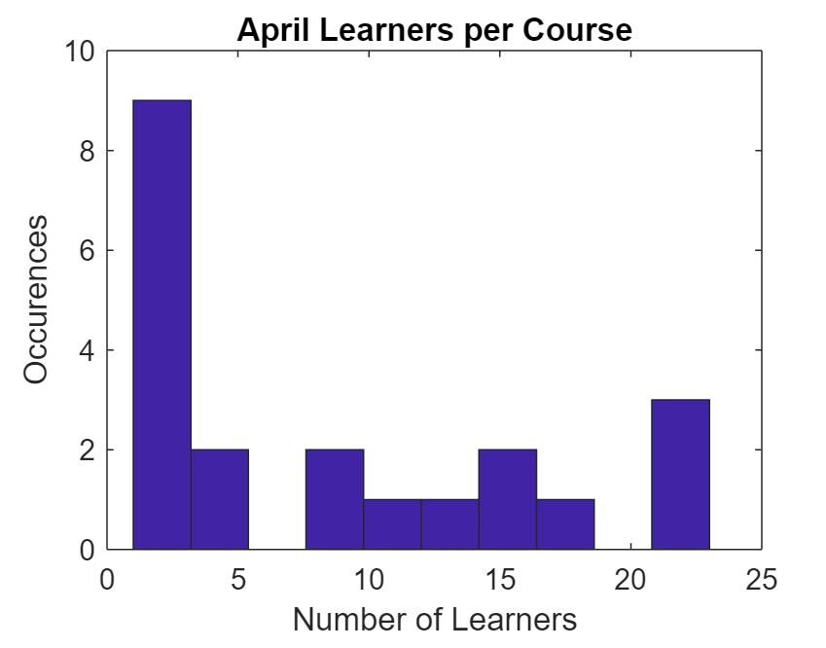
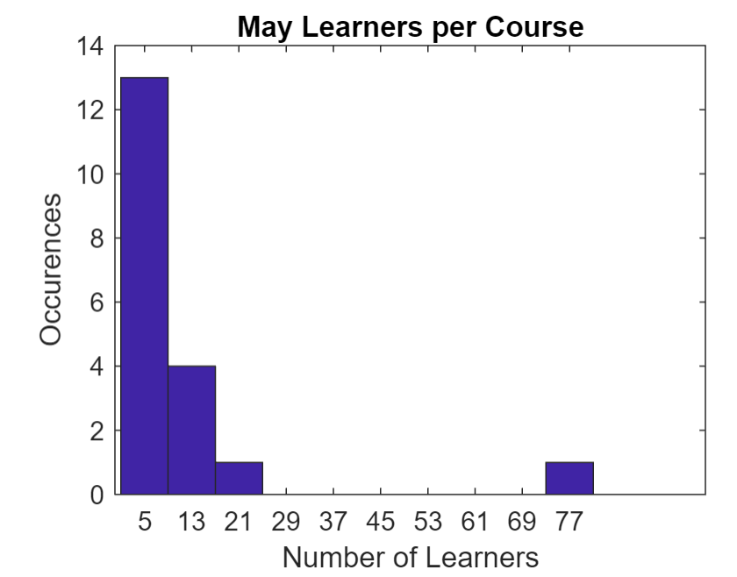
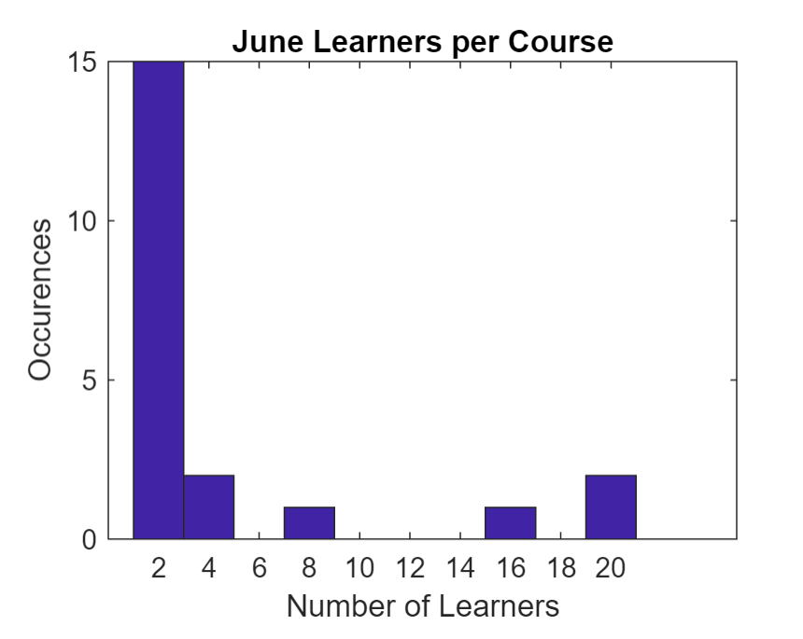
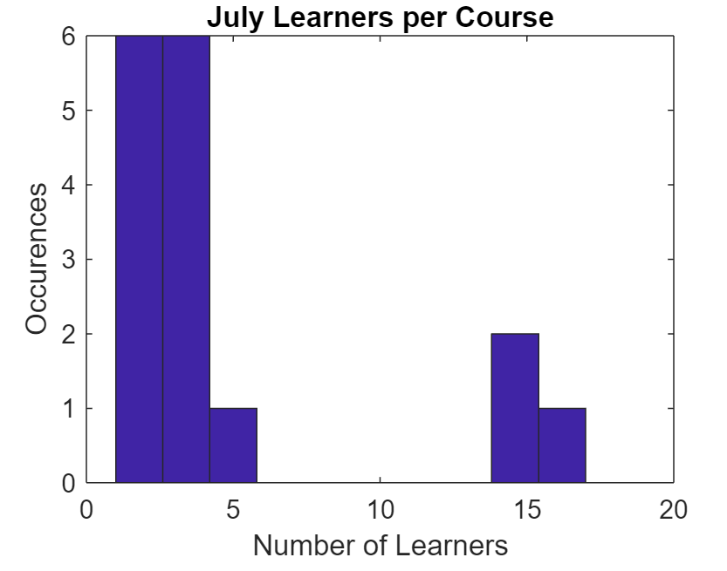
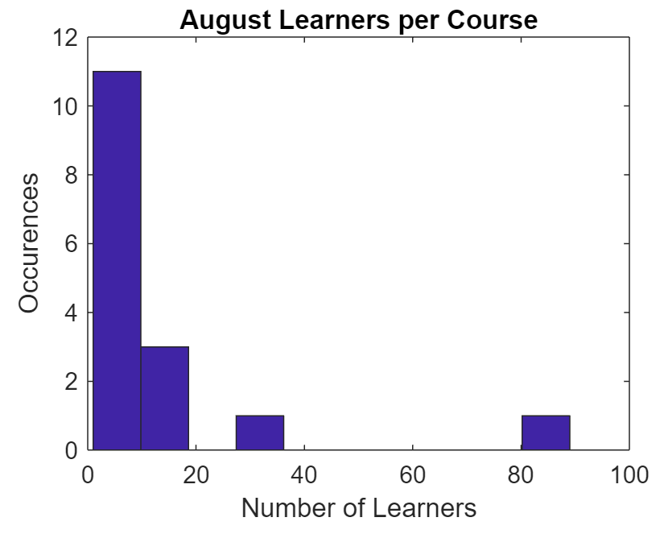
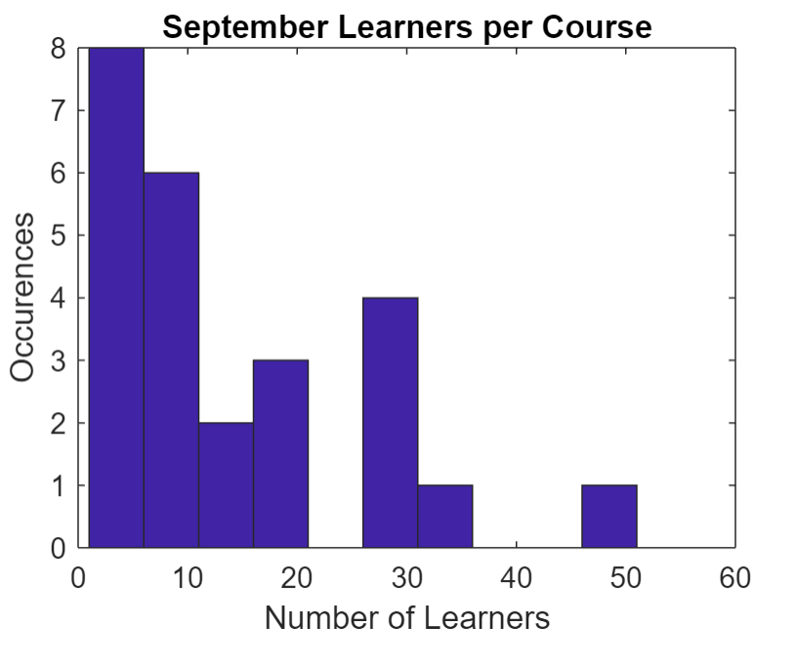
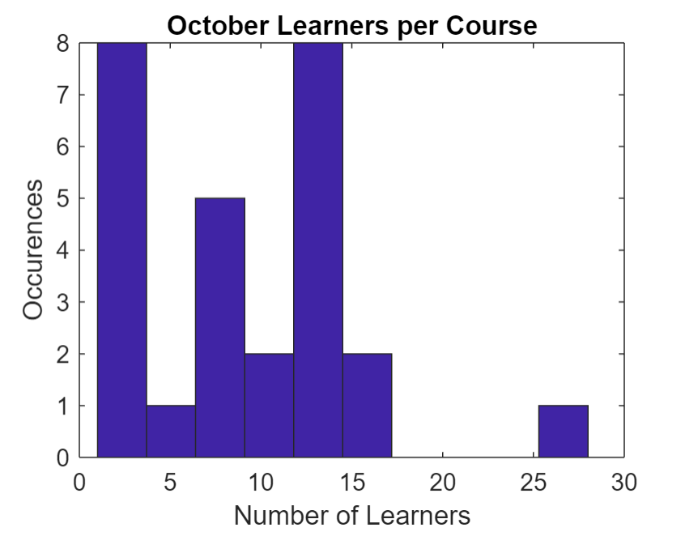
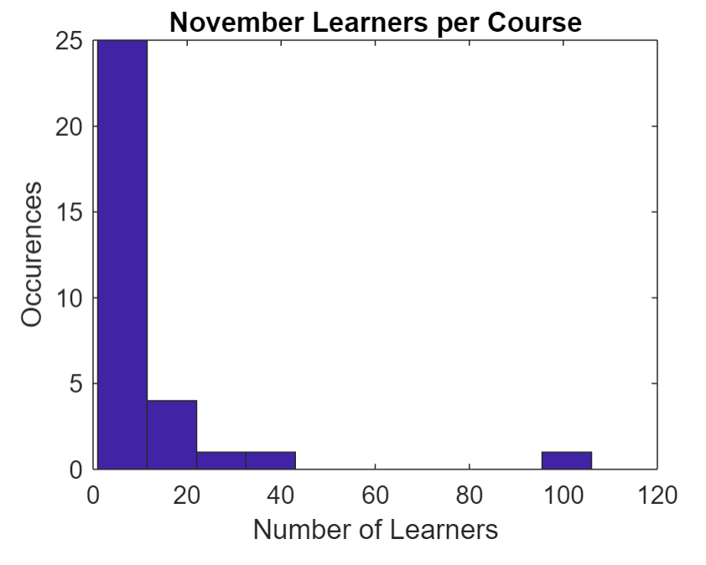
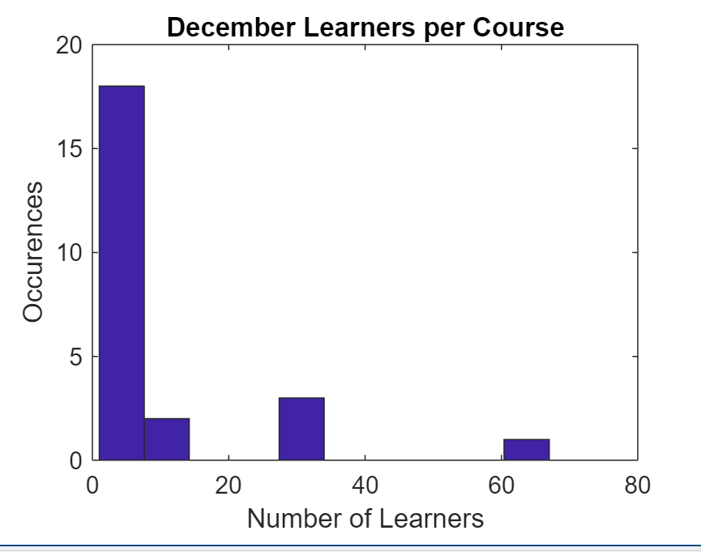

Slide 10
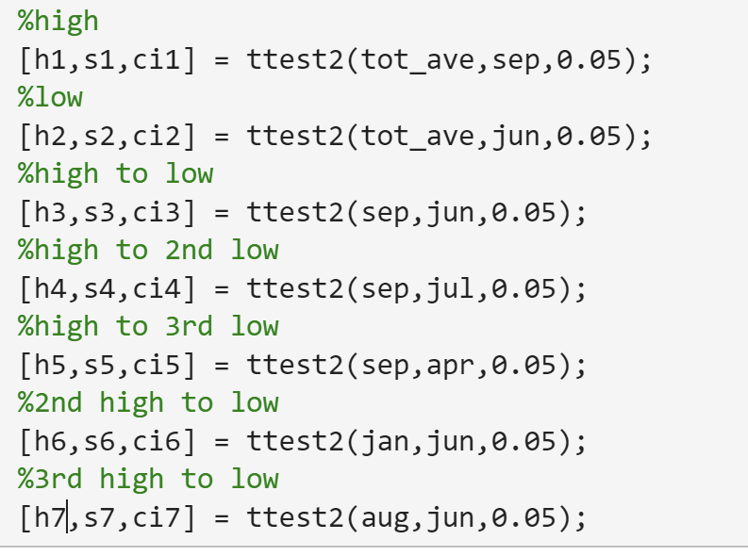
Results
Test between high (Sep) to average not significant
Test between low (Jun) and average not significant
Test between high (Sep) and low (Jun) significant!
Test between high (Sep) and second lowest (Jul) significant!
Test between high (Sep) and third lowest (Apr) not significant
Test between second highest (Jan) and low (Jun) significant!
Test between third highest (Aug) and low (Jun) not significant

Slide 11
Conclusions
No month is significantly better for business than the average
September significantly better than June and July
January significantly better than June
Summer is bad for business, fall and winter much better

