Slide 1
Understanding Inflation Using Price Indexes
Janhvi Dubey
EAS 4480

Slide 2
Motivation
Inflation: the increase in the general price level of goods and services in an economy
Indicator of economic growth
Regularly used to design economic policies, federal aid programs, and trade policies
Effects all United States residents
Goal
Analyze inflation data to understand its attributes and inform personal and national economic decisions

Slide 3
Background
Inflation is measured using price indexes.
Price Index
Basket of goods and services
Weightings

Slide 4
Background
Consumer Price Index (CPI)
Personal Consumption Expenditure Price Index (PCEPI)
Consumer Price Index
Consumer Price Index
Constructed by the Bureau of Labor Statistics (BLS)
Fixed basket of goods and services
“Urban Consumer”: surveyed in urban regions and cities
Excludes non-profit and government expenditures
Constructed by the Bureau of Economic Analysis (BEA)
Fluid basket of goods and services
Current expenditures data and consumer trends
Includes non-profit and government expenditures

Slide 5
Background

Slide 6
Data
CPI Data
The World Bank & The Bureau of Labor Statistics
PCEPI Data
FRED Economic Data

Slide 7
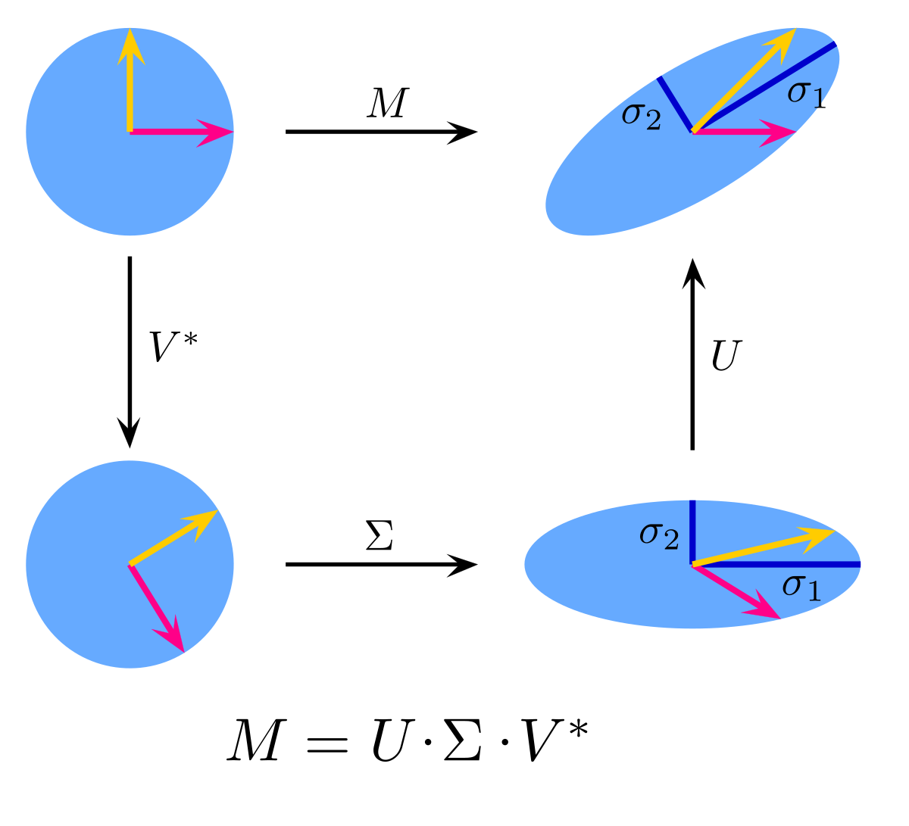
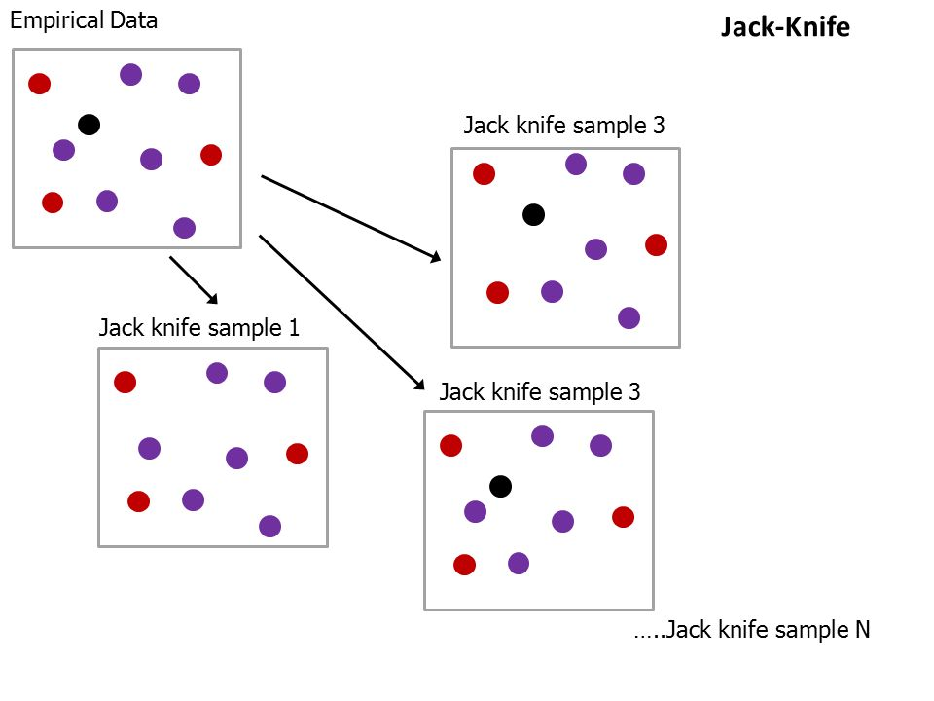
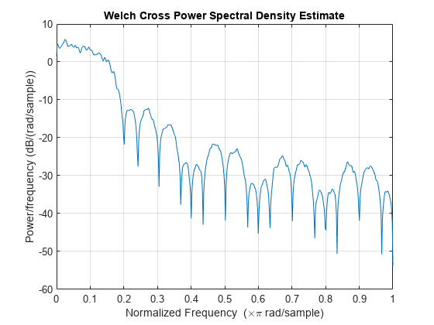
Analysis
Methods + Justification
Singular Value Decomposition (SVD)
Pearson’s Correlation Coefficient using Jackknife
Cross Power Spectral Density (CPSD)
Which groups of goods contribute the most to overall CPI or PCEPI?
Comparison of CPI and PCEPI on monthly and yearly time scales
Sensitivity Analysis: do certain time points have larger effect on overall correlation of data?
Comparison of CPI and PCEPI on a frequency scale
What is the periodicity of inflation?
Image from https://en.wikipedia.org/wiki/Singular_value_decomposition
Image from https://www.mathworks.com/help/signal/ref/cpsd.html
Image from https://slideplayer.com/slide/8340508/

Slide 8
Singular Value Decomposition (SVD)
CPI Coefficient Matrix
Singular Value (SV) | Apparel | Education | Energy | Food & Beverages | Housing | Medical Care | Other Goods | Singular Value Variance
SV 1 | -0.008 | 0.666 | 0.397 | 0.247 | 0.247 | 0.416 | 0.321 | 90.138
SV 2 | -0.017 | -0.304 | 0.916 | -0.049 | -0.097 | -0.201 | -0.128 | 9.071
SV 3 | -0.023 | 0.551 | 0.040 | -0.503 | -0.628 | -0.101 | -0.192 | 0.435
SV 4 | 0.880 | -0.040 | 0.004 | 0.162 | -0.280 | -0.107 | 0.328 | 0.244
SV 4 | -0.469 | -0.083 | -0.037 | 0.419 | -0.526 | -0.189 | 0.533 | 0.067
SV 5 | 0.054 | 0.310 | -0.031 | 0.644 | -0.010 | -0.406 | -0.566 | 0.034
SV 6 | -0.033 | 0.236 | -0.006 | -0.258 | 0.425 | -0.751 | 0.363 | 0.011

Slide 9
Singular Value Decomposition (SVD)
PCEPI Coefficient Matrix
Singular Value (SV) | Durable Goods | Non-durable Goods | Services | Food | Energy | Singular Value Variance
SV 1 | -0.222 | -0.449 | -0.552 | -0.482 | -0.461 | 87.390
SV 2 | 0.959 | 0.010 | -0.161 | -0.048 | -0.229 | 11.558
SV 3 | 0.099 | -0.015 | -0.513 | -0.229 | 0.821 | 0.978
SV 4 | 0.132 | -0.426 | 0.637 | -0.593 | 0.208 | 0.060
SV 5 | 0.066 | -0.785 | -0.023 | 0.601 | 0.131 | 0.014

Slide 10
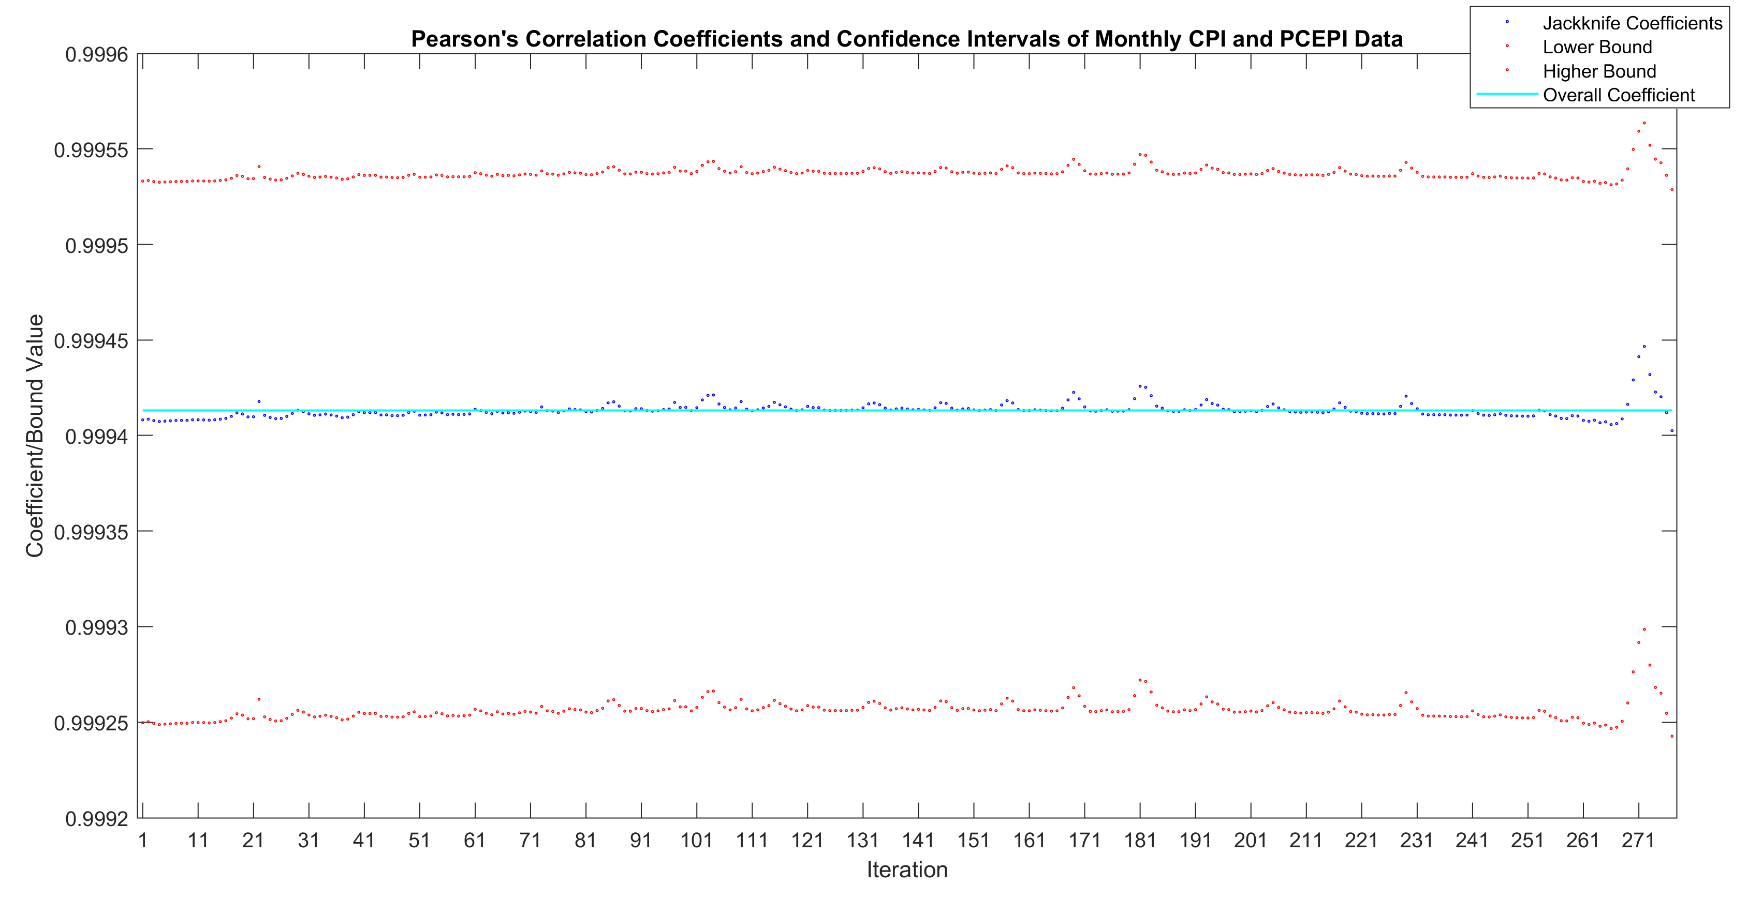
Pearson’s Correlation Coefficient using Jackknife
Monthly Data (Dec. 1999 to Dec. 2022)

Slide 11
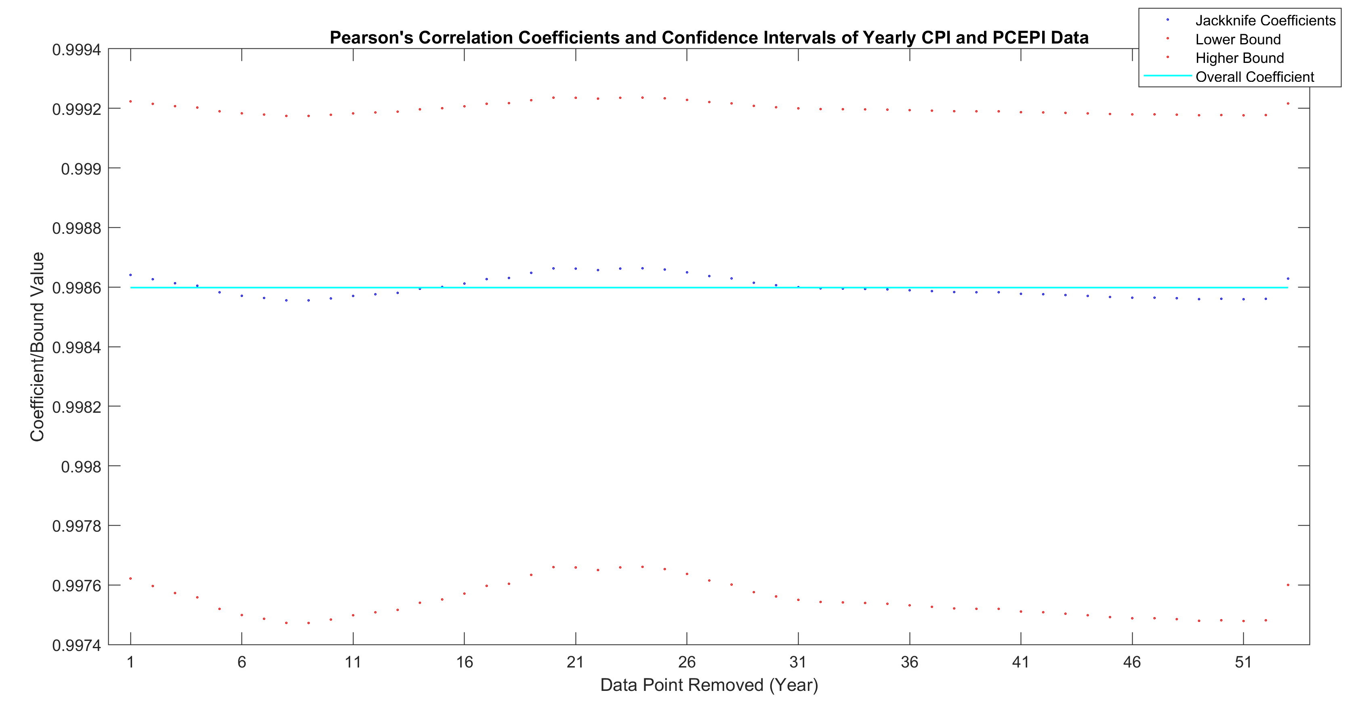
Pearson’s Correlation Coefficient using Jackknife
Yearly Data (1970 to 2022)

Slide 12
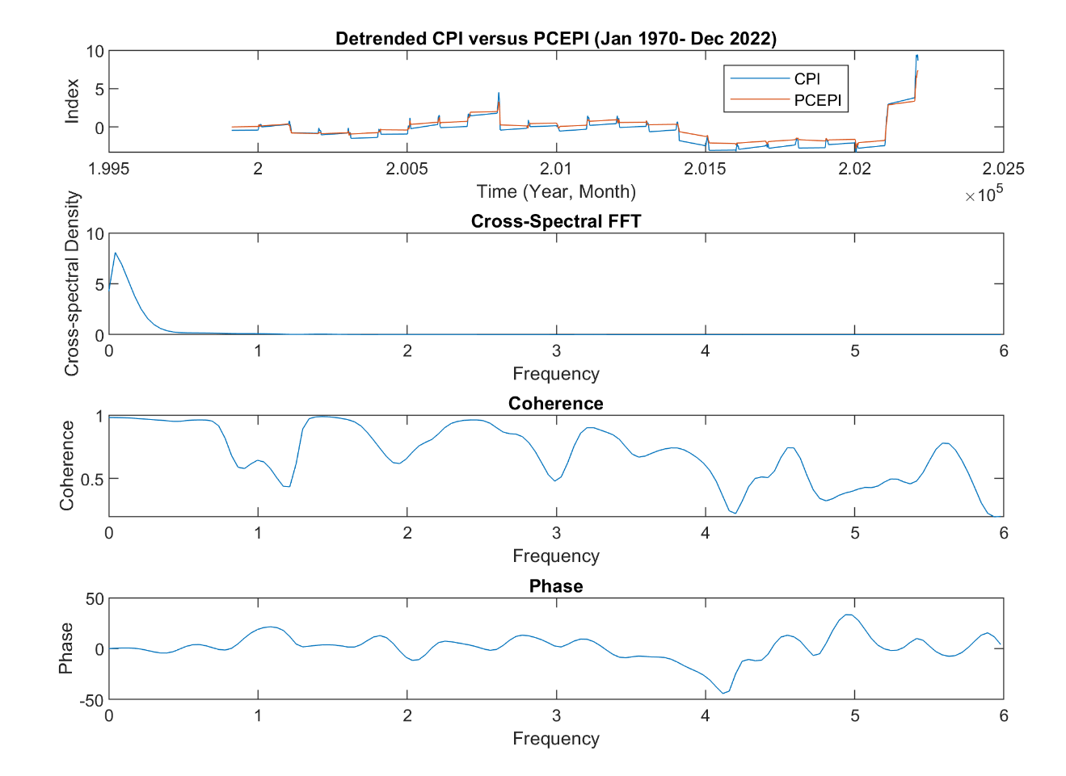
Cross Power Spectral Density (CPSD)
Bootstrap

Slide 13
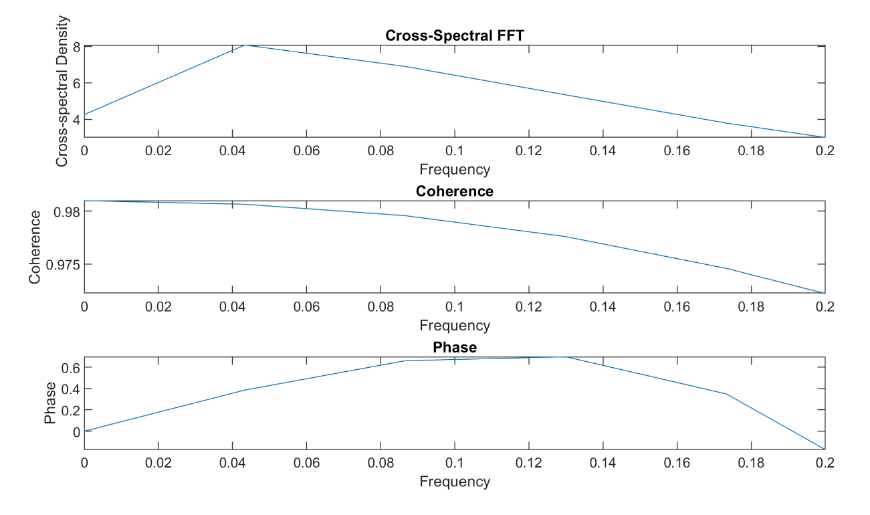
Cross Power Spectral Density (CPSD)
Frequency (1/year) | 0.05
Period (year) | 20
Coherence | 0.9805
Phase Lag (year) | 0.0238

Slide 14
Outcomes
Singular Value Decomposition (SVD)
Pearson’s Correlation Coefficient using Jackknife
Cross Power Spectral Density (CPSD)
Long term investments, like durable goods, education, and housing, are key players in price indices & inflation
More variability in Pearson’s correlation coefficient on monthly basis than yearly basis
Data is more sensitive at end of measurement period (2022 onwards) which lines up with volatile inflation experienced in last year
Price indices follow 20 year period which can loosely be related to period of technological innovation and politics swings
CPI data leads PCEPI data by 0.2 years
PCEPI basket of goods and services are fluid, and henceforth may lag behind economic trends due to reliance on current consumer trend data

Slide 15
References
Edwards, J. (2017, July 27). Resampling techniques - PPT video online download. SlidePlayer. Retrieved April 18, 2023, from https://slideplayer.com/slide/8340508/
Ha, Jongrim, M. Ayhan Kose, and Franziska Ohnsorge (2021). "One-Stop Source: A Global Database of Inflation." Policy Research Working Paper 9737. World Bank, Washington DC
U.S. Bureau of Economic Analysis, Personal Consumption Expenditures: Chain-type Price Index [PCEPI], retrieved from FRED, Federal Reserve Bank of St. Louis; https://fred.stlouisfed.org/series/PCEPI, April 18, 2023.
Wikimedia Foundation. (2023, April 13). Singular value decomposition. Wikipedia. Retrieved April 18, 2023, from https://en.wikipedia.org/wiki/Singular_value_decomposition
X. Cross power spectral density - MATLAB. (n.d.). Retrieved April 18, 2023, from https://www.mathworks.com/help/signal/ref/cpsd.html

Slide 16
Questions?

