Slide 1
Hurricane Strength and Sea Surface Temperature
Taylor Graham, EAS 4480, 2023

Slide 2
How do changing sea surface temperature affect the strength of hurricanes at landfall?
I hypothesize that as sea surface temperatures rise hurricanes will be stronger in both category and wind speed as a result of the sea surface temperature allowing hurricanes to intensify during formation

Slide 3
The Data
Sea Surface Temperature data from NOAA in 2021
  One measurement from each year 1880-2020
  Recorded the Sea Surface Temperature anomaly in the Atlantic
Using hurricane data from NOAA of hurricanes in the Atlantic Ocean
  All recorded hurricanes starting in the 1800s
    Max wind speed
    Category upon landfall
    Kept the data from 1880-2020 to match the SST data

Slide 4
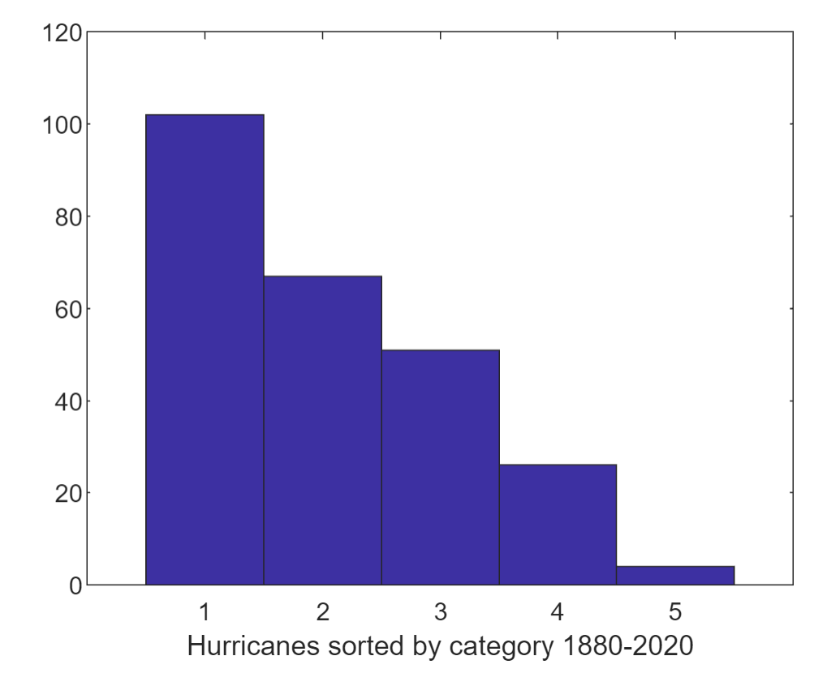
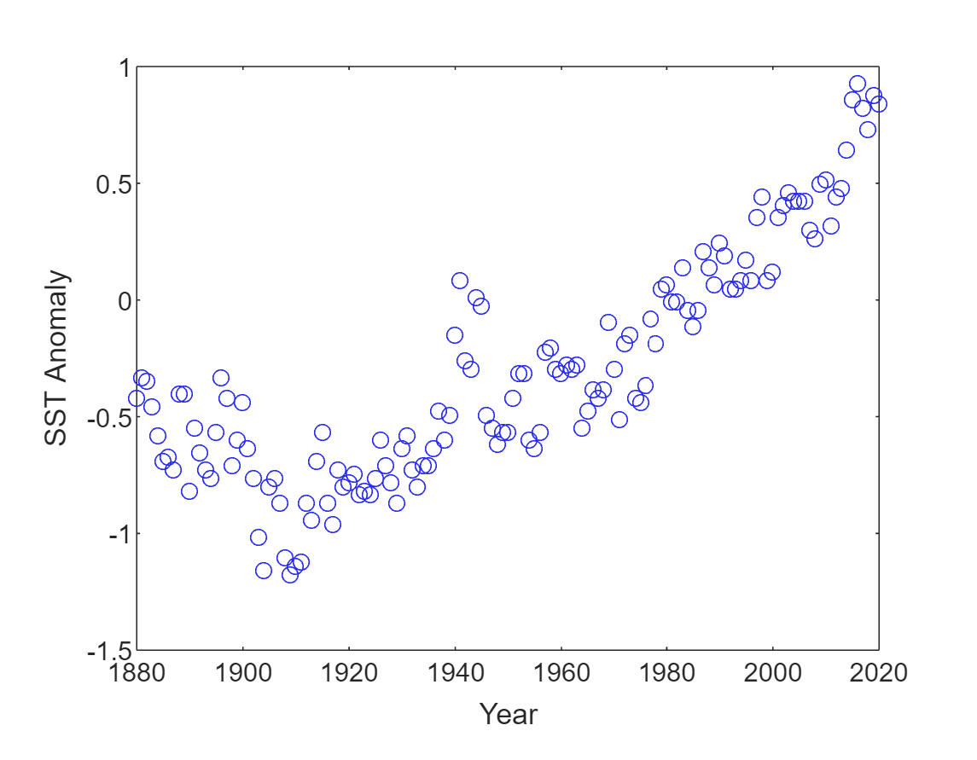
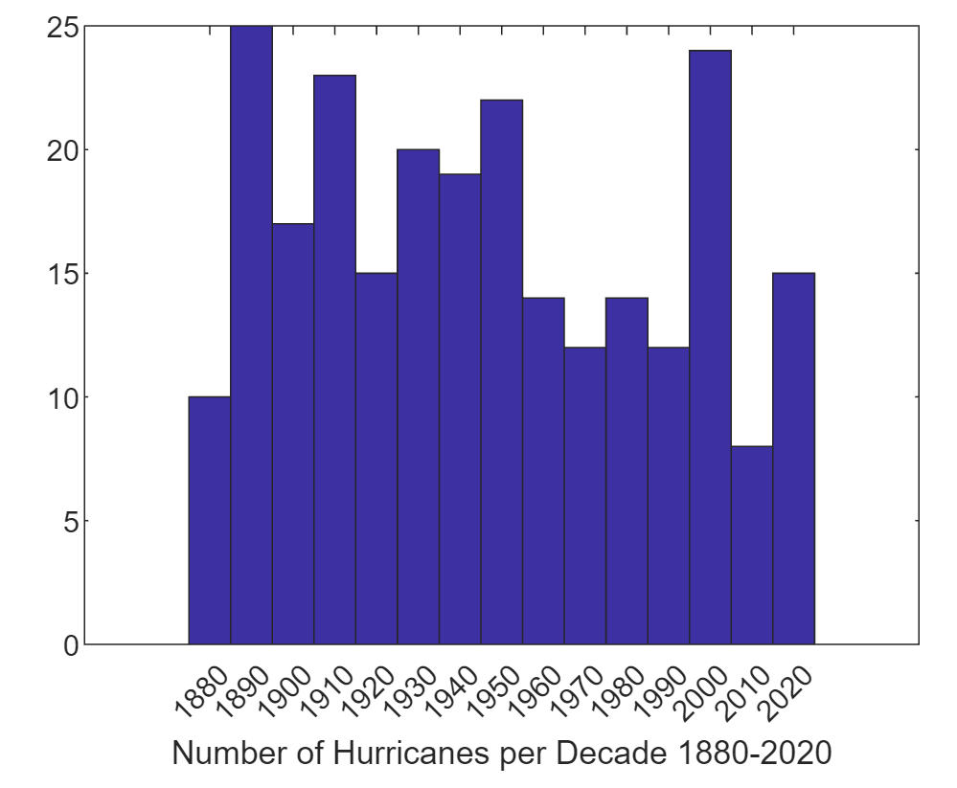
Graphically Represented Data

Slide 5
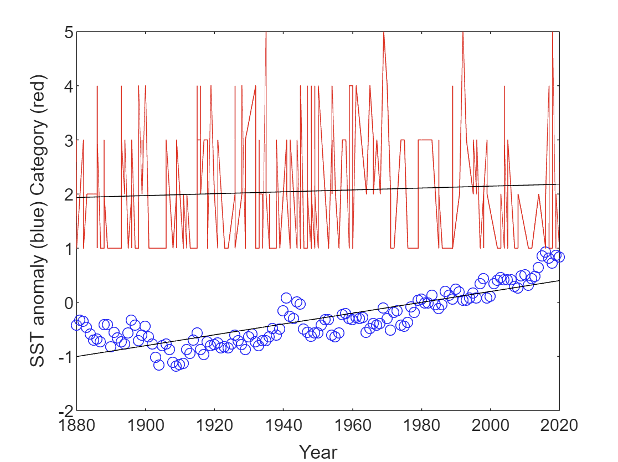
Least Squares Regression

Slide 6
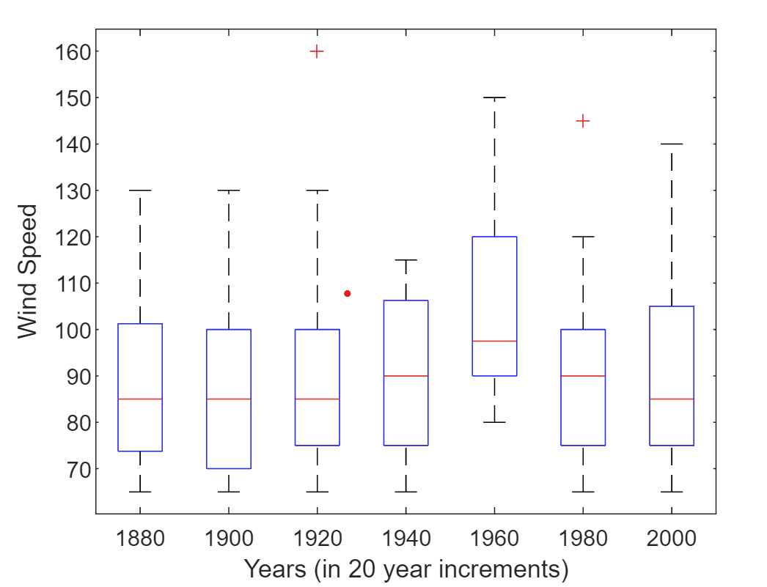
Boxplot of wind speed by 20 year increment

Slide 7
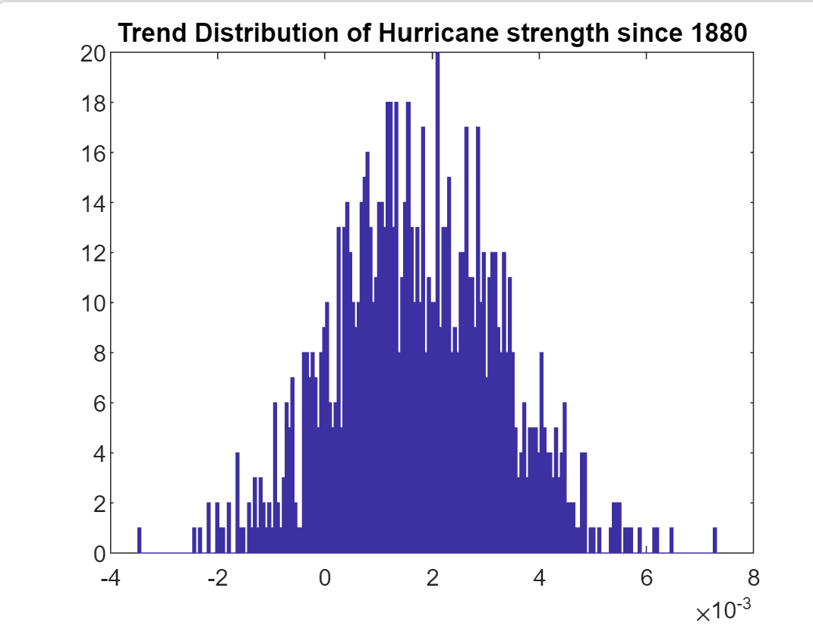
Bootstrap Analysis

Slide 8
Category of Hurricane
Mean
Using the student T-test for testing if two means are assumed to be the same we can analyze if hurricane category has really increased in the last 200 years
Using the ttest2 function in MATLAB my output for the 95% confidence interval for my test was [-0.5737 0.3433] and the hypothesis testing result was 0
In order to prove a statistically significant difference the hypothesis testing output would have to be 1

Slide 9
Category of Hurricane
Variance
Utilizing the F-test for testing if two standard deviations have a statistically significant difference between them we can see if the variance really has changed in the last 200 means in context of hurricane category
Freal = 1.4690
Ftable = 1.7023
In order to prove a statistical significant difference the value I calculated using MATLAB for Freal would have to be greater than the value of Ftable

Slide 10
Conclusions
Neither mean nor variance has a statistically significant difference from the years of 1880-1900 to 2000-2020
From the least squares regression analysis both hurricane category and sea surface temperatures have an positive slope when put on a linear regression analysis
The more recent box plots representing the most recent sets of 20 years did lend themselves to larger means (caused by greater intensity of hurricanes)
  The boxplots also showed very consistent means and symmetry throughout the years of collected data

Slide 11
Reflections
Hurricane category data was more difficult to analyze than I anticipated
  Discrete numbers with only a value of 1-5
  Lack of variability
  Wind speed data was lacking in the earliest years of my data range

Slide 12
Sources
“Climate Change Indicators: Sea Surface Temperature | US EPA.” US EPA, 1 Aug. 2022, www.epa.gov/climate-indicators/climate-change-indicators-sea-surface-temperature.
Center for Climate and Energy Solutions. (2022, September 22). Hurricanes and Climate Change - Center for Climate and Energy Solutions. https://www.c2es.org/content/hurricanes-and-climate-change/
US hurricane landfalls. (n.d.). https://www.aoml.noaa.gov/hrd/hurdat/All_U.S._Hurricanes.html

