Slide 1
US Land Temperatures vs HS Cross Country
By Garrett Hughes

Slide 2
Introduction
Cross Country is a sport consisting of 5k races and takes place all over the United States.
It is a seasonal sport taking place in the months of Oct - March depending on the region.
I will be taking a closer look at the land temperature statistics in these months to determine if there is a correlation with the number of highschool runners and these statistics.
I will mainly use linear regression and resampling methods to to determine if there is correlation.

Slide 3
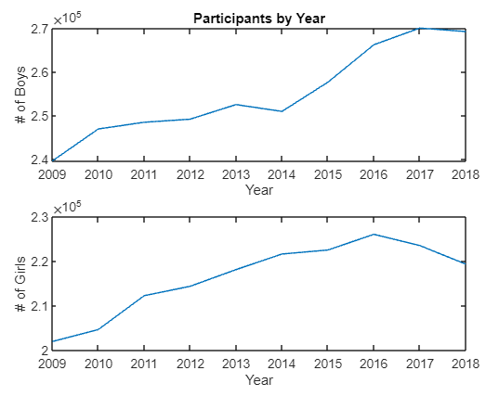
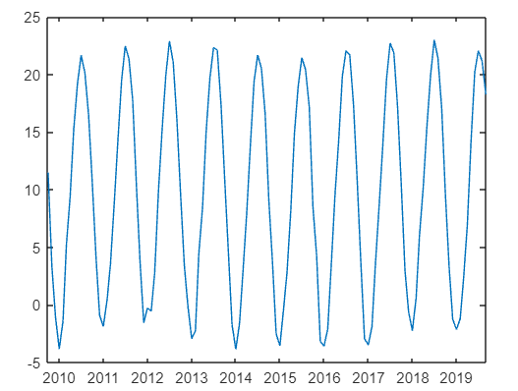
Base Data
Number of participants by year (Boy/Girl)
US surface temperature
Cut to fit seasonal runner data

Slide 4
Comparisons and Process
The first step was to trim the temperature data and format it in a way we could compare it to the runner data.
I cut the extra temperature data to range from Oct 2009 to Mar 2019. Then I omitted data from the months of April to September. This gave me ten seasonal data sets of equal size where I could compare season to season.
Range
Max-Min
Mean
Average
Plot the data then calculate the least squares regression line.
Use Bootstrap to find more slopes and intercepts.
Compare mean, standard deviation, and 95% confidence interval.
Look at residuals and perform a Chi2 test.
Autocorrelation plot and explanation.

Slide 5
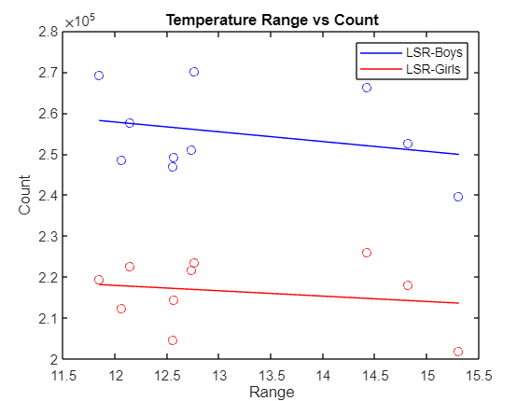
Comparing Temperature Range
Bootstrap for LS regression for Boys
Slope mean = -2.1552e+03 Intercept mean = 2.8323e+05
Slope STD = 3.6875e+03 Intercept STD = 4.6731e+04
95% CI of slope bootstrap = [-1.0658e+04, 6.341e+03]
95% CI of intercept bootstrap = [1.7547e+05, 3.9099e+05]
Bootstrap for LS regression for Girls
Slope mean = -701.7142 Intercept mean = 2.2601e+05
Slope STD = 2.8601e+03 Intercept STD = 3.6373e+04
95% CI of slope bootstrap = [-7.291e+03, 5.8937e+03]
95% CI of intercept bootstrap = [1.4214e+05, 3.0989e+05]
Boys true slope = -2.386e+03
Boys true intercept = 2.8642e+05
Girls true slope = -1.3101e+03
Girls true intercept = 2.336e+05

Slide 6
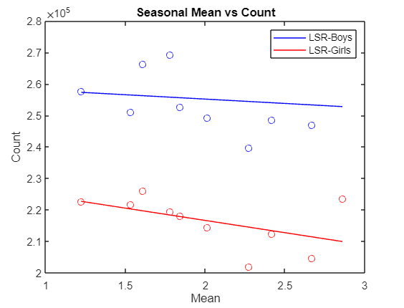
Comparing Temperature Mean
Bootstrap for LS regression for Boys
Slope mean = -4.06e+03 Intercept mean = 2.63e+05
Slope STD = 8.18e+03 Intercept STD = 1.55e+04
95% CI of slope bootstrap = [-2.29e+04, 1.479e+04]
95% CI of intercept bootstrap = [2.27e+05, 2.988e+05]
Bootstrap for LS regression for Girls
Slope mean = -9e+03 Intercept mean = 2.34e+05
Slope STD = 5.9585e+03 Intercept STD = 1.086e+04
95% CI of slope bootstrap = [-2.27e+04, 4.7397e+03]
95% CI of intercept bootstrap = [2.09e+05, 2.59e+05]
Boys true slope = -2.7688e+03
Boys true intercept = 2.61e+05
Girls true slope = -7.8e+03
Girls true intercept = 2.3e+05

Slide 7
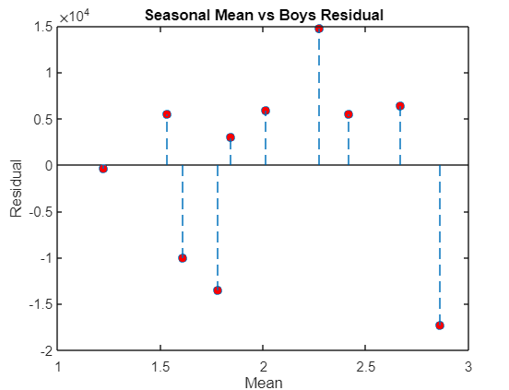
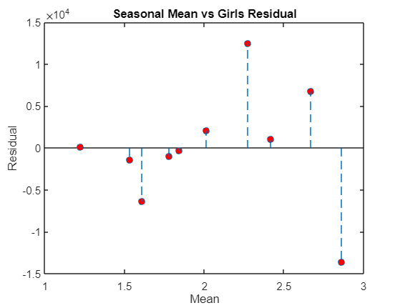
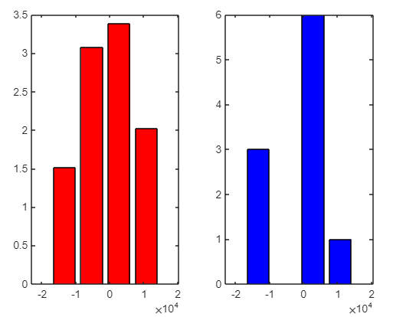
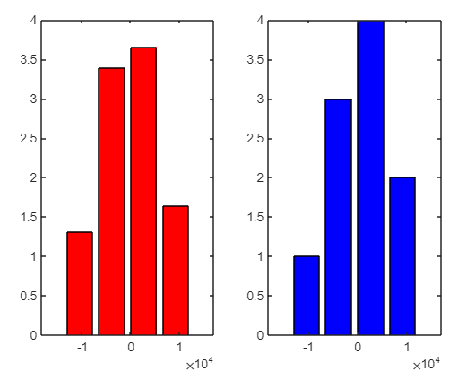
Chi2 Test for Mean
Chi-square test for male mean residuals (4 bins)
Chi2 = 7.0606
Critical Chi2 = 3.8415
Chi-square test for female mean residuals (4 bins)
Chi2 = 0.2282
Critical Chi2 = 3.8415
For males we can reject the null hypothesis that the mean residuals are normally distributed around 0. However for females, we cannot reject this hypothesis.
Thus we can only say Linear (LS) regression is not valid for the male model.
Boys Girls

Slide 8
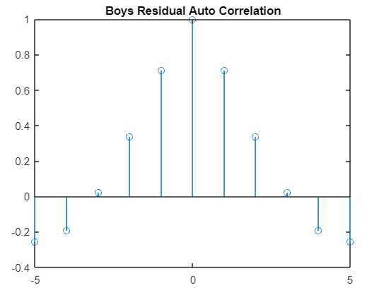
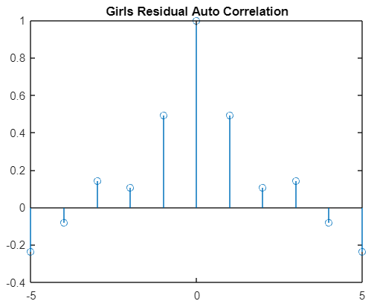
Autocorrelation for Mean Residual
Boys residual has very high spikes surrounding 0 lag
Girls residual has lower but still significant spikes surrounding 0 lag
If the data set was larger, we would be able to find more expansive results and possibly see a pattern here instead of a single large spike.
The large values surrounding when lag is 0 could be caused by the fact that runners often go season to season and are less likely to take gap years.

Slide 9
Errors
The data set is too small!
Only 10 seasons
The two data sets are hard to compare
Monthly surface temperature to a whole season
The US is Big!
Regionalized data would work better.
Runners don’t know the temperature!
We should compare previous temps instead.
Range is a bad seasonal quantifier
Mean is much better

