Slide 1
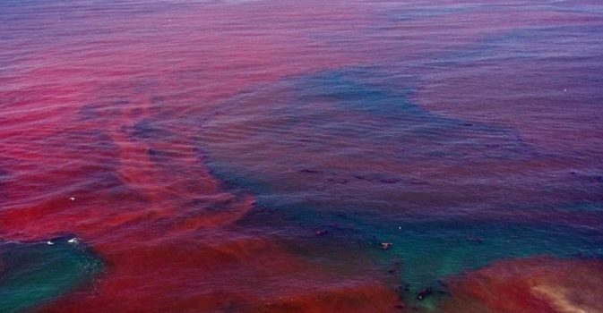
Florida’s Gulf Coast Red Tide
Looking at Florida’s Gulf coast historical records of sea surface temperatures, red tide, and fish kill data by Angela Jackson.
April 2023

Slide 2
Motivation
Helping Florida’s Gulf coast better prepare for red tides as they are a threat to human and wildlife health.
K. brevis negatively impacts the respiratory system, irritates skin and eyes, and is a toxin.
Predict microbe population with increase in temperature.

Slide 3
Background
Karenia brevis is the photosynthetic organism that causes the red tide (algal bloom) in the Gulf coast.
My analysis problem is looking at the gulf coast sea surface temperature over decades compared to the algal red tide blooms at Florida’s west coast.

Slide 4
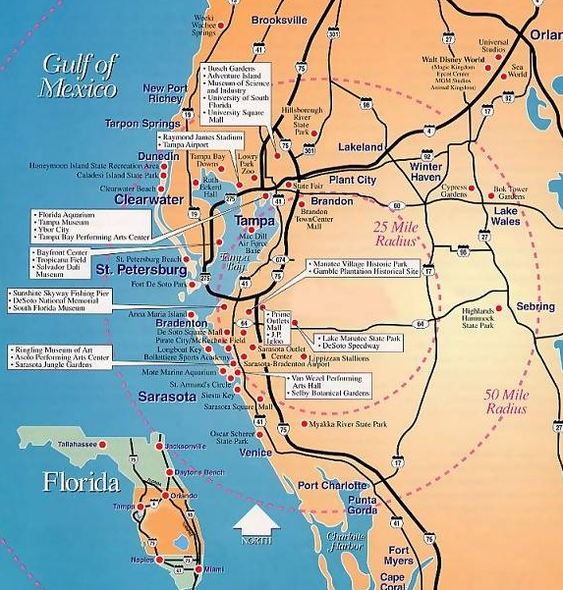
Background

Slide 5
Data
Karenia brevis monthly and yearly presence
Red tide and fish kill event occurrence per month

Slide 6
Methods
FFT
Trend analysis —> least squares fit slope error
Student-t test
Forecasting —> logistic regression & mean square error

Slide 7
FFT
FFT
43 frequencies resolved by FFT
Sampling frequency: 1

Slide 8
FFT
FFT
912 frequencies resolved by FFT
Sampling frequency: 12

Slide 9
Trends
Trend analysis —> least squares fit slope error and LSR error

Slide 10
Trends
Trend analysis —> least squares fit slope error and LSR error
LSR slope: 184654 cells/L/year
LSR 95% CI: [50309.3043, 318998.7535]
Correlation coefficient R: .3439

Slide 11
Trends
Trend analysis —> least squares fit slope error and LSR error
Correlation coefficient R: .4525

Slide 12
Hypothesis testing
Student-t test
My null hypothesis is that there has been no change in red tide algal bloom frequency and sea temperature over the decades
My alternative (main) hypothesis is that there has been an increase in the red tide over the decades followed by an increase in temperature.

Slide 13
Next steps
Student-t test
Forecasting —> logistic regression & mean square error

Slide 14
Questions
Any questions…?

