Slide 1
An Analysis in the Effectiveness of Fines
Do fines levied on chemical companies influence the occurrence of future accidents?

Slide 2
Consequences of their Actions?
ExxonMobil
Dow Chemical Company
Shell
BP
SABIC
Formosa Plastics
DuPont

Slide 3
Fines and Costs

Slide 4
Philadelphia Spill
toxic hydrofluoric acid (HF) release at the Philadelphia Energy Solutions refinery
over 5,000 pounds of highly toxic HF, launched a 38,000-pound vessel fragment off-site, and resulted in an estimated property damage loss of 750 million dollars
Sources for event fines and dates can be found in “references”

Slide 5
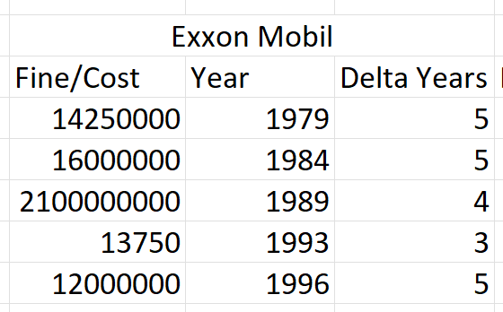
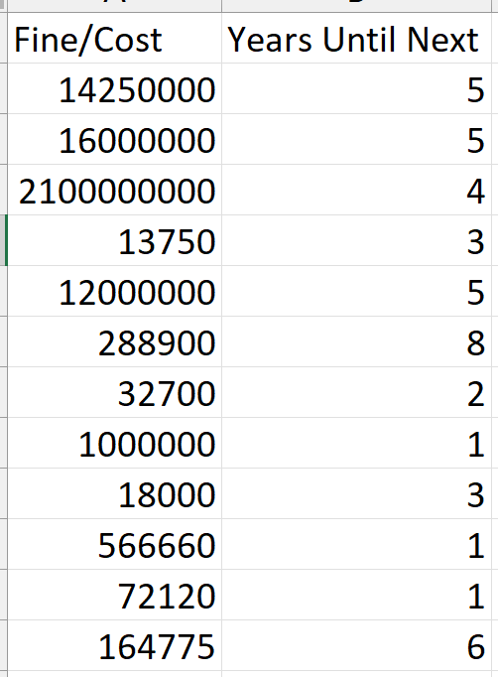
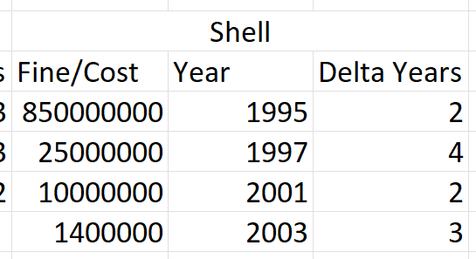
Data Organization
Sources for event fines and dates can be found in “references”

Slide 6
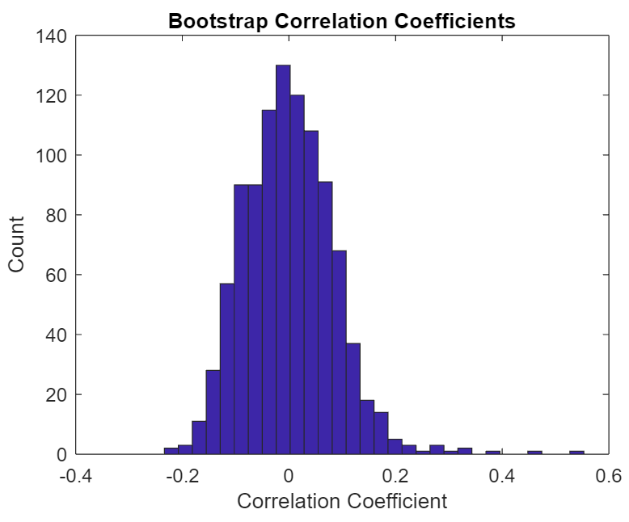
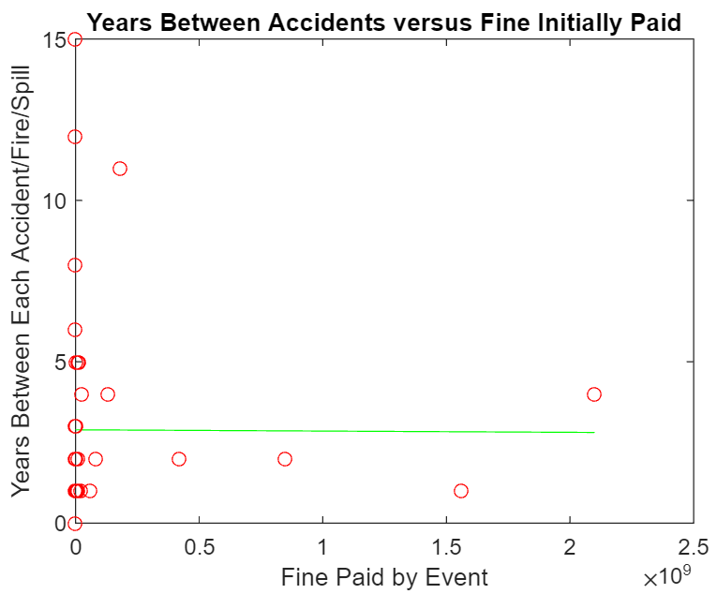
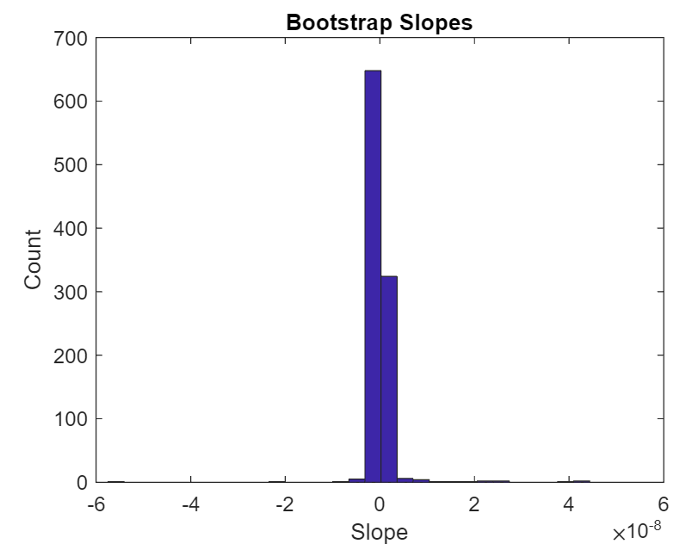
Is there a significant correlation?
[-0.2747 0.2658]
r = -0.0048
[-0.1458 0.1809]
p = 0.9729

Slide 7
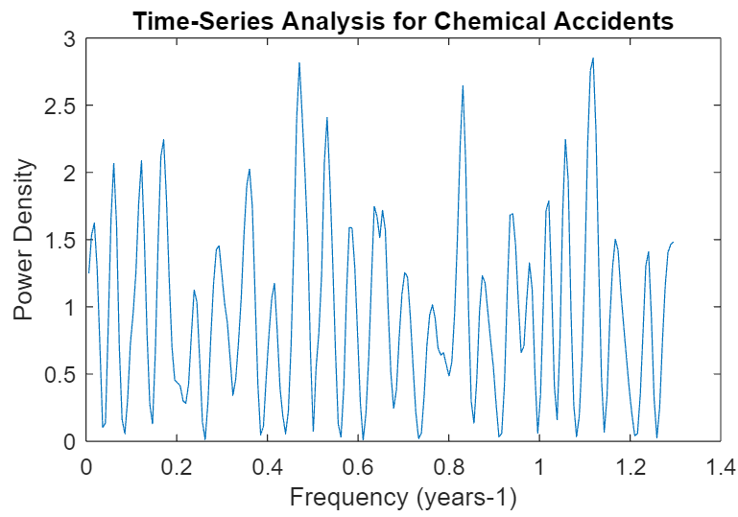
Perhaps: A Pattern to the Accidents?
Unevenly spaced data, used lombscargle
No significant frequencies found:

Slide 8
References
https://www.youtube.com/watch?v=gc8qXTh6tTY
https://www.dailybreeze.com/2015/03/01/exxonmobil-refinery-incidents-over-years-include-fires-explosions/
https://www.dailybreeze.com/2015/08/13/state-fines-exxonmobil-566600-for-serious-safety-violations-in-wake-of-torrance-refinery-explosion/
https://www.business-humanrights.org/en/latest-news/us-judge-orders-exxonmobil-to-pay-nearly-290000-to-plaintiffs-lawyer-following-botched-deposition-in-lawsuit-over-companys-alleged-involvement-in-human-rights-abuses-in-aceh-indonesia/
https://www.nytimes.com/1991/03/13/us/exxon-to-pay-100-million-fine-and-plead-guilty-in-valdez-spill.html
https://www.nytimes.com/1984/04/26/nyregion/exxon-is-sued-by-new-york-over-use-of-hudson-water.html
https://publicinterestnetwork.org/articles/bigger-in-texas-a-record-clean-air-penalty-for-exxonmobil/
https://www.theadvocate.com/baton_rouge/news/courts/exxonmobil-100-percent-at-fault-for-deadly-1993-baton-rouge-refinery-fire-state-high-court/article_c7c78fe8-4a86-11e9-bf79-83b36b069b98.html#:~:text=The%20high%20court's%20ruling%20Monday,a%20combined%20total%20of%20%2413%2C750.
https://www.reuters.com/article/us-exxon-mobil-montana-spill/exxonmobil-to-pay-12-million-in-montana-oil-spill-settlement-idUSKCN11R29O
https://www.osha.gov/news/newsreleases/national/10302009#:~:text=WASHINGTON%20%2D%20The%20U.S.%20Department%20of,the%20largest%20in%20OSHA's%20history.

Slide 9
References
https://www.osha.gov/ords/imis/accidentsearch.accident_detail?id=201925278
https://www.ourmidland.com/lifestyles/article/Throwback-Sunday-Dow-Toll-8-dead-26-hurt-6919079.php
https://www.hse.gov.uk/comah/sragtech/casedow76.htm
https://aiche.onlinelibrary.wiley.com/doi/pdf/10.1002/prsb.720090215
https://www.eagletribune.com/news/merrimack_valley/mechanical-failure-caused-dow-chemical-explosion/article_9dba371d-8271-5751-810f-f2e5832ecc2c.html
https://www.wcvb.com/article/dow-chemical-scene-of-explosion-two-years-ago/8230438
https://pophistorydig.com/topics/dow-chemical-1960s-1980s/
https://kitchener.citynews.ca/2019/04/26/exxon-agrees-to-1-million-penalty-for-montana-oil-spill/
https://www.timesunion.com/business/article/SABIC-in-Selkirk-paying-322-400-fine-after-17078219.php
https://www.osha.gov/ords/imis/establishment.inspection_detail?id=311026603
https://www.manufacturing.net/home/news/13205613/plastics-firm-agrees-to-pay-1m-civil-penalty
https://www.theguardian.com/environment/2015/jul/02/bp-will-pay-largest-environmental-fine-in-us-history-for-gulf-oil-spill

Slide 10
References
https://www.osha.gov/news/newsreleases/national/07122012
https://www.corp-research.org/BP#:~:text=For%20example%2C%20in%201990%20BP,refinery%20into%20the%20Delaware%20River.
https://www.texastribune.org/2014/11/20/gas-killed-dupont-workers-not-rare-texas/
https://aerossurance.com/news/dupont-reputational-explosion/
https://buffalonews.com/business/local/dupont-to-pay-724-000-fine-for-2010-fatal-tonawanda-explosion/article_e5fa58eb-39c7-53ac-8d22-4a49c71f6fe1.html
https://www.osha.gov/ords/imis/establishment.inspection_detail?id=960237.015
https://www.osha.gov/news/newsreleases/region6/04142015
https://www.osha.gov/news/newsreleases/region6/04052006
https://www.osha.gov/news/newsreleases/region3/03312010
https://www.osha.gov/news/newsreleases/region9/05092012
http://www.alaskawild.org/wp-content/uploads/2014/10/shell_final_report.pdf
https://www.osha.gov/enforcement/toppenalties

