Slide 1
Demographic Proximity to Hazardous Sites and Their Air Toxic Risks
By Aya Kanawati

Slide 2
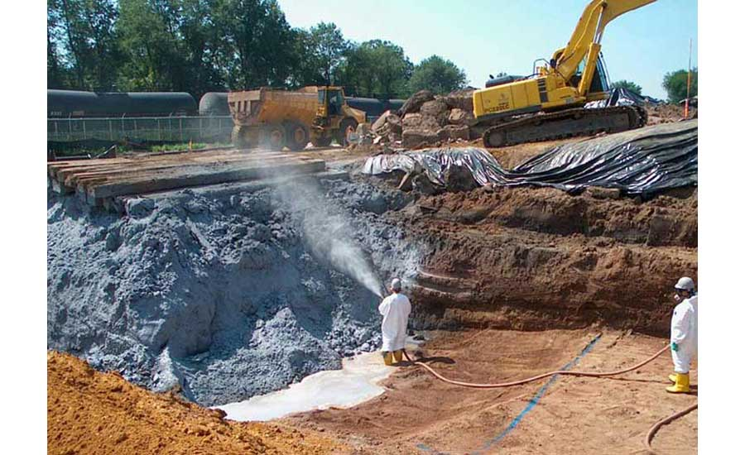
Introduction
Is there truly a correlation between higher amounts of air toxic respiratory hazards and low income/minority communities?
If so, why them? For that reason, we will look in the counts of superfund sites, RMP facilities, hazardous waste site, underground storange tanks, wastewater discharge, and the amount of traffic in each area
Notes:
So make sure to say income/minority communities – don’t freak out

Slide 3
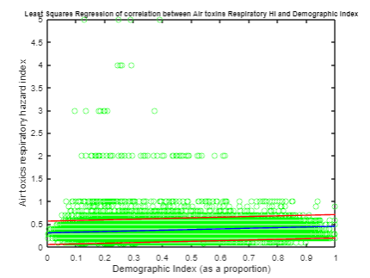
Introduction
Looked at correlation between areas with higher percentage of lower income and POC with air toxics respiratory hazard index (sum of hazard indices for air toxics with reference concentrations based on respiratory endpoints where each HI is the ratio of exposure concentration in the air)
Correlation coefficient: 0.23002
P_value <0.05 (0 on my code)
95% confidence interval: [0.22315 0.23688]
LSR equation: y =0.14386x+0.31037
Notes:
Therefore, the null hypothesis must be rejected as the 2 data sets are significantly correlated: a coefficient of 0.2101 with such a small range could indicate significant relationship between them

Slide 4
Potential Reasons That Cause This Which We’ll Look At
Superfund Proximity: the proportion of a block located near a superfund site
RMP Facility Proximity: proportion of a block located near a RMP facility (potential chemical accident management plan)
Hazardous Waste Proximity : proportion of a block located near a site that takes and disposes of hazardous waste and chemicals
Underground Storage Tanks: counts the number of these multiplied by a factor of 7.7 within a block
Wastewater discharge: modeled toxic Concentrations at streams within 500 meters, divided by distance in km
Traffic Proximity: average annual daily traffic of vehicles at major roads within 500 m of each block, divided by the distance in meters

Slide 5
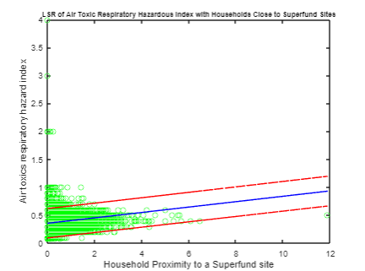
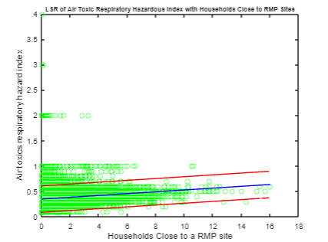
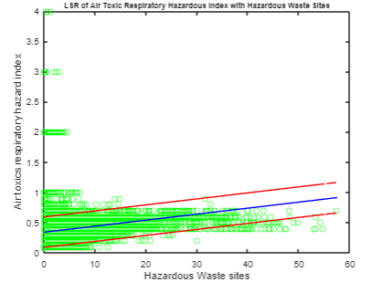
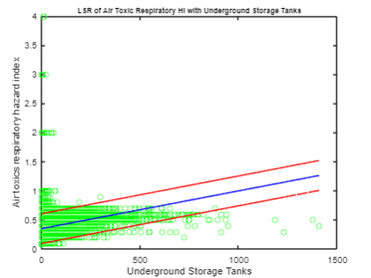
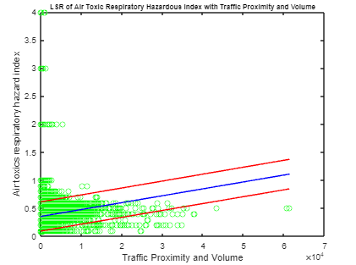

Slide 6
Risk Factor | LSR Equation | LSR Slope 95% Confidence Interval | Corr Coeff | P_Value | Correlation Coefficient 95% Confidence Interval | Reject Null?
Superfund Proximity | y = 0.048293x +0.35487 | [0.04466, 0.05192] | 0.096099 | 0 | [0.08891 0.10328] | Yes
RMP Facility Proximity | y = 0.01801x +0.34719 | [0.017128, 0.018892] | 0.14643 | 0 | [0.13932, 0.15351] | Yes
Hazardous Waste Proximity | y = 0.009952x +0.3403 | [0.0097172, 0.010187] | 0.29368 | 0 | [0.28704, 0.30029] | Yes
Underground Storage Tanks | y = 0.00064728x +0.34922 | [0.00062917, 0.0006654] | 0.25081 | 0 | [0.24401, 0.25759] | Yes
Traffic Proximity | y = 1.2303e-05x +0.35231 | [1.1717e-05, 1.2889e-05] | 0.1505 | 0 | [0.14341, 0.15758] | Yes

Slide 7
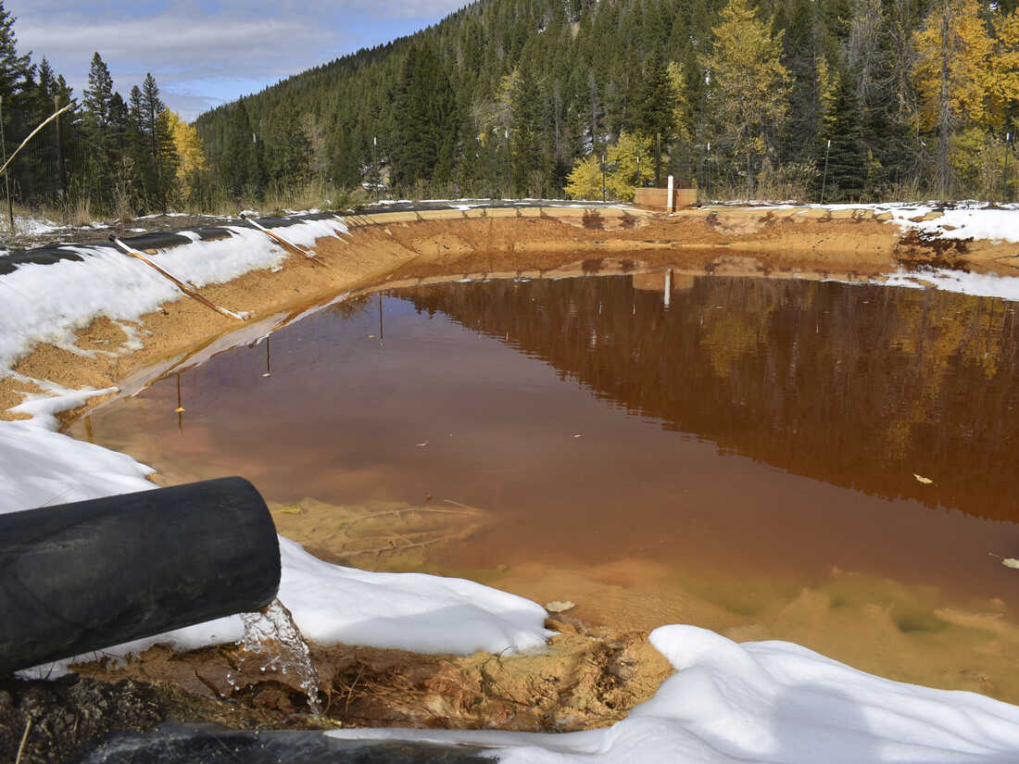
Conclusions
Correlations?
Reasoning for why choosing to live in these areas?
What to do for the future?

Slide 8
References
https://www.epa.gov/ejscreen/download-ejscreen-data
https://catalog.data.gov/dataset?q=ejscreen&sort=score+desc%2C+name+asc

Slide 9
Questions?

