Slide 1
Analysis of Life Expectancy
Megan Kilinski
EAS-4480

Slide 2
analysis problem
What economic, social, and environmental factors correlate with life expectancy?
If there are factors which correlate life expectancy, then Principal Component Analysis will show a high correlation between specific factors and life expectancy and a Principal Component regression will align the expected life expectancy given certain factors.

Slide 3
Data
EJScreen
Census tract level data
Demographic data comes from surveys
Looks at a limited number of factors associated with environmental justice
Uncertainty for small areas
Calculated factors have innate uncertainty
CDC Life Expectancy
Census tract level data
Mortality data collected from death certificates
Methodology to produce life expectancy estimates through a combination of standard demographic techniques and statistical modeling
Methodology changes for Maine, Wisconsin and small population areas

Slide 4
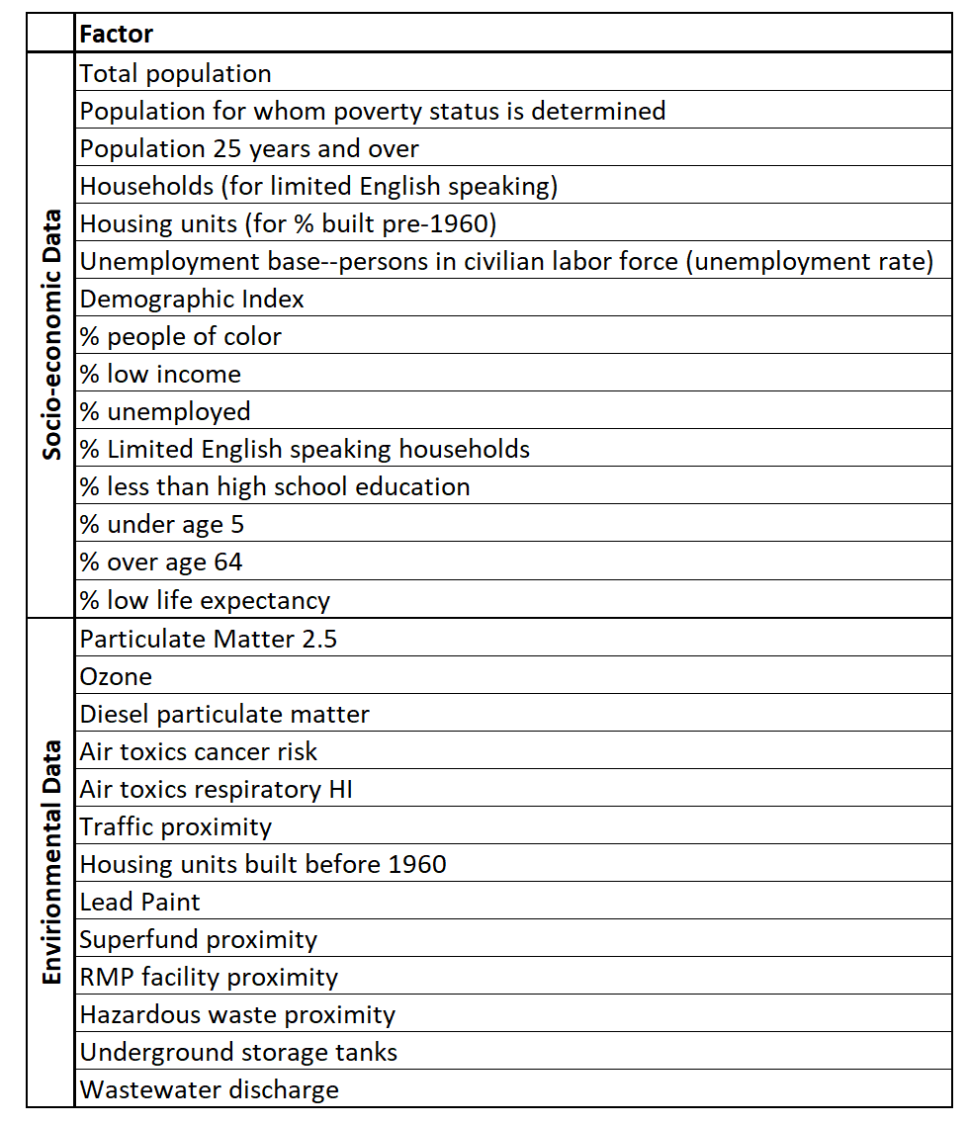
Data
EJScreen
160 factors provided
Reduced to 26 environmental and socio-economic factors
CDC Life Expectancy
Used to calculate Life Expectancy
EJScreen provides % Low Life Expectancy, calculated from CDC data
% Low Life Expectancy = 1 – (Life Expectancy / Max Life Expectancy)

Slide 5
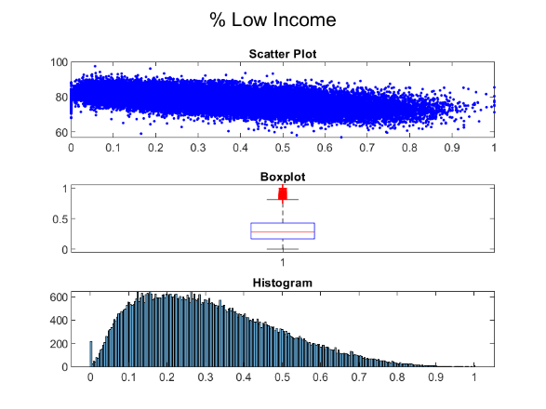
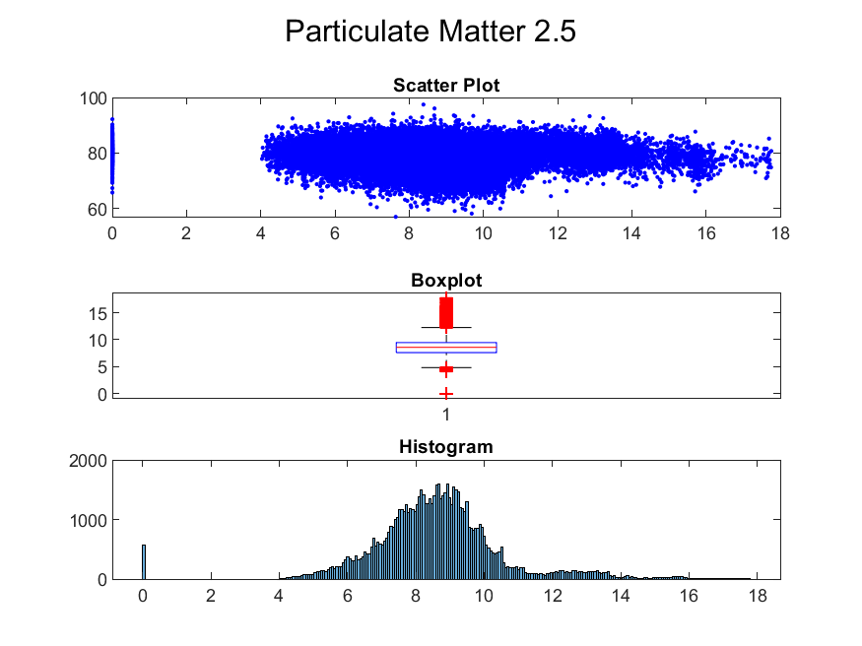
Descriptive Statistics - National

Slide 6
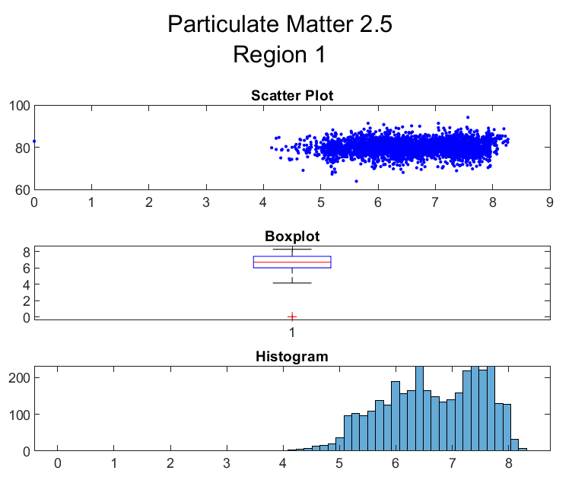
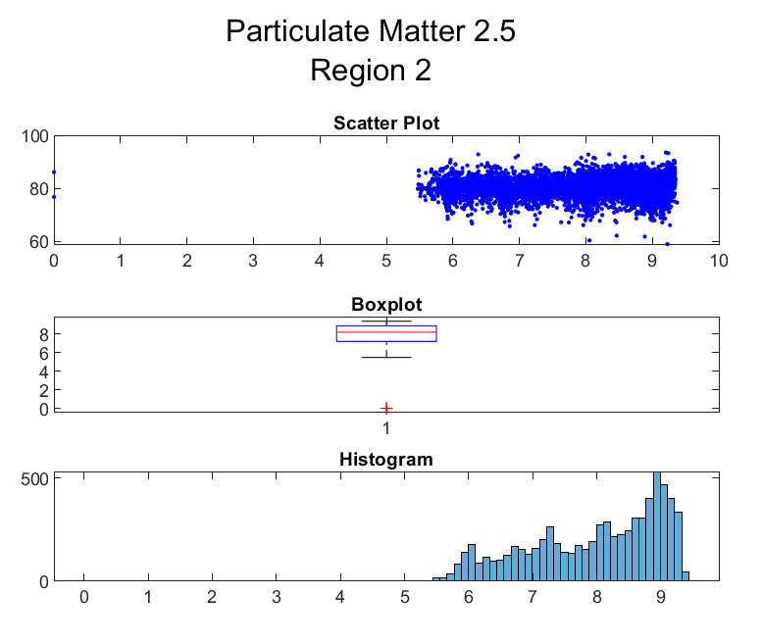
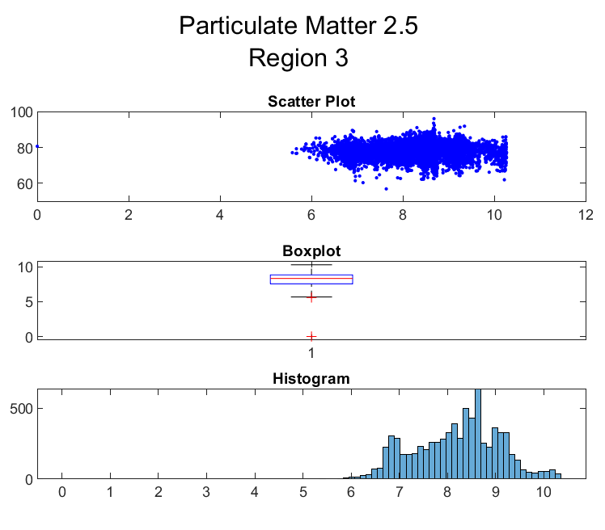
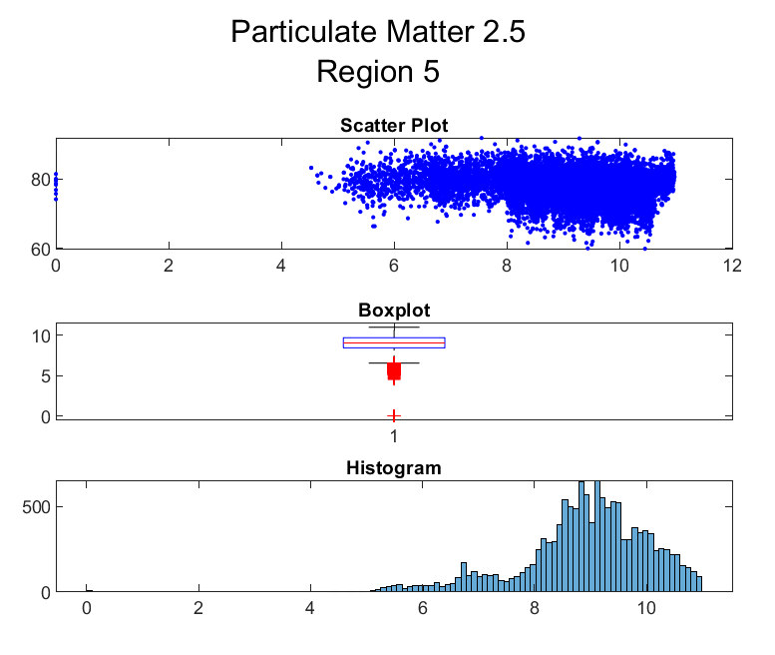
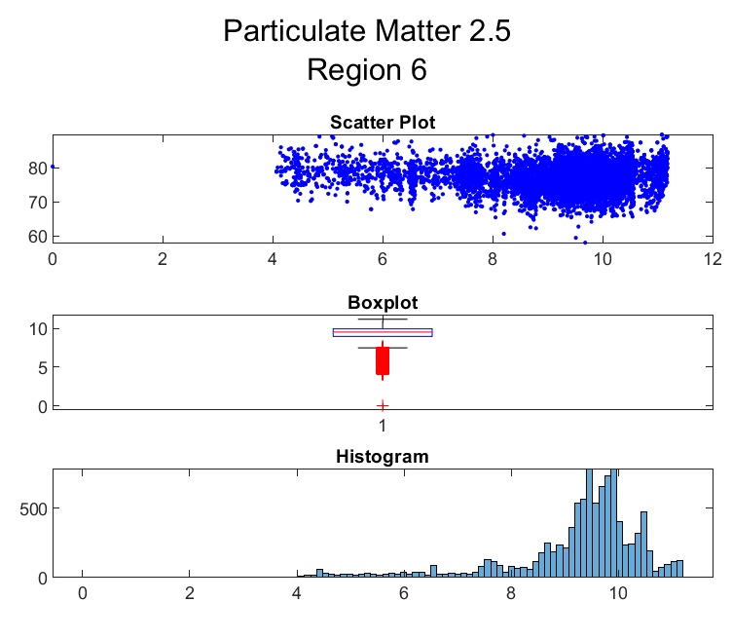
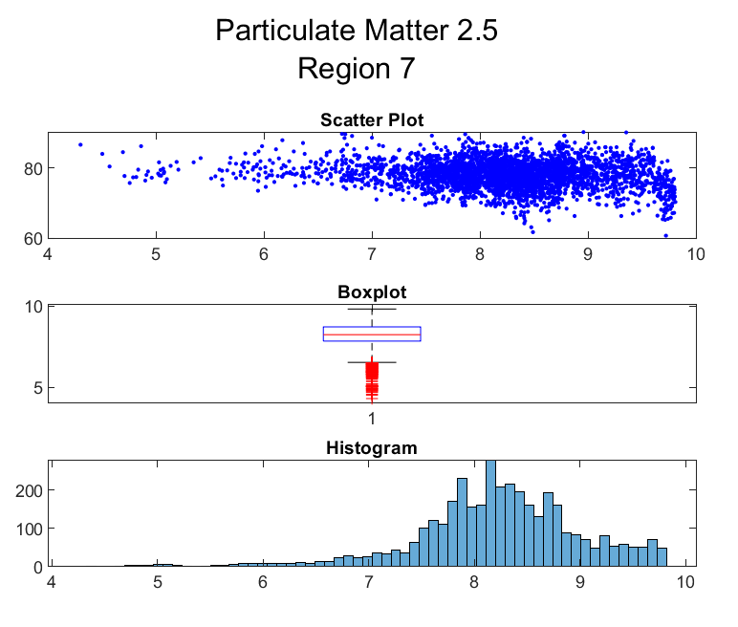
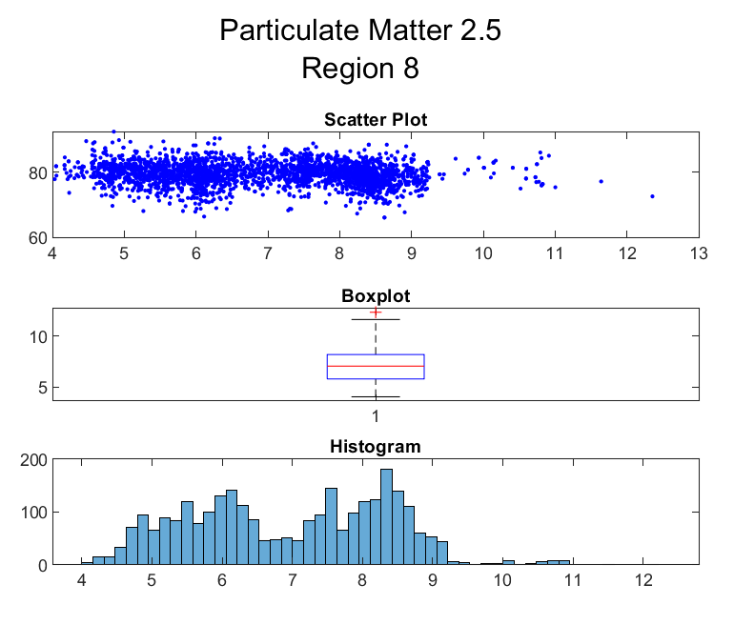
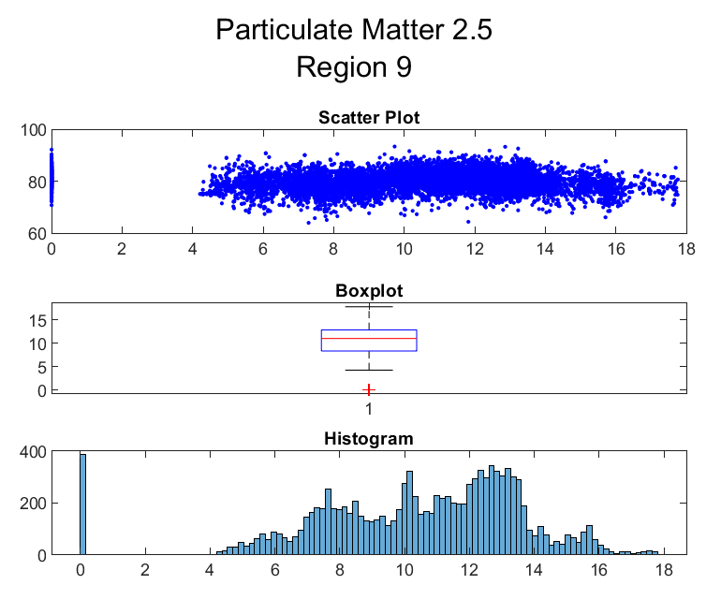
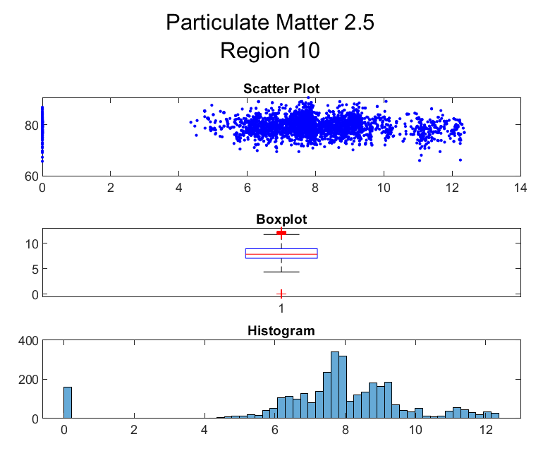
Descriptive Statistics - Regional

Slide 7
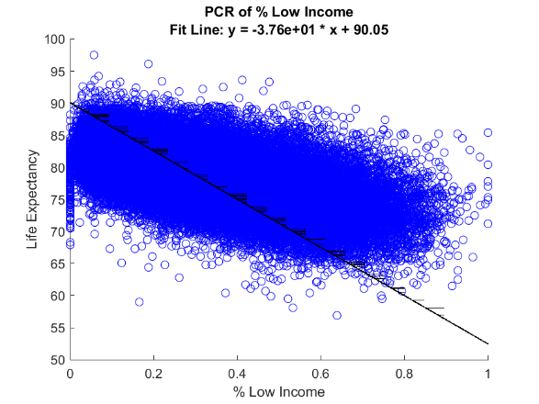
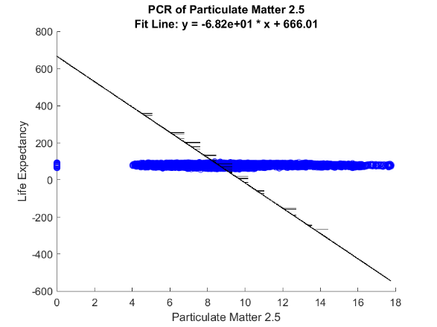
Principal Component Regression - National

Slide 8
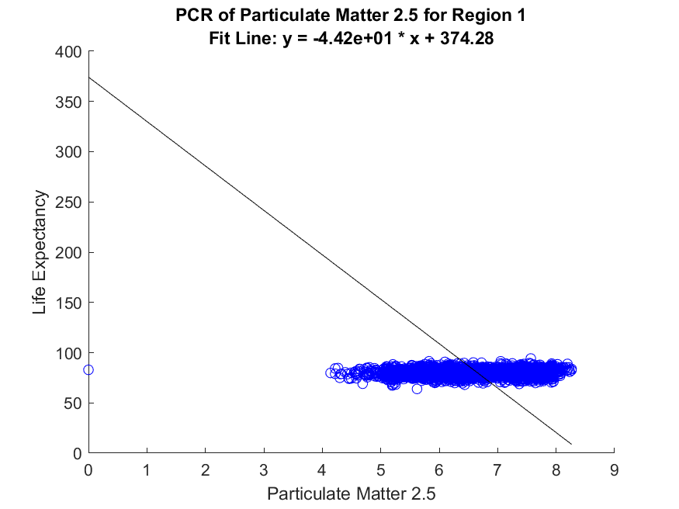
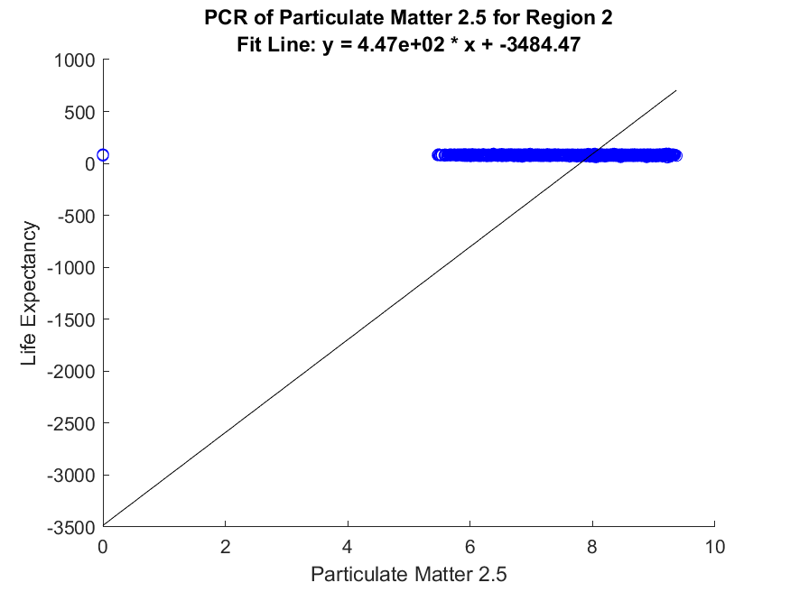
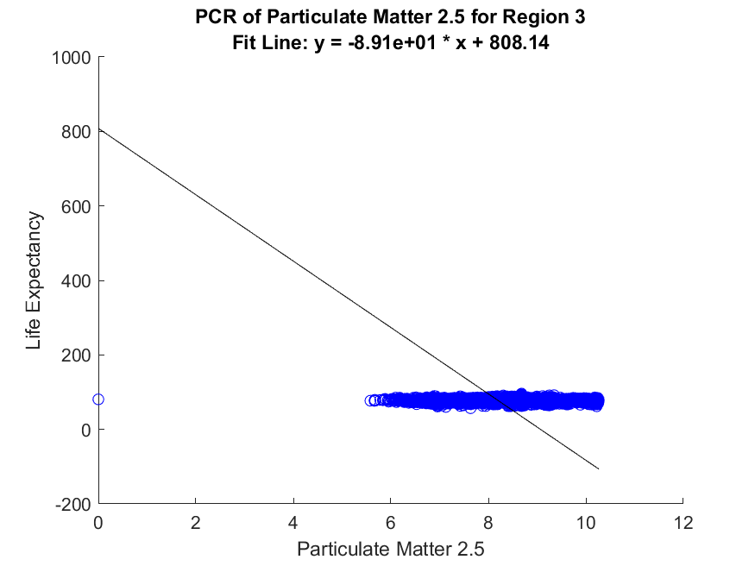
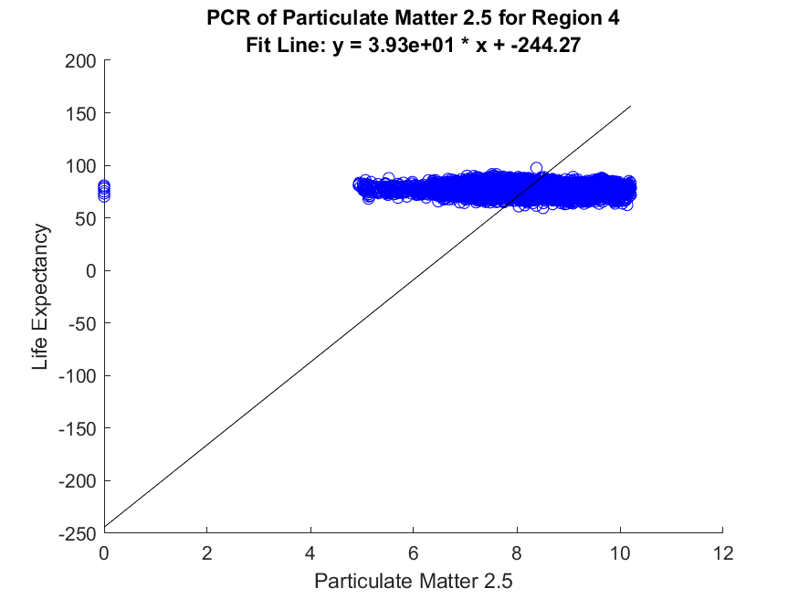
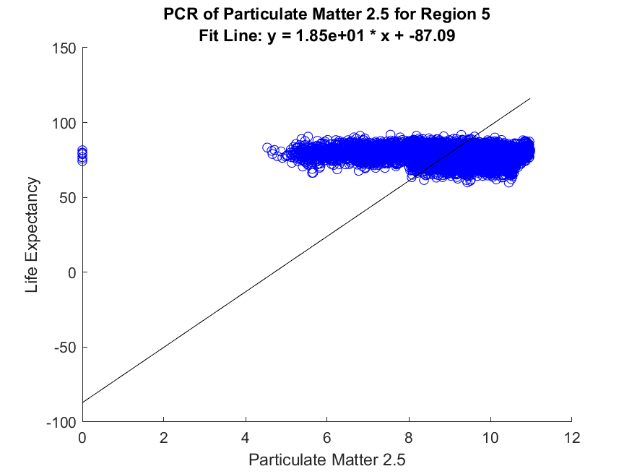
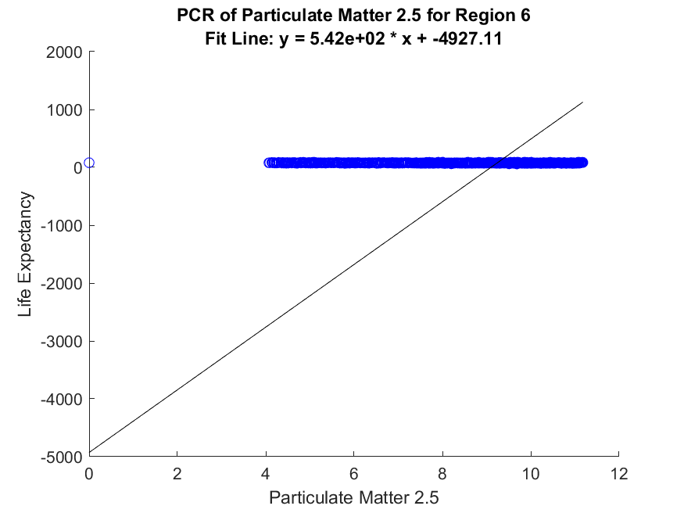
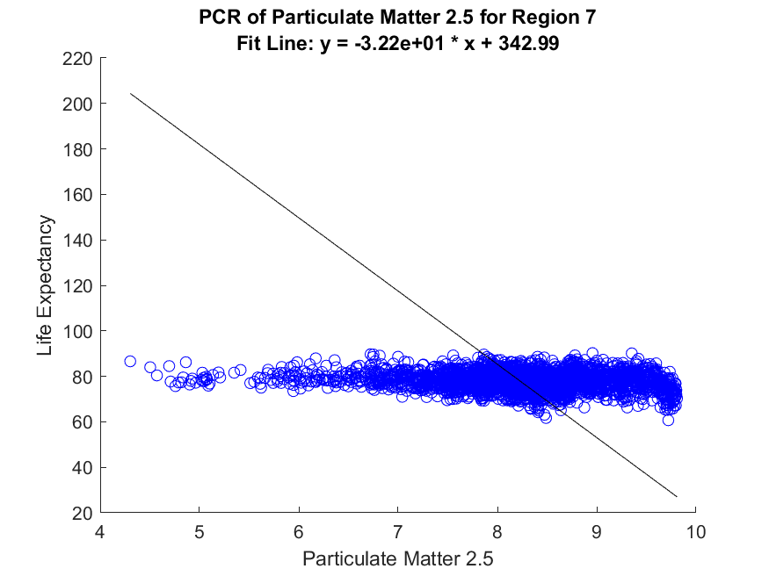
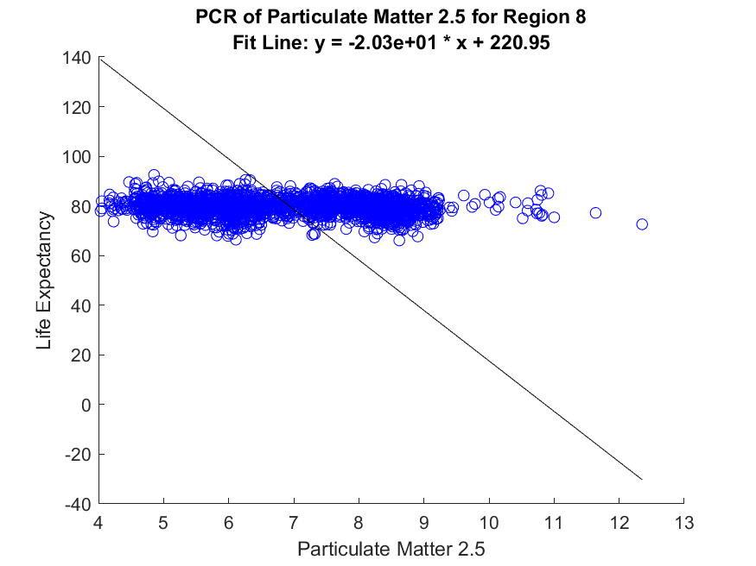
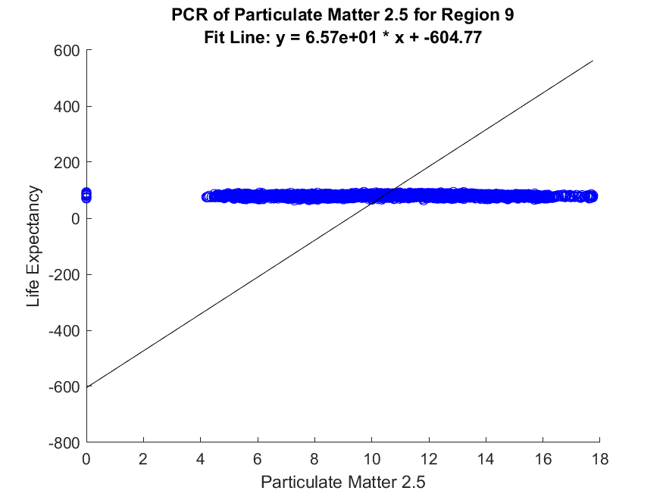
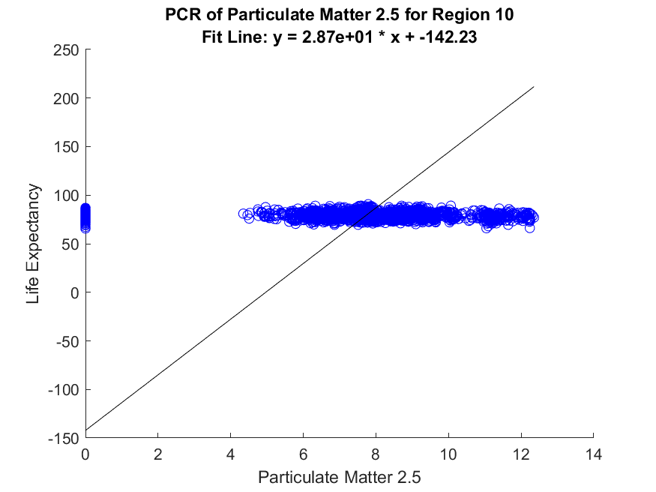
Principal Component Regression - Regional

Slide 9
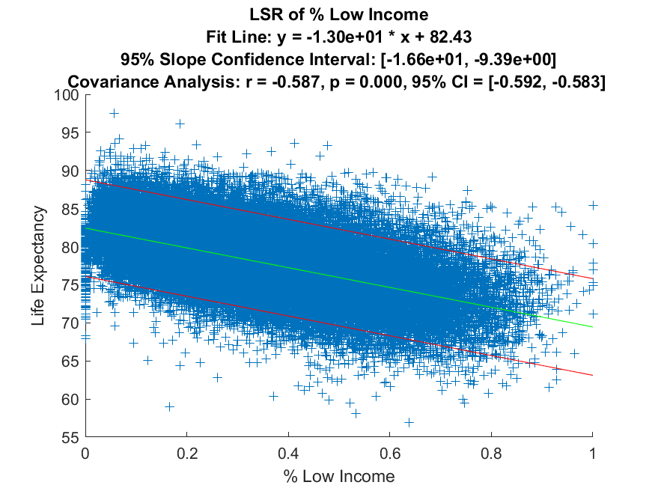
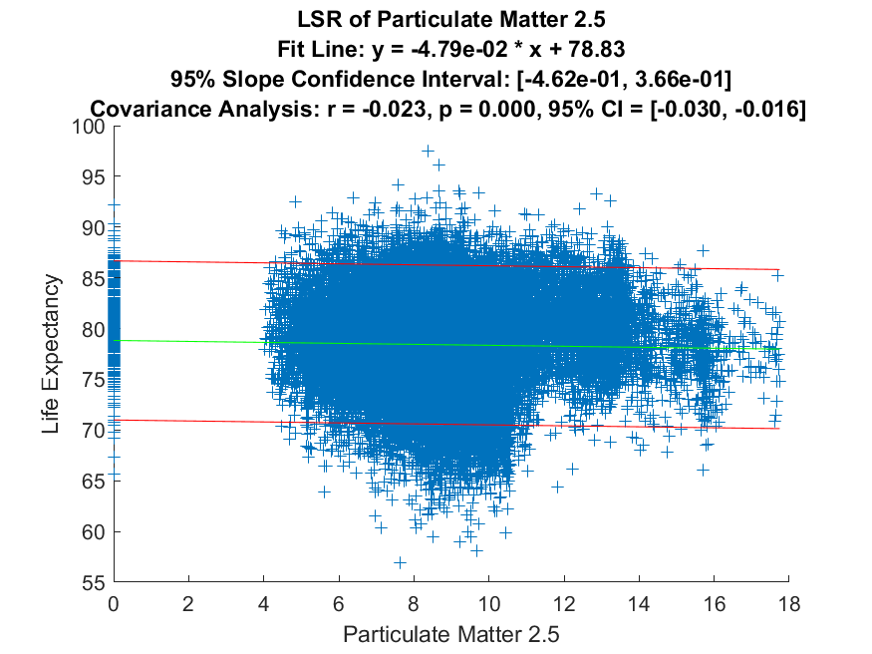
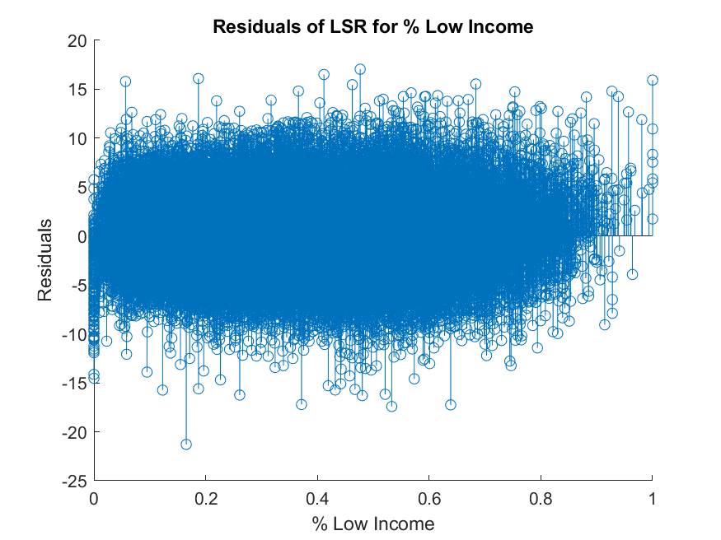
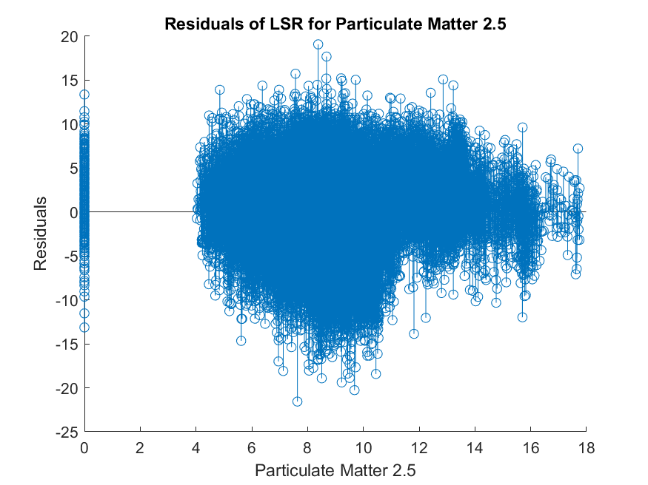
Least Squares Regression - National

Slide 10
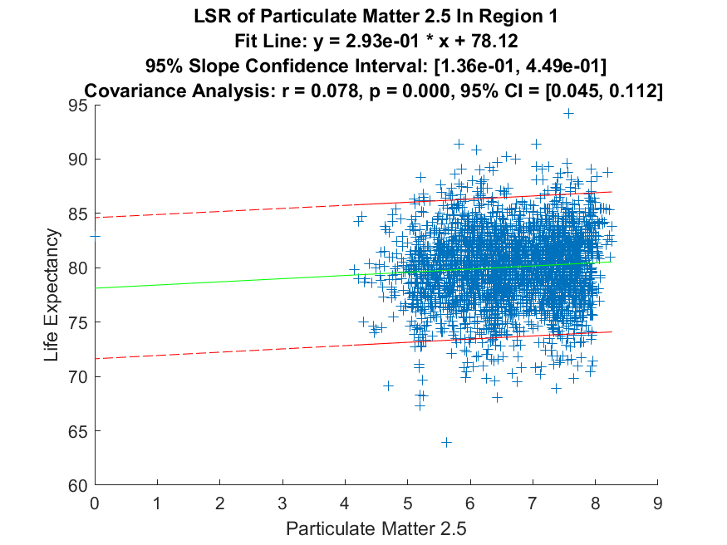
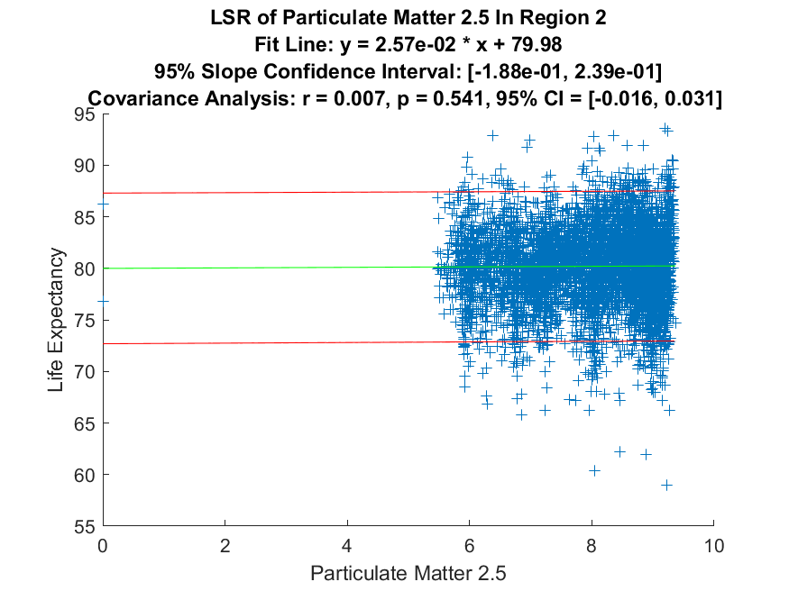
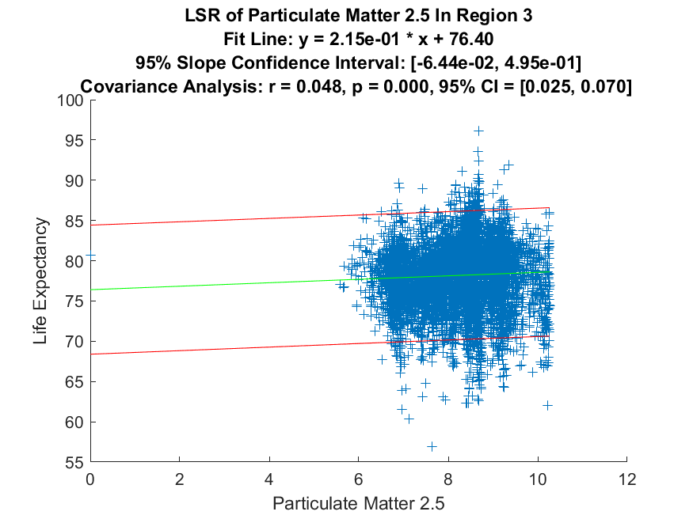
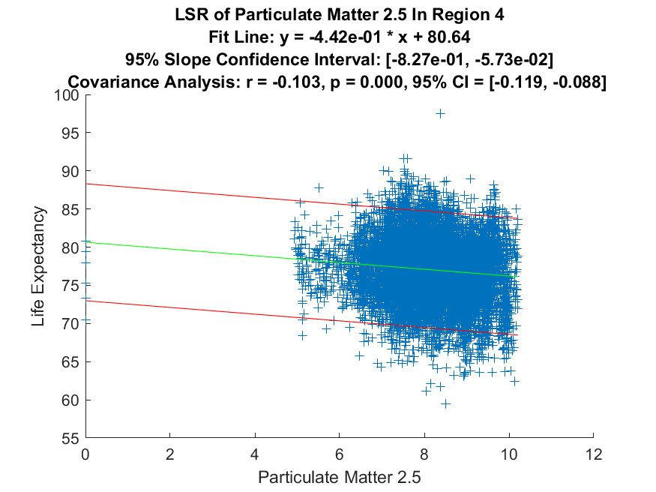
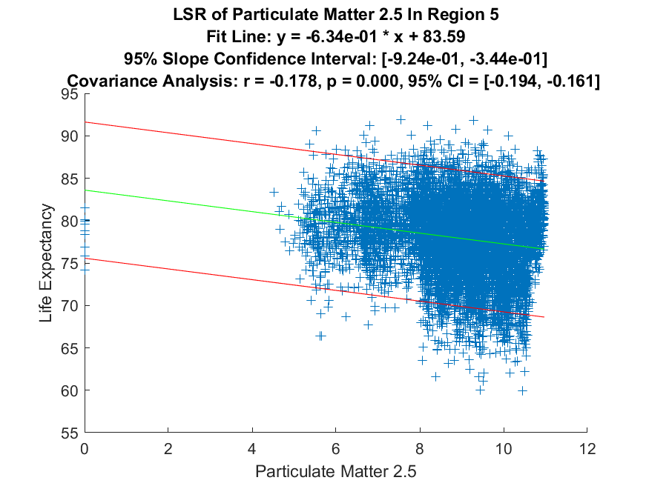
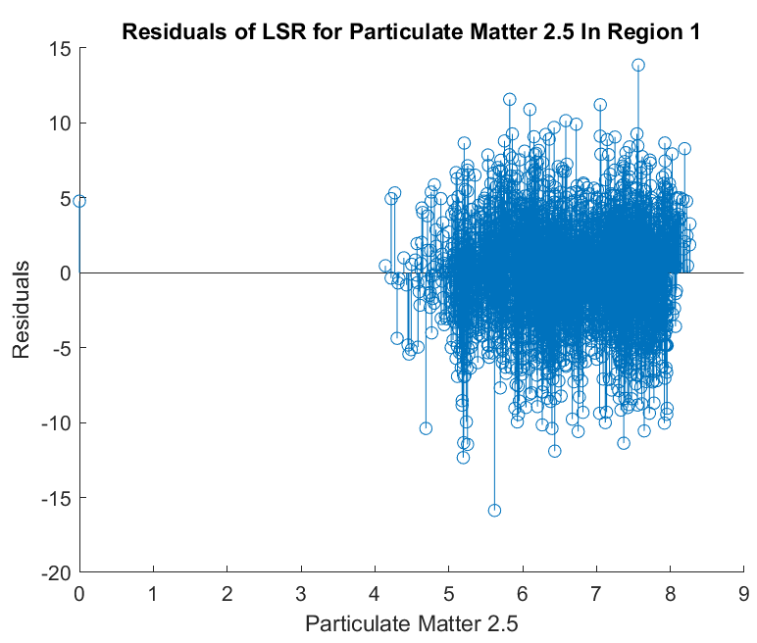
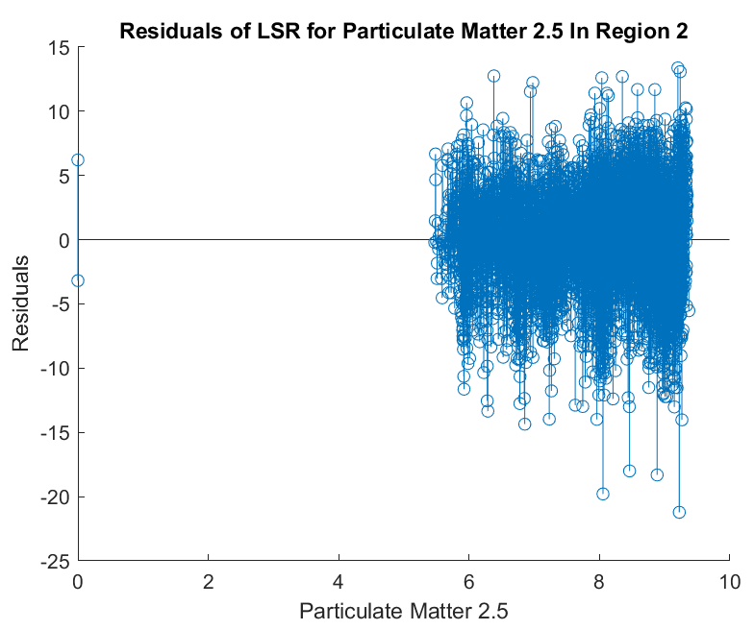
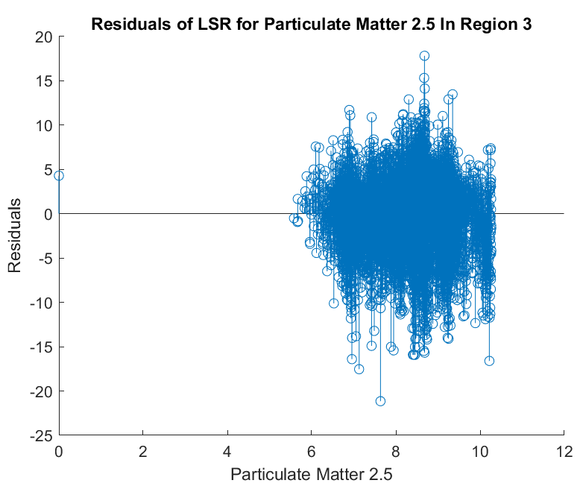
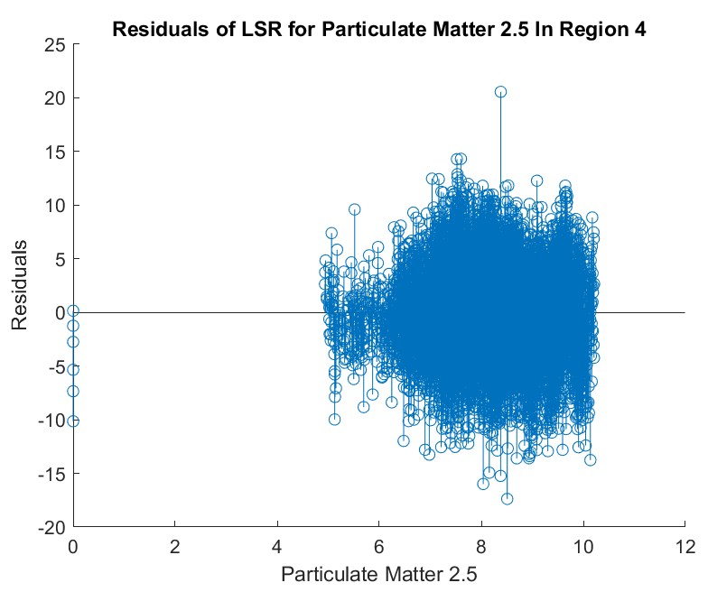
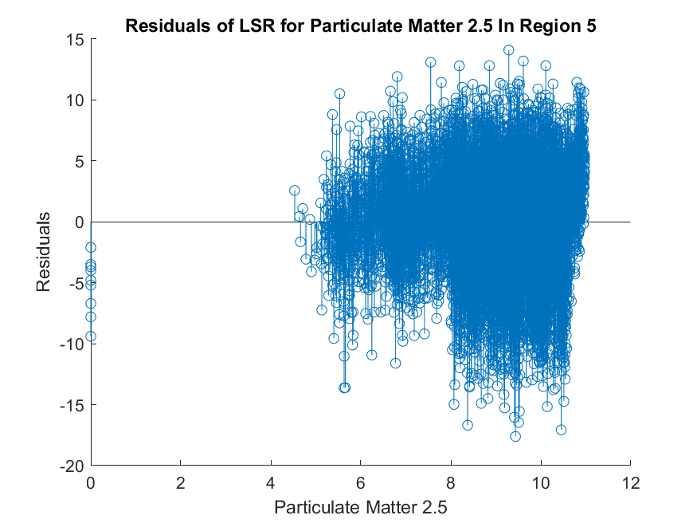
Least Squares Regression - Regional

Slide 11
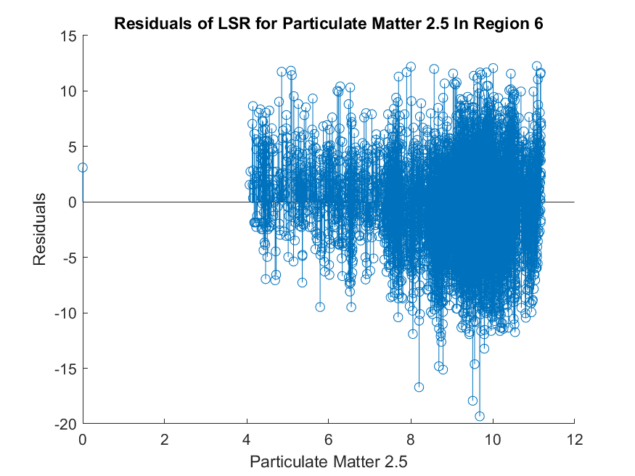
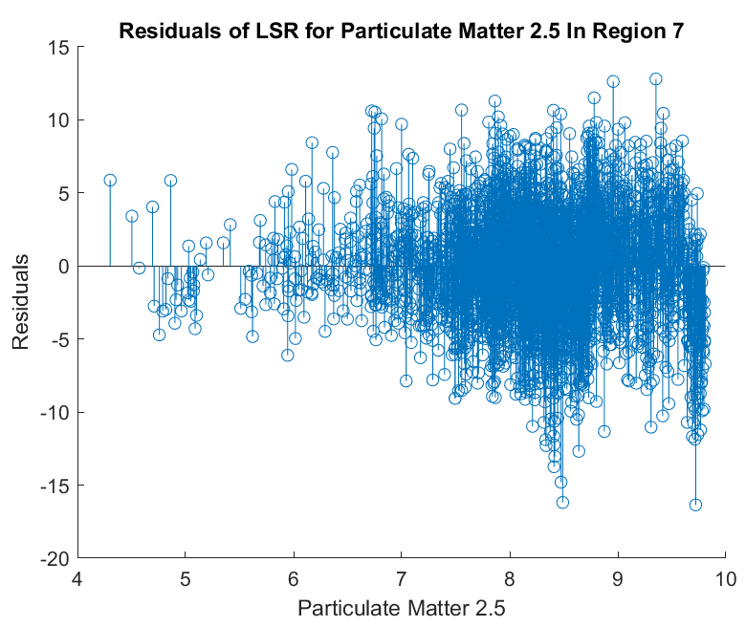
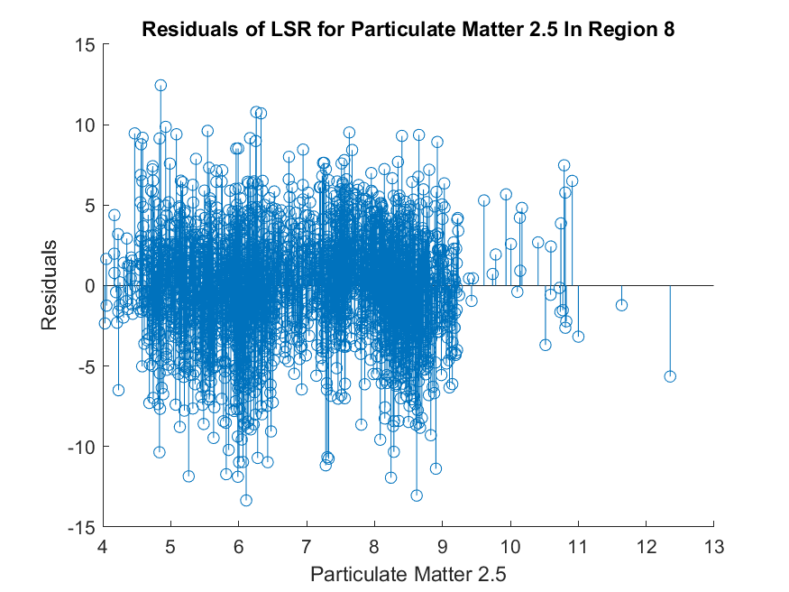
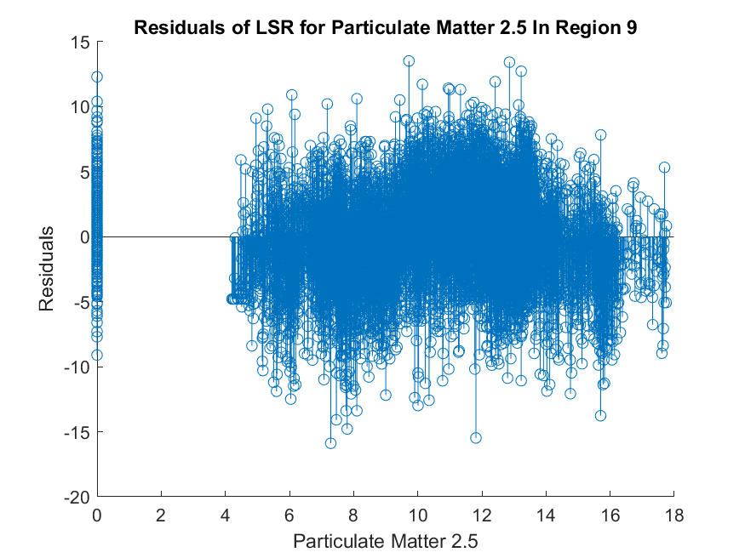
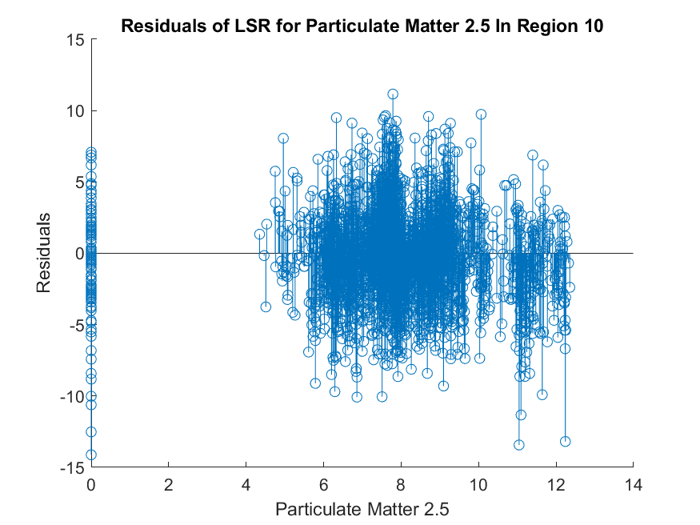
Least Squares Regression - Regional

Slide 12
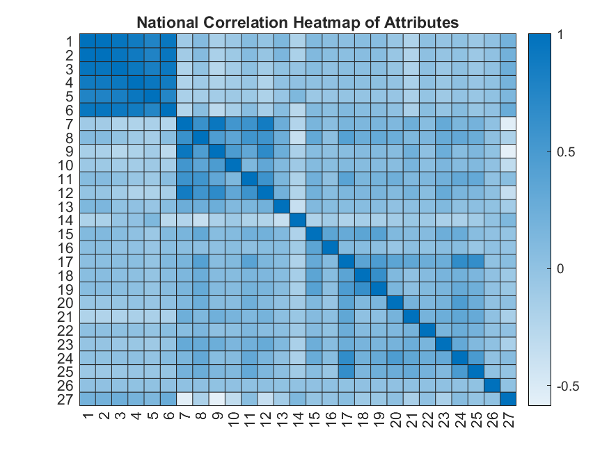
Correlation Heatmap- National

Slide 13
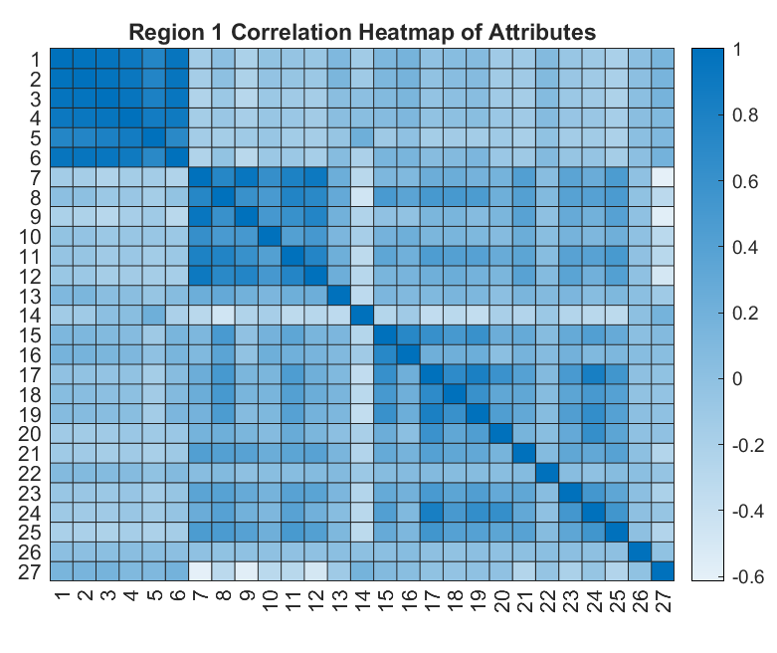
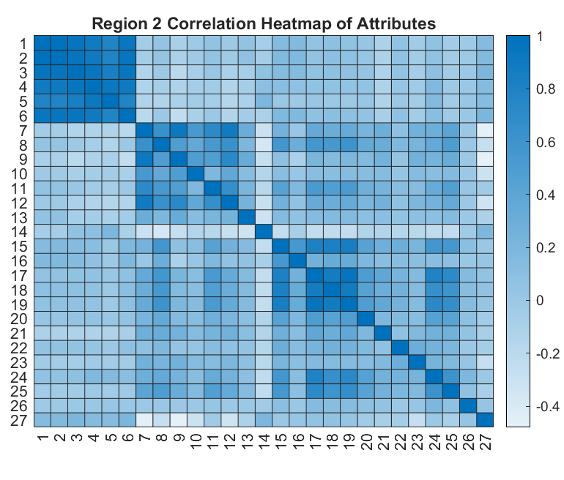
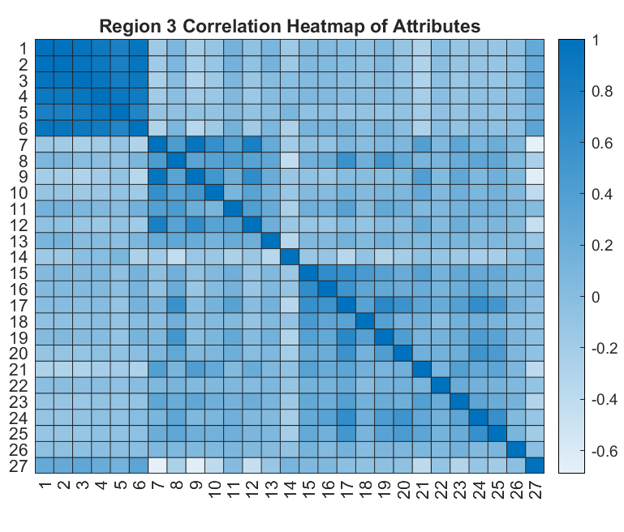
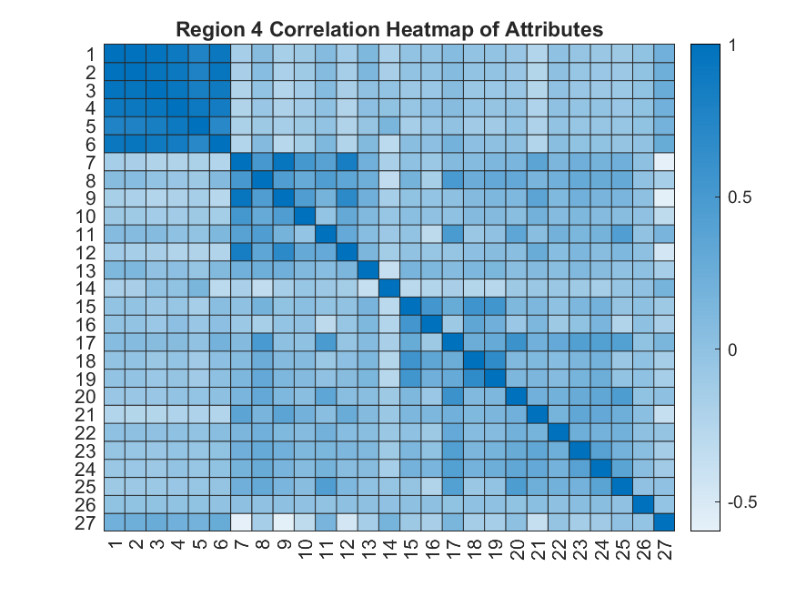
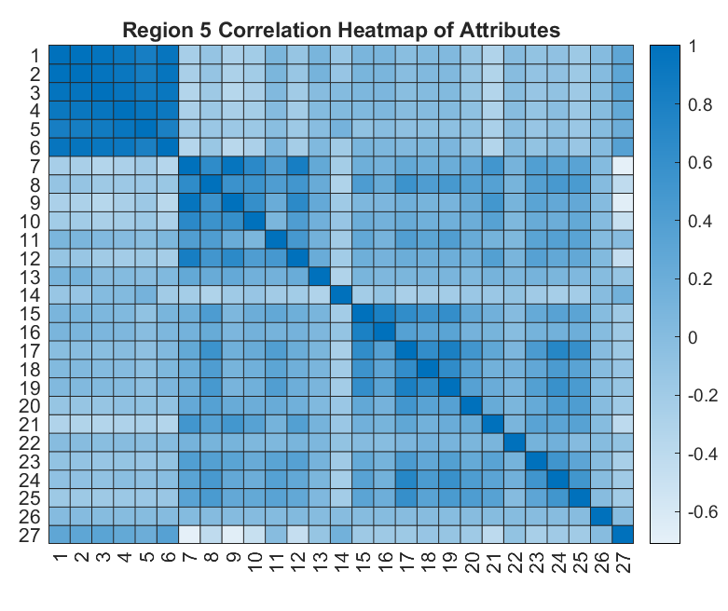
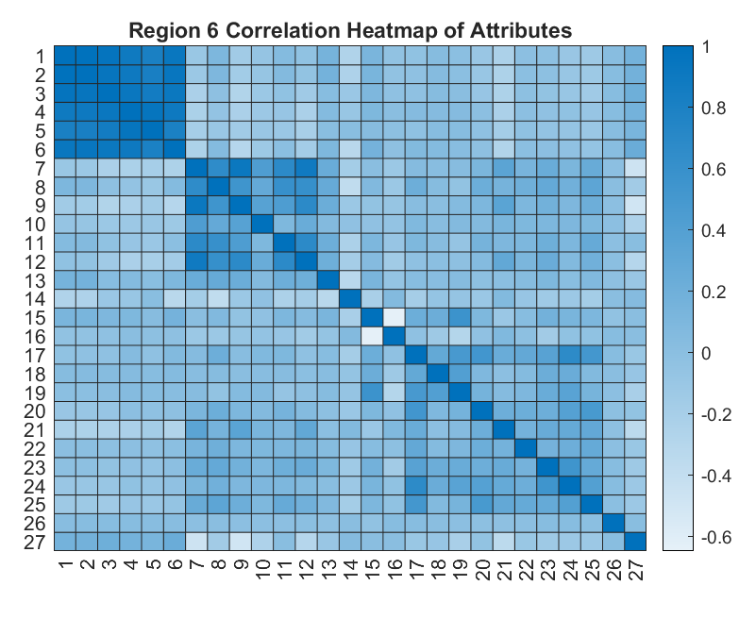
Correlation Heatmap- Regional

Slide 14
Information Learned
Statistically Significant Correlation for LSR – National & Regional
Demographic Index
% Low Income
% Unemployed
% Less Than High School Education
Socio-economic factors are more correlated with life expectancy than environmental factors

Slide 15
Future Analysis
Multivariate Regression to determine life expectancy on multiple factors
Bootstrap implementation for increased reproducibility
Analyze other correlated factors

Slide 16
Thank You
Questions?

