Slide 1
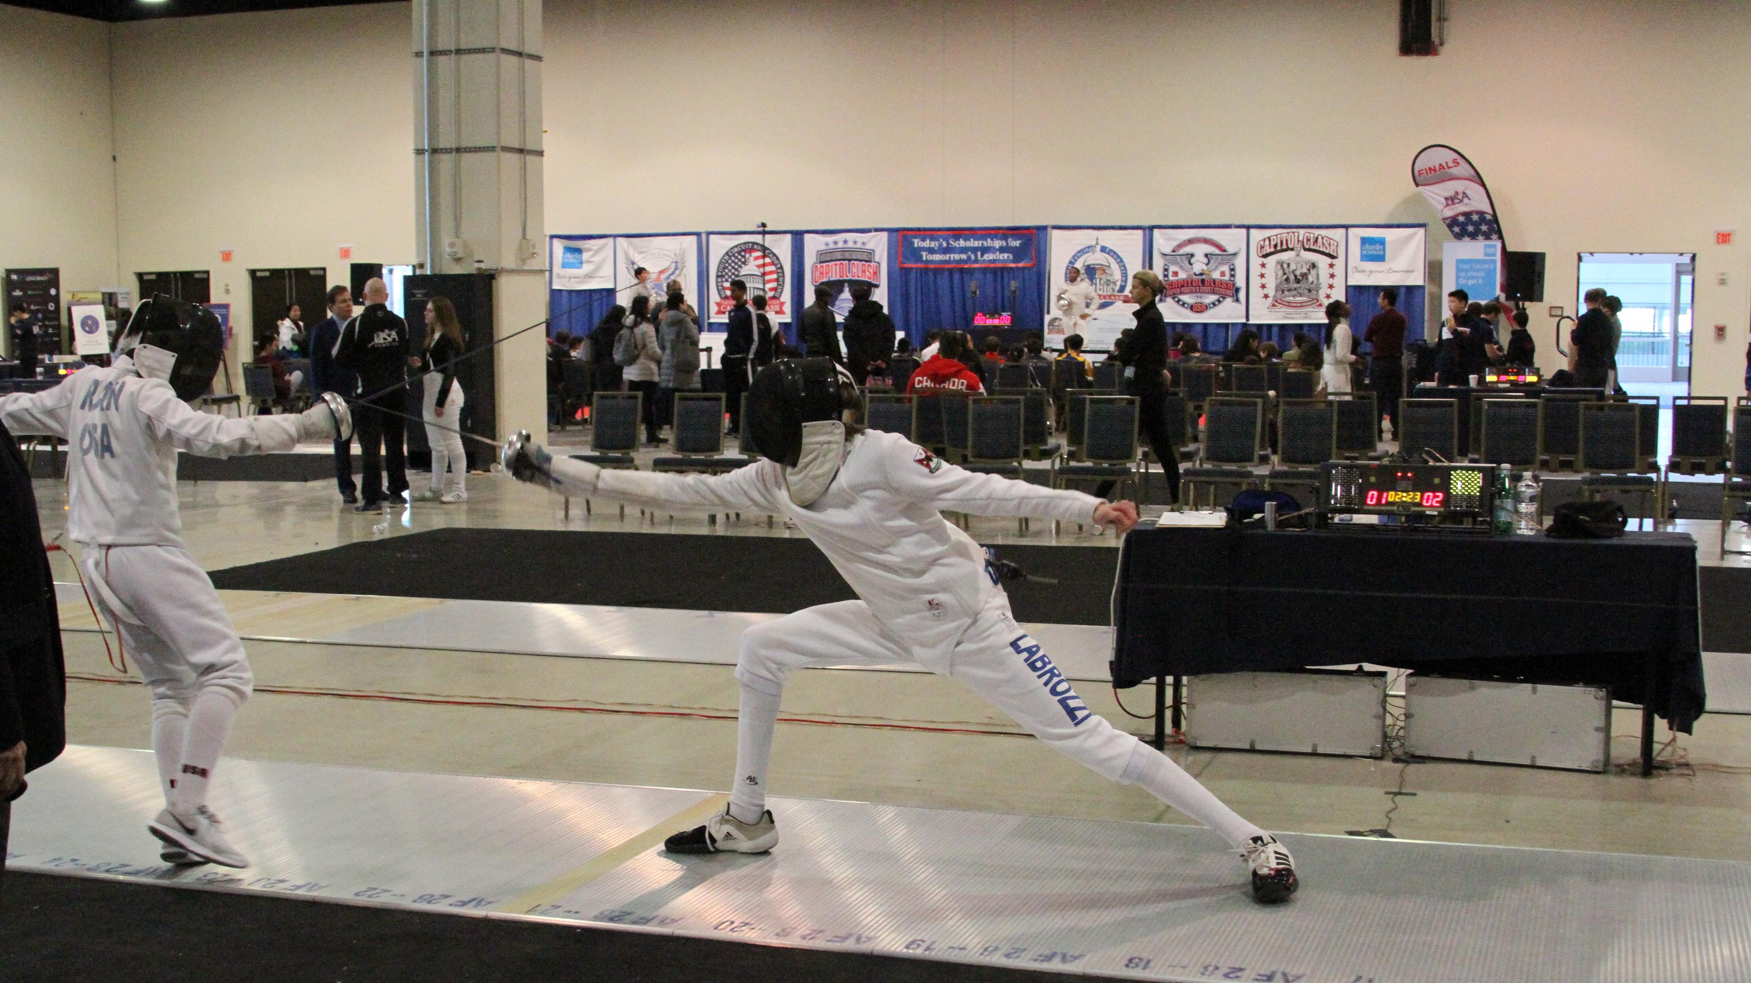
A Comparative Analysis of the USA Fencing Ranking System Across Each Weapon
By: Aidan Labrozzi

Slide 2
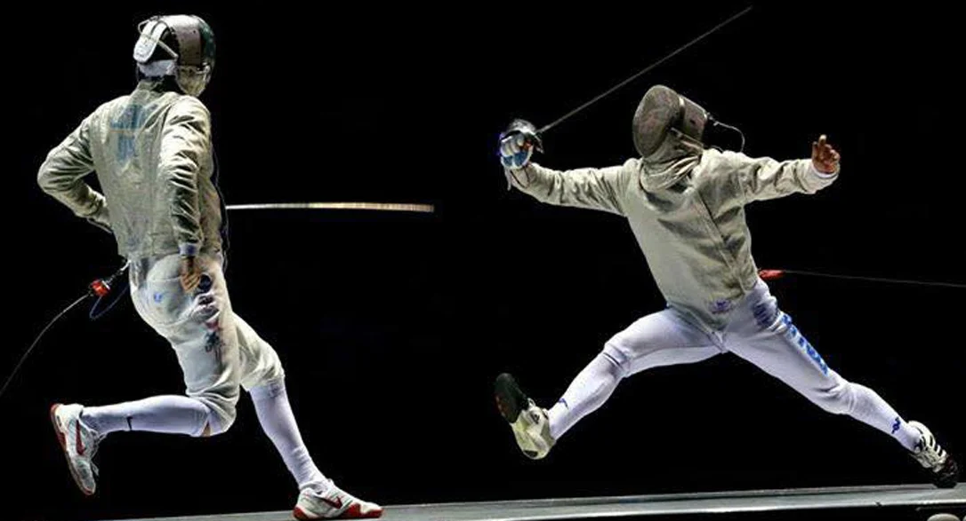
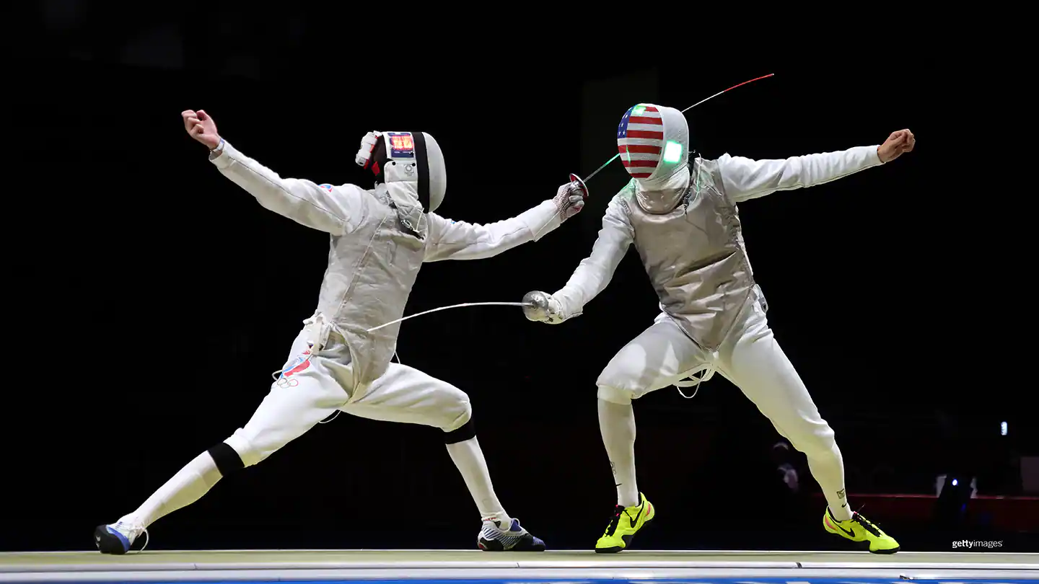
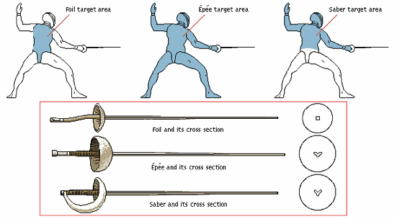
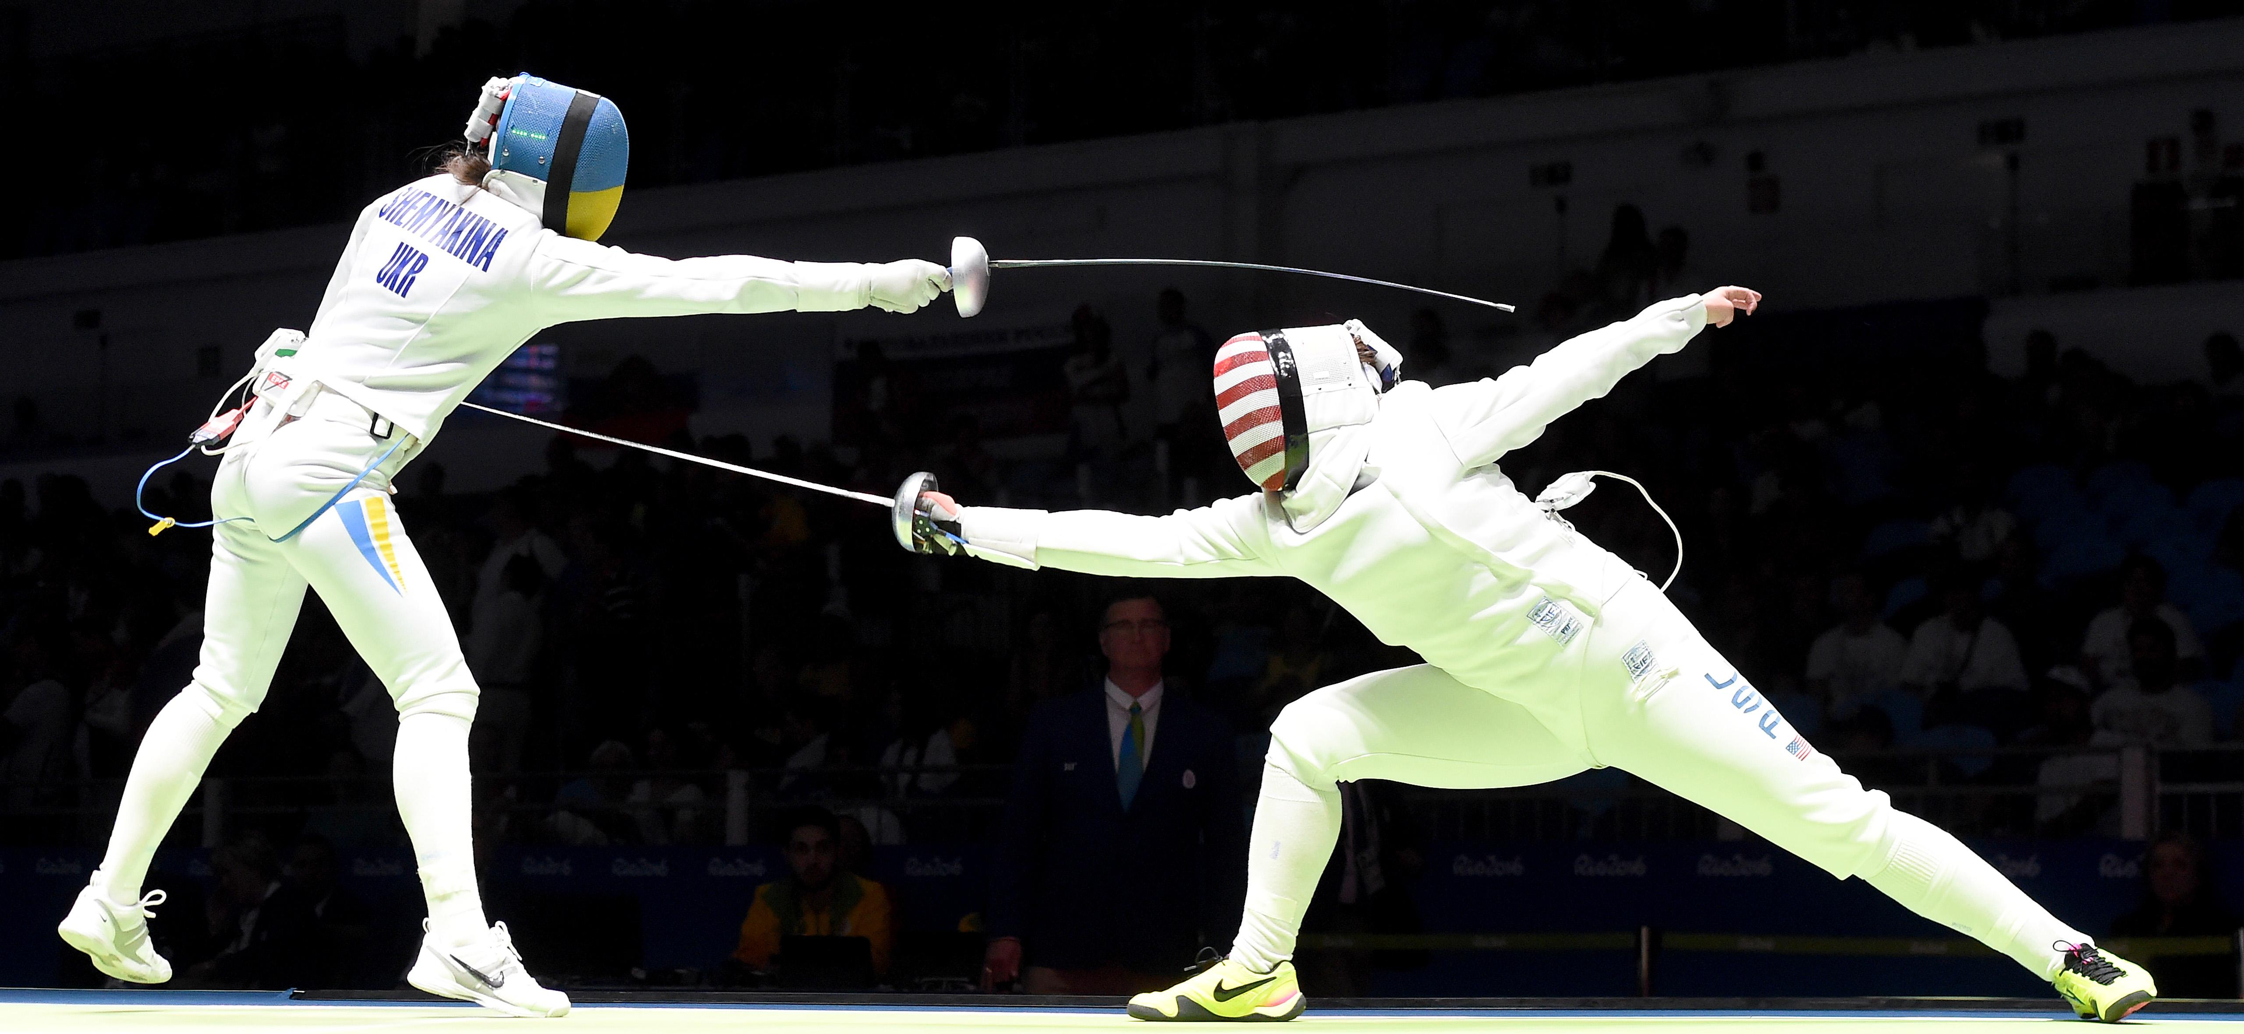
Background
Saber
Three different weapons in Olympic Fencing
Foil, Epee, and Saber
Different target areas, & rules for awarding touches (points)
Lending to different techniques and styles
Ratings
letter based rating system to rank fencers' skill levels
Highest skill = A
Lowest level = E
Unrated = U
Foil
Epee

Slide 3
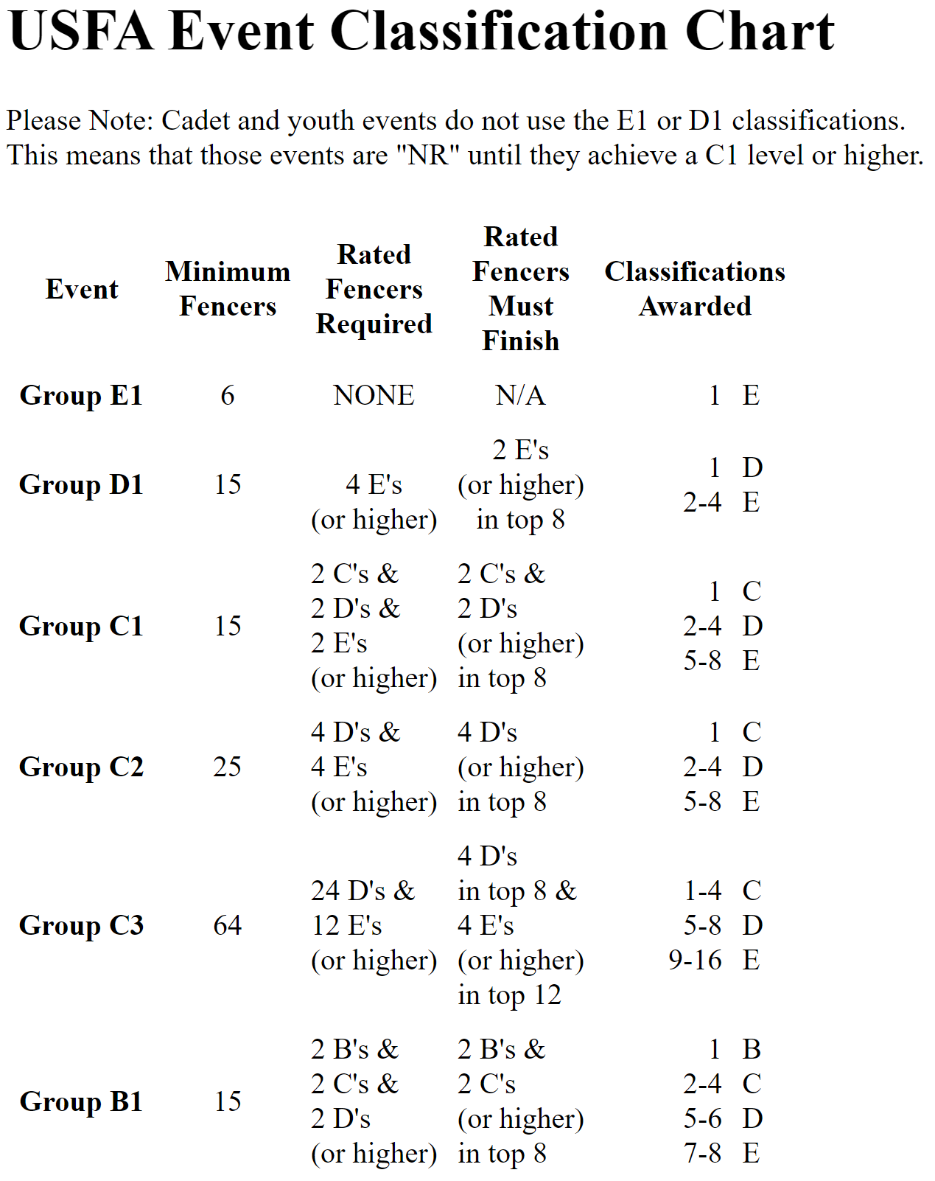

Questions Being Addressed
Frequent argument amongst fencers is which weapon is the most challenging.
Commonly believed that the same rating between different weapons do not corresponds to the same level of skill
Ex) Easier to get a rating in epee than in foil (D rating in foil equates to a C rating in epee)
How does the rating scale compare across each weapons?
How does performance differ between fencers of the same rating but different weapons?
`
Top 8 for Div III Men’s Epee 2018 April North American Cup (NAC) all fenced mainly foil or started competing in epee less than a year prior.

Slide 4
Hypothesis
Hypothesis: Various performance statistics for fencers of the same rating but different weapons differ significantly and can allow for weapon classification given rating.
Top 8 for Div III Men’s Epee 2018 April North American Cup (NAC) all fenced mainly foil or started competing in epee less than a year prior.

Slide 5
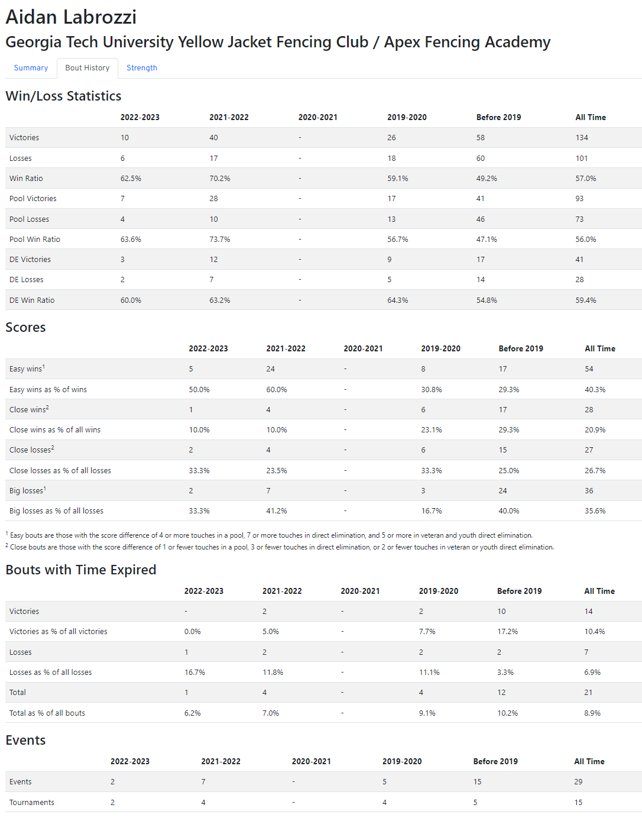

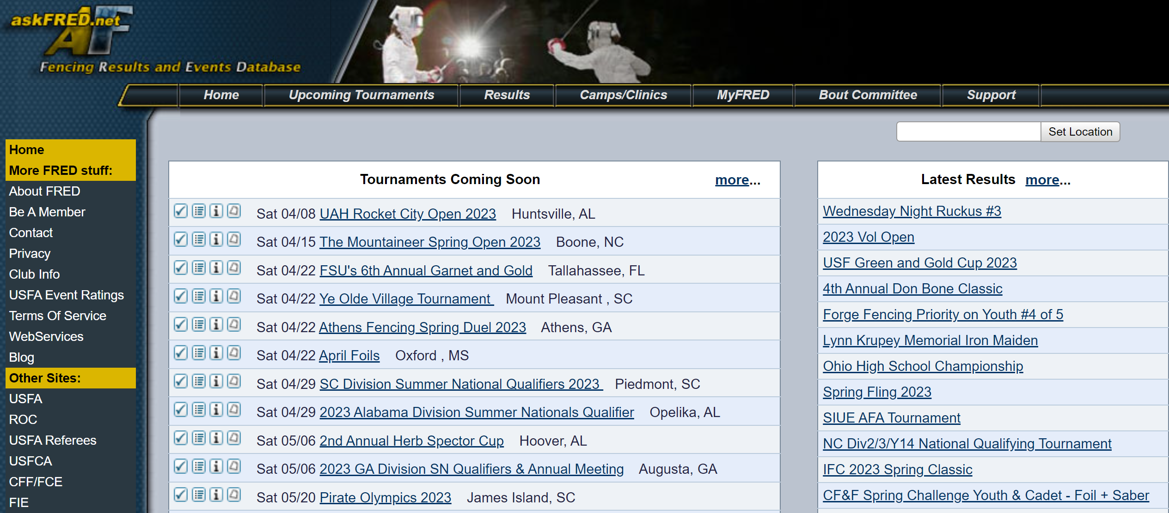
Data Source
Fencing Statistics Database: Fencing Tracker
Compiles data/statistics for all competitive fencers associated with a USA Fencing approved/affiliated club.
Data compiled from:
USA Fencing (national governing body for fencing)
askFRED (Fencing Results and Events Database)

Slide 6
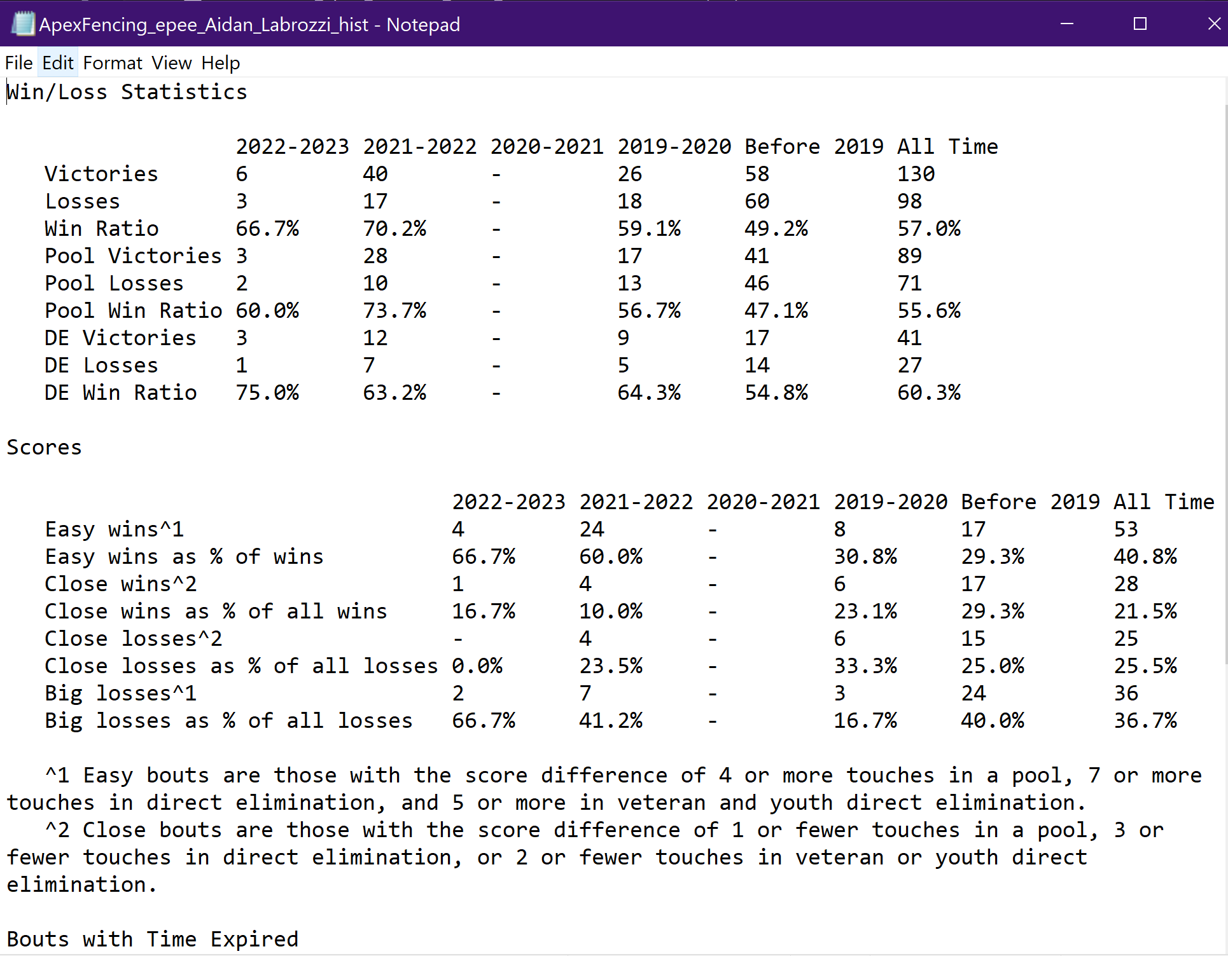
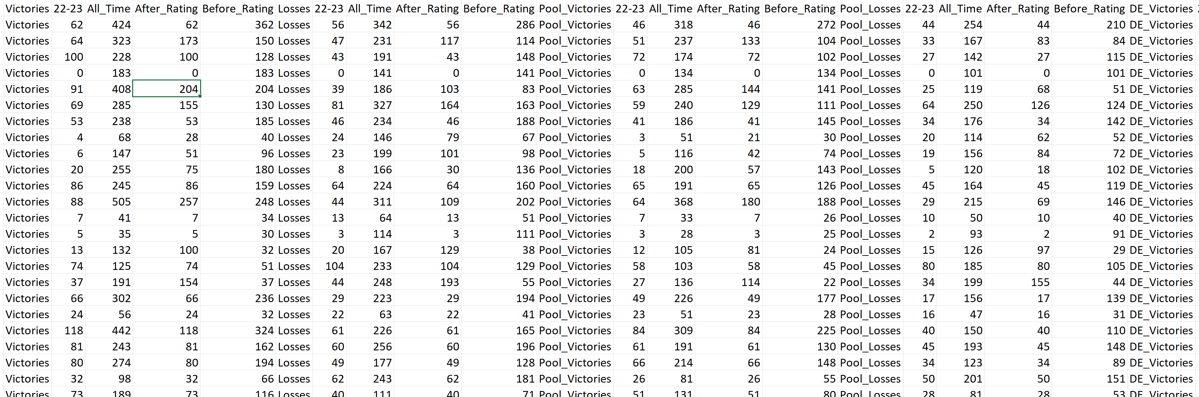
Data Formatting
Combination of Linux and MATLAB used to download and format data from Fencing Tracker
The top 15 clubs for each weapon were selected and, the webpage of each of their fencers containing their statistics were downloaded via Linux.
Data was then extracted and organized from the downloaded text files using MATLAB

Slide 7
Statistics Being Analyzed
The number of events a fencer participated in prior earning there rating
Used in lieu of / as a proxy for time spent fencing
Total Wins-to-Losses Ratio (after earning current rating)
Used as an indicator of skill
Direct Elimination Win-to-Loss Ratio (after earning current rating)
Related to how far one tends to go in tournaments
Easy-Wins-to-Hard-Losses Ratio (after earning current rating)
Alternative skill indicator
Easy wins: victory with score difference >=4 touches in a pool, or >=7 in a DE.
Hard Losses: Loss with score difference >=4 touches in a pool, or >=7 in a DE.
Additional Statistic Definitions:
Close Win/Loss: Bout with score difference <= 1 touches in a pool, or <= 3 in a DE.

Slide 8
Mean Number of Events Prior to Earning Rating
The mean number of events that a fencer participated in before earning his/her current rating was bootstrapped for a given weapon and rating to test if the means were statistically different.
Bootstrap method followed by percentile function was used to get the mean 95% and 90% confidence intervals since the original distribution was not a normal distribution
10% CI was used for significance testing.
Looked at only fencers who
Have a rating in only one weapon
Earned their rating after 2019 (Due to data limitations)

Slide 9
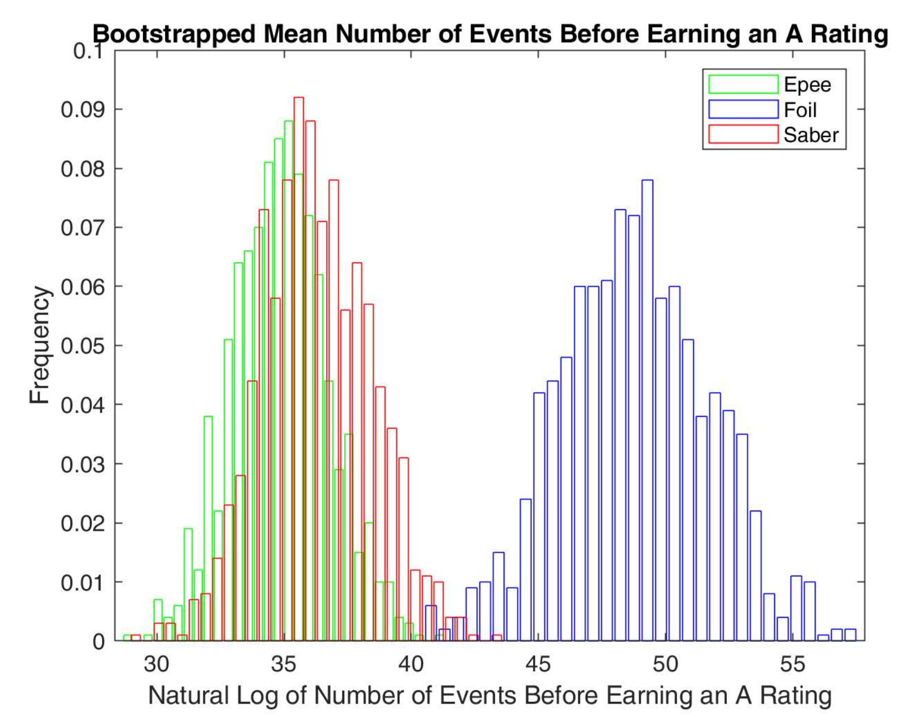
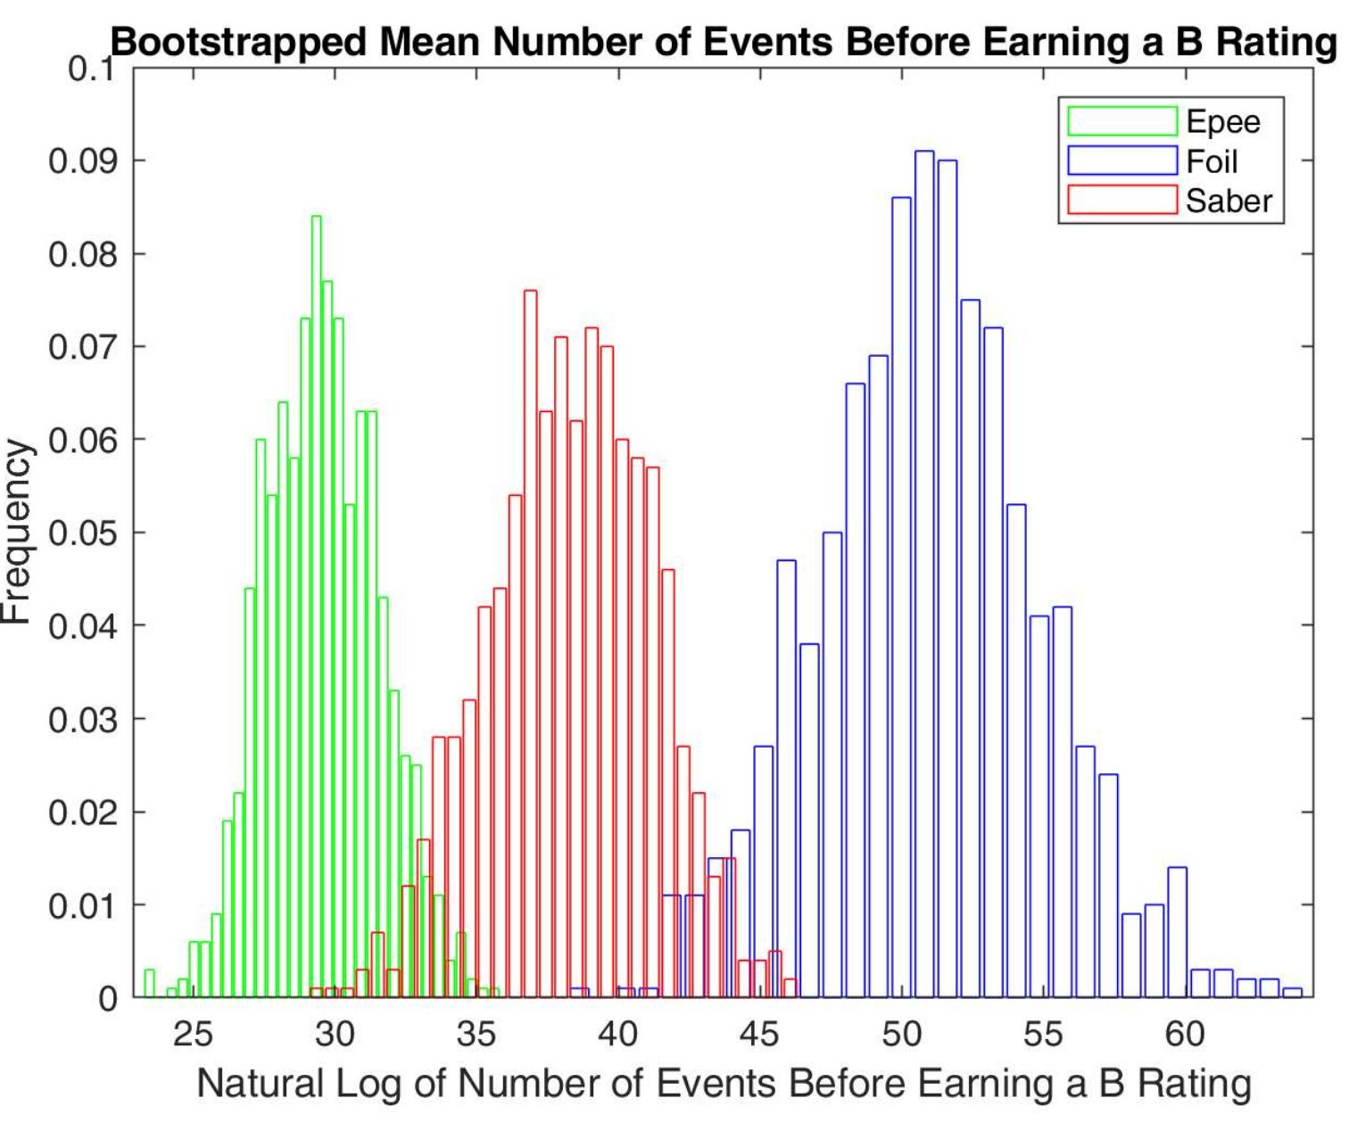
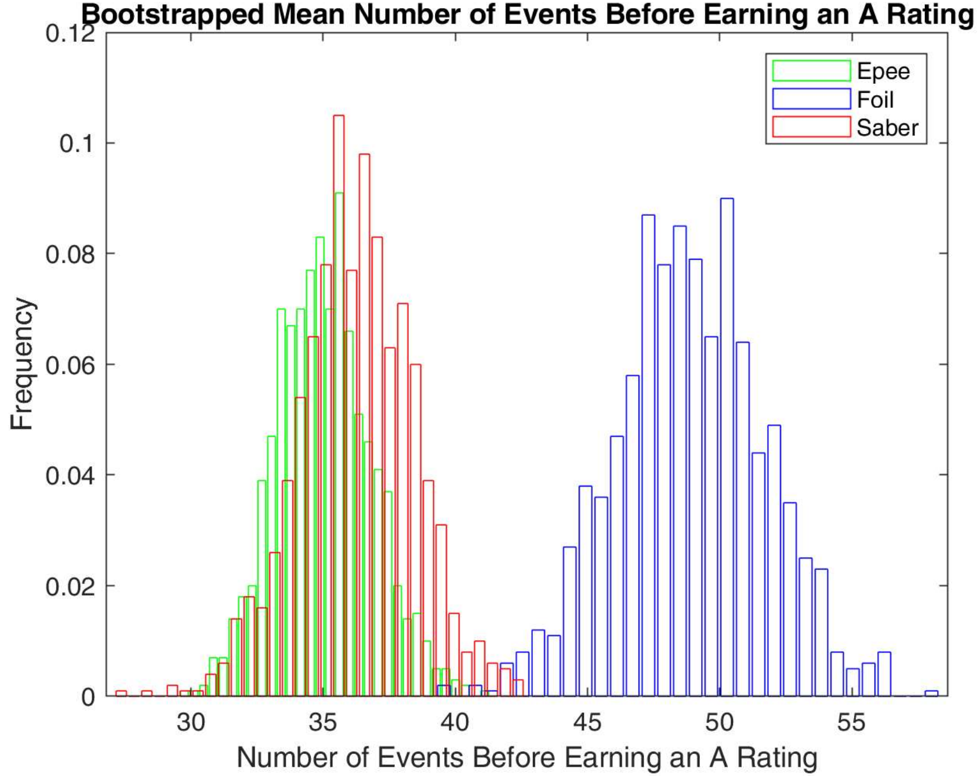
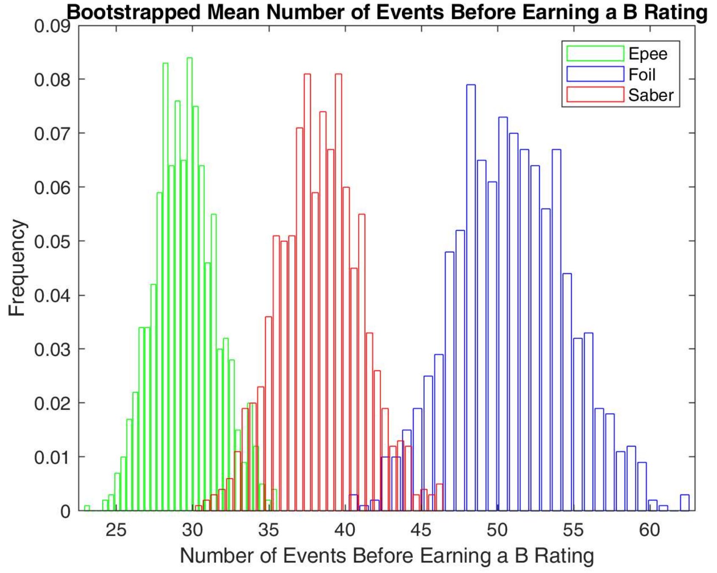
Mean Number of Events Prior to Earning Rating
Weapon | Low 95% CI Bound | MEAN | Upper 95% CI Bound
Epee | 31.56 | 35.07 | 38.75
Foil | 43.27 | 48.85 | 54.39
Saber | 31.79 | 36.25 | 40.65
Weapon | Low 95% CI Bound | Low 90% CI Bound | MEAN | Upper 90% CI Bound | Upper 95% CI Bound
Epee | 26.20 | 25.70 | 29.54 | 33.21 | 33.86
Foil | 44.82 | 43.56 | 50.87 | 57.30 | 58.47
Saber | 33.14 | 33.80 | 38.37 | 42.91 | 44.06

Slide 10
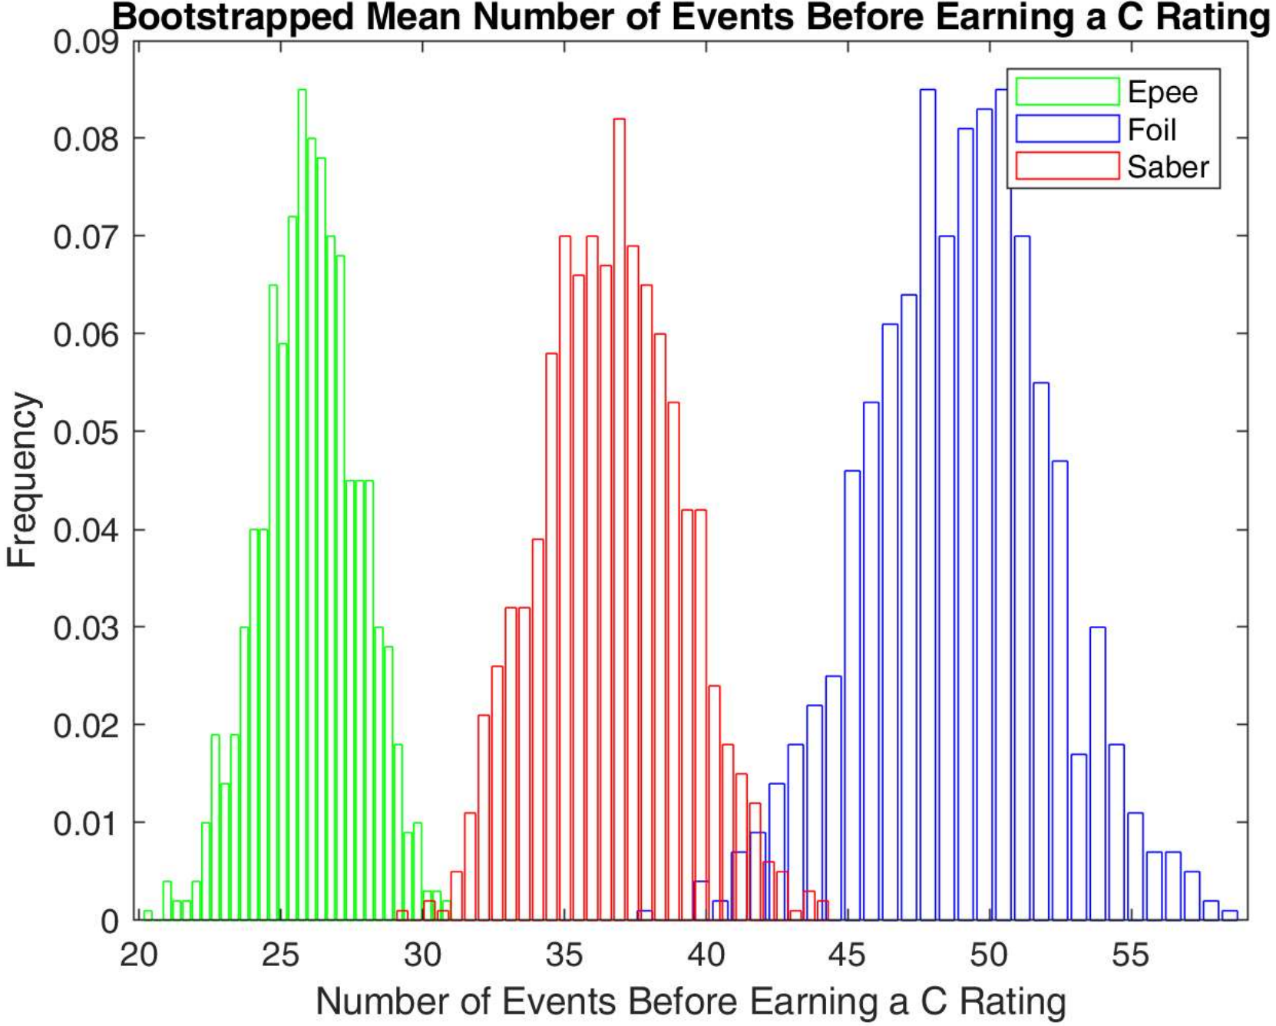
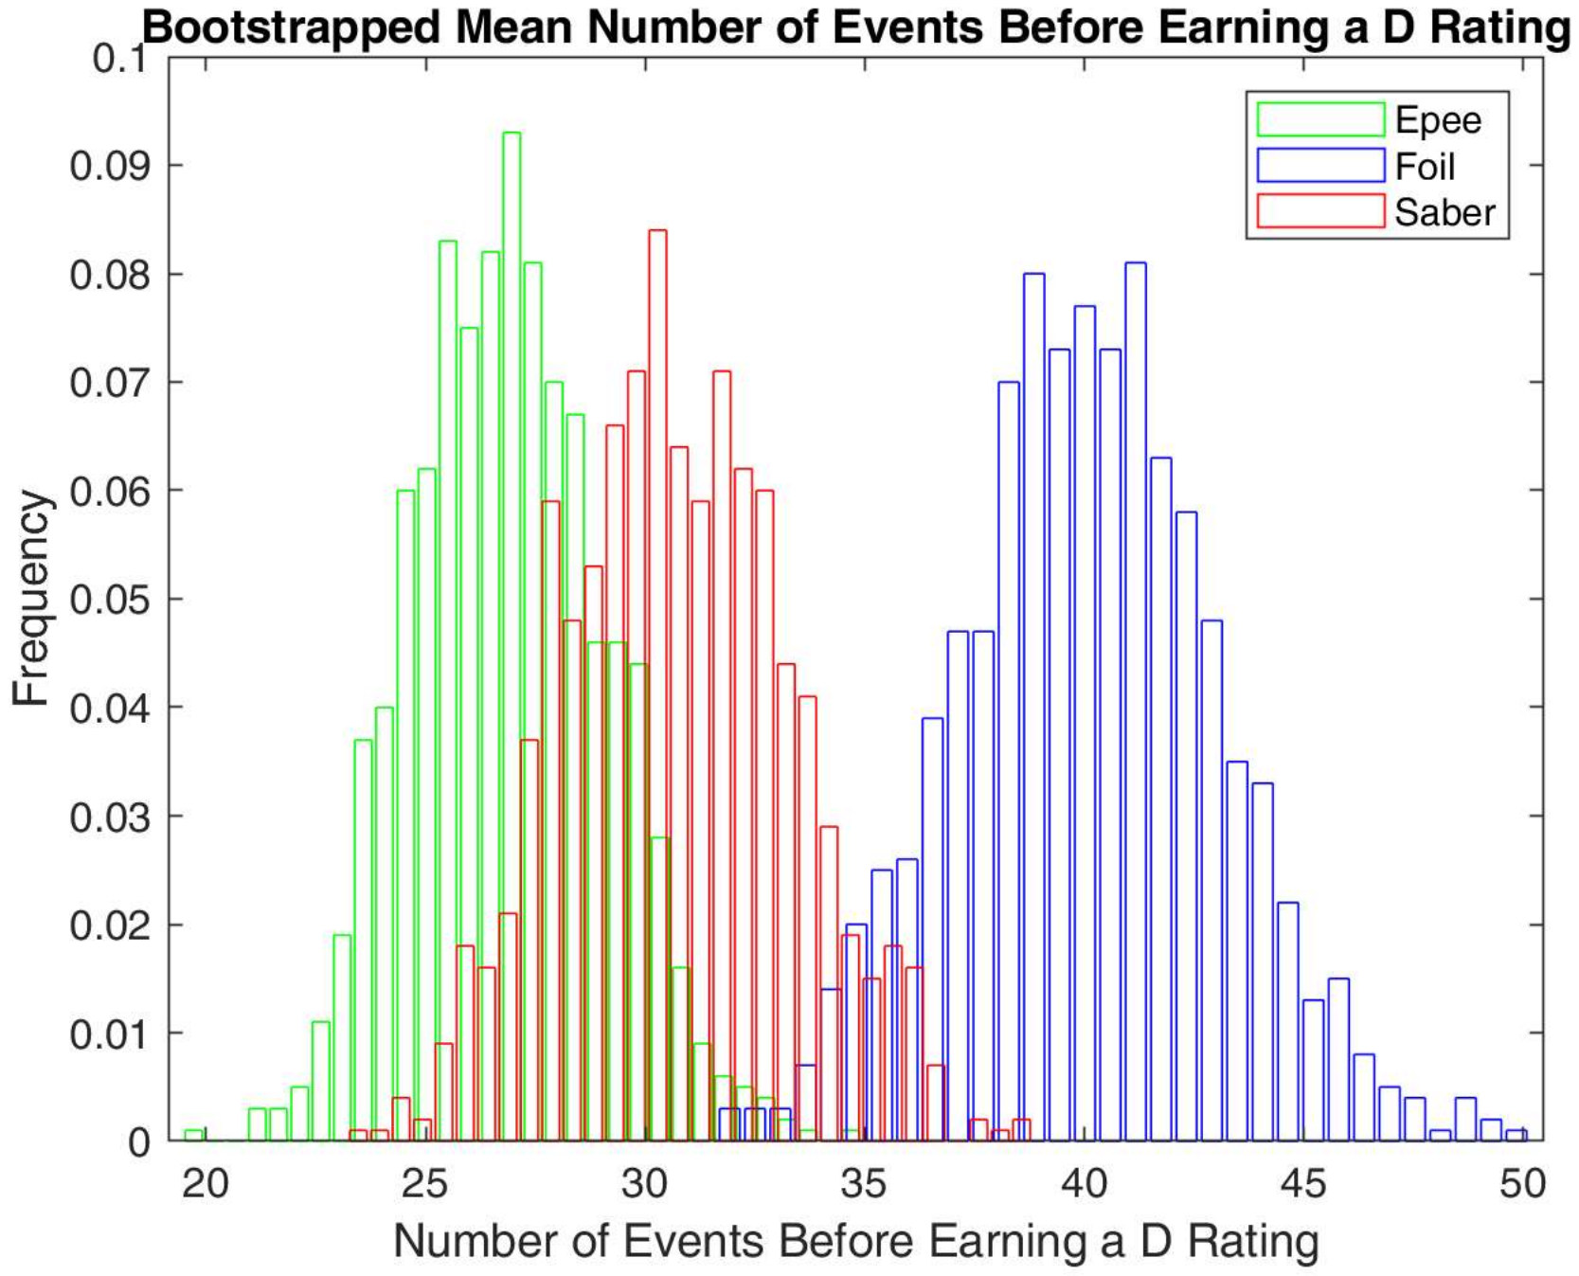
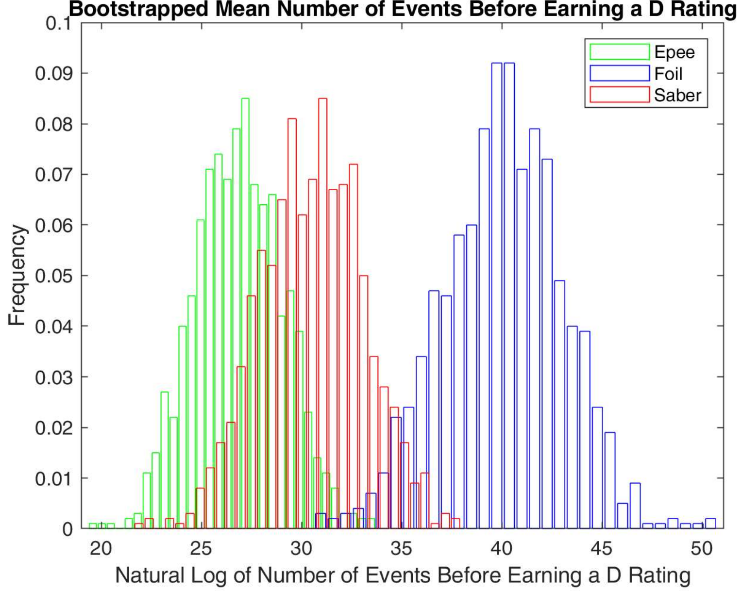
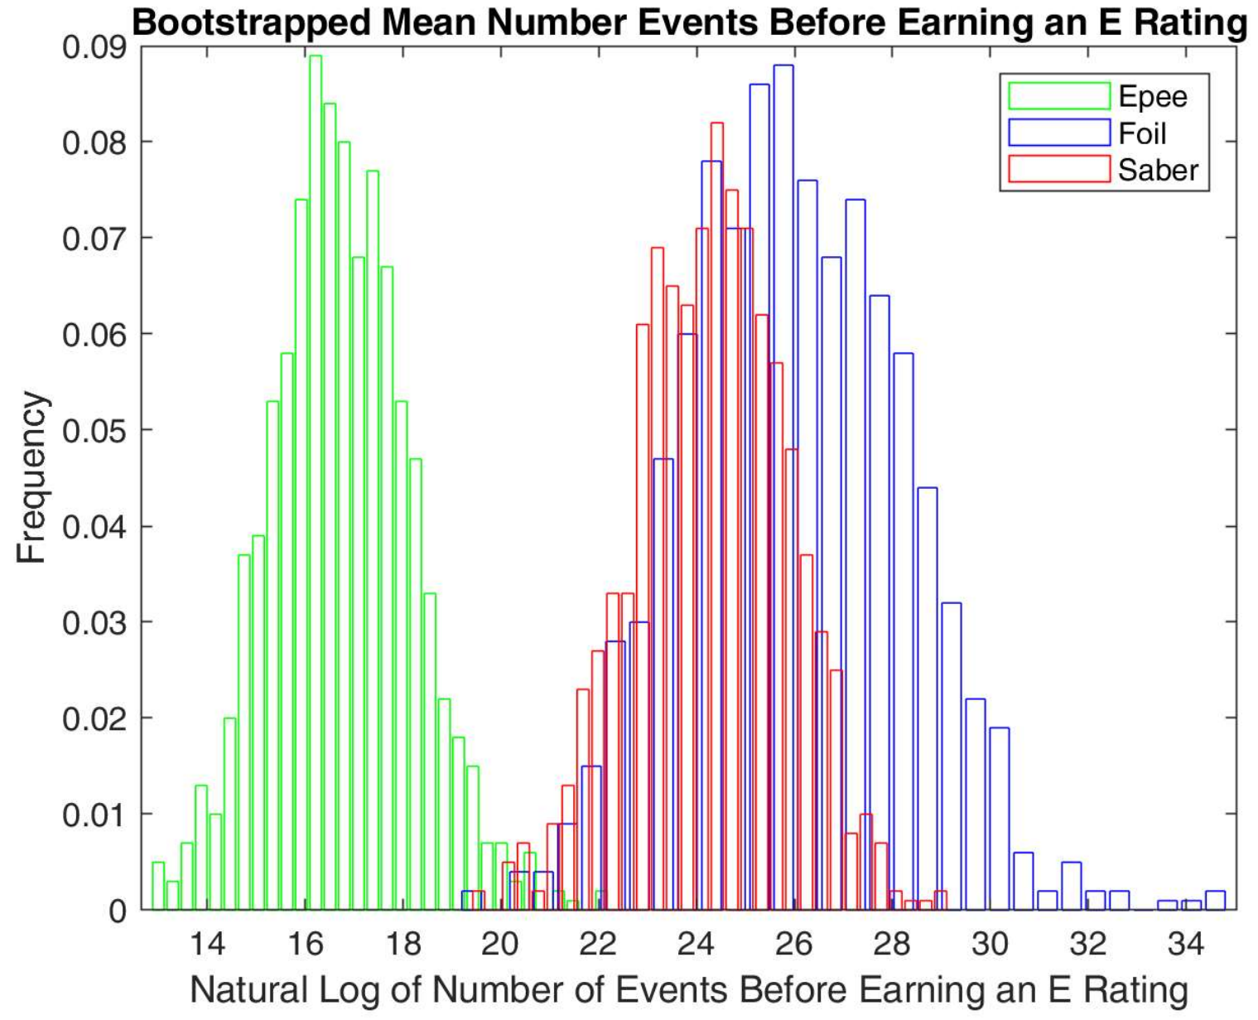
Mean Number of Events Prior to Earning Rating
Weapon | Low 95% CI Bound | MEAN | Upper 95% CI Bound
Epee | 22.55 | 26.06 | 29.34
Foil | 42.36 | 48.86 | 55.18
Saber | 32.03 | 36.67 | 41.61
Weapon | Low 95% CI Bound | Low 90% CI Bound | MEAN | Upper 90% CI Bound | Upper 95% CI Bound
Epee | 22.93 | 23.43 | 26.87 | 30.43 | 31.22
Foil | 34.38 | 35.11 | 40.09 | 45.10 | 46.09
Saber | 25.94 | 26.62 | 30.72 | 35.20 | 36.00

Slide 11
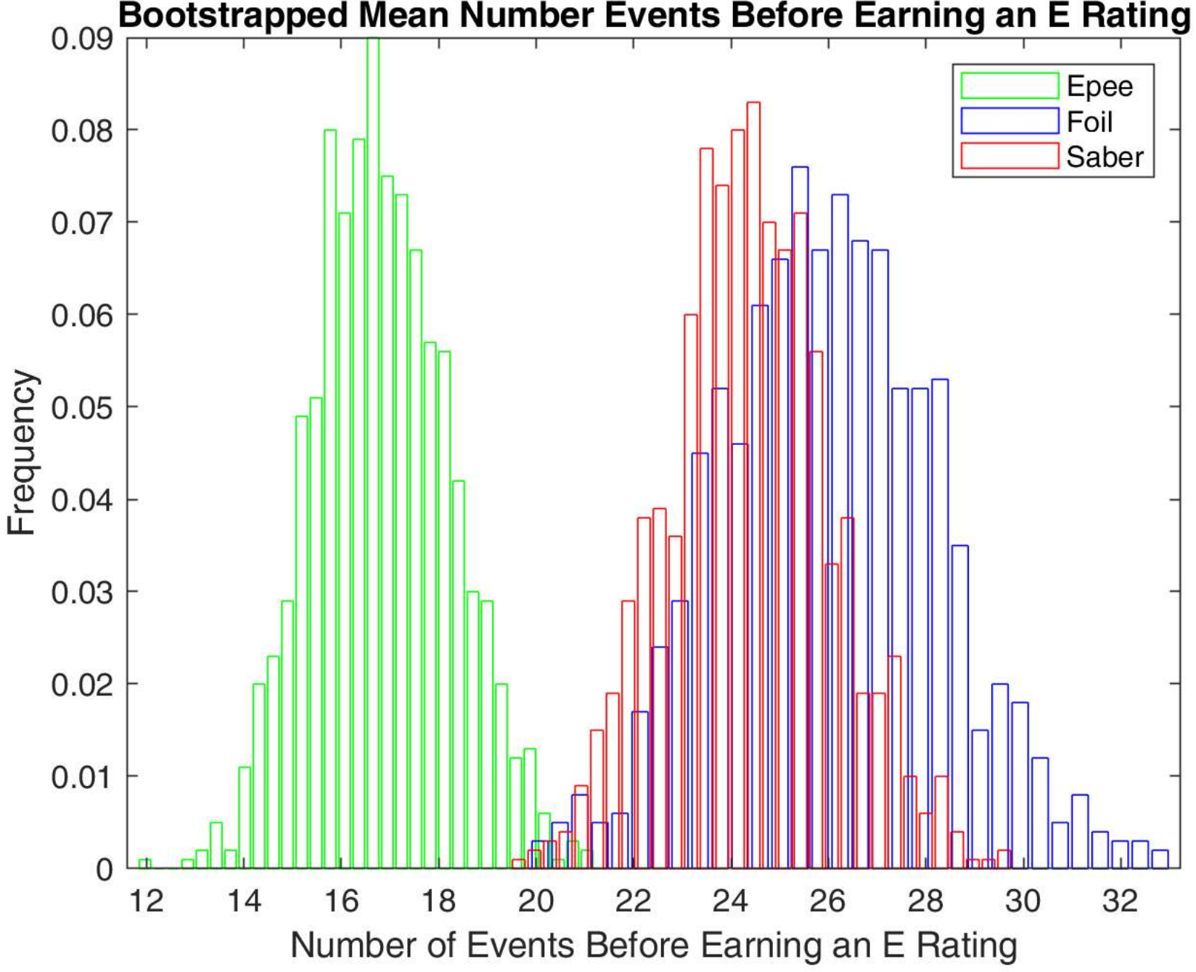
Mean Number of Events Prior to Earning Rating
Results:
The mean number of events prior to earning an A,B, and C rating is statistically higher for foil fencers than Epee and Saber fencers. (as well as D and E ratings
The mean number of events prior to earning a D and E rating is statistically higher for foil fencers than Epee fencers.
The mean number of events prior to earning a C and E rating is statistically higher for Saber fencers than Epee fencers.
Weapon | Low 95% CI Bound | MEAN | Upper 95% CI Bound
Epee | 14.26 | 16.82 | 19.73
Foil | 21.74 | 26.00 | 30.53
Saber | 21.18 | 24.38 | 27.76

Slide 12
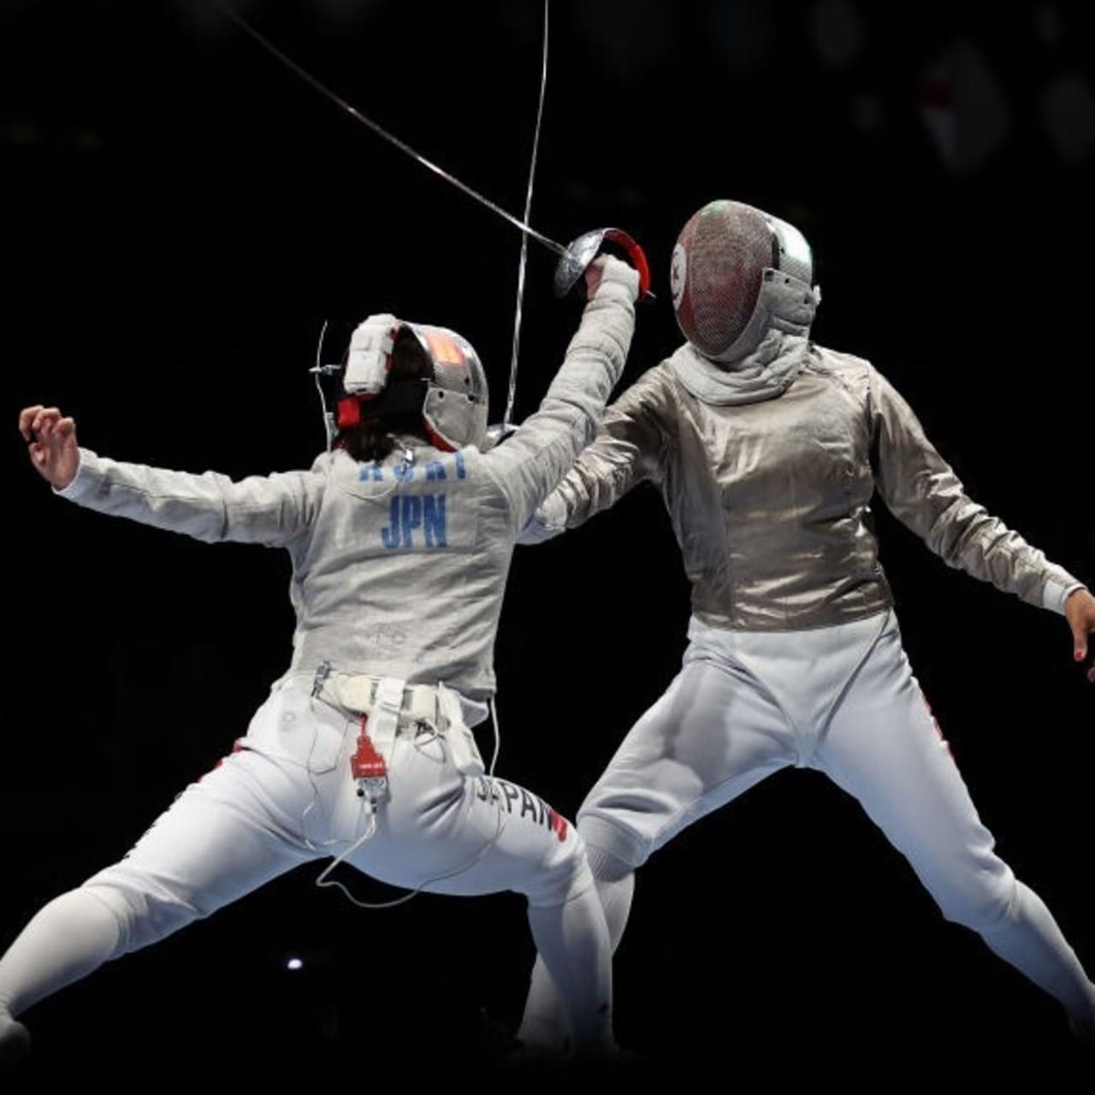
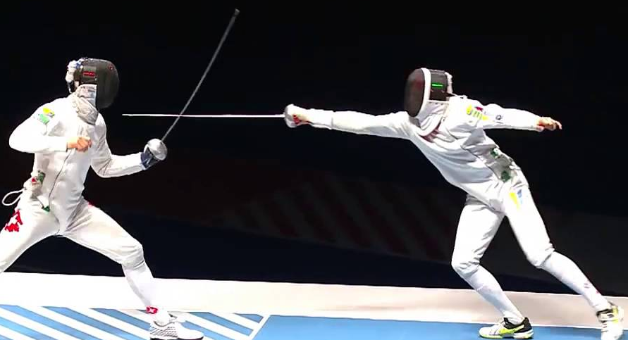
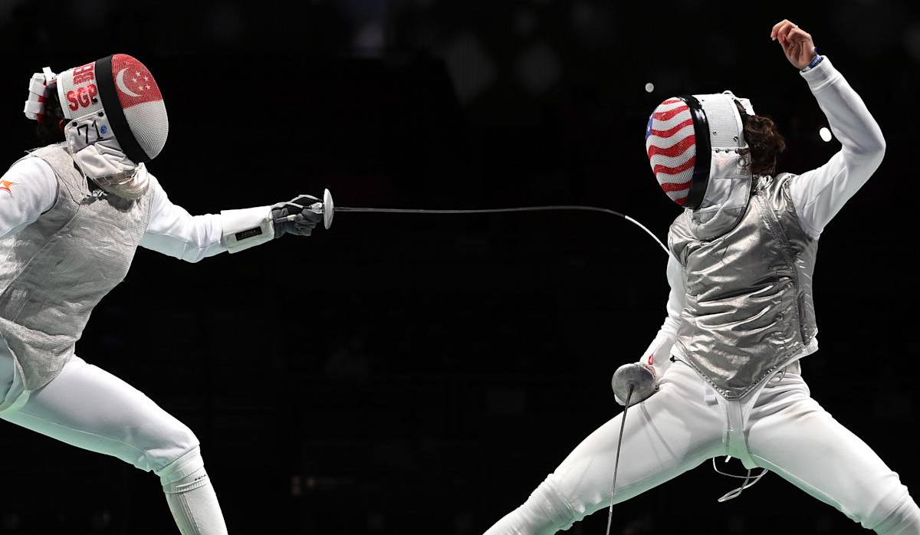
Interpretation of Bootstrapped Number of Events Results
On average it takes longer to earn an equivalent rating in foil than in epee and saber and for some ratings it takes on average more time to earn an equivalent rating in saber than in epee.
<
<

Slide 13
Bootstrapped Mean DE Win-to-Loss Ratio
The mean ratio of DE victories to DE losses was also looked at as a measure of how far a fencer of a given rating and weapon proceeds in a tournament.
DE or Direct Elimination is the second part of a fencing tournament which consists of a March-Madness style bracket where a fencers seeding is determined by their performance in their pool.
The natural log was taken of the ratio to convert the otherwise log normal distribution into a normal distribution.
Looked at only fencers who
Have a rating in only one weapon
Earned their rating after 2019 (Due to data limitations)
Have at least 1 DE victory and defeat to avoid NaN and Inf values

Slide 14
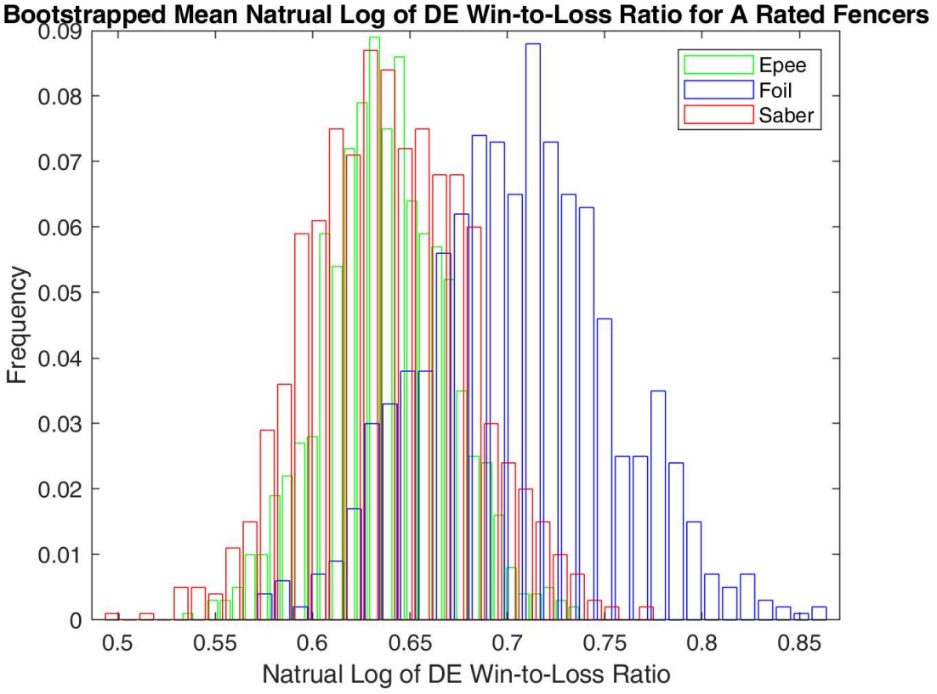
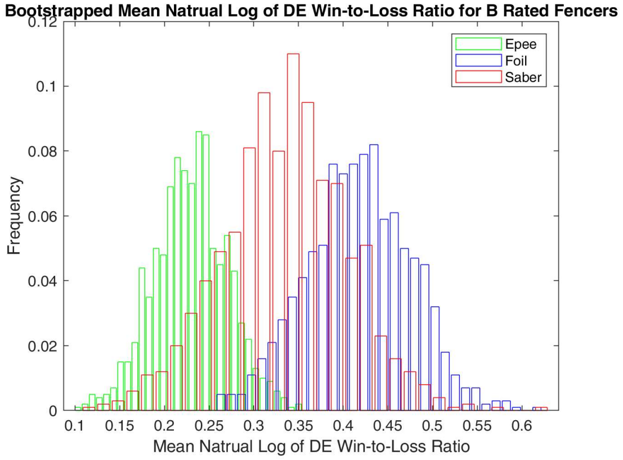
Mean Log DE Win-to-Loss Ratio
Weapon | Low 95% CI Bound | MEAN | Upper 95% CI Bound
Epee | 0.573 | 0.637 | 0.700
Foil | 0.613 | 0.706 | 0.802
Saber | 0.562 | 0.640 | 0.721
Weapon | Low 95% CI Bound | Low 90% CI Bound | MEAN | Upper 90% CI Bound | Upper 95% CI Bound
Epee | 0.149 | 0.161 | 0.229 | 0.297 | 0.313
Foil | 0.302 | 0.321 | 0.418 | 0.510 | 0.530
Saber | 0.190 | 0.218 | 0.335 | 0.447 | 0.470

Slide 15
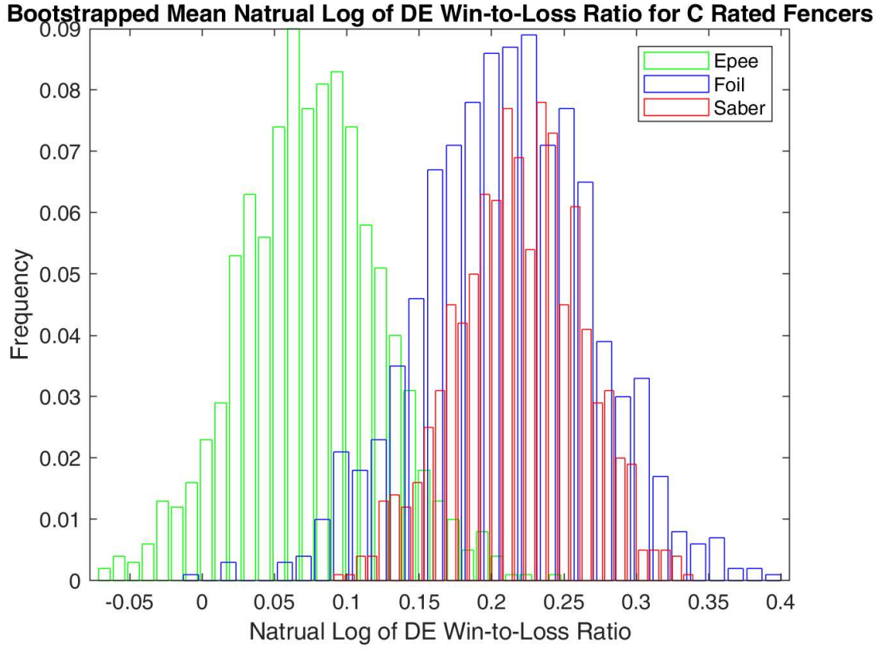
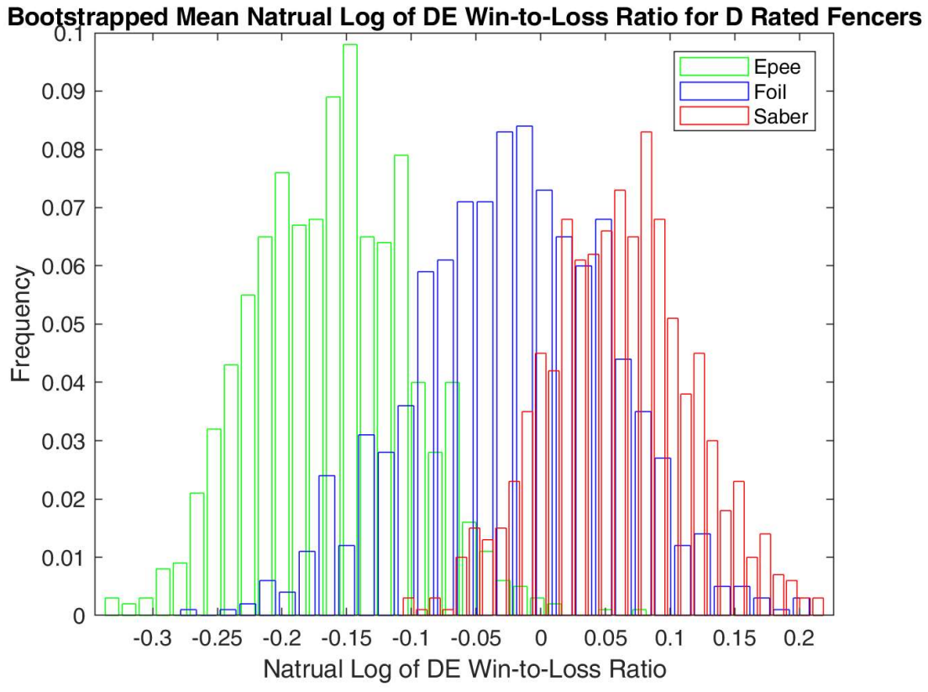
Mean Log DE Win-to-Loss Ratio
Weapon | Low 95% CI Bound | MEAN | Upper 95% CI Bound
Epee | -0.023 | 0.075 | 0.174
Foil | 0.092 | 0.211 | 0.324
Saber | 0.131 | 0.219 | 0.298
Weapon | Low 95% CI Bound | Low 90% CI Bound | MEAN | Upper 90% CI Bound | Upper 95% CI Bound
Epee | -0.272 | -0.256 | -0.161 | -0.065 | -0.044
Foil | -0.173 | -0.157 | -0.022 | 0.098 | 0.122
Saber | -0.051 | -0.033 | 0.061 | 0.155 | 0.174

Slide 16
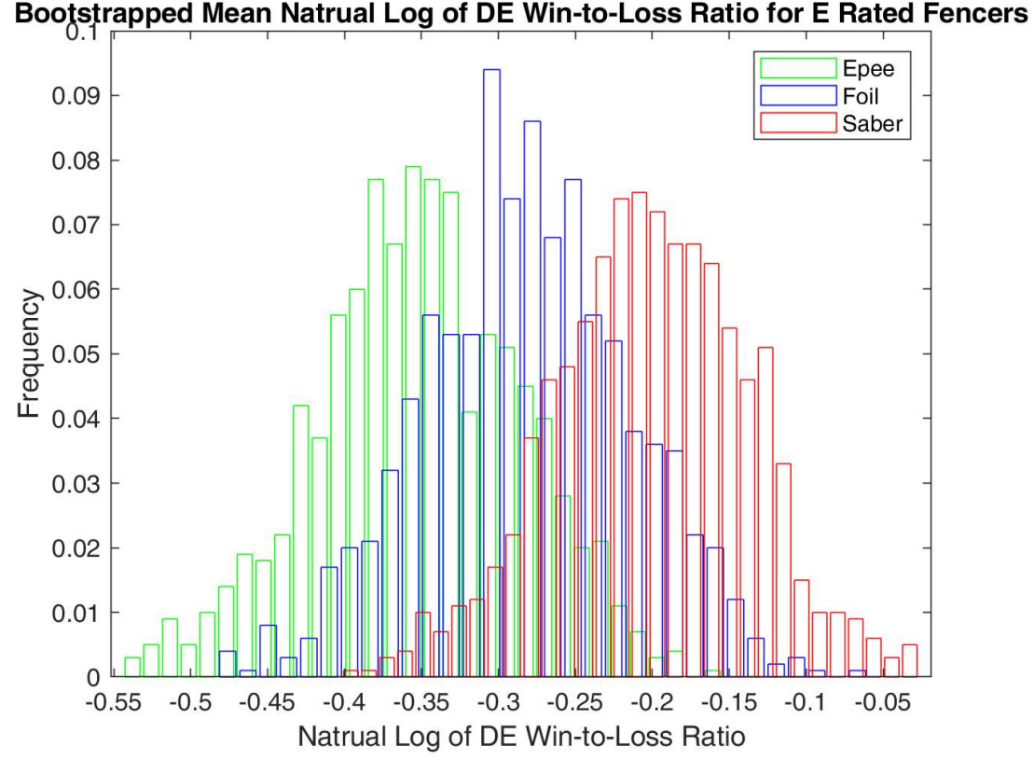
Mean Log DE Win-to-Loss Ratio
Results
The mean log of DE Win-to-Loss Ratio for B rated foil fencers was significantly higher than B rated Epee fencers
The mean log of DE Win-to-Loss Ratio for D rated saber fencers was significantly higher than D rated Epee fencers
Null hypothesis was not rejected for all other cross weapon comparisons of the same rating.
Weapon | Low 95% CI Bound | MEAN | Upper 95% CI Bound
Epee | -0.487 | -0.353 | -0.226
Foil | -0.416 | -0.282 | -0.154
Saber | -0.332 | -0.201 | -0.077

Slide 17
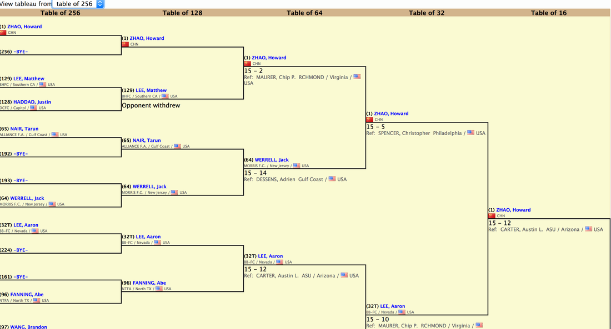
Interpretation of Bootstrapped DE Win-to-Loss Ratio
In most cases fencers of the same rating have on average the same DE Win-to-Loss Ratio and thus can be assumed to progress on average the same amount in tournaments.
Two exceptions being that B-rated and D-rated epee fencers appear to be less successful on average in tournaments compared to B-rated foilist and D-rated saberist respectfully.

Slide 18
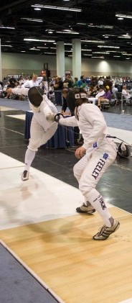
Linear Regression Analysis
Linear regression was performed to determine the correlation between the number of events participated in before earning a rating and the natural log of DE win-to-loss ratio for each weapon
Why-> Regression can approximate average trend in rate of skill progression over time for each weapon: insights into which weapon might be considered easier.
The statistics were chosen to get a proxy for the relationship between the skill of a fencer and how long they have been fencing.
Linear Regression chosen because number of events is assumed to have no uncertainty.
A-rated fencers were not included since there is no other ratings above A.

Slide 19
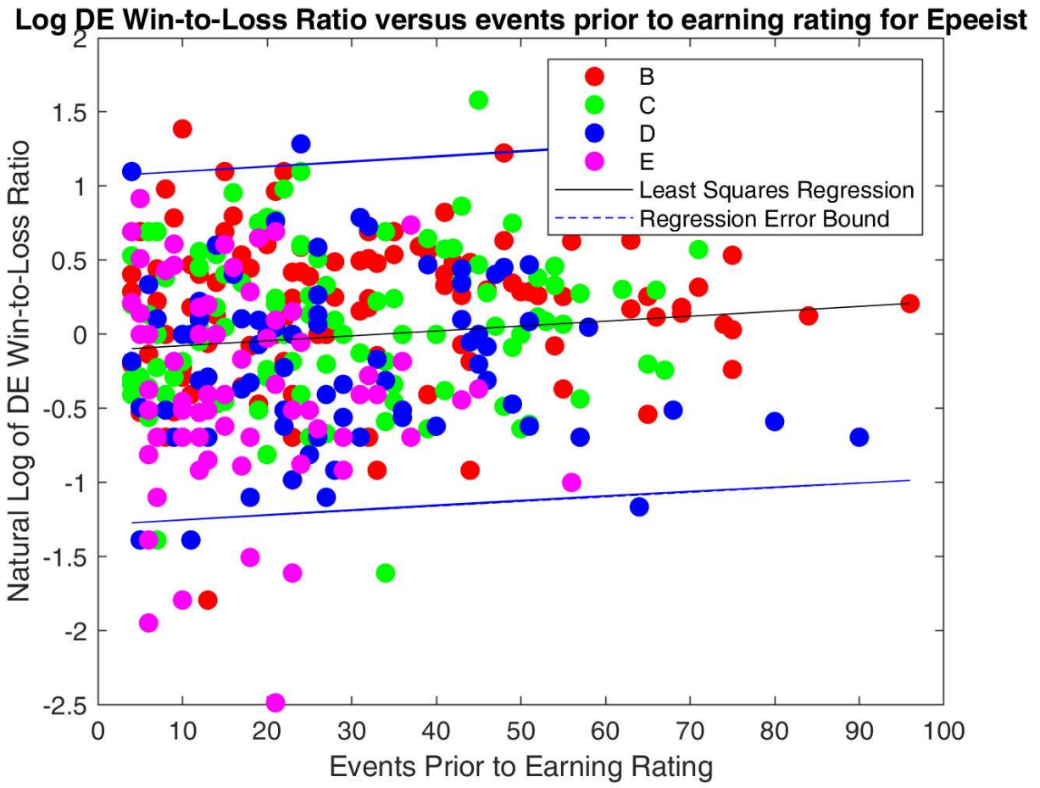
Linear Regression Analysis: Epee
Slope: 0.0033
Y-Intercept: -0.11
Correlation p-Value: 0.0415
 | Low 95% CI Bound | Value | Upper 95% CI Bound
Slope | 1.2797e-04 | 0.0033 | 0.0065
Correlation Coefficient | 0.0041 | 0.1066 | 0.2069

Slide 20
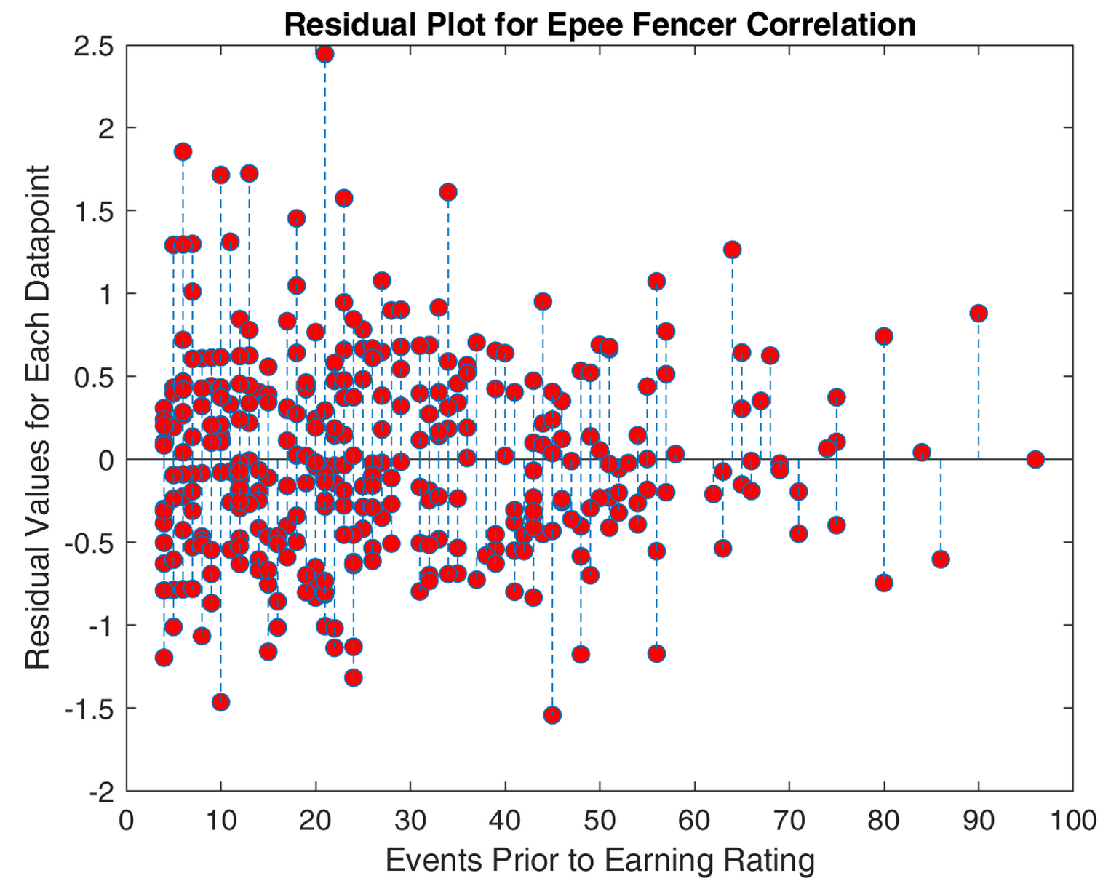
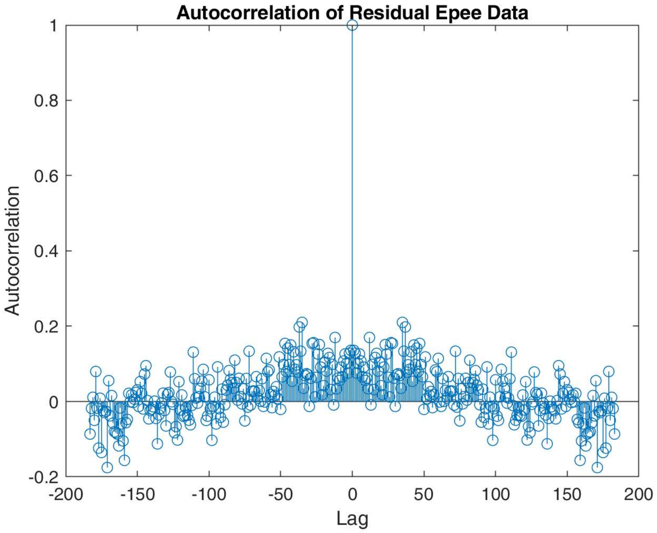
Residual Analysis: Epee
Constant Variance: Y
Chi^2 value = 0.0027
Chi^2 critical = 410.5
Normally Distributed: N
Chi^2 value = 82.7
Chi^2 Critical = 26.3
Residual Independence/ Uncorrelated Error: Y
(Autocorrelation)

Slide 21
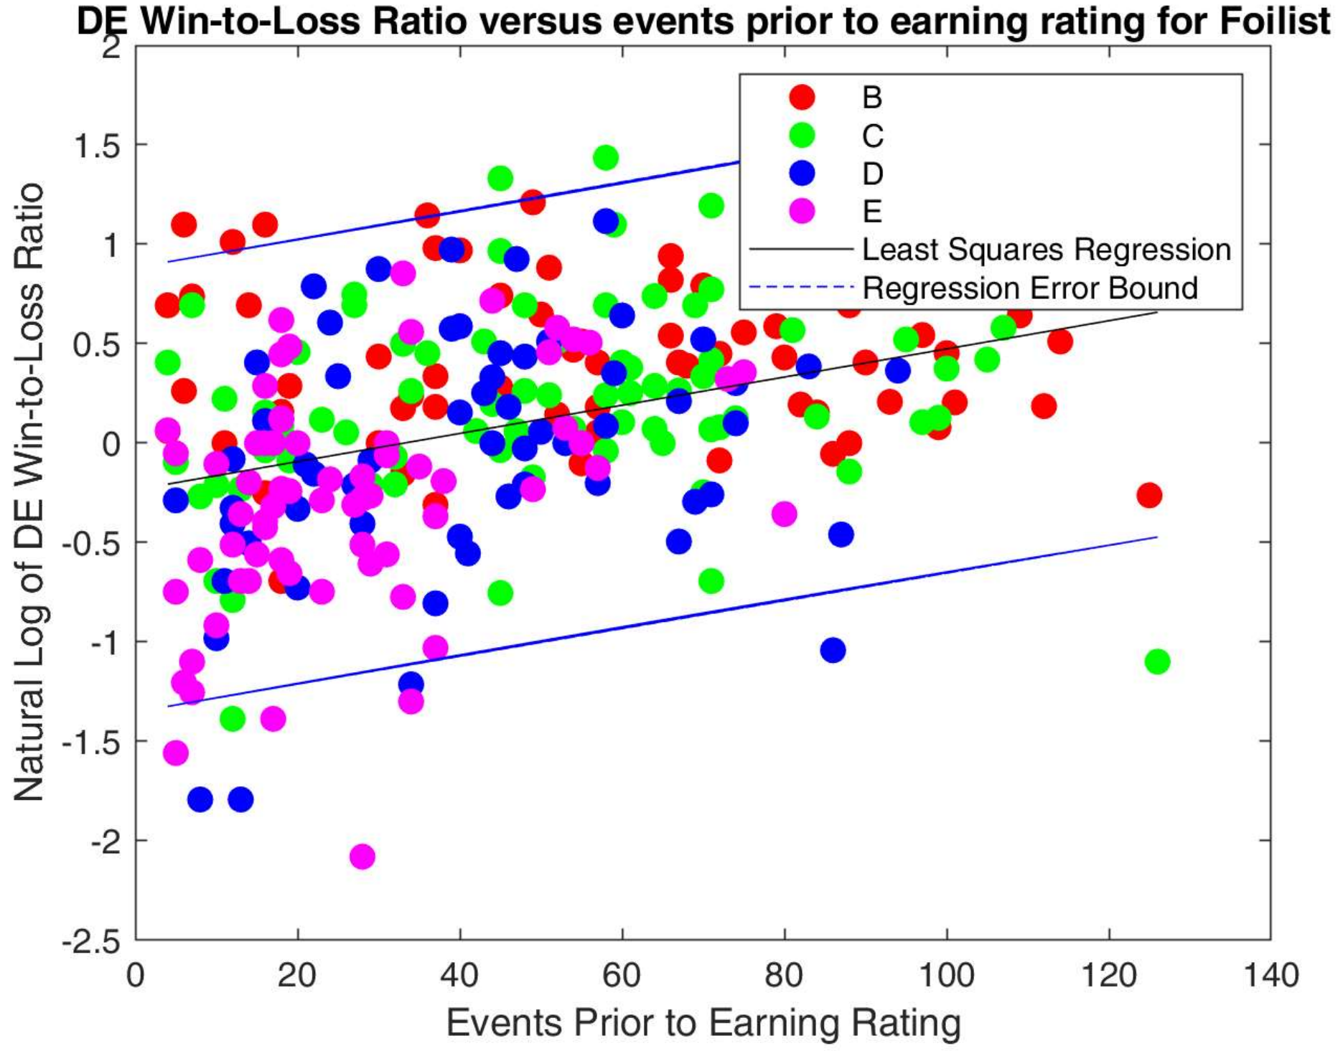
Linear Regression Analysis: Foil
Slope: 0.0071
Y-Intercept: -0.2345
Correlation p-Value: 7.6260e-09
 | Low 95% CI Bound | Value | Upper 95% CI Bound
Slope | 0.0047 | 0.0071 | 0.0094
Correlation Coefficient | 0.2313 | 0.3407 | 0.4415

Slide 22
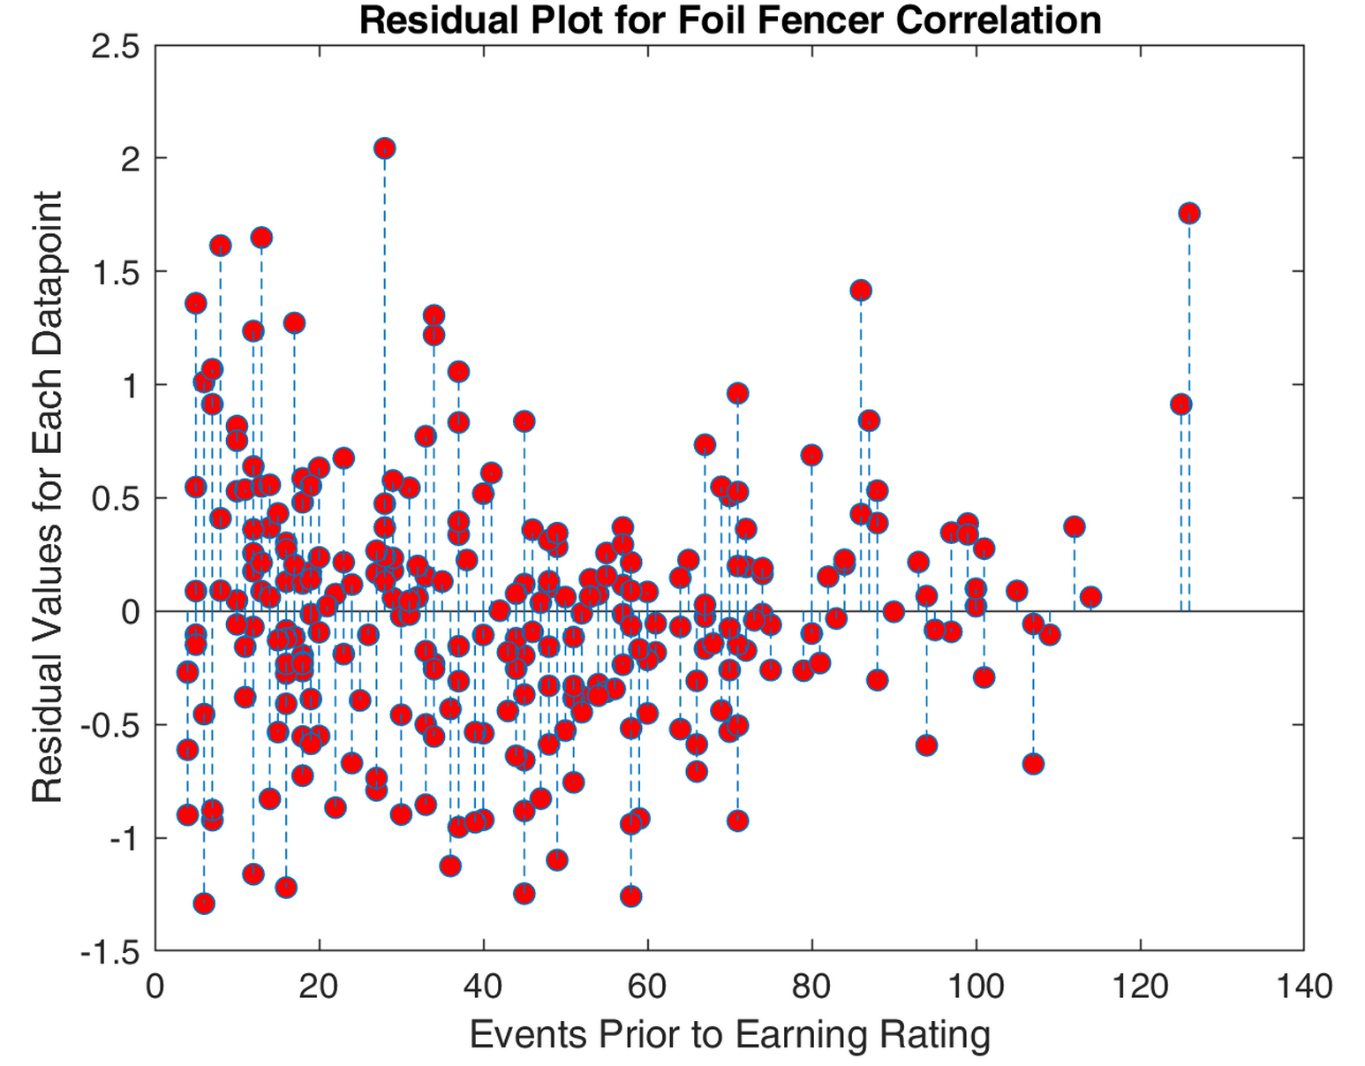
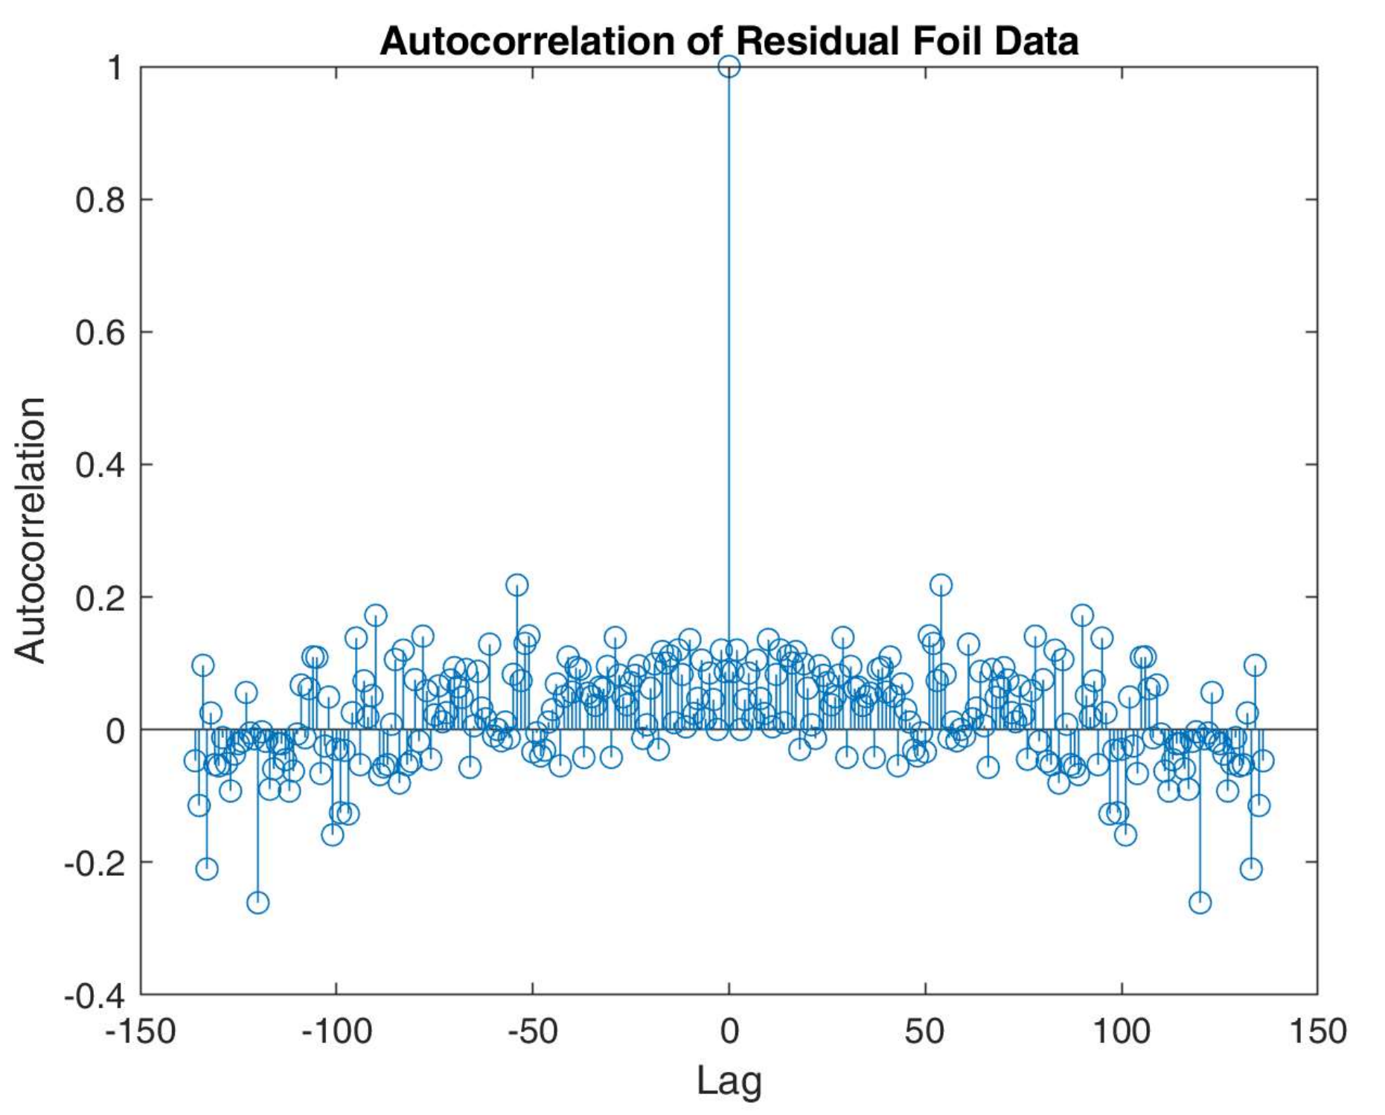
Residual Analysis: Foil
Constant Variance: Y
Chi^2 value = 0.0034
Chi^2 critical = 311.5
Normally Distributed: N
Chi^2 value = 43.7
Chi^2 Critical = 22.4
Residual Independence/ Uncorrelated Error: Y
(Autocorrelation)

Slide 23
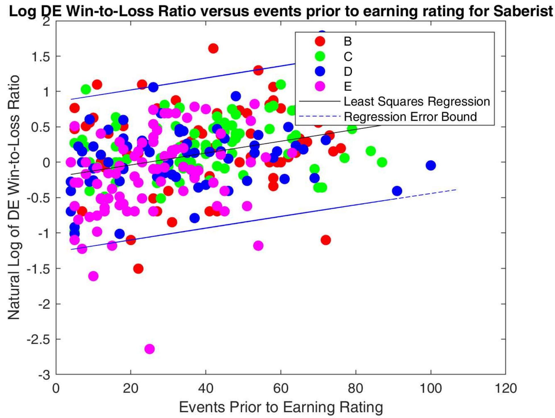
Linear Regression Analysis: Saber
Slope: 0.0084
Y-Intercept: -0.2051
Correlation p-Value: 7.3886e-09
 | Low 95% CI Bound | Value | Upper 95% CI Bound
Slope | 0.0056 | 0.0084 | 0.0111
Correlation Coefficient | 0.2180 | 0.3219 | 0.4186

Slide 24
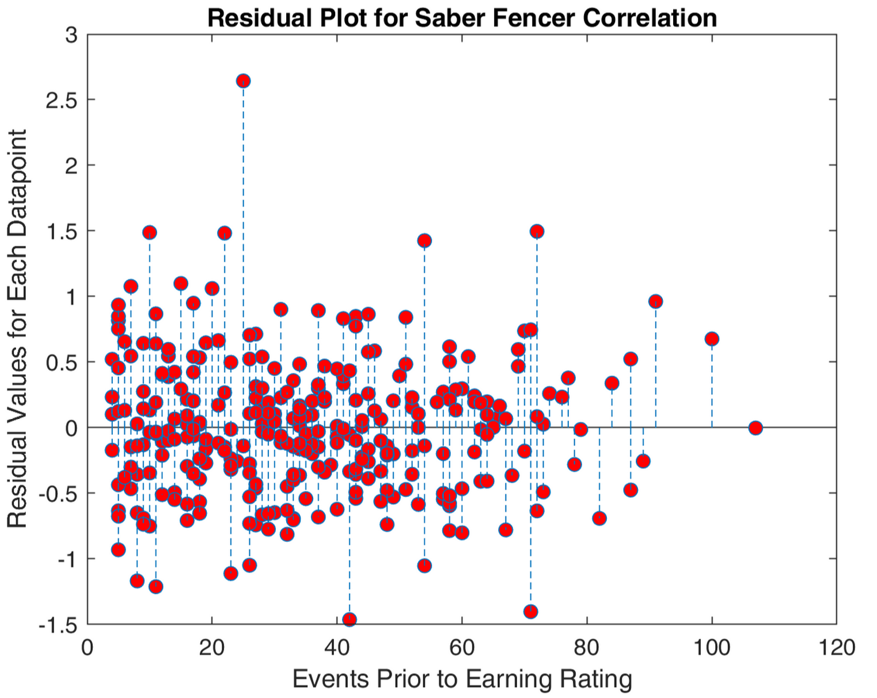
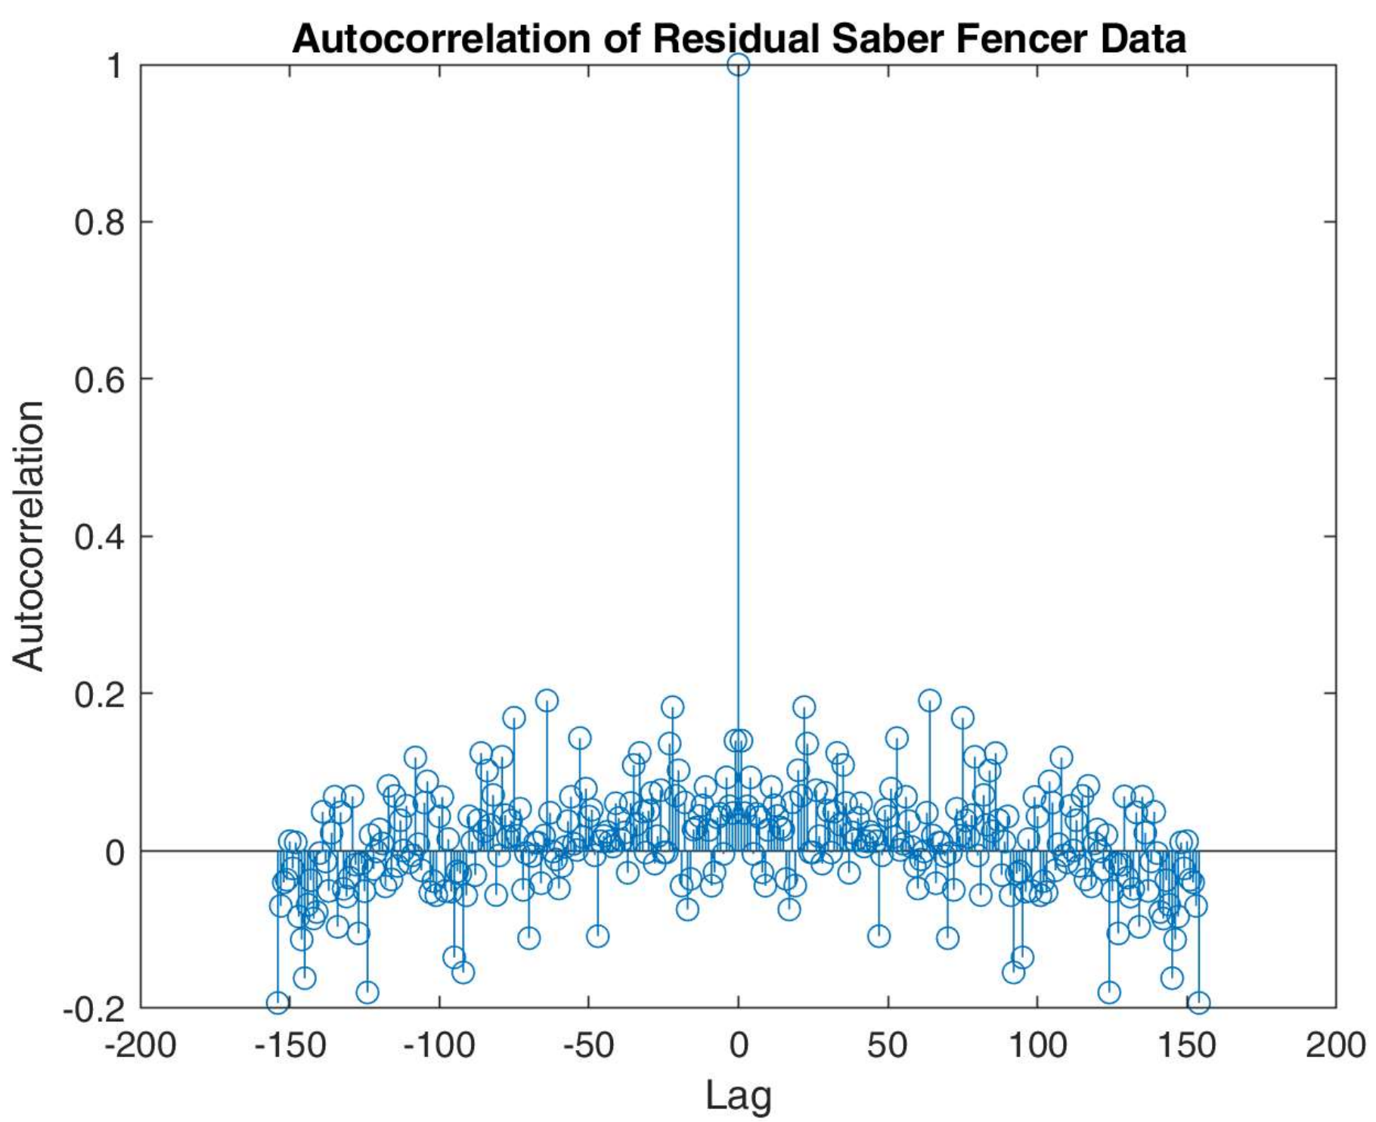
Residual Analysis: Saber
Constant Variance: Y
Chi^2 value = 0.0027
Chi^2 critical = 348.9
Normally Distributed: N
Chi^2 value =1,687
Chi^2 critical = 23.7
Residual Independence/ Uncorrelated Error: Y
(Autocorrelation)

Slide 25
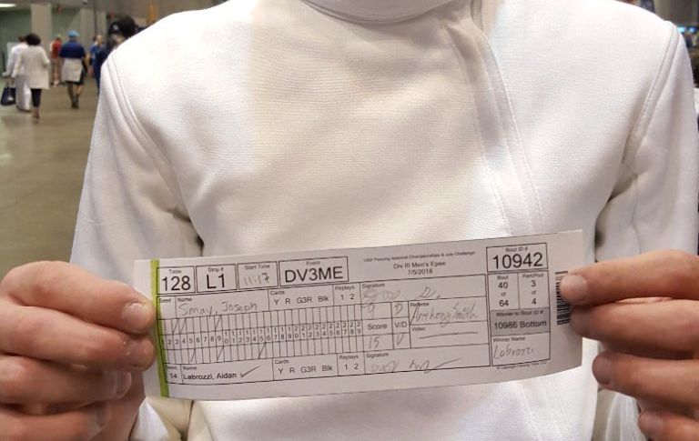
DE Win-Loss Ratio Versus Number Events Reg Results
Significant positive correlation between # of events prior to earning a rating and the ln() of the fencer’s DE win-to-loss ratio.
The correlation coefficient for Saber and Foil correlations were significantly higher than Epee
# of events participate in is a more accurate predictor of how far one makes it in tournaments on average for foil and saber
The slope of the saber and foil regressions were significantly higher than epee
Saberist and foilest tend to advance in their performance in DEs faster than epeeist
The residuals of all three regressions are not normally distributed
Regressions had poor quality

Slide 26
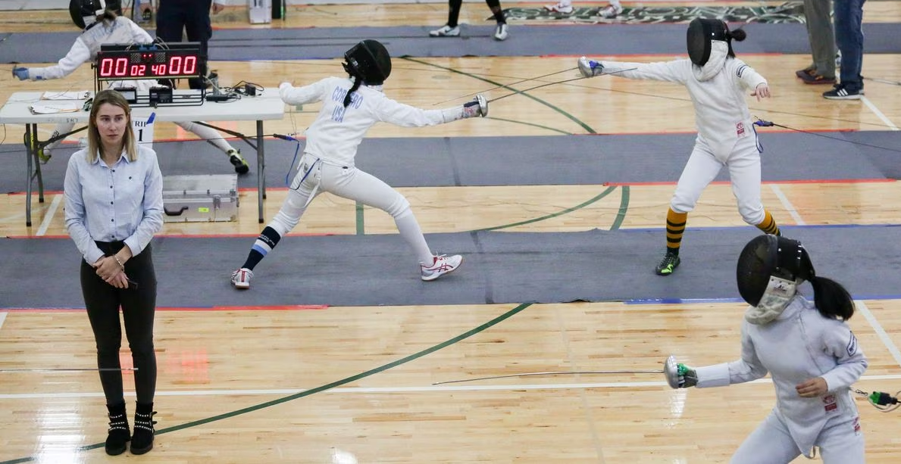
Linear Regression Analysis part 2
Linear regression was performed to determine the correlation between the number of events participated in before earning a rating and the natural log of Easy-Win-to-Hard-Loss ratio for each weapon
The statistics were chosen to get a proxy for the relationship between the skill of a fencer and how long they have been fencing.
Linear Regression chosen because number of events is assumed to have no uncertainty.
A-rated fencers were not included since there is no other ratings above A.

Slide 27
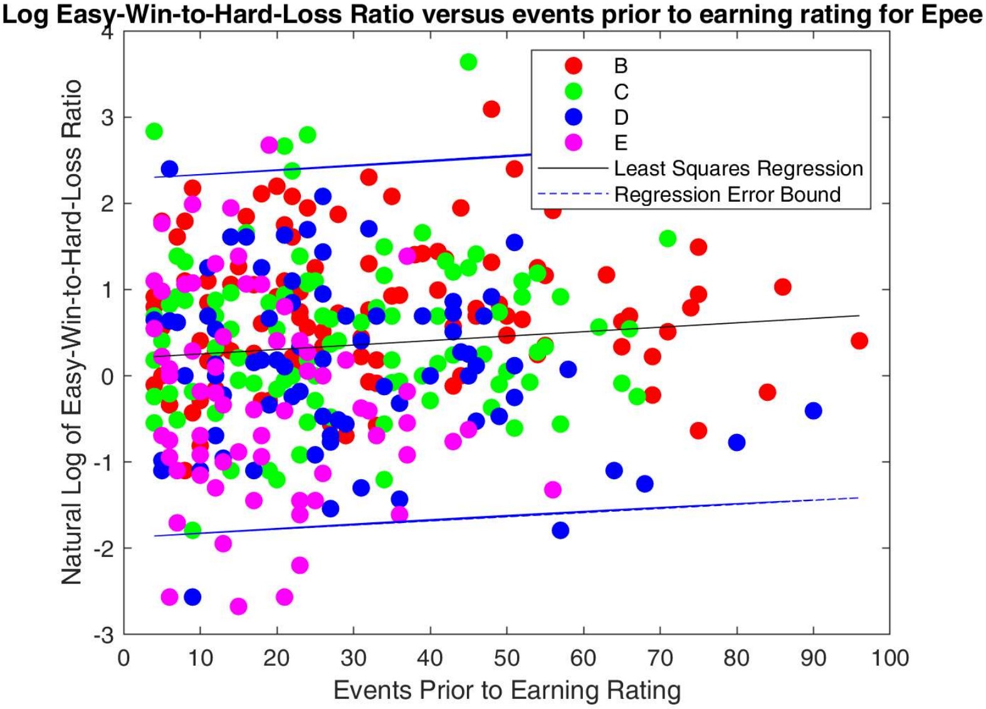
Linear Regression Analysis: Epee
Slope: 0.0052
Y-Intercept: 0.2013
Correlation p-Value: 0.0785
 | Low 95% CI Bound | Value | Upper 95% CI Bound
Slope | -5.92e-04 | 0.0052 | 0.0109
Correlation Coefficient | -0.0108 | 0.0949 | 0.1985

Slide 28
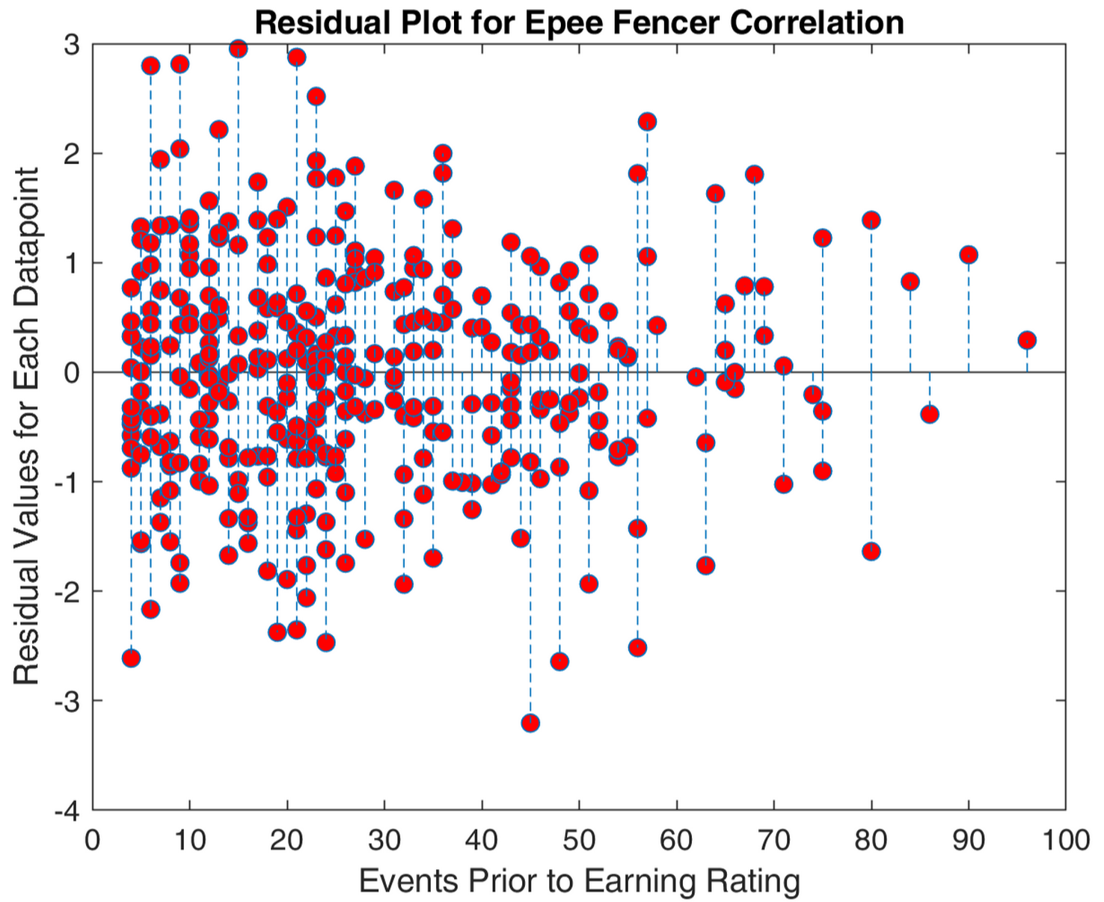
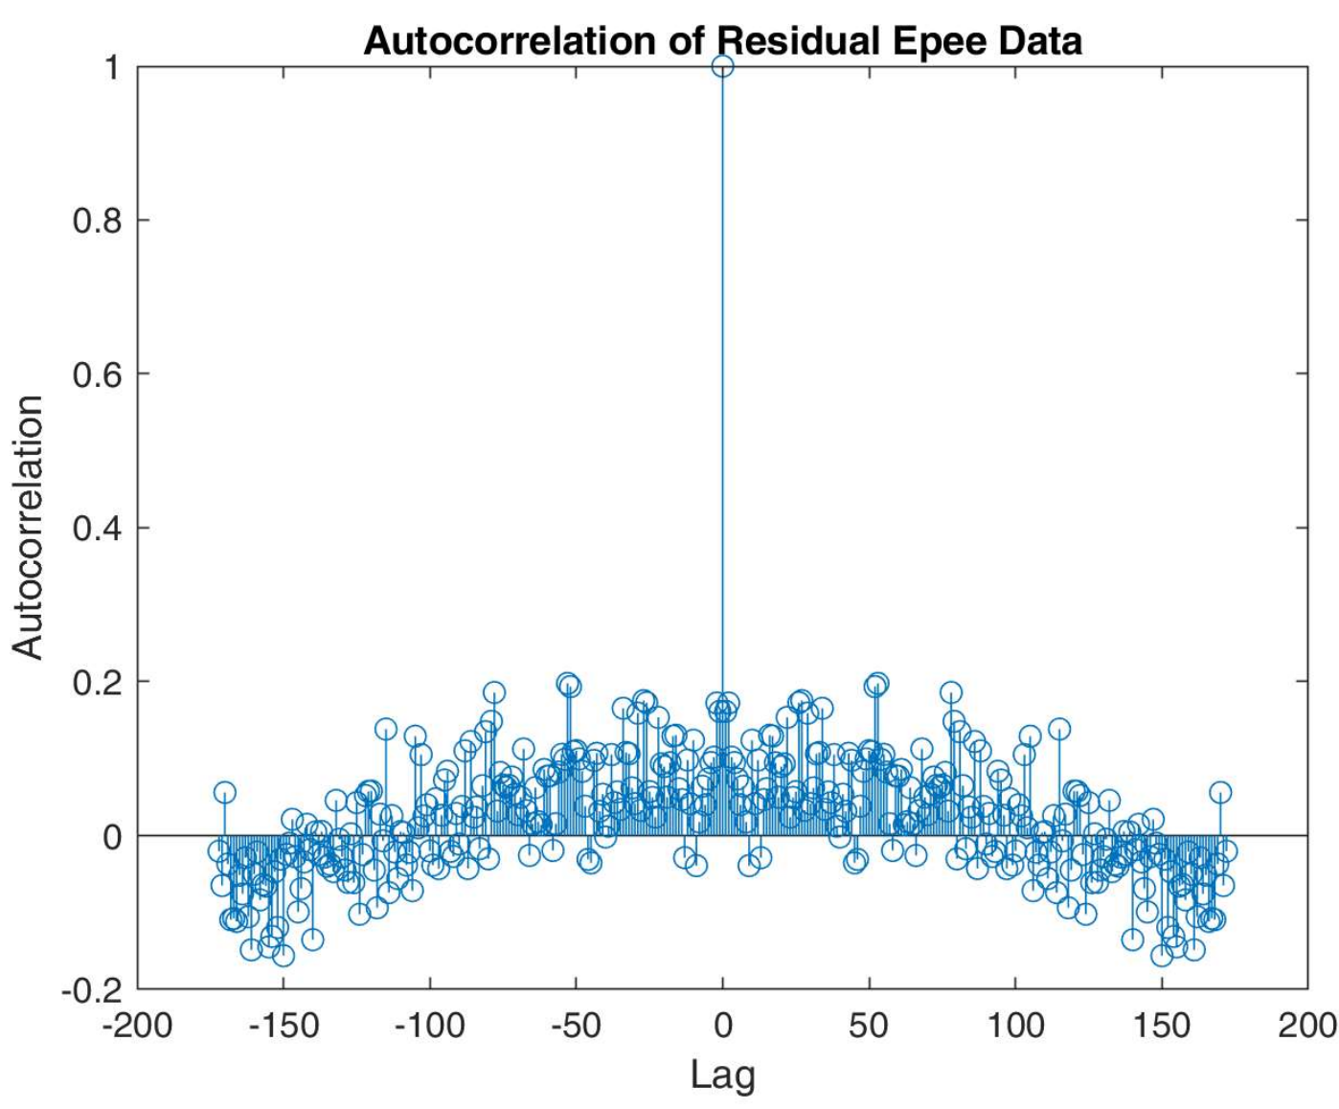
Residual Analysis: Epee
Constant Variance: Y
Chi^2 value = 0.0069
Chi^2 critical = 388.3
Normally Distributed: Y
Chi^2 value = 15.8
Chi^2 Critical = 25.0
Residual Independence/ Uncorrelated Error: Y
(Autocorrelation)

Slide 29
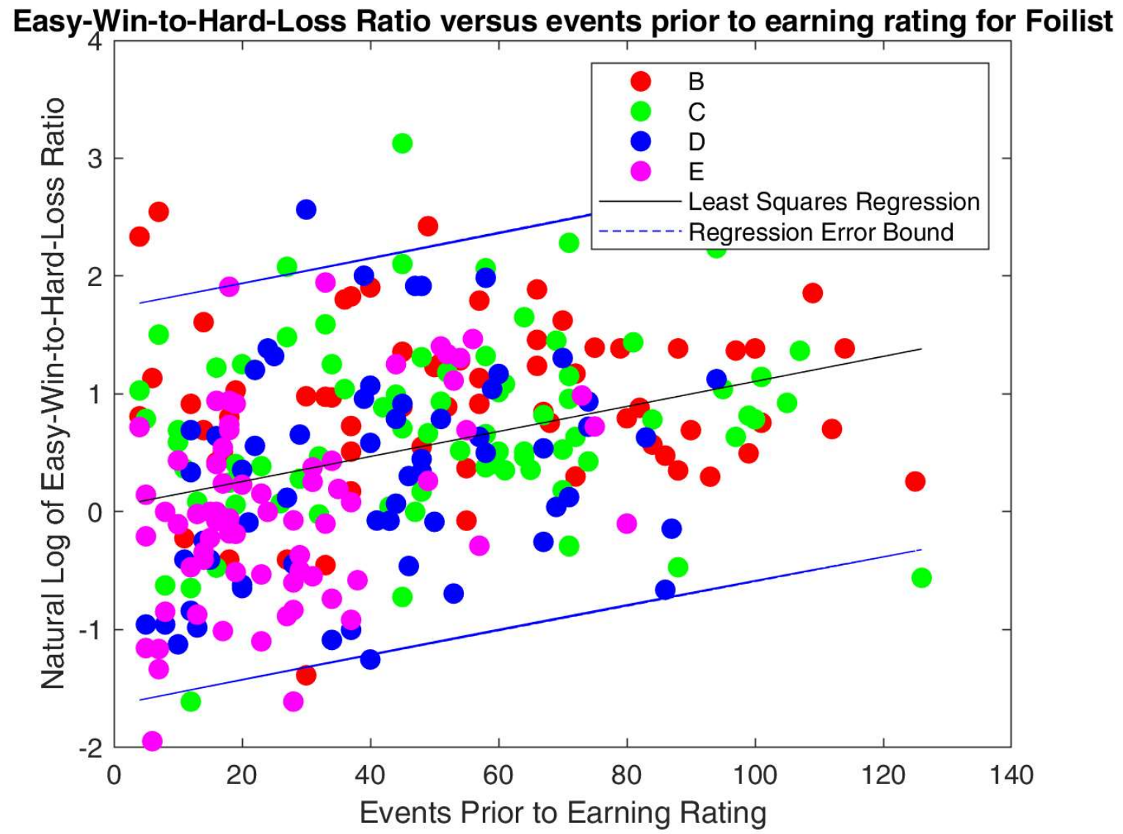
Linear Regression Analysis: Foil
Slope: 0.0106
Y-Intercept: 0.0446
Correlation p-Value: 9.024e-09
 | Low 95% CI Bound | Value | Upper 95% CI Bound
Slope | 0.0071 | 0.0106 | 0.0141
Correlation Coefficient | 0.2292 | 0.3385 | 0.4394

Slide 30
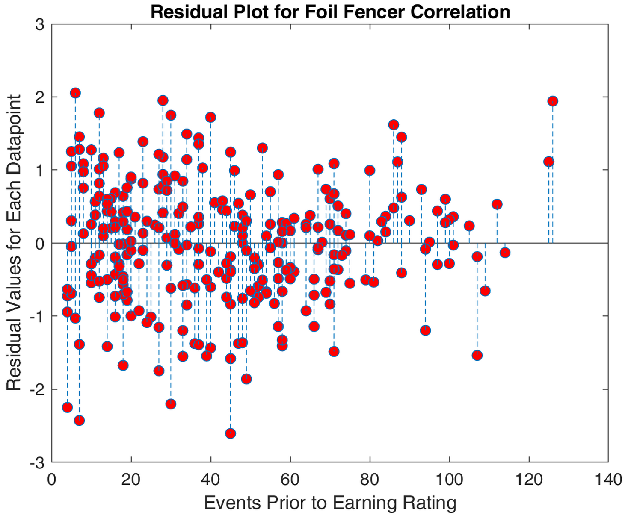
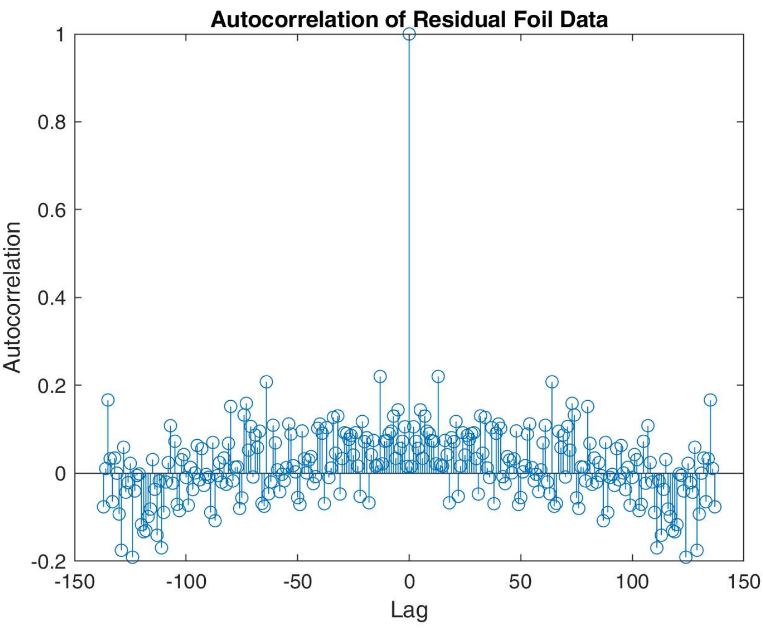
Residual Analysis: Foil
Constant Variance: Y
Chi^2 value = 0.0055
Chi^2 critical = 312.5
Normally Distributed: Y
Chi^2 value = 13.3
Chi^2 Critical = 22.4
Residual Independence/ Uncorrelated Error: Y
(Autocorrelation)

Slide 31
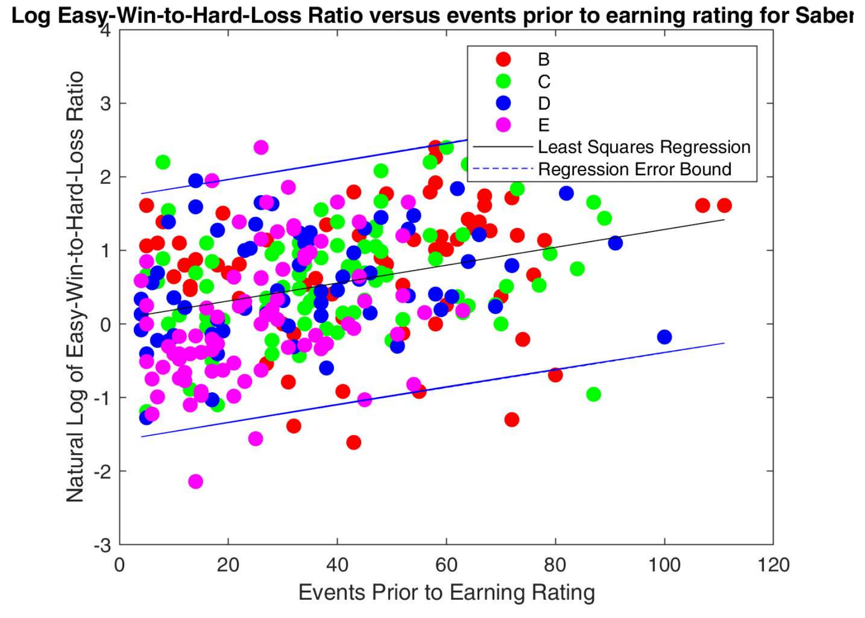
Linear Regression Analysis: Saber
Slope: 0.0121
Y-Intercept: -0.2051
Correlation p-Value: 3.629e-08
 | Low 95% CI Bound | Value | Upper 95% CI Bound
Slope | 0.0079 | 0.0121 | 0.0164
Correlation Coefficient | 0.2030 | 0.3079 | 0.4059

Slide 32
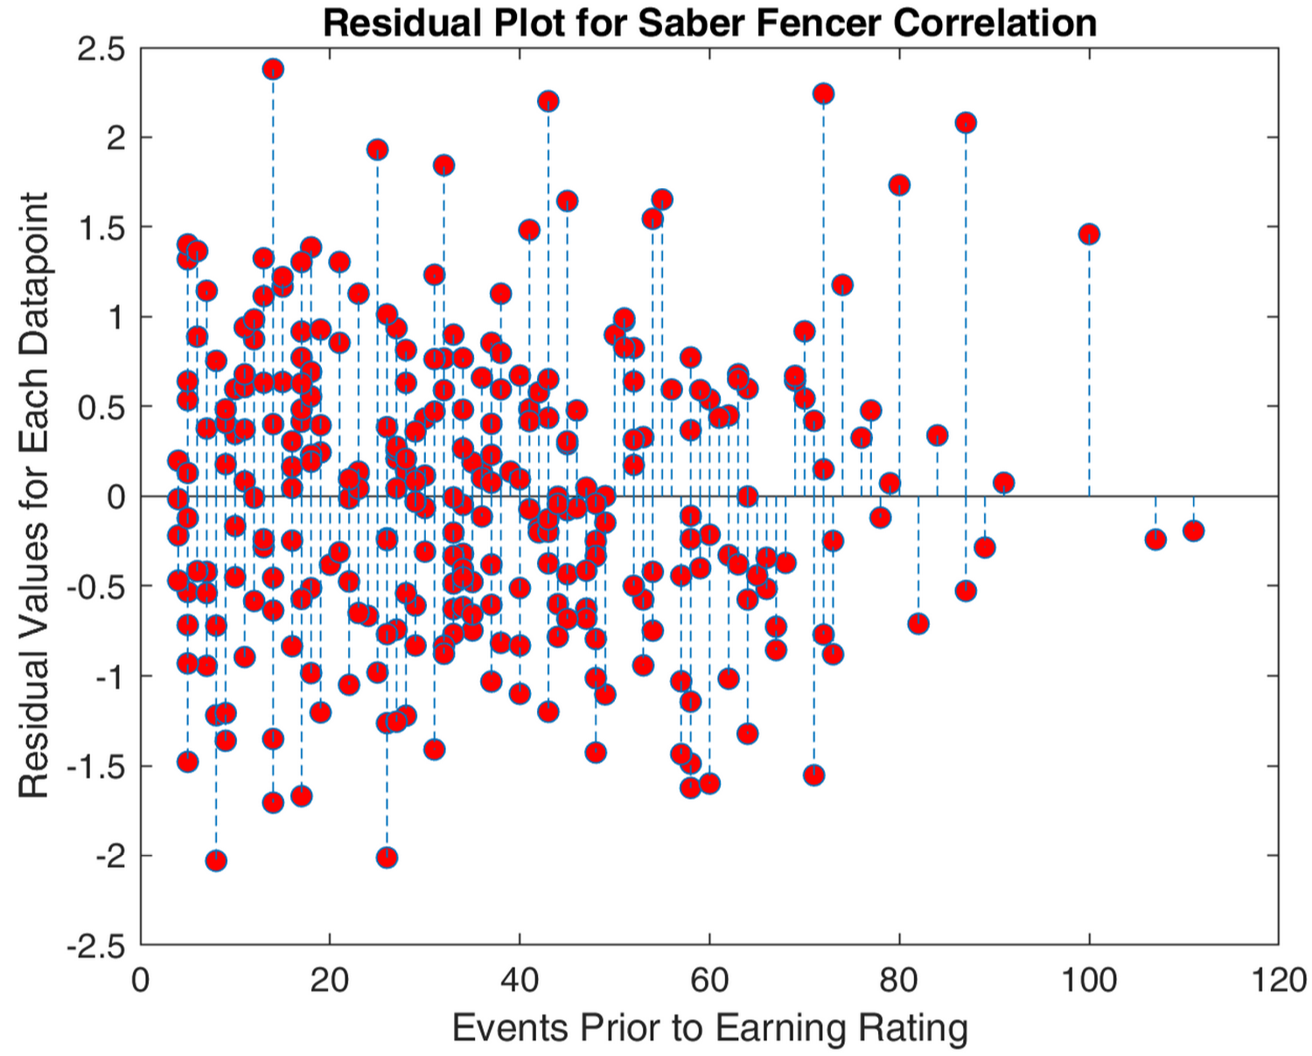
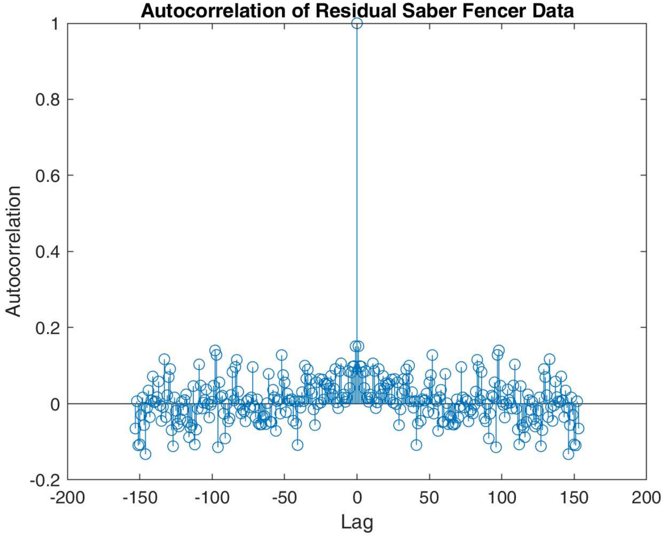
Residual Analysis: Saber
Constant Variance: Y
Chi^2 value = 0.0043
Chi^2 critical = 388.3
Normally Distributed: Y
Chi^2 value = 9.4
Chi^2 critical = 23.7
Residual Independence/ Uncorrelated Error: Y
(Autocorrelation)

Slide 33
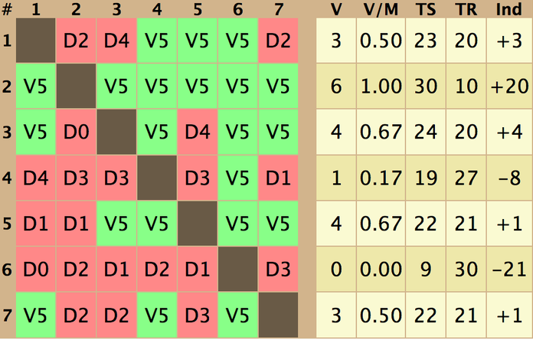
DE Win-Loss Ratio Versus Number Events Reg Results
Only foil and saber had significant positive correlation between # of events prior to earning a rating and the ln() of the fencer’s DE Easy-Win-to-Hard-Loss ratio with their rating.
# of events participated up until now does not reveal anything about an epeeist skill level.
Probably due to high variance in how fast epeeist progress in skill compared to foil and saber which shows a clearer trend
The residuals are normally distributed and independent with constant variance:
high quality regression

Slide 34

Multiple Logistic Regression
Multiple logistic regression was used to calculate the relative probabilities of a fencer of a given rating being foil, epee, or saber given certain statistics.
MATLAB function: [B, dev, stats] = mnrfit(IndepVar, Categories)
Several different combination of statistics were tested but all logistic regressions except for one gave high p-values / low significance.
Only the logistic regression amongst A-rated fencers using number of events before earning a rating and a custom ratio as the independent variables gave significant p-values for all coefficients.

Slide 35



Multiple Logistic Regression
$$\ln\left(\frac{P\left(WeaponA\right)}{P\left(WeaponB\right)}\right)=B1+B2∗(Num Events)+B3∗(Performance Ratio)$$
Logistic Regression Lines are where the relative odds are one-to-one:
Performance Ratio:
(Easy Wins + Close Losses)
(Hard Losses + Close Wins)
$$\left(Performance Ratio\right)=\frac{B1+B2∗(Num Events)}{−B3}$$

Slide 36


Multiple Logistic Regression
The relative log odds of being an epee vs. Saber fencer:
$$\ln\left(\frac{P\left(Weapon=Epee\right)}{P\left(Weapon=Foil\right)}\right)=1.6026−0.0056\left(E\right) −1.6920(R)$$
Coefficient | Low 95% CI Bound | Value | Upper 95% CI Bound | P-value
Constant | 1.1087 | 1.6026 | 2.0965 | 2.0204e-10
# Events Coefficient | -0.0133 | -0.0056 | 0.0022 | 0.1609
Performance Ratio Coef. | -2.2428 | -1.6920 | -1.1412 | 1.7381e-09
The relative log odds of being a foil vs. saber fencer:
$$\ln\left(\frac{P\left(Weapon=Epee\right)}{P\left(Weapon=Foil\right)}\right)=−1.5313−0.0144\left(E\right) −1.0053(R)$$
Coefficient | Low 95% CI Bound | Value | Upper 95% CI Bound | P-value
Constant | -2.1894 | -1.5313 | -0.8733 | 5.0949e-06
# Events Coefficient | 0.0063 | 0.0144 | 0.0226 | 5.0585e-04
Performance Ratio Coef. | 0.4474 | 1.0053 | 1.5632 | 4.1292e-04

Slide 37

Multiple Logistic Regression
The relative log odds of being an epee vs. foil fencer:
$$\ln\left(\frac{P\left(Weapon=Epee\right)}{P\left(Weapon=Foil\right)}\right)=3.0161−0.0181\left(E\right) −2.6488(R)$$
Coefficient | Low 95% CI Bound | Value | Upper 95% CI Bound | P-value
Constant | 2.3516 | 3.0161 | 3.6806 | 5.7733e-19
# Events Coefficient | -0.0266 | -0.0181 | -0.0096 | 2.8690e-05
Performance Ratio Coef. | -3.3286 | -2.6488 | -1.9690 | 2.2306e-14

Slide 38

Multiple Logistic Regression Results
Statistics
For E-B rated fencers, you can not confidently classify a fencer as foil, epee, or saber via logistic regression using the statistics
events prior to earning their current rating
DE win-to-loss ratio
Total win-to-loss ratio and/or
Performance Ratio
Logistic regression only significant for classifying A-rated fencers using number of events before earning a rating and performance ratio.

Slide 39
Key Insights:
On average, epee fencers receive a given rating in fewer tournaments than saber fencers, and foil fencers receive a given rating in more tournaments.
On average, for a given rating, epee fencers tend to perform less than foil and saber fencers.
There is a clearer positive and steeper trend between skill/results versus number of events participated in for foil and saber fencers compared to epee fencers
Rate of growth over number of tournaments is approximately the same for foil and saber fencers as measured by linear regression slope.
You can not confidently classify which weapon a fencer of a given rating competes in (other than A-rated) using the statistics analyzed in this report.

Slide 40
Conclusions:
Of the three weapons, Epee appears to be the easiest weapon in terms of the average time it takes to get a rating as well as the average skills of a fencer with a given rating.
Easier to get a rating in epee than in foil and saber
Saber and Foil showed significant higher correlations between the amount of time spent fencing in terms of events one has gone to and average performance; saber and foil is more reliable in terms of getting out what you put in.
The rating system for foil and saber appears to be more consistent
There is too much variation in fencers experience with the rating system to accurately classify fencers of a given rating and unknown weapon

