Slide 1
Crime Trends in Atlanta
By: Ciaran McCollum

Slide 2
Questions and Methods
What trends are present in crime in Atlanta?
How are different types of crimes related?
Use statistical tests to analyze distribution of the data
Use regression to find correlation and trends between different crime types
Use time series analysis to find trends in the data for each crime

Slide 3
Data
Data came from Atlanta crime reports from January 2009 to February 2017.
Each record is a crime with its type and date of occurrence
11 crime types including Aggravated Assault, Burglary, Auto Theft, Homicide, etc.

Slide 4
Data Processing
The number of crimes each month was counted and recorded
Data was further separated by crime type and counted again
Some crime types were removed due to a lack of data

Slide 5
Chi Squared Test for Normality: Entire Dataset
Ran a statistical test to check for the normality of the data
Test results did not allow us to reject the null hypothesis

Slide 6
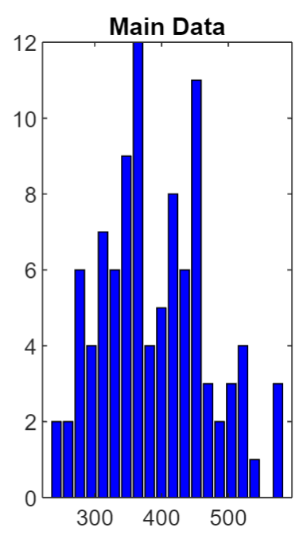
Chi Squared Test: Individual Crimes
Auto Theft
Burglary
The same test was run on individual crimes
Was able to reject the null hypothesis for Burglary and Larceny
Was not able to reject for Aggravated Assault, Auto Theft and Robbery

Slide 7
Correlation Between Crimes
P-matrix
Tested for correlation between crimes.
Found significant correlations for all interactions
Larceny has the highest correlation with the other crime types so we will focus mainly on those interactions.
Correlation Matrix

Slide 8
Regression
Used larceny to predict the other four crime types
Used least squares regression to estimate parameters
Analyzed residuals via stem plots
Checked distribution of residuals with chi squared test
Checked variance of residuals with chi squared test
Checked independence of residuals with autocorrelation plots

Slide 9
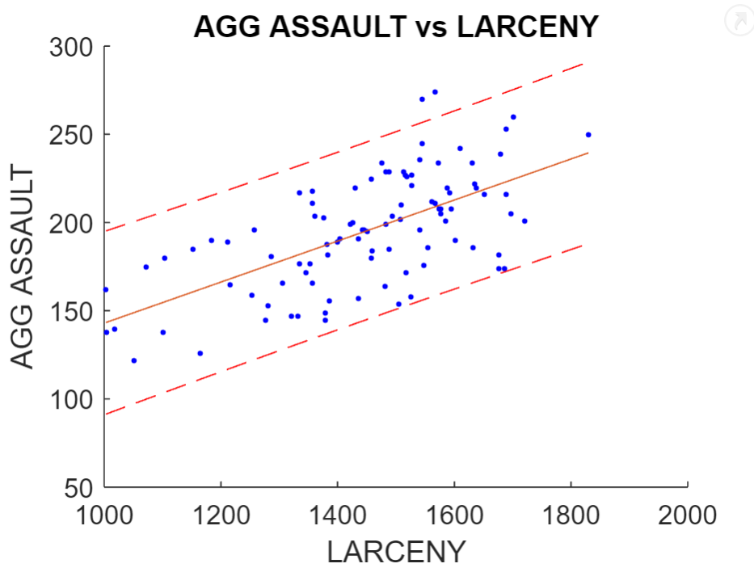
Larceny vs Aggravated Assault
Slope: 0.12
Intercept: 26.64
Statistical evidence residual variance is constant
Autocorrelation plot gives evidence residuals are independent
Statistical evidence residuals are not normally distributed

Slide 10
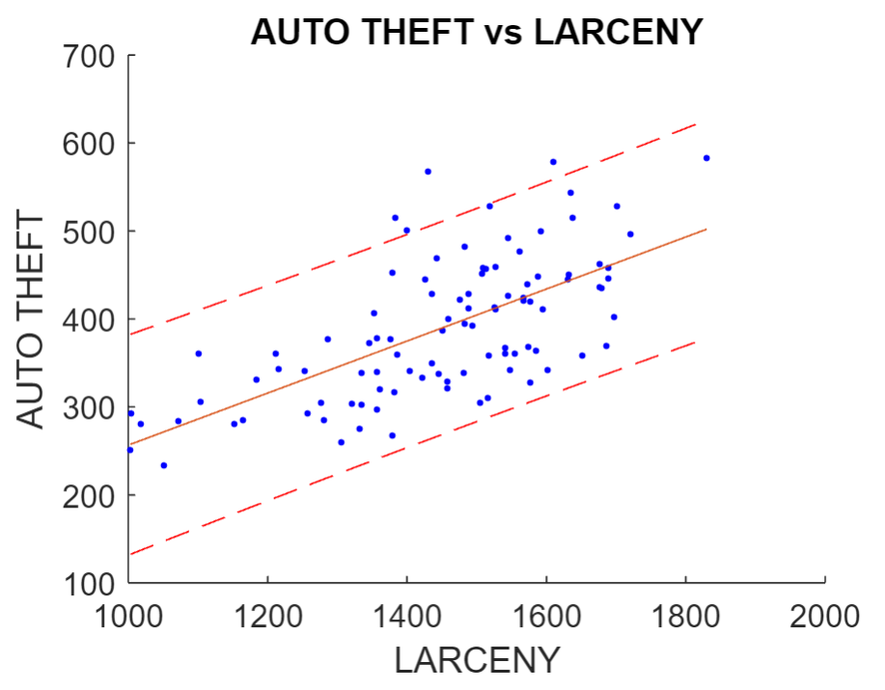
Larceny vs Auto Theft
Slope: 0.30
Intercept: -39.28
Statistical evidence residual variance is constant
Autocorrelation plot gives evidence residuals are independent
Statistical evidence residuals are not normally distributed

Slide 11
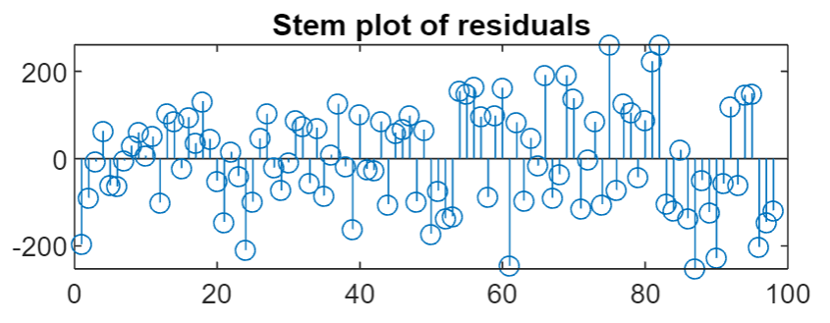
Larceny vs Burglary
Slope: 0.54
Intercept: -253.88
Statistical evidence residual variance is not constant
Autocorrelation plot gives evidence residuals are independent
Statistical evidence residuals are normally distributed

Slide 12
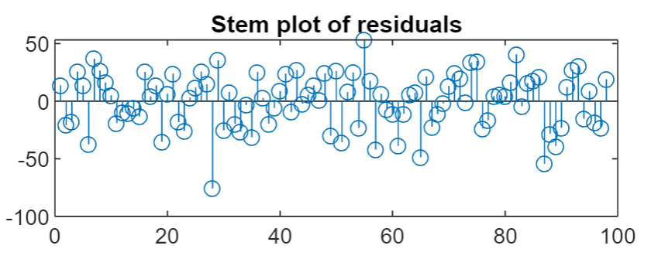
Larceny vs Robbery
Slope: 0.14
Intercept: -14.58
Statistical evidence residual variance is constant
Autocorrelation plot gives evidence residuals are independent
Statistical evidence residuals are not normally distributed

Slide 13
What does this tell us?
Each of these relationships has a positive correlation that is significantly significant. This indicates that as larceny increases other crimes are likely to increase as well.
Note that the Larceny vs Burglary model had statistical evidence the residuals did not have constant variance.

Slide 14
Periodogram Analysis
Created a periodogram for each crime dataset
All five had frequencies of about 0.085 hertz which corresponds to 12 months.
Auto Theft had a second peak at about 0.16 hertz which is 6 months
Burglary had additional peaks at 0.16,0.25 and 0.42

Slide 15
Conclusions
Overall number of crimes each month is normally distributed but individual crimes may not follow normal distributions
There is a statistically significant positive correlation between larceny and the other crime types considered
Of the five crimes considered they all seem to have a yearly cycle with Auto Theft and Burglary have higher frequency cycle as well.
Additional analysis can be performed checking the relationships between the other crimes
More time series analysis can be done to determine which crimes are likely to occur together and how long between cycles of each crime type

