Slide 1
Solar Energy Production vs Average Daily Temperature
EAS 4480 - Grace Nhan

Slide 2
How does solar energy production change over time? Is solar energy production and average daily temperature related?
Motivation
Renewable, sustainable, and environmentally friendly
Reduced carbon footprint
Increased opportunities
Energy security
Significance
Energy planning and optimization
Cost savings
Source: Live Science https://cdn.mos.cms.futurecdn.net/h3aSZJE8F3DseTRsqKJ8vh.jpg

Slide 3
Hypothesis
Solar energy production changes on a yearly time basis.
Temperature and solar energy production are correlated, and higher temperatures correspond to an increase in solar energy output.
Higher extreme temperatures can decrease the energy production and efficiency of the solar panel.
Source: Freepik https://img.freepik.com/free-photo/beautiful-alternative-energy-plant-with-solar-panels_23-2149192690.jpg?w=1380&t=st=1681680402~exp=1681681002~hmac=09975b06a443304020d997d36307e405607a2764700af3edc5aa71f8888f3427

Slide 4
Data Sources
Monthly solar energy production at City of Calgary sites
City of Calgary’s Open Data Portal
Whitehorn Multi-Service Centre
https://data.calgary.ca/Environment/Total-daily-production-at-City-solar-photovoltaic-/mhan-ekg5
Calgary Climate (Average Daily Temperature)
Environmental Climate Change Canada
Calgary, Canada
https://calgary.weatherstats.ca/download.html
Source: CTV Calgary https://calgary.ctvnews.ca/content/dam/ctvnews/en/images/2021/9/29/atco-solar-deerfoot--solar-project--1-5605387-1632940773269.jpg

Slide 5
Approach and Methods of Analysis
01.
02.
Time Series Analysis
Observe patterns and trends in the data to make predictions
Periodogram
CPSD
Help identify dominant frequencies
Determine whether frequencies are related
Source: Zeno Renewables https://www.livezeno.com/wp-content/uploads/2022/01/Panel-1.png

Slide 7
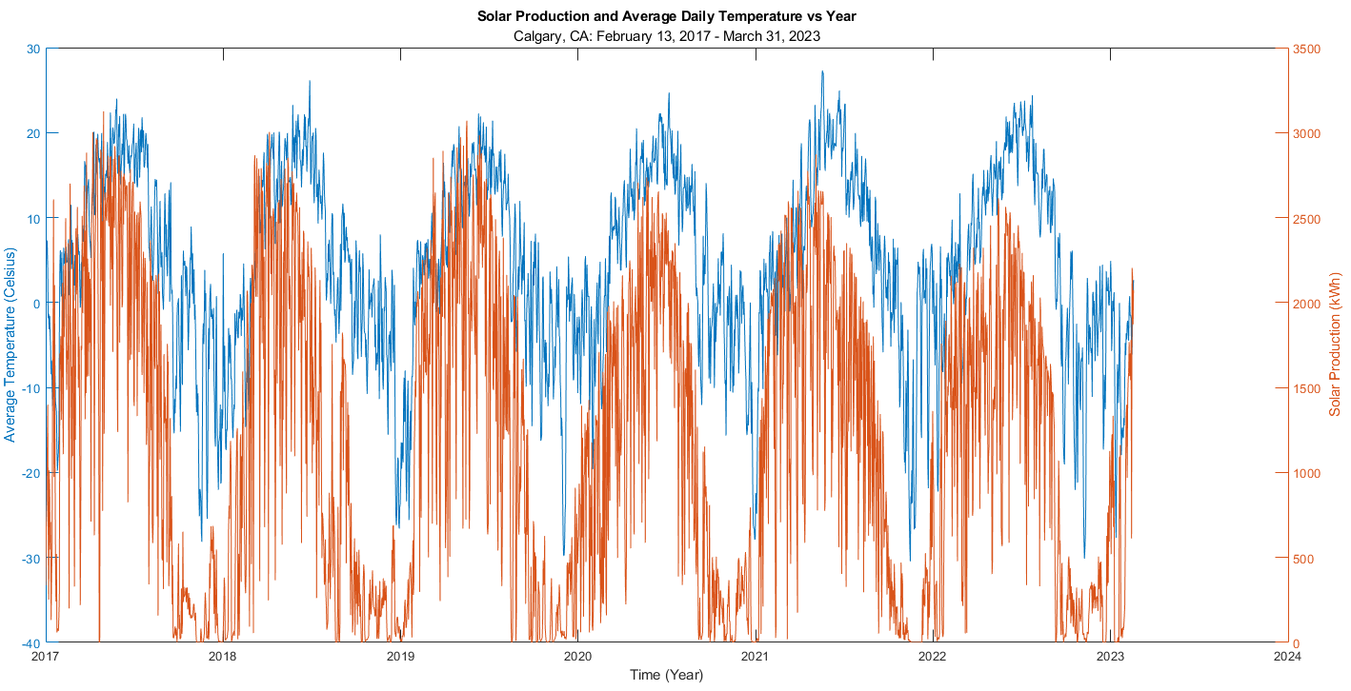

Slide 8
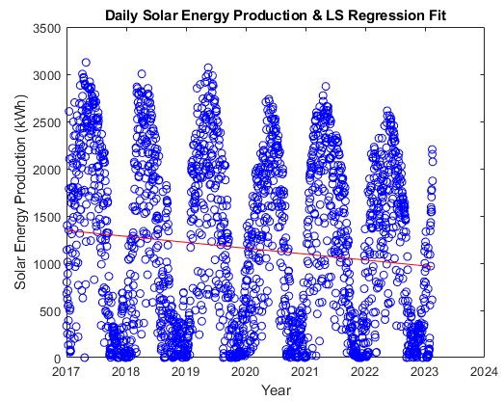
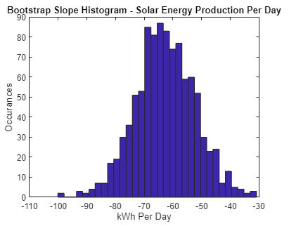
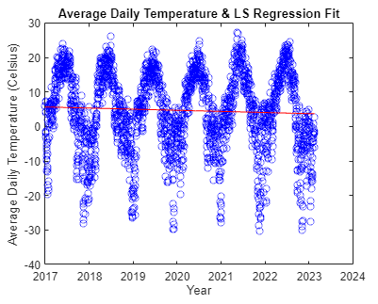
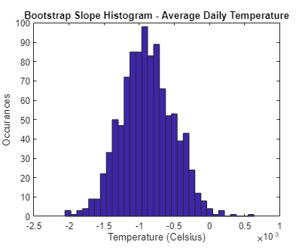
General Trends
Negative trend
Large confidence interval
Large uncertainty
Very slight negative trend
Small confidence interval
Small uncertainty

Slide 9
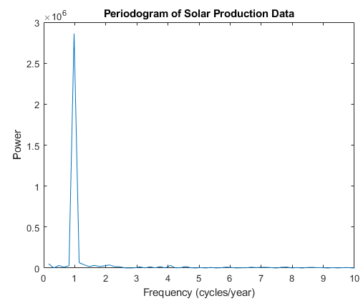
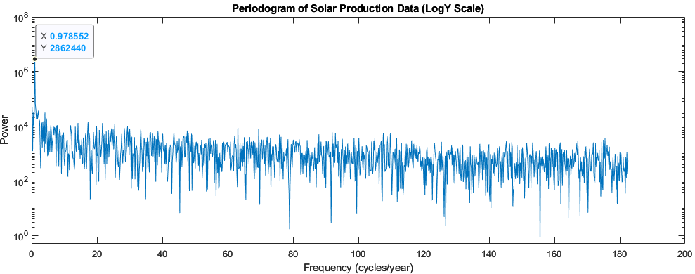
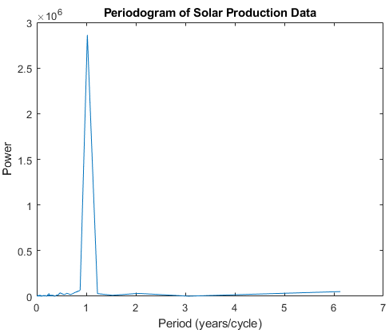
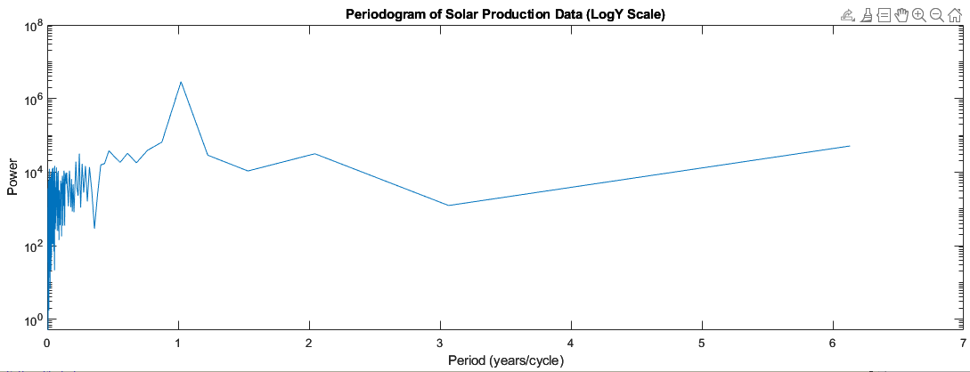
Solar Energy Production Periodogram

Slide 10
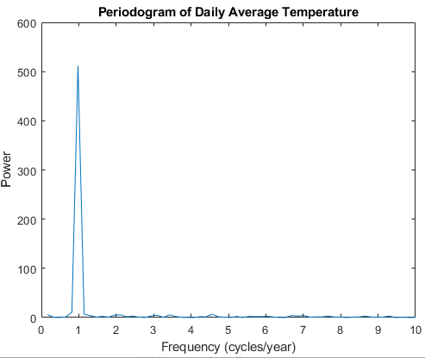
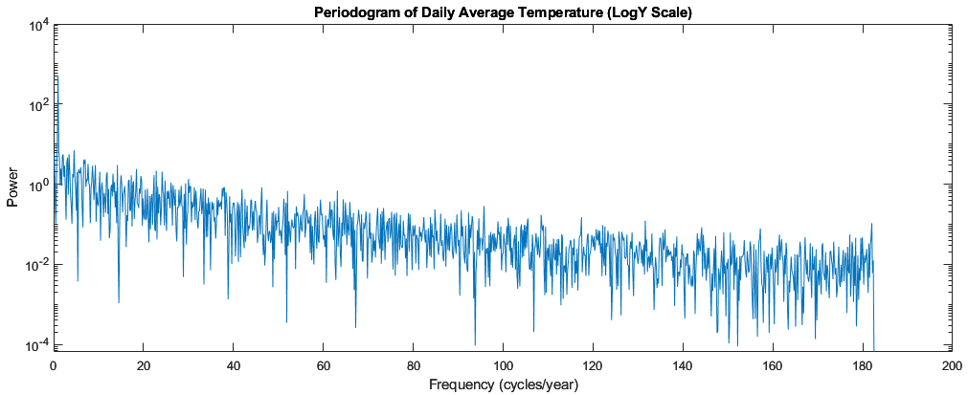
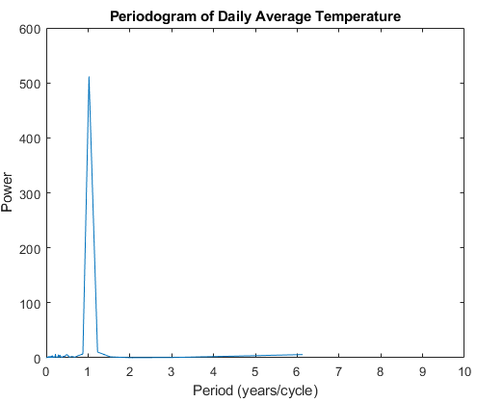
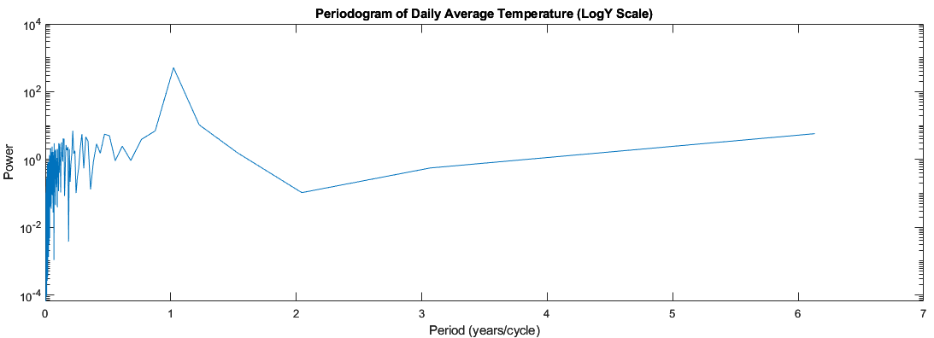
Average Daily Temperature Periodogram

Slide 11
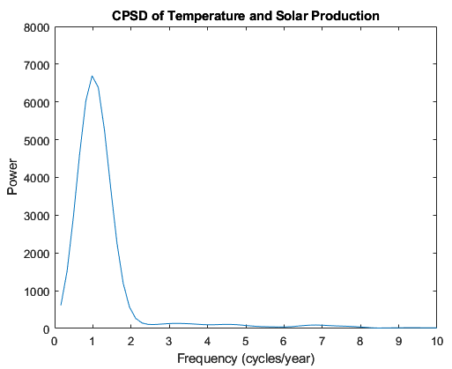
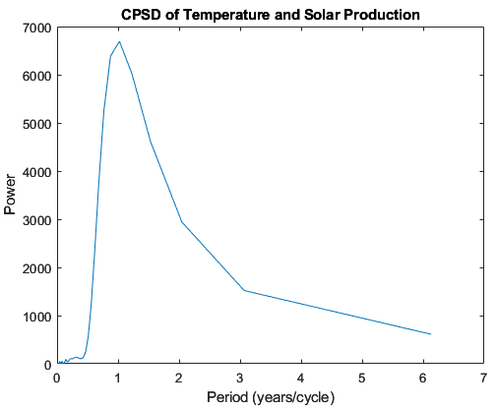
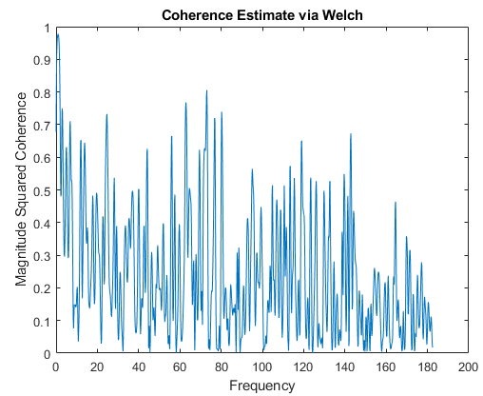
CPSD and Coherence
Frequency = 1 cycle/year
Period = 1 year/cycle
Coherence = 0.9772
→ Notable, but wide peak
→ Notable, but wide and extended peak

Slide 12
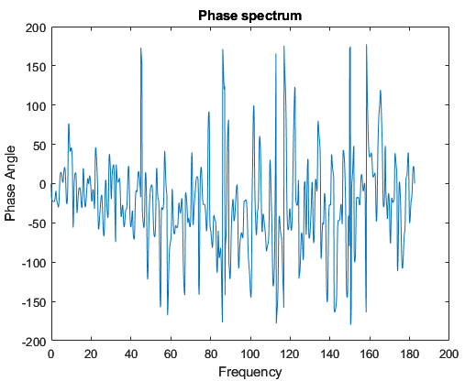
Phase and its Significance
Phase = -22.9189
Time Lag = -0.0637 years = -23 days

Slide 13
Observations, Uncertainty, and Results
Solar Energy Production
Negative trend
Uncertainty in data
→ Periodogram: dominant frequency of one cycle per year
Relationship with Temperature
High coherence, strong association
CPSD has obvious but wide and extended peak, indicating uncertainty in the period
Daily temperature lags solar energy production

Slide 14
Conclusions
Fail to reject null hypothesis
Solar energy production changes over time on a yearly basis, having a dominant frequency of one cycle a year.
Correlation
Temperature and solar energy production are correlated: higher temperatures generally correspond to an increase in solar energy output.
Solar energy production leads average daily temperature by approximately 23 days, potentially due to solar panels becoming less efficient in temperatures over 25 degrees Celsius.

Slide 15
Significance and Future Exploration
Accurately predicting solar energy output can help …
Optimize energy production and consumption
Manage energy supply and demand
Save money
To gain a better understanding …
Determine causation in addition to correlation
Investigate other variables, such as cloud coverage and solar panel location (latitude)

Slide 16
Thank you
EAS 4480 – Grace Nhan

Slide 17
Works Cited
"Calgary Weather Stats Data." Weather Stats, https://calgary.weatherstats.ca/download.html. Accessed 19 April 2023.
Meehan, Chris. "How Hot Can Solar Panels Get?" SolarReviews, 22 July 2021, https://www.solarreviews.com/blog/how-hot-can-solar-panels-get. Accessed 19 April 2023.
"Total daily production at City solar photovoltaic systems." City of Calgary Open Data, 2022, https://data.calgary.ca/Environment/Total-daily-production-at-City-solar-photovoltaic-/mhan-ekg5. Accessed 19 April 2023.

