Slide 1
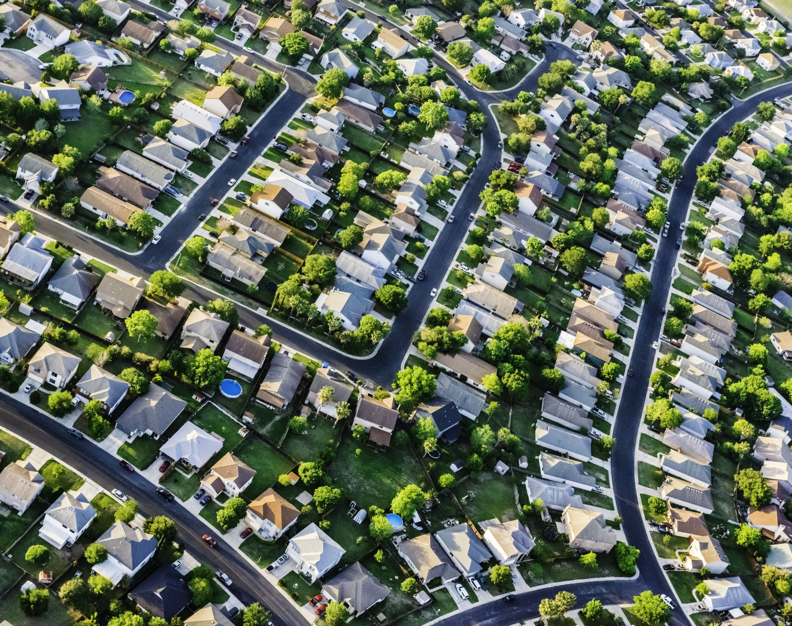
Relationships between Neighborhood Walkability, Median Income, and Air Quality
Dani Nicholas

Slide 2
Overview
Motivation
Background
Analysis
Conclusion
Sources

Slide 3
Motivation
Walkable cities boast many benefits including:
Health: greater physical activity which reduces risks of chronic illnesses
Environment: decreased reliance on cars, which emit pollutants
Social benefits: greater sense of community through street life
Safety: better pedestrian infrastructure, street design
Additionally, common claim that poor communities experience worse air quality
Is there is a correlation between the walkability score of cities/neighborhoods and the air quality?
Is there a relationship between the median income of neighborhoods and air quality?
Hypotheses:
As the walkability score in a block group increases, the levels of pollution (ozone and PM 2.5) decrease
As the median income increases, the levels of pollution (ozone and PM 2.5) decrease

Slide 4
Data Sources
National Walkability Index from the EPA
Published in 2021, using data from 2019
Census block group level
Based on 3 factors from the EPA Smart Location Database
Intersection density
Proximity to transit stops
Diversity of land uses
Variables representing employment mix and employment/household mix
Used these variables to rank every block group, place in quantiles, and give score 1-20
2019 EPA EJ Screen – mapping and screening tool for environmental justice
Ozone levels and PM 2.5 levels for each block group
Demographic data from American Community Survey from Census Bureau
Median household income for each block group

Slide 5
LS Regression: Walkability vs Ozone
LS Slope | 0.0138
95% Confidence Interval | [-0.0077, 0.0354]
Correlation coefficient (r) | 0.0065
P-value | 0.2095
Very weak positive LS slope and correlation
Not statistically significant

Slide 6
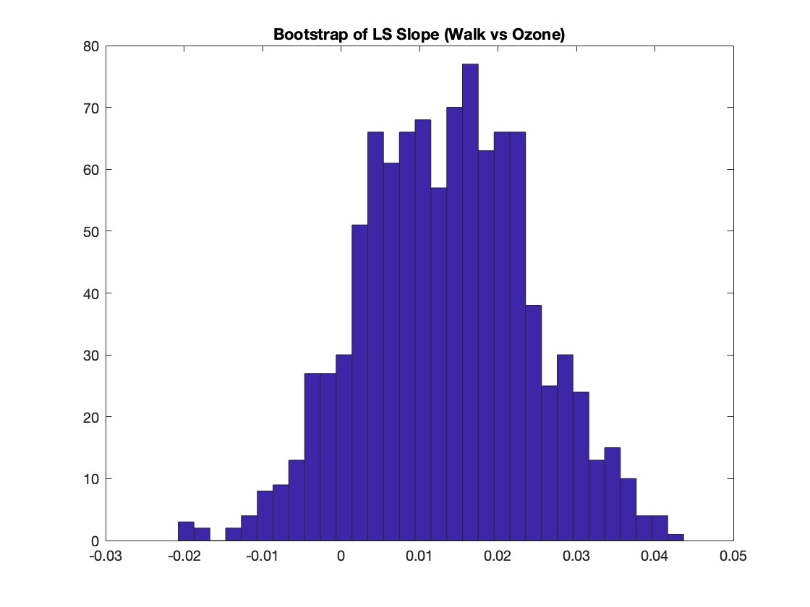
Bootstrap Analysis: Walkability vs Ozone

Slide 7
LS Regression: Walkability vs PM 2.5
LS Slope | 0.1212
95% Confidence Interval of LS slope | [0.1163, 0.1261]
Correlation coefficient (r) | 0.2416
P-value of corr coeff | 0
Weak to moderate positive slope and correlation
Expected negative
Fairly small confidence interval
Statistically significant

Slide 8
Bootstrap: Walkability vs PM2.5

Slide 9
LS Regression: Median Income vs Ozone
LS Slope | -3.2873e-5
95% Confidence Interval | [-3.5084e-5, -3.0747e-5]
Correlation coefficient (r) | -0.1512
P-value | 0
For a $1 increase in median income, we expect to see a .0000329 ppb decrease in ozone levels
Weak to moderate negative correlation
Statistically significant

Slide 10
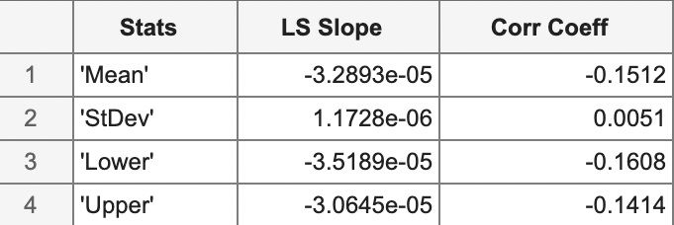
Bootstrap: Median Income vs Ozone

Slide 11
LS Regression: Median Income vs PM 2.5
LS Slope | -3.8216e-6
95% Confidence Interval | [-4.2478e-6, -3.2222e-6]
Correlation coefficient (r) | -0.0732
P-value | 0
For a $1 increase in median income, we expect to see a .0000038 decrease in PM.25 levels
Very weak negative correlation
Statistically significant

Slide 12
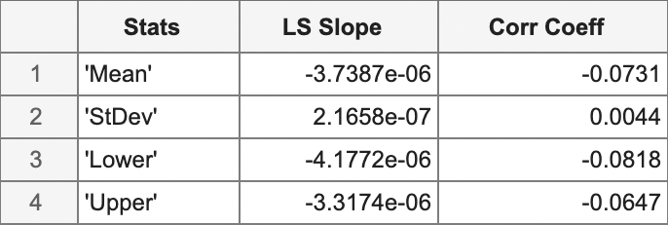
Bootstrap: Median Income vs PM 2.5

Slide 13
LS Regression: Walkability vs Median Income
LS Slope | 175
95% Confidence Interval | [76.1391, 274.1212]
Correlation coefficient (r) | .0178
P-value | .0005
For a 1-point increase in walkability score, there is a $175 increase in median income
Very weak positive correlation
Statistically significant

Slide 14
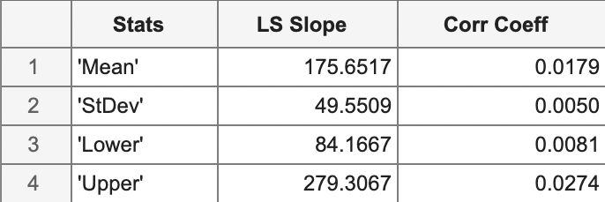
Bootstrap: Walkability vs Median Income

Slide 15
Conclusions
Statistically insignificant relationships between walkability score and ozone level
Many confounding variables
Statistically significant, but positive relationship between walkability and PM 2.5 level
Greater walkability tends to occur in more densely populated areas, which also tend to have more air pollution
Statistically significant, weak negative relationships between median income and air quality
As expected, areas with a higher median income have better air quality
Statistically significant, weak positive relationship between walkability and income
Areas with higher incomes experience greater walkability

Slide 16
Sources
National Walkability Index:
https://www.epa.gov/sites/default/files/2021-06/documents/national_walkability_index_methodology_and_user_guide_june2021.pdf
EJ Screen Data:
https://gaftp.epa.gov/EJSCREEN/
Demographics Data:
https://data.census.gov/

