Slide 1
Climate change impact on crop production
Diego Palacios (dpalacios9@gatech.edu)

Slide 2
Hypothesis
The climate change is deteriorating the Crop yield production globally.
How to prove it?
Multiple regressions relating yearly crop yield with the efects of climate change

Slide 3
Effects of climate change
01
02
03
Temperature
Precipitations
Greenhouse effect
Irregular precipitation
CO2
Higher CO2 levels

Slide 4
Areas and crops
Studied areas: Albania, Portugal, Algeria, Lithuania, Cameroon, Armenia, Chile, Australia, Colombia, Turkey, Morocco, Germany, Pakistan, Mexico and South Africa.
Crops: Three of the main crops produced worldwide Wheat, Maize (Corn) and Rice.
How is yield defined (by FAO): Hg/ha
(hectograms/área harvested)

Slide 5
Data sources
Crop yield: FAOSTAT
Temperature and Precipitation: World Data Bank

Slide 6
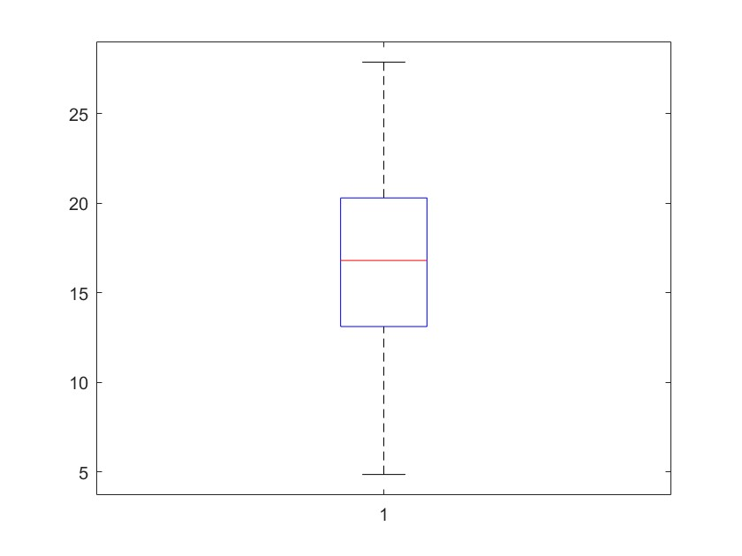
Range of temperatures covered
ºC
Temperature

Slide 7
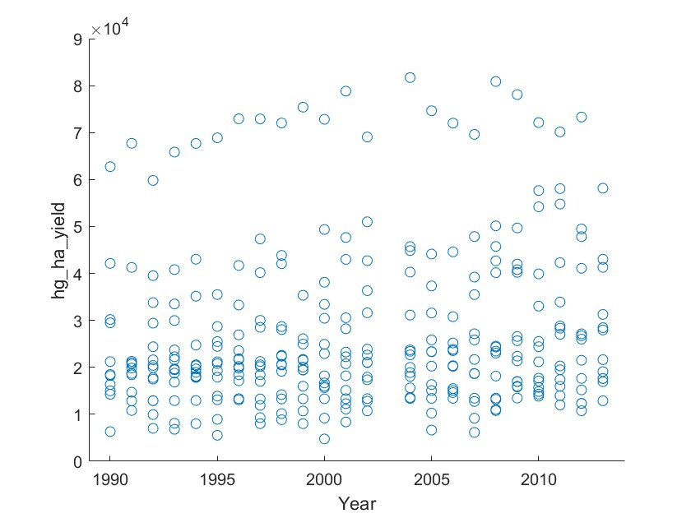
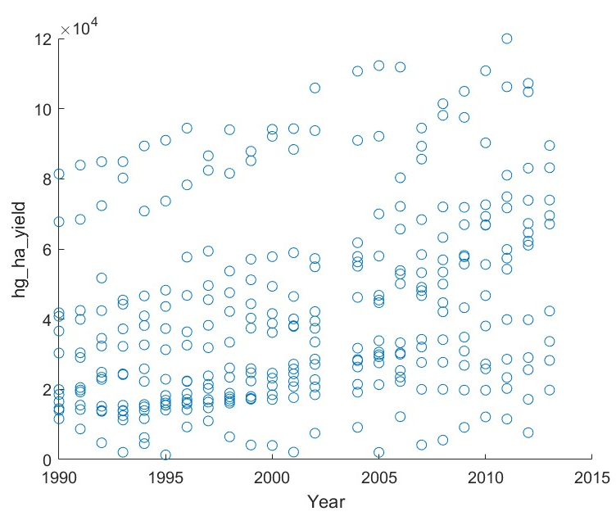
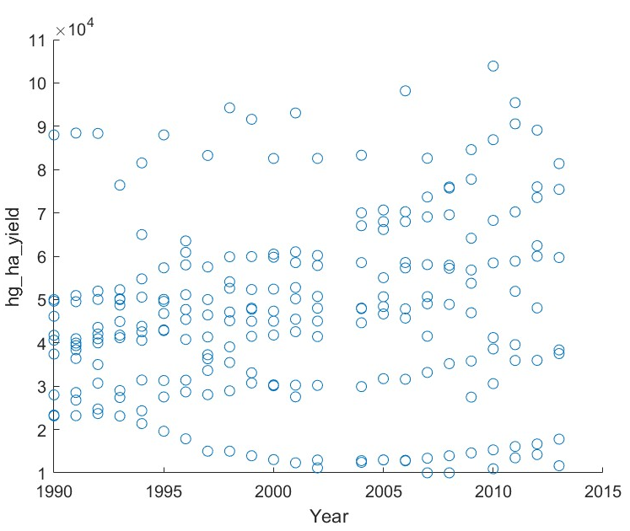
Data 23 years (1990 - 2013)
Wheat
Maize (corn)
Rice

Slide 8
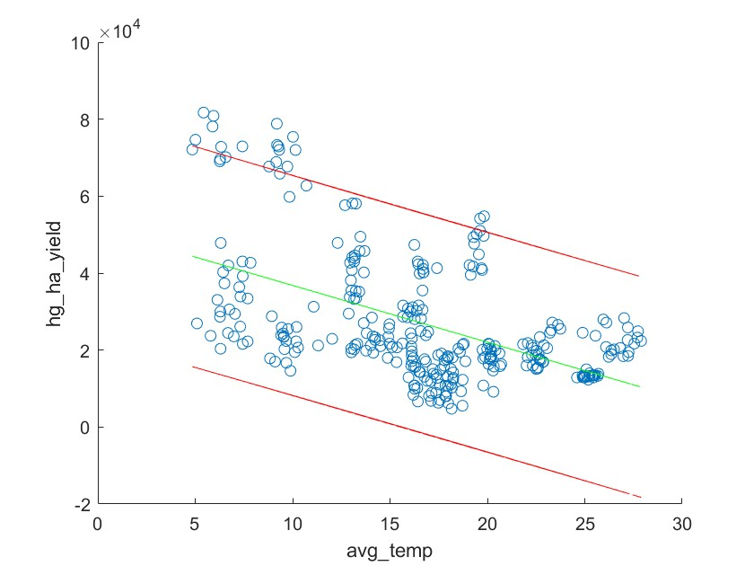
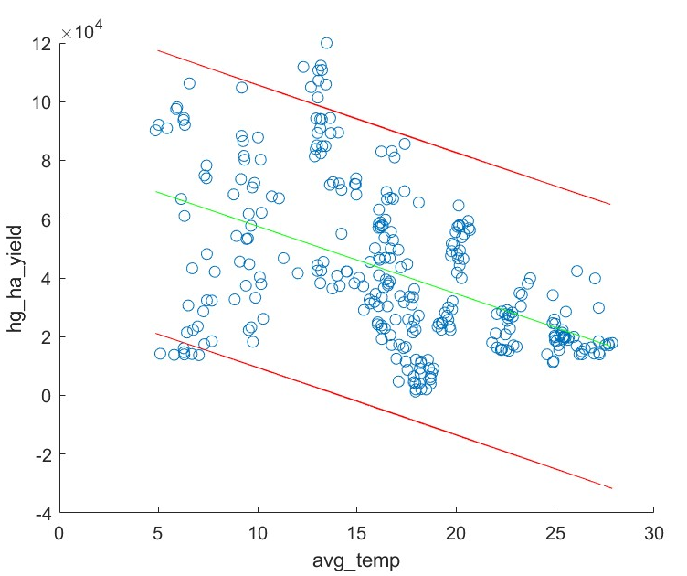
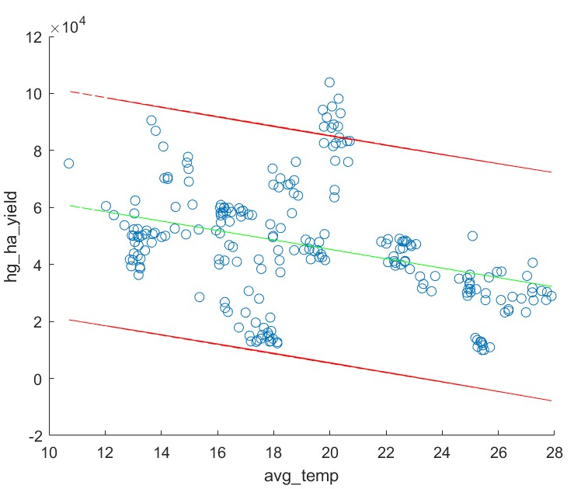
Yield vs Average Temperature
Wheat
Maize (corn)
Rice
Correlation Coefficient: -0.5195 -0.4897 -0.3395
Corrcoef Significance: 1.1e-12 5.56e-10 1.67e-7
95% Interval: -0.43 to -0.59 -0.4 to -0.57 -0.22 to -0.45

Slide 9
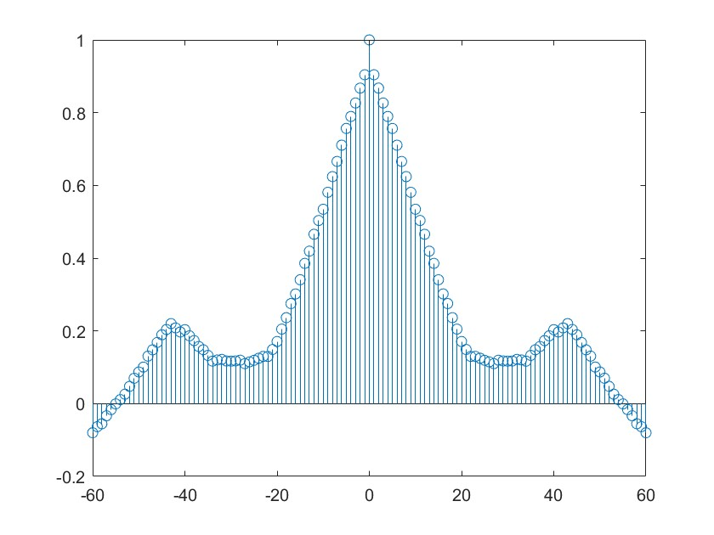
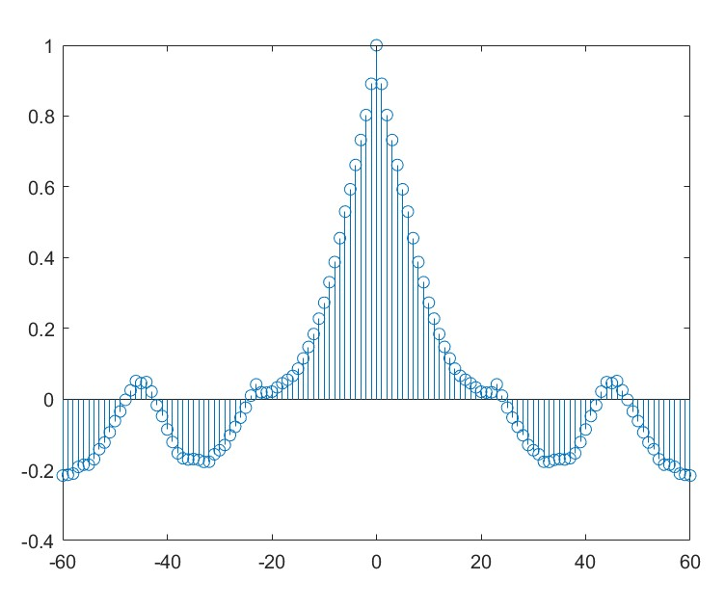
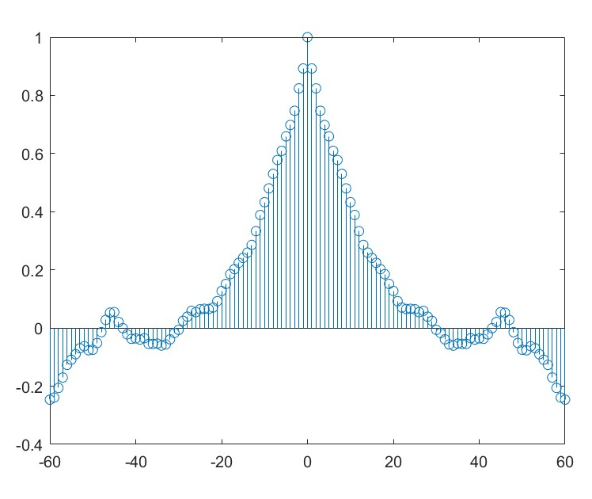
Quality test
Wheat
Maize (corn)
Rice
Normality of residuals: chi2crit = 25
chi2 = 86.52 chi2 = 49.16 chi 2 =94.57
Jacknife to test if the variance of the residuals is constant: chi2 crit = 348.8
chi2 = 14459 chi2 = 37431 chi2 = 40235
Autocorrelation:

Slide 10
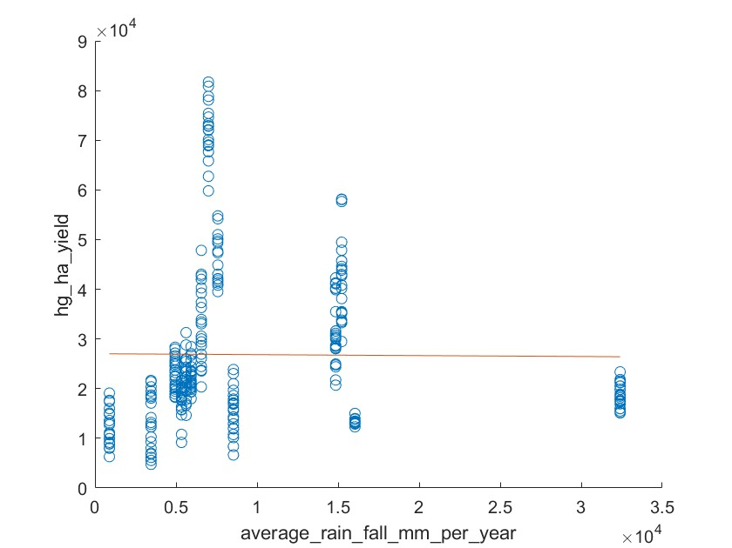
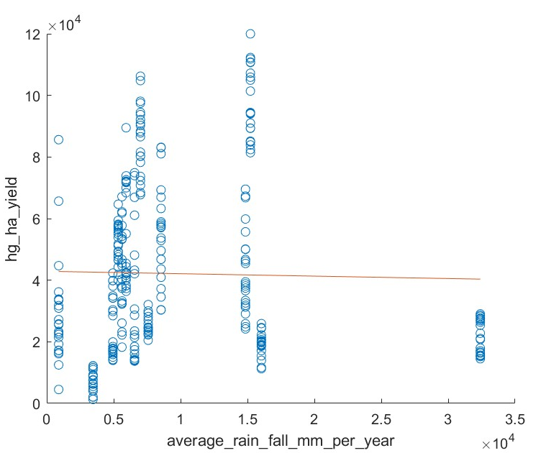
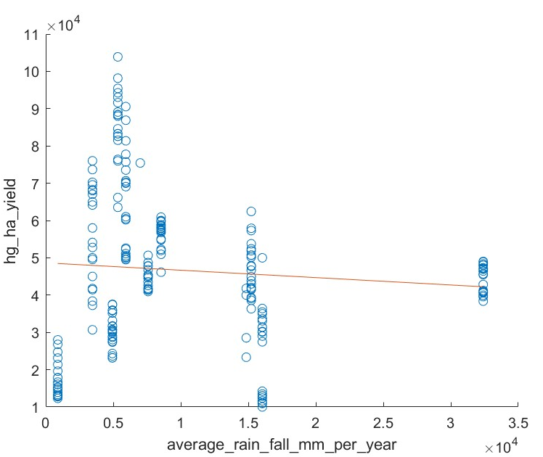
Yield vs Yearly Precipitation
Wheat
Maize (corn)
Rice
Correlation Coefficient: -0.0088 -0.0224 -0.0813
Corrcoef Significance: 0.0878 0.695 0.21

Slide 11
CO2 effect
CO2 impact on crop poduction is not very significative.
Some laboratory experiments suggest that elevated CO2 levels can increase plant growth but reduce their nutritional value

Slide 12
Conclusions
In Areas with a more extreme weather the crop yield gets worse
Quality of Regressions was not good, including more countries wold help?
Precipitation did not have any correlation to yield

