Slide 1
Analysis of Boston House Prices
Tianqi Sun
EAS 4480
Spring 2023

Slide 2
Content
1) Motivation
2) Background & Data Information
3) Analysis
4) Conclusion
5) References
https://www.destguides.com/united-states/massachusetts/boston/famous-landmarks-boston

Slide 3
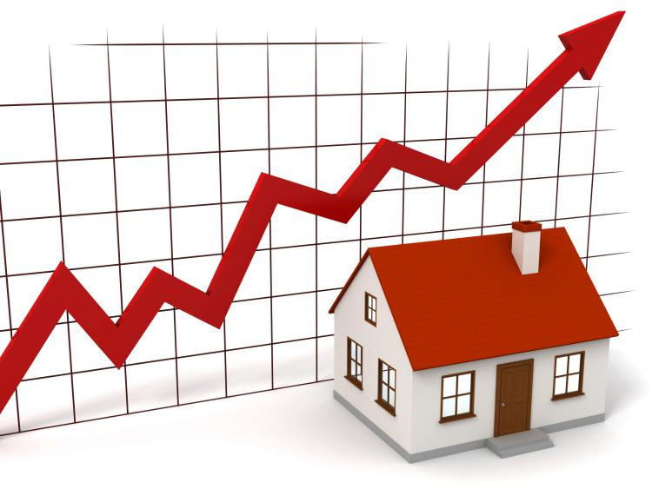
Motivation
Factors that impact house prices?
Which is/are the most significant?
Positive correlation or negative correlation?
Can we use the indicators to predict house prices?
https://mrwilliamsburg.com/buyers-are-overpaying-but-are-there-signs-of-a-bubble/

Slide 4
Background & Data Information
Factors - House itself (time it was built, number of rooms) - Demographics of the town (pupil-teacher ratio, proportion of black, proportion of labor workers, crime rate per capita) - Environmental (nitric oxides concentration) - Economic (tax rate, retail) - Geographical (river, distance to business centers)
Indicator - HOUSE PRICE!
Harrison, David & Rubinfeld, Daniel. (1978). Hedonic housing prices and the demand for clean air. Journal of Environmental Economics and Management. 5. 81-102. 10.1016/0095-0696(78)90006-2.

Slide 5
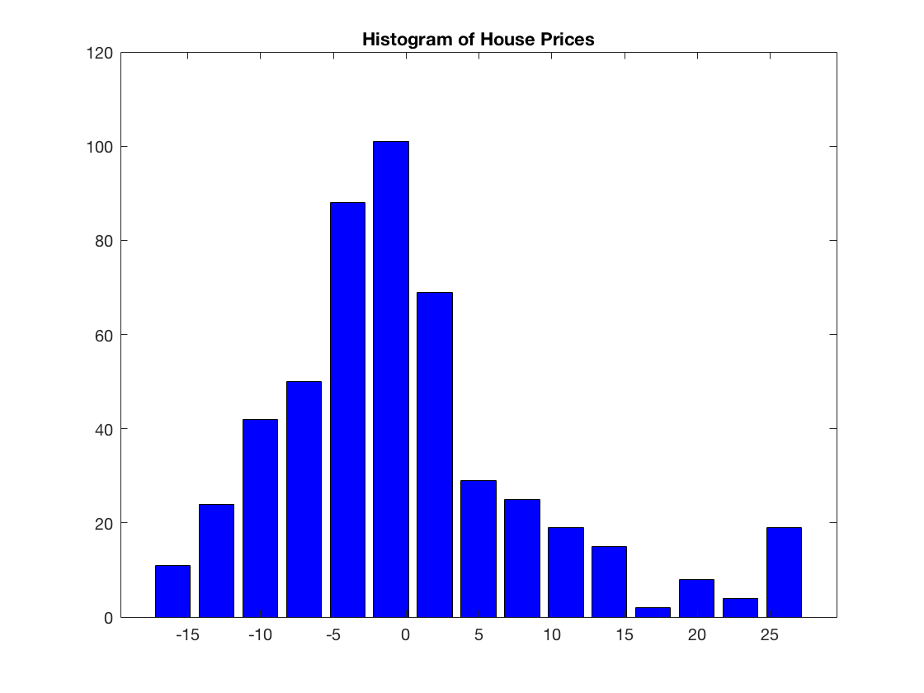
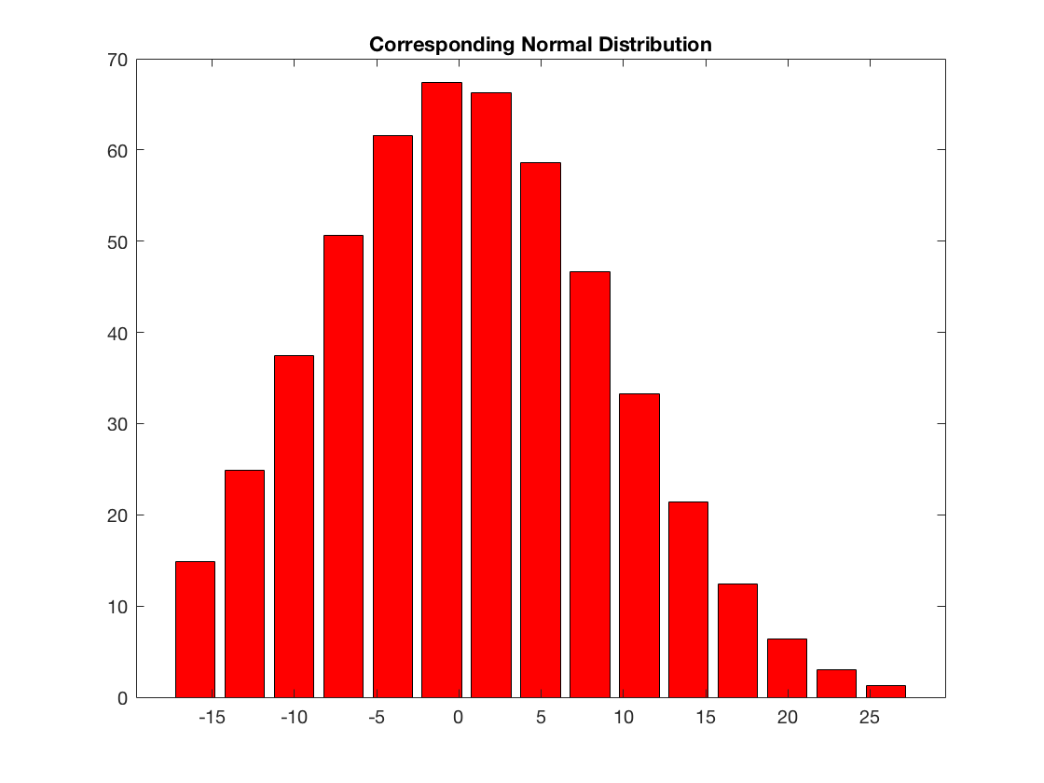
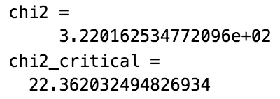
Distribution of the House Prices
NOT normally distributed

Slide 6
House tract bounds Charles River, or not?
https://collections.leventhalmap.org/search/commonwealth:js956j267

Slide 7
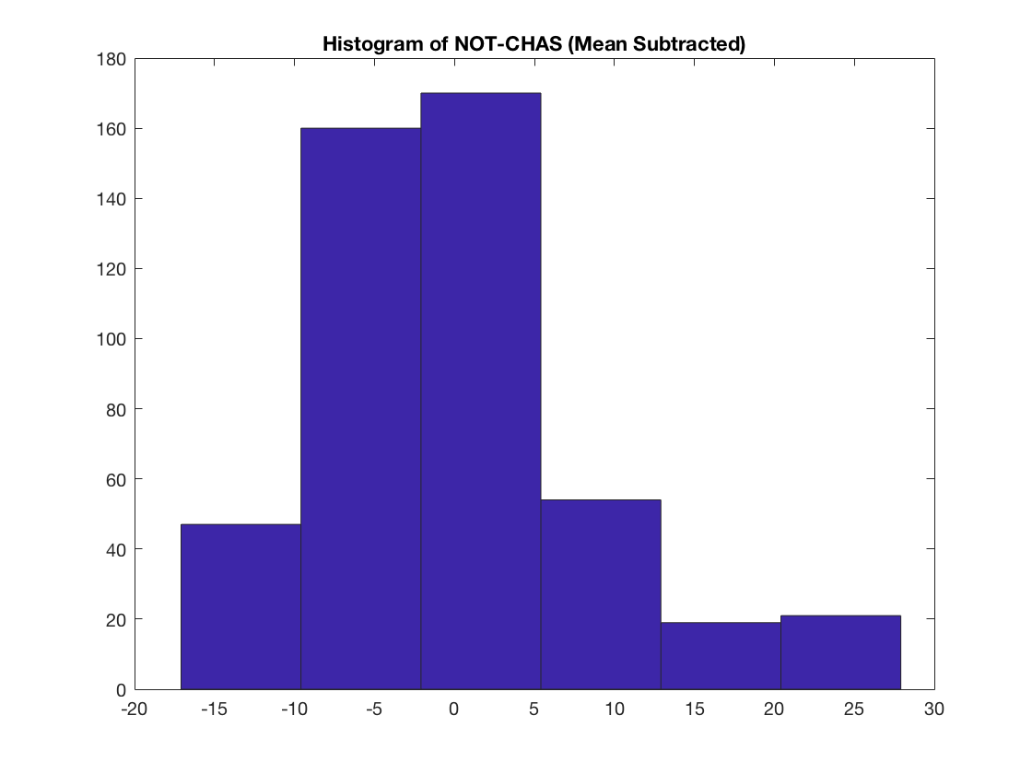
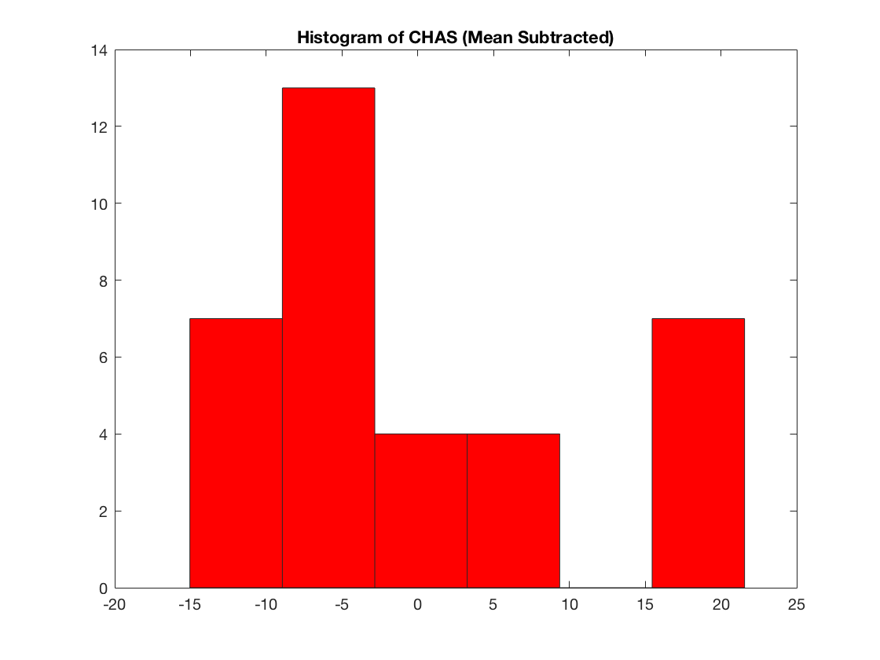
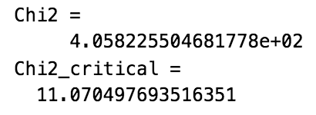
House tract bounds Charles River, or not? (Cont.)
NOT the same distribution, cannot use Student’s t-test

Slide 8
Correlation Analysis
 | r (correlation coefficient) | p | r_low | r_high
Crime rate per capita | -0.3883 | 1.174E-19 | -0.4599 | -0.3177
Non-retail business | -0.4837 | 4.900E-31 | -0.5478 | -0.4140
Nitric oxides concentration | -0.4273 | 7.065E-24 | -0.4960 | -0.3533
Average # of rooms | 0.6954 | 2.487E-74 | 0.6474 | 0.7378
Built prior to 1940 | -0.3770 | 1.570E-18 | -0.4494 | -0.2996
Distance to employment centers | 0.2499 | 1.207E-8 | 0.1664 | 0.3299
Tax rate | -0.4685 | 5.638E-29 | -0.5339 | -0.3976
Pupil-teacher ratio | -0.5078 | 1.610E-34 | -0.5697 | -0.4401
Proportion of black | 0.3335 | 1.312E-14 | 0.2537 | 0.4087
% Lower status of population | -0.7377 | 5.081E-88 | -0.7750 | -0.6952
Notes:
% lower status is defined by proportion of adults that do not have high school education or labor workers

Slide 9
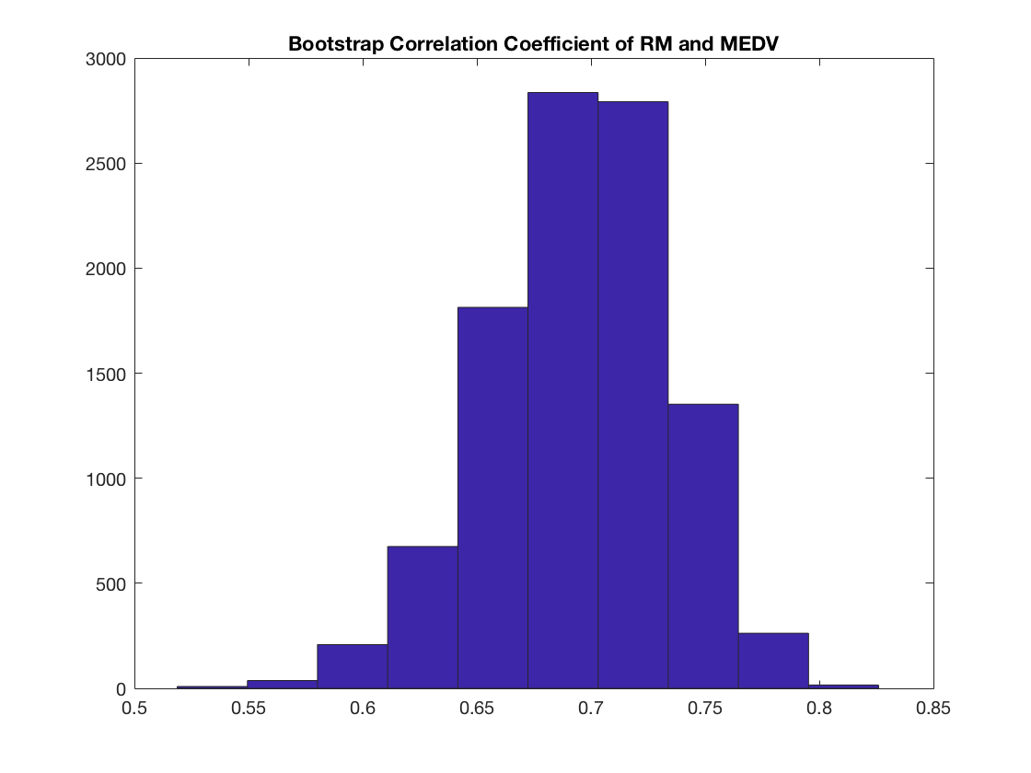
Average # of Rooms and House Price – Correlation Coefficient
Bootstrap of Correlation Coefficient
 | corr-coef | Bootstrap
r / r_mean | 0.6954 | 0.6949
r_low | 0.6474 | 0.6108
r_high | 0.7378 | 0.7662

Slide 10
Average # of Rooms and House Price – Linear Least-Square Regression

Slide 11
Average # of Rooms and House Price – Regression Slope
95% confidence interval of bootstrap of regression slope
95% confidence interval of regression slope from Student’s t-distribution
 | Student’s t-distribution | Bootstrap
Slope | 9.1021 | 9.1143
Slope_low | 9.9254 | 10.3741
Slope_high | 8.2789 | 7.7856

Slide 12
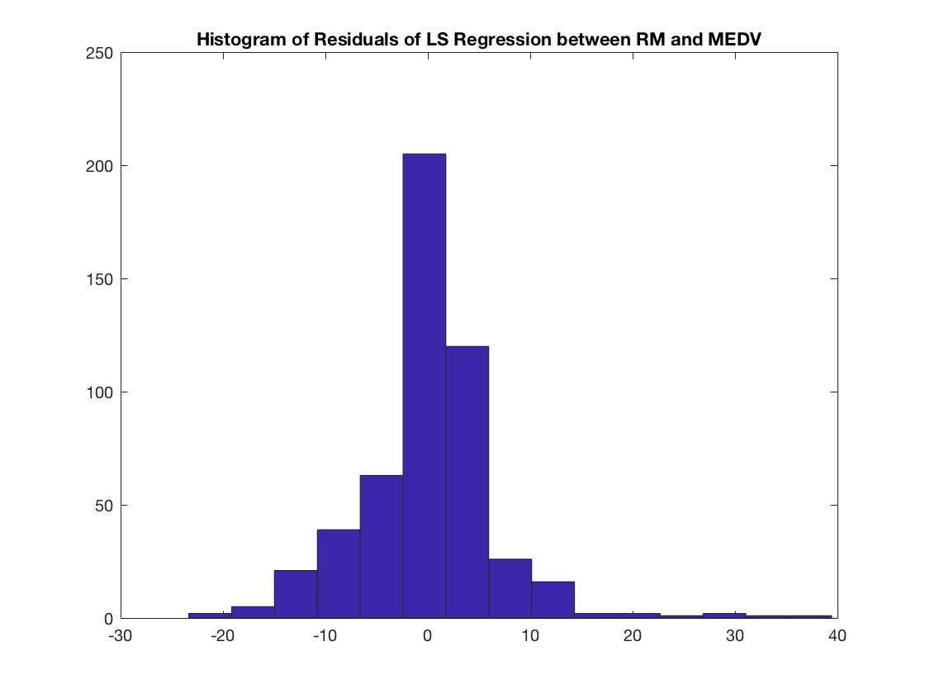
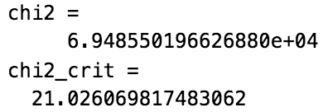
Residuals and Test for Normality
Residuals are NOT normally distributed

Slide 13
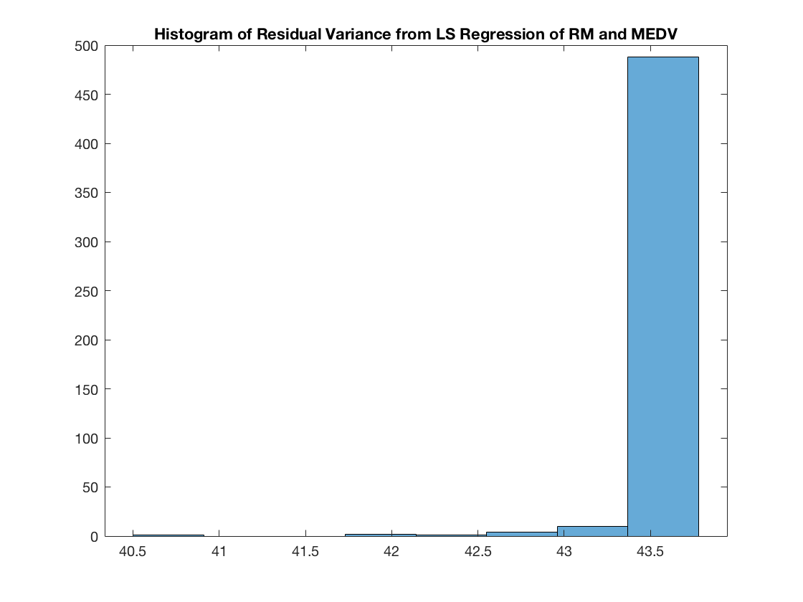
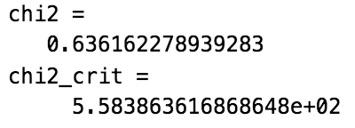
Auto-Correlation Analysis & Test of Residual Constant Variance
Residuals are independent of each other
Residuals have a constant variance

Slide 14
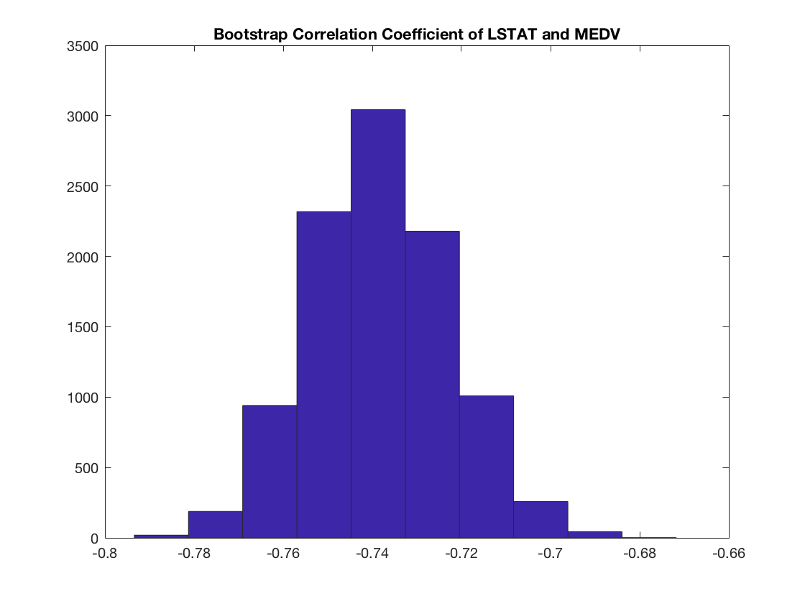
% Lower Status and House Price – Correlation Coefficient
Bootstrap of Correlation Coefficient
 | corr-coef | Bootstrap
r / r_mean | -0.7377 | -0.7383
r_low | -0.7750 | -0.7679
r_high | -0.6952 | -0.7069

Slide 15
% Lower Status and House Price – Linear Least-Square Regression

Slide 16
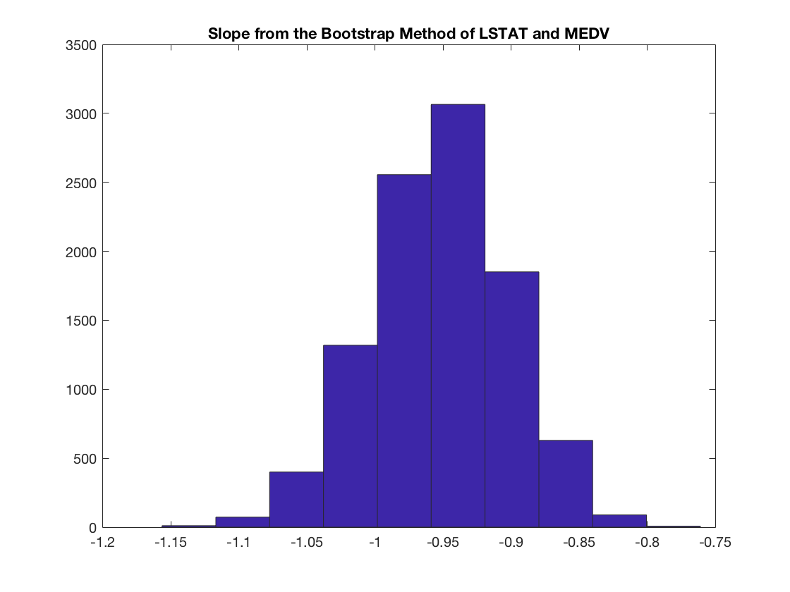
% Lower Status and House Price – Regression Slope
95% confidence interval of bootstrap of regression slope
95% confidence interval of regression slope from Student’s t-distribution
 | Student’s t-distribution | Bootstrap
Slope | -0.9500 | -0.9523
Slope_low | -0.8740 | -0.8569
Slope_high | -1.0261 | -1.0544

Slide 17
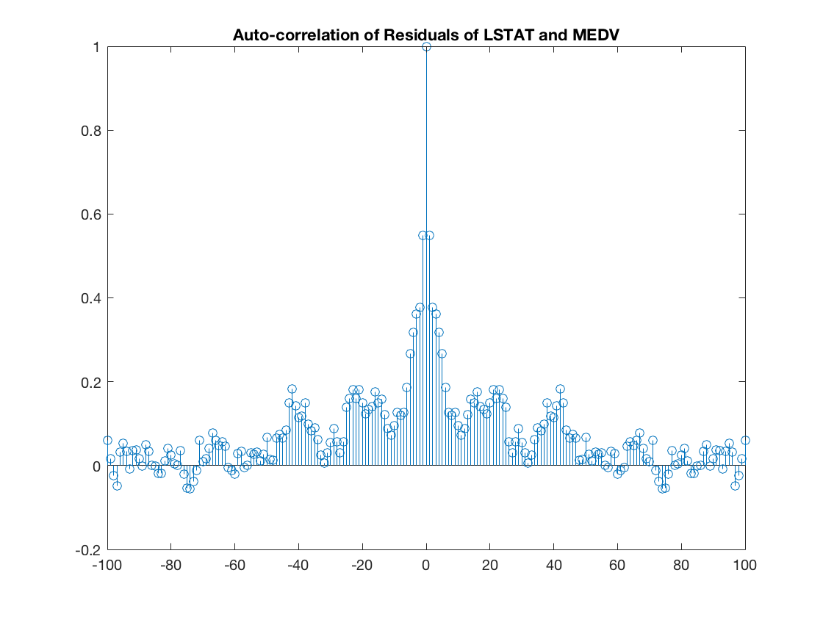
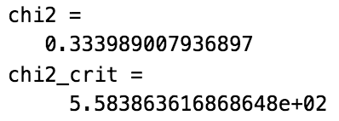
Regression Quality
Residuals are NOT normally distributed
Residuals have a constant variance

Slide 18
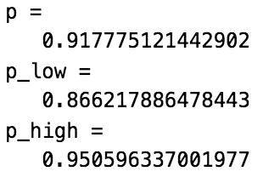
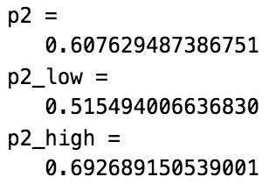
Use of Indicator to Predict House Prices
House Price
1 if greater than mean
0 if less than mean
Point 1
RM = 6.98
LSTAT = 5.64
Point 2
RM = 6.03
LSTAT = 7.88

Slide 19
Conclusion
Among all impacting factors, highest correlation are:
# of rooms per dwelling (positive correlation)
% Lower Status (negative correlation)
Residuals NOT normally distributed
More impacting factors
Significant correlation among factors
Better correlation coefficient, better regression quality
Predicting house prices using the highest two correlated factors
Could be useful

Slide 20
References
Harrison, David & Rubinfeld, Daniel. (1978). Hedonic housing prices and the demand for clean air. Journal of Environmental Economics and Management. 5. 81-102. 10.1016/0095-0696(78)90006-2.
Matlab
https://collections.leventhalmap.org/search/commonwealth:js956j267
https://mrwilliamsburg.com/buyers-are-overpaying-but-are-there-signs-of-a-bubble/
https://www.destguides.com/united-states/massachusetts/boston/famous-landmarks-boston

