Slide 1
The effect of hurricane category on cost of damages
EAS 4480
Autumn Toms

Slide 2
Goal: Determine the correlation between the maximum category of landfalling hurricanes in the Atlantic basin and the cost of damages hypothesis: increasing hurricane category will increase cost of damages

Slide 3
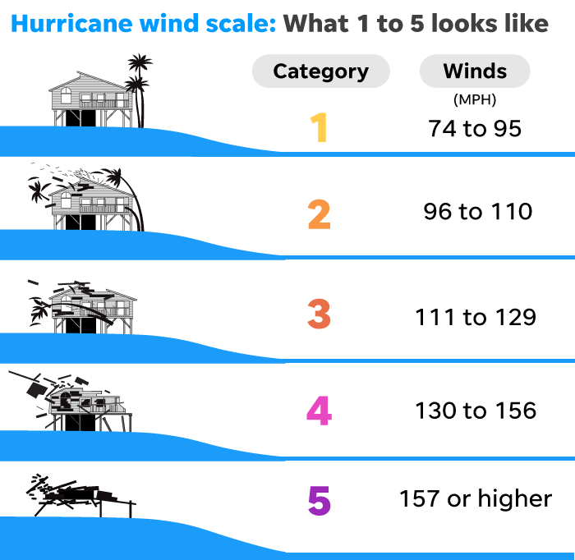
saffir-Simpson hurricane wind scale
Saffir-Simpson scale estimates damage caused by winds
Categories 3,4,5 are considered “major hurricanes”
Data collected from National Hurricane Center archive
1950 - 2022

Slide 4
Landfalling hurricanes: 1950-2022
85
63
44
36
29

Slide 5
box plots
(same as figure on left, zoomed in)
 | Cat 1 | Cat 2 | Cat 3 | Cat 4 | Cat 5
Median | 30.2 million USD | 10.7 million USD | 93.85 million USD | 319 million USD | 6.2 billion USD
Lower Q | 2.975 million USD | 1.9 million USD | 12.75 million USD | 45.3 million USD | 332.5 million USD
Upper Q | 235 million USD | 183 million USD | 1.140 billion USD | 3.09 billion | 23.75 billion USD

Slide 6
correlation coefficient
Correl Coef = 0.307
Indicates weak positive correlation
Significance (p-value): 5.178e-07 < 0.5
Indicates that the correlation is significant
95% Confidence Interval: 0.1919 - 0.4138

Slide 7
least squares regression
Least Squares Regression Slope: 3.672 billion USD/cat
LSR Slope 95% Confidence Interval: 3.058 – 4.287 billion USD/cat
Positive slope indicates positive correlation

Slide 8
bootstrap Correlation Coefficient
Mean: 0.310
Standard deviation: 0.0374
95% Confidence Interval: 0.2370 - 0.3836

Slide 9
bootstrap Least squares regression slope
Mean: 3.686 billion USD / cat
Standard deviation: 0.896
95% Confidence Interval: 2.0665 - 5.6482

Slide 10
Results
Cost of damages increases hurricane category increases
Weak correlation makes sense because many other factors impact damage caused by a hurricane
Saffir Simpson scale does not take tornadoes, flooding, and storm surge into account
Landfall location – populated vs unpopulated region
Category at landfall
Future work completing a comprehensive analysis needs to include intensity changes over time and adjust cost of damages to inflation

Slide 11
References
https://www.usatoday.com/story/news/nation/2022/05/19/hurricane-wind-speed-saffir-simpson-scale/9807231002/
https://www.aoml.noaa.gov/general/lib/lib1/nhclib/mwreviews.html

