Slide 1
Water Quality Analysis
Emily Tribby
EAS 4480
Notes:
Goals: analyze the water quality of the Savannah River at GA highway 25 and investigate the relationships between parameters

Slide 2
Savannah River at GA 25

Slide 3
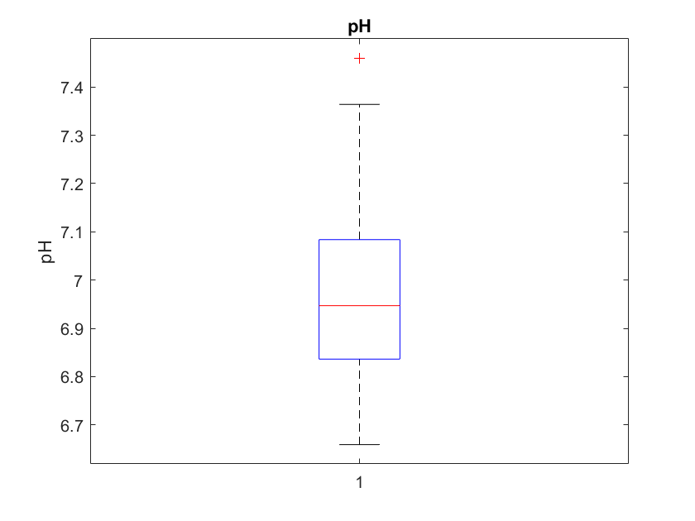
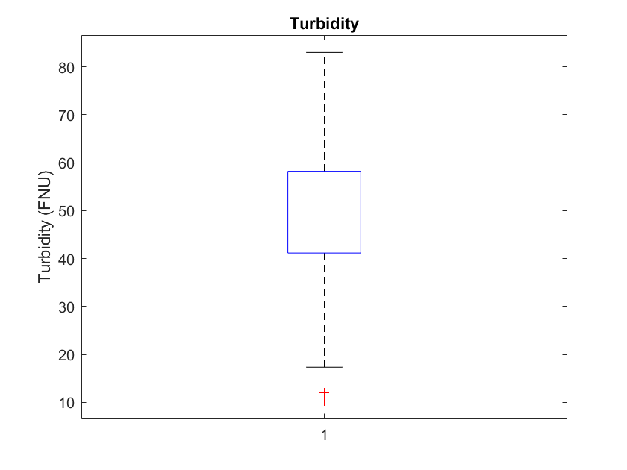
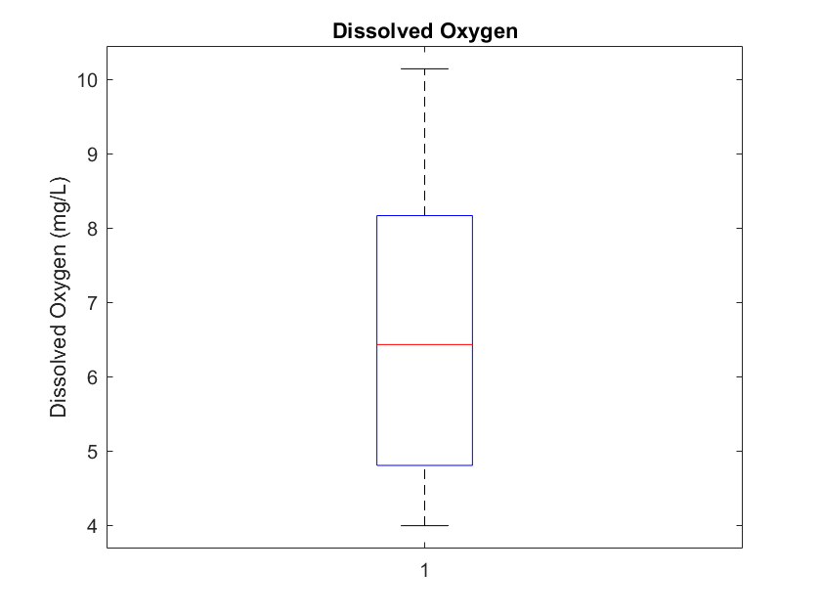
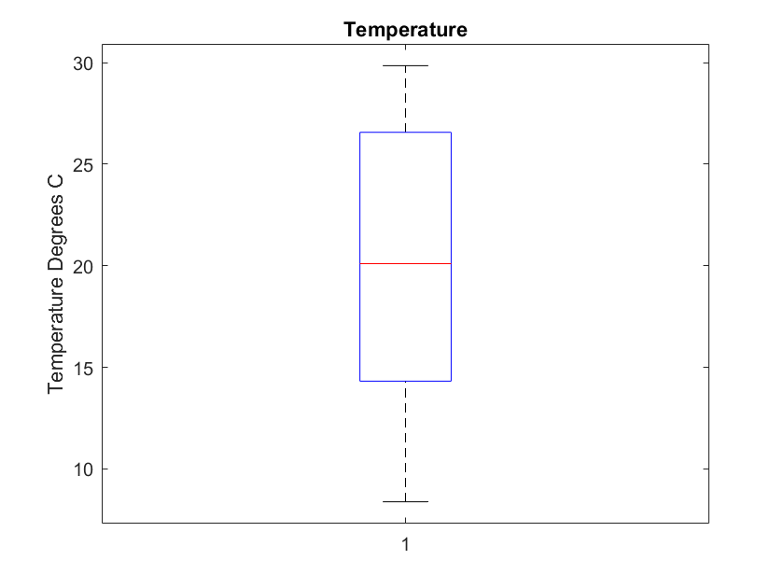
Results: Distribution of Parameters
Notes:
My chosen parameters were pH, Turbidity, Water Temp, and DO because they are often the parameters that are sampled most regularly because they can be tested in-situ very easily. This data consists of measurements taken at 15 min increments over the time period of jan 2014- march 2019, then converted into monthly averages to suppress outliers. Temperature and DO vary the most, which makes it would take a large distruption to significantly change pH Farly symmetric around their means

Slide 4
Water Quality Standards
Notes:
I have the water quality standards for Georgia listed above, 90 DegF~32/33DegC

Slide 5
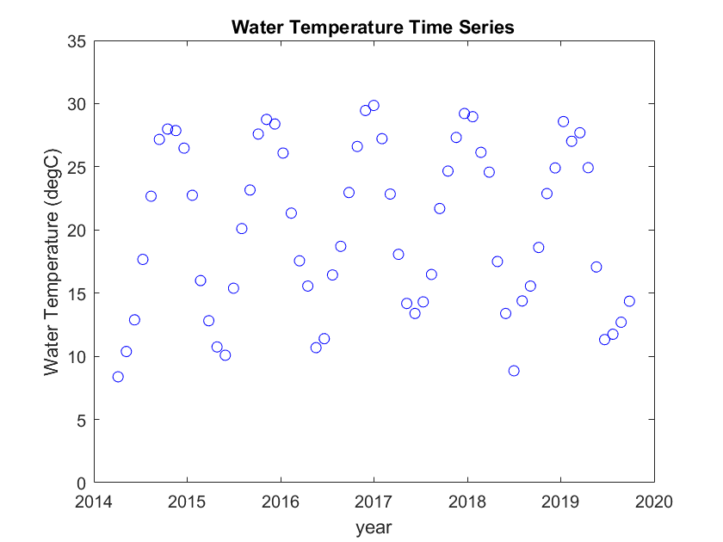
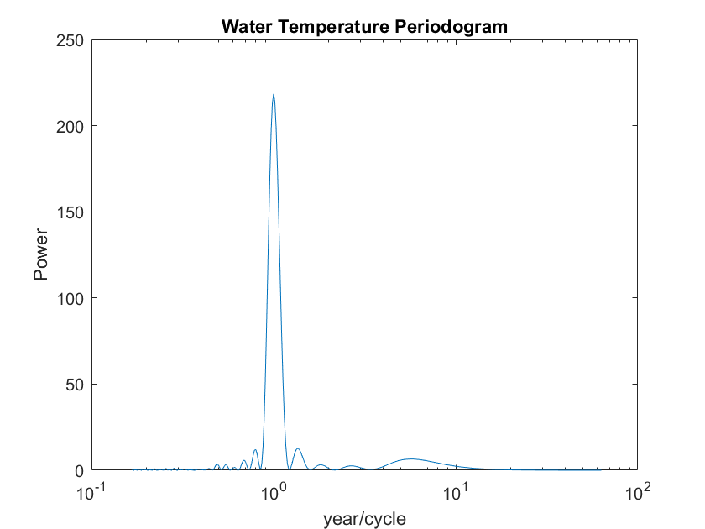
Results: Periodogram Water Temperature
Notes:
We see an expected yearly trend as the temperature changes yearly

Slide 6
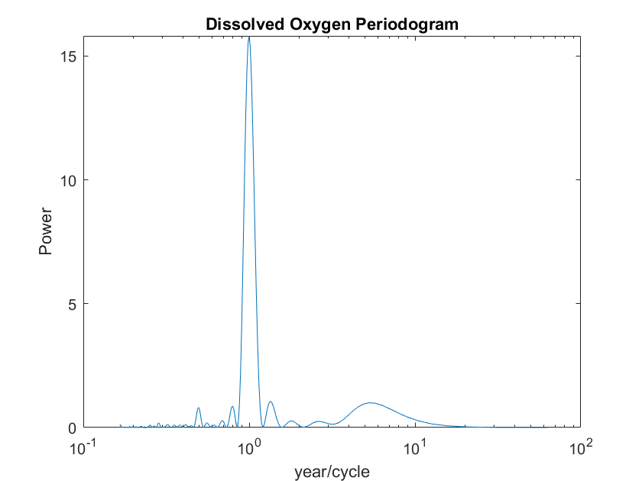
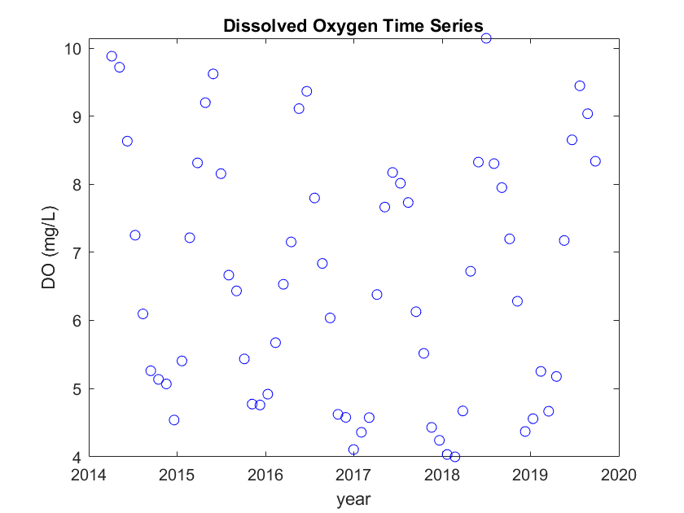
Results: Dissolved Oxygen Trends
Notes:
See a similar yearly trend as with temperature but we also see a peak at 4.5 years which is not a physically logical trend

Slide 7
Notes:
Because both DO and Water temp had a yearly trend and they do have a physical relationship, I wanted to further investigate them. Shown here is just an example of how the two parameters would change over one year, to show seasonal cycles. As you can see there is an inverse relationship, with the highest water temperature corresponding to the lowest DO. Typically cold water holds more DO than warm water due. As water heats up the oxygen moleucles move more and can be lost to the surrounding atmosphere. DO is very important for the biological health of a stream, which is why it is monitored.

Slide 8
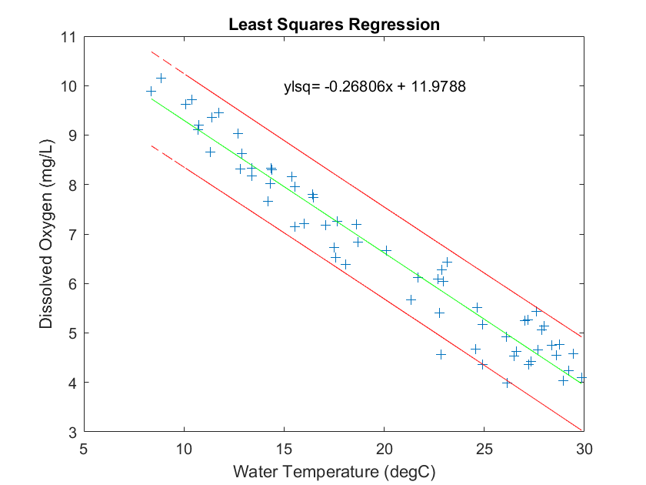
Relationship Between DO and Water Temp
Notes:
To further examine this relationship I did a least squares regression between the two parameters the result is as expected a negative correlation between the two parameters red lines indicate the 95% CI of the error green line is the regression and blue crosses are the data points for the monthly averaged temperature for the year 2014-19 As we know a perfect comparison would give you an intercept of zero and a slope of 1 which is clearly not the case

Slide 9
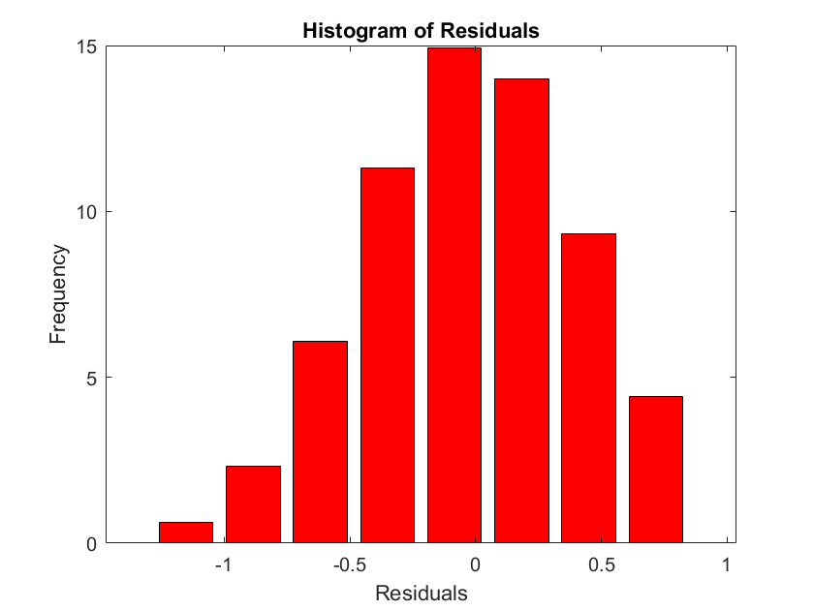
Regression Quality: Residuals
Residuals passed the Chi Squared Test for Normalcy
Analysis of Autocorrelation of Residuals
Passed the Chi Squared test for constant variance
Notes:
To test the quality of this regression, I performed the necessary analysis including examining the distribution of the residuals, analysis of auto correlation of residual and the test for constant variance

Slide 10
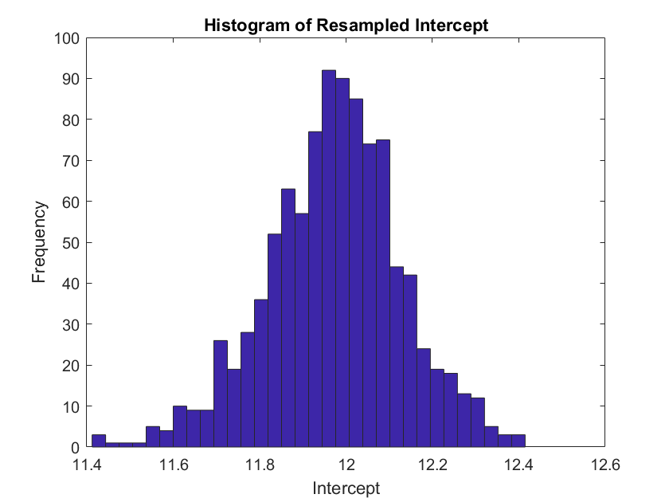
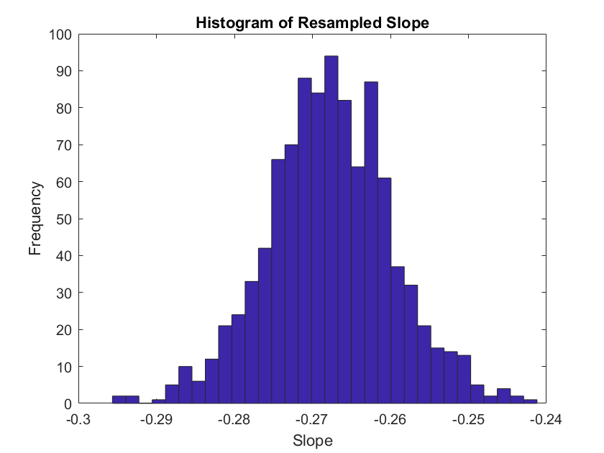
Resampled slope and Intercept with Bootstrap
Notes:
To further analyze this regression, I performed a bootstrap resampling of the regression and plotted the resulting histograms of the slope and intercept. My observed and resampled values are very similar, indicating that if I repeated the experiment many times I would likely get a similar result

Slide 11
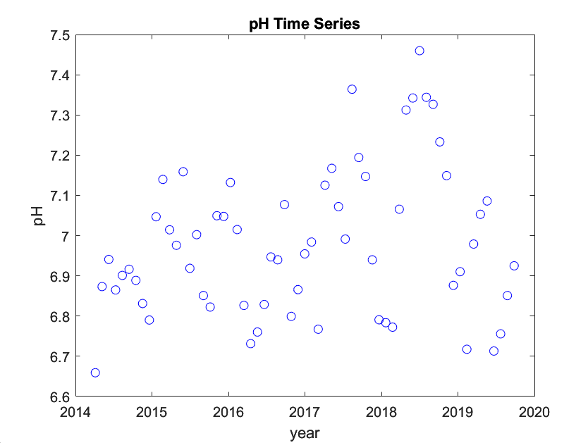
Results: pH Trends
Notes:
I would guess this is a result of precipitation trends due to the breaking down of sediments releasing calcium carbonate

Slide 12
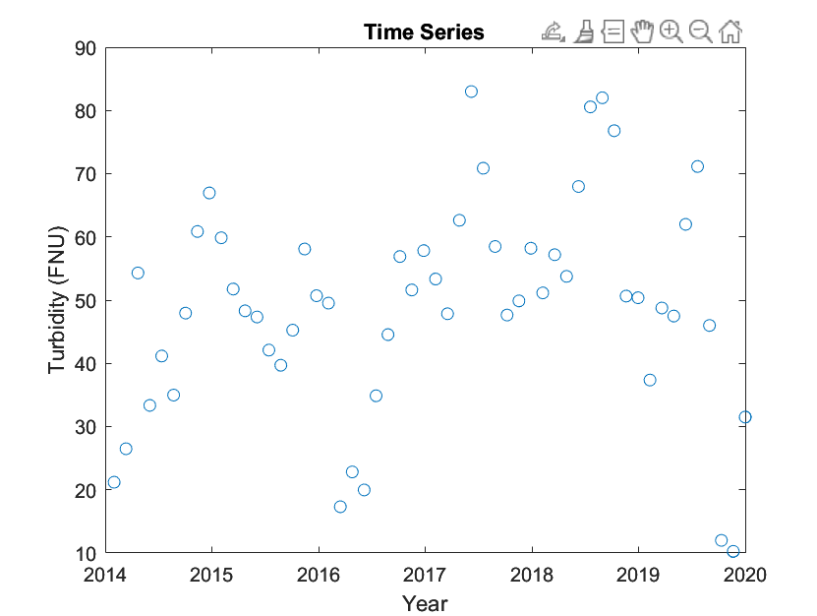
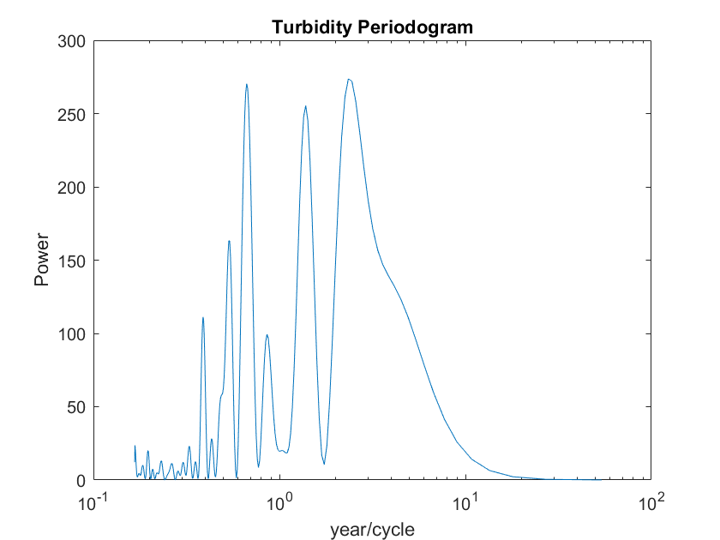
Results: Turbidity Trends

Slide 13
Conclusions and Further Steps
In terms of basic water quality parameters, this site is fairly healthy.
pH and Turbidity show trends of increasing. Heightened turbidity allows for more pollutant transport throughout a stream.
Noticeable trend between DO and Water Temperature, although there are other factors to consider
Analyze Precipitation affects

Slide 14
References
USGS
https://waterdata.usgs.gov/monitoring-location/02198920/#parameterCode=00065&period=P7D
https://www.usgs.gov/special-topics/water-science-school/science/dissolved-oxygen-and-water#:~:text=Cold%20water%20can%20hold%20more,oxygen%20concentration%20is%20often%20lower.
Georgia EPD
https://epd.georgia.gov/watershed-protection-branch/watershed-planning-and-monitoring-program/georgia-water-quality
EPA
https://www.epa.gov/national-aquatic-resource-surveys/indicators-dissolved-oxygen

