Slide 1
Investigating the Relationship between Drought Severity and Wildfires in California
Amita Anand
EAS 4480

Slide 2
Questions
Is there a statistically significant relationship between drought severity and wildfire occurrence?
Is there a statistically significant relationship between drought severity and acres burned by wildfire?
Can the periodicity of drought severity help predict wildfires?

Slide 3
Data
Wildfire Occurrence Per Year
% of Total Area Covered in Drought by Severity
Acres Burned by Wildfires Per Year
Time Period:
2000-2020
California, USA

Slide 4
Analysis Methods
Regression
Error Analysis
Time Series
Least Squares
Bootstrap
Test of Normality
Periodogram
Assign line of best fit using least squares regression
Report R^2 value
Access regression reproducibility
Calculate 95% confidence intervals for slope of regression lines
Compute stem plot of residuals
Perform Chi Squared test for normality on residual terms
Identify tends in drought occurrence and severity over a period of 20 years
Compute periodogram to identify the period (if any) of drought occurrence

Slide 5
Least Squares Regression

Slide 6
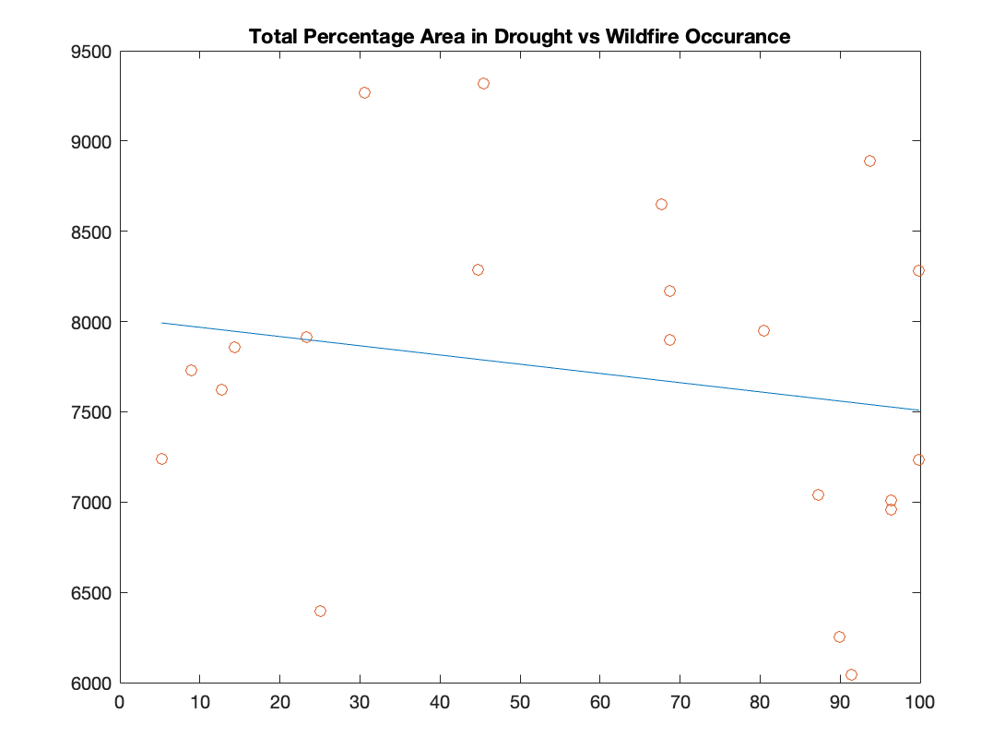
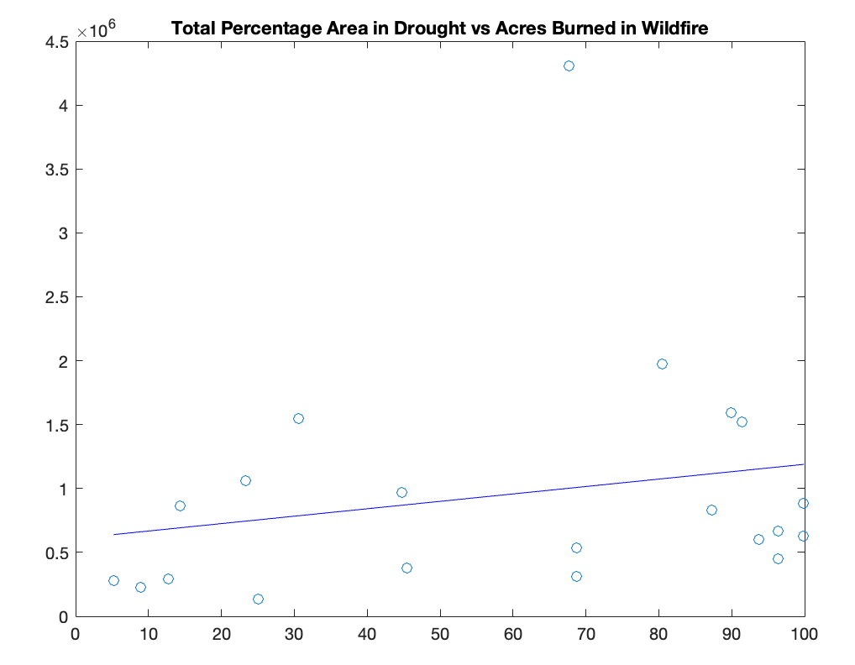
Least Squares Regression Results
R^2 = 0.0371
R^2 = 0.0477

Slide 7
Error Analysis

Slide 8
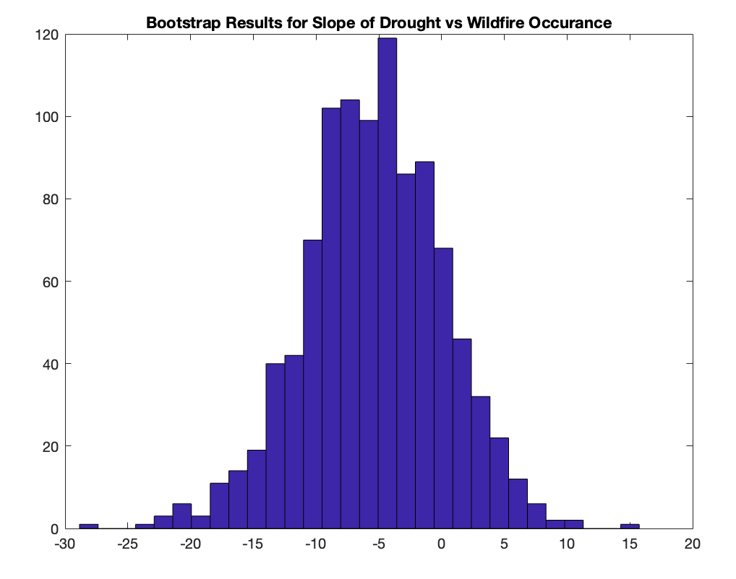
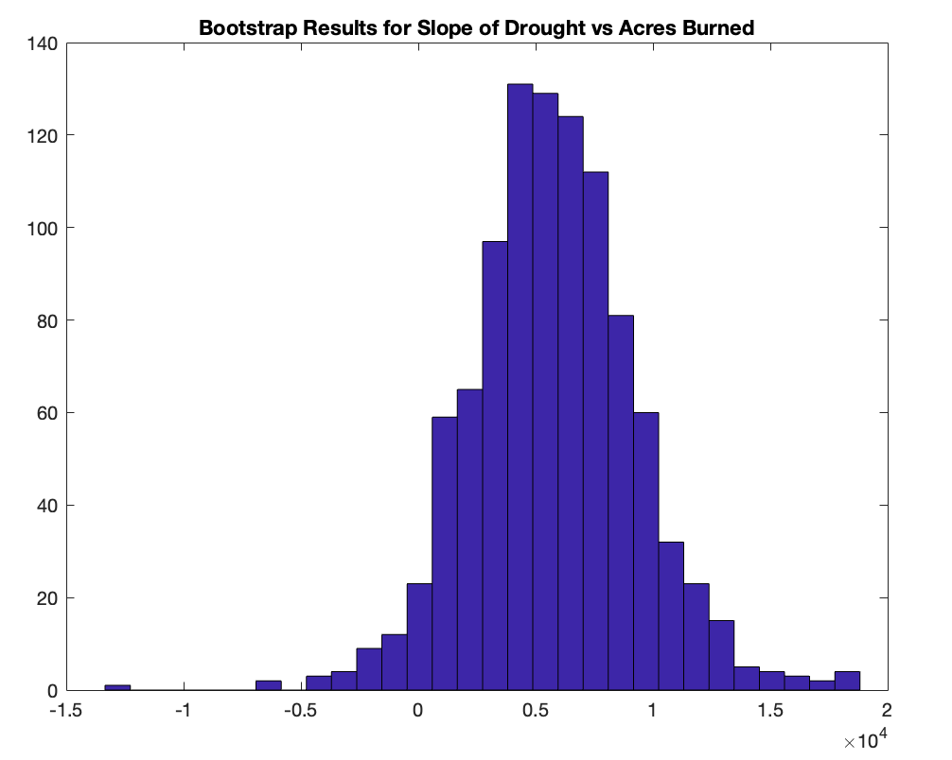
Bootstrap Results
95% CI = [-16.8238, 5.0099]
95% CI = [-1.1029e+03, 1.3141e+04]

Slide 9
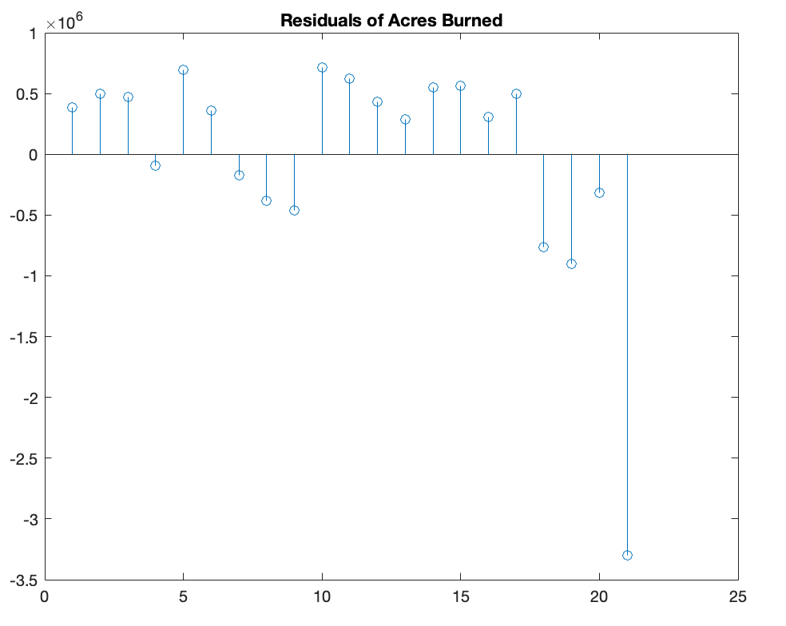
Stem Plots of Residuals

Slide 10
Chi Square Test for Normality
H0: The distribution of the residuals of least squares regression follows a normal distribution
H1: The distribution of residuals of least squares regression does not follow a normal distribution

Slide 11
Results of Chi Squared Test
 | Wildfire Occurrences | Acres Burned
DOF | 3 | 3
Chi Squared Value | 1.4496 | 22.1950
Critical Value (95%) | 5.9915 | 5.9915
Result | Accept H0 | Reject H0

Slide 12
Time Series Analysis

Slide 13
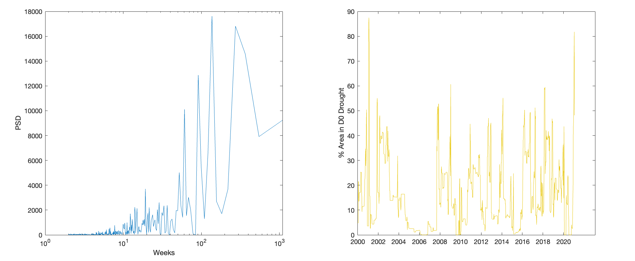
Time Series Analysis – D0
Period ~ 137 weeks/ 2.63 years

Slide 14
Time Series Analysis – D1
Period ~ 219 weeks/ 4.21 years

Slide 15
Time Series Analysis – D2
Period ~ 274 weeks/ 5.27 years

Slide 16
Time Series Analysis – D3
Period ~ 365 weeks/ 7.02 years

Slide 17
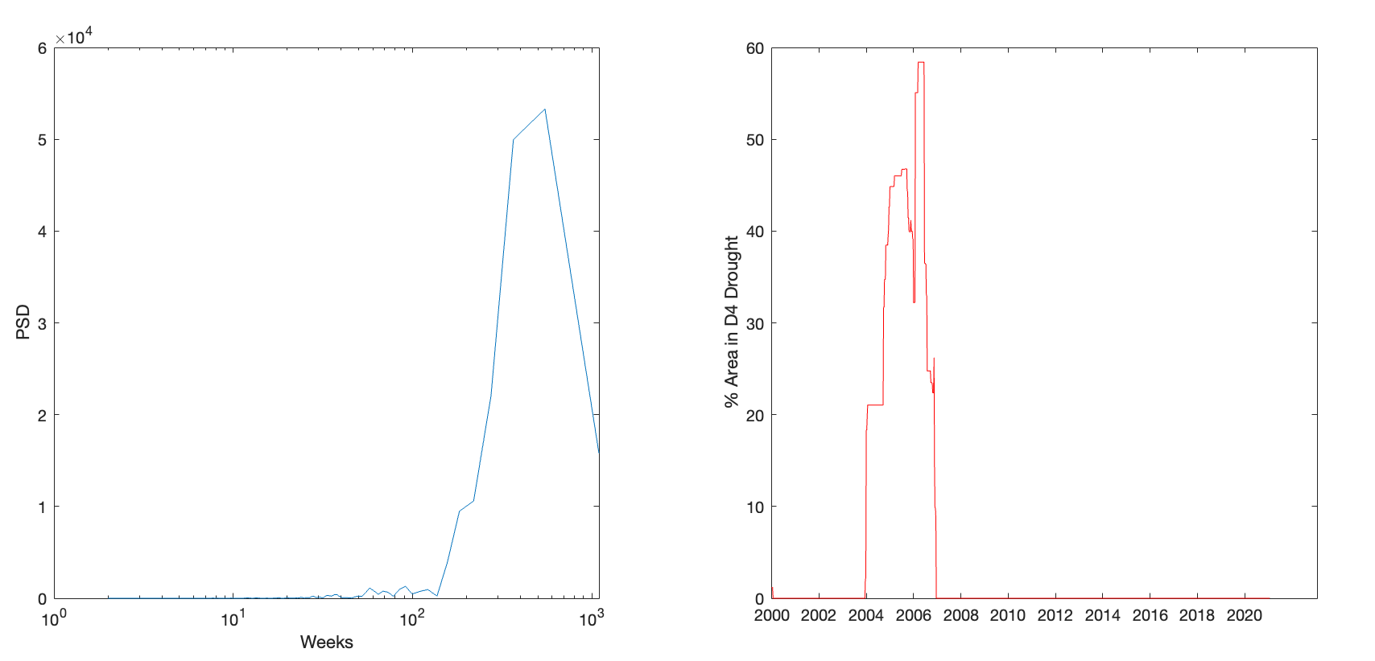
Time Series Analysis – D4
Period ~ 548 weeks/ 10.53 years

Slide 18
Conclusions
Least squares:
Negative correlation between drought area and wildfire occurrence
Positive but weak correlation between drought area and acres burned by wildfire
Negative/weak positive could be due to lack of data
Error Analysis
Bootstrap gives 95% confidence intervals for slope of LS regression
Residual for acres burned by wildfire LS is NOT normal
Time Series
Periods increase with drought severity

