Slide 1
Air Quality vs. Mental Health
Delaney Diggins

Slide 2
Overview
Comparing Median Air Quality Index to the percentage of population reporting mental illness
Hypothesis: Areas with poorer average air quality will have higher rates of mental illness
Analysis:
Least Squares Regression
Regression Quality Analysis
Regression & Data Improvement

Slide 3
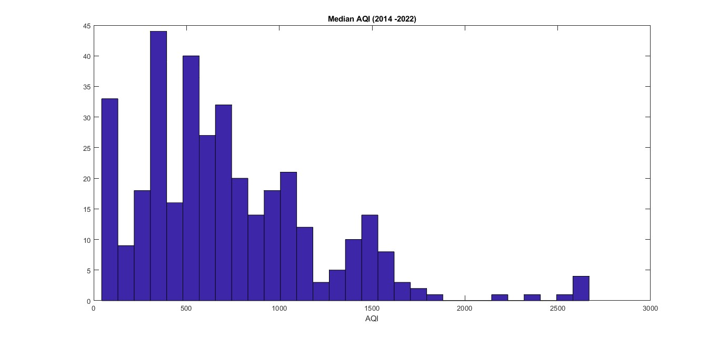
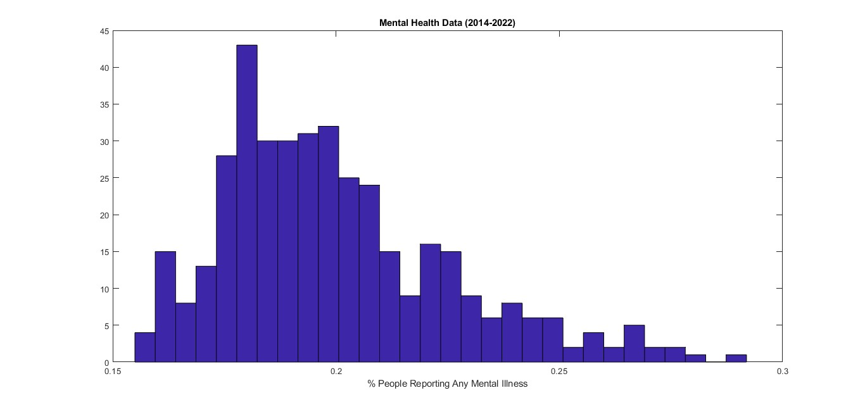
Data Overview
Air Quality: Median AQI each year for each U.S. state (US EPA)
Mental Health: Percentage of population reporting any mental illness each year (US SAMHSA)

Slide 4
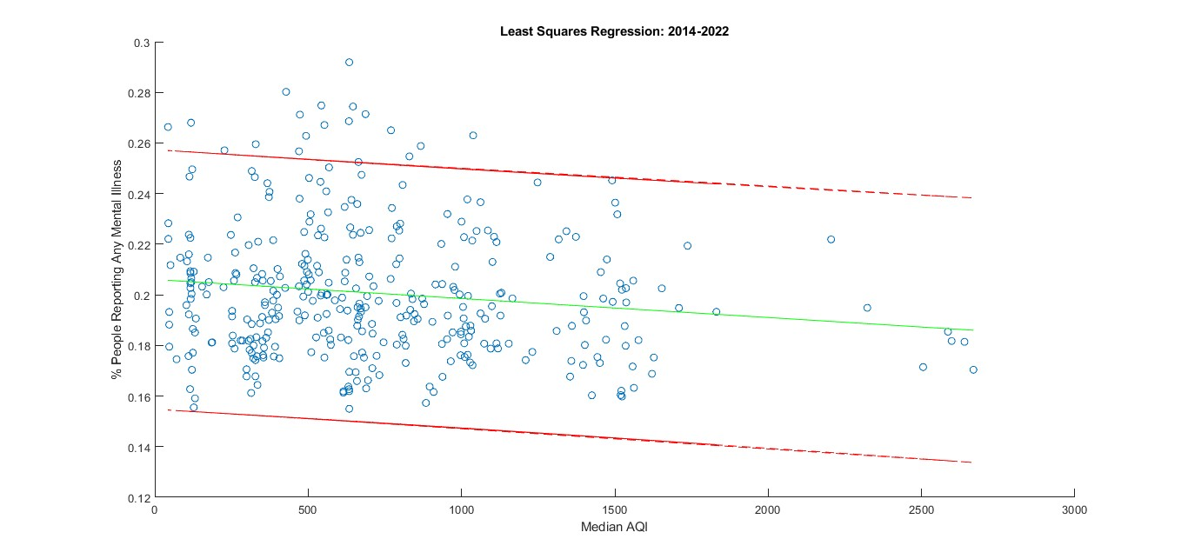
Slope = -7.5130e-06
Intercept = 0.2061
Correlation Coefficient: -0.139025

Slide 5
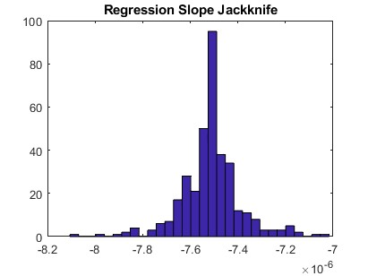
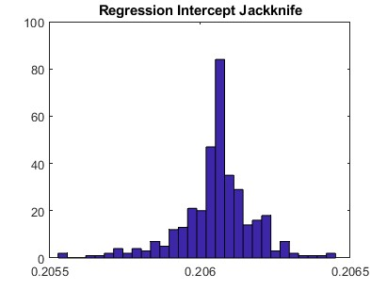
Regression Quality
Residuals do not follow a normal distribution
Confirmed with a chi2 test
Very low correlation coefficient
Overall not a good regression

Slide 6
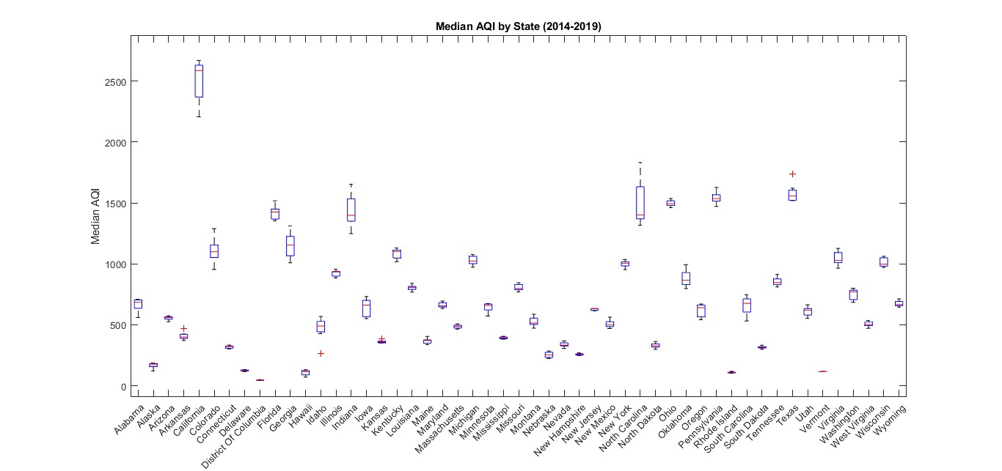
What other factors are important?

Slide 7
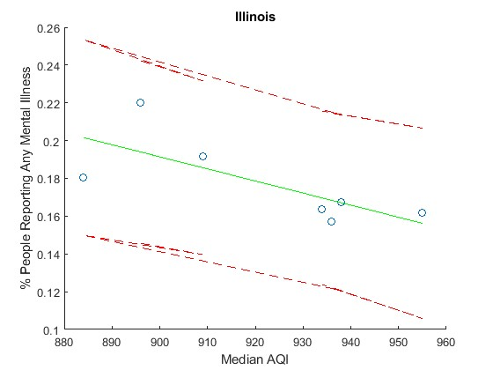
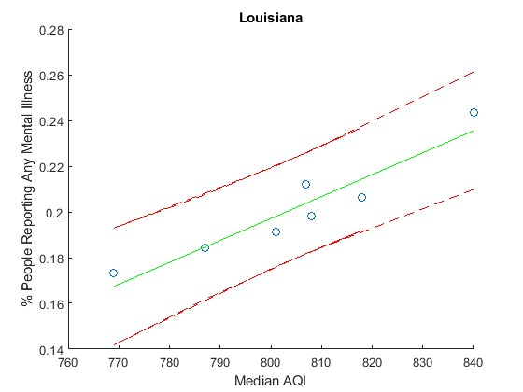
Location Specific Data
Can see much more significant correlations when looking at more specific regions
These correlations still have a wide range and large confidence intervals
Regression quality:
Residuals still do not follow a normal distribution based on state-specific LSR
Poor regression quality

Slide 8
Conclusions
Unable to confirm hypothesis from data set
Reducing potential variables:
Track the aqi and mental health data from a single city over several years
Compare two areas with similar demographics but different average air quality
Multivariable approach/account for potential other variables:
Population
Major pollution or weather events
Number of metropolitan areas

Slide 9
References
Annual AQI by County 1980-2023, United States Environmental Protection Agency, Oct. 2023.
NSDUH Detailed Tables 2014-2022, Substance Abuse and Mental Health Services Administration, Jan. 2023.

