Slide 1
Analyzing Greenhouse Gas Emissions and Correlations by Country
Risha Goel

Slide 2
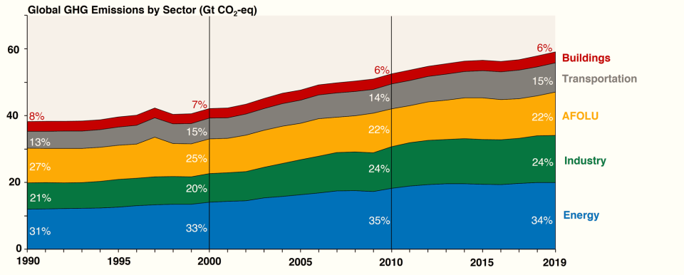
Introduction
Greenhouse gas (GHGs) emissions are a major pollutant and contributor to climate change
Among the biggest sources for GHG are industrial activities, electricity, and transportation
Question(s): What specific factors affect GHG emissions within countries? Are there statistically significant relationships between these measures and GHG emissions? Can these be used to predict trends?
https://www.epa.gov/ghgemissions/global-greenhouse-gas-overview

Slide 3
Overview
Bootstraps of Correlation Coefficients
Periodograms
Correlation Analysis
Analyze trends/cycles in these factors for each country. Determine if they can be explained by events in that country
Between GHG and Energy/Infrastructure measures for countries from 1991-2021
Analyze error/uncertainty to ensure quality of regression

Slide 4
Data Source
Organisation for Economic Co-operation and Development (OECD)
International organization that has compiled data on many indicators for many countries
Data Cleaning
Removing null/missing values
Picking common years across datasets (1991-2021)
Finding common countries between datasets

Slide 5
Variables Analyzed
GHG Emissions
Gross R&D Spending
Share of Electricity Production from Renewables
Rail and Road Freight
Thousands of kg of CO2 per $1000 USD
- Contributor to pollution and climate change
----------------------- As a function of -----------------------
% of Total Electricity Production
% of GDP
Rail Investment
Million-tonne km of goods
Euros
--------------------------From 1991 to 2021 --------------------------

Slide 6
Countries Analyzed
Iceland
Estonia
Latvia
Luxembourg
Slovenia
Lithuania
New Zealand
Finland
Hungary
Denmark
Greece
Portugal
Norway
Ireland
Czechia
Austria
Sweden
Belgium
Switzerland
Netherlands
Poland
Australia
Canada
Spain
Turkey
Italy
Mexico
France
United Kingdom
Germany
Japan
United States
Countries that were common in all data sets were chosen. Ordered from lowest to highest GDP
*Limitation: Most of these countries are in Europe. African and Asian countries are underrepresented here as there was not consistent data for all datasets for these countries

Slide 7
Hypotheses
Are there statistically significant relationships between GHG and the other variables?
Is there a periodicity of each indicator that can be used to predict future trend?
Hypothesis: periodicities may follow a yearly cycle as these variables can be affected by weather/season, budgets/fundings on an annual cycle, etc.
There will be a negative correlation between investments in clean energy & infrastructure and GHG
Renewable electricity share
R&D spending
Rail Investment
There will be a positive correlation between amount of goods transported and GHG
Rail freight
Road freight

Slide 8
Preliminary Data Analysis

Slide 9
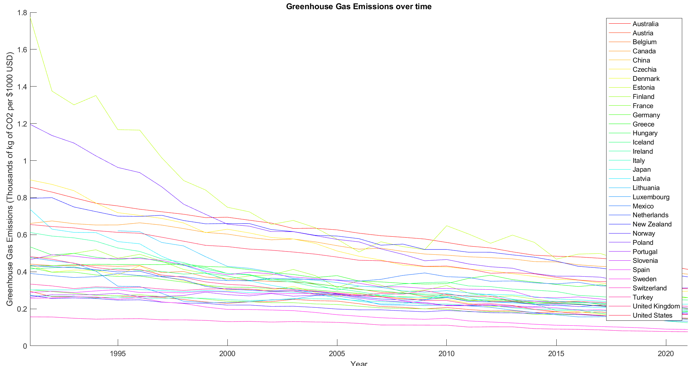
Time Series - GHG

Slide 10
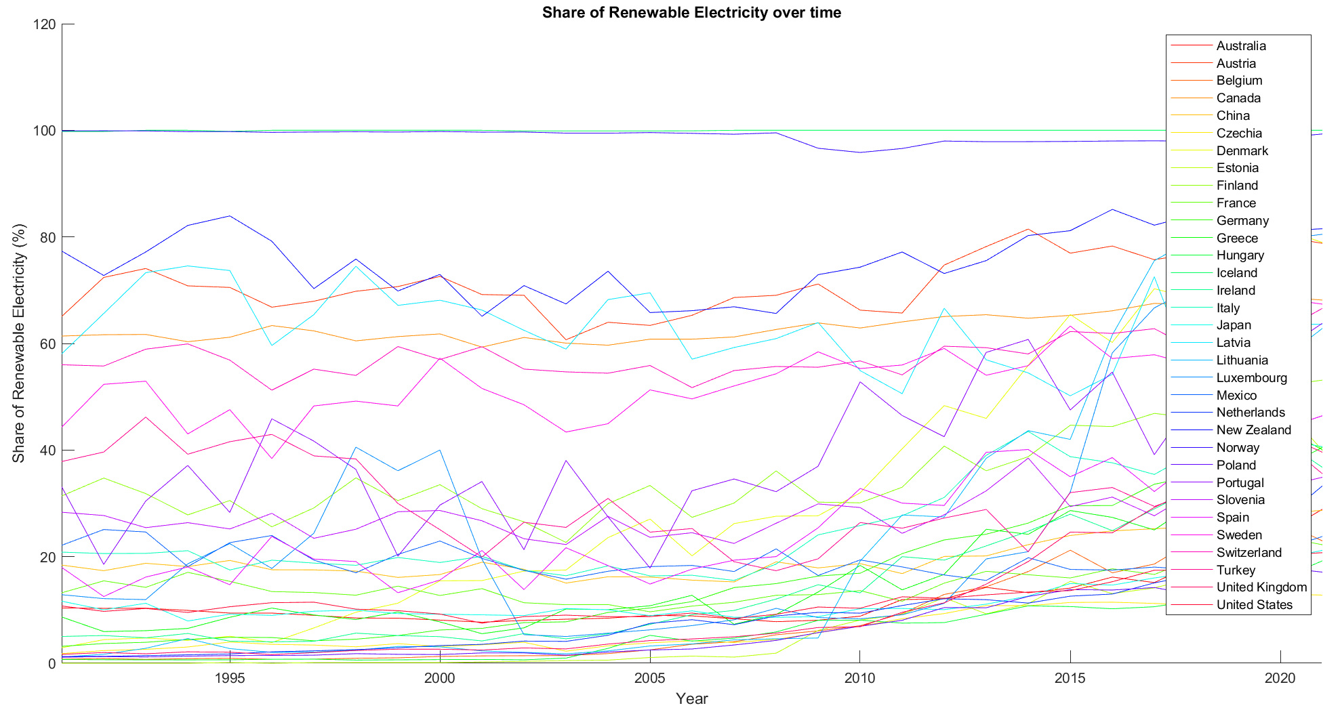
Time Series – Renewable Electricity

Slide 11
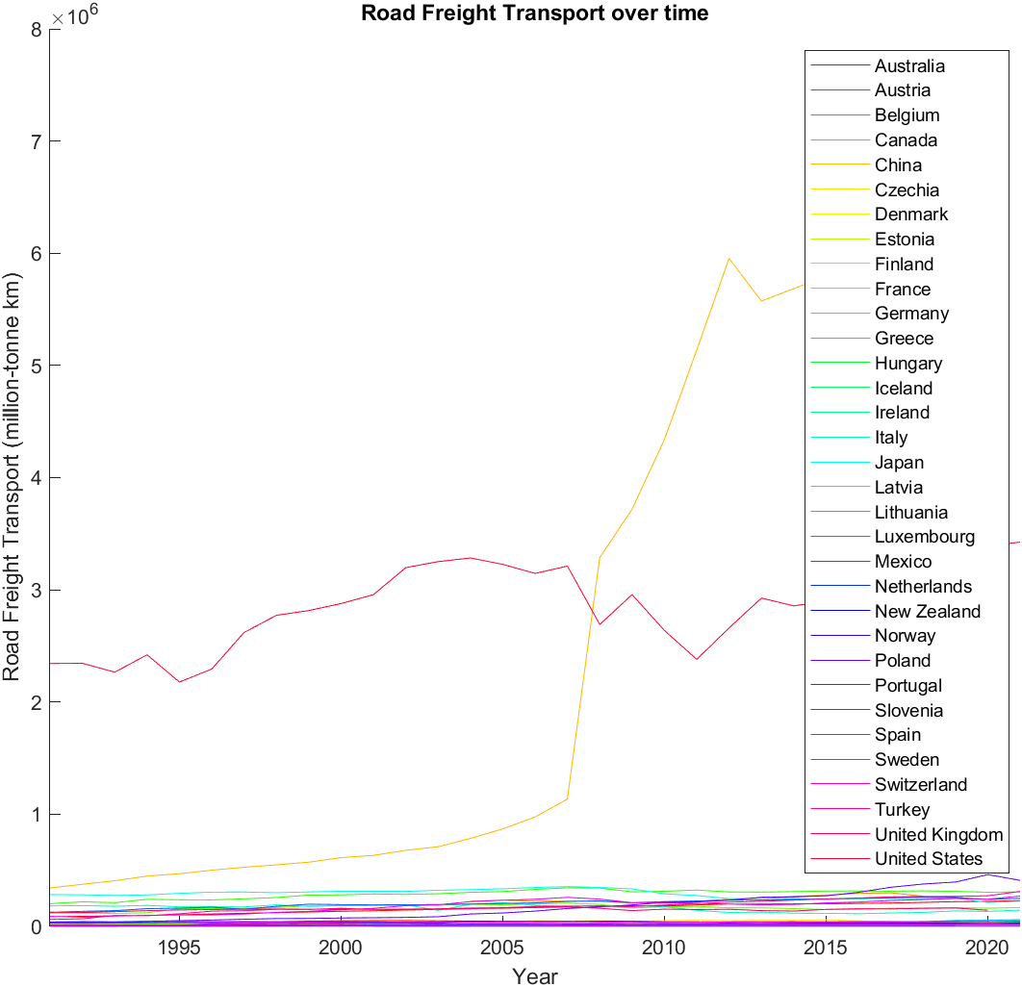
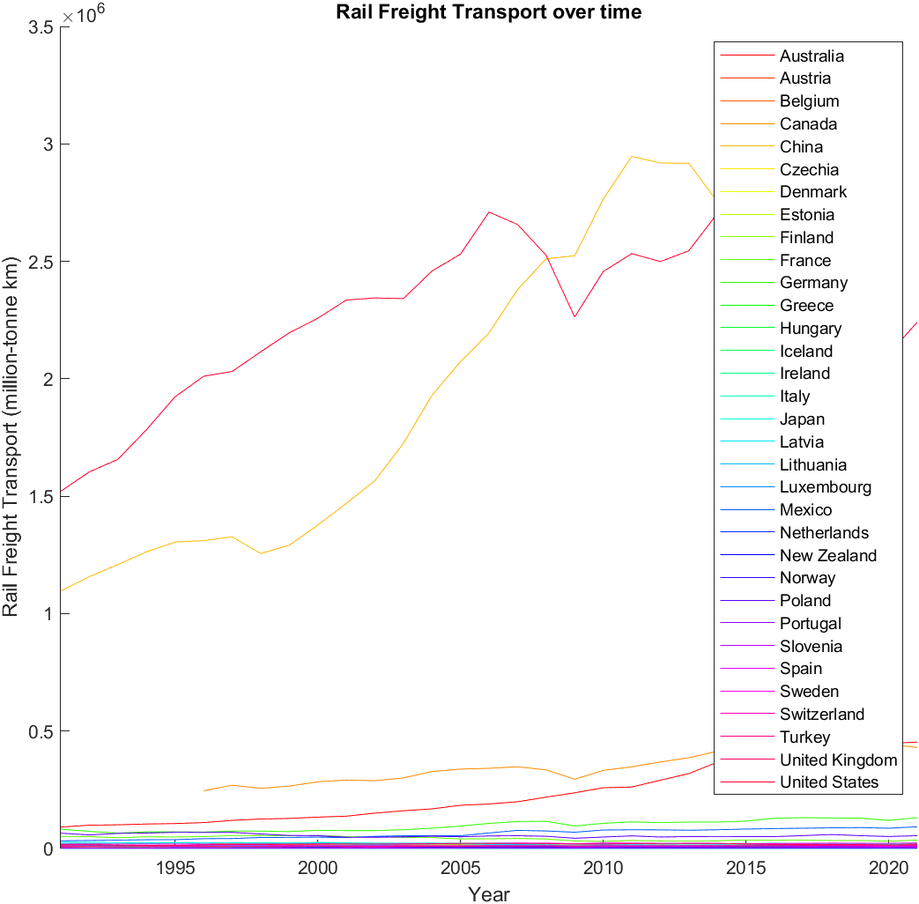
Time Series – Freight
Road Freight Transport
Rail Freight Transport

Slide 12
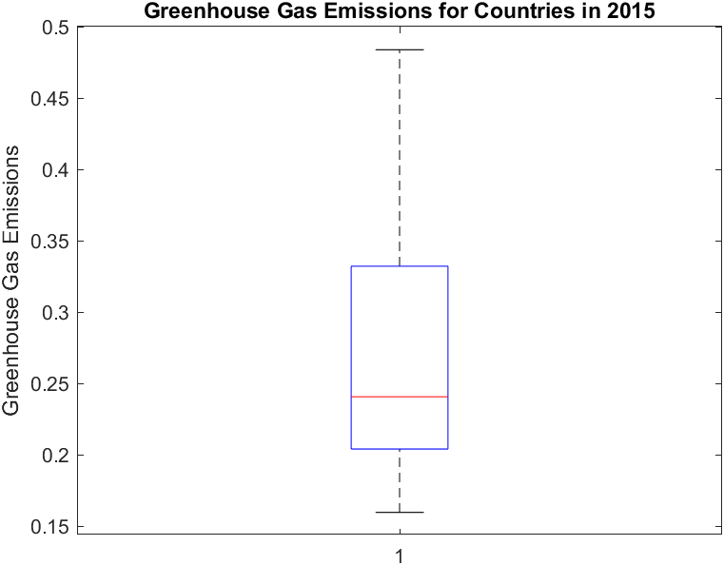
Boxplot of Greenhouse Gas Emissions
There are a few countries that are emitting a major portion of emissions

Slide 13
Correlation Analysis

Slide 14
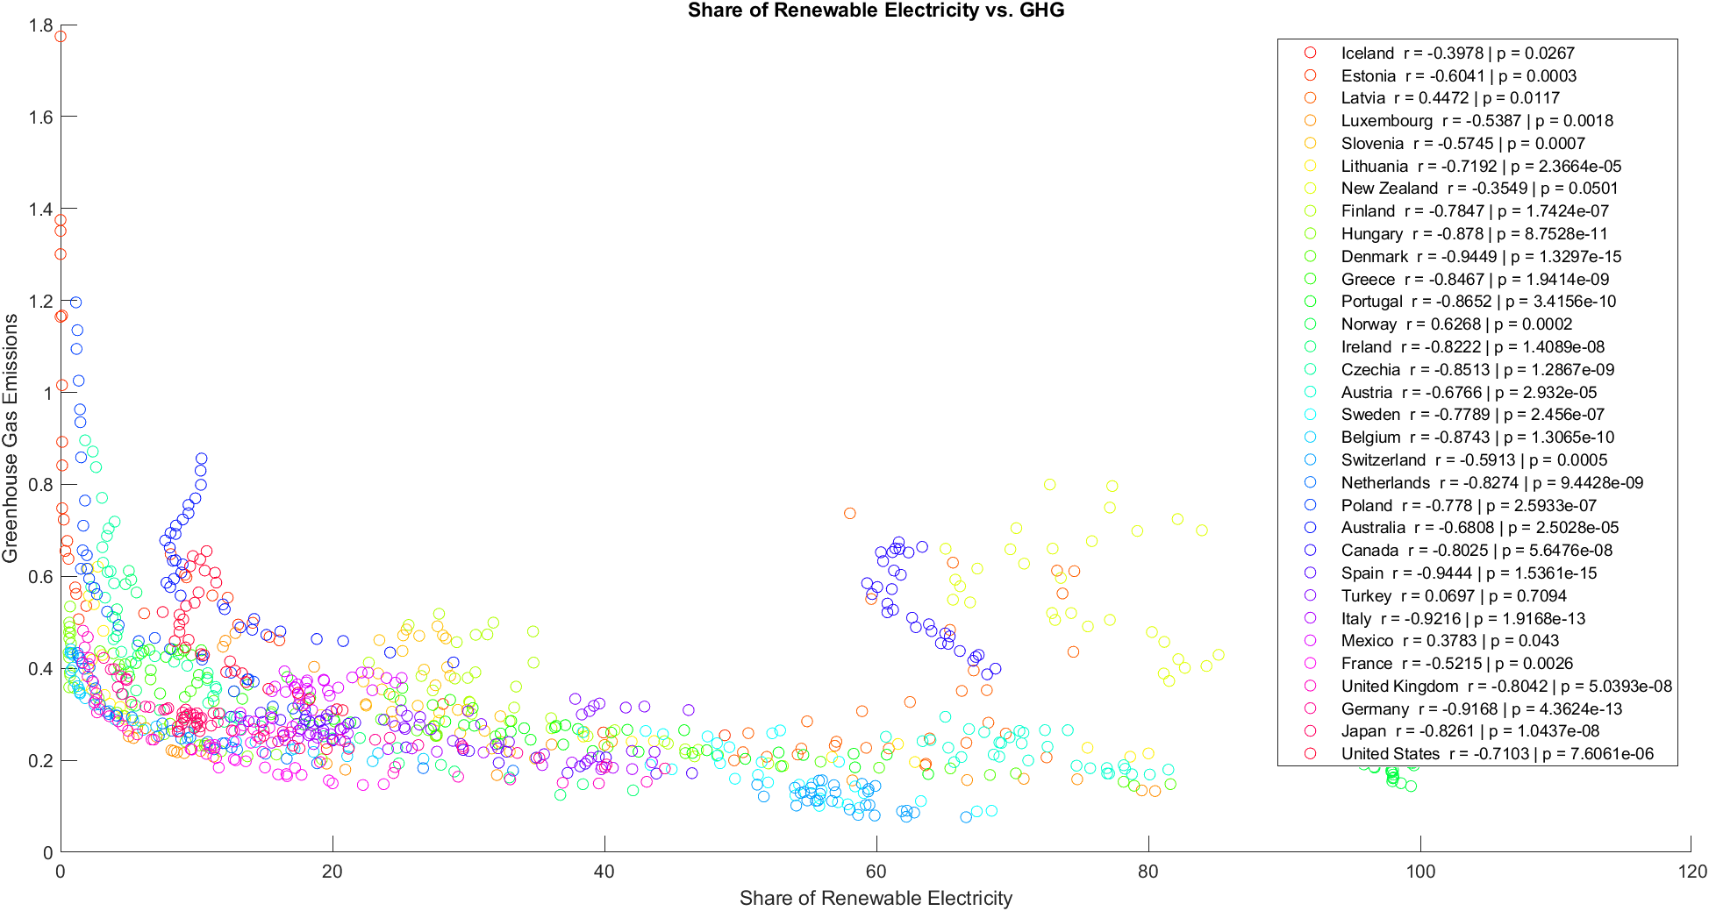
Correlation Analysis of GHG vs. Share of Renewable Electricity
Notes:
R values for most countries are between -.7 and -.95 → as renewable electricity usage grows, greenhouse gas emissions strong negative decrease
Iceland, Latvia, Luxembourg, Slovenia (at lower end of GDP) have low correlation coefficients
For some countries (Mexico and Latvia), there is a very weak positive correlation (r > 0)
Pvals are <0.05 for all

Slide 15
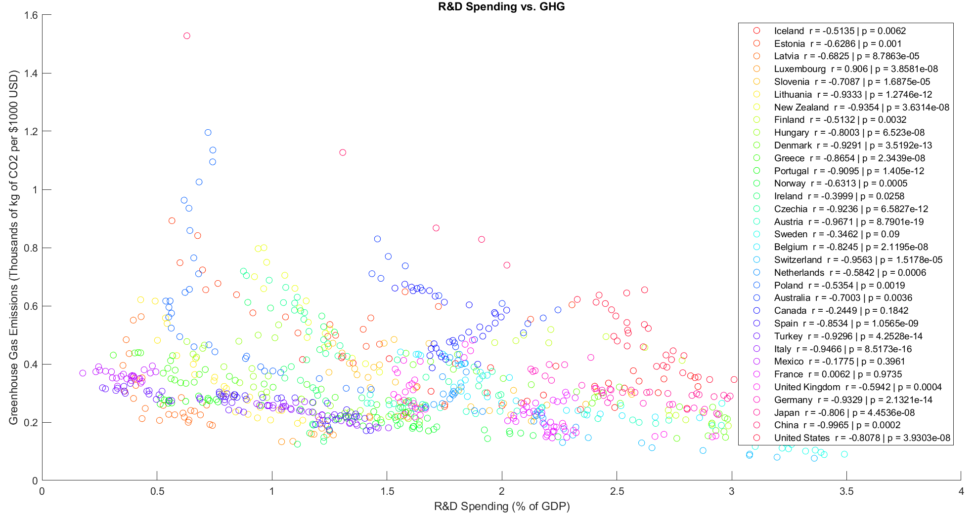
Correlation Analysis of GHG vs. R&D Spending
Notes:
Most correlation coefficients are negative. Variation in being either pretty strong or medium-strength

Slide 16
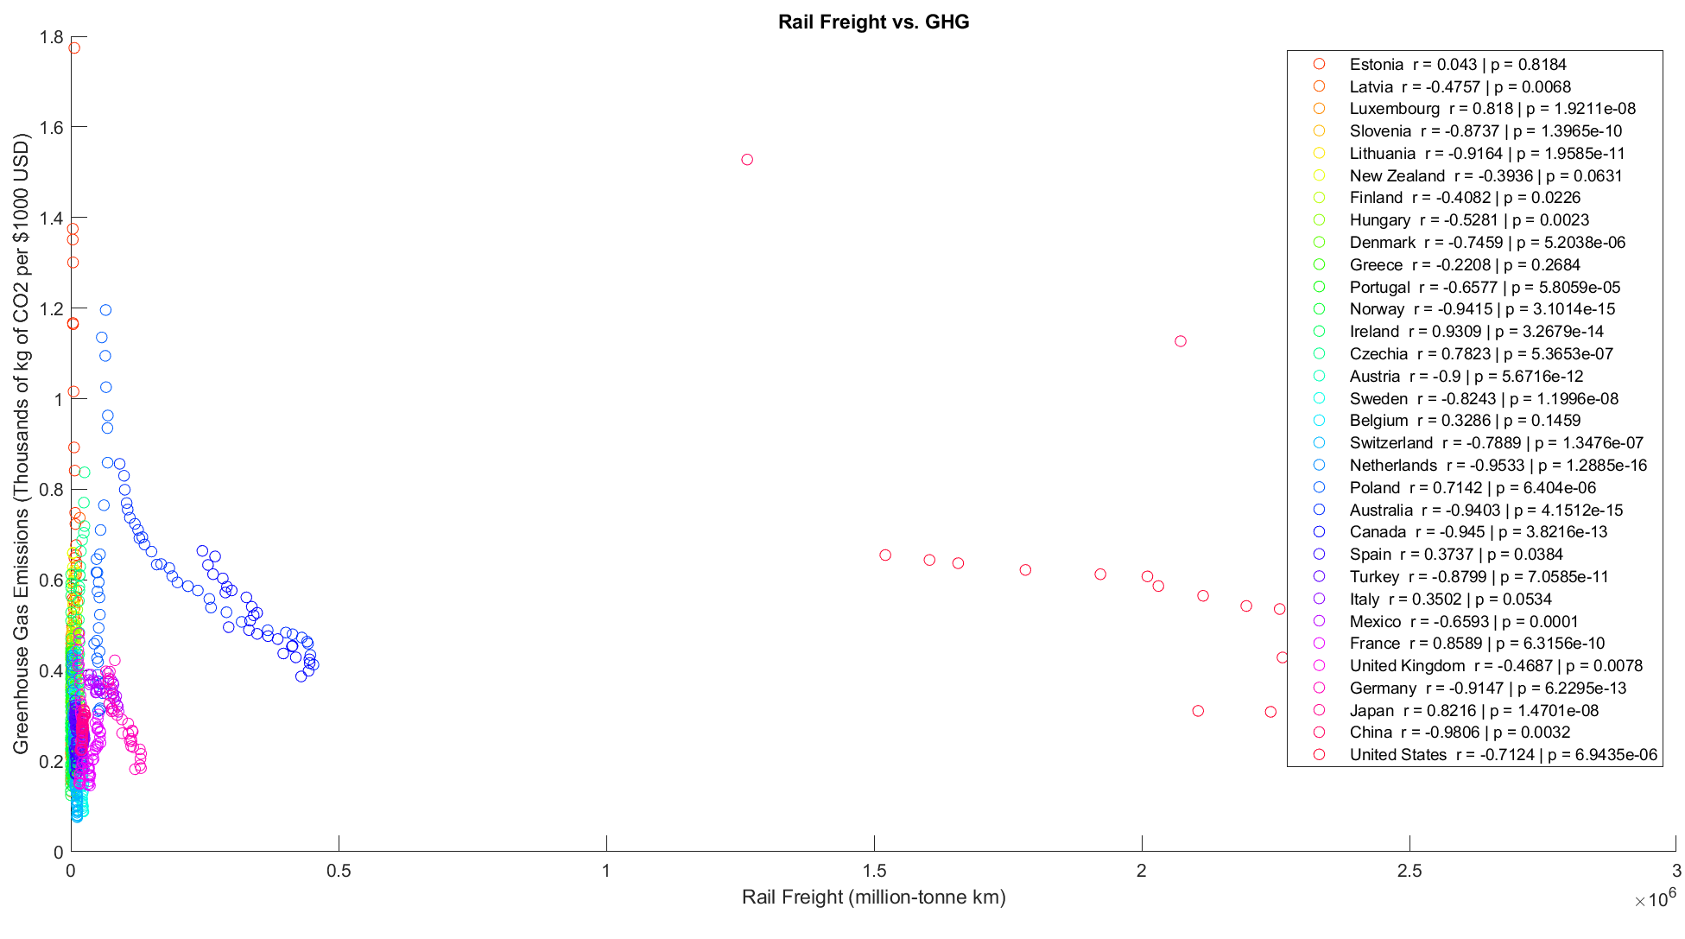
Correlation Analysis of GHG vs. Rail Freight
Notes:
Very weak correlations for most countries. For those who have strong correlations, there are some that are positive (like Japan and France) and some that are negative (like China and Australia)

Slide 17
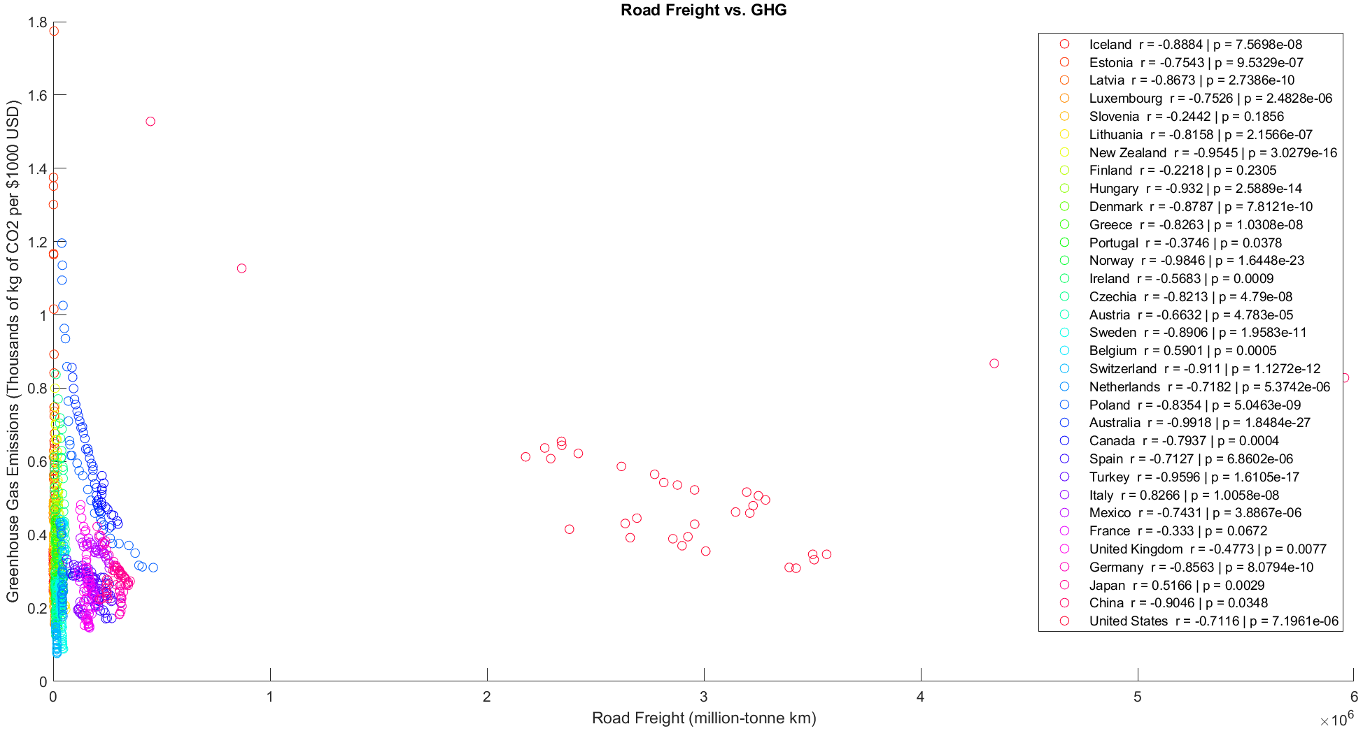
Correlation Analysis of GHG vs. Road Freight
Notes:
Most correlations are negative, variation in strenghts

Slide 18
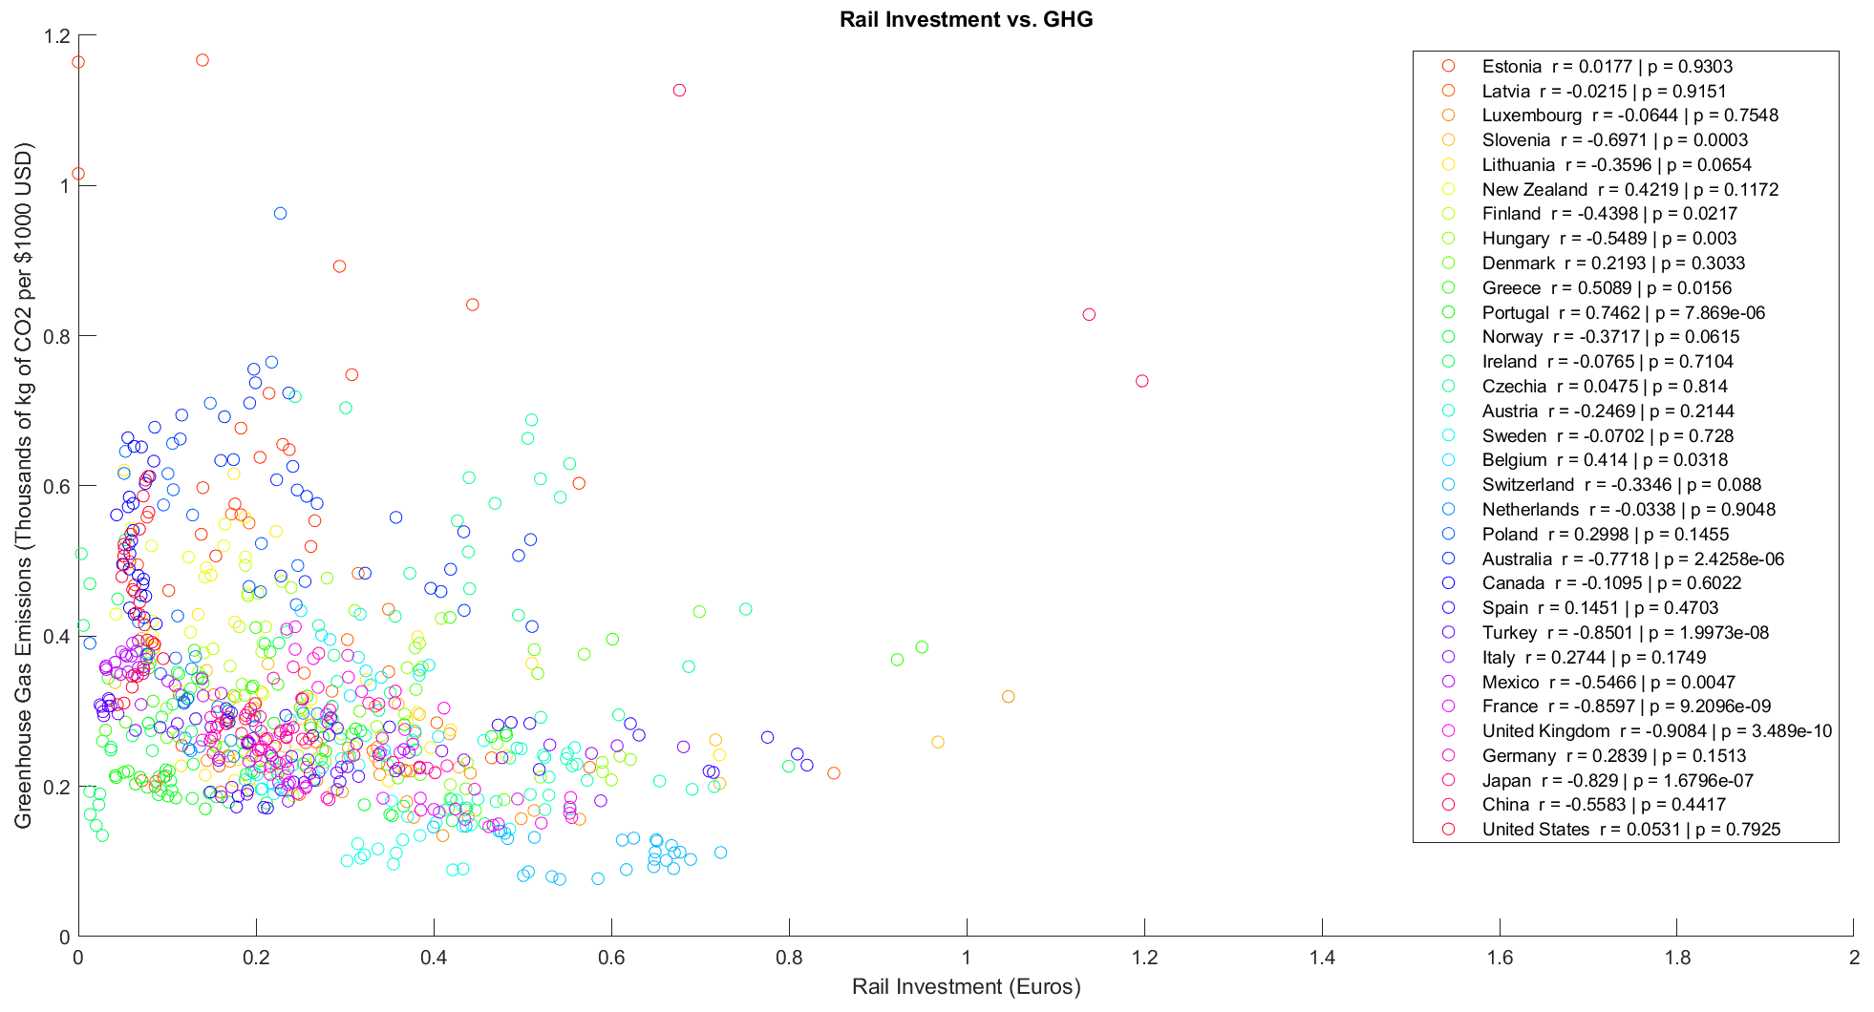
Correlation Analysis of GHG vs. Rail Investment
Notes:
Doesn’t seem to be a dependable correlation – wide fluctuation in r values

Slide 19
Error Analysis

Slide 20
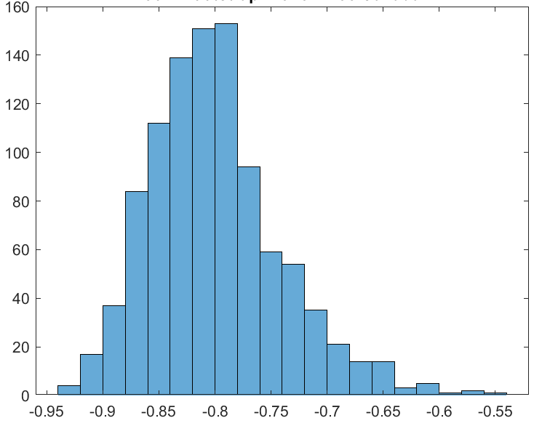
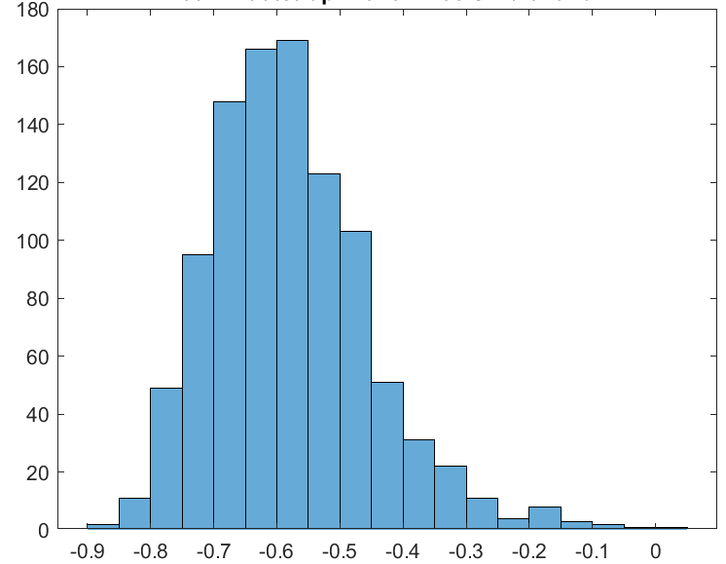
Error Analysis: Bootstrapping Correlation Coefficients
Sample Bootstrap of correlation coefficient for GHG vs. Renewable Electricity Share for Canada:
Sample Bootstrap of correlation coefficient for GHG vs. Renewable Electricity Share for Switzerland:
95% CI: r = -0.91 to -0.69
95% CI: r = -0.83 to -0.33
Notes:
This was done for each country’s correlation of each variable with its GHG
The 95th percent confidence intervals for the correlation coefficients based on the bootstraps having high r values indicates that the correlations drawn are likely justified
The bootstrap is normally distributed
For some countries like Switzerland which have very low GHG to begin with, the correlation is weak because renewElec is increasing but GHG is relatively consistent. Since the low end of CI is 0.33, we can’t say there is a strong correlation

Slide 21
Conclusions – Correlation Analyses
Renewable Electricity and GHG: strong negative correlation for most countries
R&D and GHG: mostly negative correlations that are strong to medium-strength
Rail Freight and GHG: very weak correlations for most countries. Within countries with strong correlations, there are some with negative and some with positive correlations
Road Freight and GHG: mostly negative correlations but variation in strength
Rail Investment and GHG: weak correlations
Bootstraps of the correlation coefficients used to estimate 95% CI
Different countries have different indicators that are most strongly correlated with their GHG emissions.
GDP does not appear to affect the strength of correlations between their GHG and other variables.
Share of Electricity from Renewables had a strong negative correlations across the board – this is an influential factor in helping countries reduce their GHG emissions
Notes:
Checkboxes/Xs indicate whether hypothesis was rejected/supported

Slide 22
Periodograms

Slide 23
Periodograms for Selected Countries
1
2
Common Frequencies across Variables – picked countries with noteable spikes
Economic/Political Factors that may contribute to the existence of that period

Slide 24
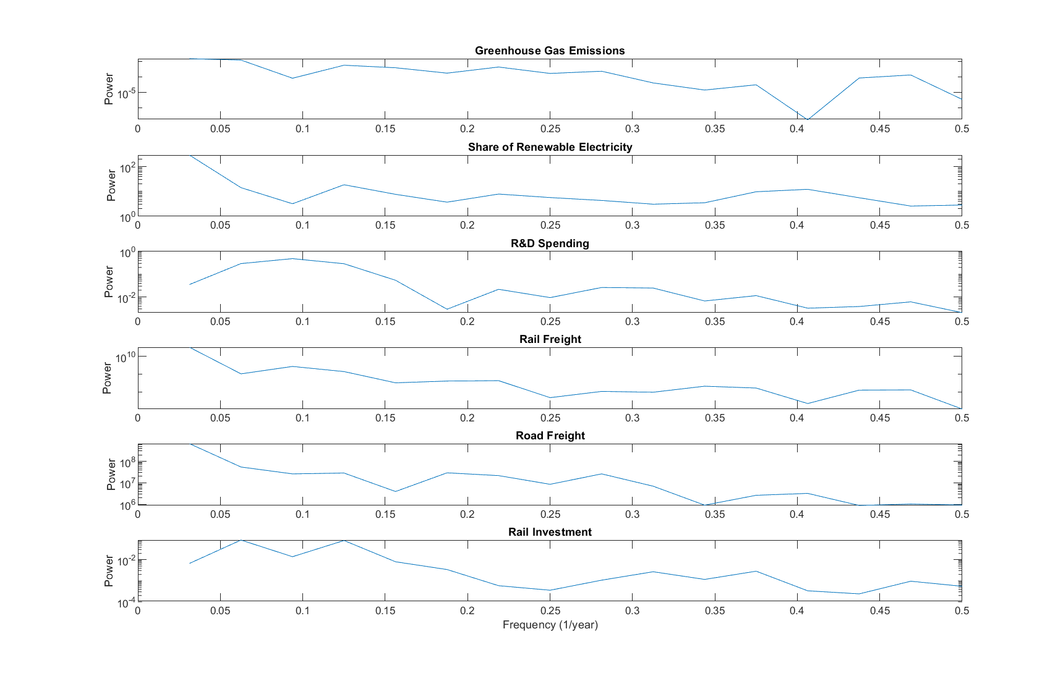
Australia
0.4 Hz → 2.5 years
Notes:
Oceania region
Political/economic cycles? – Australia has 2 and 4 year terms

Slide 25
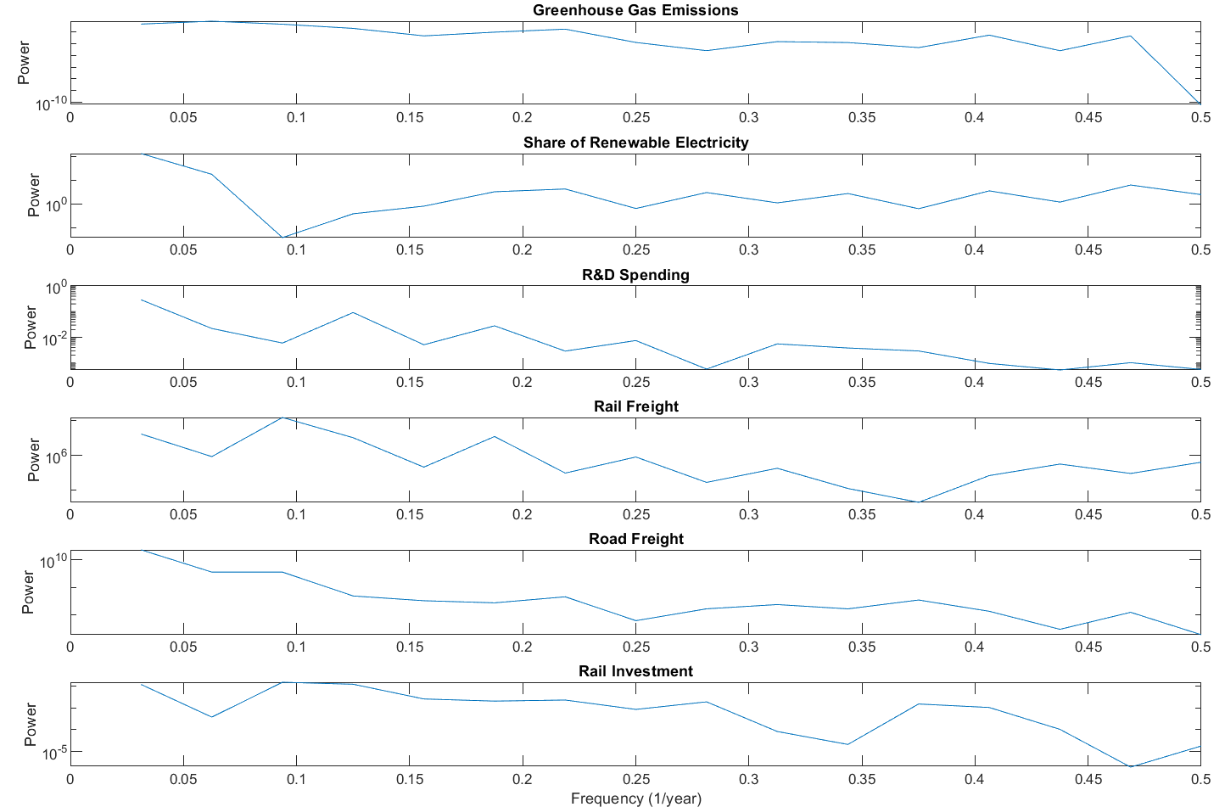
Japan
0.1 Hz → 10 years
Notes:
Japan is known for its efficient rail network. We don’t really see any cycles at the high-end of the frequencies.
For renew-elec and rail freight/inv, there is a min/max frequency at 0.1 Hz → 10 years, but this is very long term

Slide 26
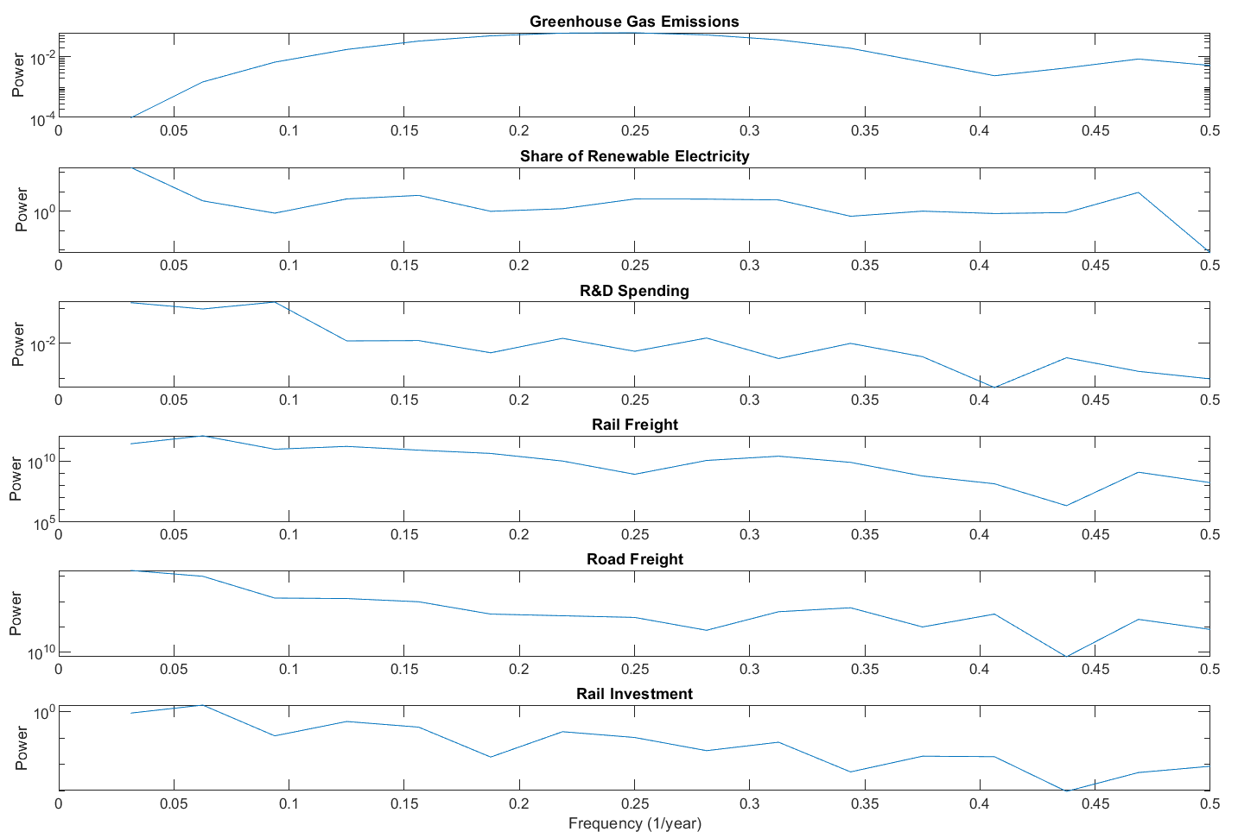
China
Notes:
- One of the highest emitters of GHG, but also lot of rail freight
R & D, Road and Rail Freight, Rail Inv: 0.42-0.44 Hz → 2.2-2.5 years

Slide 27
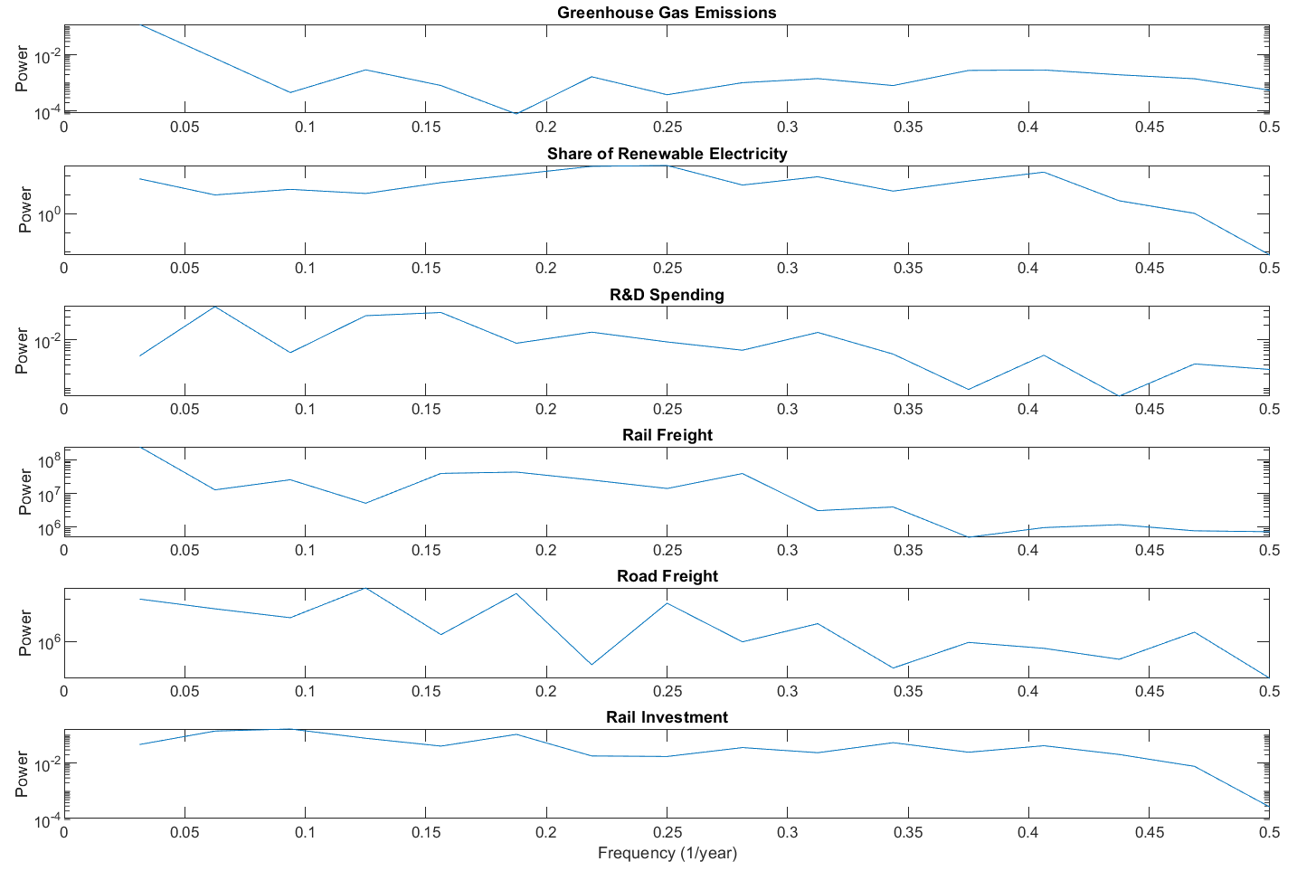
Latvia
No discernable frequencies (noise)
Notes:
Developing economy
Sporadicness of the graphs → noise

Slide 28
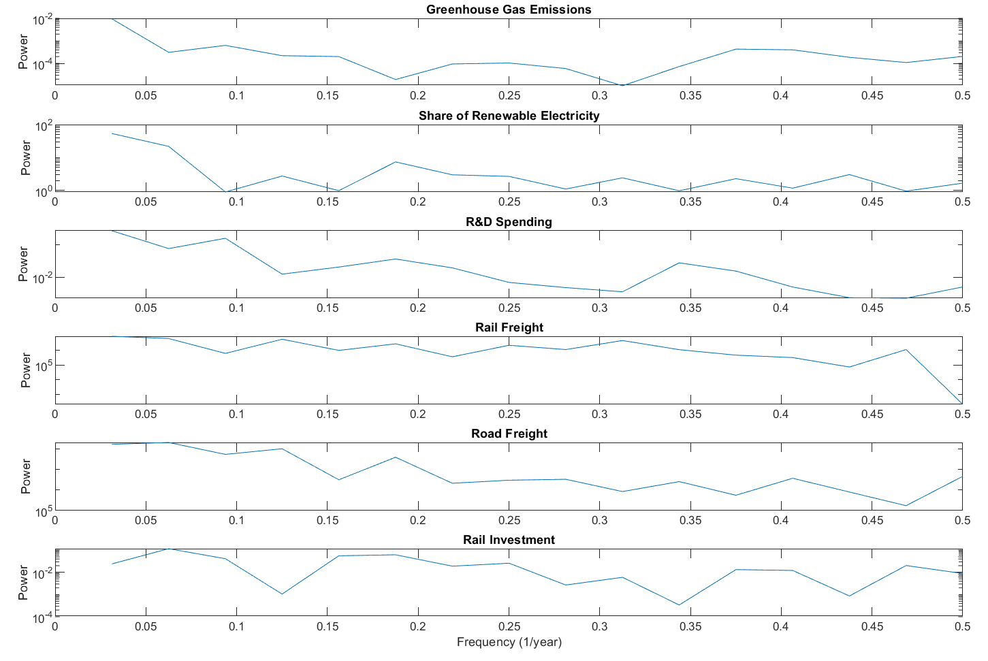
Hungary
No discernable frequencies (noise)
Notes:
Developing economy
Lot of noise

Slide 29
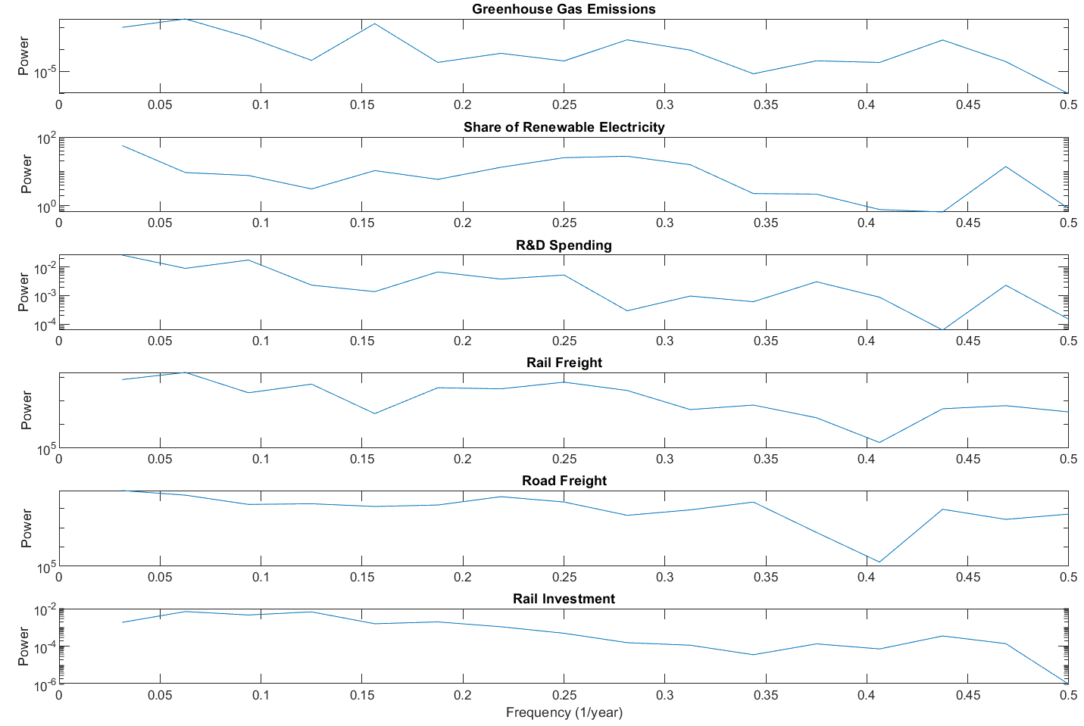
Mexico
Notes:
Mid-GDP
RenewElec, rd, rail and road freight: 0.4-0.45 Hz → 2.2-2.5 years

Slide 30
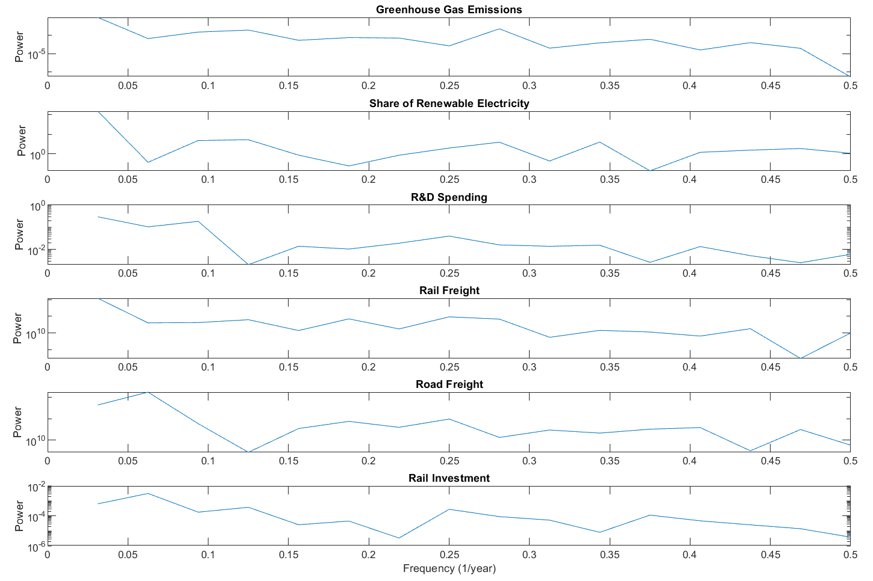
United States
0.06 Hz → 16 years
Notes:
renewElec, roadfreight at 0.06 Hz → 16 years
NA: Rd and road freight: .125 Hz → 8 years → political cycles and budgeting?

Slide 31
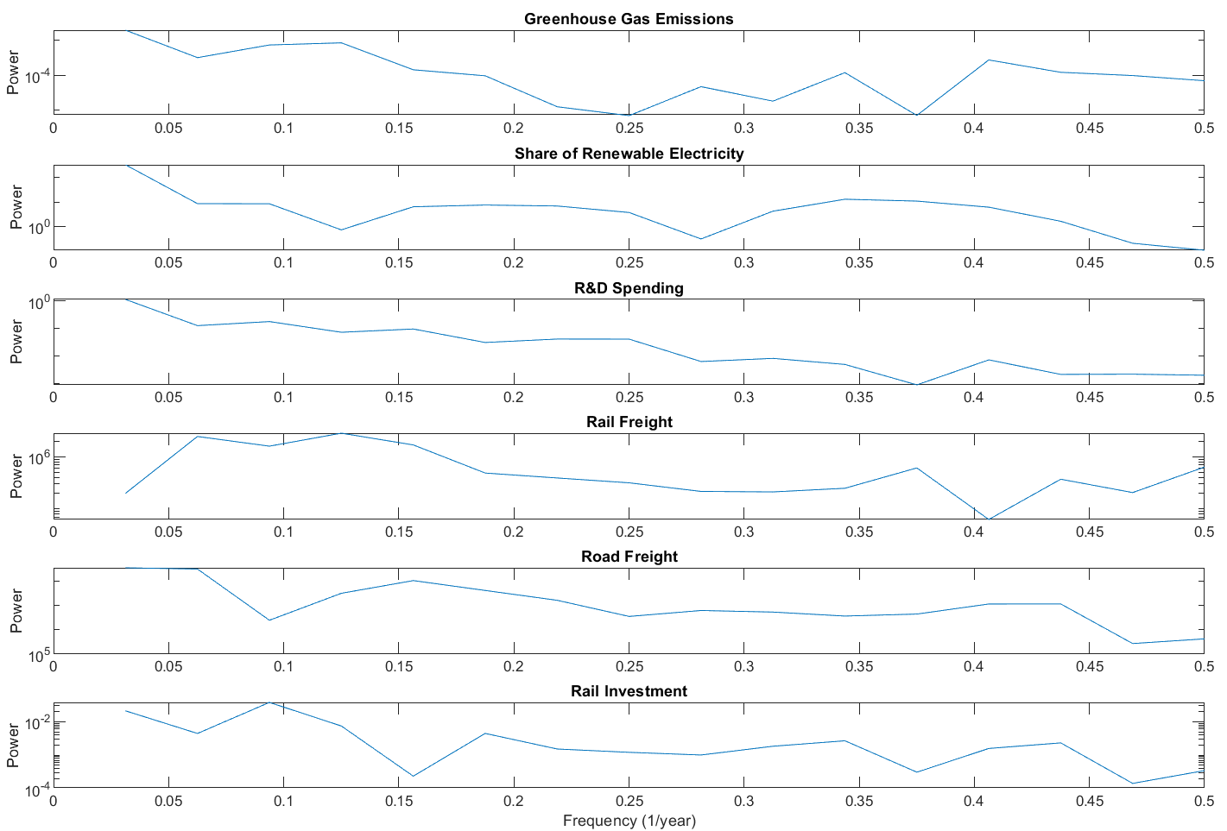
Belgium
Notes:
Most: 0.38-0.42 Hz → ~2.5 years

Slide 32
Conclusions - Periodograms
While some countries have noticeable signals at frequencies, many do not
The significant changes in these variables are continuous and long-term, rather than sporadic and from singular/short-term events
Some common periods observed are around 3-4 years. Further investigation is necessary to determine what these could be attributed to
Potentially political/economic factors since many countries have elections every 4 years?
Signals signifying longer periods (8-10 years) in categories like Renewable Electricity and Rail Density could potentially be representative of the long-term efforts necessary for energy/infrastructure development
Reject hypothesis: based on these results, it is unlikely that we can predict future trends in greenhouse gas emissions of countries based on the examined factors

Slide 33
Limitations
Greenhouse gas emissions are, in reality, impacted by a multitude of factors which were not looked at here
There could be cofactors in the correlations observed between variables
SVD could be used to address this source of error
The scope of countries examined is relatively narrow due to lack of data for many non-European countries and countries with developing economies

Slide 34
Questions?

