Slide 1
Seasonality of
Ozone & PM2.5
+ Wind’s role!
Kathleen Griffin

Slide 2
01
Introduction

Slide 3
Background: OZONE V. PM2.5
Ozone: Peaks in Summer
PM2.5: Peaks in Winter
As wind’s are stronger, pollutant concentrations are more dispersed, so as wind speed increases, pollutant concentrations should decrease.

Slide 4
HYPOTHESIS: OZONE V. PM2.5
Focus: Atlanta Area
Daily wind speed data from NOAA
Daily AQI for Ozone & PM2.5 data from the EPA
Period: 2000-2024
Are Ozone and PM2.5 truly different seasonally? Does wind play any significant part to this?
HYP: Ozone and PM2.5 should have 180 degree phase lags, and be negatively correlated with wind speed.

Slide 5
Analysis METHODS
PERIODICITY
CPSD & Coherence
I performed this on both the wind, pm 2.5, and the ozone data, to find trends in period. The hypothesis is that they will have yearly cycles as Ozone usually peaks in the Summer and PM2.5 peaks in the winter.
I used this to compare the time series of wind and ozone, as well as wind and pm2.5. This will show where they overlap, and how strong this overlap is. I’ll also be able to see any phase lags, and if wind and strong concentrations of pollutants share yearly cycles.

Slide 6
Analysis METHODS
Correlation
I performed this with wind speed and the different air pollutants, to see if there was any direct correlation. According to my hypothesis, there should be a negative correlation.

Slide 7
02
Results

Slide 8
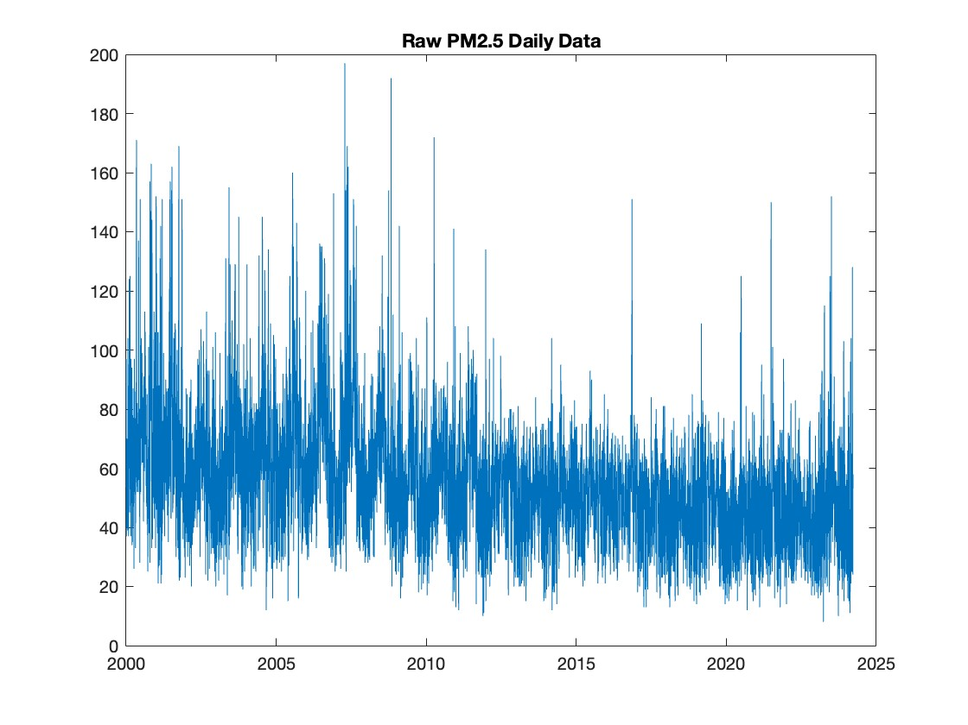
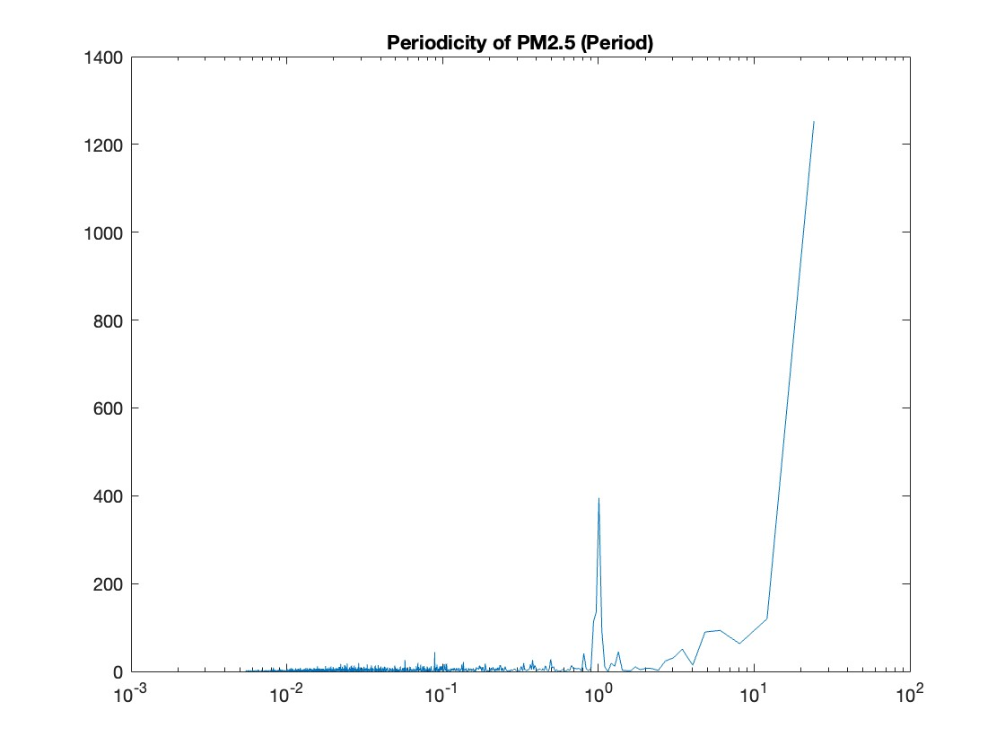
Raw PM2.5 Data

Slide 9
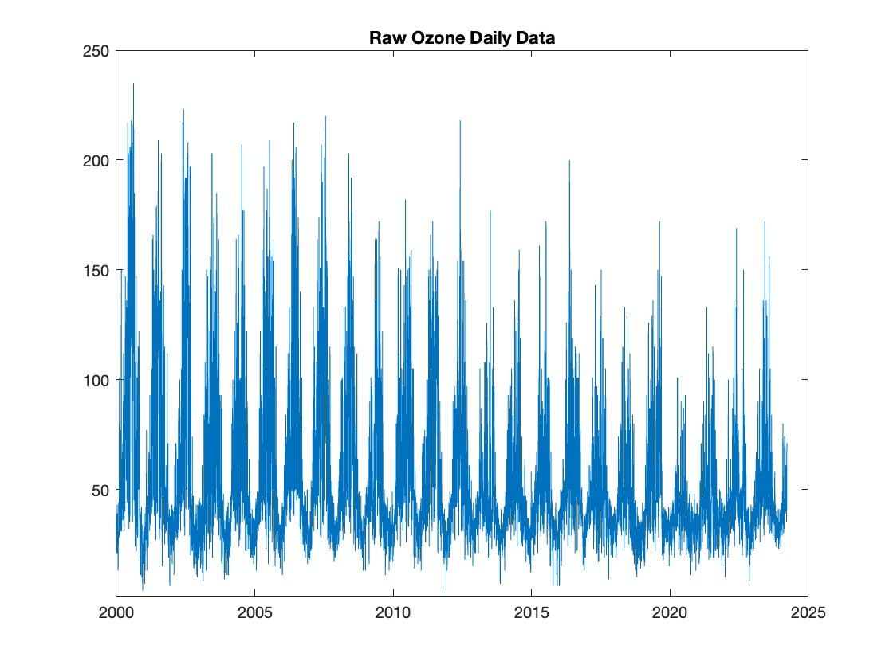
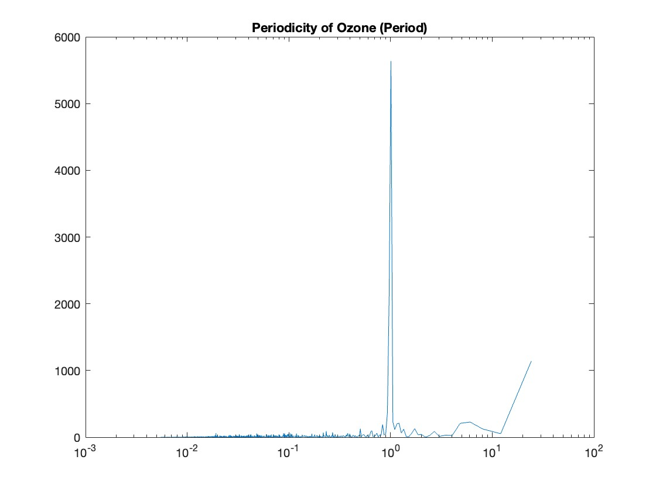
Raw Ozone Data

Slide 10
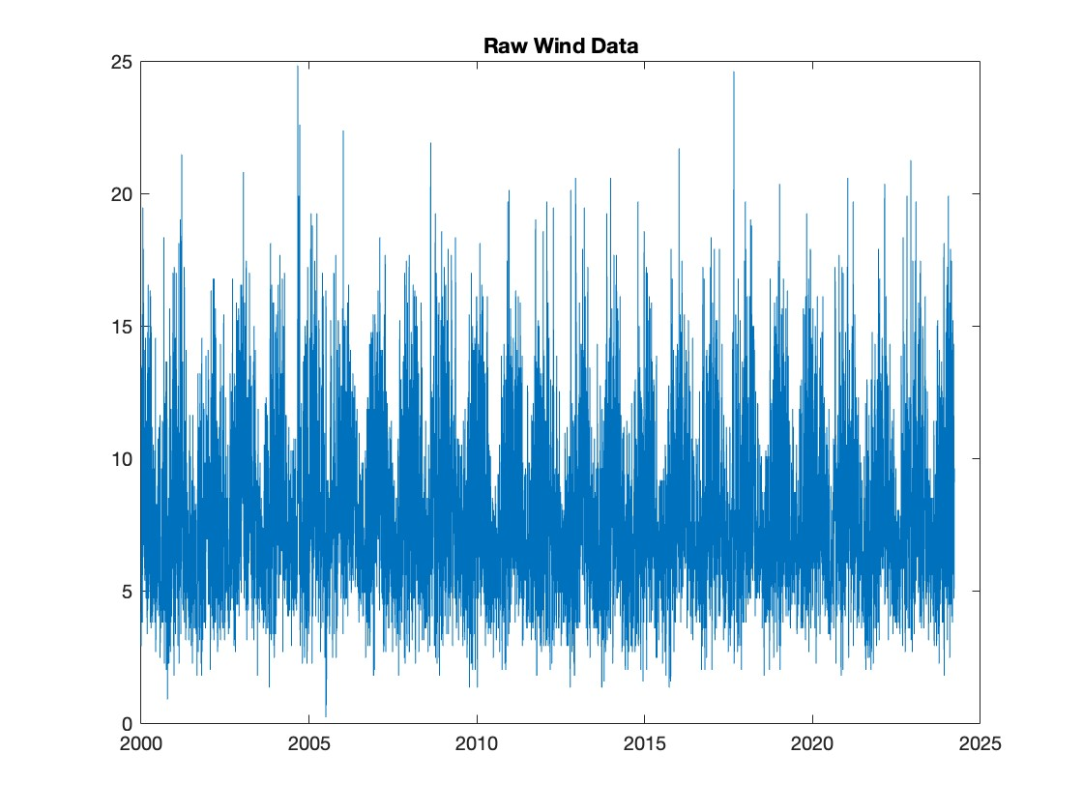
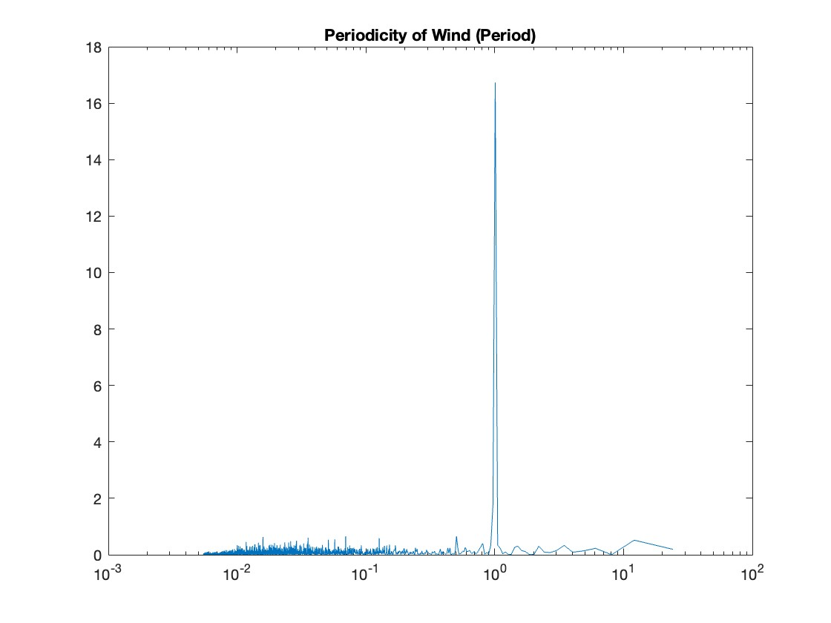
Raw Wind Data

Slide 11
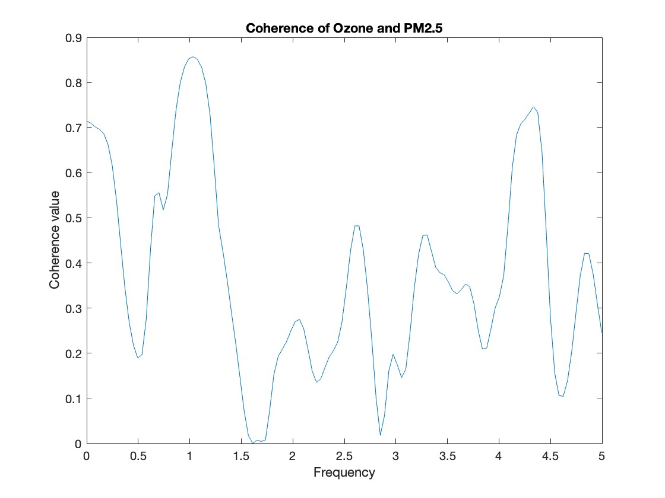
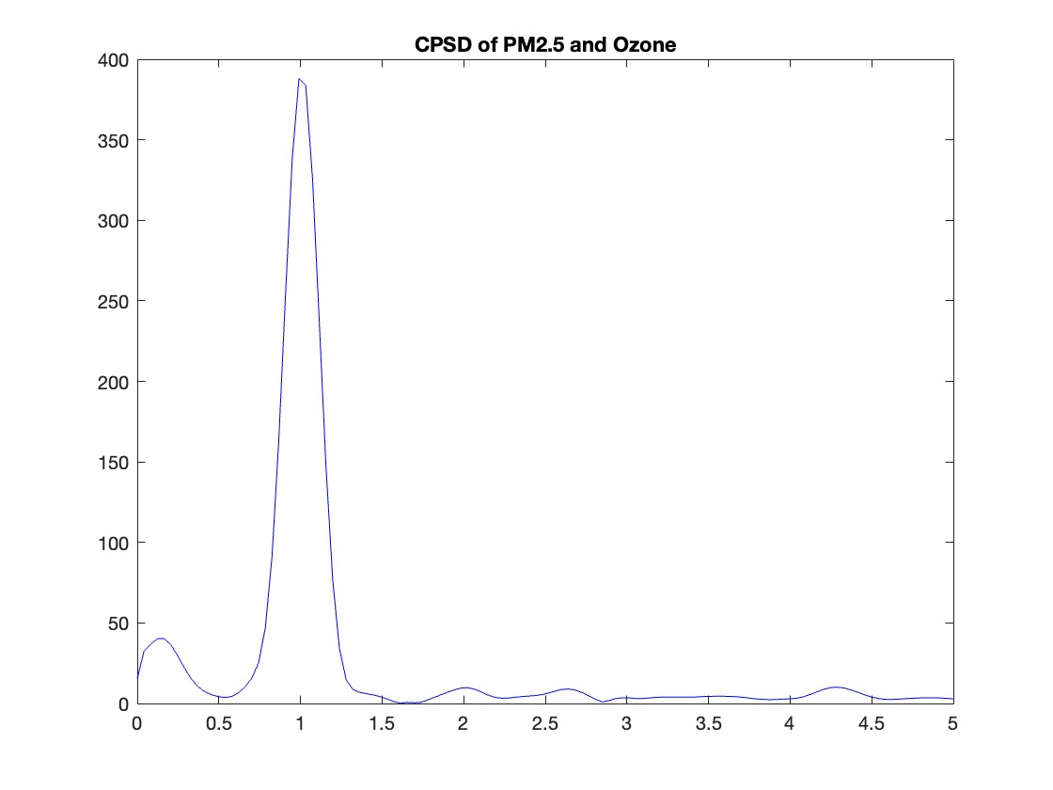
CPSD PM2.5 & Ozone
Cross PSD as a function of periodicity shows both datasets share a major periodicity of 1 year
Phase angle at 1 cycle per year frequency is -33.13
Phase time lag is -.092years
PM2.5 lags behind Ozone by 33.6 days, so the difference isn’t as stark as seasonally would suggest.
Coherence at 1 cycle per year frequency is 0.86
Relatively high r-squared value at dominant frequency – the yearly cycles of the two datasets line up very closely

Slide 12
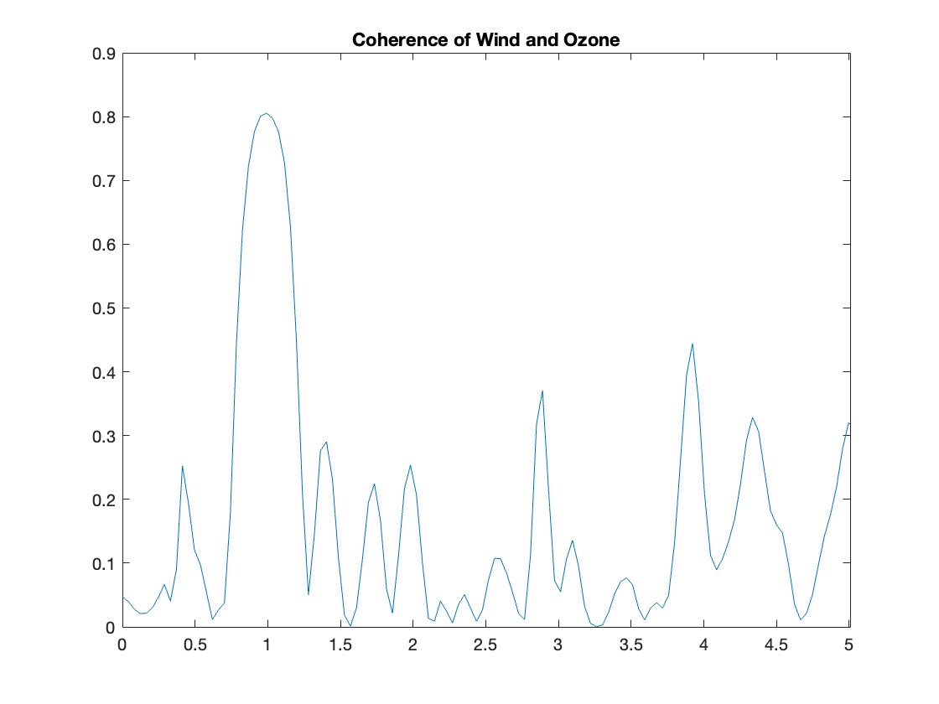
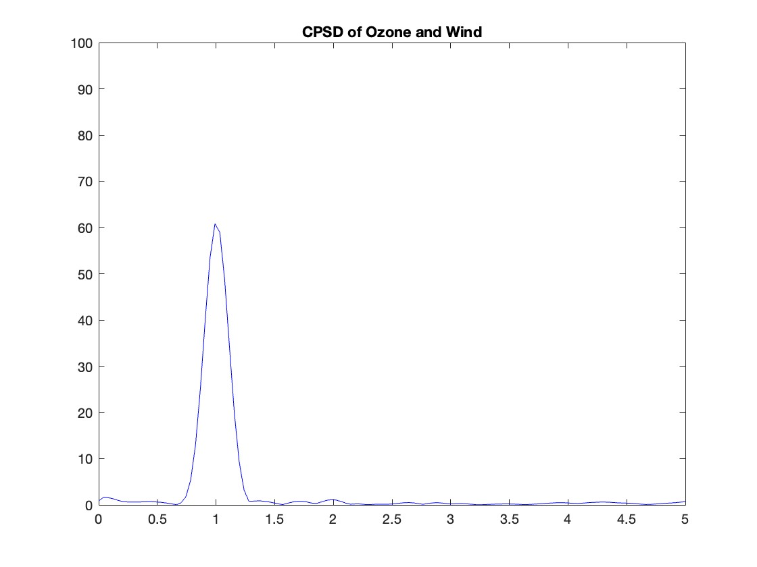
CPSD Wind & Ozone
Cross PSD as a function of periodicity shows both datasets share a major periodicity of 1 year
Phase angle at 1 cycle per year frequency is -137.99
Phase time lag is -.3833 years
Ozone lags behind wind by 140 days, so although they have similar yearly cycles, they’re almost opposite seasons.
Coherence at 1 cycle per year frequency is 0.8
Relatively high r-squared value at dominant frequency – the yearly cycles of the two datasets line up very closely

Slide 13
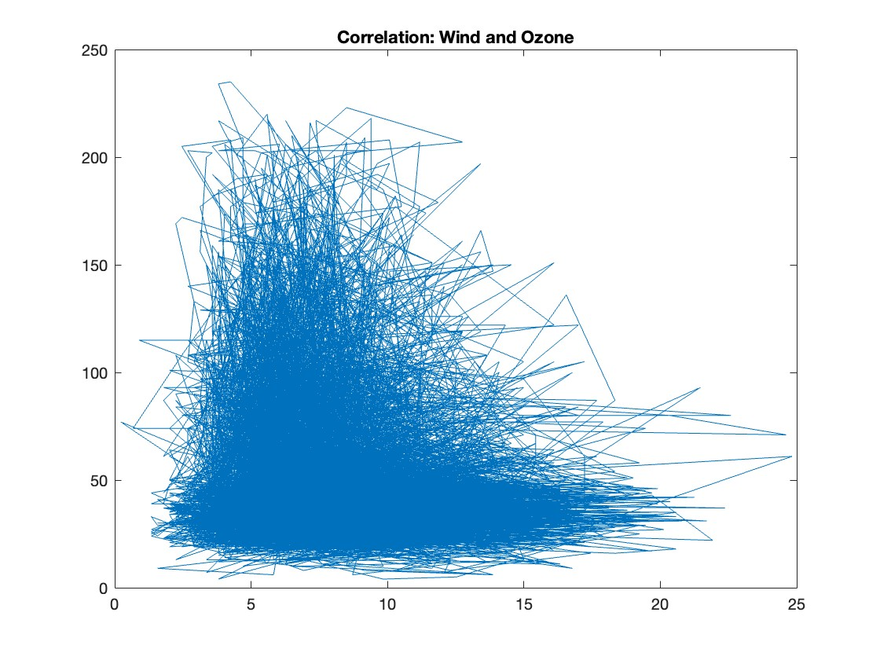
Correlation: Ozone
Correlation was slightly negative: -.1078
Rlow = -.12
Rhigh = -.08
Pvalue = 0
Shows correlation

Slide 14
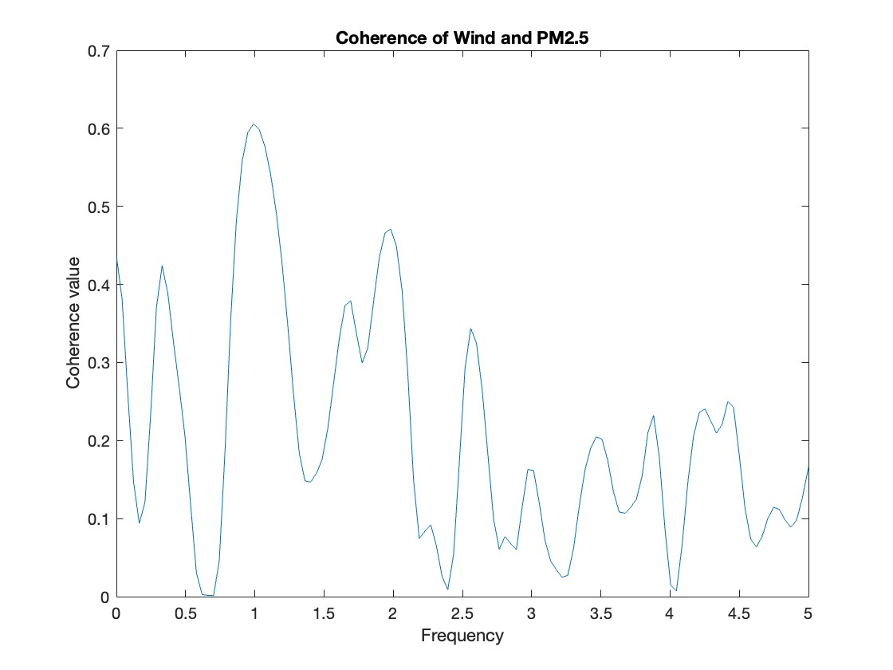
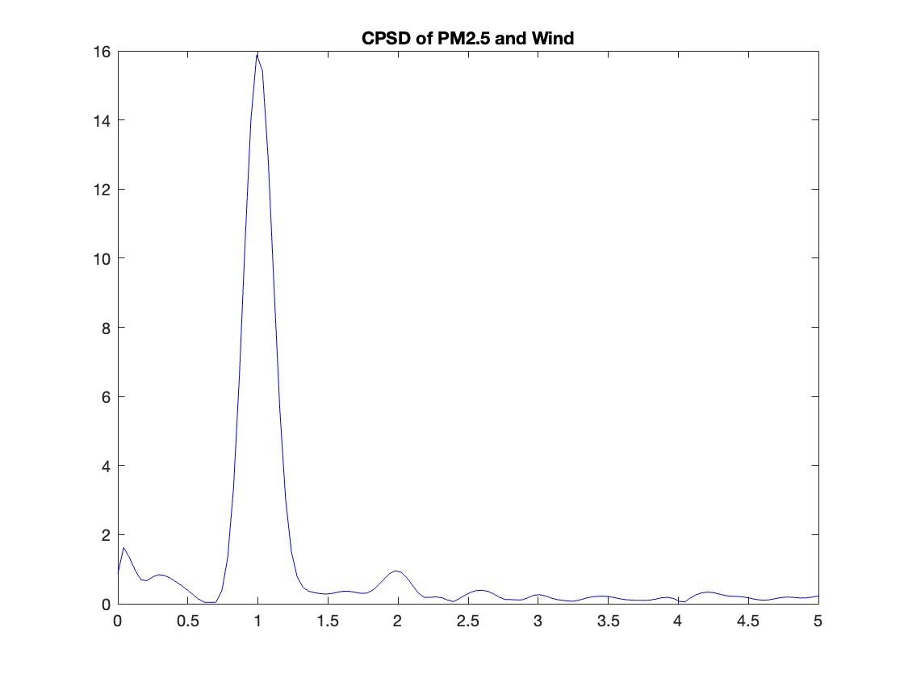
CPSD Wind & PM2.5
Cross PSD as a function of periodicity shows both datasets share a major periodicity of once a year.
Phase angle at 1 cycle per year frequency is -174 degrees
Phase time lag is -.4853 years
PM2.5 lags wind speeds by 177 days.
Coherence at 1 cycle per year frequency is .6
Much lower coherence- the yearly cycles of PM2.5 and wind don’t align as well as the Ozone and wind levels, but it’s still a significant alignment. Almost exactly 180 degrees shows that they are seasonal opposites: Wind speeds are high one season, PM2.5 is high the other.

Slide 15
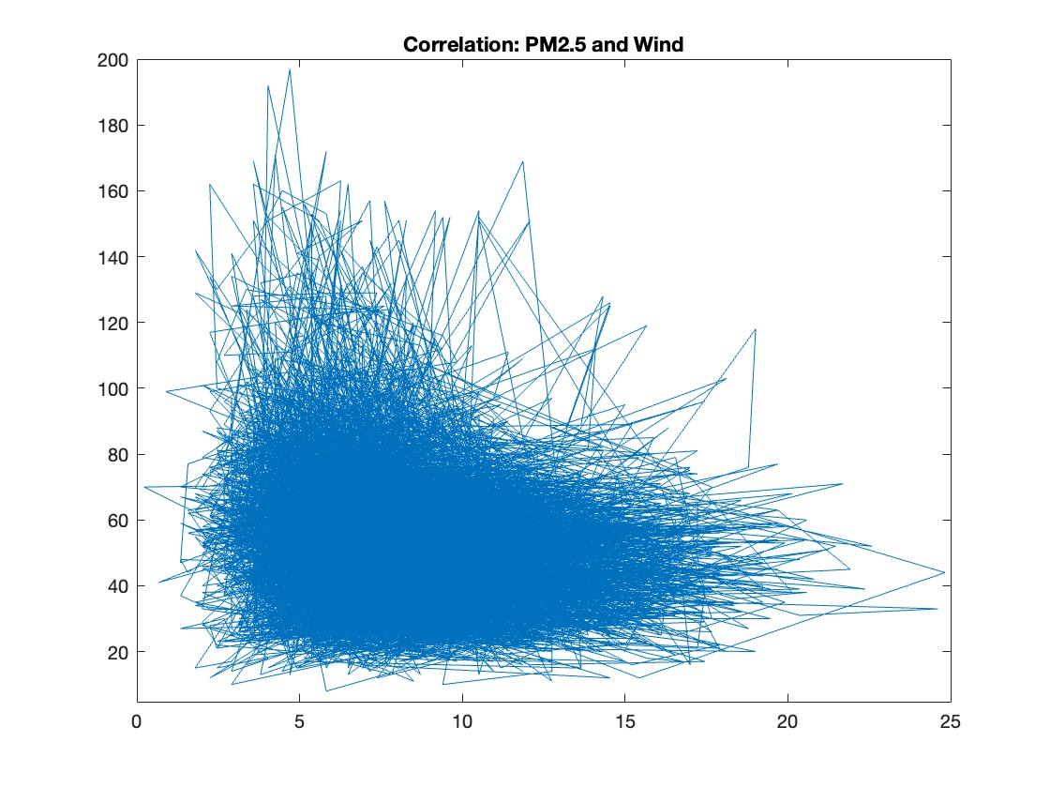
Correlation: PM2.5
Correlation was slightly negative, but far to small to be significant: -.1716
Error:
Rlow = -.1918
Rhigh = -.1513
Pvalue = 0
Shows Correlation

Slide 16
03
Conclusions

Slide 17
Both Ozone and PM2.5 vary seasonally, although not as opposite as once thought.
Wind is negatively correlated with both PM2.5 and Ozone

Slide 18
Analysis Conclusions
Phase Lags
While wind, ozone, and pm2.5 all have very similar yearly cycles, these cycles have significant phase lags, showing differences between seasons.
Correlation
Wind is correlated with PM2.5 and Ozone concentrations significantly, and they have similar yearly cycles
Future Research
Work with hourly data instead of daily, focusing just on summer or winter data to see wind’s effect more clearly.

Slide 19
Sources
https://www.ncdc.noaa.gov/cdo-web/confirmation
https://www.epa.gov/outdoor-air-quality-data/air-data-multiyear-tile-plo
https://www.ncbi.nlm.nih.gov/pmc/articles/PMC5750928/#:~:text=As%20shown%20in%20the%20figure,35%2C36%2C37%5D.t
https://earthobservatory.nasa.gov/features/ChemistrySunlight/chemistry_sunlight2.php#:~:text=The%20highest%20ozone%20concentrations%20of,x%20and%20VOCs%20also%20rise.
https://www.ncbi.nlm.nih.gov/pmc/articles/PMC8656694/#:~:text=In%20both%20cities%2C%20PM2.5,closely%20related%20to%20O3.

