Slide 1

Comparison of Estuary Inflow & Nutrients
Cecilia Guterman
EAS4480

Slide 2

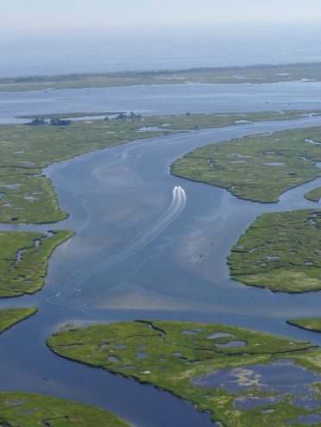
UNDERLYING SCIENCE
  Estuary - where a river (freshwater) meets the sea (saltwater) (x)
  Inflow - incoming freshwater to the estuary
  It is thought that inflow is an important source of nutrients to estuaries
    One experiment found a correlation between inflow and phytoplankton (x)
  Nitrogen, bioavailable as nitrite and nitrate, is a major nutrient needed for photosynthesis
  Given all this, I wanted to see if I could find a statistical correlation between inflow and nitrogen concentrations in an estuary

Slide 3

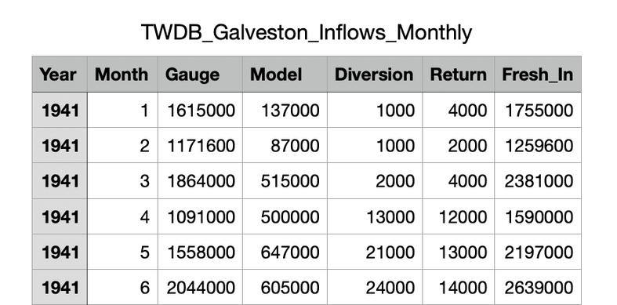
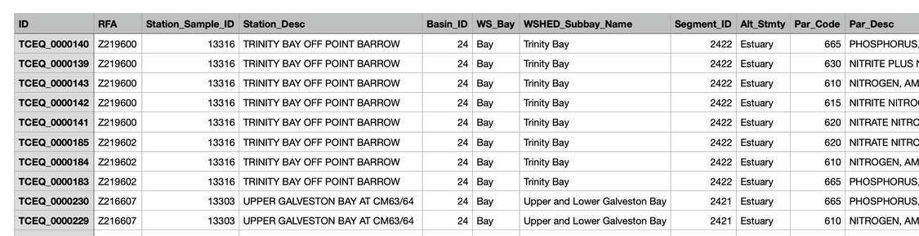
DATA
  Galveston Bay Regional Monitoring Database
  Inflows: Monthly values in acre-feet going back to 1941
  Nitrogen: Nitrite + Nitrate (mg/L) (and some other values) in mg/L at irregular intervals going back to 1969

Slide 4
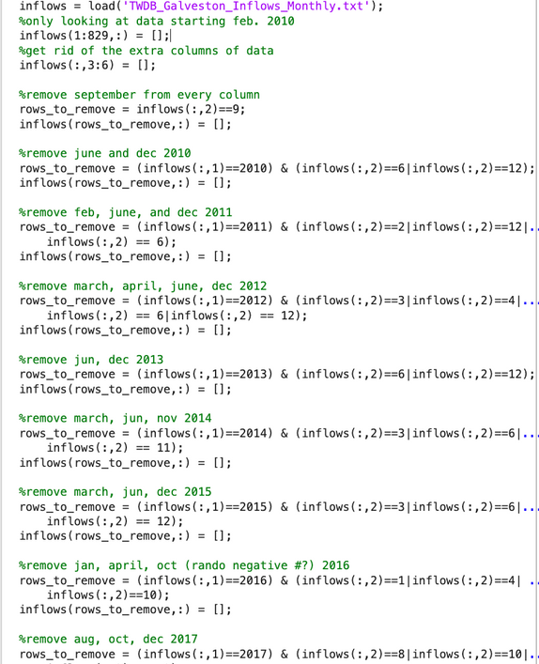
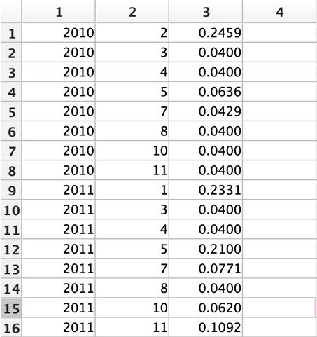
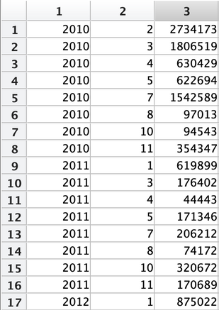
DATA - MAKING IT USABLE
  Removed data from before 2010
  Nutrients
    Removed non-Nitrogen measurements
    Removed data from sites not within the estuary
    Calculated a monthly mean (for every month that there was data)
  Inflows
    Removed months that did not have nutrient data

Slide 5
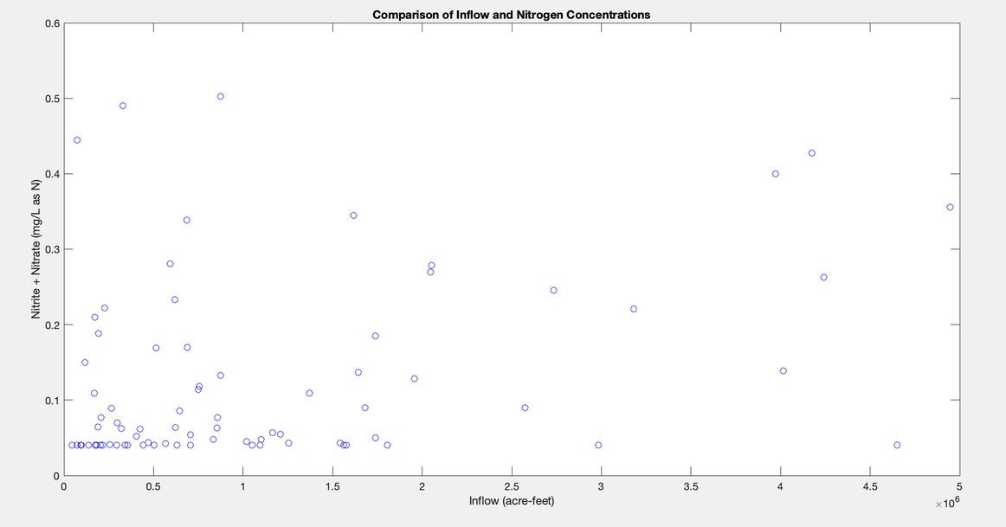

STATISTICS: CORRELATION TEST
  Calculated the Pearson Correlation Coefficient to test the linear relationship between inflow and Nitrogen
  Found that r = 0.3355, meaning there is a medium positive correlation between the two variables (0.3 < r < 0.5)
  Found that p = 0.0027 (p < 0.05), so the correlation is significant
  Confidence interval of r = 0.1220 to 0.5192

Slide 6
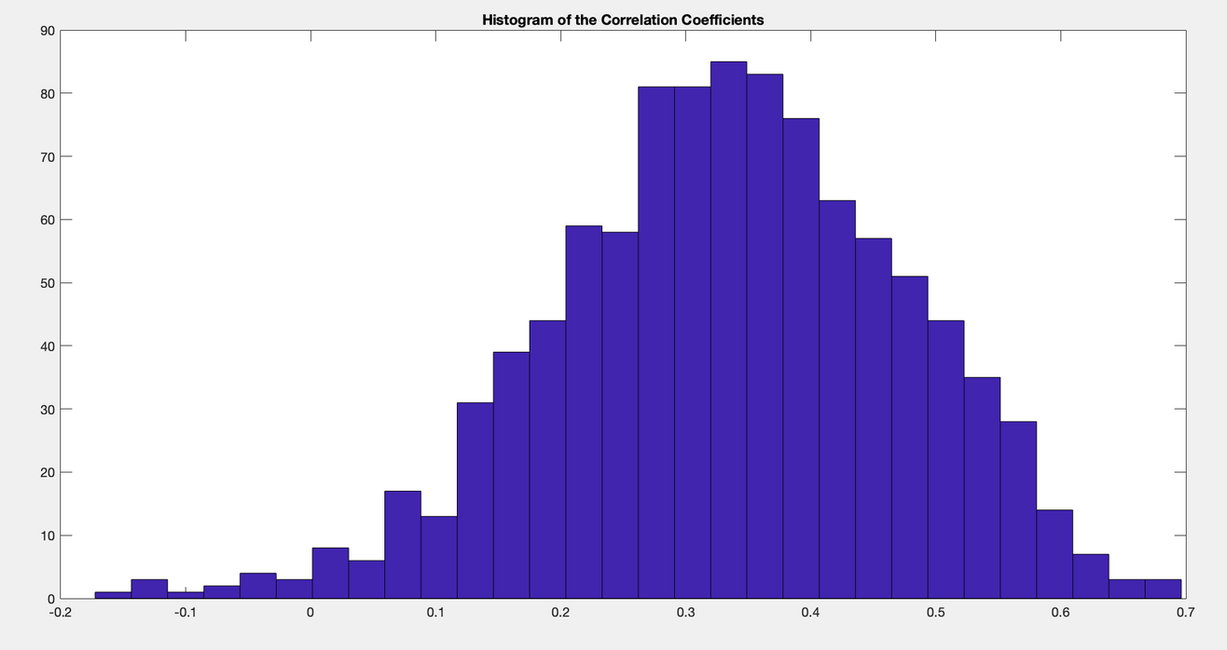
STATISTICS: BOOTSTRAP
  Uncertainties
  Mean = 0.3440

Slide 7
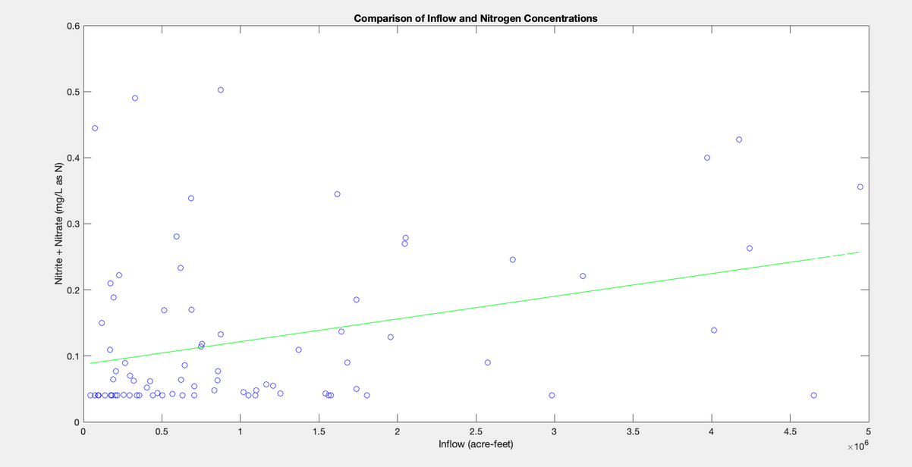
CONCLUSIONS
  There is a positive correlation between inflows and nitrogen concentrations in the Galveston Bay estuary
  Correlation does not mean causation
    Cannot conclude that the increase in nutrients are due to inflows
    Future Analyses
    Periodicity -> Is there a connection between
    month/season and inflows/nutrients?

Slide 8
Questions?

