Slide 1
Comparing Host Star Metallicity, Age, and Exoplanet Population
Maci Harrell
EAS 4480

Slide 2
TERMINOLOGY
Metallicity
Age
Population
Measure of the amount of elements heavier than hydrogen and helium present in a star; usually measured as the iron-to-hydrogen ratio [1]
How old the star is, measured in gigayears (1 Gya = 1 billion years)
Number of exoplanets orbiting the star

Slide 3
PREDICTIONS
Exoplanet Population and Star Metallicity
Exoplanet Population and Star Age
Star Metallicity and Star Age
Predict that higher metallicity will correspond with larger exoplanet population [2]
Predict that the number of exoplanets will decrease with star age [3]
Predict that older stars will have slightly lower metallicity [4]

Slide 4
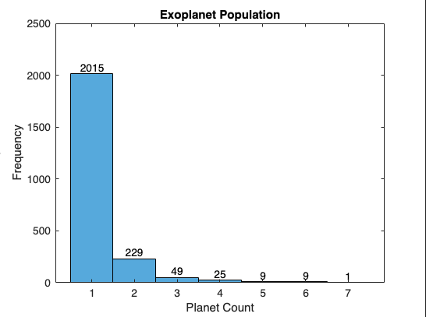
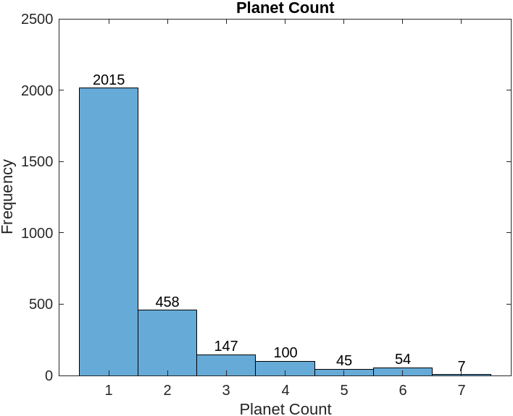
EXOPLANET POPULATIONS
Majority of exoplanetary systems only contain one or a few planets

Slide 5
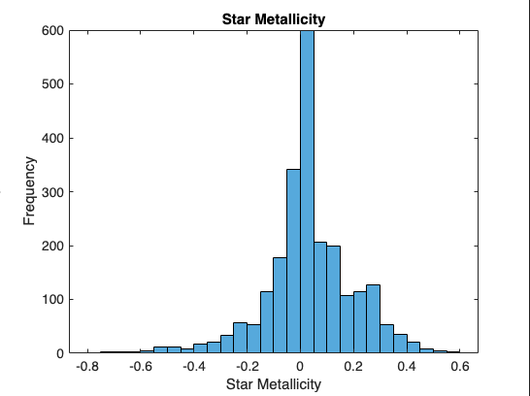
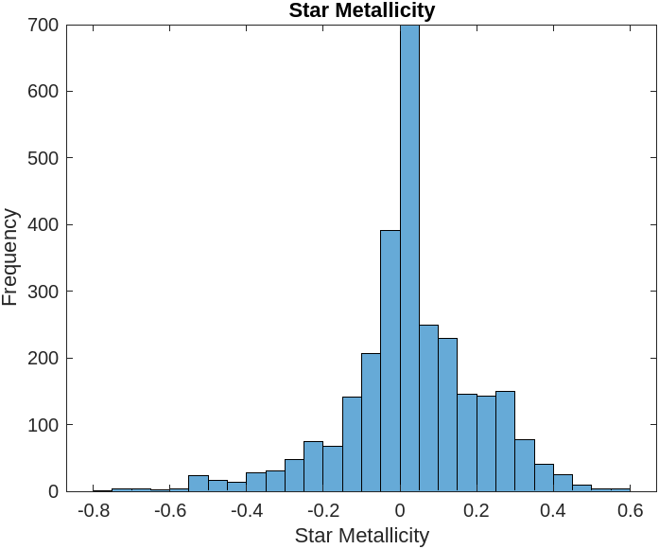
STAR METALLICITY
Majority of exoplanetary stars have metallicity slightly higher than the Sun’s

Slide 6
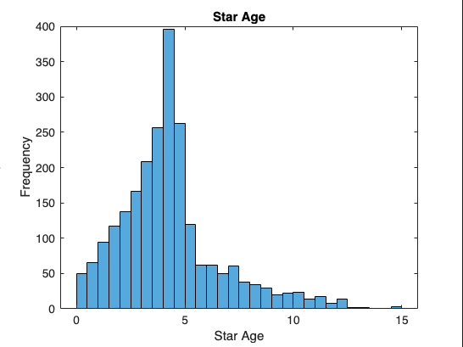
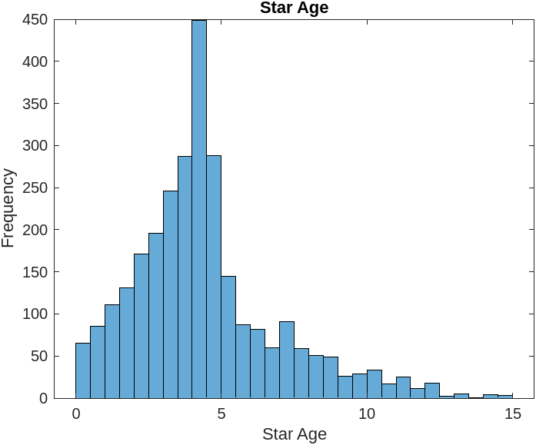
STAR AGE
Majority of exoplanetary stars are < 5 Gya

Slide 7
ANALYSIS
Data taken from the Open Exoplanet Catalogue [5]
Calculated number of planets in each star system based on star’s unique name
Removed any rows with blanks or NaNs; left with 2337 unique star systems
Calculated correlation coefficient between each relationship
Jackknife Resampling to get mean and standard deviation of correlation coefficient
Got least squares regression slope and confidence intervals
Used Bootstrap Resampling for LSR slope mean and standard deviation
Calculated Bootstrap confidence intervals

Slide 8
EXOPLANET POPULATION AND STAR METALLICITY
Correlation Coefficient
p-Value
Corr. Coeff. Mean
Corr. Coeff. Std. Dev.
CORRELATION COEFFICIENT ANALYSIS
-0.0361
0.0813
-0.036
0.0

Slide 9
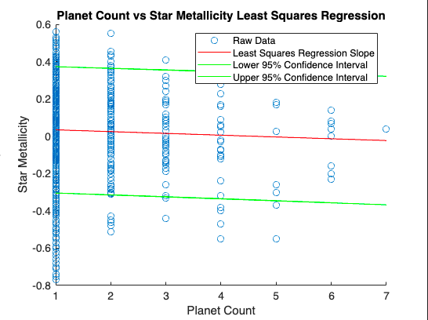
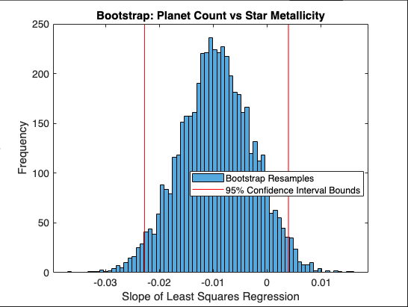
EXOPLANET POPULATION AND STAR METALLICITY
LEAST SQUARES REGRESSION ANALYSIS
Slope: -0.0096 CI: [-0.0203, 0.0012]
Slope Mean: -0.009
Slope Standard Deviation: 0.007 CI: [-0.023, 0.004]

Slide 10
EXOPLANET POPULATION AND STAR METALLICITY
1.
Weak Negative Correlation
2.
Jackknife Resampling is Consistent
3.
LSR Slope is Negative
4.
Bootstrap Slope is Similar
RESULTS
With minimal variability
However, p-value is greater than significance level
But the CI contains zero
Minimal variability, but CI also contains 0

Slide 11
EXOPLANET POPULATION AND STAR AGE
Correlation Coefficient
p-Value
Corr. Coeff. Mean
Corr. Coeff. Std. Dev.
CORRELATION COEFFICIENT ANALYSIS
0.0958
0.0
0.096
0.0

Slide 12
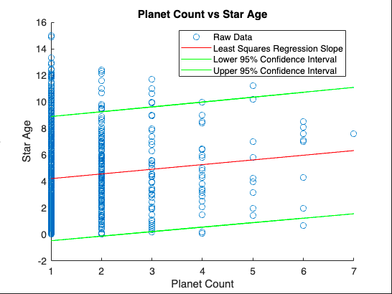
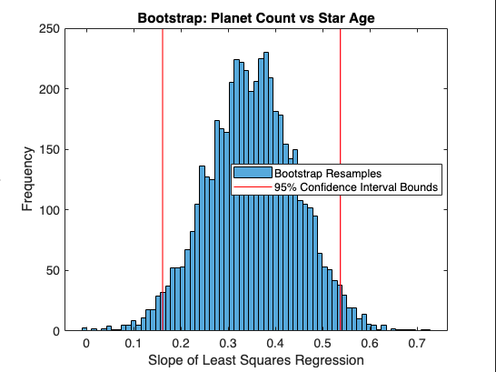
EXOPLANET POPULATION AND STAR AGE
LEAST SQUARES REGRESSION ANALYSIS
Slope: 0.3526 CI: [0.2039, 0.5013]
Slope Mean: 0.351
Slope Standard Deviation: 0.096 CI: [0.161, 0.538]

Slide 13
EXOPLANET POPULATION AND STAR AGE
1.
2.
Weak Positive Correlation
Jackknife Resampling is Consistent
3.
LSR Slope is Positive
4.
Bootstrap Slope is Similar
RESULTS
With a p-value of 0
With minimal variability
With CI not containing zero
Some variability, with CI also not containing zero

Slide 14
STAR METALLICITY AND STAR AGE
Correlation Coefficient
p-Value
Corr. Coeff. Mean
Corr. Coeff. Std. Dev.
CORRELATION COEFFICIENT ANALYSIS
-0.0462
0.0256
-0.046
0.0

Slide 15
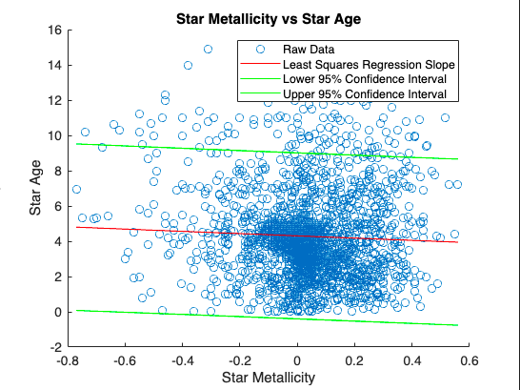
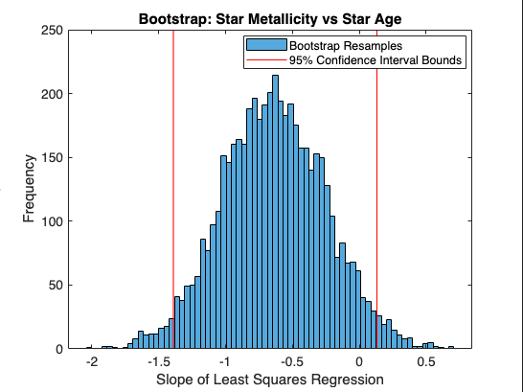
STAR METALLICITY AND STAR AGE
LEAST SQUARES REGRESSION ANALYSIS
Slope: -0.6407 CI: [-1.2034, -0.0781]
Slope Mean: -0.637
Slope Standard Deviation: 0.386 CI: [-1.389, 0.132]

Slide 16
STAR METALLICITY AND STAR AGE
1.
Weak Negative Correlation
2.
Jackknife Resampling is Consistent
3.
LSR Slope is Negative
4.
Bootstrap Slope is Similar
RESULTS
With minimal variability
With p-value lower than 0.05
With a CI that does not contain zero
Some variability, with CI that does not contain zero

Slide 17
CONCLUSIONS
Exoplanet Population and Star Metallicity
Exoplanet Population and Star Age
Star Metallicity and Star Age
No relationship
Positive relationship
Negative relationship

Slide 18
CITATIONS
[1] Astronomy & Astrophysics. Metallicity. https://www.aanda.org/glossary/194-metallicity
[2] Adibekyan, V. (2019). Heavy Metal Rules. I. Exoplanet Incidence and Metallicity. Geosciences, 9(3), 105. https://doi.org/10.3390/geosciences9030105
[3] Safonova, M., Murthy, J., & Shchekinov, Y. (2015). Age aspects of habitability. International Journal of Astrobiology, 0(0), 1-13. https://doi.org/ 10.1017/S1473550415000208
[4] Carrillo, A., Ness, M., Hawkins, K., Sanderson, R., Wang, K., Wetzel, A., & Bellardini, M. The Astrophysical Journal, 942(3). https://doi.org/10.3847/1538-4357/aca1c7
[5] Encyclopaedia of Exoplanetary Systems. Catalogue of Exoplanets. https://exoplanet.eu/catalog/

Slide 19
Questions?

