Slide 1
How Do Velocity and Spin Rate Contribute to MLB Pitchers’ Success
Hudson McGaughey

Slide 2
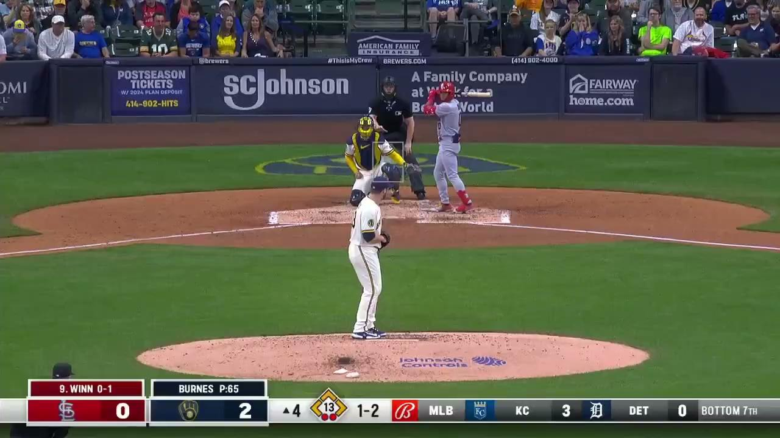
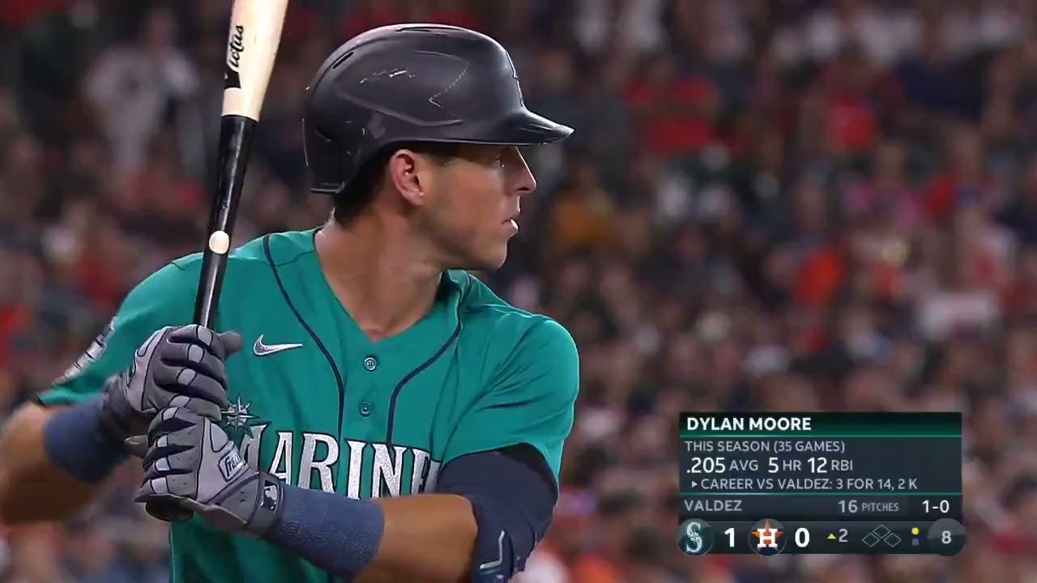
Background
Studying 3 types of fastballs
Measuring swing and miss rate against velocity and spin rate of pitch
Hypothesis: The spin rate of a fastball will contribute more to the effectiveness than the velocity.

Slide 3
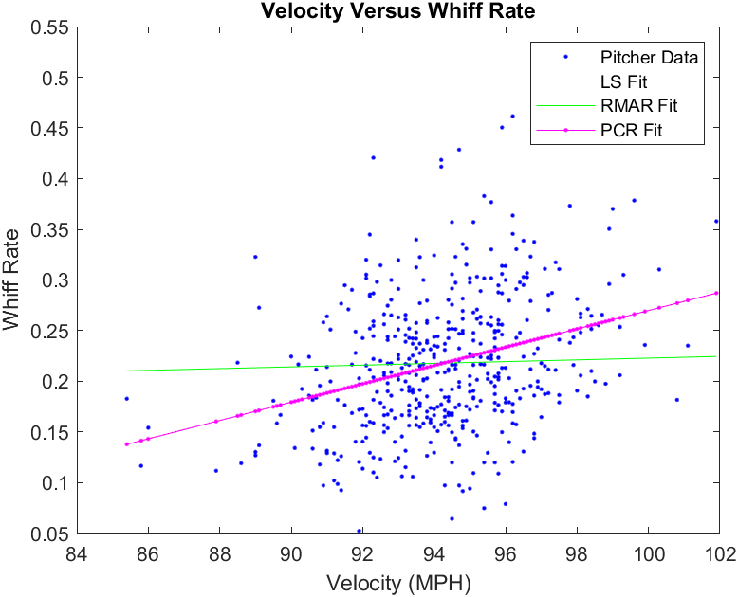
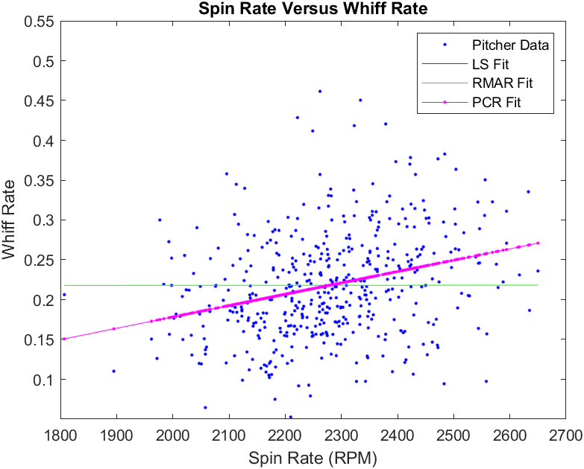
4 Seam Fastball
R2 = .0947 R2 = .0849

Slide 4
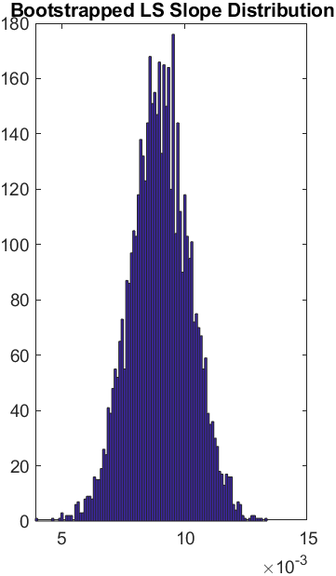
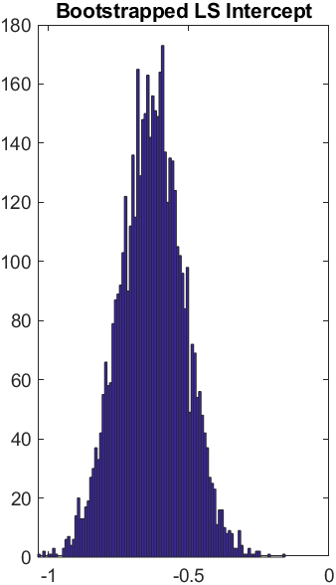
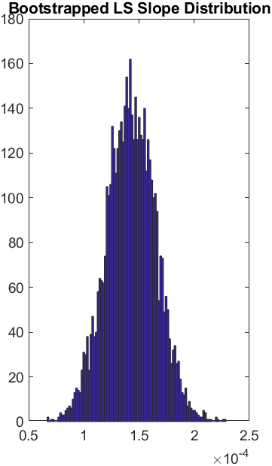
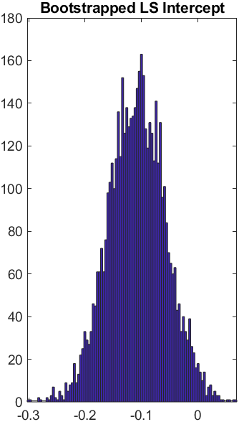
4 Seam Fastball
Bootstrapping WRT Velocity Bootstrapping WRT Spin Rate

Slide 5
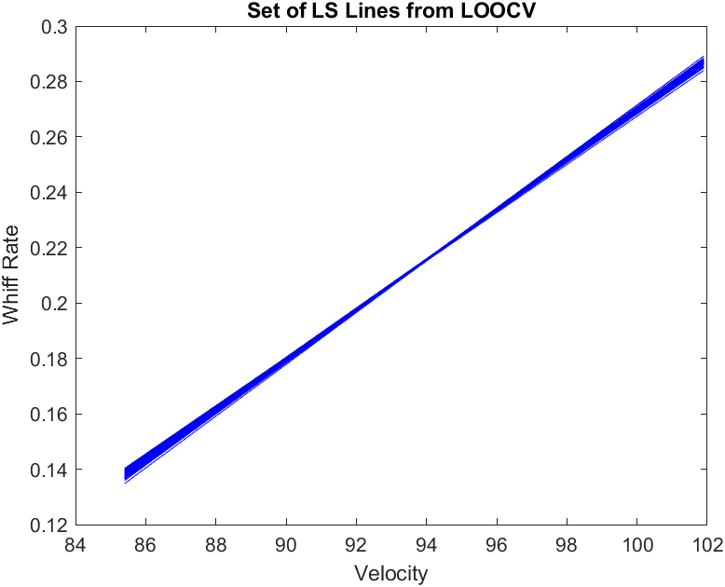
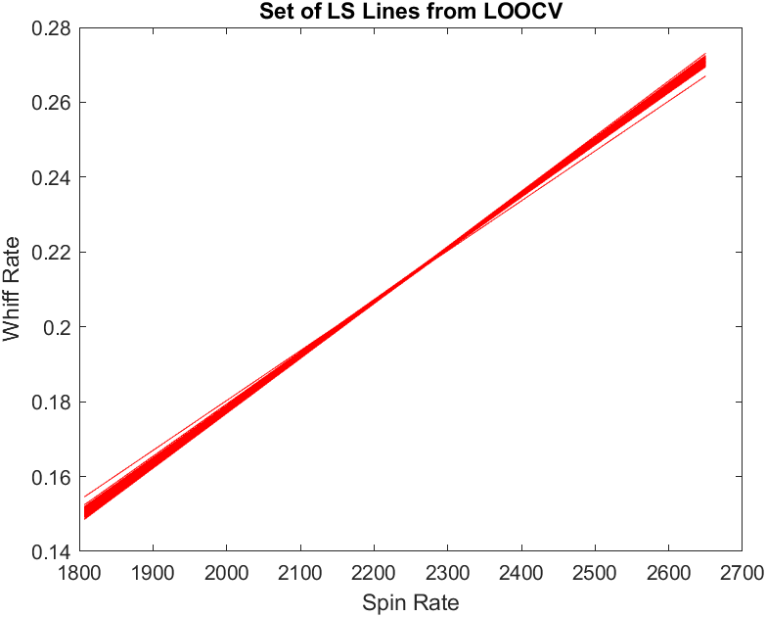
4 Seam Fastball

Slide 6
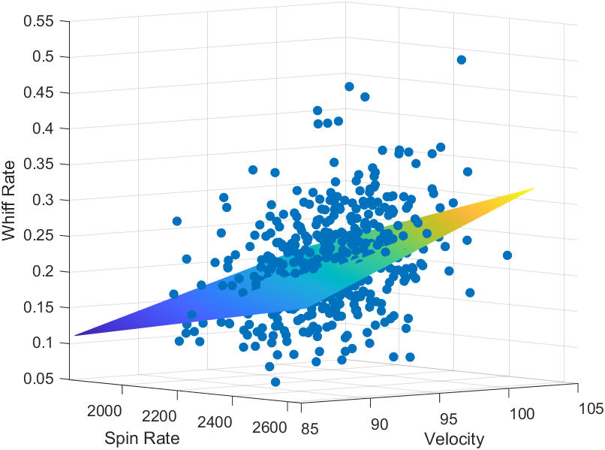
4 Seam Fastball
y = -.0512 -1.943E-04 * X1+ 8.807E-05 * X2

Slide 7
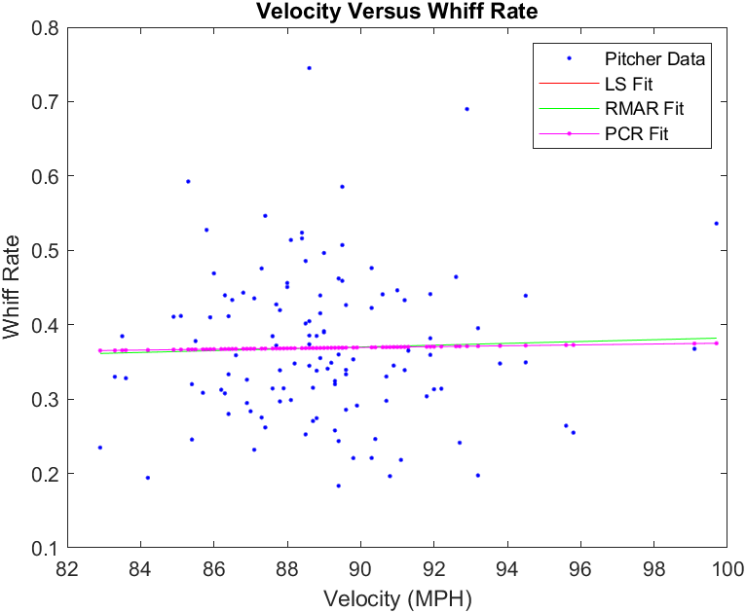
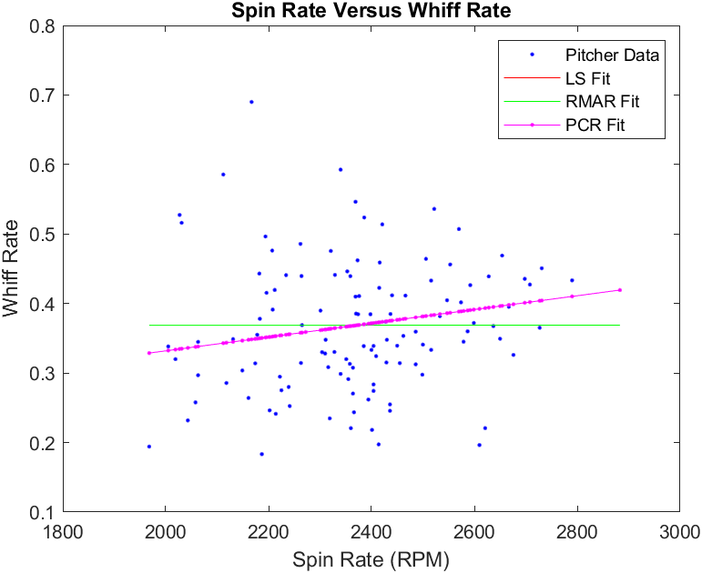
Cutter
R2 = 0 R2 = .03367

Slide 8
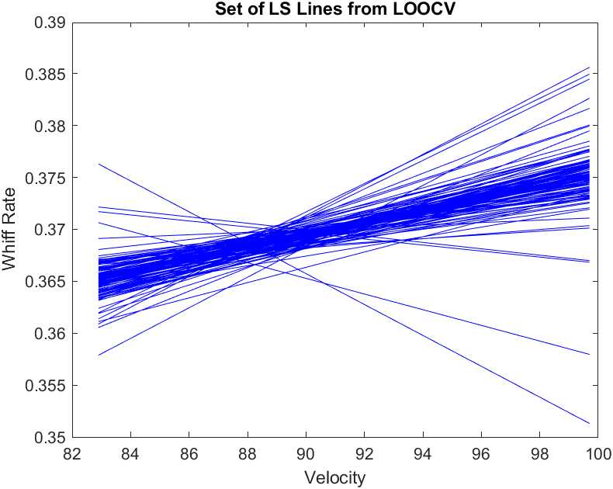
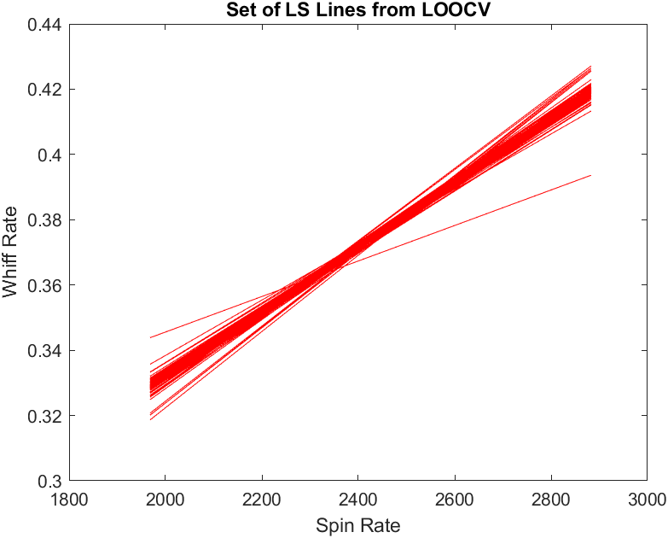

Slide 9
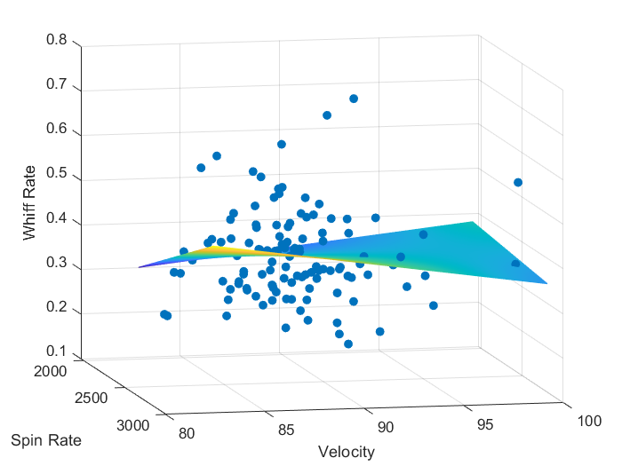
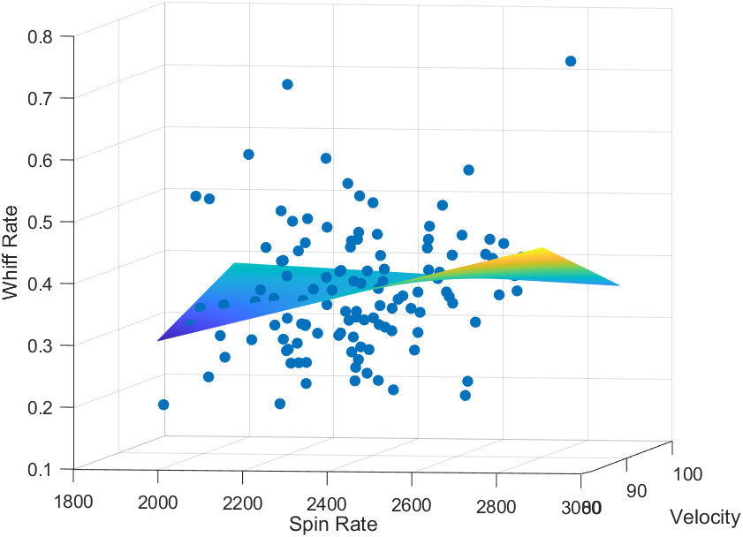
Cutter

Slide 10
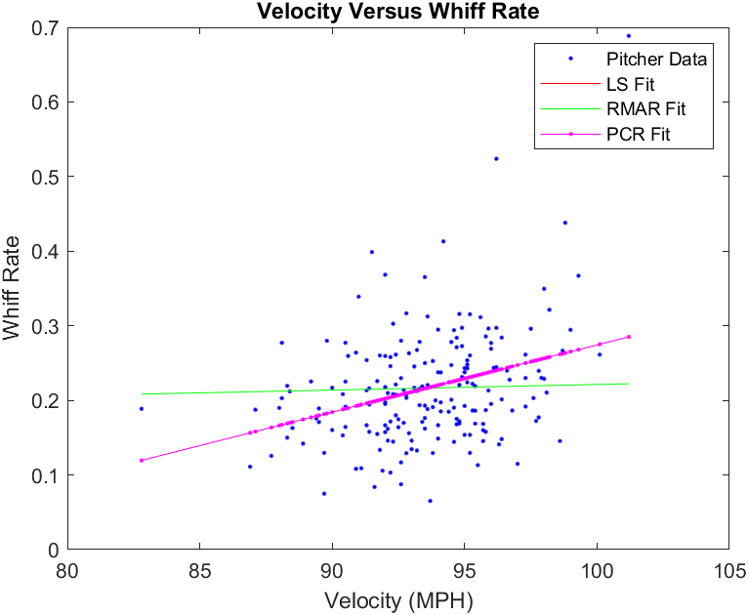
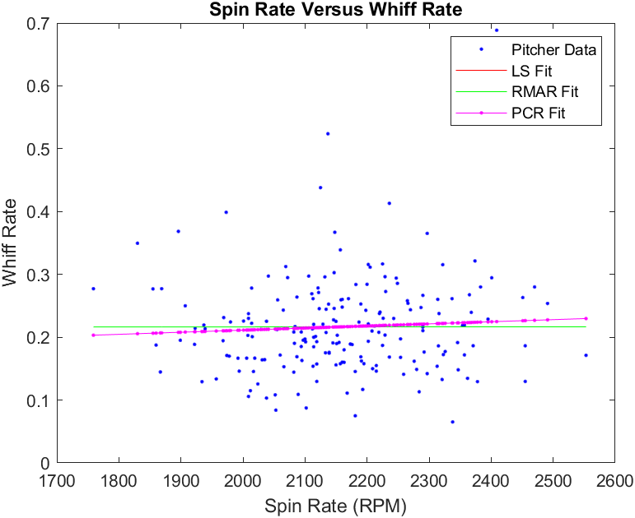
Sinker
R2 = .1077 R2 = .0038

Slide 11
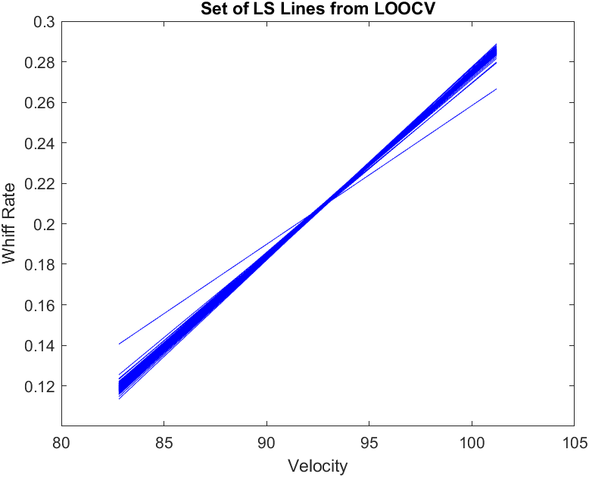
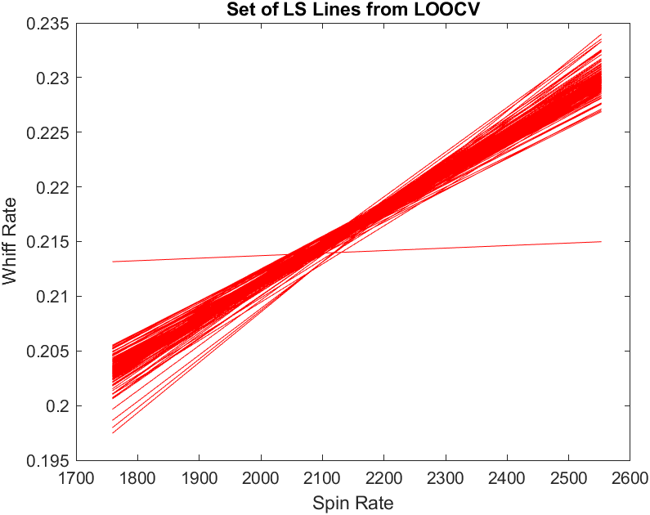
Sinker

Slide 12
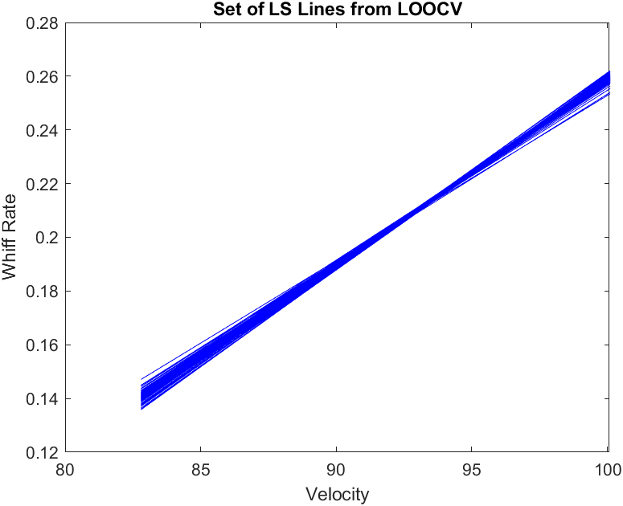
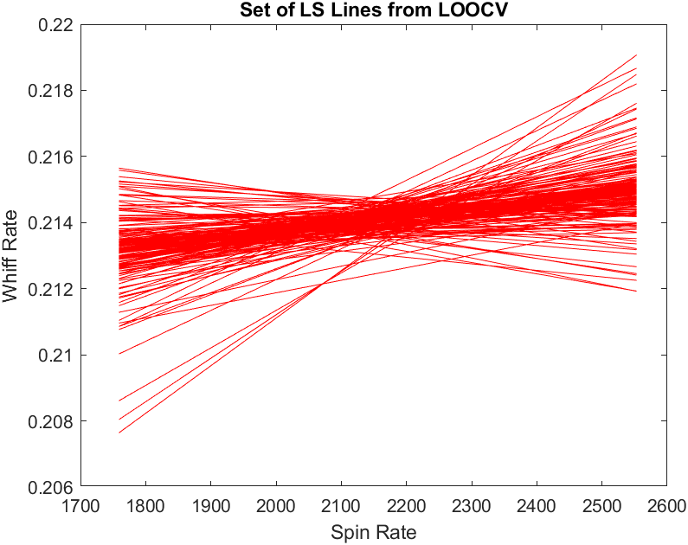
Sinker (without Aroldis Chapman)

Slide 13
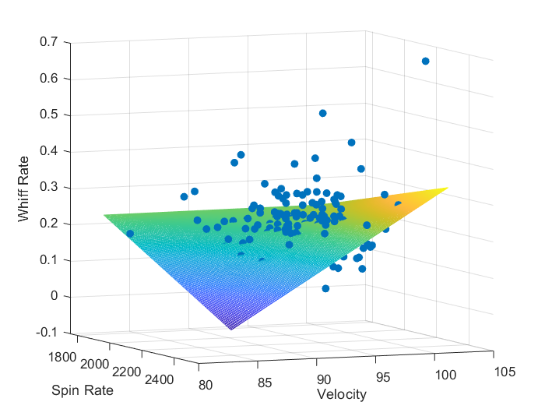
Sinker

Slide 14
Conclusion
Importance of velocity versus spin depends on type of fastball
Trends are largely caused by extreme outliers
Other factors may contribute more to success, i.e. release point, spin direction
Hypothesis is not validated

