Slide 1
SST and Sea Ice in the Arctic
Emily Melvin
Notes:
6 minutes max (30 sec leeway)
Spend time describing the data
Look into cramers v effect size

Slide 2
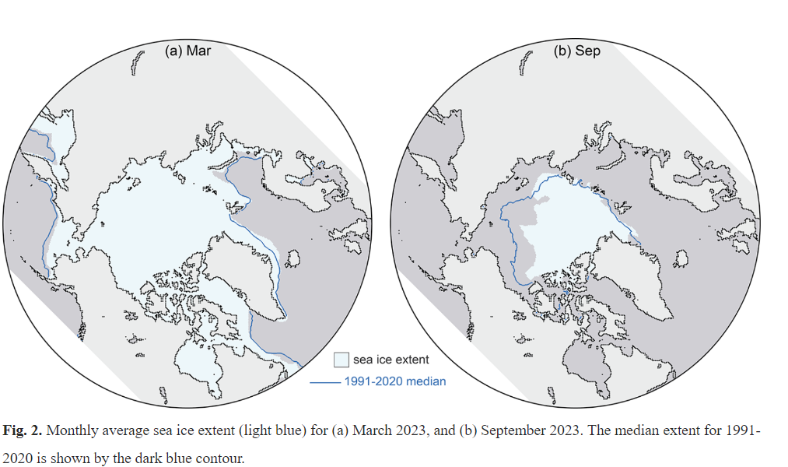
Project Goal
Determine if sea ice cover in the arctic ocean is more highly correlated to sea surface temperature in the North Atlantic ocean or the North Pacific ocean.
I hypothesize that the Pacific SST will have a higher correlation because it is a larger ocean basin.
Motivation
Sea ice impacts many important environmental factors including the albedo (reflection of incoming solar radiation to space), keeps heat in the ocean, decreasing multi year ice impacts ecosystems, water density/ AMOC, etc.
*Sea Ice Doesn’t Impact Sea Level Rise*
Notes:
The student clearly identifies the goal of the project – the question being answered. This is accompanied by some motivation of the underlying physical phenomena

Slide 3
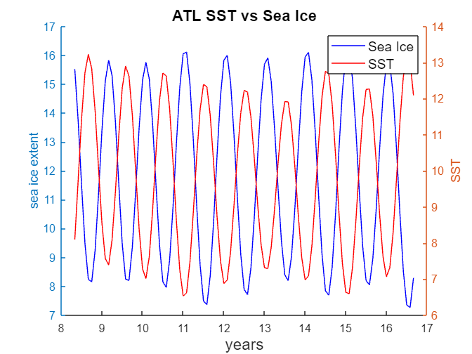
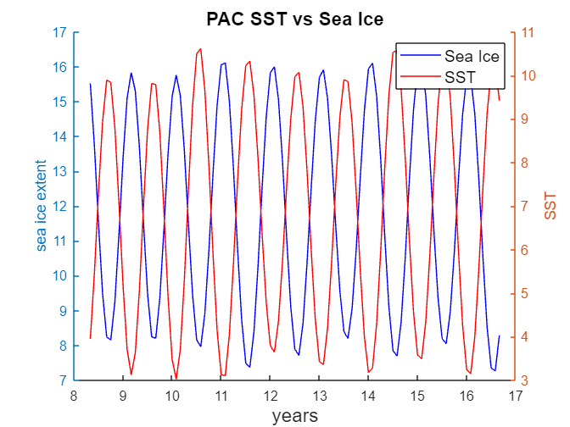
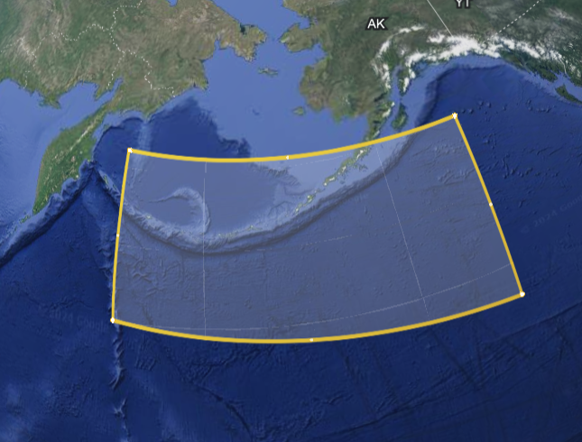
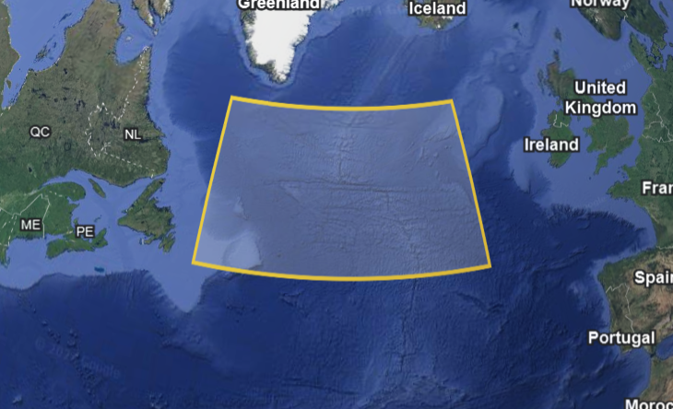
Data Sources
Sea Ice: NSIDC sea ice index monthly data, sea ice extent in millions of square km
1979 - 2020
SST: NOAA Extended Reconstructed SST V4
1979 – 2020
Atlantic : lat (58, 46) lon (310, 340) or (-50,-20)
Pacific: lat (58, 46) lon (168, 213) or (-192, - 147)
Averaged the values in each rectangle for each month to create one monthly SST
Notes:
The student identifies data sources and explains (if necessary) how the data were arranged for use in the statistical analysis.

Slide 4
Statistical Techniques
Least squares regression between each respective SST and sea ice cover to demonstrate the relationship between the dependent variable (ice cover) and the independent variable (SST)
Determine if residuals are normally distributed using chi2
Autocorrelation on residual
Pearsons’s correlation coefficient with a 95% confidence interval to determine whether there is significant correlation, and compare which basin has a higher correlation.
Apply the Jackknife method to estimate the mean and standard deviation of the correlation coefficient
Timeseries analysis using periodogram method
Cross – spectral cpsd to determine lag between sst and sea ice signals
Coherence at largest cpsd
Notes:
Appropriate statistical techniques that address the goal of the project are employed to analyze the data. The techniques should be used correctly. Error/uncertainty estimates should be made where necessary. The student should identify why analysis techniques were chosen. Describing the steps of hypothesis testing would be ideal.
Add bootstrap for slope an chi squared for normality

Slide 5
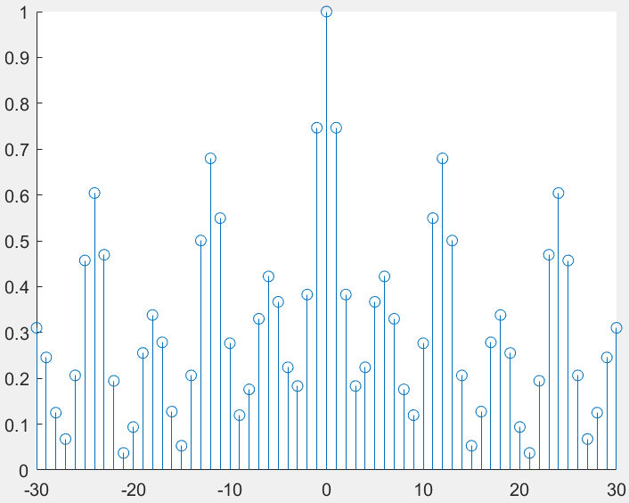
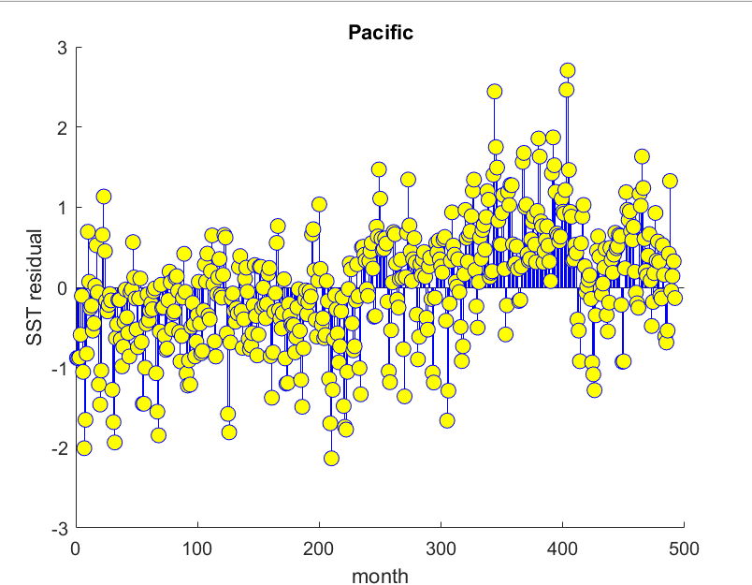
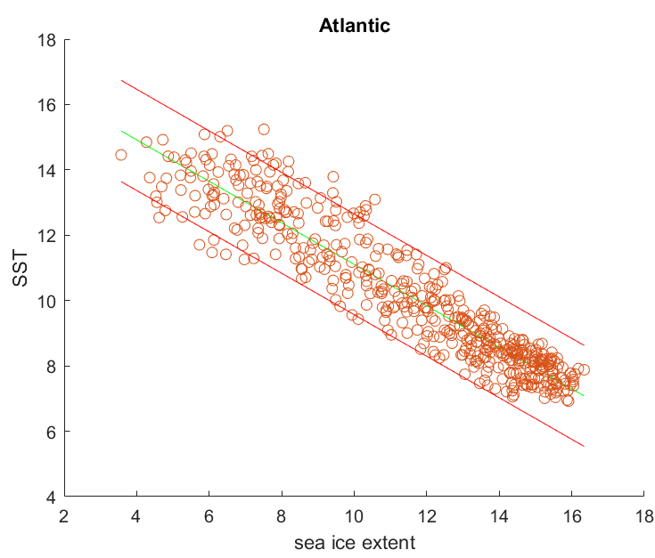
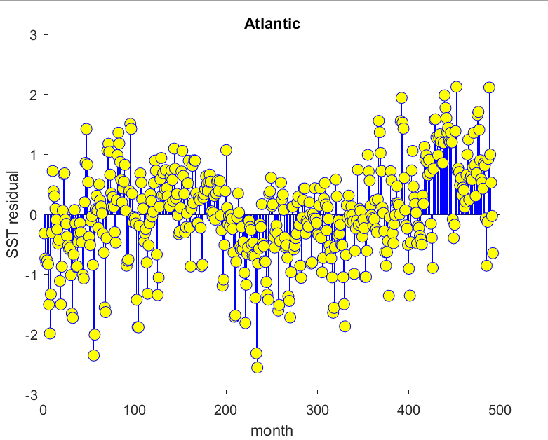
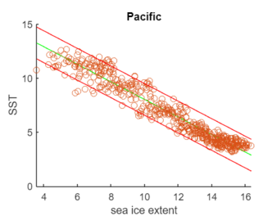
Results – Least Squares
Chi2: 8 Bins 95% Critical Value 11.07
Pacific: 10.85 Normal
Atlantic: 12.49 NOT Normal
Autocorrelation on residual
High Autocorrelation at 12 month intervals
Notes:
The student should identify why analysis techniques were chosen. Describing the steps of hypothesis testing would be ideal.

Slide 6
Results – Correlation Coefficient
Using the Jackknife method to estimate the mean, std, and confidence interval of the correlation coefficient
Pacific
Mean: - 0.962
Std: 0
CI: [-0.963, -0.962]
Atlantic
Mean: - 0.935
Std: 0
CI: [-0.935, -0.934]
Stronger Correlation in the Pacific Ocean
Notes:
The student demonstrates either their in-depth understanding of a particular analysis technique (sophisticated method) or their breadth in multiple relevant techniques. For instance, the analysis should not be limited to calculating the correlation coefficient between different variables.

Slide 7
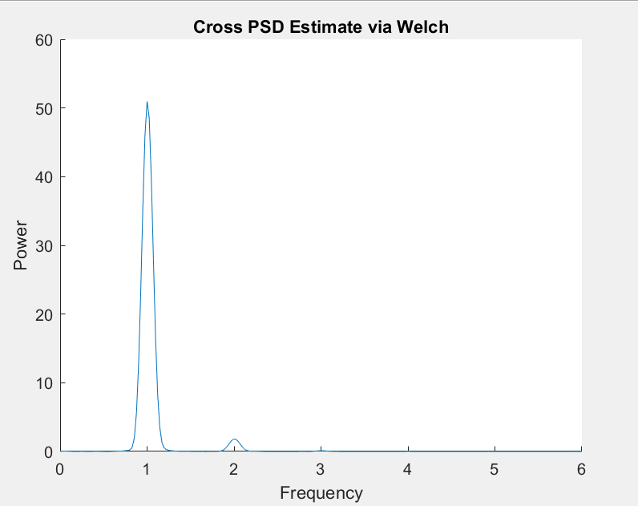
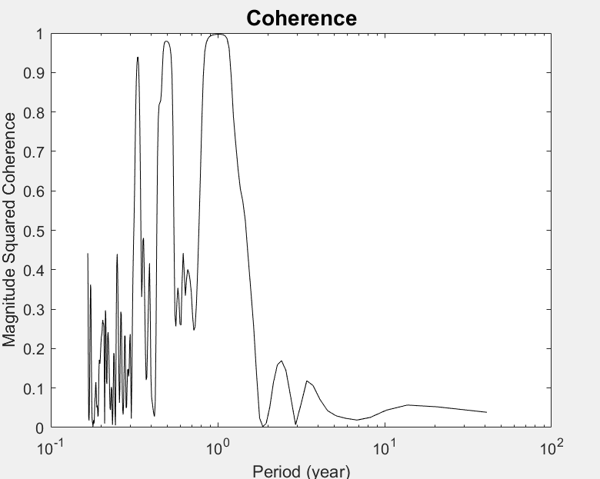
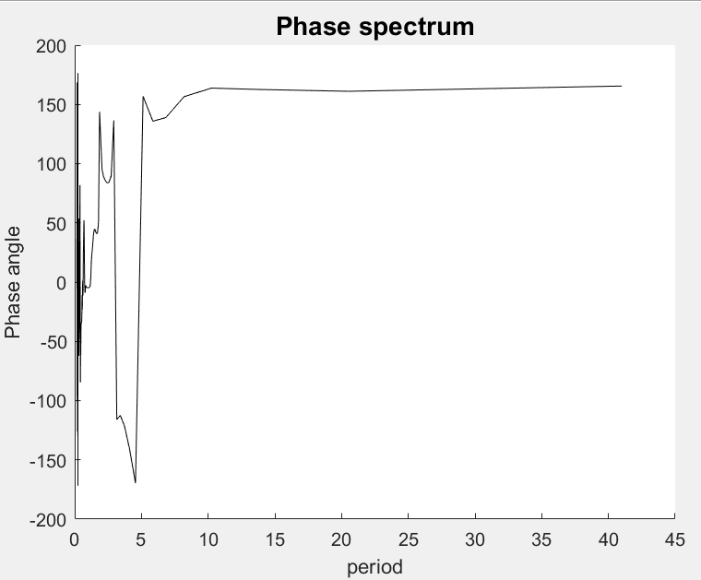
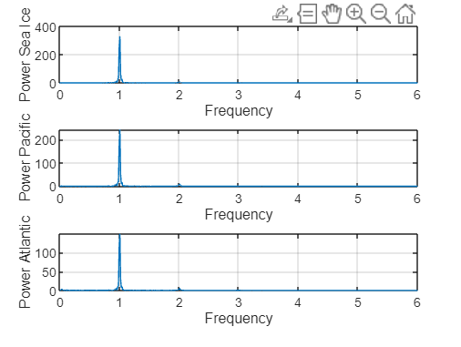
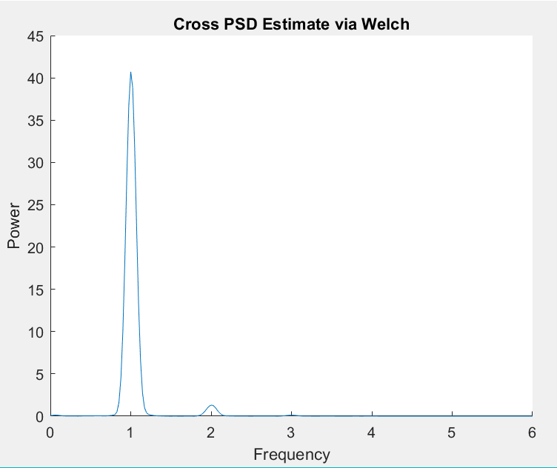
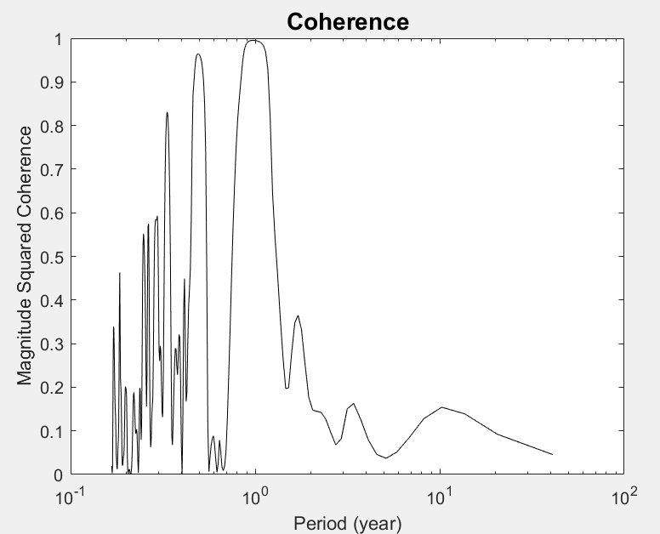
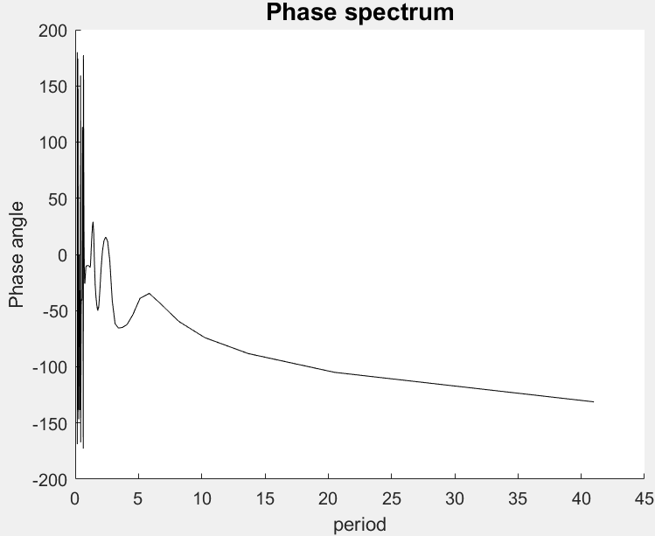
Results – Time Series
Periodogram shows dominant period of 1 year
sea ice has the strongest signal followed by Pacific and then Atlantic
CPSD
Pacific: ice lags by -0.0128 years ~5 days
Atlantic: ice lags by -0.0274 years ~10 days
Coherence at 1 year
Pacific: 0.9969
Atlantic: 0.9948
Pacific
Atlantic
Notes:
Sea ice * -1 so that the phases line up
Detrened because a linear trend aliases low frequencies
Arctic sea ice does indeed follow the patterns of the pacific ocean more closely
However, the least squares regression between did not fully pass

Slide 8
Sources
https://arctic.noaa.gov/report-card/report-card-2023/sea-ice-2023/
https://psl.noaa.gov/data/gridded/data.noaa.ersst.v4.html
https://nsidc.org/data/g02135/versions/3
Notes:
The student demonstrates clear understanding of errors/uncertainties in the analysis and discusses the underlying physical phenomena in light of the analysis results and error estimates.

