Slide 1
OBGYN Access Compared to Successful Births Across GA Counties
Mireya Ramirez
EAS 4480
Spring 2024

Slide 2
Scientific Problem & Motivation
How does access to OBGYN’s affect successful births (healthy) across Georgia Counties?
I hypothesize more OBGYN’s would mean more successful births.
Many counties in GA have no practicing OBGYN’s or in counties nearby (such as in South GA).
OBGYN’s can affect change through all states of the pregnancy process, from fertility, to maternal care, to infant care.

Slide 3
Considerations
I am not considering county size or population because of difficulty when working with data, however the number of pregnancies recorded by county that lead to successful births should reflect the population of the county.
All data comes from the GA Department of Public Health & GEORGIA BOARD of
HEALTH CARE WORKFORCE and is largely voluntary.

Slide 4
Scientific Data

Slide 5
What is classified as a successful birth according to data found?
Successful Births: Pregnancy leading to a live and healthy baby & healthy mother
Data that quantifies unsuccessful births
Number of Live Births
Feto-Infant Mortality
Very Low Birthweight
Premature Live Births: went unused as premature births don’t necessarily indicate an unhealthy birth
Unfortunately, not enough data could be found on Maternal Mortality, so that is not included in the analysis

Slide 6
What is Good OBGYN Access?
OBGYN Practitioners
Number of OBGYN’s per county (for years: 1994, 1996, 1998, 2000, 2002, 2004, 2006, 2008, 2010, 2013, 2015, 2017, 2020)
Deaths Related to Health Care Level & Access
Women’s Health Care
Maternal Health Care
Newborn Health Care
Infant Health Care
Prenatal Visits
Data not included because it was missing for all counties 2008-2014

Slide 7
Data Analysis

Slide 8
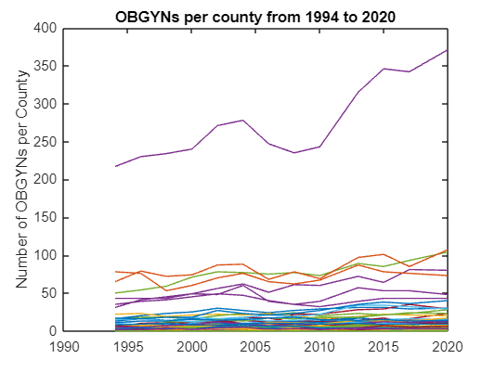
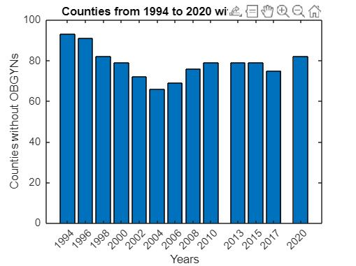
Visualizing the Data

Slide 9
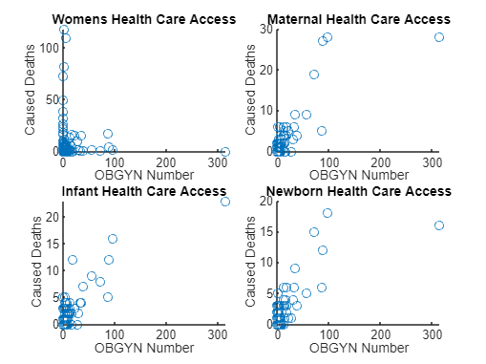
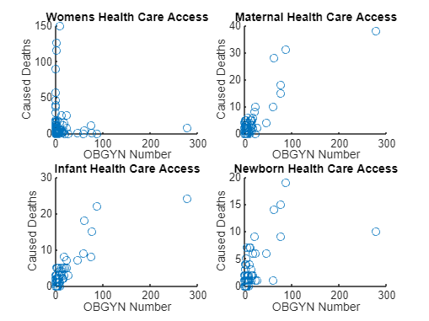
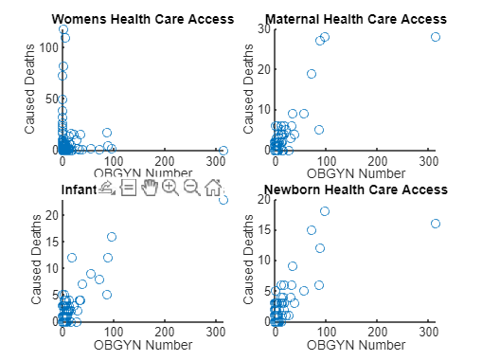
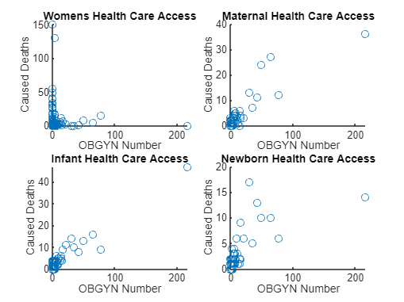
Visualizing the Data
Deaths Caused by Issues that Could’ve been Prevented at Different Levels of HealthCare
1994 2004 2013 2020

Slide 10
What Analyses Were Chosen & Why?
Univariate:
Mean & Standard Deviation of OBGYN’s per county across years. I chose this to understand how the number of OBGYN’s increased across all of GA over the years
Boxplot of OBGYNs across counties in certain years, I chose this to visualize the spread of data between counties on the number of OBGYN’s
Bivariate
Least Squares was chosen to compare Fetus-Infant Mortality Rate & Healthy Births Against OBGYN Numbers to show a correlation between the datasets.
Reduced Major Axes was used for the same comparison of the means across years because it can be assumed that there is error in both datasets as not every death is recorded and there could be physicians doing OBGYN work with quality, but reporting as one.
Principal Component was chosen because the viability and success of a birth can be affected by many other things even with the best of care
Visual Analysis of Change Over Time
I wanted to look at if the peaks of OBGYN Number will correspond with the peaks of Healthy Births and data troughs of Fetus-Infant Mortality
Bootstrap was chosen to show uncertainty

Slide 11
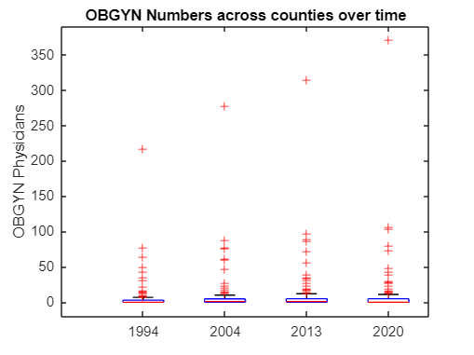
Univariate Analysis
Between 1994 and 2020 the average amount of OBGYN’s per county increased from 5.09 to 8.97. However Standard Deviation also increased from 19.8892 to 33.1245
The figure shows OBGYN numbers across counties at 4 points in time

Slide 12
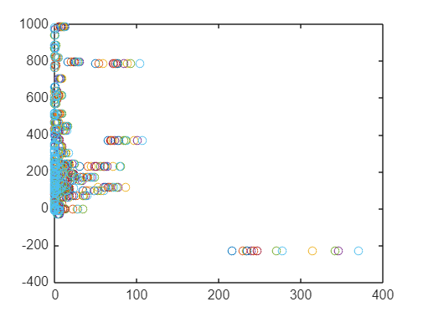
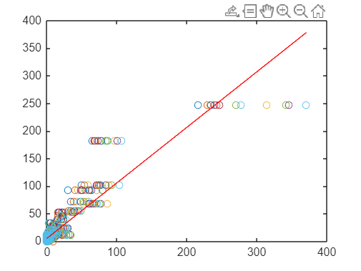
Bivariate Analysis Least - Sqaures
Healthy Births Versus OBGYN Number
According to the r value there is no relationship.
According to the p value there is not significant evidence of correlation.
Feto Infant Mortality Rate Versus OBGYN Number
According to the r value there is near a linear relationship.
According to the p value there IS significant evidence of correlation.

Slide 13
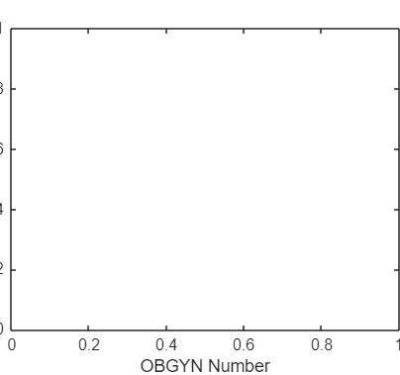
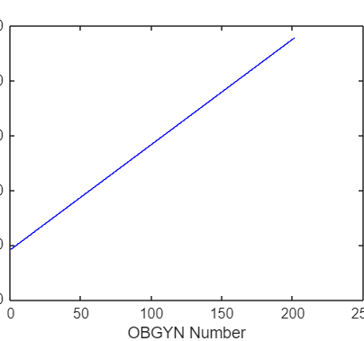
Bivariate Analysis Reduced Major Axis
Healthy Births Versus OBGYN Number
There is no relationship between the two datasets
Feto Infant Mortality Rate Versus OBGYN Number
There is a relatively positive relationship between the two datasets

Slide 14
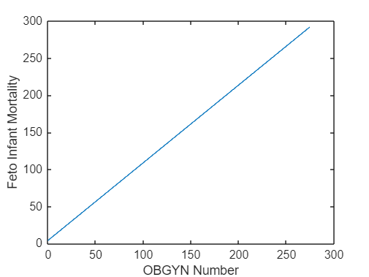
Bivariate Analysis Principal Component
Healthy Births Versus OBGYN Number
At this point it was clear there was no relationship so principal companant regression was not done
Feto Infant Mortality Rate Versus OBGYN Number
There is a relatively positive relationship between the two datasets

Slide 15
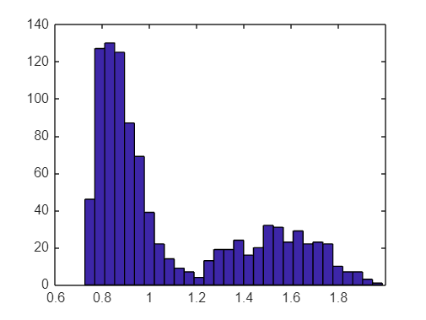
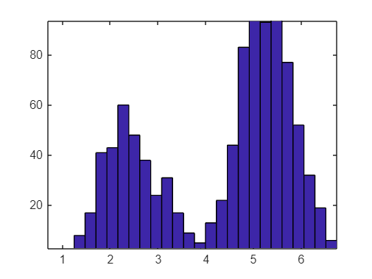
Bivariate Analysis Bootstrap
Feto Infant Mortality Rate Versus OBGYN Number
The 95% interval of Regression Slope using the bootstrap method is 1.6725, 6.3984

Slide 16
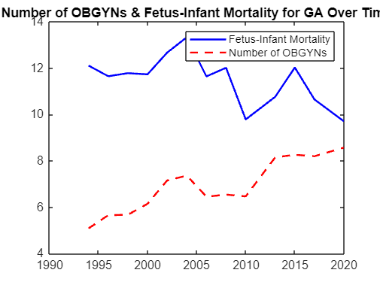
Visual Analysis of Change Over Time
Where there is more OBGYN’s there should be less Fetus-Infant Mortality. So there should be an inverse relationship.
However, there is not an inverse relationship.

Slide 17
Results

Slide 18
Synthesizing the Results
As we can see there is a correlation/relationship of OBGYNs to Successful births.
However, it can be shown in the last figure that this relationship is largely positive, meaning that as there is more OBGYN’s in an area the number of Successful births (As indicated by Fetus-Infant Mortality, in this case) goes down.

Slide 19
Contextualizing the Results
However, this is very likely not the case.
If we contextualize the data:
Although the number of OBGYN’s per county has been largely increasing so likely has the population. If population is outgrowing OBGYN’s at a much faster rate than that means that even though Fetus-Infant Mortality is increasing, its rate in reference to the population could be decreasing.
As we see at the end of the time figure, just show, the OBGYN Number and Fetus Infant Mortality seem to changing in relationship. This could be because of the previous statement, or perhaps reporting methods have improved
Because of data formatting issues, all data points are simply the amount per county and not rate per county. If in the future population is used as reference, it could very likely give a different result.

Slide 20
To Improve
Before submitting the paper
To fully look into the research and understand if the results will hold true with population. I will compare FIMR & OBGYN per 100k to take into account population to see if my hypothesis about the population out-tracking OBGYN growth is correct.
Uncertainty Analysis

Slide 21
Questions?

Slide 22
References
https://oasis.state.ga.us/
Georgia. Department of Community Health (1994). Physicians by county by specialty, Georgia, 1994. Retrieved from https://dlg.galileo.usg.edu/do:dlg_ggpd_y-ga-bc910-b-ps1-bp47-b1994-belec-p-btext
Georgia. Department of Community Health (1996). Physicians by specialty by county, Georgia, 1996. Retrieved from https://dlg.usg.edu/record/dlg_ggpd_y-ga-bc910-b-ps1-bp47-b1996-belec-p-btext
Georgia. Department of Community Health (1998). Physicians by specialty by county, Georgia, 1998. Retrieved from https://dlg.usg.edu/record/dlg_ggpd_y-ga-bc910-b-ps1-bp47-b1998-belec-p-btext
Georgia. Department of Community Health (2000). Physicians by specialty by county, Georgia, 2000. Retrieved from https://dlg.usg.edu/record/dlg_ggpd_y-ga-bc910-b-ps1-bp47-b2000-belec-p-btext
Georgia. Department of Community Health (2002). Physicians by specialty by county, Georgia, 2002. Retrieved from https://dlg.usg.edu/record/dlg_ggpd_y-ga-bc910-b-ps1-bp47-b2002-belec-p-btext
Georgia. Department of Community Health (2004). Physicians by specialty by county, Georgia, 2004. Retrieved from https://dlg.usg.edu/record/dlg_ggpd_y-ga-bc910-b-ps1-bp47-b2004-belec-p-btext
Georgia. Department of Community Health (2006). Physicians by specialty by county, Georgia, 2006. Retrieved from https://dlg.usg.edu/record/dlg_ggpd_y-ga-bc910-b-ps1-bp47-b2006-belec-p-btext
Georgia. Department of Community Health (2008). Physicians by specialty by county, Georgia, 2008. Retrieved from https://dlg.usg.edu/record/dlg_ggpd_y-ga-bc910-b-ps1-bp47-b2008-belec-p-btext
Georgia. Department of Community Health (2010). Physicians by specialty by county, Georgia, 2010. Retrieved from https://dlg.galileo.usg.edu/do:dlg_ggpd_y-ga-bc910-b-ps1-bp47-b2010-belec-p-btext
Georgia. Department of Community Health (2013). Physicians by specialty by county, Georgia, 2013. Retrieved from https://dlg.galileo.usg.edu/do:dlg_ggpd_y-ga-bc910-b-ps1-bp47-b2013-belec-p-btext
Georgia. Department of Community Health (2015). Physicians by specialty by county, Georgia, 2015. Retrieved from https://dlg.galileo.usg.edu/do:dlg_ggpd_y-ga-bc910-b-ps1-bp47-b2015-belec-p-btext
Georgia. Department of Community Health (2017). Physicians by specialty by county, Georgia, 2017. Retrieved from https://dlg.galileo.usg.edu/do:dlg_ggpd_y-ga-bc910-b-ps1-bp47-b2017-belec-p-btext
Georgia. Department of Community Health (2020). Physicians by specialty by county, Georgia, 2020. Retrieved from https://dlg.galileo.usg.edu/do:dlg_ggpd_y-ga-bc910-b-ps1-bp47-b2020-belec-p-btext

