Slide 1
Influences on the Valence of Songs
Search
Home
Library
Claire Tran

Slide 2
Table of contents
01
02
03
04
Goal and Motivation
Data Source
Statistical Techniques and Analysis
Conclusion

Slide 3
01
Goal/Motivation
Search
Home
Library

Slide 4
Goal and Motivation
What characteristic of a song most influences the valence, the emotion, of a song?
Motivation is driven to understand what feature of a song impacts the emotional tone to understand the psychological implications and to understand mood-based playlists

Slide 5
02
Data Source
Search
Home
Library

Slide 6
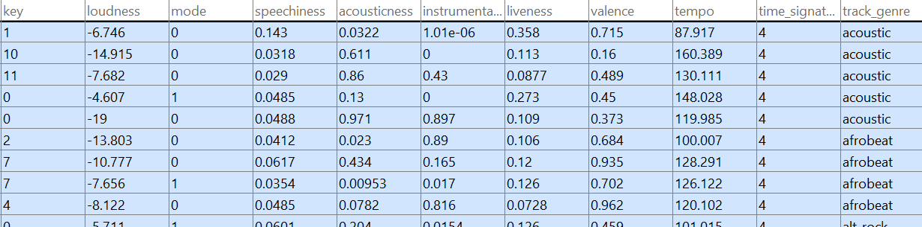
Data Source
Notes:
Contains over 2000 songs

Slide 7
Factors
Dancebility
Tempo
Danceability based on a combination of musical elements including tempo, rhythm stability, beat strength, and overall regularity. A value of 0.0 is least danceable and 1.0 is most danceable
The overall estimated tempo of a track in beats per minute (BPM). In musical terminology, tempo is the speed of a given piece and derives directly from the average beat duration
Energy
Acousticness
Energy is a measure from 0.0 to 1.0 and represents a perceptual measure of intensity and activity. For example, death metal has high energy, while a Bach prelude scores low on the scale
A confidence measure from 0.0 to 1.0 of whether the track is acoustic. 1.0 represents high confidence the track is acoustic
Loudness
Instramentalness
The overall loudness of a track in decibels (dB)
Predicts whether a track contains no vocals. "Ooh" and "aah" sounds are treated as instrumental in this context. The closer the instrumentalness value is to 1.0, the greater likelihood the track contains no vocal content

Slide 8
03
Statistical Techniques and Analysis
Search
Home
Library

Slide 9
Statistical Techniques
Pearson Correlation Coefficient & p-test
Bootstrap
Resample the data to estimate the sampling distribution of a statistic by repeatedly sampling from oberserved data with replacement
Strength and significance of linear relationship between 2 variables
Multilinear analysis
Jackknife
Resamples the data to determine if there’s bias by systematically leaving out 1 obersvation at a time
Helps account for varying levels of importance (weights) associated with different factors

Slide 10
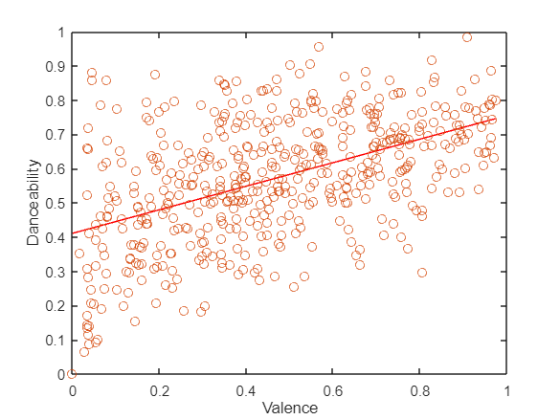
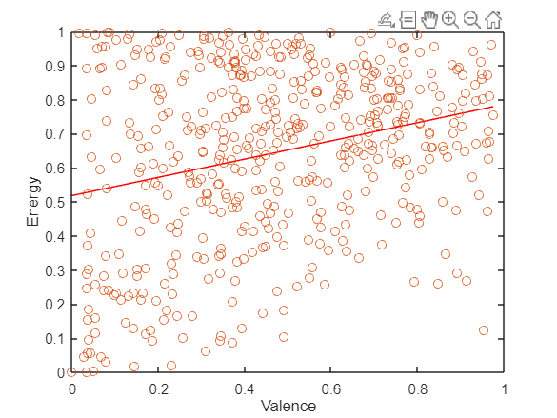
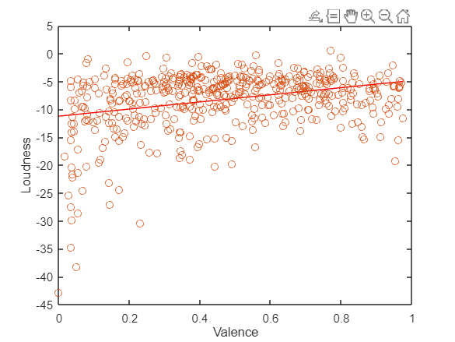
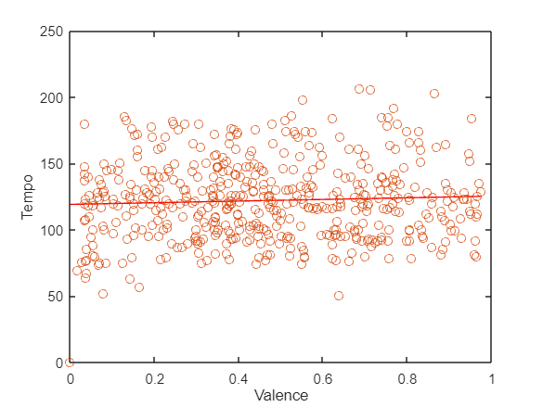
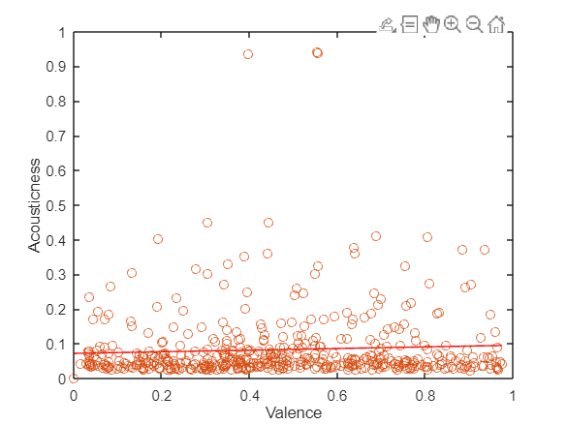
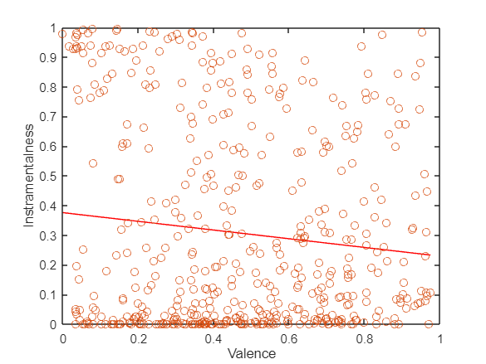
Correlation Coefficient
r = 0.4981 p = 0 r = 0.2718 p = 0 r = 0.3080 p = 0
r = 0.0543 p = 0.2257 r = 0.060 p = 0.1802 r = -0.1124 p = 0.0119
Notes:
If p<0.05 correlation is significant
R<0.3 low
0.3-0.5 medium

Slide 11
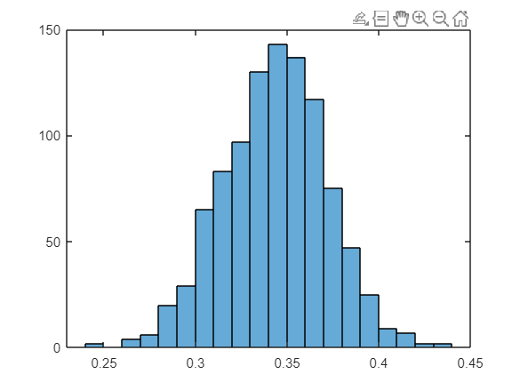
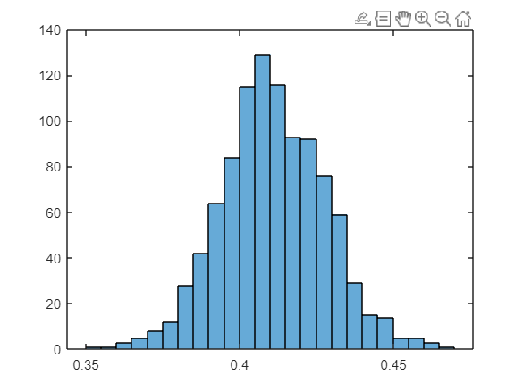
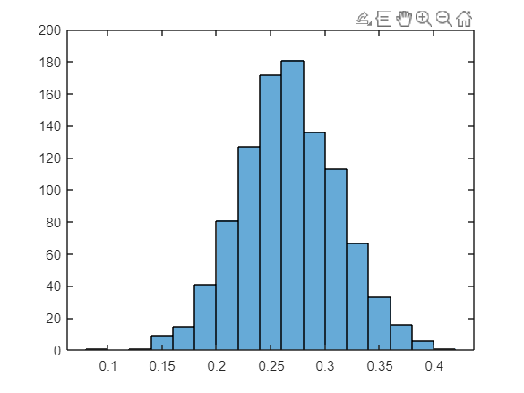
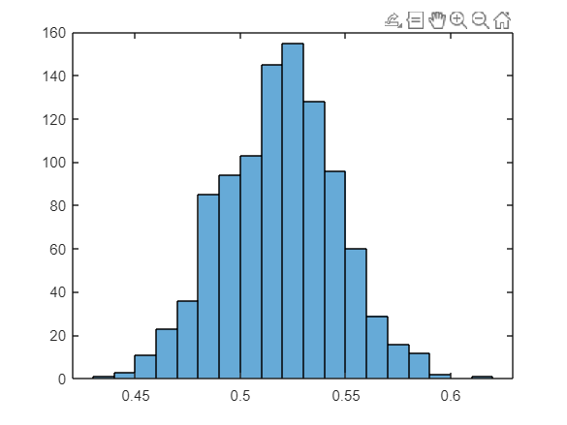
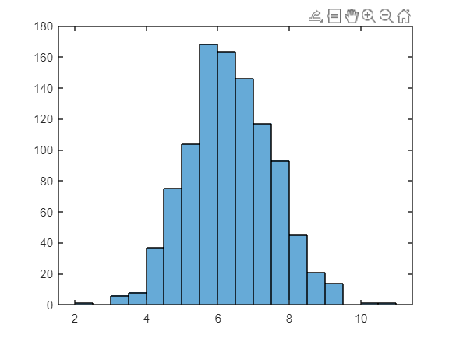
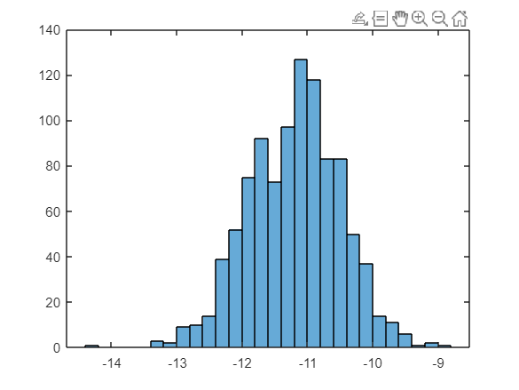
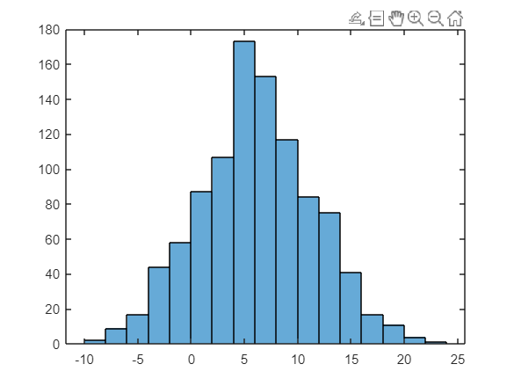
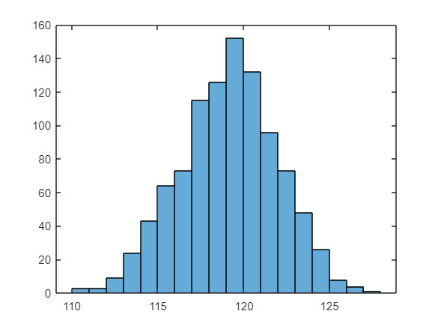
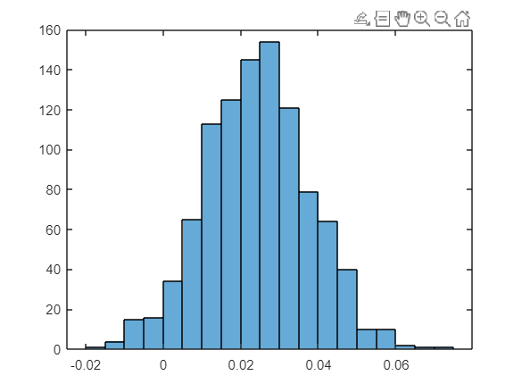
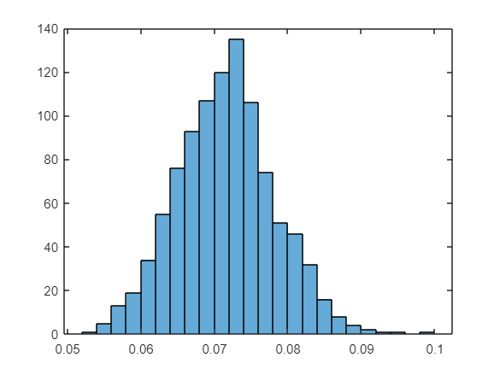
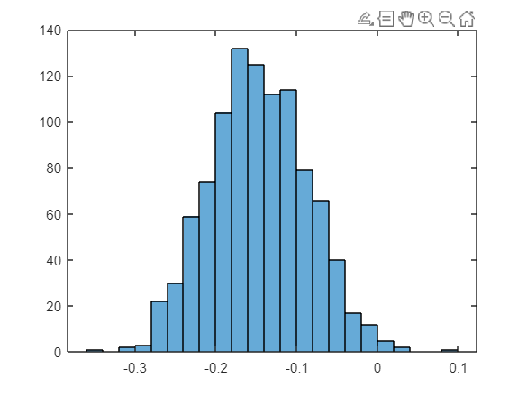
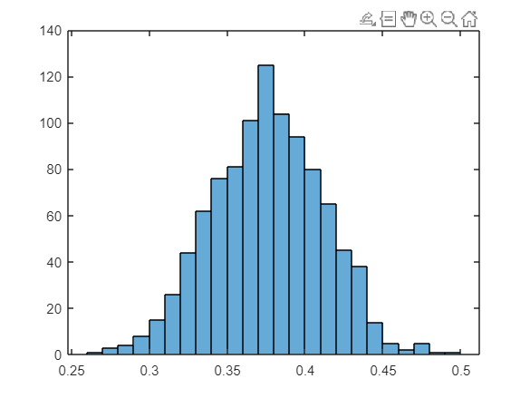
Bootstrap (slope and intercept)
Danceability
Energy
Loudness
Tempo
Acousticness
Instramentalness

Slide 12
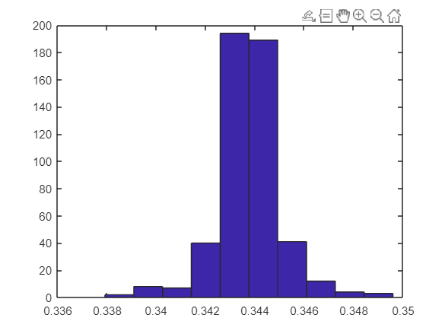
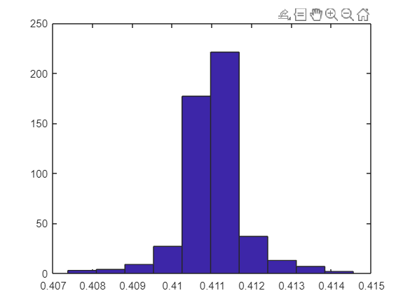
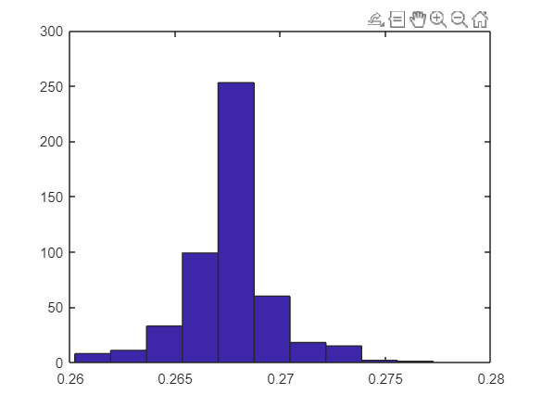
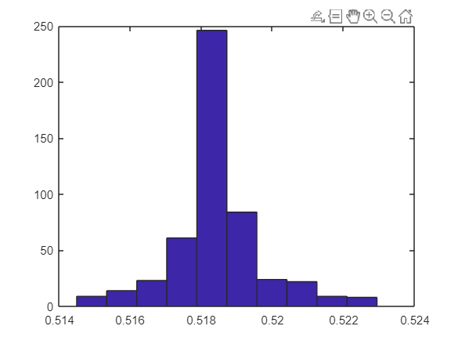
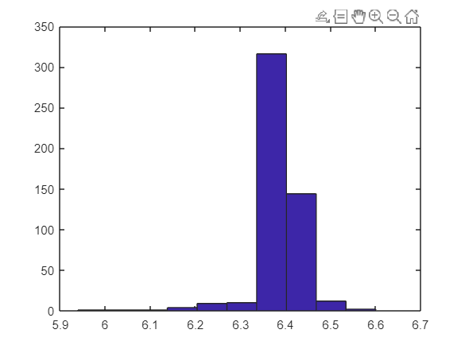
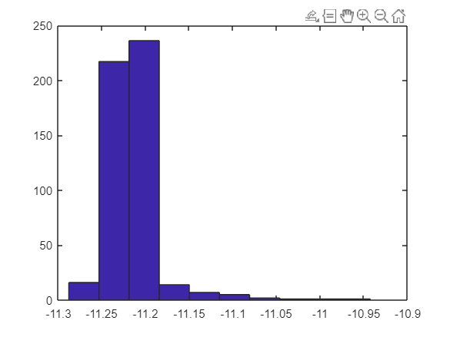
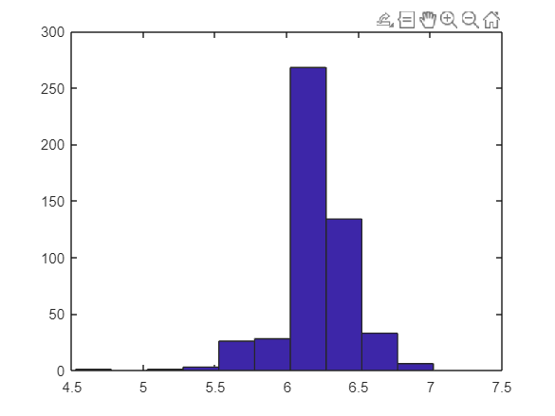
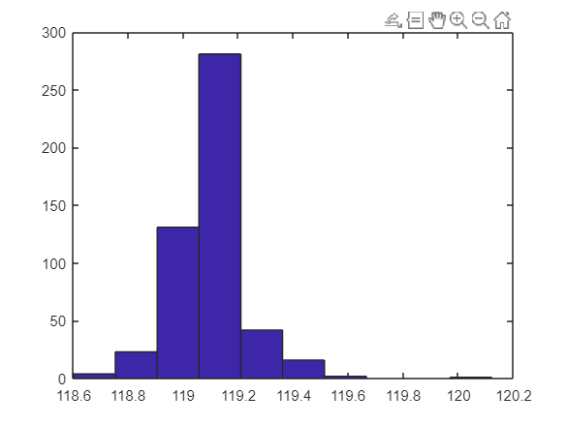
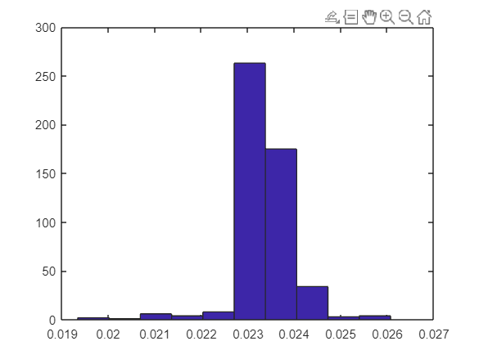
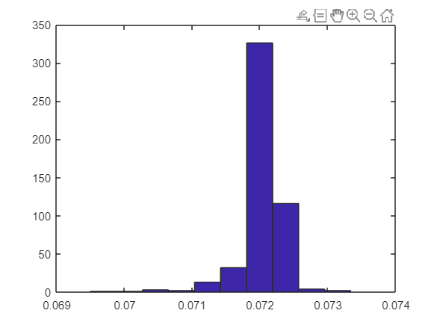
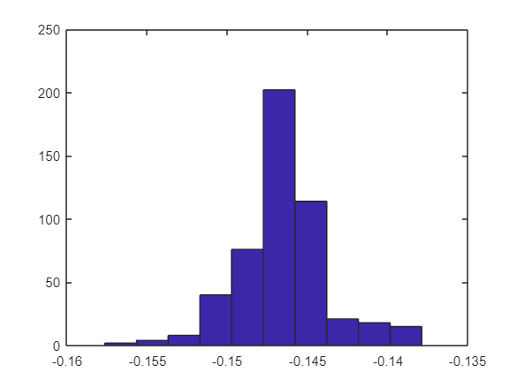
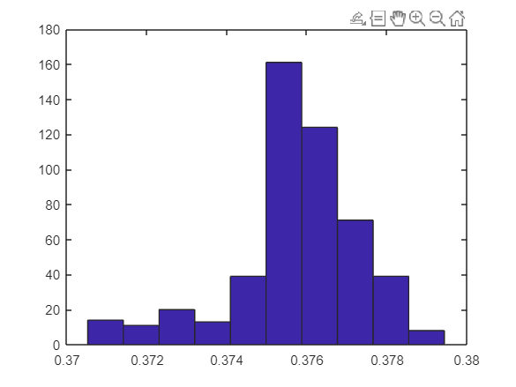
Jackknife (slope and intercept)
Danceability
Energy
Loudness
Tempo
Acousticness
Instramentalness

Slide 13
Weighted Regression
X = [dance, energy, loudness, instramentalness];
[beta, bint] = regress(valence, X);
Danceability
Energy
Loudness
Instramentalness
beta = 0.6142
bint = [0.5192, 0.7092 ]
beta = 0.2055
bint = [0.1347, 0.2762 ]
beta = 0.0085
bint = [-0.0045, 0.0125 ]
beta = 0.1780
bint = [0.1037, 0.2523]
Notes:
bint of 95% confidence intervals for the coefficient estimates.

Slide 14
04
Conclusion
Search
Home
Library

Slide 15
Conclusions
Search
Home
Unexpected result for Danceability and Tempo
Correlation between loudness and energy to valence
Negative relationship between valence and instramentalness
Library

Slide 16
Questions?
Search
Home
Library

