Slide 1
How Bread (£) Affects Bread (🥖)
EAS 4480: Environmental Data Analysis
Helen Tran

Slide 2
Objectives
Economy & Purchases
Weather & Purchases
Do changes in the value of a currency (pound sterling £) affect the amount and kind of purchases at a bakery?
Does weather affect the amount and kind of purchases at a bakery?
Motivations
The lipstick effect: during economic crisis women substitute higher cost luxury goods for lower cost ones like lipstick. (MacDonald & Dildar, 2020)
Would baked goods be considered a lower cost luxury or follow standard economic theory where all consumption decreases?
Studies have shown that weather significantly impacts the retail sales and foot traffic. (Stulec, 2013)
Does this also apply to food retailers and if so can it change the kind of purchases made?

Slide 3
Data Sources
Bakery Purchases
Economic
Weather
The Bread Basket - Kaggle
Edinburgh, Scotland
Over 20,000 transcations
Jan 11, 2016 – Dec 3, 2017
Data is bimonthly for most of the time with more frequent data only available from Nov 2016 to March 2017
Great British Pound (GBP) to United States Dollar (USD)
Investing.com
Jan 11, 2016 – Dec 1, 2017
Does not include weekends or holidays for data
Edinburgh, Scotland
Visual Crossing
Daily weather data
Temperature
Humidity
Precipitation
Moonphase & more
Abundant data, even has the option for hourly data

Slide 4
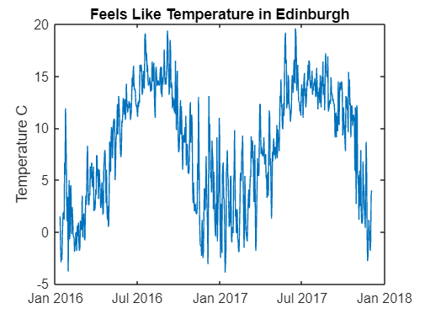
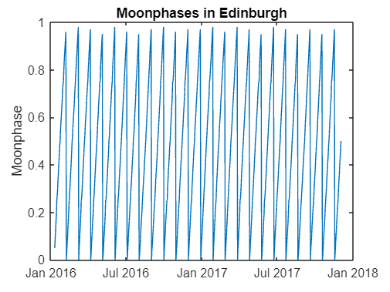
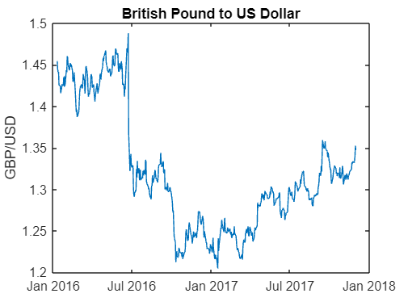
Statistical Techniques
01
02
0
Correlation
Variables: feels like temperature, moonphase, GBP/USD
Bootstrap
Will be used to measure accuracy of significant correlations

Slide 5
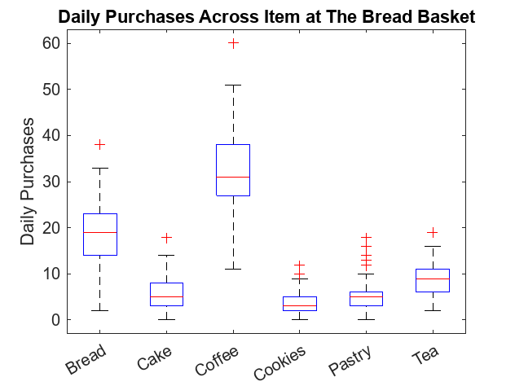
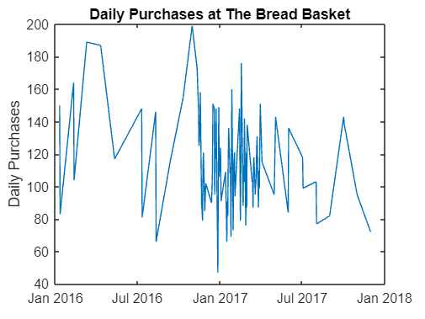
Total Purchases
Correlation
Feels like temperature & daily purchases: r = -0.0062 & p = 0.9507 not significant
Moon phase & daily purchases: r = -0.1611 & p = 0.1040 not significant
GBP/USD & daily purchases: r = 0.1589 & p = 0.1090 not significant
These are no significant correlations between the total amount of daily purchases and the variables.

Slide 6
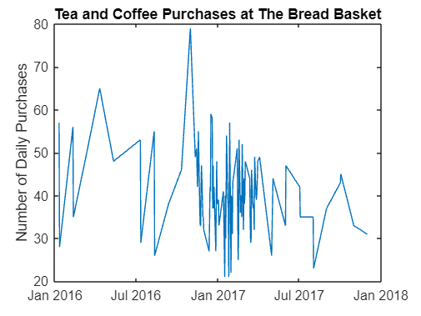
Beverages: Coffee & Tea
Correlation
Feels like temperature & beverage purchases: r = -0.0279 & p = 0.7793 not significant
Moon phase & beverage purchases: r = -0.1021 & p = 0.3047 not significant
GBP/USD & beverage purchases: r = 0.1146 & p = 0.2490 not significant
These are no significant correlations between the amount of daily beverage purchases and the variables.

Slide 7
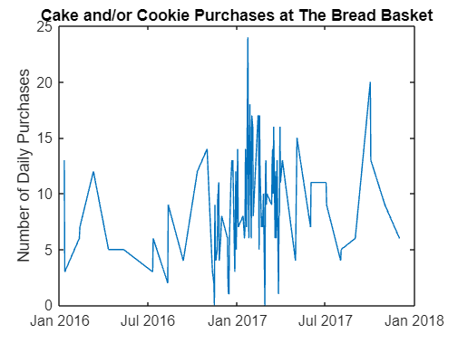
Desserts: Cake & Cookies
Correlation
Feels like temperature & dessert purchases: r = -0.1261 & p = 0.2042 not significant
Moon phase & dessert purchases: r = 0.0481 & p = 0. 6295 not significant
GBP/USD & dessert purchases: r = -0.1374 & p = 0.1663 not significant
These are no significant correlations between the amount of dessert purchases and the variables.

Slide 8
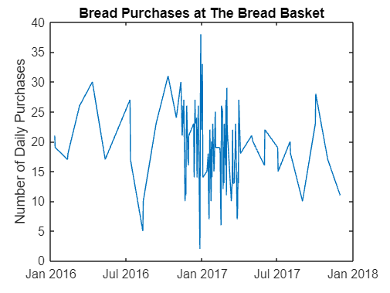
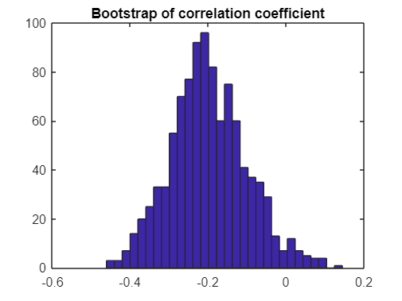
Bread
Institution name here
20xx-20xx
Correlation & Bootstrap
Feels like temperature & bread purchases: r = -0.0255 & p = 0.7979 not significant
Moon phase & bread purchases: r = -0.1983 & p = 0. 0447 significant
GBP/USD & bread purchases: r = 0.0554 & p = 0.5787 not significant
There is only a significant correlation between bread purchases and the moon phase and had a small negative value of -0.1983.
Bootstrap sampling of the moon phase correlation coefficient had a mean of -0.1975 meaning the original correlation coefficient was accurate.

Slide 9
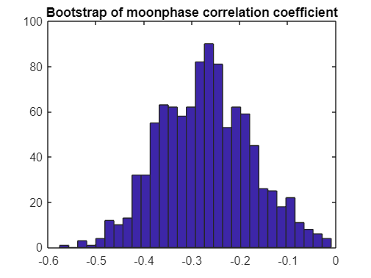
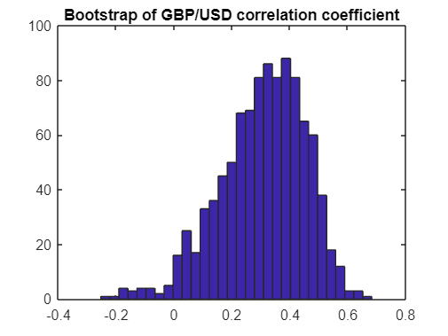
Pastries
Institution name here
20xx-20xx
Correlation & Bootstrap
Feels like temperature & pastry purchases: r = -0.0797 & p = 0.4238 not significant
Moon phase & pastry purchases: r = -0.2716 & p = 0. 0055 significant
GBP/USD & pastry purchases: r = 0.3251 & p = 0.0008 significant
Moon phase and GBP/USD both had small significant correlations with daily pastry purchases.
Bootstrap sampling of the moon phase correlation coefficient had a mean of -0.2719 meaning the original correlation coefficient was accurate. For the GBP/USD it was 0.3071.

Slide 10
Conclusion
Pastries positive correlation with GBP could mean that it is seen as a treat that follows standard economic theory where its consumption decreases during difficult economic times.
Both bread and pastries had a negative correlation coefficient with moonphase meaning that with fuller moons people ate less. This aligns with previous research where peoples’ meals became smaller with full moons (De Castro & Pearcey, 1995).

Slide 11
References
De Castro, John M & Pearcey, Sharon M. (1995). Lunar rhythms of the meal and alcohol intake of humans.
Physiology & Behavior. 57(3). 10.1016/0031-9384(94)00232-T.
MacDonald, Daniel & Dildar, Yasemin. (2020). Social and psychological determinants of consumption: Evidence for the lipstick effect during the Great Recession. Journal of Behavioral and Experimental Economics. 86. 101527. 10.1016/j.socec.2020.101527.
Rose, Natalie & Dolega, Les. (2022). It’s the Weather: Quantifying the Impact of Weather on Retail Sales. Applied Spatial Analysis and Policy. 15. 10.1007/s12061-021-09397-0.
Data Sources
Bakery Sales Dataset (kaggle.com)
GBP USD Historical Data - Investing.com
Historical weather data for Edinburgh,United Kingdom | Visual Crossing

Slide 12
Thanks!
Do you have any questions?

