Slide 1
The Impact of Air Pollution on U.S. Economy
Parker Chilton

Slide 2
Why is this important?
Air pollution caused by energy production in the US caused at least $131 billion in damages in the year 2011 alone

Slide 3
Why is this important?
Air pollution caused by energy production in the US caused at least $131 billion in damages in the year 2011 alone
With $131 billion, you could afford to give every man, woman, and child in Canada $3,638.89.

Slide 4
Why is this important?
Air pollution caused by energy production in the US caused at least $131 billion in damages in the year 2011 alone
With $131 billion, you could afford to give every man, woman, and child in Canada $3,638.89.
$131 billion is about 20% of the amount Congress spends annually on Defense ($737 billion).

Slide 5
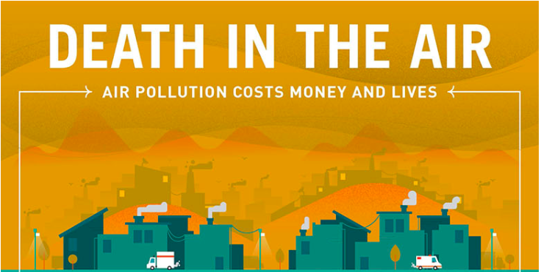
Why is this important?
Air pollution caused by energy production in the US caused at least $131 billion in damages in the year 2011 alone
With $131 billion, you could afford to give every man, woman, and child in Canada $3,638.89.
$131 billion is about 20% of the amount Congress spends annually on Defense ($737 billion).
Globally, welfare costs in 2015 from premature deaths due to air pollution were $3.2 trillion.

Slide 6
Background Information:
CBSA (Core Based Statistical Area): consists of one or more counties anchored by an urban center of at least 10,000 people plus adjacent counties that are socioeconomically tied to the urban center by commuting. CBSA’s are designated by codes similar to the ZIP code system.

Slide 7
Background Information:
CBSA (Core Based Statistical Area): consists of one or more counties anchored by an urban center of at least 10,000 people plus adjacent counties that are socioeconomically tied to the urban center by commuting. CBSA’s are designated by codes similar to the ZIP code system.
Air Quality Index (AQI): tells you how clean or polluted the air is, and what associated health effects might be a concern for you. The higher the AQI value, the greater the level of air pollution and the greater the health concern.

Slide 8
Background Information:
CBSA (Core Based Statistical Area): consists of one or more counties anchored by an urban center of at least 10,000 people plus adjacent counties that are socioeconomically tied to the urban center by commuting. CBSA’s are designated by codes similar to the ZIP code system.
Air Quality Index (AQI): tells you how clean or polluted the air is, and what associated health effects might be a concern for you. The higher the AQI value, the greater the level of air pollution and the greater the health concern.

Slide 9
Background Information:
CBSA (Core Based Statistical Area): consists of one or more counties anchored by an urban center of at least 10,000 people plus adjacent counties that are socioeconomically tied to the urban center by commuting. CBSA’s are designated by codes similar to the ZIP code system.
Air Quality Index (AQI): tells you how clean or polluted the air is, and what associated health effects might be a concern for you. The higher the AQI value, the greater the level of air pollution and the greater the health concern.
Economic Variables of Interest:

Slide 10
Background Information:
CBSA (Core Based Statistical Area): consists of one or more counties anchored by an urban center of at least 10,000 people plus adjacent counties that are socioeconomically tied to the urban center by commuting. CBSA’s are designated by codes similar to the ZIP code system.
Air Quality Index (AQI): tells you how clean or polluted the air is, and what associated health effects might be a concern for you. The higher the AQI value, the greater the level of air pollution and the greater the health concern.
Economic Variables of Interest:
Unemployment Rate: the share of the labor force that is jobless, expressed as a percentage.

Slide 11
Background Information:
CBSA (Core Based Statistical Area): consists of one or more counties anchored by an urban center of at least 10,000 people plus adjacent counties that are socioeconomically tied to the urban center by commuting. CBSA’s are designated by codes similar to the ZIP code system.
Air Quality Index (AQI): tells you how clean or polluted the air is, and what associated health effects might be a concern for you. The higher the AQI value, the greater the level of air pollution and the greater the health concern.
Economic Variables of Interest:
Unemployment Rate: the share of the labor force that is jobless, expressed as a percentage.
GDP (Gross Domestic Product): the monetary value of all goods and services made within a border in a certain time period.

Slide 12
Background Information:
CBSA (Core Based Statistical Area): consists of one or more counties anchored by an urban center of at least 10,000 people plus adjacent counties that are socioeconomically tied to the urban center by commuting. CBSA’s are designated by codes similar to the ZIP code system.
Air Quality Index (AQI): tells you how clean or polluted the air is, and what associated health effects might be a concern for you. The higher the AQI value, the greater the level of air pollution and the greater the health concern.
Economic Variables of Interest:
Unemployment Rate: the share of the labor force that is jobless, expressed as a percentage.
GDP (Gross Domestic Product): the monetary value of all goods and services made within a border in a certain time period.
GDP Per Capita: the GDP divided by the number of people in a certain area.

Slide 13
The Data:
My first job was compiling everything into one useful location.

Slide 14
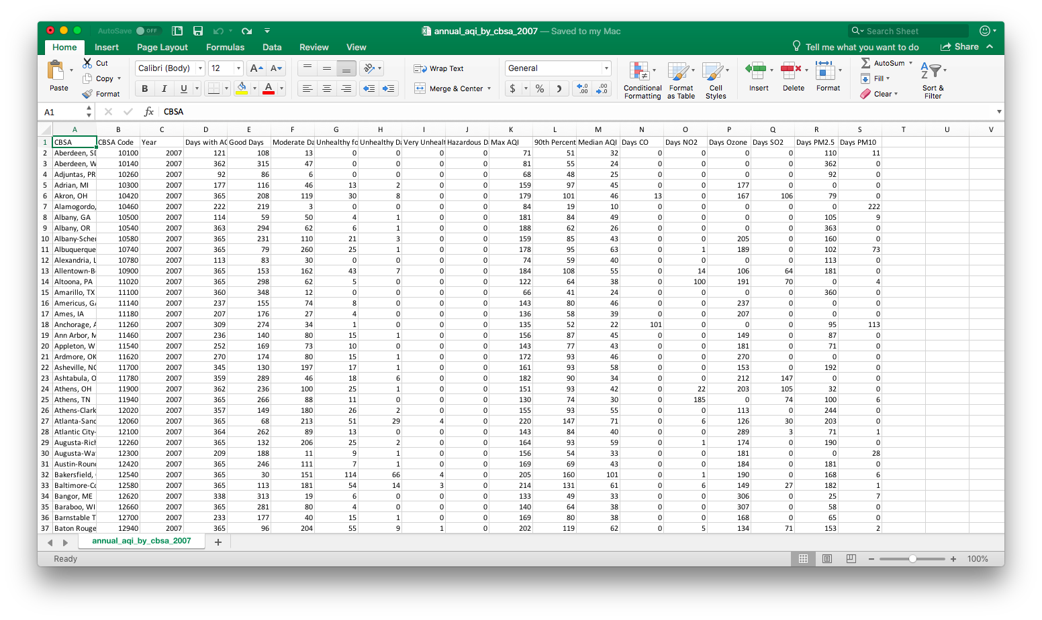
The Data:
My first job was compiling everything into one useful location.

Slide 15
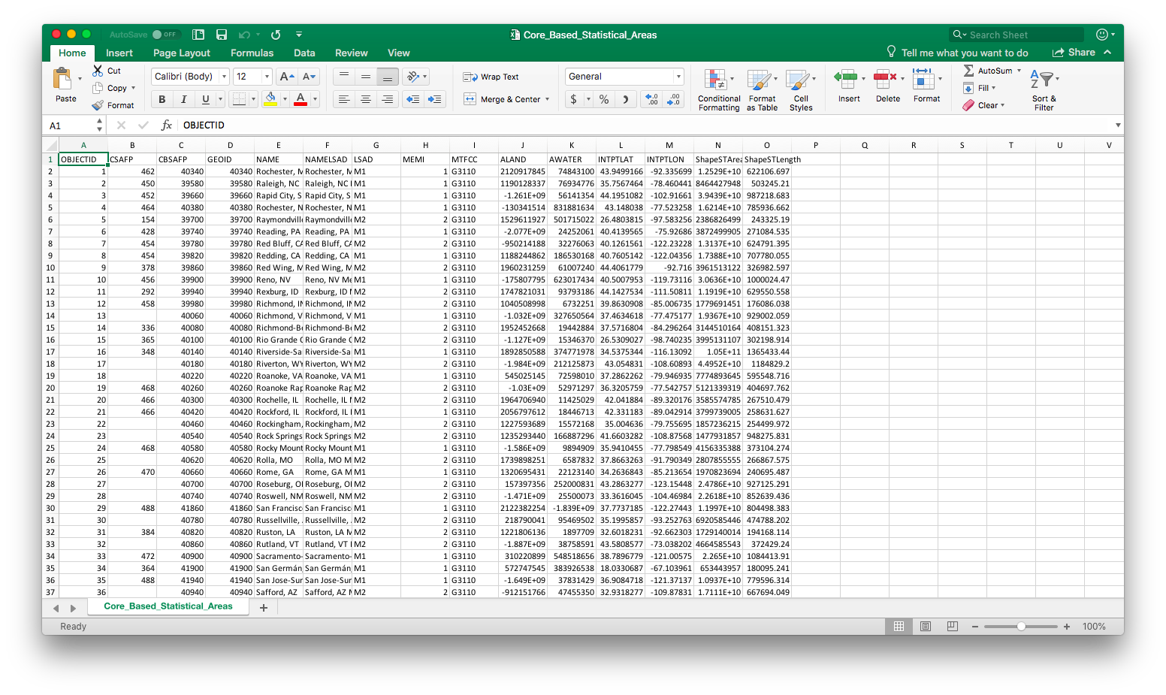
The Data:
My first job was compiling everything into one useful location.

Slide 16
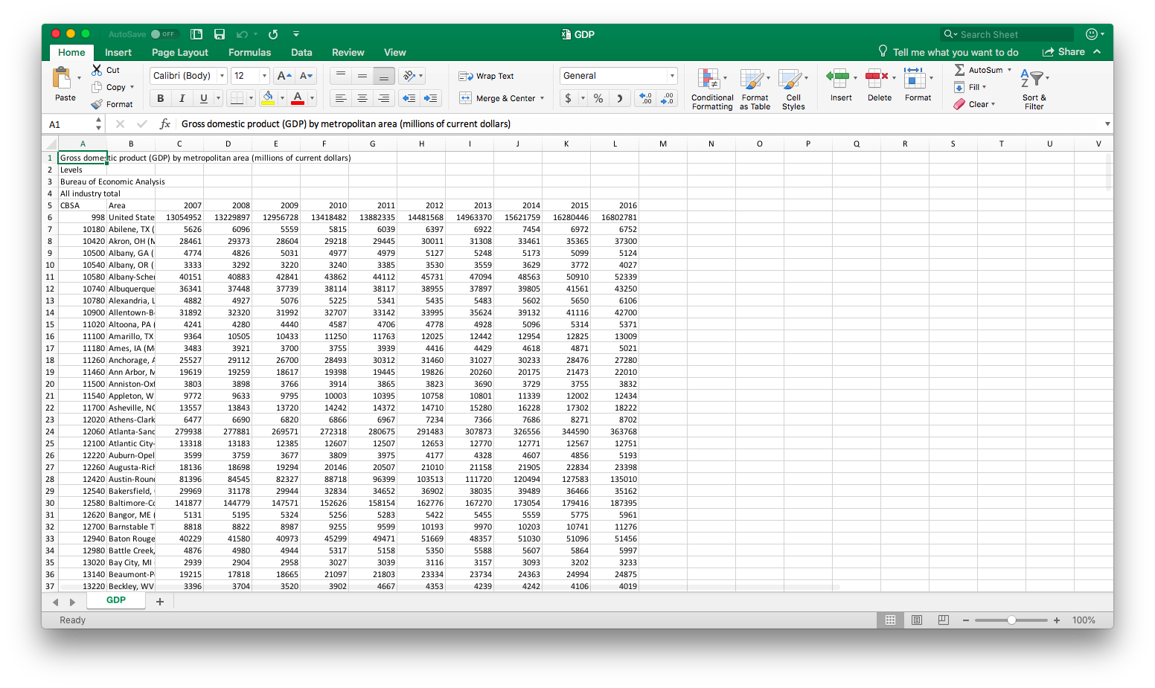
The Data:
My first job was compiling everything into one useful location.

Slide 17
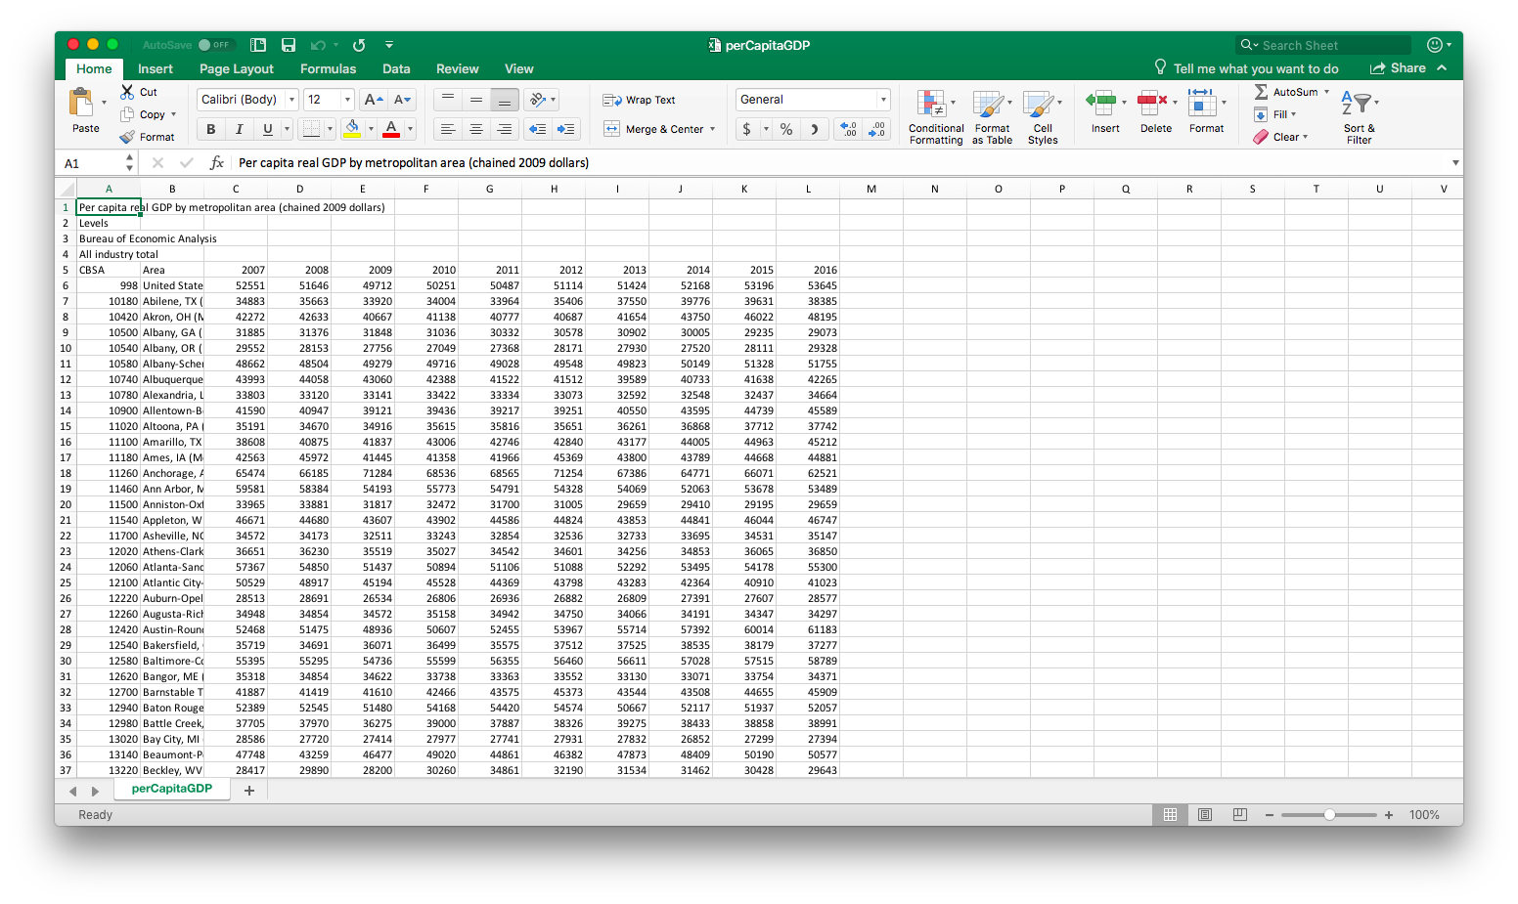
The Data:
My first job was compiling everything into one useful location.

Slide 18
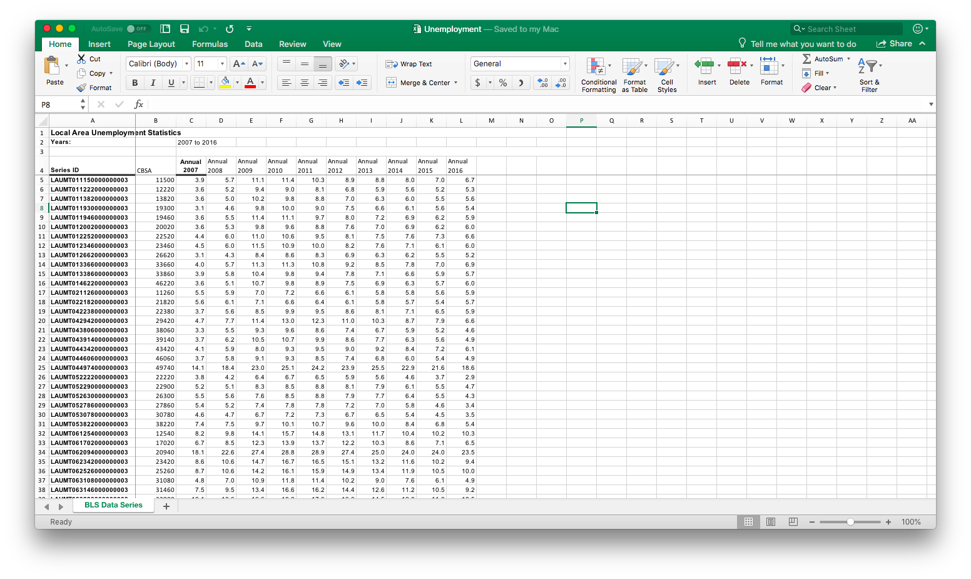
The Data:
My first job was compiling everything into one useful location.

Slide 19
The Data:
My first job was compiling everything into one useful location. → In total 15 sheets

Slide 20
The Data:
My first job was compiling everything into one useful location.
The solution? A Python Dataframe.

Slide 21
The Data:
My first job was compiling everything into one useful location.
The solution? A Python Dataframe. In total 304 CBSA’s across the US.

Slide 22
I Initially looked at Median AQI vs. Unemployment, GDP, and GDP per Capita ignoring year or location.
There were no obvious trends yet (except possibly a Gaussian Distribution).
I still decided to look at the other air pollution metrics to make sure there were no patterns.

Slide 23
I Initially looked at Median AQI vs. Unemployment, GDP, and GDP per Capita ignoring year or location.
There were no obvious trends yet (except possibly a Gaussian Distribution).
I still decided to look at the other air pollution metrics to make sure there were no patterns.
A Gaussian Distribution?

Slide 24
CO National Standard = 9 ppm
NO₂ National Standard = 0.053 ppm
O₃ National Standard = 0.070 ppm

Slide 25
CO National Standard = 9 ppm
NO₂ National Standard = 0.053 ppm
O₃ National Standard = 0.070 ppm
A Gaussian Distribution?

Slide 26
SO₂ National Standard = 75 ppb
PM 2.5 National Standard = 12 μg/m³
PM 10 National Standard = 150 μg/m³

Slide 27
SO₂ National Standard = 75 ppb
PM 2.5 National Standard = 12 μg/m³
PM 10 National Standard = 150 μg/m³
A Gaussian Distribution?

Slide 28
SO₂ National Standard = 75 ppb
PM 2.5 National Standard = 12 μg/m³
PM 10 National Standard = 150 μg/m³
A Gaussian Distribution?

Slide 29
North Port-Sarasota-
Bradenton, FL
Farmington, NM
Allentown-Bethlehem
-Easton, PA-NJ
Is there a correlation between Unemployment Rate and Median AQI?

Slide 30
North Port-Sarasota-
Bradenton, FL
R² = 0.8900
Farmington, NM
Allentown-Bethlehem
-Easton, PA-NJ
Is there a correlation between Unemployment Rate and Median AQI?
Some cities show a large positive correlation!

Slide 31
North Port-Sarasota-
Bradenton, FL
R² = 0.8900
Farmington, NM
R² = -0.7172
Allentown-Bethlehem
-Easton, PA-NJ
Is there a correlation between Unemployment Rate and Median AQI?
Some cities show a large positive correlation!
Others show a large negative correlation.

Slide 32
North Port-Sarasota-
Bradenton, FL
R² = 0.8900
Farmington, NM
R² = -0.7172
Allentown-Bethlehem
-Easton, PA-NJ
Is there a correlation between Unemployment Rate and Median AQI?
Some cities show a large positive correlation!
Others show a large negative correlation.
And some show no correlation at all.
R² = -3.548 e-17

Slide 33
North Port-Sarasota-
Bradenton, FL
R² = 0.8900
Farmington, NM
R² = -0.7172
Allentown-Bethlehem
-Easton, PA-NJ
Is there a correlation between Unemployment Rate and Median AQI?
Some cities show a large positive correlation!
Others show a large negative correlation.
And some show no correlation at all.
In general across the US, there is practically no correlation at all.
R² = -3.548 e-17
Overall R² = 0.0446

Slide 34
Amarillo, TX
R² = 0.8599
St. Louis, MO-IL
R² = -0.9524
Is there a correlation between GDP and Median AQI?
We see the same story as last time, however GDP may not be the best variable to look at.
GDP in general has increased across the country since 2007.
Janesville-Beloit, WI
R² = 0.0027

Slide 35
Average GDP Across all CBSA’s vs. Time

Slide 36
Average GDP Across all CBSA’s vs. Time

Slide 37
Amarillo, TX
R² = 0.8599
St. Louis, MO-IL
R² = -0.9524
Is there a correlation between GDP and Median AQI?
We see the same story as last time, however GDP may not be the best variable to look at.
GDP in general has increased across the country since 2008.
In general across the US, there is a weak to moderate negative correlation (this is likely biased by the nature of the GDP data).
Janesville-Beloit, WI
R² = 0.0027
Overall R² = -0.3454

Slide 38
Lincoln, NE
R² = 0.9196
Prescott, AZ
R² = -0.9630
Lewiston, ID-WA
R² = 0.0002
Is there a correlation between GDP per capita and Median AQI?
Again the same story, but this time GDP per capita is not generally increasing.
In general across the US, there is a virtually no correlation.
Overall R² = 0.0518

Slide 39
To Recap:
Across the US, looking at AQI:

Slide 40
To Recap:
Across the US, looking at AQI:
No Correlation
GDP Per Capita
R² = 0.0518
Unemployment
R² = 0.0446

Slide 41
To Recap:
Across the US, looking at AQI:
No Correlation
Weak Negative Correlation
GDP Per Capita
R² = 0.0518
GDP
R² = -0.3454
Unemployment
R² = 0.0446

Slide 42
To Recap:
Across the US, looking at AQI:
The weak negative correlation with GDP is likely biased by the fact that
GDP generally always increased.
No Correlation
Weak Negative Correlation
GDP Per Capita
R² = 0.0518
GDP
R² = -0.3454
Unemployment
R² = 0.0446

Slide 43
To Recap:
Across the US, looking at AQI:
The weak negative correlation with GDP is likely biased by the fact that
GDP generally always increased.
We can’t make specific statements about correlation between AQI and
economy on a national level, but we can for most cities.
No Correlation
Weak Negative Correlation
GDP Per Capita
R² = 0.0518
GDP
R² = -0.3454
Unemployment
R² = 0.0446

Slide 44
To Recap:
Across the US, looking at AQI:
The weak negative correlation with GDP is likely biased by the fact that
GDP generally always increased.
We can’t make specific statements about correlation between AQI and
economy on a national level, but we can for most cities.
What about Atlanta?
No Correlation
Weak Negative Correlation
GDP Per Capita
R² = 0.0518
GDP
R² = -0.3454
Unemployment
R² = 0.0446

Slide 45
Atlanta-Sandy
Springs-Roswell
Atlanta-Sandy
Springs-Roswell
R² = -0.2965
R² = -0.4717
Atlanta-Sandy
Springs-Roswell
R² = 0.4917
A weak-moderate negative correlation between AQI and unemployment rate
A moderate positive correlation between AQI and GDP per Capita

Slide 46
What are some take-aways from the data?
We can’t make specific statements about correlation between AQI and economy on a national level, but we can for most cities.
GDP isn’t a great variable to work with when testing correlations with air pollution.
More analysis is needed with other economic statistics to really determine the impact on the economy:
Personal Income
Inflation Rates
Currency Strength
When data goes against our expectations, it’s likely that other factors beyond the economy are at play.

Slide 47
What are some take-aways from the data?
We can’t make specific statements about correlation between AQI and economy on a national level, but we can for most cities.
GDP isn’t a great variable to work with when testing correlations with air pollution.
More analysis is needed with other economic statistics to really determine the impact on the economy:
Personal Income
Inflation Rates
Currency Strength
When data goes against our expectations, it’s likely that other factors beyond the economy are at play.

Slide 48
What are some take-aways from the data?
We can’t make specific statements about correlation between AQI and economy on a national level, but we can for most cities.
GDP isn’t a great variable to work with when testing correlations with air pollution.
More analysis is needed with other economic statistics to really determine the impact on the economy:
Personal Income
Inflation Rates
Currency Strength
When data goes against our expectations, it’s likely that other factors beyond the economy are at play.

Slide 49
What are some take-aways from the data?
We can’t make specific statements about correlation between AQI and economy on a national level, but we can for most cities.
GDP isn’t a great variable to work with when testing correlations with air pollution.
More analysis is needed with other economic statistics to really determine the impact on the economy:
Personal Income
Inflation Rates
Currency Strength
When data goes against our expectations, it’s likely that other factors beyond the economy are at play.

Slide 50
Discussion Questions:
Atlanta-Sandy
Springs-Roswell
R² = -0.2965
What are some possible reasons for an inverse relationship in AQI and unemployment in Atlanta?

Slide 51
Discussion Questions:
Atlanta-Sandy
Springs-Roswell
R² = -0.2965
What are some possible reasons for an inverse relationship in AQI and unemployment in Atlanta?
Less commuters when economy is doing worse.
Less consumption of energy when economy is doing worse.

Slide 52
Discussion Questions:
Atlanta-Sandy
Springs-Roswell
R² = -0.2965
What are some possible reasons for an inverse relationship in AQI and unemployment in Atlanta?
Less commuters when economy is doing worse.
Less consumption of energy when economy is doing worse.
North Port-Sarasota-
Bradenton, FL
R² = 0.8900
What are some possible reasons for a direct relationship in AQI and unemployment in this Florida CBSA?

Slide 53
Discussion Questions:
Atlanta-Sandy
Springs-Roswell
R² = -0.2965
What are some possible reasons for an inverse relationship in AQI and unemployment in Atlanta?
Less commuters when economy is doing worse.
Less consumption of energy when economy is doing worse.
North Port-Sarasota-
Bradenton, FL
R² = 0.8900
What are some possible reasons for a direct relationship in AQI and unemployment in this Florida CBSA?
Higher consumption of energy to try and stimulate economy.
This is the opposite of what we’d expect, so there are probably other factors at play.

