Slide 1
Air quality and structural changes
Jordan dobson
Notes:
Chlorides, asbestos, ventilation

Slide 2
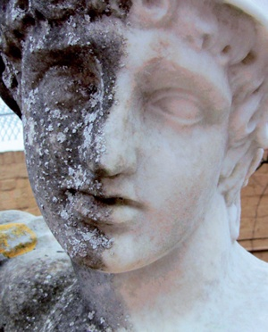
Sulfur dioxide
SO₂ can result in acid rain via sulfate formation.
Sulfate in acid rain can react with gypsum and ettringite in concrete, resulting in surface degradation.
Limestone, marble, carbon-steel, zinc, nickel, paint, and some plastics can be damaged. This impact can be seen on sculptures.

Slide 3
Particulate matter
PM can be abrasive in high wind, speeding wind erosion.
PM can also accelerate degradation resulting from SO2.
High PM concentrations tend to be centralized in cities, which have high wind speeds and high building density

Slide 4
Carbon monoxide
Carbon monoxide is dangerous to human health and has many anthropogenic sources.
Carbon monoxide has no significant effect on structural or aesthetic building components.

Slide 5
ozone
Ozone is a strong oxidant and reacts with many compounds.
Ozone reacts with aldehydes emitted by indoor materials.
It can act as a deodorizing compound or an odorant.
Stratospheric ozone degradation is strongly protected under global regulations.
This involved the development of new refrigerants, aerosol propellants, and solvents.

Slide 6
Nitrogen dioxide
NO₃ can result in acid rain.
Nitrate in acid rain can react with gypsum and ettringite in concrete, resulting in surface degradation.
Limestone, marble, carbon-steel, zinc, nickel, paint, and some plastics can be damaged.

Slide 7
lead
Lead is highly toxic, and consumption has been reduced so that the general population does not come into contact with it as often.
This has resulted in the replacement of some commonly used materials in construction, like lead water pipes, lead solder, and lead paint.
Some of these products are still exported from the US.

Slide 8
Other concerns
Asbestos
Asbestos was determined to be carcinogenic. It is no longer used as an insulation material and many regulations control how to work with existing asbestos. This affects how structures are designed, but not degradation.
Chlorides
Chlorides dissolved in rain can result in steel and reinforcing steel degradation via chloride attack.
Ventilation
New concerns about indoor air quality are increasing the requirements for buildings to have high quality ventilation systems.

Slide 9
Sources
http://chemistry.elmhurst.edu/vchembook/196buildings.html
http://ajer.org/papers/v3(3)/ZT33359364.pdf
http://www.toxipedia.org/display/toxipedia/History+of+Lead+Use
https://www.epa.gov/indoor-air-quality-iaq/adapting-buildings-indoor-air-quality-changing-climate
https://theplumbinginfo.com/top-seven-plumbing-products-no-longer-use/
http://www.air-quality.org.uk/12.php
http://www.mfe.govt.nz/air/specific-air-pollutants/nitrogen-dioxide
https://www.designingbuildings.co.uk/wiki/Ozone_depleting_substances#Examples_of_ozone_depleting_substances
https://inspectapedia.com/sickhouse/Ozone_Toxicity.php
https://www.sciencedirect.com/science/article/pii/S135223100601123X
https://www.sciencedirect.com/science/article/pii/S1352231015305082
https://www.epa.gov/indoor-air-quality-iaq/carbon-monoxides-impact-indoor-air-quality
https://www.sciencedirect.com/science/article/pii/S0950061801000125

