Slide 1
Light Pollution
Kelsey Abernathy

Slide 2
What is Light Pollution?
Inappropriate or excessive use of artificial light in ordinarily dark conditions
Atmosphere not entirely dark without terrestrial light—artificial light just increases this
Air glow
Ionization of particles from UV radiation emits photon—constant emission even at night
Light scattering
From distant stars, Milky Way, and zodiacal light
Artificial light is this but from the ground, which blocks out the stars
Before and during the 2003 Northeast blackout, a massive power outage that affected 55 million people. Photo by of Todd Carlson
Notes:
t high altitudes, primarily above the mesosphere, there is enough UV radiation from the sun of very short wavelength to cause ionization. When the ions collide with electrically neutral particles they recombine and emit photons in the process, causing airglow. The degree of ionization is sufficiently large to allow a constant emission of radiation even during the night when the upper atmosphere is in the Earth's shadow. Lower in the atmosphere all the solar photons with energies above the ionization potential of N₂ and O₂ have already been absorbed by the higher layers and thus no appreciable ionization occurs.

Slide 3
Components of light pollution include:
Glare – excessive brightness that causes visual discomfort
Skyglow – brightening of the night sky over inhabited areas
Light trespass – light falling where it is not intended or needed
Clutter – bright, confusing and excessive groupings of light sources

Slide 4
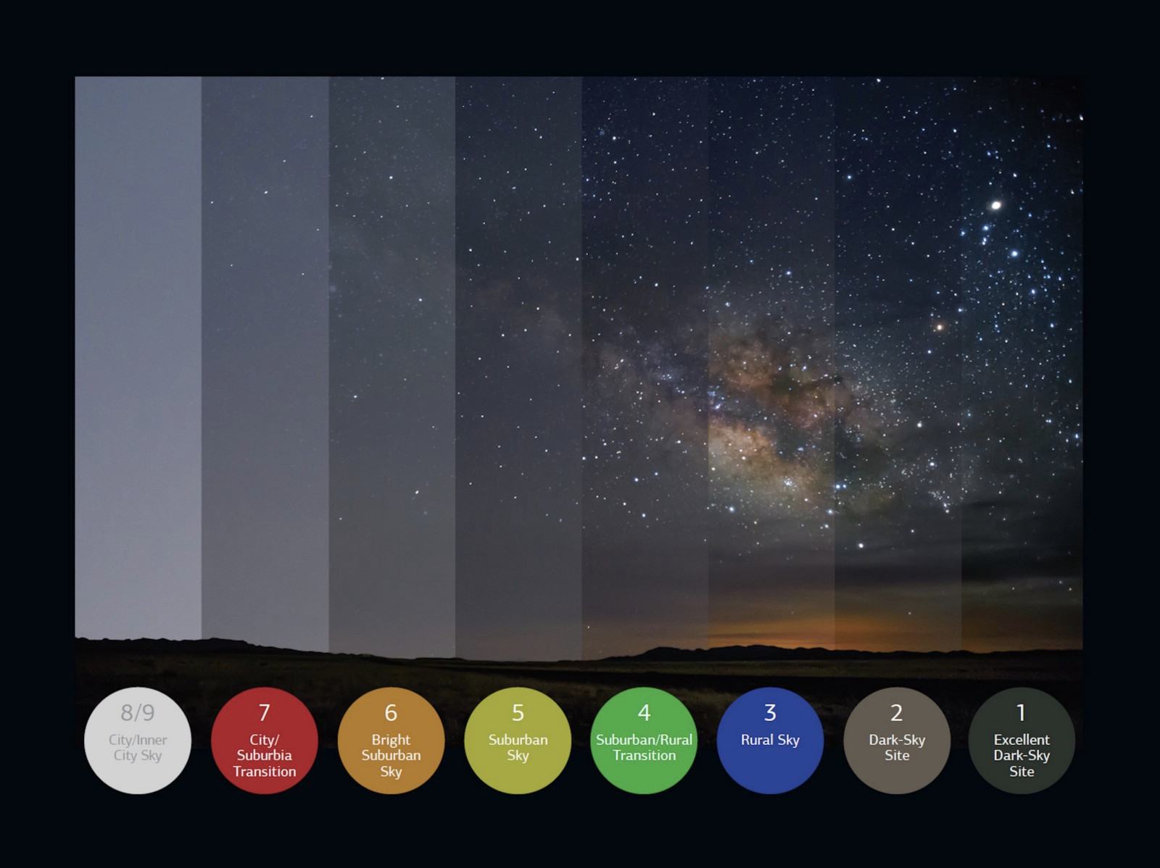
Bortle scale is a nine-level measuring system used to track how much light pollution there is
Under 5 can see the Milky Way, 8 and 9 given to brightest cities

Slide 5
How does it affect us?
Human Health
Messes up natural circadian rhythm → noted a carcinogen in 2007
Increased headaches, stress, and anxiety
Ecosystems
negative impacts on plant and animal physiology
Confuse navigation
Astronomy
reduces the contrast between stars and galaxies and the sky itself
Increase in atmosphere pollution
Destroys nitrate radicals → preventing the normal night time reduction of atmospheric smog produced by fumes emitted from cars and factories
Notes:
increased headache incidence, worker fatigue, medically defined stress, decrease in sexual function and increase in anxiety
can confuse animal navigation, alter competitive interactions, change predator-prey relations, and cause physiological harm

Slide 6
Solutions?
Only use lighting when necessary
Improving lighting fixtures
Change bulbs in street lamps, face light bulbs downward, etc.
3. Reduce air pollution
Significantly worsened by the presence of dusts and polluting gases
4. Dark hours

Slide 7
References
https://www.darksky.org/
https://www.importantindia.com/23694/light-pollution-meaning-causes/
https://www.rsc.org/images/environmental-brief-no-3-2014_tcm18-237724.pdf
https://www.globeatnight.org/light-pollution.php
https://www.bbc.com/news/science-environment-11990737
https://www.sciencetopia.net/pollution/light/causes-effects

Slide 8
Questions?

