Slide 1
CO₂ as a Polymer Precursor
A summarization of potential pathways for use of CO₂ as both a monomer and a precursor for polymer production
Kevin Adams

Slide 2
Why is this important
CO₂ as a greenhouse gas
CO₂ production from fossil fuels > green consumption [2]
Most polymers currently derived from petroleum based feedstocks
CO₂ as polymer precursor will decrease fossil fuel consumption and potentially lower currently levels

Slide 3
CO₂ as a monomer
Epoxide copolymerization
Alkyne copolymerization
Olefin copolymerization
Diol copolymerization
Polymethacrylates
Bioderived epoxides

Slide 4
Epoxide Copolymerization
First successfully carried out by Inoue et al. in 1969 [7]
Can be used to synthesize polycarbonates
Safer than older methods involving bisphenol A (BPA) and phosgene
Diethylzinc/water (1:1) catalyst system found to be best with PPO and multiple other simple epoxides
Trans product formation
Cyclic byproduct by backbiting and high polyether copolymerization
Later work by Darensbourg et al. in 1995 expanded on catalyst systems [5]
Synthesis of poly(cyclohexene carbonate) from cyclohexene oxide [1]
Copolymer system | Catalyst | p (CO₂) (bar) | T (°C) | t (h) | References
CO₂ + PPO | ZnEt₂/H₂O | 20–50 | 80 | 48 | [3]
CO₂ + CHO | ZnEt₂/H₂O | ~50 | RT | 45 | [4]
CO₂ + CHO | Zn(II) phenoxides | ~55 | 90 | 69 | [5]
CO₂ + CHO | Zn-fluoroalkyl | ~57 | 60–172 | 24 | [6]
CO₂ polymerization parameters with epoxides. PPO is propylene oxide, CHO is 1,2 cyclohexene oxide [1]
Notes:
-BPA leaks out of plastic, harmful
-High turnover
-Already widely accepted of PC production (BPA free and old)

Slide 5
Alkyne Copolymerization
Work by Song et al. in 2018 [8]
Reacting CO₂ with diyne and alkyl dihalide in presence of Ag₂WO₄ catalyst with Cs₂CO₃ and N,N-dimethylacetamide additives
Reacting with a triphenylamine containing diyne lead to formation of telechelic polymer
High yield (~95%) under mild conditions (80 C over 12 h)
Poly(alkanoate)s can be hydrolyzed under alkaline environment at ambient conditions
Synthesis of poly(alkatone) from diyne, alkyl dihalide, and CO₂ [1]
Notes:
-Strong contender for industrial process
-Promising for medical applications
-Biodegradable

Slide 6
Olefin Copolymerization
Synthesize poly(caprolactone)/polyester
Direct olefin copolymerization with CO₂ is often limited by the propagation step (endothermic)
Often leads to homopolymerization of the olefin [1]
Nakano et al. used a lactone intermediate to get around this in 2014 [9]
Also developed one-pot processes for both co- and ter-polymerization with other dienes
Sustainable and scalable process
35-46% yield at 80 C for 3-20 h
Synthesis of poly(caprolactone) through conceited radical polymerization of lactone synthesized from diene and CO₂ [1]
Notes:
-Original to step process later refined into one step
-Scalable, but low yield make not as desirable
-Also shown to work with Pd/phophine catalyst

Slide 7
Diol Copolymerization
Synthesize polycarbonates
Kadokawa et al. reacted CO₂ with p- and m-xylenes to form poly(xylylene carbonate) in 1998 [10]
Tamura et al. reacted CO₂ with 1,4-butylene diol to form poly(tetramethylene carbonate) using a cerium oxide catalyst and 2-cyanopyridine promotor in 2016 [11]
Required high pressures (up to 12 MPa = 120 bar) and elevated temperature (160 C)
Harder than Epoxide copolymerization, but reactants cheaper (1,4-butanediol is ~30% price of cyclohexene oxide)
Synthesis of poly(tetramethylene carbonate) from 1,4-butanediol and CO₂
Notes:
-Xylenes from petroleum sources
-Promoter necessary to consume water and drive polymerization forward

Slide 8
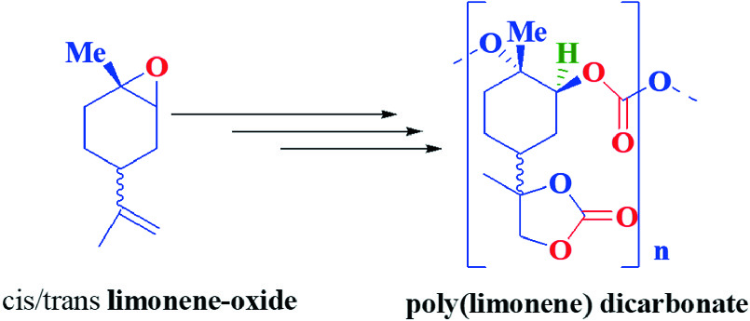
Other methods
Polymethacrylates
Bioderived Epoxides
Typically conceited two step mechanism to form polymethacrylates
Ochiai et al. proposed radical polymerization of glycidyl methacrylate [12]
Works under 1 atm CO₂
CO₂ incorporation controlled by LiBr
D-limonene obtained from orange peel
Limonene oxide is abundant and structurally similar to cyclohexene oxide
Byrne et al. reported alternating copolymerization under mild conditions (25 C, 100 psi) using CO₂ and limonene oxide [13]
Notes:
-Polymethacrylate works under low pressures
-Limonene oxide is nature source of epoxide (rather than synthetic)

Slide 9
Future
Using CO₂ as feedstock for polymers is more sustainable than relying solely on fossil fuel sources
Most CO₂ based polymers are more biodegradable and biocompatible than fossil fuel based alternatives
Multiple different potential polymers (not just polycarbonates)
Reactions must be made cost effective if they are to be deployed enmass
Cost to produce CO₂ must be less than cost to produce FF polymer
Atmospheric P_{co2} ≈ 4 x 10⁻⁴ bar
Will require CO₂ scrubber or direct to source access to get partial pressure high enough
P_{CO2} increasing at ~2.3 x 10⁻⁶ bar each year, or 2.6 x 10¹⁴ mol yr⁻¹
Using CO₂ for polymer production (~1000 mol CO₂ per mol polymer, ~2 x 10⁸ mol polyethylene produced each year) cannot offset yearly CO₂ increase alone

Slide 10
Sources
[1] Mulchandani N., Katiyar V. (2020) Polymers from Carbon Dioxide—A Route Towards a Sustainable Future. In: Katiyar V., Kumar A., Mulchandani N. (eds) Advances in Sustainable Polymers. Materials Horizons: From Nature to Nanomaterials. Springer, Singapore
[2] Cui Y, Tang X, Huang X, Chen Y (2003) Synthesis of the star-shaped copolymer of ε-caprolactone and l-lactide from a cyclotriphosphazene core. Biomacromol 4:1491–1494.
[3] Inoue S, Kobayashi M, Koinuma H, Tsuruta T (1972) Reactivities of some organozinc initiators for copolymerization of carbon dioxide and propylene oxide. Makromol Chem 155:61–73.
[4] Inoue S, Koinuma H, Tsuruta T (1969) Copolymerization of carbon dioxide and epoxide. J Polym Sci B 7:287–292.
[5] Darensbourg DJ, Holtcamp MW (1995) Catalytic activity of zinc(II) phenoxides which possess readily accessible coordination sites. copolymerization and terpolymerization of epoxides and carbon dioxide. Macromolecules 28:7577–7579.
[6] Super M, Beckman EJ (1998) Copolymerization of CO2 and cyclohexene oxide. Macromol Symp 127:89–108.
[7] Inoue S, Koinuma H, Tsuruta T (1969) Copolymerization of carbon dioxide and epoxide with organometallic compounds. Makromol Chem 130:210–220.
[8] Song B, He B, Qin A, Tang BZ (2018) Direct polymerization of carbon dioxide, diynes, and alkyl dihalides under mild reaction conditions. Macromolecules 51:42–48.
[9] Nakano R, Ito S, Nozaki K (2014) Copolymerization of carbon dioxide and butadiene via a lactone intermediate. Nat Chem 6:325.
[10] Kadokawa J, Habu H, Fukamachi S, Karasu M, Tagaya H, Chiba K (1998) Direct polycondensation of carbon dioxide with xylylene glycols: a new method for the synthesis of polycarbonates. Macromol Rapid Commun 19:657–660.
[11] Tamura M, Ito K, Honda M, Nakagawa Y, Sugimoto H, Tomishige K (2016) Direct Copolymerization of CO2 and Diols. Sci Rep 6:24038.
[12] Ochiai B, Hatano Y, Endo T (2008) fixing carbon dioxide concurrently with radical polymerization for utilizing carbon dioxide by low-energy cost. Macromolecules 41:9937–9939.
[13] Byrne CM, Allen SD, Lobkovsky EB, Coates GW (2004) Alternating copolymerization of limonene oxide and carbon dioxide. J Am Chem Soc 126:11404–11405.

