Slide 1
Greenhouse Emissions from the Energy Sector
Devon Goldy
Chem 4740

Slide 2
Objective
Background to Unites States energy sector
Explain why this is important to the realm of atmospheric chemistry
Discuss changes being made to the sector
Give brief discussion of current research in the area

Slide 3
Background
Energy sector is one of the largest sectors in the United States
Makes up about 12% of total exports
Approximately 100 quadrillion BTU of energy are consumed each year (United States, EIA)
Production is about 95 quadrillion BTU
Made up of fossil fuels, nuclear, and renewable sources
***I say the US has to export (which we do) but I meant to say we have to import energy sources to meet demand***

Slide 4
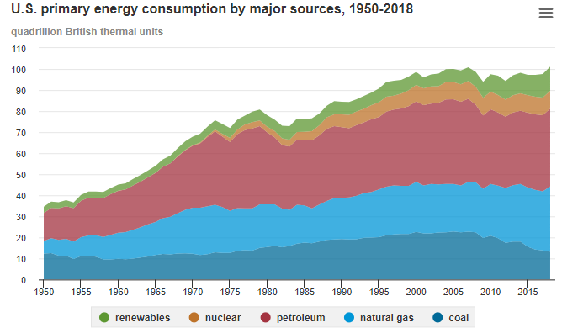
Breakdown of Energy Sources
https://www.eia.gov/energyexplained/us-energy-facts/
Notes:
Fossil fuel breakdown (80 quadrillion)
Coal→13%
Petroleum →36%
Natural Gas →31%
Renewable (11.52 quadrillion BTU)
Biomass → 45% (biofuels, wood, and waste)
Hydro → 23%
Solar →8%
Wind→22%
Geothermal→2%

Slide 5
Why Should We Care?
Fossil Fuel sources make up the majority of energy in the US
Large amount of GHG emissions in the Atmosphere
Increased ground level ozone
The ability to produce these fuels requires:
Mining
Horizontal Drilling
Fracking (Hydraulic Fracturing)
Notes:
80% of energy produced
76% of GHG emissions
GHG →CO₂, methane, nitrous oxides, HFCs, PFCs and other high GWP gases
93 % of CO₂ comes from fossil fuels
Methods to obtain can cause for leakage of gases into the atmosphere or require venting of gases

Slide 6
CO₂ produced from Fossil Fuels
Fuel Source | Pounds of CO₂ emitted/BTU
Coal | 215.4
Diesel | 161.3
Ethanol Free Gasoline | 157.2
Natural Gas | 117.0
https://www.eia.gov/tools/faqs/faq.php?id=73&t=11

Slide 7
Energy Sector Changes
Use of natural gas increases over other fossil fuels
Renewable sources were previously unreliable
Increased research in the use of various renewable sources
Notes:
Natural gas has higher efficiency rate at approx. 40% vs other fossil fuels which fall below 30%; produces less CO₂
detrimental due to increased GWP of methane if leakage occurs
Most renewable sources of energy have been considered unreliable for quite some time
Factors that contribute to this are the efficiency of the sources being relatively low, issues with infrastructure and location, potential toxins that could be present in high efficiency solar cells
Current research has evolved due to the growing desire to reduce GHG.
efficiency improvements in solar power have been found with the use of stacked cells
wind turbines have had improvements in the amount of energy providable

Slide 8
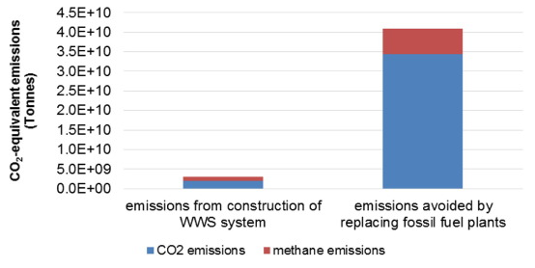
Current Research to Adjust
Transition to renewable sources by the use of excess natural gas
Would make over 80% of United States energy source be renewable over 30 year period
Methane has a leakage rate of 0.013 g CH₄/1 g Natural Gas
CO₂ less potent as GHG than methane by about 30x over 100 year period
Could be reduced to 15 year process if resources are allocated
Wu, K.; Paranjothi, G.; Milford, J. B.; Kreith, F. Transition to Sustainability with Natural Gas from Fracking. Sustain. Energy Technol. Assessments 2016, 14, 26–34.
Notes:
Majority of excess comes from fracking
Renewable → wind, hydro, solar
Would require 10⁷ GWh of energy from natural gas over a 30 year time period; return of 10⁸ GWh from renewables
Leakage causes concerns of increased GWP from the methane

Slide 9
References
Wu, K.; Paranjothi, G.; Milford, J. B.; Kreith, F. Transition to Sustainability with Natural Gas from Fracking. Sustain. Energy Technol. Assessments 2016, 14, 26–34.
U.S. energy facts explained - consumption and production - U.S. Energy Information Administration (EIA) https://www.eia.gov/energyexplained/us-energy-facts/
Where greenhouse gases come from - U.S. Energy Information Administration (EIA) https://www.eia.gov/energyexplained/energy-and-the-environment/where-greenhouse-gases-come-from.php.
How much carbon dioxide is produced when different fuels are burned? - FAQ - U.S. Energy Information Administration (EIA) https://www.eia.gov/tools/faqs/faq.php?id=73&t=11.

