Slide 1
Air Travel and Earth’s Atmosphere
Juan Pablo Gomez
Chem 4740

Slide 2
Agenda - Air Travel
Airplanes
Rockets
Space debris
Pollution - how much?
Current and future solutions

Slide 3
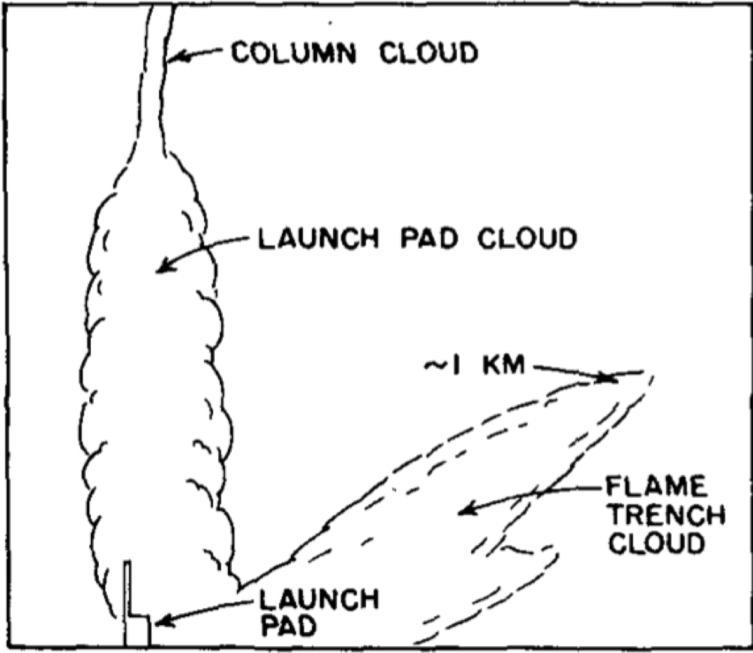
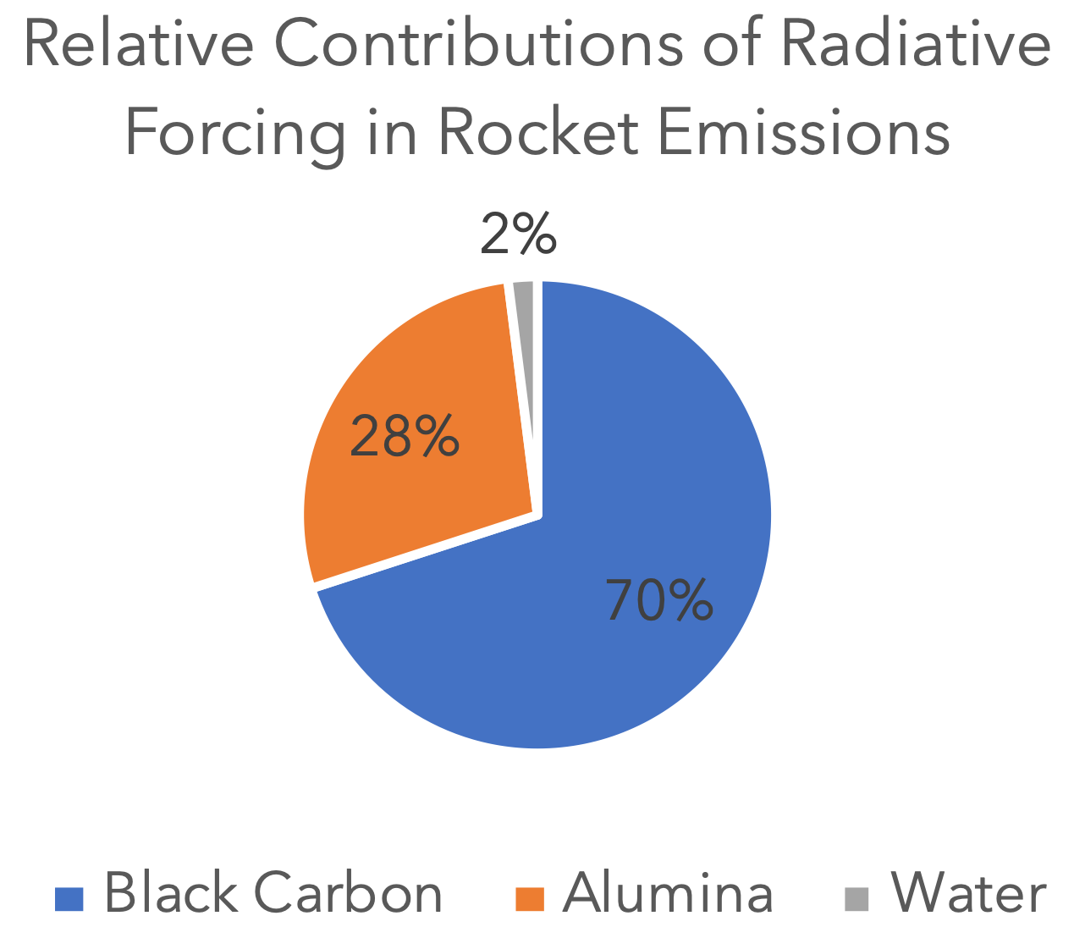
Rockets
Fuel: kerosene
CO2, H2O, NO (10³ to 10⁵ Saturn- type rockets per year)
Na, K, Li, (less than ~100 launches per year)
Alumina Particles/soot (0.1 $\frac{μ\text{g}}{{\text{m}}^{3}⋅\text{min}}$)
Total radiative forcing of rockets: 16 $±$ 8 $\frac{\text{mW}}{{\text{m}}^{2}}$
Kellogg, W. W., Pollution of the upper atmosphere by rockets. Space Science Reviews 1964, 3 (2), 275-316.
Notes:
Rocket fuel is made of kerosene with a smaller mixture of other components so that the most available energy is packed into the smallest amount of space. The combustion of this fuel releases what you see below. But how much pollution are rockets generating per year? Is this enough to contribute like other modes of transportation?
Alumna particles source of pollution for several days
The Montreal Protocol does not specifically address emission sources such as rockets
Solutions include: Change public perception of rocket launchers
Research new propellants that are better and less harmful for environment (analyzing plumes)
Regulations: MP only for gases emitted from Earth surface so Ozone Depletion Potential (ODP) aren’t formally assigned an ODP = no regulation. Expand regulations for rockets too

Slide 4
“The pace of rocket launches is predicted to grow and space transport RF could become comparable to global aviation RF in coming decades.”
-Martin N. Ross, AGU (American Geophysical Union)
Notes:
The American Geophysical Union (AGU) is a 501(c)(3) nonprofit organization of Earth/Atmospheric scientists, consisting of over 62,000 members from all over world
Washington DC HQ

Slide 5
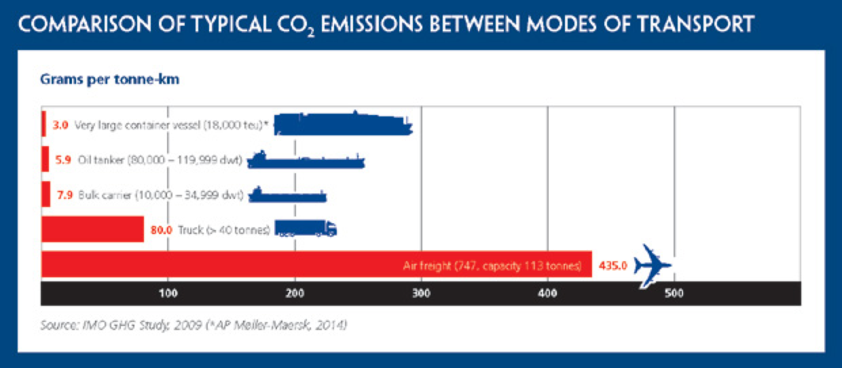
Airplanes
Airplane emissions make up 12% of all CO2 emissions from transport sources
CO2, NOx, H2O
Current Regulations: U.S. Clean Air Act
Possible solutions?
Fuel efficiency
Regulations
Ross, M., and Vedda , J. A. (2018, April) The Policy and Science of Rocket Emissions . Aerospace. The Aerospace Corporation.
Notes:
CO2 = more global warming and acidifies ocean
NOx = effective in forming ozone (O3) in the upper troposphere.
H2O = forms contrails (higher RF than CO2) that warms planet
“some of the top 20 transatlantic air carriers can drive down emissions by as much as 51 percent using existing technology and operational improvements, and still remain competitive with their better-performing peers.” - Council on Clean Transportation

Slide 6
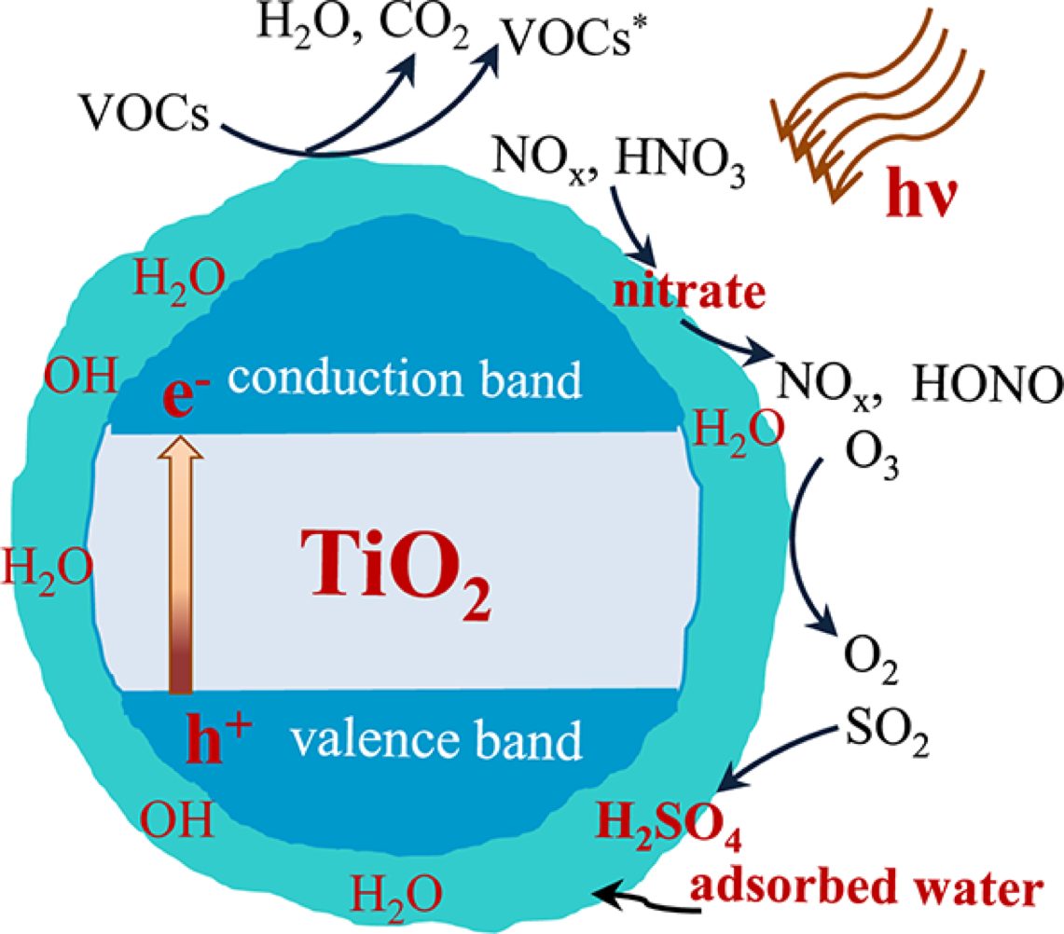
Space Debris
Rapid recent growth
As of 2009, 19,000 debris over 5 cm (2 in) were tracked.
Aluminum and titanium
Ecological dangers?
Transparency of near-Earth space and the atmosphere
Photochemistry
Solutions?
Clean up solutions met with controversy
Chen, H.; Nanayakkara, C. E.; Grassian, V. H., Titanium Dioxide Photocatalysis in Atmospheric Chemistry. Chemical Reviews 2012, 112 (11), 5919-5948.
Notes:
9% aluminum aerosol is soluble in water in Pacific
Controversy = who funds trash removal?
= negotiating the international diplomatic space with other countries

Slide 7
Conclusion and Further Work
Rockets
Not as much as cars/airplanes, but growing
Fuel Propellant research
Airplanes
Highest radiative forcing, closely regulated internationally
New regulations
Satellite Space debris
Recent growth, photocatalysis
Further research
Notes:
National defense, space flight
Lifeline for remote areas, globalization
GPS, weather tracking, telecommunications, space exploration

Slide 8
References
Kellogg, W. W., Pollution of the upper atmosphere by rockets. Space Science Reviews 1964, 3 (2), 275-316.
Hindman, E.; Radke, L.; Eltgroth, M., Measurements of Cloud Nuclei in the Effluents from Launches of Liquid- and Solid-Fueled Rockets. J Appl Meteorol 1982, 21.
Ross, M. N.; Sheaffer, P. M., Radiative forcing caused by rocket engine emissions. Earth's Future 2014, 2 (4), 177-196.
Pardee, V. (2017) Airplane Emissions.
Lawrence F Radke, P. V. H., and Dean A. Hegg, Aerosols and Trace Gases in the Effluents Produced by Launch of Large Liquid- and Solid-fueled Rockets. Journal of Applied Meteorology 1982, 21, 1332-1345.
McCarthy, N. (2019, October 21) The Worst Offenders For Air Travel Emissions. Forbes. Forbes Magazine.
Ross, M., and Vedda , J. A. (2018, April) The Policy and Science of Rocket Emissions . Aerospace. The Aerospace Corporation.
Camero, K. (2019, July 2) Aviation's dirty secret: Airplane contrails are a surprisingly potent cause of global warming. Science Magazine. American Association for the Advancement of Science.
Kärcher, B., The importance of contrail ice formation for mitigating the climate impact of aviation. Journal of Geophysical Research: Atmospheres 2016, 121 (7), 3497-3505.
Cirium. (2020, January 3) BA begins offsetting domestic flight emissions. Flight Global. DVV Media International Limited .
Maring, H. B.; Duce, R. A., The impact of atmospheric aerosols on trace metal chemistry in open ocean surface seawater, 1. Aluminum. Earth and Planetary Science Letters 1987, 84 (4), 381-392.
Appendix C: The Atmospheric Corrosion Chemistry of Aluminum. In Atmospheric Corrosion, pp 272-281.
Chen, H.; Nanayakkara, C. E.; Grassian, V. H., Titanium Dioxide Photocatalysis in Atmospheric Chemistry. Chemical Reviews 2012, 112 (11), 5919-5948.
Garcia, M. (2009, April 28) The Threat of Orbital Debris and Protecting NASA Space Assets from Satellite Collisions. NASA. NASA.

Slide 9
Questions?

