Slide 1
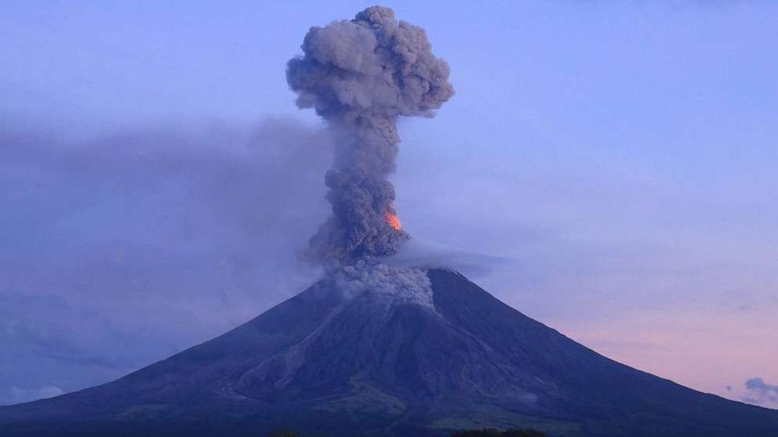
The Effect of Volcanic Eruptions on Stratospheric Ozone
MC Hulgan
CHEM 4740
14 April 2020
Image: ABC News, Charism Sayat

Slide 2
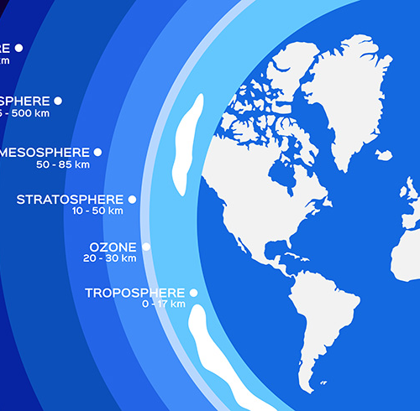
The Ozone Layer
Altitude 20-30 km
Absorbs solar UV radiation
In danger of depletion by atmospheric pollution
Image: The GEF
Notes:
As we’ve talked about in class, the ozone layer is a relatively thin layer of ozone in Earth’s stratosphere at an altitude of 20-30 km. It’s important for the environment because it absorbs solar ultraviolet radiation that would otherwise reach the surface, where it could cause harm to living beings exposed to it by destruction of DNA, leading to complications ranging from burns and irritation to skin cancer . Without the UV protection provided by the ozone layer, the earth would be functionally uninhabitable. Since the 1980s, it has been known that the ozone layer is in danger of depletion by atmospheric pollutants such as chlorine compounds known as ClOx. A hole in the layer has been observed over Antarctica since 1985. Since the introduction of the Montreal protocol in 1987, efforts have been made to slow this depletion and repair the hole by eliminating human production of chlorofluorocarbons, which were previously a common ingredient in aerosol sprays and can react in the atmosphere to form ozone-depleting ClOx. Significant progress has been made since 1987, and the hole is believed to be shrinking, indicating that it may eventually be restored. However, the threat of ozone depletion remains and continued efforts are required to facilitate its replenishment and prevent further damage. Part of this process requires identifying substances that may deplete the ozone layer, the sources of these substances, and the mechanisms by which they cause depletion.

Slide 3
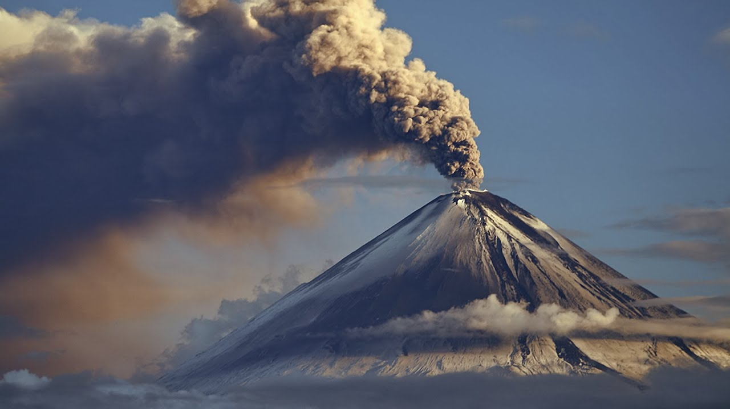
Volcanic Eruptions
Release lava, ash, and gases
CO2, SO2, H2S, F2, HF, etc
Image: BBC
Notes:
As we all probably know, volcanic eruptions occur when molten rock, ash, and gases escape through a rupture in Earth’s crust and reach the surface. Every aspect of a volcanic eruption can have a dramatic impact both on the immediate area surrounding the volcano and on the environment around the world, but for this presentation we’re focusing on the effects of gaseous emissions.

Slide 4
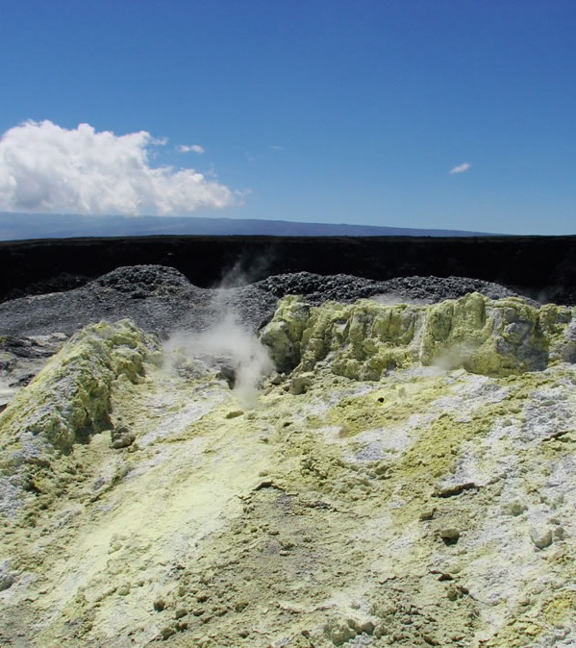
Volcanic Emissions
CO2
Greenhouse gas
Can cause suffocation at surface level
F2
Extremely toxic, denser than air so collects in low places
HF
Corrosive and toxic, causes internal burns
Can be absorbed into plants and cause long-term poisoning
H2S, SO2
SO2 can react with water vapor to form sulfuric acid; H2S is itself acidic
Volcanic fog – dangerous to breathe
Corrosive and toxic
Sulfur aerosols in upper atmosphere are the main cause of ozone depletion by volcanic eruptions
Photo: Jessica Ball
Notes:
Many of the gases released in a volcanic eruption have potentially harmful effects on the environment and on human life. Carbon dioxide is, as we know, a greenhouse gas capable of increasing heat retention around the Earth, and since it’s denser than air it can also cause suffocation if large amounts are released at once and collect near the ground. F2 is extremely toxic and, like carbon dioxide, is also denser than air and may cause suffocation and burns if it collects near the ground. Hydrofluoric acid is highly corrosive and toxic, with a special capacity to cause internal damage to the skeletal system. H2S and SO2 are or can become acidic when in contact with water vapor in the atmosphere. This can form volcanic fog, which is harmful to breathe. Finally, and the focus of this presentation, sulfur aerosols in the upper atmosphere are the main cause of ozone depletion by volcanic eruptions.

Slide 5
Effect of Sulfur Dioxide on Atmospheric Ozone
Can either slow or catalyze O3 production
Mechanism of Catalysis:
SO₂ + hv = SO + O (wavelength<220nm)
SO + O₂ = SO₂ + O
2(O + O₂ + M = O₃ + M)
3O₂ = 2O₃
Absorbs solar radiation at the same range of wavelengths (180-390 nm) needed for photolysis of O2 to produce O3
Reduces solar flux, slows photolysis, reduces ozone production
Removes NOx from atmosphere, making the ozone layer more sensitive to ClOx
Huff, 1996
Notes:
A study in 1996 found that SO2 can actually act as both a hindrance and a catalyst to ozone production. The mechanism of catalysis described here involves SO2 undergoing photolysis to produce oxygen, which reacts with O2 to form ozone. However, SO2 also absorbs solar radiation at the same range of wavelengths as O2 does, thereby reducing solar flux and slowing the photolysis of O2 to produce ozone. These two processes largely cancel each other out – however, when SO2 condenses as sulfuric acid into atmospheric aerosols, the surface of these aerosols can react with NOx to form nitric acid, thereby removing NOx from the atmosphere. Since NOx usually reacts with and neutralizes ozone-depleting chlorine compounds, its removal from the atmosphere allows the unmitigated destruction of ozone by ClOx.

Slide 6
Differences over Time
Immediately after volcanic eruption
25 km: Absorption and catalysis effects balance out and ozone levels remain stable
Below cloud: Solar radiation blocked, ozone depleted
After 2 months
Most SO2 converted to H2SO4
Condensed to atmospheric aerosols which remove NOx from the atmosphere
20 km: Ozone-depleting radicals increased 25-50% with assumption of slight stratospheric heating
NO2 decreased 40%; ClO increased by a factor of 2.3 when studied without heating
After 7 months
Even cloud distribution over the earth
20-25 km: NO2 decreased 30-35%
Notes:
The time-dependent effects of SO2 after a volcanic eruption were studied using three computer models based on the 1991 eruption of Mt. Pinatubo in the Philippines, which released 15-30 MT of SO2 into the atmosphere and was linked to subsequent depletion of stratospheric ozone. The models simulated conditions immediately after the eruption, two months later, and seven months later. Immediately after the eruption, ozone levels at an altitude of around 25 km remained stable as the absorption and catalysis effects balanced each other out. Below the cloud, however, ozone levels were depleted because solar radiation was blocked.
After two months, assuming the cloud was mainly confined to the tropics, most of the SO2 was found to have been converted to sulfuric acid and condensed into atmospheric aerosols which in turn remove NOx from the atmosphere. At an altitude of 20 km and with the assumption of slight stratospheric heating due to SO2’s greenhouse effect, ozone-depleting radicals saw a 25-50% increase. Without the heating assumption, NO2 decreased by 40% and ClO increased by a factor of 2.3.
After 7 months, it was assumed that the cloud would be evenly distributed over the earth. At an altitude of 20-25 km, NO2 was decreased by 30-35%.
These models together illustrate both the short- and long-term effects of volcanic SO2 on the ozone layer and show that, while initially it doesn’t have a particularly strong impact, the long-term effects are significant.

Slide 7
Dependence on Atmospheric Pollution
SO2 catalysis/absorption effects generally balance out in an unpolluted atmosphere
However, if significant ClOx pollution is present, SO2 can magnify its effects by slowing its reduction
SO2 can also react with CFCs and convert them to more potent ozone-depleting species
Thus, volcanic eruptions become more dangerous if the atmosphere is already polluted with CFCs and other sources of chlorine
Notes:
Something I’ve touched on in the previous slides is that the primary mechanism of ozone depletion resulting from volcanic eruptions is not direct interaction between SO2 and ozone. In fact, the catalytic acceleration and absorptive slowing of ozone production by SO2 tend to balance each other out in the absence of other factors. The real difference comes from SO2’s potential to remove NOx from the atmosphere, thereby slowing the reduction of ozone-depleting ClOx, as well as its potential to react with CFCs and convert them to more potent ozone depleting species such as ClOx. Thus, volcanic eruptions become more dangerous to the ozone layer if the atmosphere is already polluted with CFCs and other sources of chlorine.

Slide 8
Future Implications
Due to current ClOx pollution, a large volcanic eruption today would have a significant negative impact on the ozone layer
If ozone-depleting pollution levels are driven down, volcanic eruptions may increase ozone layer thickness
Vulnerability to ozone depletion expected to continue into late 21st century
Previous estimates ranged from 2015 to 2040
Failed to account for other pollutants such as halogens and pollutants from nonhuman sources
Current estimate around 2070
Taal Volcano, Philippines
Erupted January 2020
Environmental effects not yet known/studied
Klobas et al. 2017
Notes:
With the current state of atmospheric pollution, the ozone layer is very vulnerable to damage caused by volcanic emissions. If a large volcanic eruption were to occur today, it could have a devastating impact on the ozone layer.
However, if pollution levels are driven down in the future, eruptions may actually increase the thickness of the ozone layer.
While previous estimates put the transition from ozone depletion to replenishment by volcanic emissions between 2015 and 2040, these estimates were based solely on interactions between anthropogenic pollutants and SO2 and failed to account for other volcanic emissions and pollutants from nonhuman sources such as plankton and microalgae. These species include halogen compounds such as organic bromine and hydrogen chloride, whose effect on ozone depletion would be potentially devastating.
More recent models indicate that the atmosphere will likely remain vulnerable to ozone depletion by volcanic emissions into the late 21st century, around 2070.
In recent news, you might have heard about the Taal Volcano in the Philippines, which erupted in January of this year and sent a plume of ash and gas up to 9 miles into the air, causing tens of thousands of residents to evacuate the area. As of right now, the long-term effects this eruption will have on the environment are not yet known, but will likely be studied in the coming months to years.

Slide 9
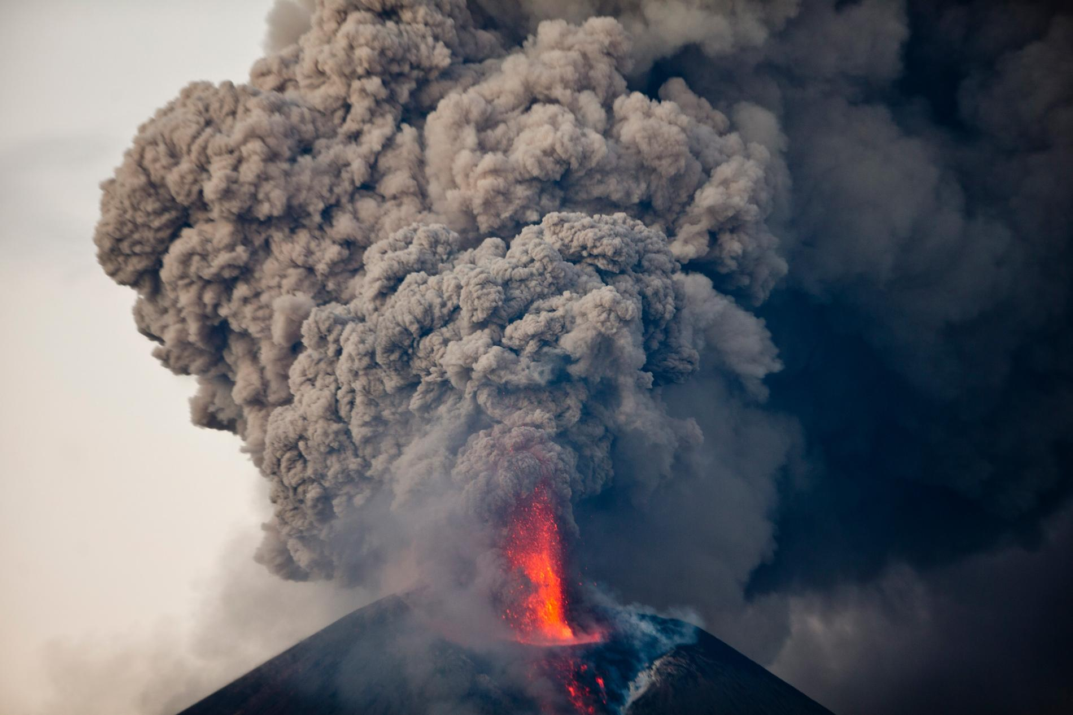
Thanks for listening!
Any questions?
Photo: National Geographic

Slide 10
Sources
Ball, J. Volcanic Hazards. https://geology.com/volcanoes/volcanic-hazards/
Huff, K. The Effects of Volcanic Sulfur Dioxide on the Ozone Layer. https://meteor.geol.iastate.edu/gcp/studentpapers/1996/atmoschem/huff.html
Klobas, J. E.; Wilmouth, D. M.; Weisenstein, D. K.; Anderson, J. G.; Salawitch, R. J. Ozone Depletion Following Future Volcanic Eruptions. Geophysical Research Letters 2017, 44 (14), 7490–7499.
How future volcanic eruptions will impact Earth's ozone layer. https://phys.org/news/2017-08-future-volcanic-eruptions-impact-earth.html (accessed Apr 14, 2020).
Weather.com. Volcanic Eruption in Philippines Forces Tens of Thousands to Flee. https://weather.com/news/news/2020-01-13-volcano-erupts-in-philippines-taal
The Global Environment Facility. World Ozone Day 2017: celebrating 30 years of the Montreal Protocol. https://www.thegef.org/news/world-ozone-day-2017-celebrating-30-years-montreal-protocol

