Slide 1
Acid Rain Against Ecology
By: Jason E Martinez

Slide 2
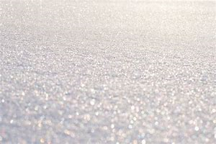
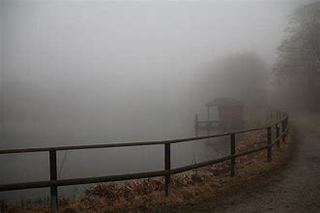
Introduction – What is Acid Rain
When fuels of nitrogen oxides, $NO_{X}$, and sulfur oxides, $SO_{X}$, are released to the atmosphere they react with water vapor
The reaction creates $HNO_{3}$ and $H_{2}SO_{4}$
Acid rain can take multiple forms:
Dust
Sleet
Drizzle
Fun Fact: The most acidic thing humans can handle is vinegar
Notes:
Why would we be worried about acid rain if the most acidic rain recorded equals to vinegar’s pH?

Slide 3
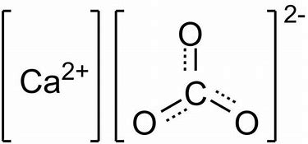
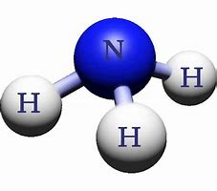
Tree Trunks, Branches, and Roots
Trees are sensitive to acid rain but in a certain part of terrain
The trees are so weak to acid that the wax protecting leaves are damaged badly enough they cannot use photosynthesis
Even though there have been acts against acid rain they are futuristically poor
Notes:
Soils naturally contain acid. These chemicals that make rain acidic are ammonia and calcium carbonate. However, mountainous regions are susceptible to acid rain because of their thin soils.
Some acts agree to lower the hydrogen cation concentration by a factor of two. That is not sufficient because that translates to a decrease pH of 0.3. Another dilemma is soils become sensitive after being neutralized from acid. Any additional acid in the future would be even more harmful than the past event.

Slide 4
Experiment #1: Appalachian Heights
From 1989 to 2012, the U.S. Forest Service doused acidic soil harmful to patches of trees
The purpose of the experiment is to see the effects it has on the ecosystem
The result was…
Five percent of additional water was soaked up by trees exposed to acidic soil
Calcium deteriorated from the acid causing the trees’ thirst for more water
Notes:
Less water can impact organisms who need water in small amounts.

Slide 5
Concerns About Experiment #1
Some say different trees and soils can have different results
Others say trees taking away 13.6 million liters of water each year is a huge risk
One said that…
Ecosystems are so sensitive to acid rain that rapid change can be hard to reverse
However, five percent might be too small since it is in a ‘natural range’
Yet, calcium is slow to recover in soils

Slide 6
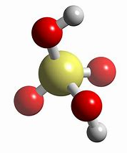
Volcanism Aftermaths
Acids can occur naturally than just soils
Toxic metals can be dissolved into sediments because of acidity
In the next article, the two hazardous elements are
Iron
Aluminum
Notes:
$H_{2}SO_{4}$ is produced by oxidation of the atmosphere. This gas is also possible by volcanic eruptions.

Slide 7
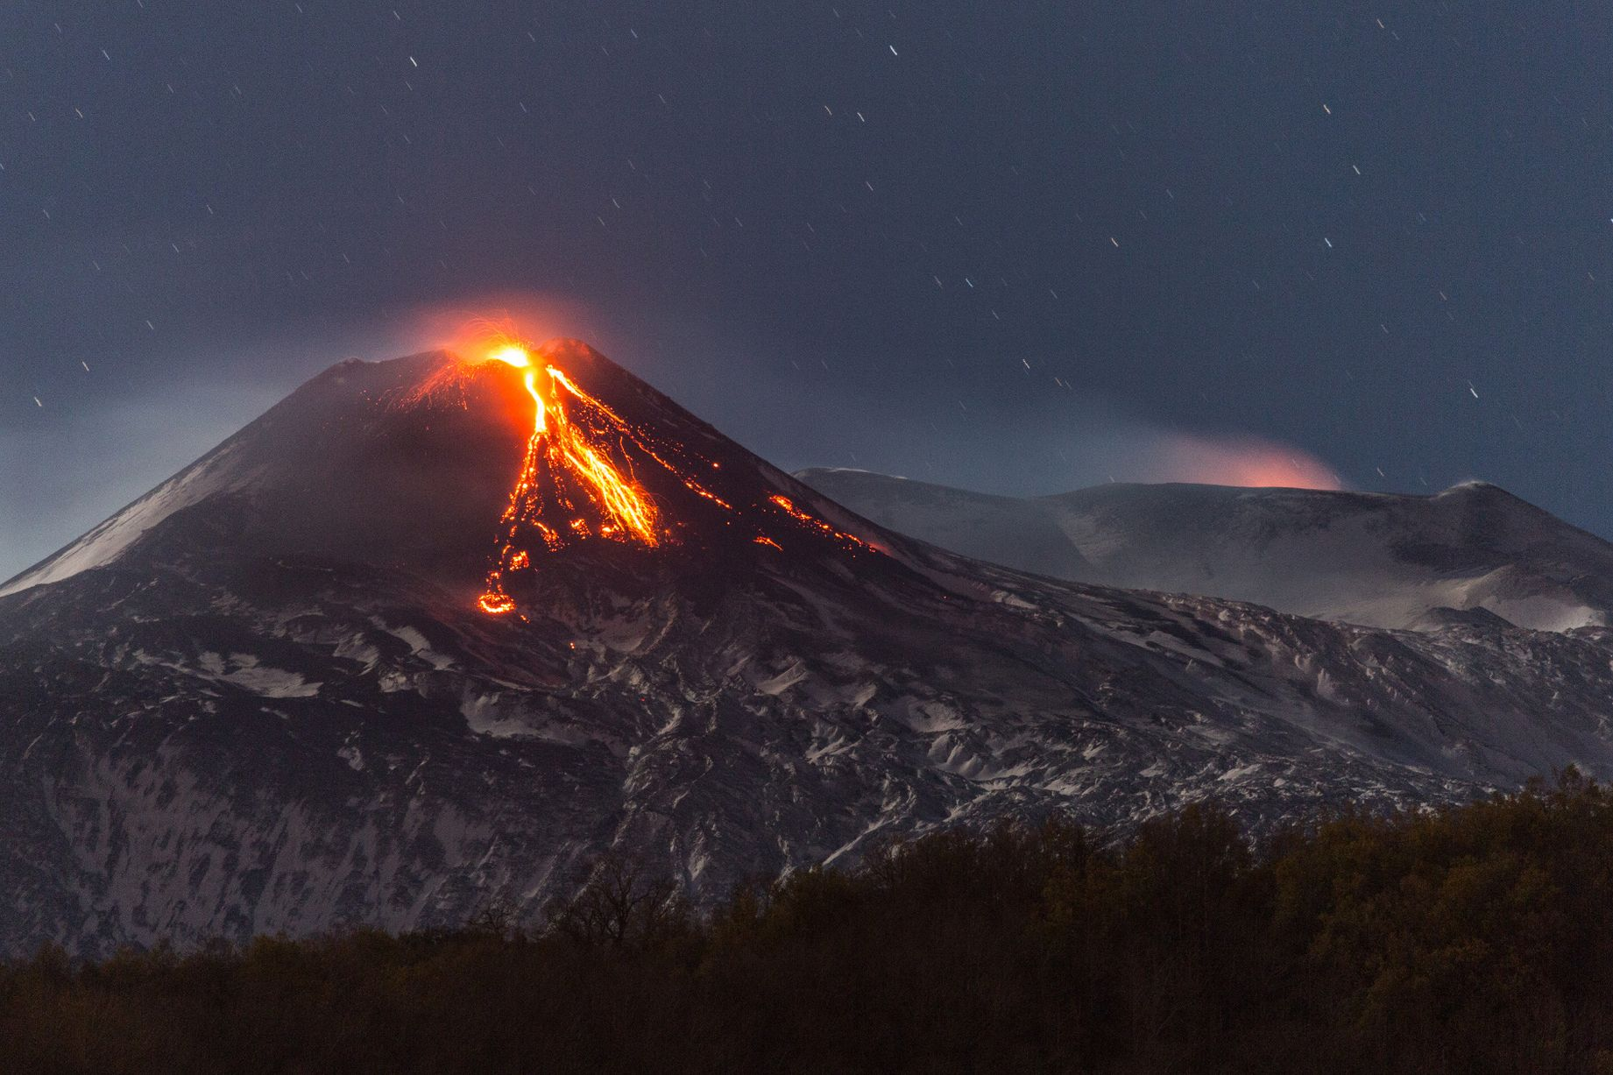
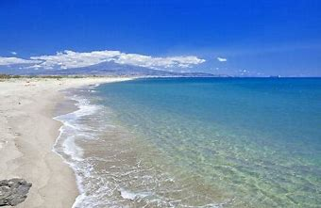
Experiment #2: Selenium (Se) Troubles
Location: Mount Etna, Italy
Livelihood
If acid rain is below a pH of four, Al and Fe precipitate Se to…
Selenate ($SeO_{4}^{ 2−})$
Selenite ($HSeO_{3}^{ 1−}$)
Se is easily able to be messed with since it is already naturally acidic
Plus, the volcano spews ten kilograms daily
Notes:
One million people live around Mount Etna rely on the mountain’s water source. Even though it contains sixty-six micrograms per liter of selenium above the World Health Organization’s guidelines of ten micrograms per liter, selenium being precipitated along with agriculture and urban wastewaters create additional hazards.
Thirteen micrograms per liter of selenium is already mixed with rainwater.

Slide 8
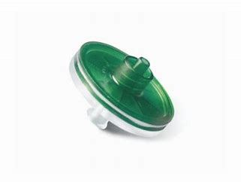
How They Did It
For two weeks…
Soils were collected from ten different distances away from the crater
Sartorius Minisart
Notes:
Rainwater was collected five and a half kilometers away from the volcano's craters. After being filtered using a Sartorius Minisart, the pH was at 2.95 with no precipitates.
In addition, iron was found between twelve hundredths to thirty- six milligrams per liter, and aluminum was found between two to one-hundred thirty milligrams per liter. The pH of soil was between 2.2 to 2.4.

Slide 9
Aftermath of Experiment #2
Selenium (Se) additional release may be responsible because…
Competition against sulfate
Dissolution of Al
Selenite ($HSeO_{3}^{1−}$) absorbs Al more effectively than selenate ($SeO_{4}^{ 2−})$
Two-thirds of the rainwater had the precipitate of selenite
Selenate ($SeO_{4}^{ 2−}$) is dominant in acidic soil within a three-kilometer radius of a crater
Sulfate competes with only selenate ($SeO_{4}^{ 2−})$ on soil absorption
Rocks do not have to be oversaturated to become precipitated from Al and Fe
Rocks precipitated with Al and Fe can be done without sulfate to a pH of less than four
Retention Time
Bromine (Br) was also found along with Al and Fe
A soil with lower pH can add up selenite ($SeO_{4}^{ 2−})$
Notes:
Selenite’s time formed on Earth’s surface has no affect on pH while selenate does.

Slide 10
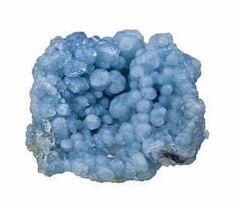
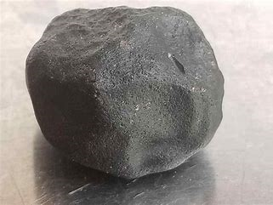
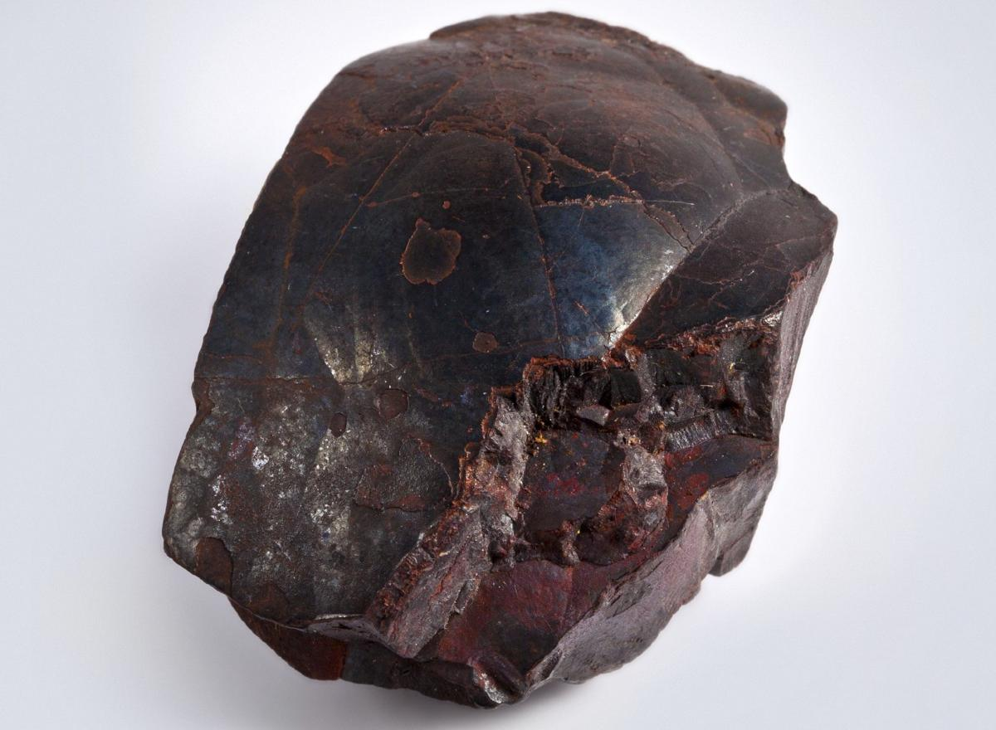
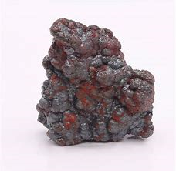
End of Mountain Trail
Rocks naturally containing Al and Fe such as…
Gibbsite
Amorphous
Hematite
Goethite
Selenate is more susceptible to enter aquifers than selenite
Research can solve other environmental problems
Thermal Waters
Acid Mine Drainage
Notes:
All these rocks can precipitate to a pH below four.

Slide 11
References
Floor, G.H., M. Iglesías, G. Román-Ross, P.F.X Corvini, and M. Lenz, 2011: Selenium speciation in acidic environmental samples: Application to acid rain-soil interaction at Mount Etna volcano, Chemosphere, 84, 1664-1670, https://doi.org/ 10.1016/j.chemosphere.2011.05.006.
Jacob, D.J., 1999: Acid Rain. INTRODUCTION TO ATMOSPHERIC CHEMISTRY, 247-256.
Wilke, C., 2019: Decades of dumping acid suggest acid rain may make trees thirstier. ScienceNews. Accessed 23 March 2020, https://www.sciencenews.org/article/decades-dumping-acid-suggest-acid-rain-may-make-trees-thirstier.
Young Peoples Trust for the Environment: Acid Rain. FACTSHEET. Accessed 08 April 2020, http://projects.ncsu.edu/project/bio183de/Black/chemreview/chemreview_reading/acid_rain.html.

