Slide 1
Long-Term Implications and Air Quality Benefits of Wind and Solar Power in the United States
Presented by Amy Moran
CHEM 4740
4/16/20

Slide 2
Overview of Air-Pollution Impacts
Wind and solar deployment have increased rapidly while regulatory and fossil fuel changes have decreased overall power-sector emissions of criteria air pollutants and CO₂
Beyond GHG reductions, expanded use of wind and solar energy could produce health, environmental, and ecosystem impacts related to air pollutants, water pollutants, land use and degradation, and waste generation and disposal
Air pollution is important to consider because of its significant costs to society
Benefits of wind and solar energy relative to fossil fuel energy sources include carbon and air-pollution emissions reductions, potential benefits from energy diversity and risk reduction, and local economic development activity

Slide 3
Modeling and Estimates
From 2007-2015:
- Estimated avoided generation and emissions using AVERT model
- Suite of air-quality models that cover different impact pathways, estimated
monetary and physical benefits, average of model results
From 2013-2050:
- Model scenarios of the U.S. electric sector in which wind generation
reaches 20% of end-use electricity demand in 2020, 20% in 2030, and
35% in 2050 compared against a baseline
- Evaluated impacts, costs, and benefits of this scenario using the ReEDS
capacity-expansion model
- Emission reductions translated into monetized health-damage reductions
using methods from the U.S. EPA Clean Power Plan and Air Pollution
Emission Experiments and Policy analysis model version 2 (AP2)

Slide 4
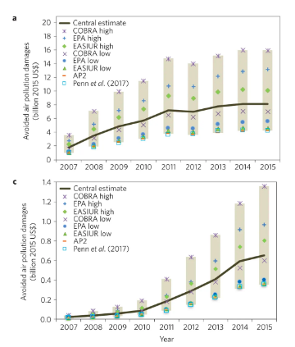
Avoided Damages
Emissions avoided due to wind generation between 2007 and 2015 produced $28.4-$107.9 billion ($54 billion for central case) in air-quality and public health benefits
Emissions avoided due to solar generation produced $1.3- $4.9 billion in air-quality and public health benefits

Slide 5
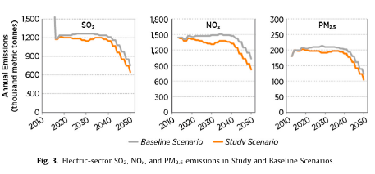
SO₂, NO_{x}, and PM_{2.5} Emissions

Slide 6
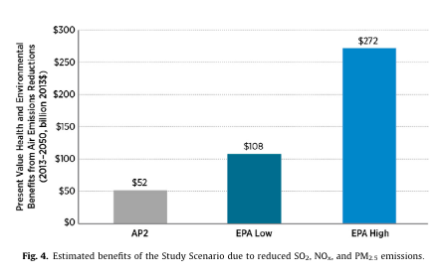
Estimated Benefits

Slide 7
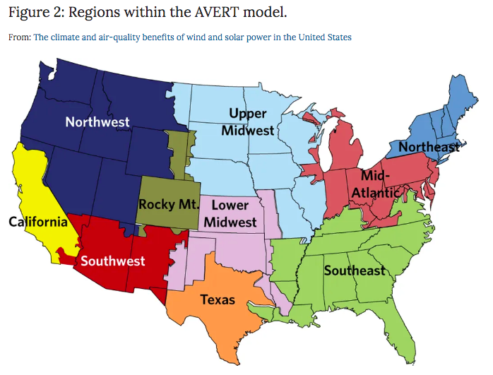
Conclusions
Future U.S. electricity system with wind as a major component could result in national and local benefits
Future applications include informing policymakers and justifying future wind deployment, methods for analysis can be used in other countries or with different technologies beyond wind
Refined policy mechanisms that direct wind and solar deployment to the regions of the country that offer the greatest benefits at the lowest cost would offer additional gain
Limitations include the assumption of no new wind development post-2013, U.S. wind demand has grown over time

Slide 8
References
Millstein, D., Wiser, R., Bolinger, M. et al. The climate and air-quality benefits of wind and solar power in the United States. Nat Energy 2, 17134 (2017). https://doi.org/10.1038/nenergy.2017.134
Wiser, R.; Bolinger, M.; Heath, G.; Keyser, D.; Lantz, E.; Macknick, J.; Mai, T.; Millstein, D. Long-Term Implications of Sustained Wind Power Growth in the United States: Potential Benefits and Secondary Impacts. Applied Energy 2016, 179, 146–158.
AVoided Emissions and geneRation Tool (AVERT). https://www.epa.gov/statelocalenergy/avoided-emissions-and-generation-tool-avert#what AVERT (accessed Apr 14, 2020).
Wind Vision. https://www.energy.gov/eere/wind/wind-vision (accessed Apr 14, 2020).

