Slide 1
Effects of Pollution on Human Health
By: Tyler Pollard

Slide 2
Criteria Air Pollutants¹
O₃
Particulate Matter
SO₂
NO₂
Pb
CO

Slide 3
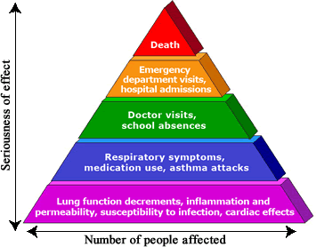
Ozone
Sources
Industrial facilities
Electrical utilities
Motor vehicles
Oxygen precursors
Effects
Inflammation of lining in lungs
Reduced lung function³
Possibly cause asthma and death (2)

Slide 4
Particulate Matter
2 Types
PM₁₀
PM_{2.5}
(4)

Slide 5
Particulate Matter
2 Types
PM₁₀
PM_{2.5}
(4)

Slide 6
Particulate Matter
(4)

Slide 7
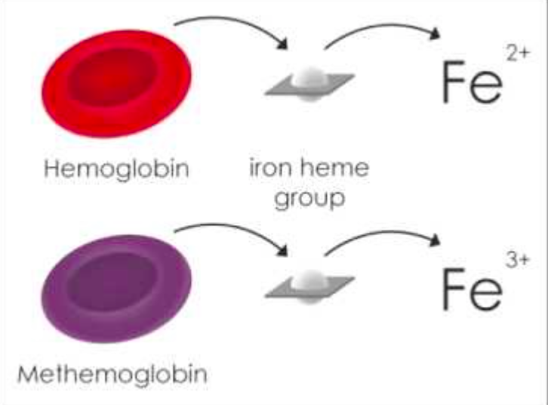
Nitrogen Dioxide
Sources
Automobiles
Power plants
Effects
Respiratory symptoms
Methemoglobin formation
(5)

Slide 8
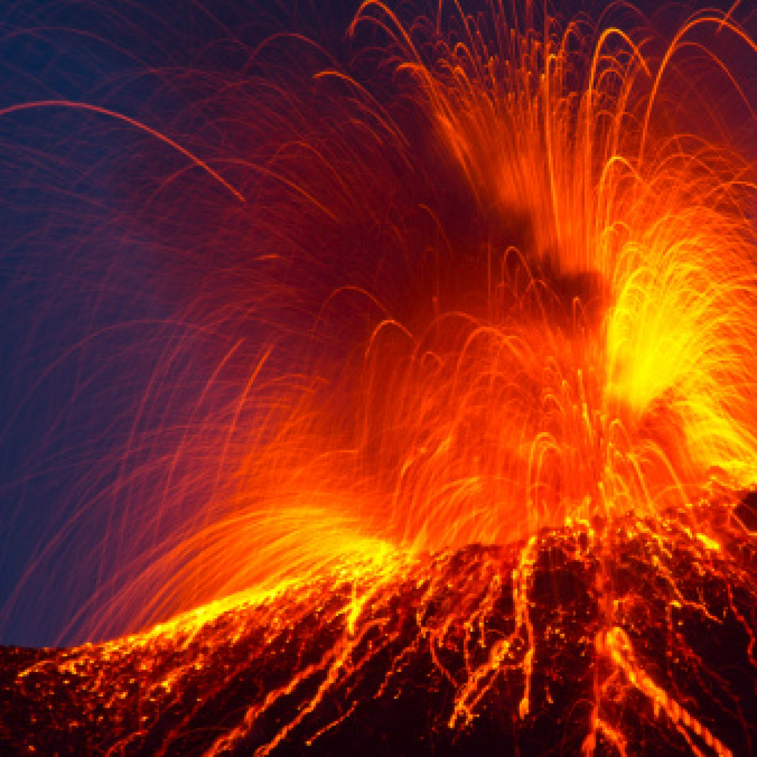
Sulfur Dioxide
Sources
Electrical utilities
Fuel combustion
Volcanoes
Effects
General respiratory issues
Constriction of the lungs⁶

Slide 9
Sulfur Dioxide
Sources
Electrical utilities
Fuel combustion
Volcanoes
Effects
General respiratory issues
Constriction of the lungs⁶

Slide 10
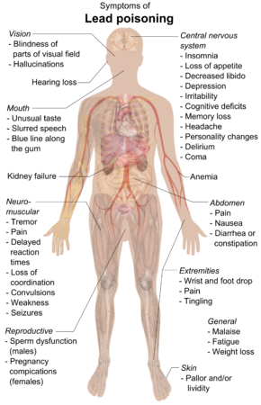
Lead
Sources
Lead smelting
Battery recycling
Other industrial sources
(7)

Slide 11
Lead
Sources
Lead smelting
Battery recycling
Other industrial sources
(7)

Slide 12
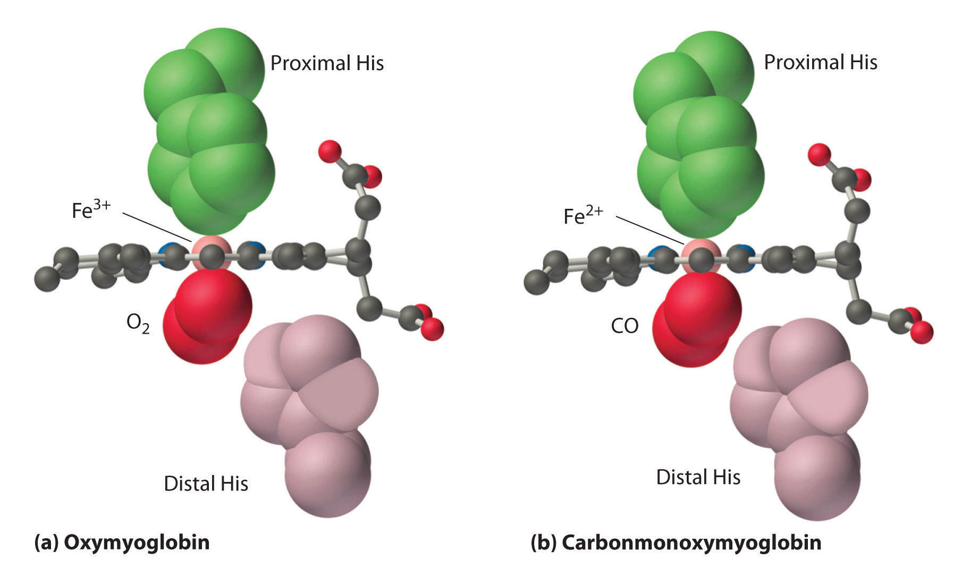
Carbon Monoxide
Sources
Gasoline fueled vehicles
Effects
Takes oxygens place in hemoglobin
(8)

Slide 13
Carbon Monoxide
Sources
Gasoline fueled vehicles
Effects
Takes oxygens place in hemoglobin
(8)

Slide 14
Carbon Monoxide
Sources
Gasoline fueled vehicles
Effects
Takes oxygens place in hemoglobin
(8)

Slide 15
Summary

Slide 16
Sources
1. Criteria Air Pollutants. https://www.epa.gov/criteria-air-pollutants (accessed Apr 16, 2020).
2. Health Effects of Ozone in the General Population. https://www.epa.gov/ozone-pollution-and-your-patients-health/health-effects-ozone-general-population (accessed Apr 16, 2020).
3. Ozone. https://en.wikipedia.org/wiki/Ozone#Acute_Ozone_Exposure (accessed Apr 16, 2020).
4.https://www.tandfonline.com/doi/pdf/10.1080/10473289.2006.10464485?needAccess=true (accessed Apr 16, 2020).
5. Methemoglobinemia. https://coreem.net/core/methemoglobinemia/ (accessed Apr 16, 2020).
6. Ghorani-Azam, A.; Riahi-Zanjani, B.; Balali-Mood, M. Effects of air pollution on human health and practical measures for prevention in Iran. https://www.ncbi.nlm.nih.gov/pmc/articles/PMC5122104/#ref70 (accessed Apr 16, 2020).
7. Lead poisoning. https://en.wikipedia.org/wiki/Lead_poisoning (accessed Apr 16, 2020).
8. bonCodigobonCodigo 1; JanJan 56k88 gold badges136136 silver badges298298 bronze badges; Breaking BioinformaticsBreaking Bioinformatics 1. Why does carbon monoxide have a greater affinity for hemoglobin than oxygen? https://chemistry.stackexchange.com/questions/33780/why-does-carbon-monoxide-have-a-greater-affinity-for-hemoglobin-than-oxygen (accessed Apr 16, 2020).

Slide 17
Questions?

