Slide 1
Australia’s Wildfires: Air Quality, Air Pollution, and Health Effects
BY: Matt Salamoni

Slide 2
Background
January 2, 2019:
Australia’s capital records its worst air quality day, 200 µg/m³
Spring 2019:
Australia has driest spring on record
December 18, 2019:
Australia has its hottest day on record
Late 2018:
Australia has extremely dry weather
October 2019:
Brushfires Begin in Australia
December - January 2019:
Some of the worst Brushfires in Australia burn across the country
Mid January 2019:
Winds slow down, and temperatures decrease allowing some of the fires to die down

Slide 3
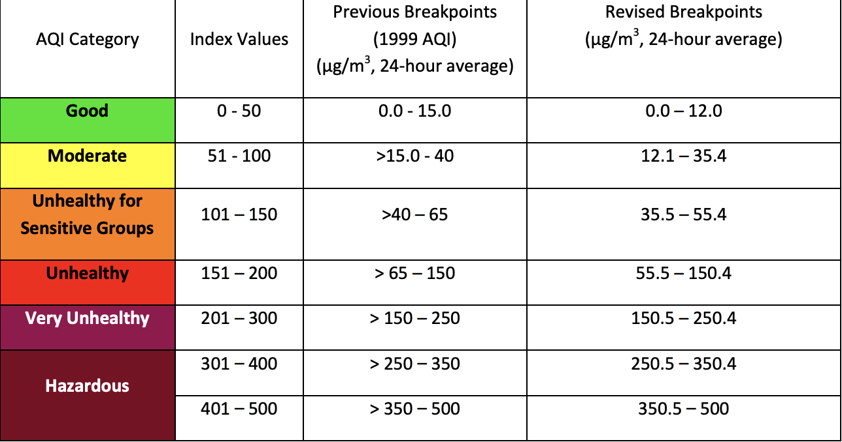
Air Quality Index for Fine Particle Pollution (PM_{2.5})
EPA has an Air Quality index table
On normal days, Australia is “Good”
0-12 micrograms/m³
During the months of the fires:
SE Australia mainly rated as “Unhealthy for Sensitive Groups”
A period in early to mid January New South Wales was rated as ”Very Unhealthy”

Slide 4
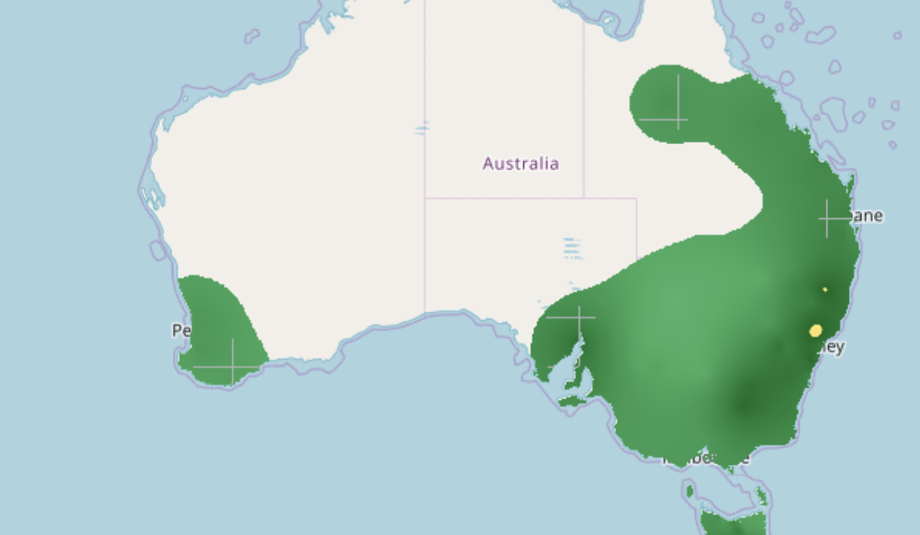
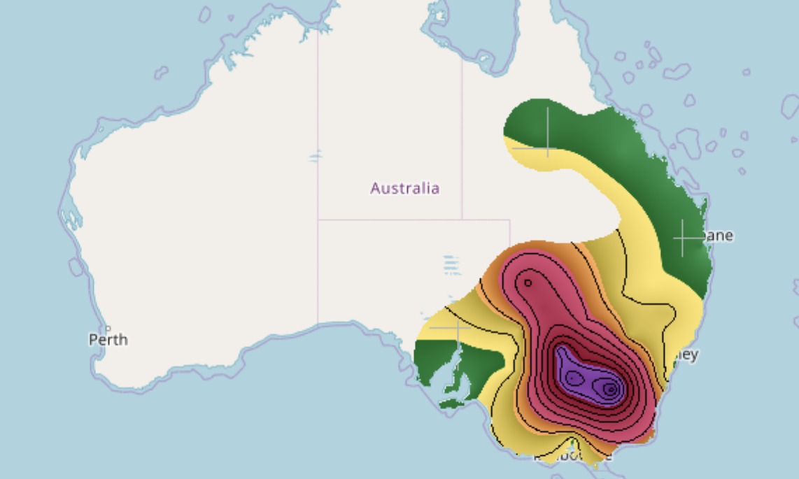
Australia: Normal Day versus Brushfire Days
Maps of Australia color coded to match AQI
Top Image
April 14
Australia is in good range minus Sydney
Bottom Image:
Jan 7th
Most fires burning in this time frame
Index Value: 277.7
“Very Unhealthy” Rating
Concentration of Particulate Matter: 227.8 µg/m³
23 µg/m³ from being “Hazardous”
Highest recorded concentration in the world that day
This bad of air quality is on par with China’s air quality

Slide 5
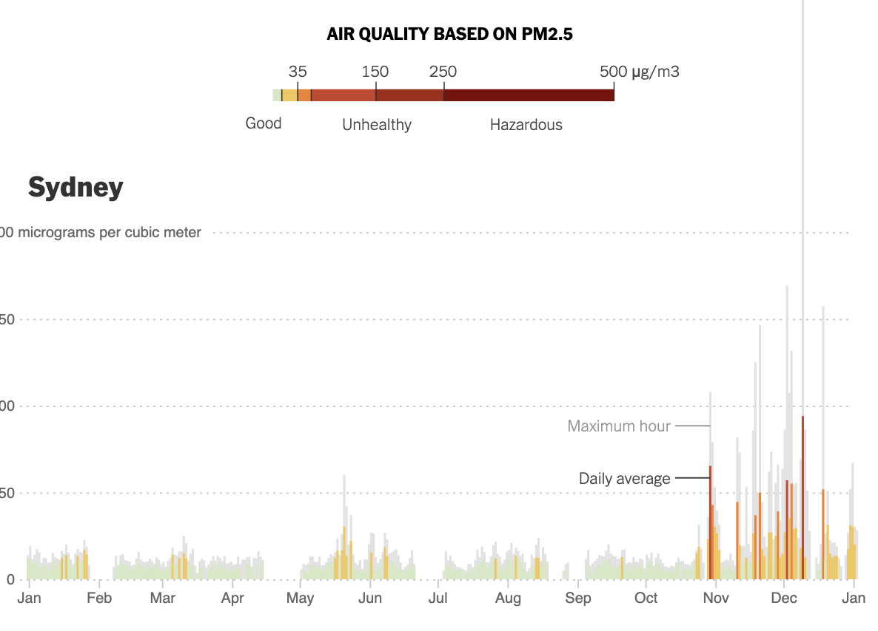
Graphical Display
Data Collected from Berkley Earth
Graph by New York Times
Data Collected from Berkley Earth
Graph by New York Times

Slide 6
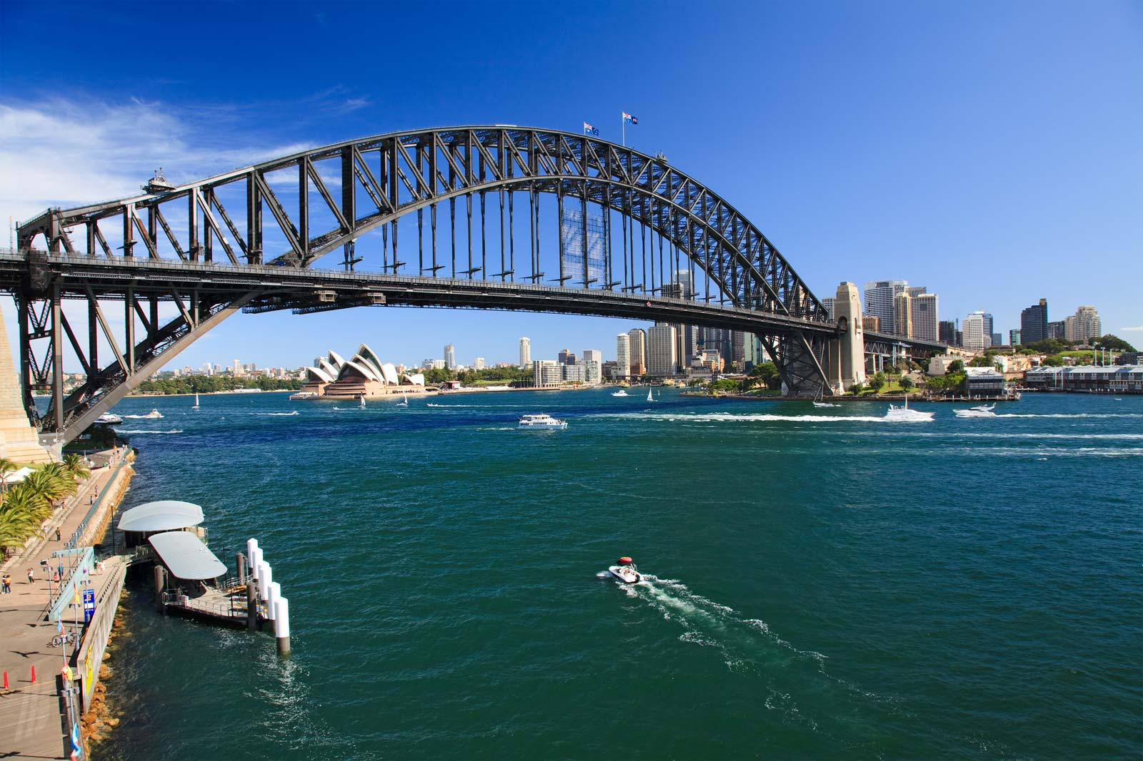
What does this look like?
Sydney Harbour Bridge on a “Good” rated day
< 12 µg/m³
Sydney Harbour Bridge on a “Very Unhealthy” rated day
150.5 µg/m³ – 250.4 µg/m³

Slide 7
Pollutants from Wildfires
CO – Carbon Monoxide
NO₂ – Nitrogen Dioxide
CH₂O – Formaldehyde
CH₃CHO – Acetaldehyde
Black Carbon
Brown Carbon
Both are Greenhouse Gases and add to overall concentrations in the atmosphere
Both hazardous air pollutants
Carcinogenic at high concentrations
Components of fine particulate matter
PM_{2.5}

Slide 8
Atmospheric Transport
Smoke from these wildfires circumnavigated the globe
NASA Study:
Suomi NPP Satellite traced the transport of the of the smoke
Aerosol Index Layer
Can detect UV absoribing particles, like aerosols
On image, the higher the concentration of aerosols the more red it appears

Slide 9
Aerosol Index Layer Image

Slide 10
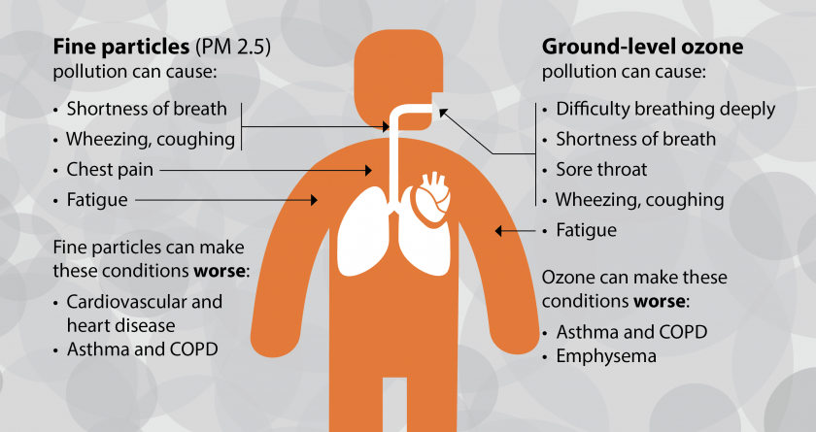
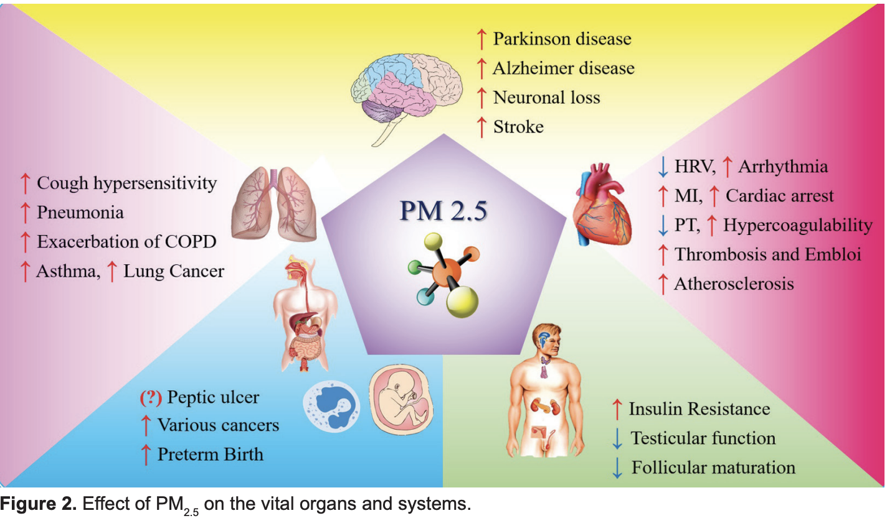
Health Effects
PM_{2.5} pollution can cause everyday health problems for humans
Both minor and serious

Slide 11
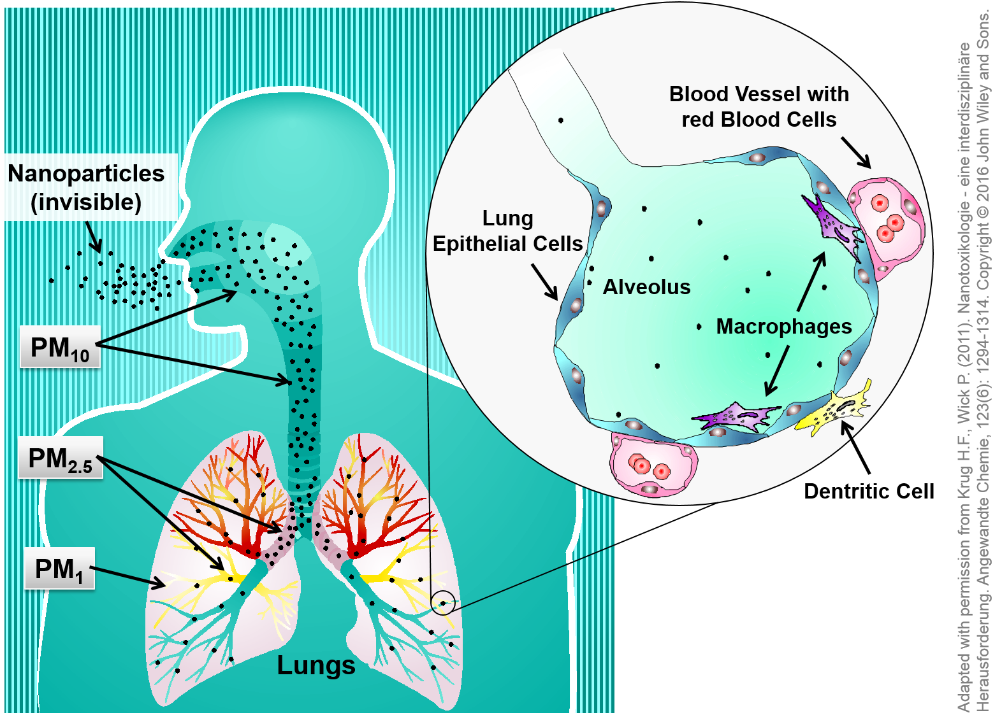
How does it cause these issues?
The particulate matter is inhaled
Gets Trapped in Bronchial tubes
Particles begin to enter cells
This not only causes local problems, but can transport the issue elsewhere in the body.

Slide 12
References
http://berkeleyearth.org/air-quality-real-time-map/?z=4&x=144.60743&y=-31.04601#links
https://iaqscience.lbl.gov/cc-wildfires
https://www.nytimes.com/interactive/2020/01/03/climate/australia-fires-air.html
https://www.epa.gov/sites/production/files/2016-04/documents/2012_aqi_factsheet.pdf
https://www.esrl.noaa.gov/csl/factsheets/csdWildfiresFIREX.pdf
https://www.nasa.gov/feature/goddard/2020/from-smoke-going-round-the-world-to-aerosol-levels-nasa-observes-australias-bushfires
https://static1.squarespace.com/static/56034c20e4b047f1e0c1bfca/t/59e2e4fe0100271556d54e1a/1508041986866/smoke_MMZ_201710.pdf
https://www.ncbi.nlm.nih.gov/pmc/articles/PMC5130603/
https://www.nanopartikel.info/en/nanoinfo/body-barriers/2388-nanoparticles-and-the-lung
https://www.pca.state.mn.us/air/why-you-should-care-air-quality-and-health
Baghbeheshti_M-2017-Fine_particulate_matter_PM25_and_health_effects_An.pdf

Slide 13
Questions?

