Slide 1
Volcanic Effects on the Atmosphere
Jackson Sims
EAS 4740
16 April 2020

Slide 2
Volcanoes
Mechanism for tephra, molten rock, and gases from beneath Earth’s surface to erupt
Magma consists of molten rock, crystals, and dissolved gases
Gases are released as it rises or reaches the surface
Two types of eruptions
Effusive
Explosive
Explosive eruptions can send gases, ash, and aerosols high into the troposphere (and into the stratosphere)

Slide 3
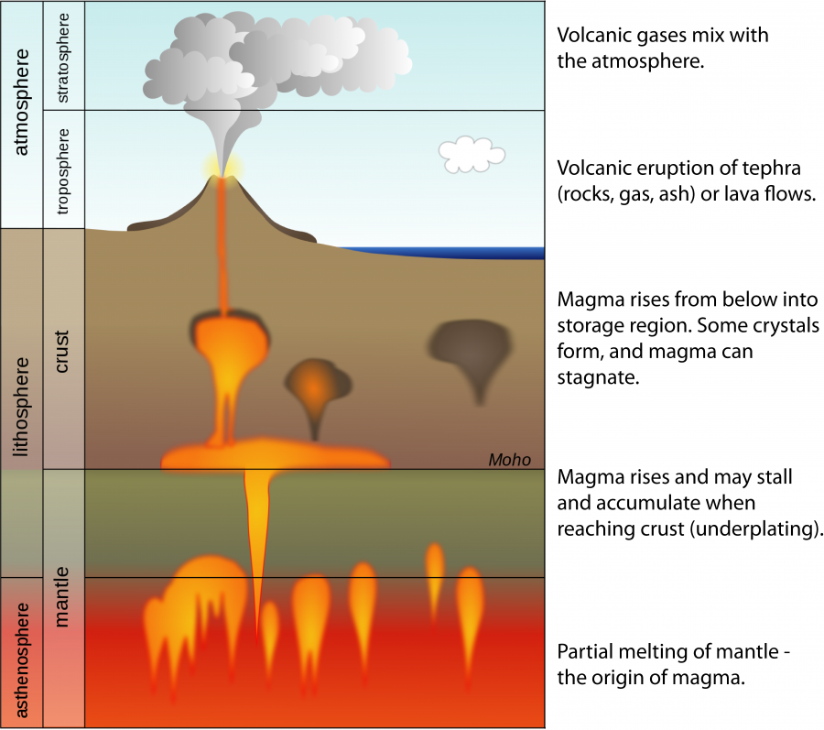

Slide 4
Volcanic Source of Pollution
Outgassing releases large volumes of greenhouse gases and aerosols into the atmosphere
H₂O, CO₂, SO₂, H₂S, CO, HCl, HF
Can be harmful to plants and animals
Long term exposure lethal to vegetation
Some are especially harmful to respiratory system
SO₂ and HF
Sulfur dioxide and water vapor in atmosphere react to form sulfuric acid
Condense as hazy droplets which affect albedo of atmosphere
Contributes to acidic rain

Slide 5
Stratospheric Impact
Violent explosive eruptions can send gases and aerosols into the stratosphere
Can remain in this stable layer of the atmosphere for years after eruption
Most particulates are <2mm in diameter and can remain for months
Ash and silicate dust
Sulfuric acid condenses on particles forming aerosols in stratosphere
Weak absorbers of incoming solar radiation
Scatter some radiation back to space (increasing atmospheric albedo)
Potential to absorb outgoing terrestrial radiation (IR) varies with aerosol size

Slide 6
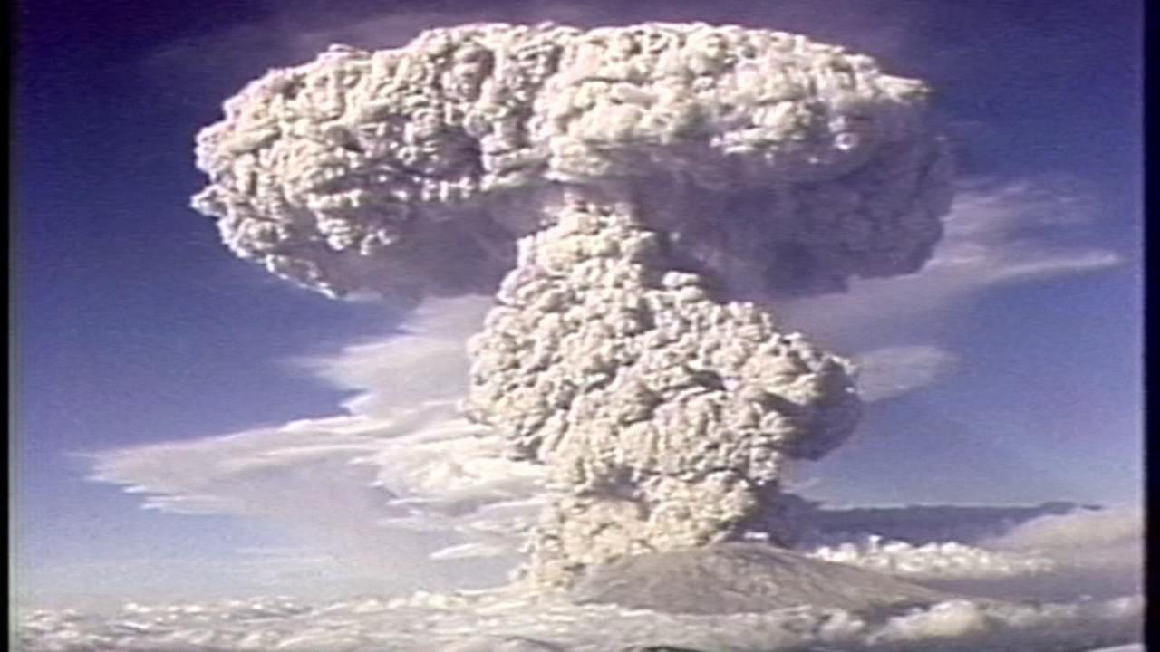
Mount St. Helens Eruption 18 May 1980

Slide 7
Mount St. Helens Eruption
Plume height reached above the tropopause
Aerosols and particulates blocked sunlight and reduced visibility
Plume acted as a thermal blanket for locations near eruption
Locations in Montana and Idaho experienced temperature increases up to 8ºC
Depressions in temperature measured days after the eruption (8ºC cooler)
Global temperatures lowered by 0.1ºC in the short term
Eruption emitted around 10 million tons CO₂
Contributes to long term atmospheric warming

Slide 8
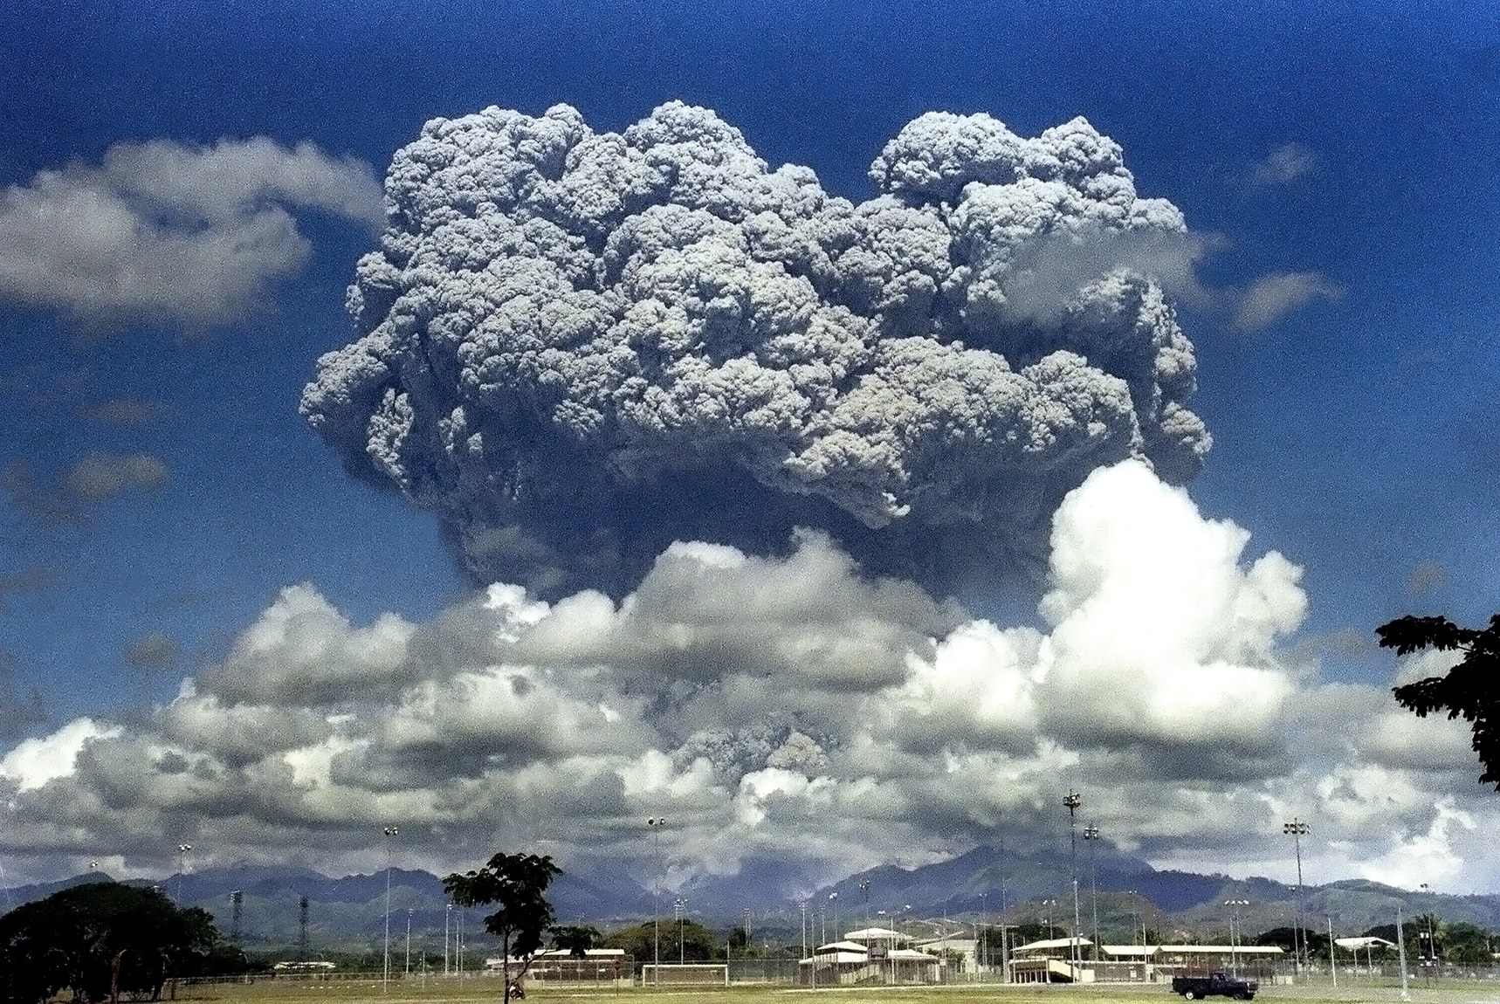
Mt Pinatubo Eruption 15 June 1991

Slide 9
Mount Pinatubo Eruption
Ash plume erupted over 22 miles into the atmosphere
Upper level winds transported pollutants around globe
Enhanced atmospheric transport from typhoon occurring simultaneously
Ash fell as far as the Indian Ocean
Eruption ejected over 20 million tons of SO₂ into atmosphere
Aerosol optical depth increased to 10-100 times normal
Global temperatures decreased by 0.6ºC
Max recorded cooling 1.5ºC
Emissions also contributed to long term warming
Approximately 50 million tons CO₂

Slide 10
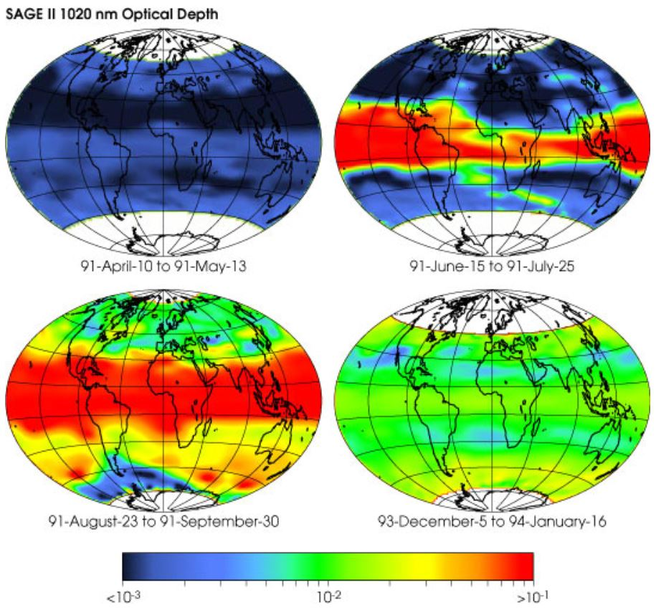

Slide 11
Stratospheric Impact
Volcanic aerosols launched into atmosphere can enable reactions to occur
Sulfate and water aerosols can react with species in stratosphere
Reactions with HCl and ClONO₂ will release chlorine
Reactions NO, NO₂, and NO₃ can form HNO₃
The above reactions and products would act to decrease atmospheric ozone

Slide 12
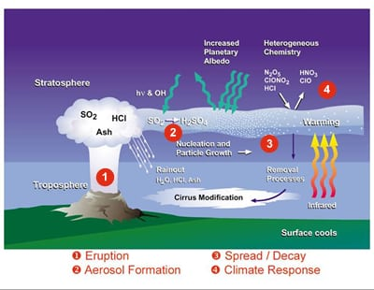

Slide 13
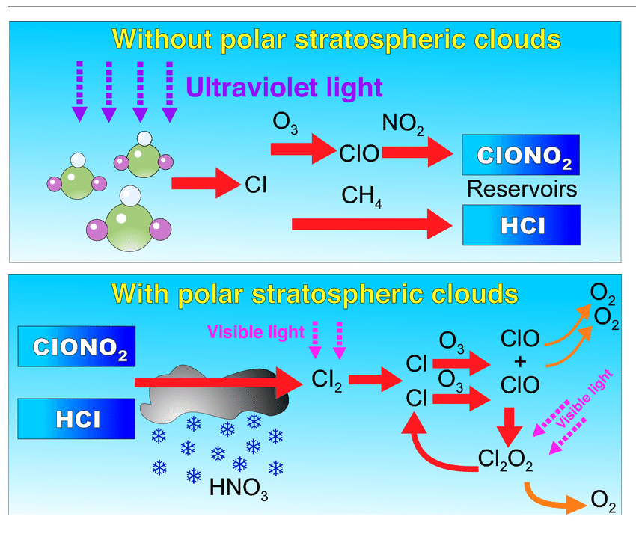

Slide 14
Effusive Eruptions and “Vog”
Kīlauea Volcano in Hawaii emits 500-10,000 tons SO₂/day
Source is lower troposphere, not launched into stratosphere
Volcanic smog (vog) is a problematic aspect of constant effusive eruptions
Produced from SO₂, aerosols, O₂, H₂O, and light energy
Hazy droplets limit visibility
Harmful to respiratory system and vegetation (crops)
Rich in acidic aerosols and unreacted SO₂

Slide 15
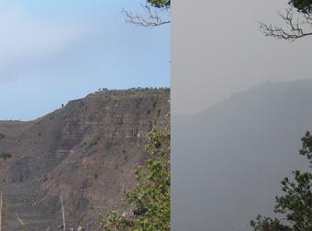

Slide 16
Summary
Volcanoes emit large amounts of gases into the atmosphere
Greenhouse gases contribute to long term warming
Hazy aerosols contribute to short term cooling
Explosive eruptions can launch gases and particles into the stratosphere
Enables reactions that contribute to destruction of stratospheric ozone
Effusive eruptions emitting more gases than transport can diffuse
Cause vog in the lower troposphere
Harmful to health (respiration, crops)
Limits visibility
Average volcanic emissions less than 1% of anthropogenic CO₂ emissions

Slide 17
References
Braathen, G. “WMO Antarctic Ozone Bulletin No. 4.” Research Gate, 2012, www.researchgate.net/figure/Diagram-showing-the-effe ct-of-polar-stratospheric-clouds-on-ozone-loss-The-upper-panel_fig1_260869459.
Coffey, M. T., and J. W. Hannigan. “Volcanic Aerosol.” Volcanic Aerosol - an Overview | ScienceDirect Topics, 2015, www.sciencedirect.com/topics/earth-and-planetary-sciences/volcanic-aerosol.
Editorial Team, SchoolWork Helper. “How Volcanoes Affect Climate.” SchoolWorkHelper, 2019, schoolworkhelper.net/how-volcanoes-affect-climate/.
George, Sara. “Volcanic Pollution.” International Pollution Issues, City University of New York, Dec. 2014, intlpollution.commons.gc.cuny.edu/volcanic-pollution/.
Langley Research Center. “Global Effects of Mount Pinatubo.” NASA, NASA, 15 June 2001, earthobservatory.nasa.gov/images/1510/global-effects-of-mount-pinatubo.
Mass, Clifford, and Alan Robock. “The Short-Term Influence of the Mount St. Helens Volcanic Eruption on Surface Temperature in the Northwest United States.” Monthly Weather Review, vol. 110, no. 6, 1982, pp. 614–622., doi:10.1175/1520-0493(1982)1102.0.co;2.
Newhall, Chris, et al. “The Cataclysmic 1991 Eruption of Mount Pinatubo, Philippines, Fact.” U.S. Geological Survey Fact Sheet 113-97, 2005, pubs.usgs.gov/fs/1997/fs113-97/.
Program, Volcano Hazards. “Volcano Hazards Program.” USGS, 2017, volcanoes.usgs.gov/vhp/gas_climate.html.
Sutton, Jeff, et al. “Volcanic Air Pollution—A Hazard in Hawaii.” U.S. Geological Survey Fact Sheet 169-97, 2000, pubs.usgs.gov/fs/2017/3017/fs20173017.pdf.
USGS. “Frequently Asked Questions About Volcanic Smog (Vog).” Hawaiian Volcano Observatory, 2018, www.usgs.gov/observatories/hawaiian-volcano-observatory/frequently-asked-questions-about-volcanic-smog-vog.

Slide 18
Questions?

