Slide 1
Weakening Car Mileage Standards in the U.S.
Skyler Voisin

Slide 2
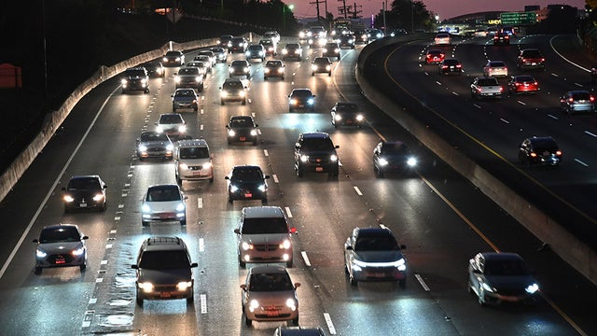
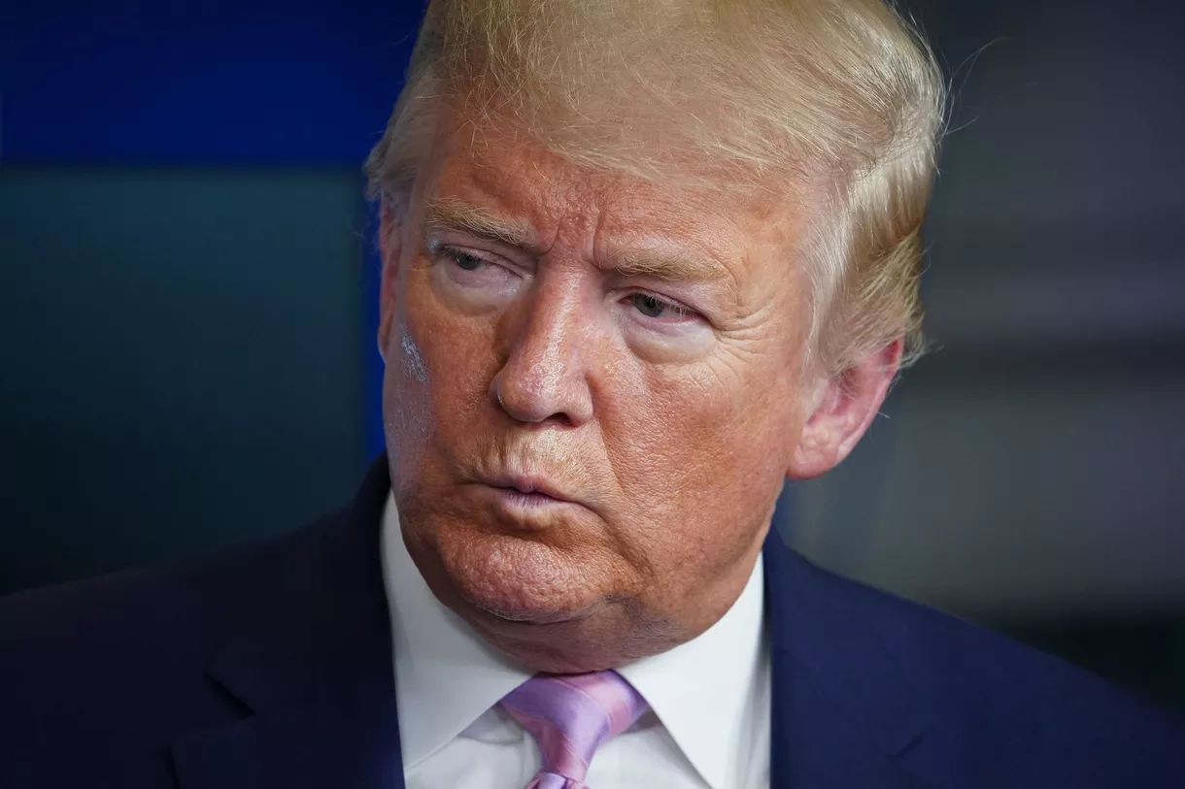
Background
Under the Obama administration, corporations must reach average of 54 mpg by 2026
Trump administration drops the standard to 40.4 mpg

Slide 3
Before change, Obama admin required 5 percent annual increase in fuel efficiency
Avoid 6 billion metric tons of greenhouse gases
Cut to 1.5 percent
Claimed that increasing fuel efficiency make them more expensive and encourages people to drive older, less safe cars
Avert up to 12,000 crash fatalities
Other estimates say more people will die from air pollution difference in same period
Consumers pay more at gas pump
Lower car price by $1000, but $1400 increase in gas spending
California and many other states suing federal government for right to set own fuel efficiency standards
Several automakers already signed deals with California for minimum of 50 mpg by 2026

Slide 4
What is in Car Exhaust?

Slide 5
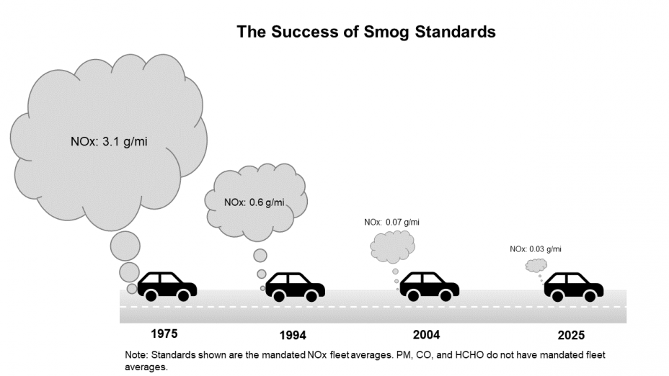
Car Exhaust
Carbon dioxide, water vapor, nitrogen oxide and dioxide, carbon monoxide, PM 2.5 are all found in car exhausts in significant amounts. Each has detrimental effects.

Slide 6
Gas Effects
Carbon Dioxide: Most commonly known greenhouse gas
Water Vapor: Greenhouse effect but negligible in comparison to ocean evaporation, but also create clouds that increase albedo.
Nitrogen Oxide reacts with Volatile Organic Compounds to form Nitrogen Dioxide, which reacts with Oxygen gas to form tropospheric ozone. NO2 and O3 aggravate breathing issues and cause haze. O3 contributes to crop damage and the greenhouse effect.
Carbon Monoxide reacts to form Carbon Dioxide, but also both helps create and avoid the creation of methane and ozone.

Slide 7
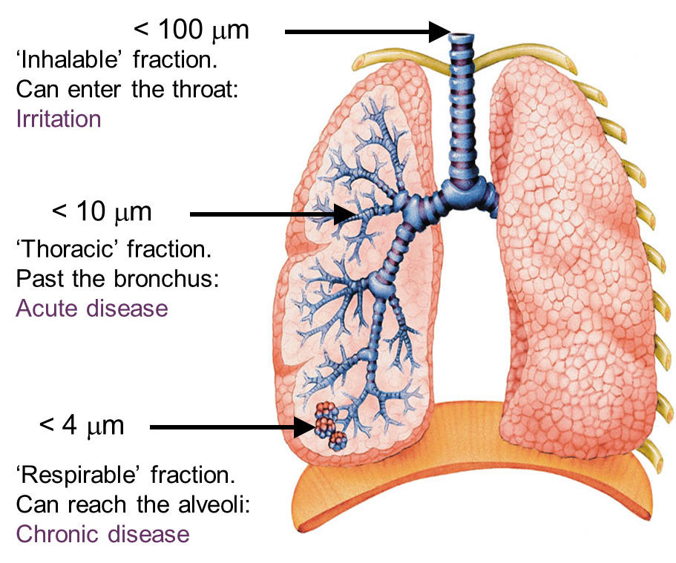
Particulate Matter 2.5
The PM2.5 in car exhaust causes irritation in the lungs.
This can worsen already chronic health problems that people have.

Slide 8
So How Does It All Connect?
Decreasing fuel efficiency standards allows the car industry to sell cars that release much more of the carbon dioxide, nitrogen oxides, and particulate matter that accelerate climate change and cause respiratory distress
There is the argument that vehicle fatalities will decrease as a result of the new policy, but the effects of the pollutants will likely cause more damage and deaths

Slide 9
Questions?

Slide 10
References
Beitsch, R. (2020, April 7). Trump rollback of Obama-era mileage standards faces challenges in courts. The Hill. Retrieved from https://thehill.com/policy/energy-environment/491608-trump-rollback-of-obama-era-mileage-standards-faces-challenges-in
Eilperin, J., & Dennis, B. (2020, January 23). Trump promised his mileage standards would make cars cheaper and safer. New documents raise doubts about that. Washington Post. Retrieved from https://www.washingtonpost.com/climate-environment/2020/01/23/trump-vowed-his-mileage-standards-would-make-cars-cheaper-safer-new-documents-raise-doubts-about-that/
Eilperin, J., & Dennis, B. (2020, March 30). Trump administration to finalize weaker mileage standards, dealing a blow to Obama-era climate policy. Washington Post. Retrieved from https://www.washingtonpost.com/health/2020/03/30/trump-mileage-standards-environment/
New York State Department of Health. (2018, February). Fine Particles (PM 2.5) Questions and Answers. Retrieved from https://www.health.ny.gov/environmental/indoors/air/pmq_a.htm
Roberts, D. (2020, April 2). Gutting fuel economy standards during a pandemic is peak Trump. Vox Media. Retrieved from https://www.vox.com/energy-and-environment/2020/4/2/21202509/trump-climate-change-fuel-economy-standards-coronavirus-pandemic-peak
US Department of Transportation & US Environmental Protection Agency. (n.d.). Fact Sheet: MYs 2021-2026 CAFE Proposal - by the Numbers. Retrieved April 16, 2020, from https://www.nhtsa.gov/sites/nhtsa.dot.gov/files/documents/rev_fact_sheet_cafe_nprm_by_the_numbers_003-tag.pdf

Slide 11
References (part 2)
US Environmental Protection Agency. (n.d.). Basic Information about NO2. Retrieved April 16, 2020, from https://www.epa.gov/no2-pollution/basic-information-about-no2#Effects
US Environmental Protection Agency. (n.d.). Ground-level Ozone Basics. Retrieved April 16, 2020, from https://www.epa.gov/ground-level-ozone-pollution/ground-level-ozone-basics
US Environmental Protection Agency. (n.d.). Light Duty Vehicle Emissions. Retrieved April 16, 2020, from https://www.epa.gov/greenvehicles/light-duty-vehicle-emissions
White House Office of the Press Secretary. (2012, August 28). Obama Administration Finalizes Historic 54.5 MPG Fuel Efficiency Standards. Retrieved April 16, 2020, from https://obamawhitehouse.archives.gov/the-press-office/2012/08/28/obama-administration-finalizes-historic-545-MPG-fuel-efficiency-standard
Wikimedia Commons. (2019, September 16). File:Grain size dependence of penetration of airborne particulate matter.jpg. Retrieved April 16, 2020, from https://commons.wikimedia.org/wiki/File:Grain_size_dependence_of_penetration_of_airborne_particulate_matter.jpg

