Slide 1
The Benefits and Issues with CO2 Satellite Measurements
Alexis Wilson

Slide 2
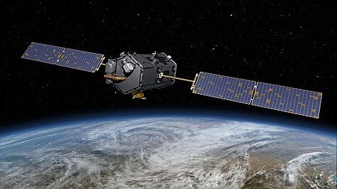
Introduction - History
The HIRS/2, launched in 1987, was the first satellite to measure atmospheric CO2
Japanese Greenhouse Gases Observing Satellite (GOSAT) was the first satellite dedicated to measuring CO2
The Orbiting Carbon Observatory (OCO) series is the most current satellite used to measure atmospheric CO2
OCO-2 was launched in 2014 and is what is currently used
OCO-3 was launched in 2019 and is currently in the testing and validation phase. It is mounted on the ISS

Slide 3
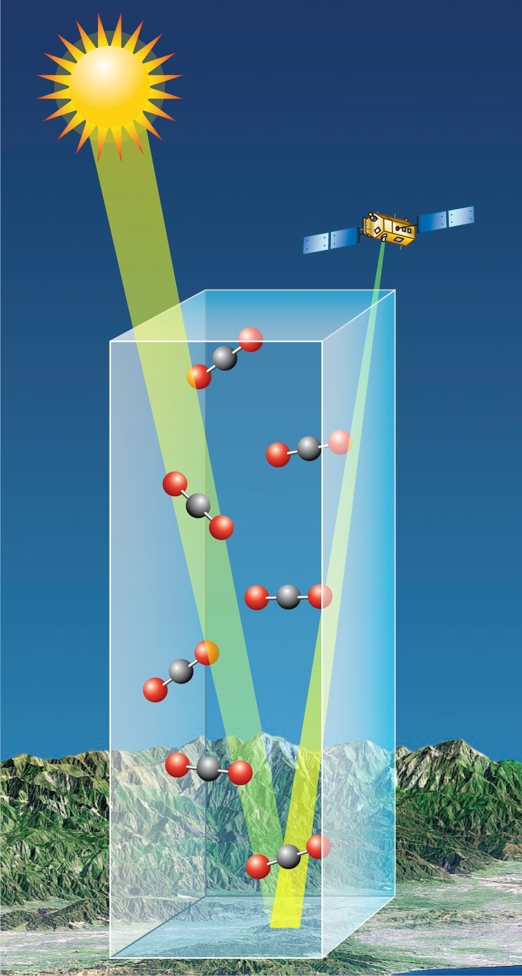
Introduction - CO2 Measurements
OCO-2 doesn’t directly measure CO2, it measures how much sunlight reflected from Earth is absorbed by CO2
It collects 24 soundings per second in 3 different bands
Weak CO2 band, Strong CO2 band, O2 band
Only those readings collected in a cloud free environment are used for analysis
Around 13% of soundings are cloud-free
The Oxygen band is used to calculate the total dry air column

Slide 4
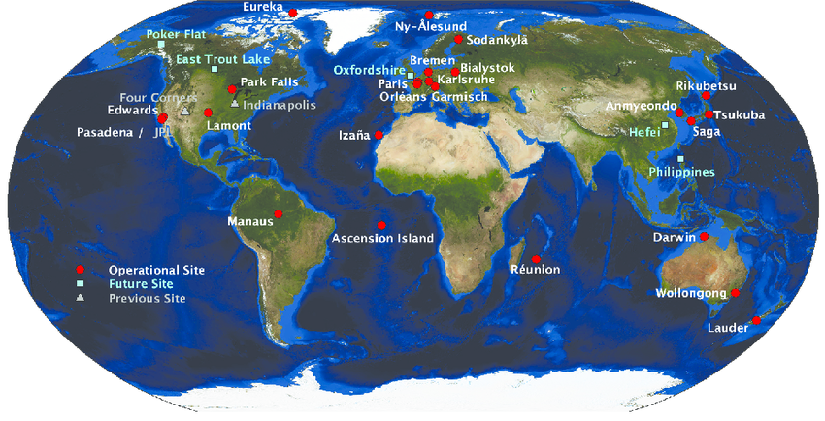
Benefits of CO2 Satellite Measurements
Due to the scattered and uneven distribution of carbon column sampling stations, it can be highly difficult to infer surface sources and sinks of CO2 based on these stations alone.
It is helpful from a policy perspective to have a method of tracking CO2 sources.

Slide 5
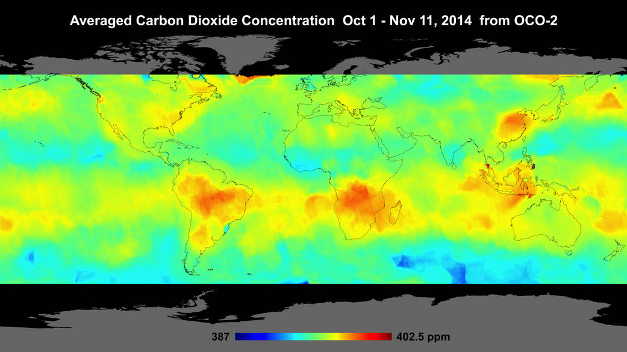
Benefits of CO2 Satellite Measurements
CO2 satellite measurements, such as the ones on OCO-2, work to resolve this problem by offering a much larger spatial resolution
Currently, the OCO-2 has a root mean square (RMS) of 1.5ppm when compared to surface observations

Slide 6
Benefits of CO2 Satellite Measurements
Based off of data from OCO-2, mean CO2 anomalies show sources of CO2 emissions in places such as Eastern China, Europe, and the Eastern US. Also highlighted is the areas in Africa where biomass burning frequently occurs.

Slide 7
Problems with CO2 Satellite Measurements
As with most satellite measurements, there are inherent biases present.
Rapid vertical mixing often present in the tropics would result in a much more diluted signal or surface sources than in the relatively more stable atmosphere in the mid-latitudes.
This presents a problem in source tracking, as the measurements of the tropics will be less impactful on pinpointing a source than an equally precise measurement in the mid-latitudes

Slide 8
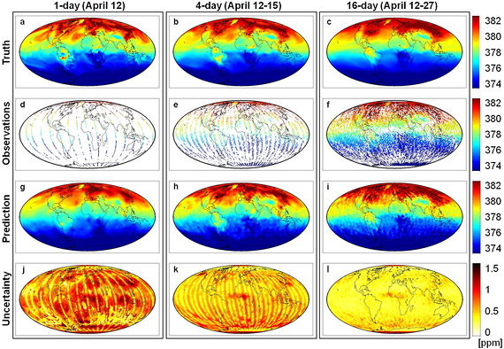
Problems with CO2 Satellite Measurements
Another problem lies within the presence of clouds and aerosols. In order to reduce error due to biases, there has to be a sufficiently low amount of cloud cover and aerosols present.
This limits the retrieval of CO2 concentration data, which can result in added uncertainty that can only be resolved by giving up temporal resolution.

Slide 9
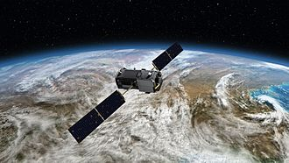
Conclusion
Satellite measurements of CO2 concentrations are useful to resolve spatial resolution issues. While the biases and resulting errors in ppm are greater when the data is collected via satellite, the uncertainty for sources and sinks are greatly reduced. CO2 satellite measurements work best when used in conjunction to surface station measurements.

Slide 10
References
https://agupubs.onlinelibrary.wiley.com/doi/full/10.1029/2003JD003439
https://oco.jpl.nasa.gov/instrument/
https://docserver.gesdisc.eosdis.nasa.gov/public/project/OCO/OCO2_DUG.V6.pdf
https://agupubs.onlinelibrary.wiley.com/doi/epdf/10.1029/2000GL011912
https://ro.uow.edu.au/cgi/viewcontent.cgi?article=5751&context=smhpapers
https://agupubs.onlinelibrary.wiley.com/doi/full/10.1002/2016GL070885

