Slide 1
Atlantic Meridional Overturning Circulation (AMOC)
Carson Joseph Clements
Zachary Michael D'Aquino
Sukanya Kumar

Slide 2
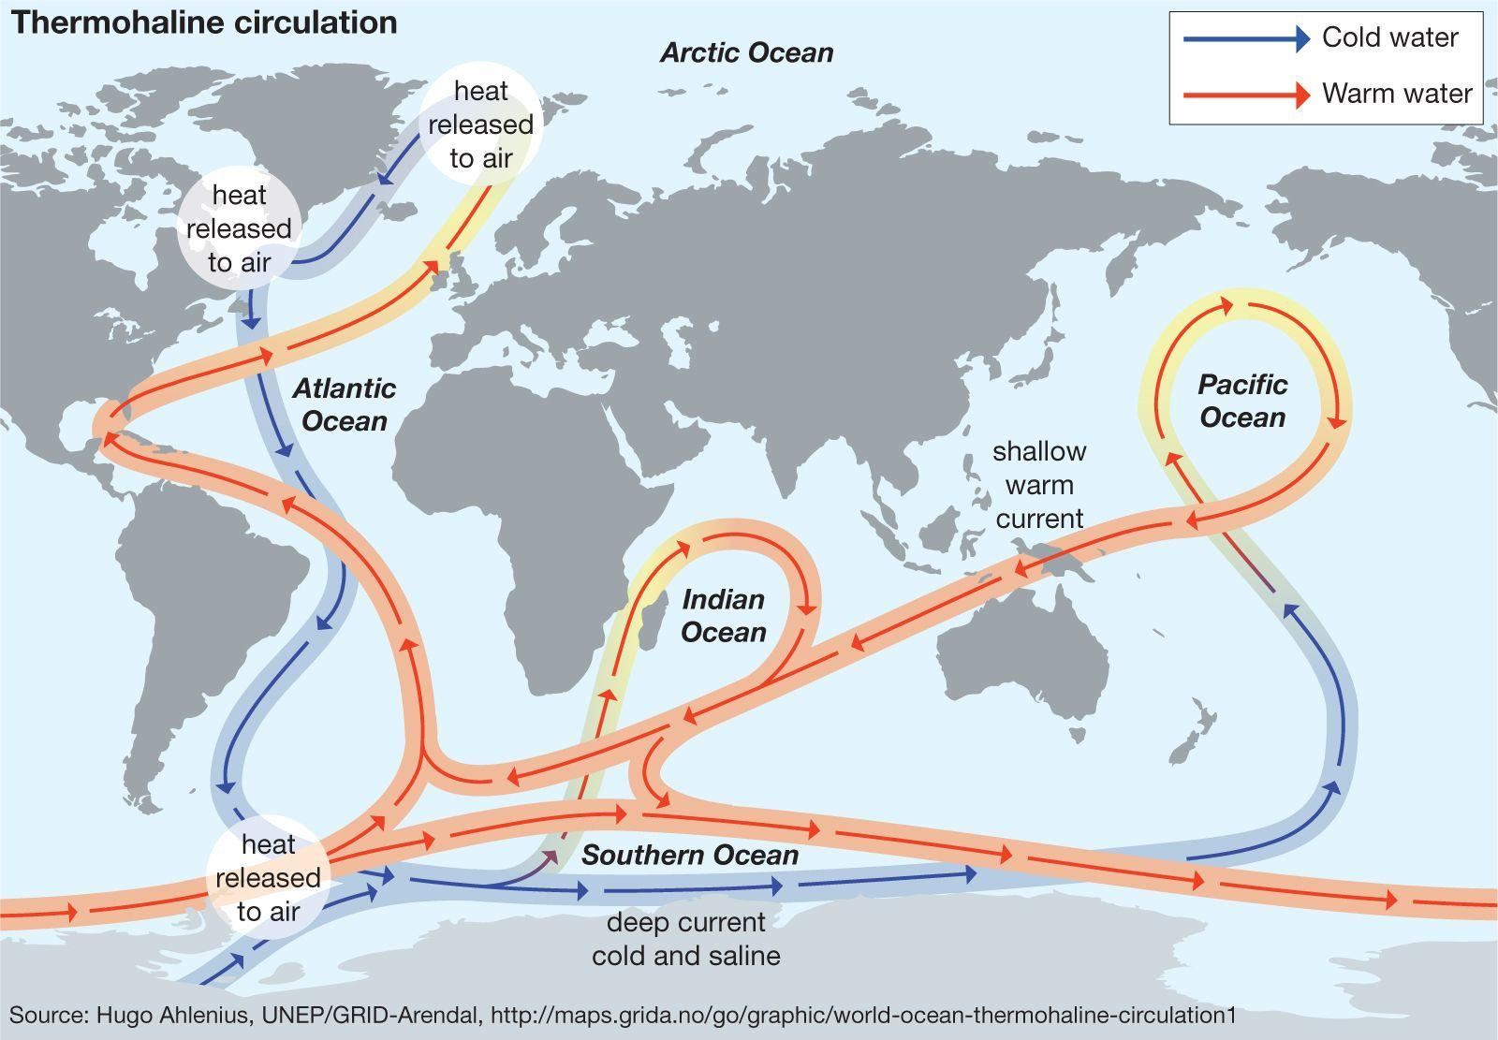
Definition and Mechanisms

Slide 3
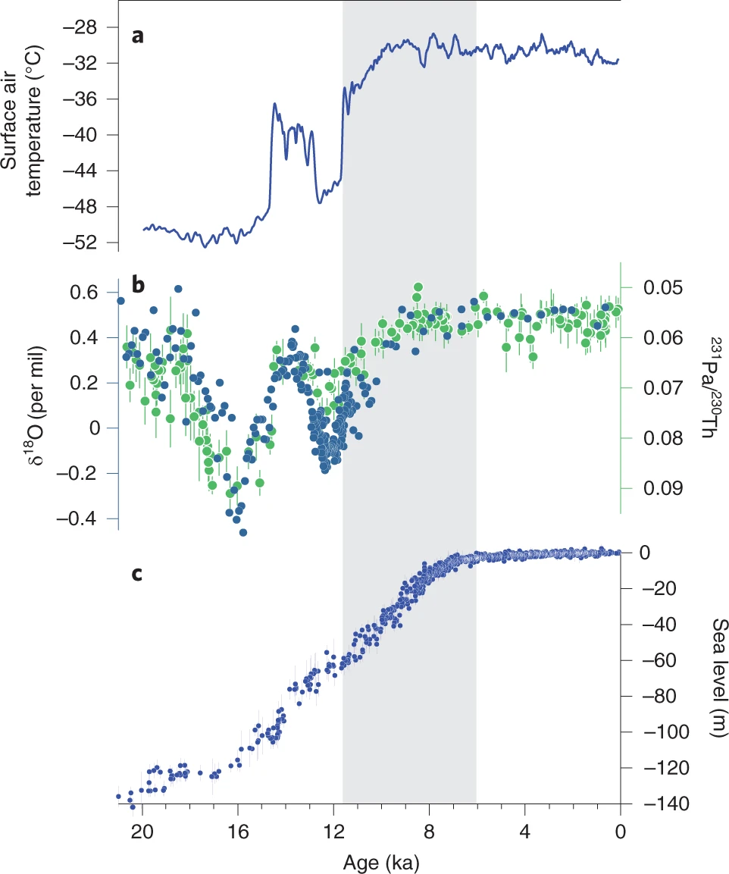
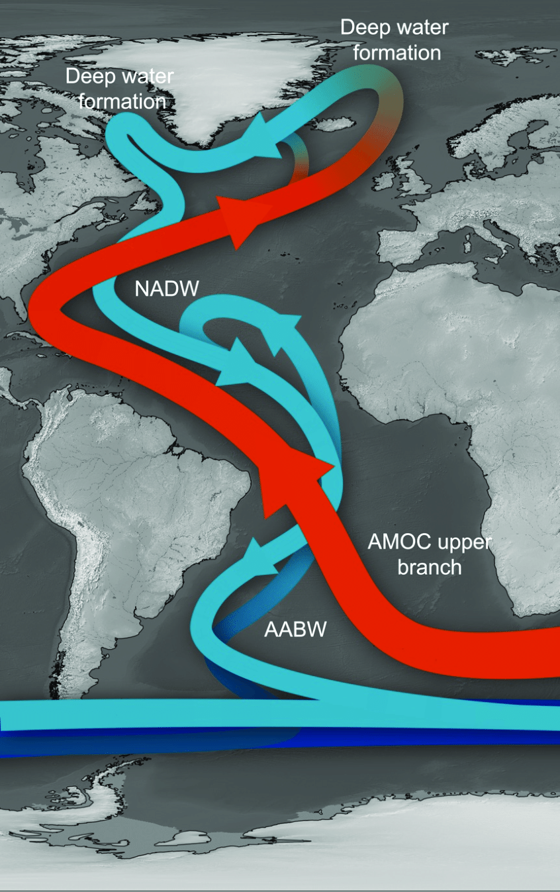
Variability and Uncertainty
https://doi.org/10.1038/s41558-022-01328-2

Slide 4
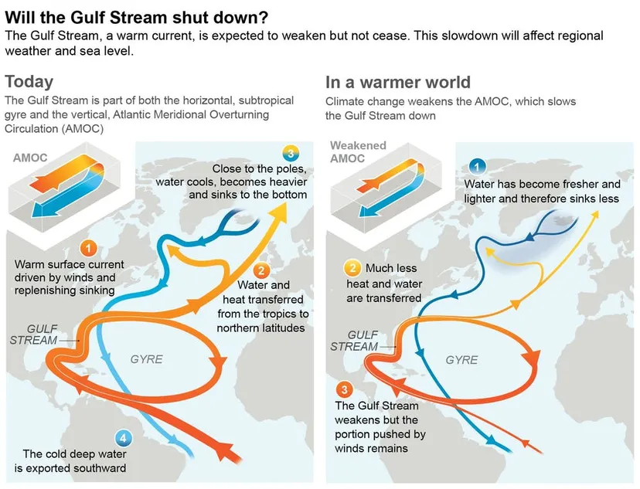
General Consequences of Slowdown/Shutdown
~10 degree decrease
across North Atlantic
Sea level rise
Extreme Weather
Anoxia and euxinia
IPCC Sixth Assessment

Slide 5
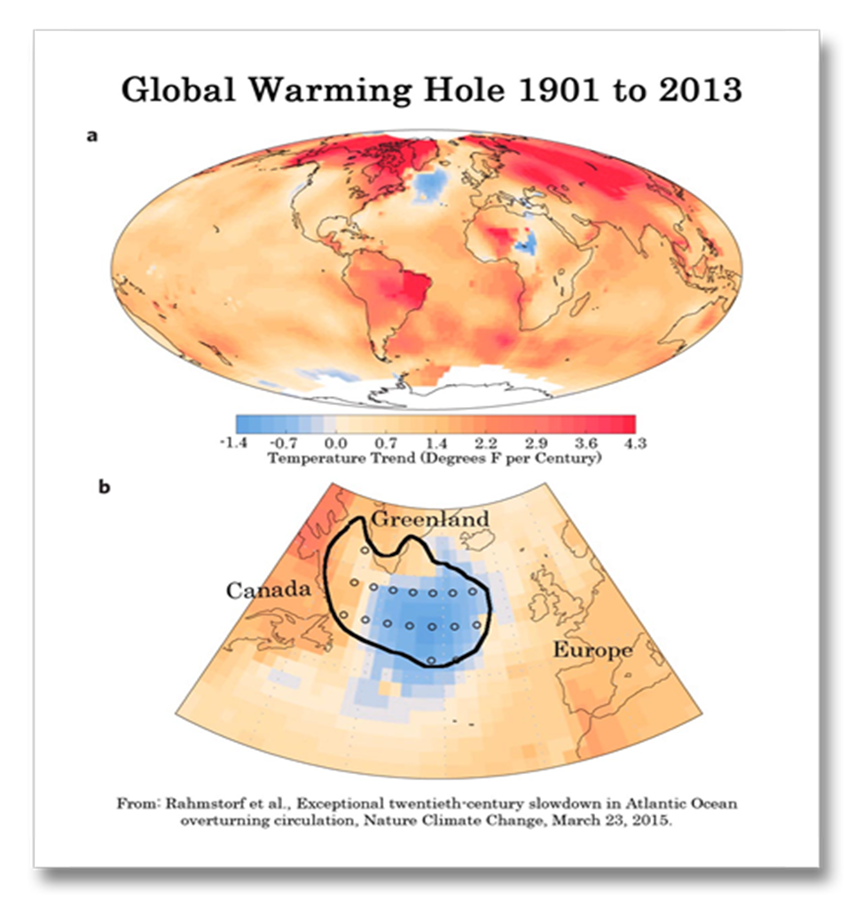
North Atlantic Warming Hole :
It describes a cold temperature anomaly of North Atlantic ocean surface water
Modelling studies suggest that the warming hole is associated with an AMOC decline in historical runs and climate change projection scenarios [Liu et al.,2020]

Slide 6
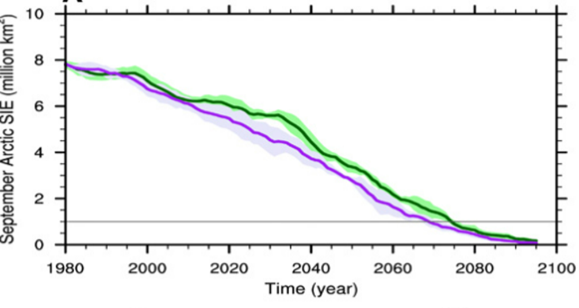
Arctic sea ice loss
The weakened AMOC slows the pace of future Arctic sea ice loss
If the AMOC had not slowed down,oceanic heat would be transported into the Arctic leading to an ice-free Arctic in summer by late 2060s
September Arctic sea ice extent (SIE) in CCSM4 historical and RCP8.5 simulations (green, ensemble mean; light green, ensemble spread) and AMOC_fx (purple, ensemble mean; light purple, ensemble spread) with 11-year running mean adopted. SIE is defined as the total ocean area that has an ice concentration of 15% or more. The horizontal line in (A) denotes the common threshold for an ice-free Arctic
https://www.science.org/doi/10.1126/sciadv.aaz4876

Slide 7
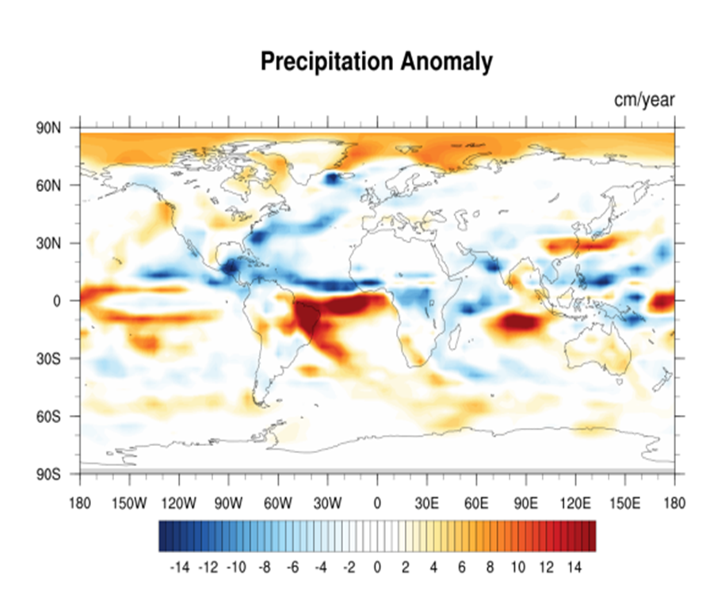
Impact on global rainfall pattern
In the North Atlantic, the weakened AMOC significantly reduces the rainfall over the warming hole region because of reduced evaporation from the ocean into the overlying atmosphere.
A weakened AMOC cools the North Atlantic, leading to a southward shift of the ITCZ, with associated drying in the Caribbean, Sahel region of Africa, and the Indian and Asian monsoon region
convective and large-scale precipitation anomaly averaged over last 50 years of model runs.

Slide 8
Impact on carbon cycle :
Freshwater-induced AMOC shutdown generally leads to a decrease in ocean CO2 uptake
The simultaneous decrease of carbon storage on land and in the ocean then leads to rapid increase in atmospheric CO2
The rise in atmospheric CO2 ranges from 13 ppm to 34 ppm in 2500, depending on the amount of AMOC weakening [ [ Zickfeld et al.,2008]

Slide 9
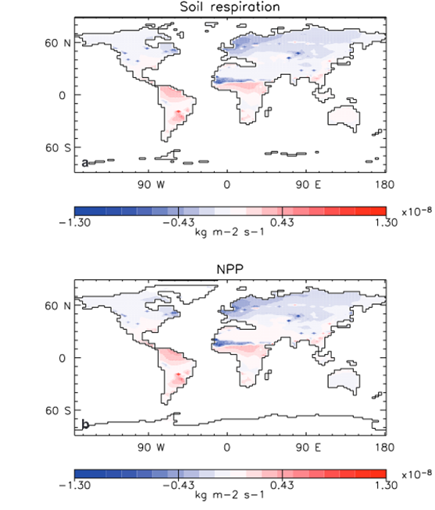
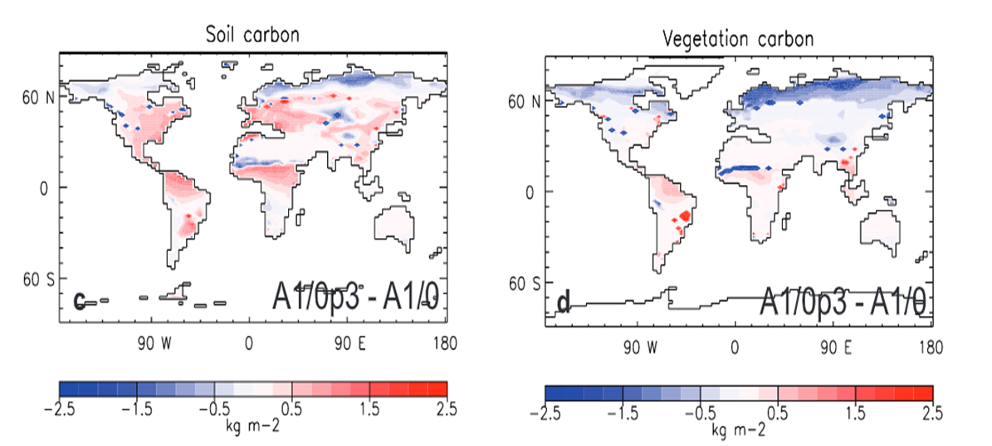
What causes the response of the biological pump under AMOC shutdown?
Year 2500 differences in annually averaged soil, vegetation carbon, soil respiration and NPP as a effect of AMOC shutdown

Slide 10
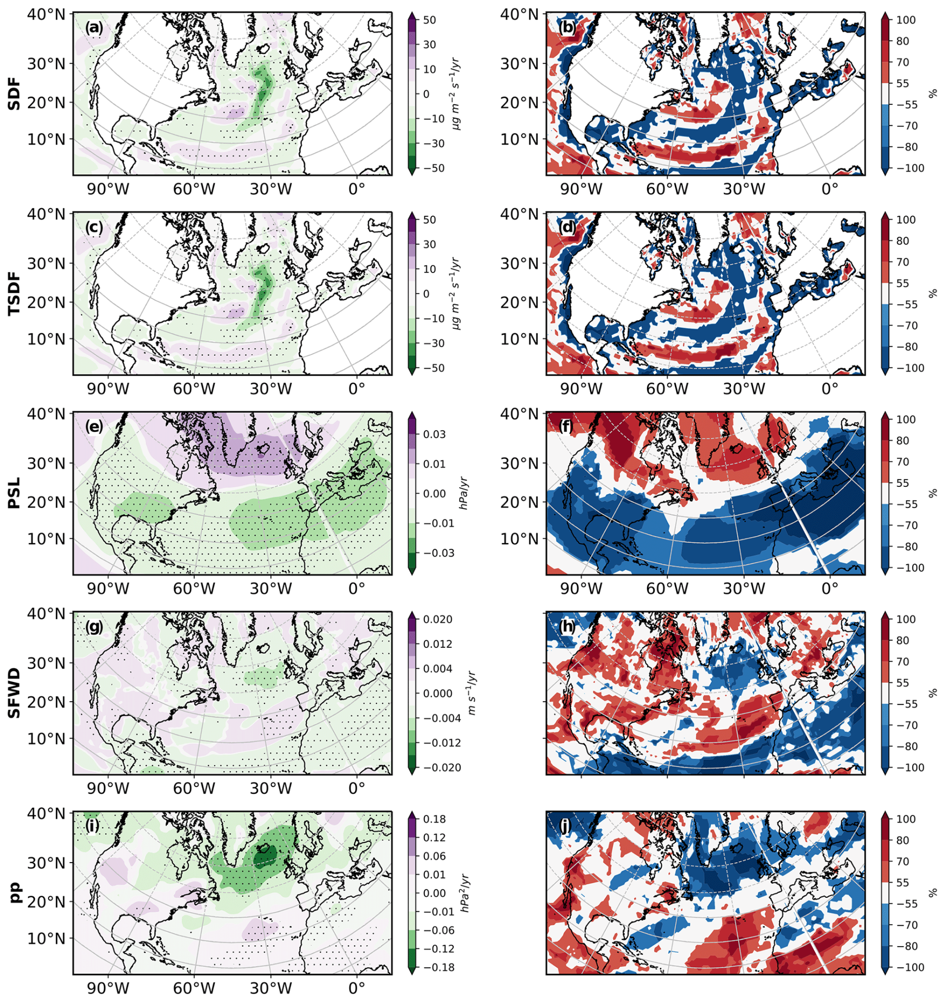
Connection to Anthropogenic Aerosols
Much of the AMOC slowdown can be tied to the propagation of these aerosols
Perturbations in aerosol concentrations -> corresponding alterations in AMOC flow/surface density
Increase in anthropogenic aerosols -> strengthening of AMOC
https://acp.copernicus.org/articles/21/5821/2021/

Slide 11
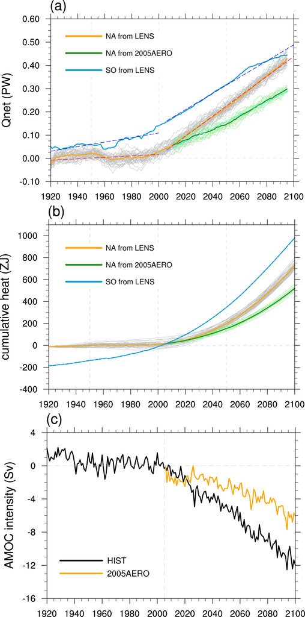
AMOC Balancing - Climate Change Implications
As AMOC weakens, NATL will start absorbing more of the anthropogenic heat due to Aerosol concentration not changing much, but CO2 (and other GHG) concentrations continuing to increase
Slowdown of AMOC will increase NATL heat uptake but decrease heat transport to Europe despite anthropogenic aerosol forcing
Will not counteract rising atmospheric CO2 amounts due to growth disparity
https://journals.ametsoc.org/view/journals/clim/31/18/jcli-d-18-0170.1.xml?rskey=FNkP9j&result=1

Slide 12
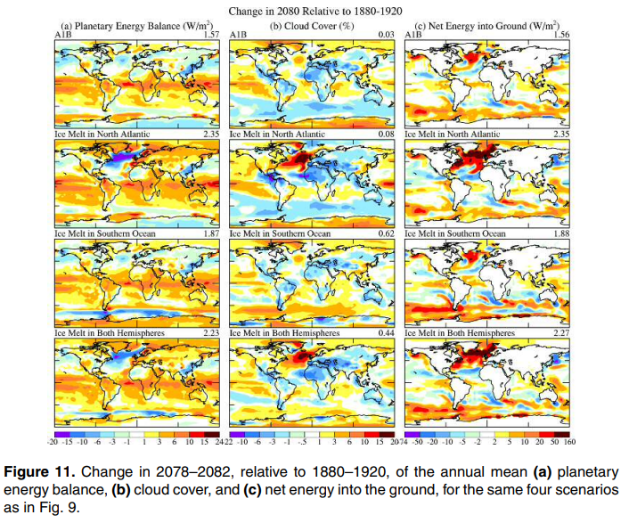
AMOC - Climate Change Implications (con’t)
Could lead to an increase in severe weather events due to stronger baroclinicity over NATL/mid-latitudes
Loss of cross-equator transport and diminishing of inter-hemispheric transport
Source of further damage for endangered species and regions, like Amazon and coral reefs
http://kanata-forum.ca/ice-melt.pdf

Slide 13
Conclusions
AMOC expected to weaken over next century due to anthropogenic climate change
Will most likely result in reduction of deep-sea mixing/deep-water formation, decrease in heat transport across NATL, a sea level rise, more extreme weather, and rise in anoxic/eunixic condition events
Will cause a shift in ITCZ southward and a slight decrease in polar sea ice melt rate (but not enough to save them)
NATL will transition to being a greater heat sink over time (compared to Southern Ocean)
Noticeable decrease in Ocean CO2 uptake, leading to a more rapid rise of atmospheric CO2

