Slide 1
Acid Rain
Nathan Banks, Chloe Lecates, and Amanda Mitchell

Slide 2
Introduction
Discovered in 1852
Acidity levels in industrialized England vs rural
Rediscovered in 1950s
Death of Norwegian fish populations
Corrodes limestone and marble
Buildings and statue structure disrupted
Causes ~550 premature deaths/year
Most common in Eastern US and Europe
Increasingly observed in India and China
Notes:
Amanda
Premature deaths primarily from leached heavy metals getting into drinking water, contaminating food

Slide 3
Acid Rain Formation
Notes:
Efforts to control acid deposition have focused on cutting emissions of sulphur dioxide , because sulphuric acid is a more important acidifying agent than are nitrogen oxides (once the latter have been converted to nitrate, they are rapidly absorbed by plants).

Slide 4
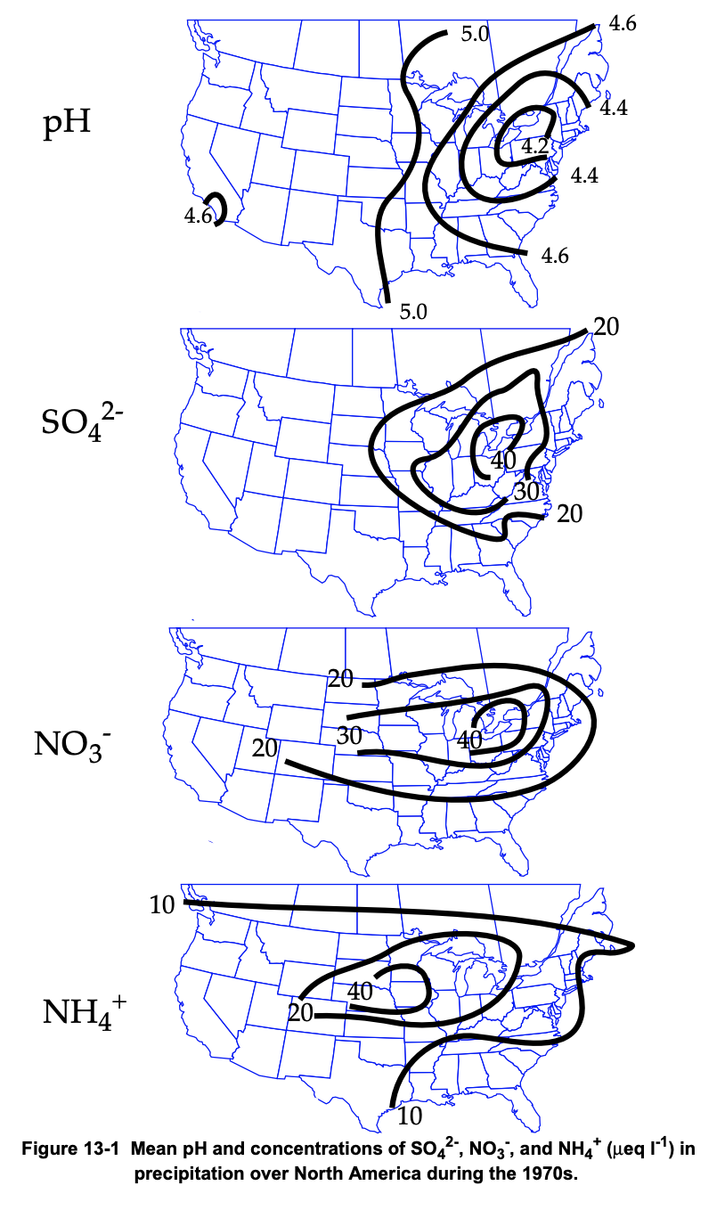
Emissions
Primary pollutants that contribute to acid rain: NO_{x} and SO₂
SO₂ sources: power plants, petroleum refining, metal processing
NO_{x} sources: cars/trucks, power plants, residential oil and gas
Acidity balanced by natural bases (NH₃)
Ammonia sources: agriculture (fertilizer and manure), car emissions, industry
Notes:
Chloe

Slide 5
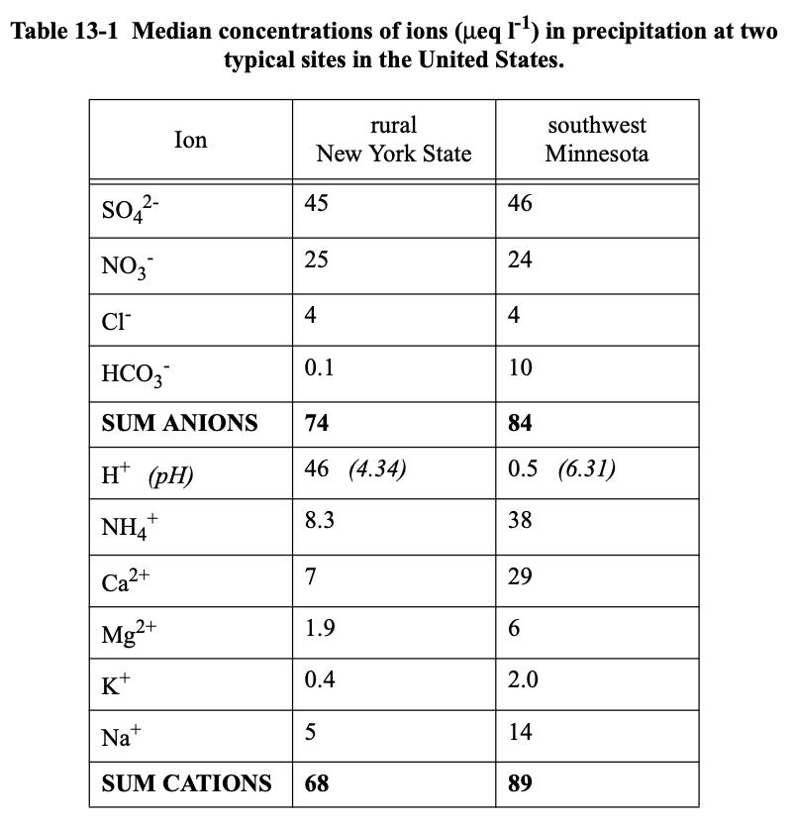
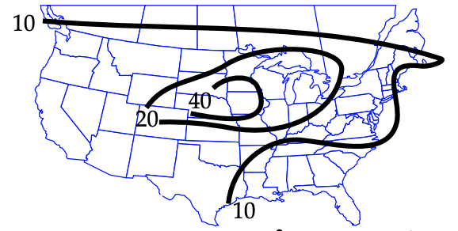
Ions in Rainwater
Variety of ions based on local emissions
SO_{x} and NO_{x} are equal
NH₃ common in midwest
NH₃

Slide 6
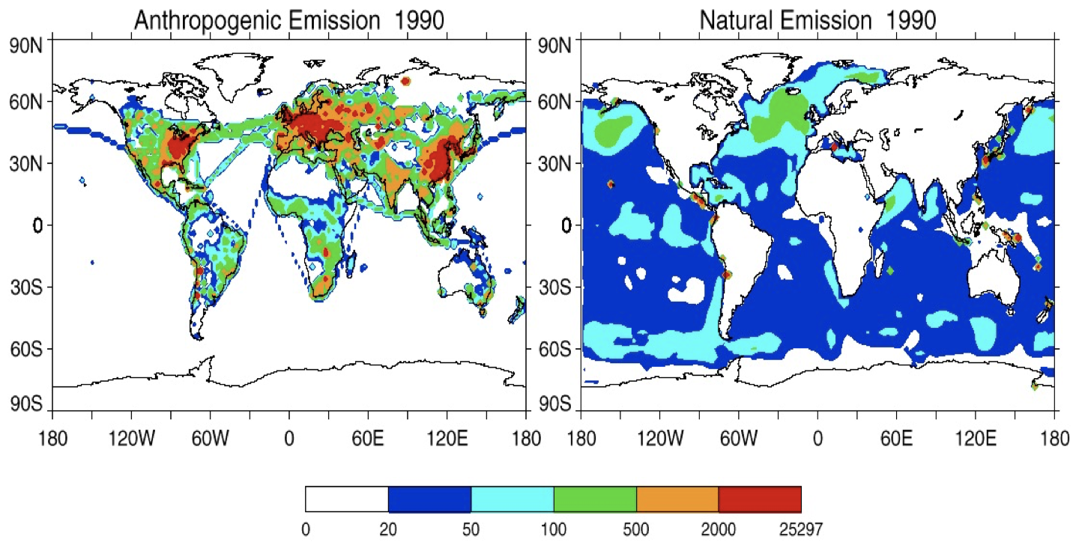
Global Sulfur Emission to Atmosphere

Slide 7
Chemical Reactions in Atmosphere (SO₂)
O₂
H₂O + M
OH +
SO₂
+ M
M + HSO₃
HO₂ + SO₃
H₂SO₄ + M
Dissolution
Lifetime against oxidation with OH is 1-2 weeks… why is acid rain so local?
SO₄²⁻ + 2H⁺
SO₂
Notes:
Chloe

Slide 8
Chemical Reactions in Clouds (SO₂)
2HO₂
Dissolution
SO₂
SO₂ᐧ H₂O
HSO₃⁻ + H⁺
H₂O₂
H₂O₂
SO₄²⁻ + 2H⁺ + H₂O
SO₂
Notes:
Chloe

Slide 9
Chemical Reactions in Atmosphere (NO_{x})
OH +
NO₂
+ M
M + HNO₃
NO₃²⁻ + H⁺
O₃
NO₂ + M
NO₂
O₂ + NO₃͘
N₂O₅ + M
Daytime Photolysis
H₂O (l)
O + NO₂
2HNO₃
2NO₃²⁻ + 2H⁺
NO₂
Notes:
Chloe

Slide 10
Geological Effects

Slide 11
Calcium Carbonate Neutralization
CaCO₃ + H₂SO₄ CaSO₄ + H₂CO₃
H₂CO₃ CO₂ + H₂O
Alkaline soils directly neutralize acid and converts it to water
Found in middle of US
Notes:
Amanda

Slide 12
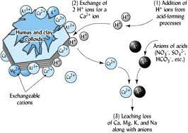
Cation Exchange Neutralization
H⁺ switch places with metal ions
H⁺ neutralized
Metal ions leached into lower soil
Cannot be used as nutrients for plant growth

Slide 13
Aluminum Hydroxide Neutralization
Al(OH)₃ + H₂SO₄ Al₂(SO₄)₃ + H₂CO₃
Aluminum mobilized as aluminum sulfate is soluble in water
Causes stunted root growth and prevents calcium accumulation
Inhibits release of nutrients from microorganisms
NH₄⁺ + 2O₂ NO₃⁻ + H₂O + 2H⁺
Same process can occur with other toxic metals

Slide 14
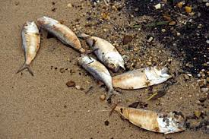
Impact on Aquatic Ecosystems
Acid rain over oceans rapidly neutralized by CO₃²⁻
Increased fish mortality rate
Reproductive failure
Reduced growth rate
Increased heavy metal concentration
Leaching of Ca²⁺
Disrupts shell and skeleton formation

Slide 15
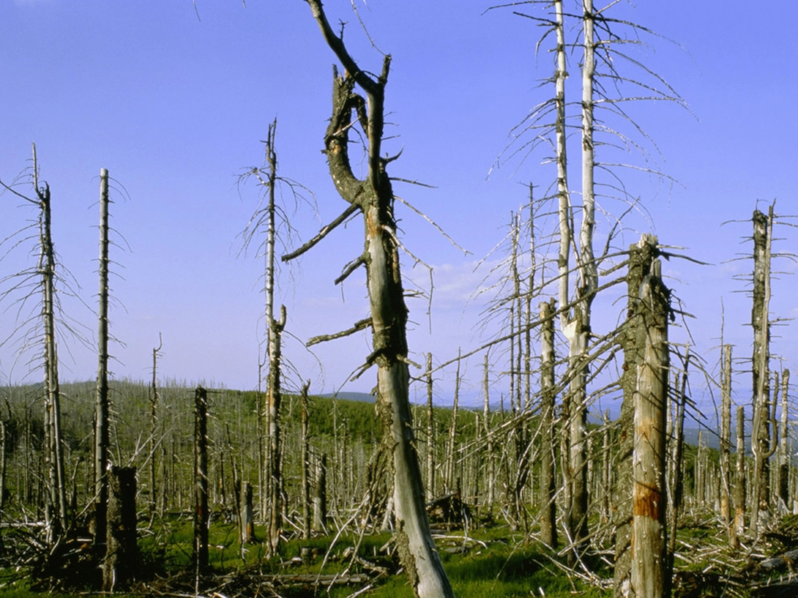
Impact on Forests
Direct damage to plant tissue
Roots and foliage
Reduced canopy cover
Discoloration
Leaching of Ca²⁺
Displacement of Ca²⁺ in cell membrane
Protein concentration reduction
Anatomical changes in leaves
Necrosis, epicuticular wax erosion, and epidermis rupture

Slide 16
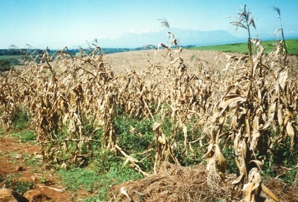
Impact on Crops
Reduced CO₂ fixation
Decreased primary production
Reduced photosynthesis in wheat
Smaller root length
Overall yield decrease
Biomass was also smaller
Notes:
Leaches nutrients, exit ecosystem as runoff
Ammonia naturally scavanges H, but ammonium with oxygen can create nitric acid and restore acidity

Slide 17
Governmental Regulations

Slide 18
Effects of War and The Clean Air Act
During World War II, industry rapidly increased, causing greenhouse gas production to also increase
This caused an increase of NO_{x} and SO_{x} to be dumped into the atmosphere
The air pollution effects started being noticed in the 60’s and as a result, The United States passed the Clean Air Act in 1970
The Clean Air Act
Gave the EPA more powers to combat air pollution
Originally was focused more on protecting ozone layer
Made a set of national air quality guidelines that each state had to follow (NAAQS)

Slide 19
European Regulation
United National Conference on Human Environment
Held in Stockholm, Sweden in 1972
First world conference specifically talking about environmental issues
Resulted in the Stockholm Declaration and Action Plan
Stockholm Declaration contained 26 principles on the relations between industrial and economic growth and air, water, and ocean pollution
Geneva Convention on Long-Range Transboundary Air pollution in Europe
Started in 1979
Joint committee of 51 parties all focused on air pollutants and their transportative properties

Slide 20
Canadian Regulation
Eastern Canada Acid Rain Program
Started in 1985
Sought to reduce SO_{x} emissions by 50% of 1980 by 1993
Canada-wide Acid Rain Strategy replaces Eastern Canada Acid Rain program
Started in 1998 and was a replacement to the Eastern Canada Acid Rain Program
Included the rest of the Canadian provinces and restated new goals for post 2000

Slide 21
American Regulation
Clean Air Act Amendments
Amendments to the original clean air act were added in 1990 to specifically target and reduce Acid Rain Production from electrical production facilities that use coal
Phase 1 started in 1995
Sought to reduce SO_{x} and NO_{x} emissions by 10 million tons and 2 million tons below 1980 levels, respectively
Reduced emissions from a total of 445 electricity generating units in the US
Phase 2 started in 2000
Incorporated more units to continuously reduce emissions and added a cap on pollutant concentrations

Slide 22
Timeline
1939 - 1945: World War II increases production of NO_{x} and SO_{x}.
1970: Clean Air Act in United States
1972: United Nations Conference on Human Environment in Stockholm, Sweden
1979: Geneva Convention on Long-Range Transboundary Air pollution in Europe
1985: Eastern Canada Acid Rain Program
1990: Clean Air Act Amendments (Acid Rain Program)
1995: Initiation of phase 1 of Acid Rain Program
1998: Canada-wide Acid Rain Strategy replaces Eastern Canada Acid Rain program
2000: Initiation of phase 2 of Acid Rain Program

Slide 23
Conclusion
NO_{x} and SO_{x} are the primary pollutants that cause acid rain
Emissions react with particles in the air to form acid rain
Acid rain has nasty geological effects on plant life, particularly forests and crops
For the last 50 years, regulations have been put in place to reduce NO_{x} and SO_{x} emission and production

Slide 24
Resources
Introduction to Atmospheric Chemistry Textbook, Chapter 13
NOx Wikipedia Page
Ophardt, C. (2003). Acid Rain Effects - Soil Interactions. Elmhurst College. Retrieved from http://chemistry.elmhurst.edu/vchembook/196soil.html.
Singh, A., Agrawal, M. (2008). Acid Rain and its Ecological Consequences. Journal of Environmental Biology, 29(1). Retrieved from http://www.jeb.co.in/journal_issues/200801_jan08/paper_02.pdf
Encyclopædia Britannica, inc. (n.d.). Clean Air Act. Encyclopædia Britannica. Retrieved April 25, 2022, from https://www.britannica.com/topic/Clean-Air-Act-United-States-1970
United Nations. (n.d.). United Nations Conference on the human environment, Stockholm 1972. United Nations. Retrieved April 25, 2022, from https://www.un.org/en/conferences/environment/stockholm1972
U.S. Department of State. (2021, January 5). Convention on long-range transboundary air pollution - united states department of state. U.S. Department of State. Retrieved April 25, 2022, from https://www.state.gov/key-topics-office-of-environmental-quality-and-transboundary-issues/convention-on-long-range-transboundary-air-pollution/#:~:text=The%201979%20Convention%20on%20Long,pollution%20and%20better%20understanding%20air
Acid rain regulations in North America. School of Engineering. (n.d.). Retrieved April 25, 2022, from http://www.soe.uoguelph.ca/webfiles/gej/AQ2017/Sinha/index.html#:~:text=Acid%20Rain%20Regulations%20in%20the%20United%20States&text=The%20program%20was%20instituted%20in,power%20generation%20units%20and%20boilers.
Environmental Protection Agency. (n.d.). Acid Rain Program. EPA. Retrieved April 25, 2022, from https://www.epa.gov/acidrain/acid-rain-program

Slide 25
Thank you!

