Slide 1
Air Quality Impact on Climate Change
Aman, Aria, Marcus

Slide 2
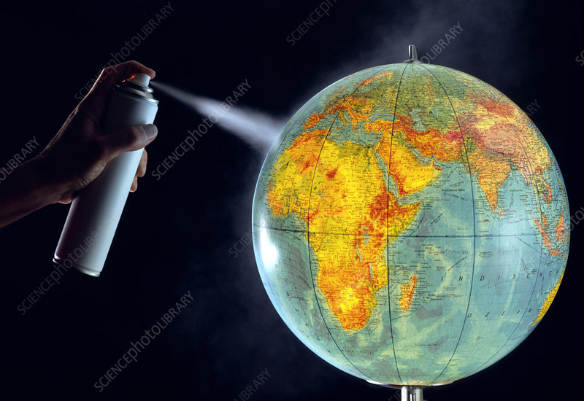
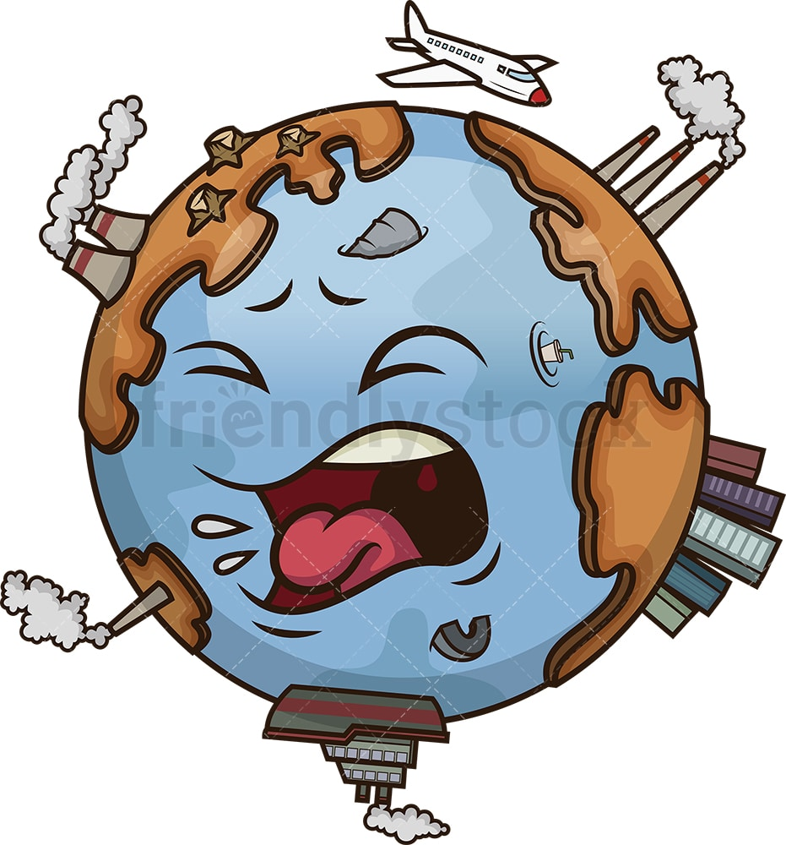
Overview
The recent increase in greenhouse gas is trapping excess heat and causing the climate to heat. This presentation is looking at how air quality impacts climate change. Specifically looking at aerosol, biosphere, and cryosphere interaction. This is a global overview of climate change. Finally, going over ways to reduce the impact of climate change by improving air quality through an individual and global standpoint.

Slide 3
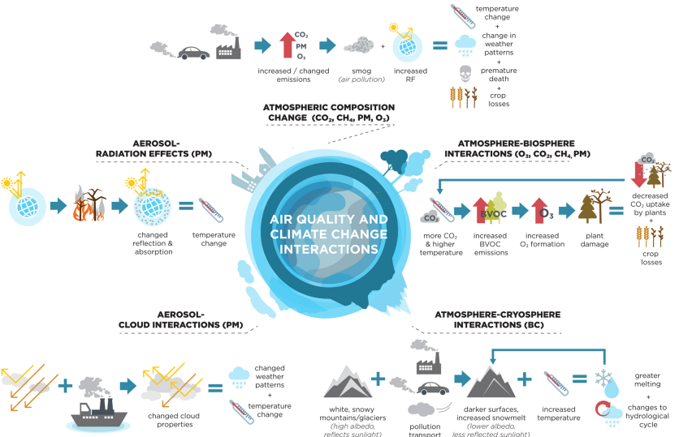

Slide 4
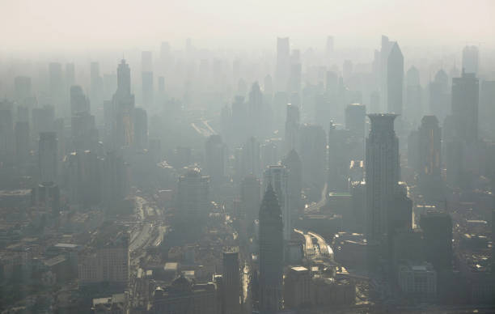
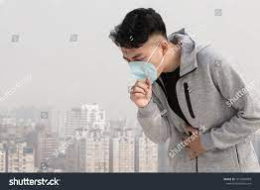
Aerosols
Aerosols affect climate in many ways. First, they scatter and absorb sunlight, which modifies the radiative balance. Aerosol scattering generally makes the planet more reflective and tends to cool the climate, but aerosol absorption has the opposite effect, tending to warm the climate system. However, both aerosol scattering and absorption cause less solar radiation to reach the surface.

Slide 5
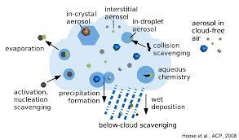
Aerosol Cloud Interactions
Aerosols are responsible for a radiative forcing of climate change through their interactions with radiation and clouds. This radiative forcing of aerosols could inhibit the warming effect of greenhouse gases.
In comparing pristine versus polluted storms, it is shown that aerosols increase the liquid water content, cloud cover and consequently the albedo of polluted systems, enhancing outgoing shortwave radiation by upwards of 4 W m−2 within the storm.

Slide 6
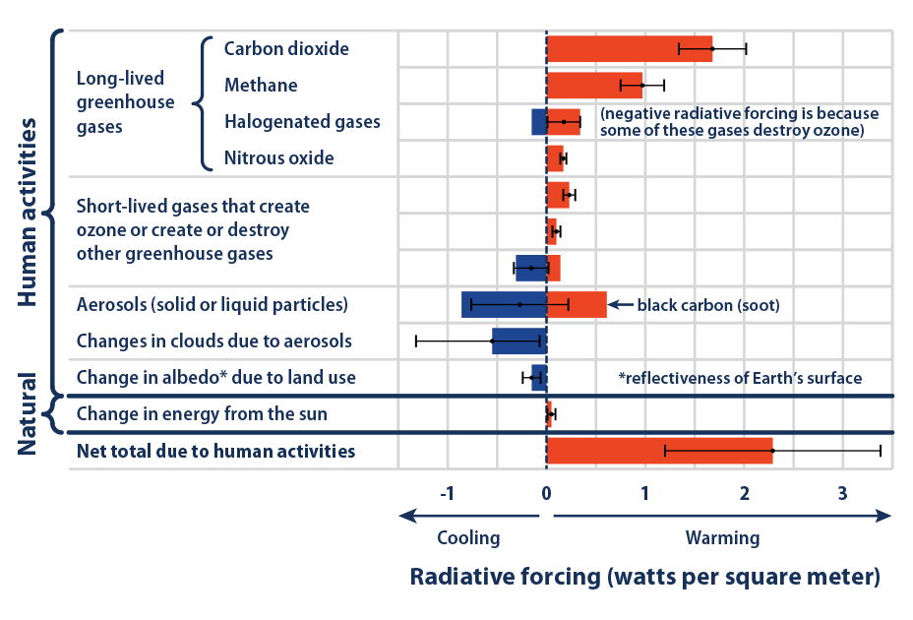
1750-2011
https://www.epa.gov/climate-indicators/climate-change-indicators-climate-forcing

Slide 7
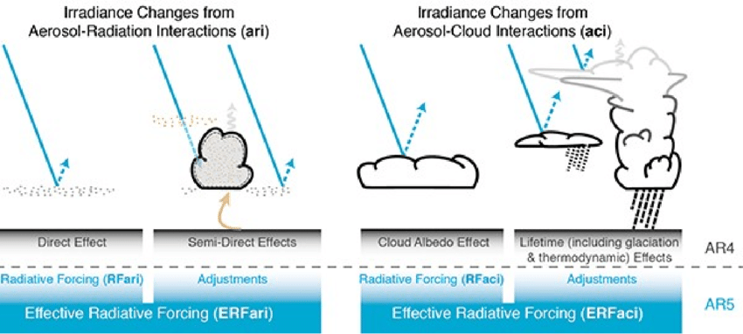
Direct effects
Scattering and absorption of solar radiation and changes in energy budgets caused by aerosols imposing a positive or negative radiative forcing at the top of the atmosphere and a negative radiative forcing near the surface

Slide 8
Sulfate Aerosols
Anthropogenic sources include: Emissions from fossil fuel combustion and biomass burning
Sulfate aerosols scatter solar radiation, resulting in a cooling effect
Radiative forcing of -0.41 W/m²(IPCC AR5)
Sulfate particles from ship emissions are the especially potent climate-forcers because of rapid coagulation that occurs in ship emission plumes
Relatively low lifetime (few days in the troposphere)
Emission reductions can be achieved through decreased use of sulfur-containing energy sources (i.e. coal) and/or the adoption of post-combustion scrubbing to reduce sulfur emissions
Due to the low lifetime, this would result in short term warming in areas of high emission reductions
Notes:
sulfate particles can grow and reach sizes of about 100 nm within minutes after the emissions where they can be activated as cloud droplets

Slide 9
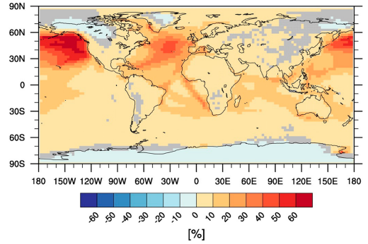
Relative Contribution of Shipping to Sulfate Aerosols
Notes:
Grey squares indicate non significant contribution. Ship emissions are significant b/c the low quality fuel used in ships has high sulfur content

Slide 10
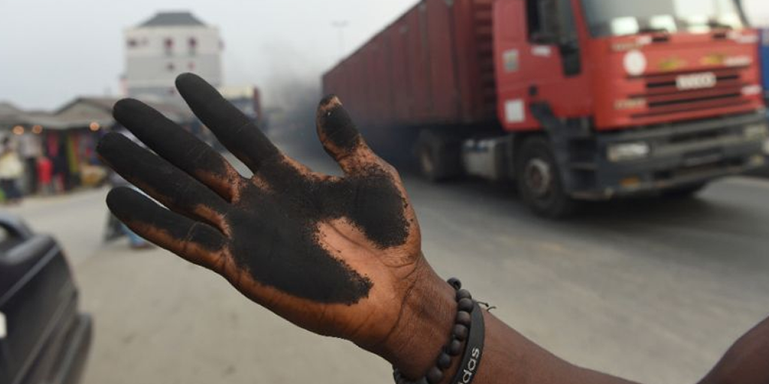
Black Carbon Aerosol-Radiation Effects
Sourced from the incomplete combustion of biomass, diesel, and coal
Primary anthropogenic sources are household energy, transportation, and industry
In the atmosphere, it’s characterized by its strong absorption of visible and near-infrared light that causes atmospheric warming
Relatively low lifetime of 1-2 weeks
Emission reductions can be achieved through the transition away from biomass powered heating and cooking infrastructure towards modern fuel stoves. Elimination of high-emitting diesel vehicles would also contribute to reductions

Slide 11
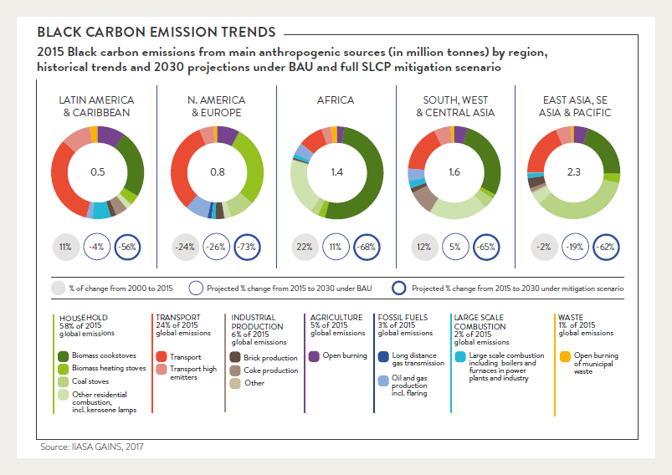
Black Carbon Regional Sources

Slide 12
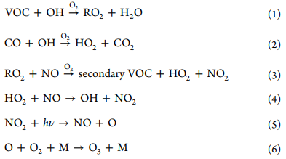
Tropospheric Ozone
In the troposphere, ozone is a secondary pollutant chemically produced from a combination of nitrous oxides, volatile organic compounds (VOCs), carbon monoxide, and methane in the presence of sunlight
As a GHG, increased concentrations of ozone will contribute to global warming
Emissions of VOCs and NOx are key in the formation of tropospheric ozone
Regulation of ozone production depends on if the area is NOx limited or saturated

Slide 13
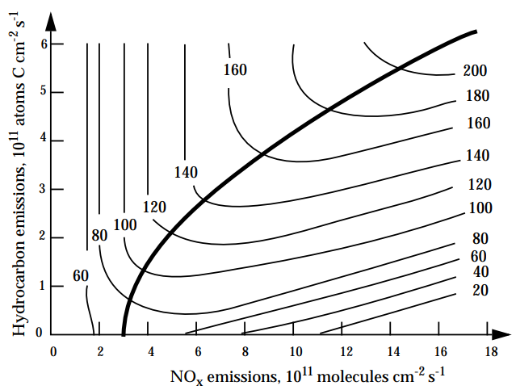
Ozone Production Dependence on VOC and NOx
NOx Limited Regime
VOC Limited Regime
Notes:
In urban areas we typically follow the NOx saturated regime, so decreasing VOC is needed to lower ozone production.

Slide 14
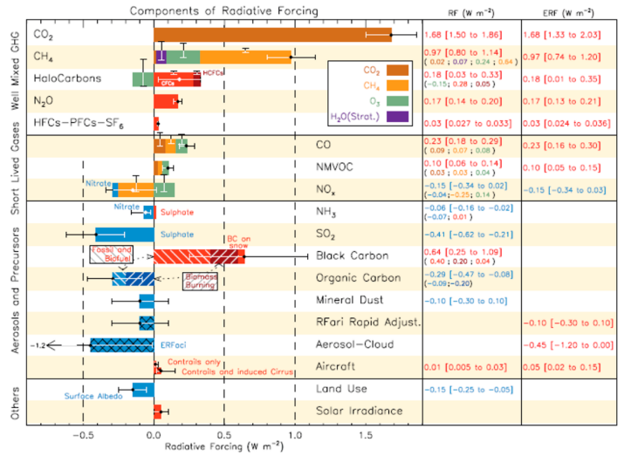
Other Chemical Compounds’ Radiative Forcing

Slide 15
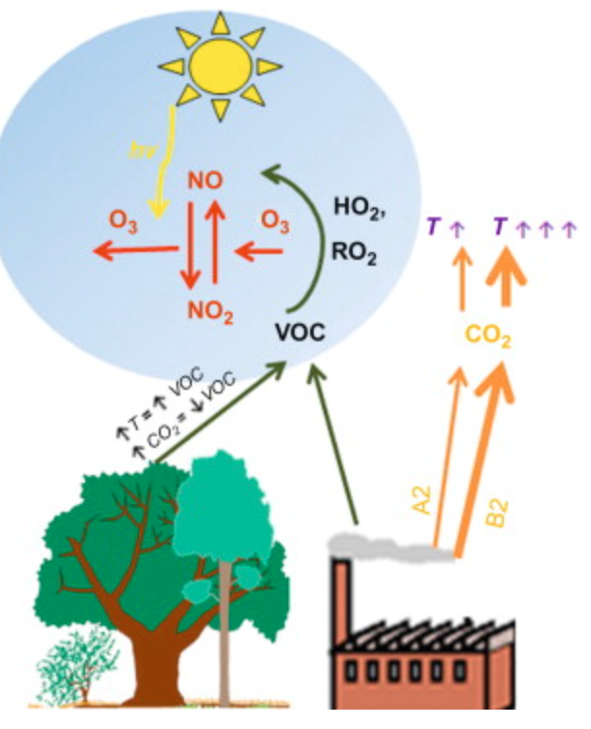
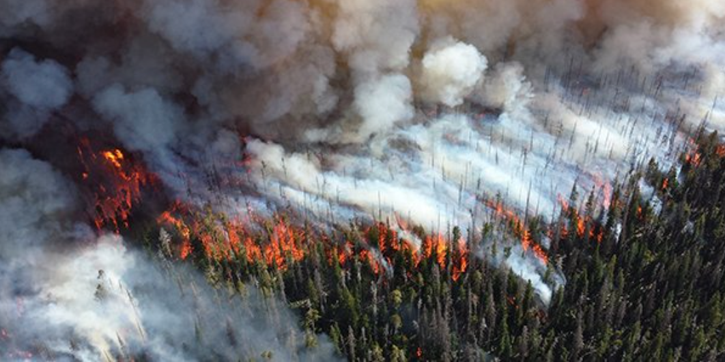
Biosphere
CO₂ sinks
Emission of biomass aerosols
Dimethyl sulfide
Secondary organic aerosols
Biomass burning from wildfires, etc
VOCs
Ozone - vegetation feedbacks lead to increased ozone concentrations in the troposphere
Notes:
“Natural aerosols play an important role in vegetation-atmosphere-climate interactions. The terrestrial biosphere and the oceans are a large source of atmospheric aerosols, such as secondary organic aerosol (SOA), biomass burning from wildfires, dimethyl sulfide (DMS) from plankton, and sea-salt. Once in the atmosphere, these natural aerosols affect climate through their direct and indirect radiative effects. In addition, through their induced changes on diffuse surface radiation, these aerosol can strongly affect land vegetation growth.”

Slide 16
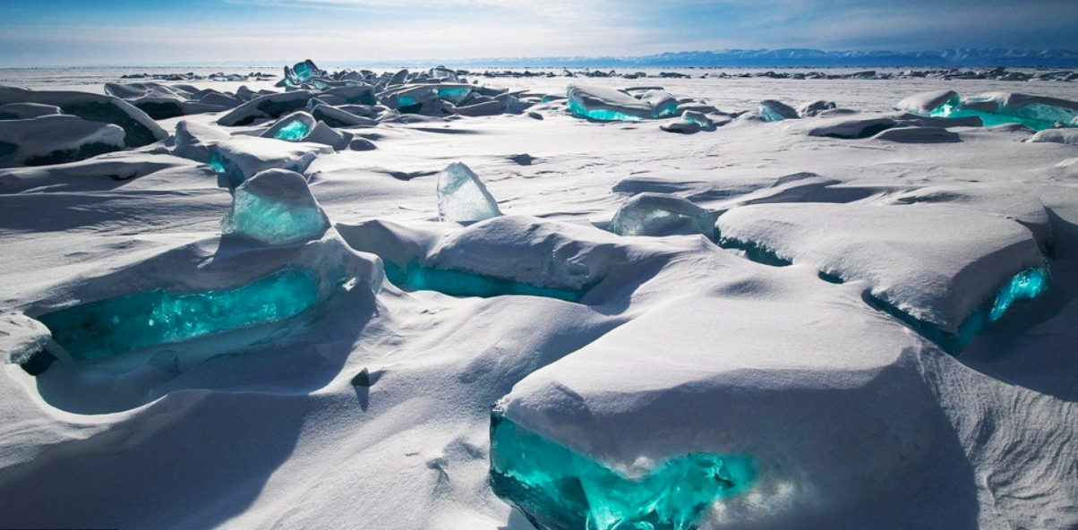
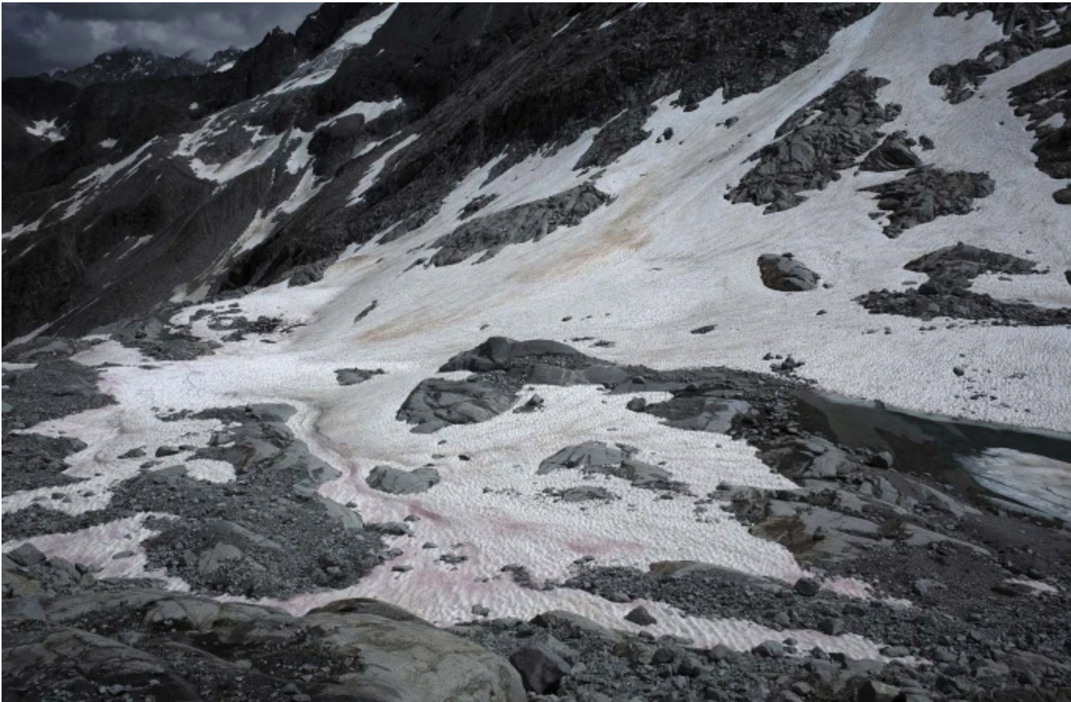
Cryosphere
All frozen water on earth: snow, ice, etc.
Most of Earth’s albedo effect comes from cryosphere
Aerosols settle on snow
Black carbon from wildfires
Dust from the Sahara desert
Notes:
Cryosphere and atmosphere have several interactions back and forth in a cyclic fashion
Positive feedback loop

Slide 17
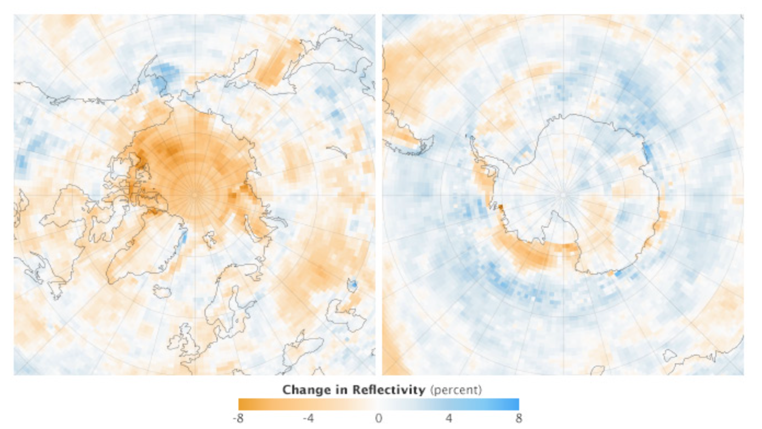
Change in reflectivity Mar.1.2000 - Dec.31.2011

Slide 18
Ways to Help Improve Air Quality
Reduce the number of trips you take in your car.
Reduce or eliminate fireplace and wood stove use.
Avoid burning leaves, trash, and other materials.
Avoid using gas-powered lawn and garden equipment.
Reduce airplane trips.

Slide 19
Conclusion
Aerosol scattering has a cooling effect while aerosol absorption has a heating effect.
Aerosols tend to be cooling in the stratosphere and warming in the troposphere and on the surface
Pollution transfer to the cryosphere reduces surface albedo, leading to increased temperature and greater melting in a positive feedback loop.
The reduction of fossil fuel emissions will overall reduce the positive radiative forcing by air pollutants.

Slide 20
Questions?

Slide 21
Sources
https://earthobservatory.nasa.gov/images/84499/measuring-earths-albedo
https://pubs.acs.org/doi/pdf/10.1021/acs.chemrev.5b00089
https://blogs.egu.eu/divisions/cr/2019/09/20/climate-change-cryosphere-summer-2019-the-year-that-the-arctic-was-sunburned/
https://www.nature.com/articles/s41558-020-00911-9
https://iopscience.iop.org/article/10.1088/1748-9326/3/2/025002
https://acp.copernicus.org/articles/21/1049/2021/#:~:text=Aerosol%E2%80%93cloud%20interactions%2C%20also%20termed,albedo%20(Twomey%2C%201977).
https://www.ccacoalition.org/en/slcps/black-carbon#:~:text=Per%20unit%20of%20mass%2C%20black,regional%20circulation%20and%20rainfall%20patterns.
https://agu.confex.com/agu/fm19/meetingapp.cgi/Paper/533251

