Slide 1
Effect of Atmospheric SO_{x} on Aminosilica Adsorbents for Air Capture
Steph Didas
EAS 6410
April 26, 2012

Slide 2
Air Capture Technologies & CO₂ Adsorption Mechanism
Solid Adsorbents
CO₂ rich air
amine-oxide
Regeneration
Sorbent regen &
CO₂ recovery
CO₂ removal from air
CO₂ lean air
CO₂-amine-oxide
CO₂
Caplow, J. Am. Chem. Soc., 1968.
Donaldson & Nguyen, Ind. Eng. Chem. Fundam., 1980.

Slide 3
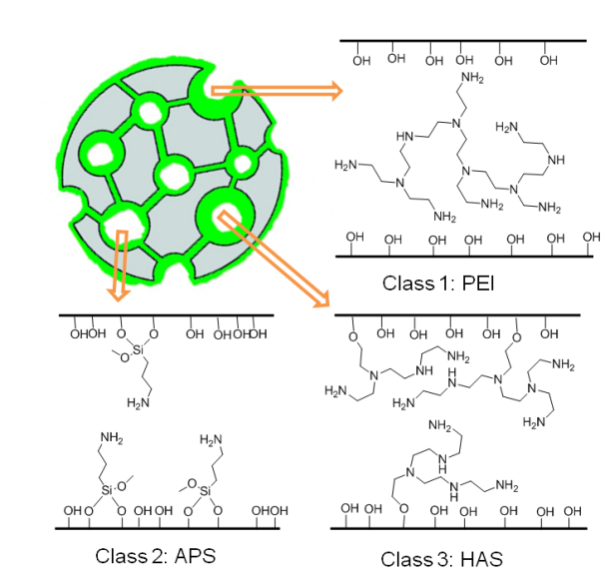
Supported Amine Adsorbents
Class 1:
High amine content
Not stable
Class 2:
Low amine content
Stable
Class 3:
High amine content
Stable
Class 1: Physical impregnation
Class 2: Covalent tethering
Class 3: In situ polymerization
Li et al., ChemSusChem, 2010.
Bollini et al., J. Mater. Chem., 2011.

Slide 4
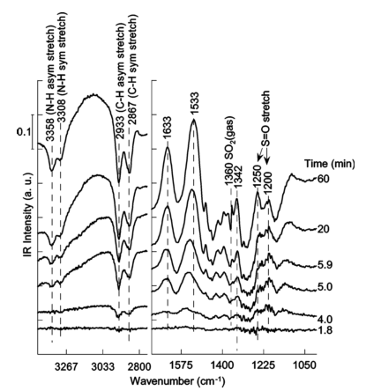
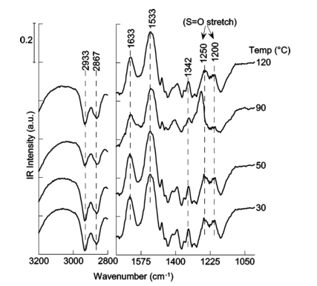
Sorbent Degradation from SO_{x} in Flue Gas Streams
DRIFTS absorbance spectra during SO₂ adsorption
DRIFTS absorbance spectra during SO₂ temperature programmed desorption
SO₂ irreversibly adsorbs forming heat stable corrosive salts
Flue gas SO₂ concentrations 500-2000 ppm → What happens at air capture concentrations?
Khatri et al., Energy Fuels, 2006.

Slide 5
Objective of Study
Estimate adsorbent deactivation due to SO_{x} concentrations in the atmosphere based on reported data for flue gas degradation
6

Slide 6
Adsorption Mechanism & Proposed Model
K
RNH₂ + SO₂
RNH₂⁺ + SO₂⁻
Assumptions:
[SO₂] is equal to feed concentration due to constant supply
[RNH₂⁺] = [SO₂⁻] due to 1:1 stoichiometric ratio
Belmabkhout & Sayari, Energy Fuels, 2010.
Diaf et al., J. Appl. Polym. Sci., 1994.

Slide 7
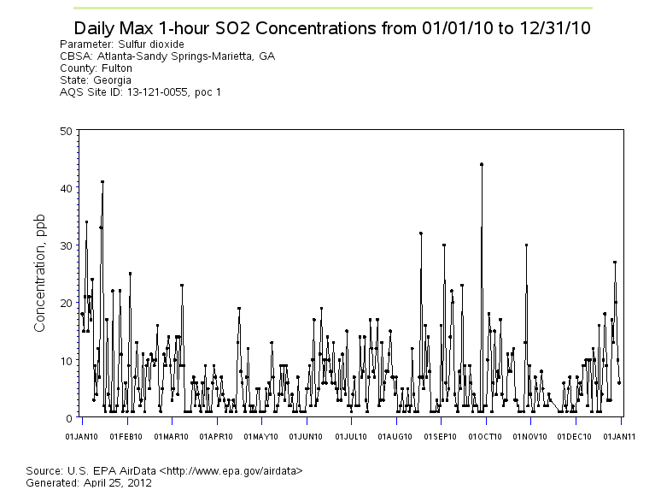
[SO₂] Trends: Atlanta
Upper limit: 45 ppb
Lower limit: 5 ppb

Slide 8
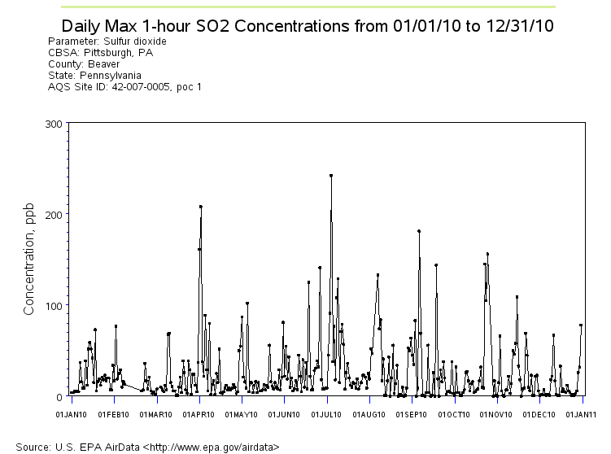
[SO₂] Trends: Pittsburgh
Upper limit: 250 ppb
Lower limit: 5 ppb

Slide 9
Atmospheric SO₂ Adsorption Results
 | % of FG Upper Limit | % of FG Lower Limit
Atlanta | 0.47 | 0.95
Pittsburgh | 1.1 | 2.2
SO₂ adsorption/degradation potential very low at harshest atmospheric conditions
Can set up capture stations at locations with less extreme variation

Slide 10
Summary & Future Work
Atmospheric SO_{x} degradation location dependent
Should set up air capture station in low pollution area
NO_{x} degradation studies needed
Flue gas streams 2500-1500 ppm vs. atmospheric levels of 80-5 ppb
More complicated mechanism → data needed for additional products

Slide 11
Questions?

