Slide 1
Gas/Particle Partitioning of Polycyclic Aromatic Hydrocarbons in the Spring of Beijing, China
Xiaoxi Liu
EAS 6410, Spring 2012

Slide 2
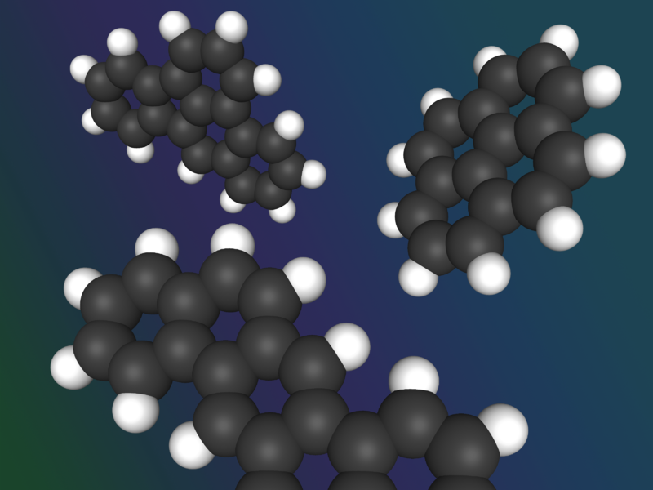
Summary
Introduction
Sampling and Analysis
Results and Discussion
- PAHs concentrations
- Assessment of three gas/particle partitioning models
Conclusions

Slide 3
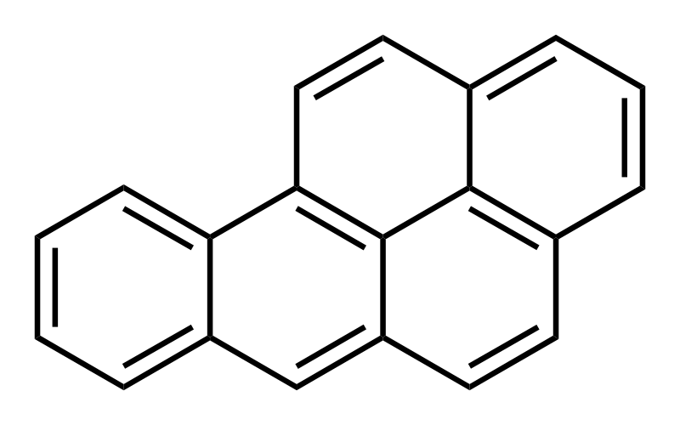
PAHs and Gas/Particle Partitioning
Polycyclic aromatic hydrocarbons (PAHs): organic compounds arranged in two or more aromatic rings
Human Health: carcinogenic, mutagenic, teratogenic
Benzo(a)pyrene
Gas/particle partitioning influencing their fate (long-range transport, transformation, and removal mechanism)
Many efforts have been devoted to study the particulate concentrations of PAHs, not many to Gas
Controlling air quality needs concurrent study of gas and particle phase PAHs

Slide 4
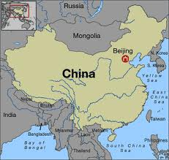
Sampling
Beijing, China
Dingling
Dongsi
Gucheng
Yizhuang
April 1, 8, 14, 20 and 26, 2011. 0:00-24:00

Slide 5
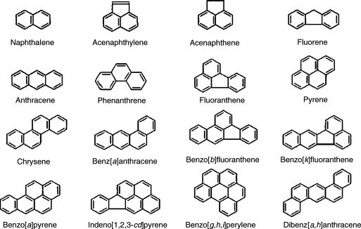
Analysis
16 EPA priority PAHs: Gas chromatography – mass spectrometry (GC-MS)
Quality control: calibration curve, recoveries, detection limits
Measurement of Organic Carbon/Elemental Carbon: Thermal-Optical-Transmittance (TOT) analysis method
NAP ACY ACE FLU
ANT PHE FLT PYR
CHR BaA BbF BkF
BaP IND BGP DBA

Slide 6
Results and Discussion – PAHs Levels
ng/m^3
PAH | particle-phase gas-phase
 | Dingling | Gucheng | Dongsi | Yizhuang Dingling |  | Gucheng | Dongsi | Yizhuang
NAP | 0.31 | 0.96 | 0.69 | 0.29 | 6.47 | 22.97 | 10.77 | 12.49
ACY | N.D. | N.D. | 0.16 | N.D. | 1.19 | 4.24 | 2.18 | 2.73
ACE | N.D. | N.D. | N.D. | N.D. | 0.71 | 3.90 | 1.41 | 1.31
FLU | 0.69 | 1.08 | 0.81 | 0.64 | 5.81 | 16.94 | 9.73 | 12.08
PHE | 1.91 | 2.75 | 1.92 | 2.10 | 12.60 | 39.09 | 25.28 | 31.87
ANT | 2.28 | 1.53 | 1.82 | 1.16 | 1.18 | 2.95 | 1.77 | 2.49
FLT | 3.11 | 4.52 | 2.75 | 4.18 | 3.07 | 8.76 | 5.98 | 8.69
PYR | 2.64 | 3.75 | 2.24 | 3.76 | 1.83 | 5.53 | 3.69 | 5.88
BaA | 2.02 | 2.90 | 1.90 | 2.69 | 1.26 | 1.69 | 1.21 | 1.46
CHR | 1.60 | 3.66 | 1.81 | 3.07 | 0.15 | 0.45 | 0.49 | 0.75
BbF | 4.29 | 7.95 | 4.81 | 7.31 | 0.58 | 1.11 | 0.47 | 0.60
BkF | 0.92 | 1.93 | 0.95 | 1.75 | N.D. | N.D. | 0.04 | 0.01
BaP | 2.20 | 3.24 | 1.97 | 3.23 | N.D. | N.D. | N.D. | N.D.
IND | 4.17 | 6.36 | 4.45 | 6.00 | N.D. | N.D. | N.D. | N.D.
DBA | 0.73 | 1.78 | 0.71 | 1.83 | N.D. | N.D. | N.D. | N.D.
BGP | 2.63 | 4.56 | 2.95 | 4.34 | N.D. | N.D. | N.D. | N.D.
16 PAHs | 29.49 | 46.96 | 29.94 | 42.34 | 34.84 | 107.63 | 63.31 | 80.37

Slide 7
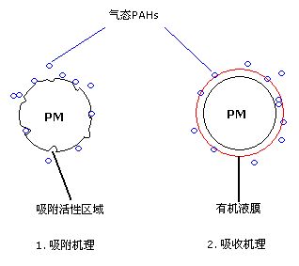
Partitioning Mechanisms
Emitted PAHs
Physical adsorption onto the particle surface
Absorption into the organic matter of aerosols
Gas-particle partition coefficient, K_{p} (m³/ug ):
F (ng/m³) -particle concentration of PAHs
A (ng/m³) -gas concentration of PAHs
TSP - concentration (ug/m³) of the total suspended particles
Active sites
Organic matter
Adsorption
Absorption
Both mechanisms lead to a linear relationship between logK_{p} and the log of the PAH subcooled liquid vapor pressure (logp_{L}⁰):
Ideally, under equilibrium conditions, the slope should be equal to −1

Slide 8
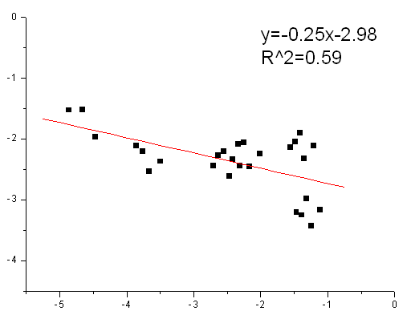
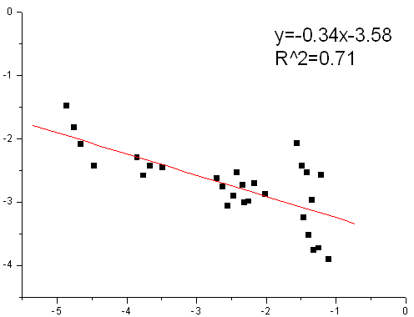
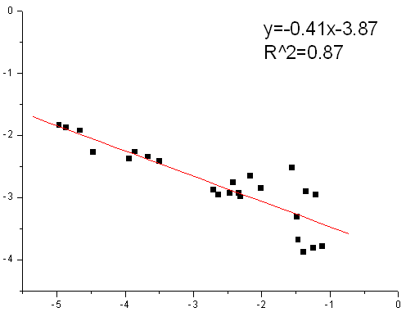
The logKp-logp_{L}⁰ Relationship
The partitioning of PHE, ANT, FLT, PYR, BaA, CHR was studied
Dingling
Gucheng
 |  | Slope m_{r} |  |  | Intercept b_{r}
Locations | Sites | min | max | mean | min | max | mean | R² | References
Beijing /China | Urban& Suburban | -0.46 | -0.25 |  | -4.02 | -2.98 |  | 0.59-0.87 | present study
Beijing /China | Urban | -1.45 | -0.90 | -1.28 | -6.16 | -4.97 | -5.61 | 0.57(Spring)， 0.73(Annual) | Wang，2011
Guangzhou /China | Urban | -0.86 | -0.46 | -0.64 |  | -6.09 |  | 0.85 | Yang,2010
 | Suburban | -0.79 | -0.45 | -0.63 |  | -5.96 |  | 0.86 | Yang,2010
Petrana /Greece | Continental background | -0.48 | -0.23 | -0.32 | -3.38 | -1.98 | -2.75 | 0.65 | Terzi,2004
Athens /Greece | Urban | -1.49 | -0.16 |  | -6.50 | -3.20 |  |  | Sitaras,2003
Dongsi
Yizhuang

Slide 9
Partitioning Models
1. Junge-Pankow Adsorption Model
calculated from K_{p} and TSP:
- the fraction of PAH sorbed to particulate matter
2. K_{OA} Absorption Model
K_{OA} - octanol–air partition coefficient
3. K_{OA} – K_{SA} Model: the dual organic matter absorption model combined with the soot carbon adsorption model
K_{SA} - soot–air partition coefficients
$$∅$$

Slide 10
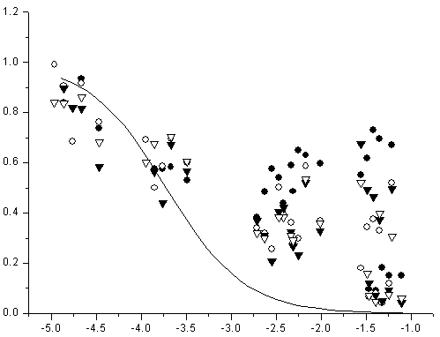
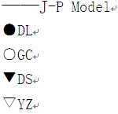
Assessment of Junge-Pankow Model
$$∅$$
The Junge–Pankow model underestimated the particulate sorption of PAHs Other absorption partitioning mechanisms in addition to surface adsorption

Slide 11
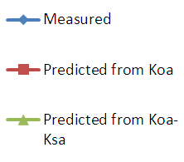
Assessment of K_{OA} & K_{OA}-K_{SA} Models

Slide 12
Adsorption onto soot is more important for PAHs with lower molecular weight.

Slide 13
Conclusions
The average total PAH concentrations were 64.33 ng/m³, 154.59 ng/m³, 93.25 ng/m³ and 122.71 ng/m³, at Dingling, Gucheng, Dongsi, Yizhuang
Lighter PAHs are found predominantly in the gas phase, while those with four or more rings are found mainly in the particle phase
The regression slopes of logK_{p} versus logp_{L}⁰ were much shallower than -1, suggesting non-equilibrium partitioning
The Junge–Pankow adsorption model and K_{OA} model both under-predicted experimental K_{p}. However, in general the dual model fit our experimental K_{p} well, suggesting that PAHs adsorption onto soot carbon and absorption into organic matter were both important for PAHs gas/particle partitioning in Beijing

