Slide 1
Improvement of Cloud Cover Fraction parameterization in Chemistry Transport Model(CTM)
Zhenzhen Yin

Slide 2
Outline
Introduction and Motivation
Application
Results and Discussion

Slide 3
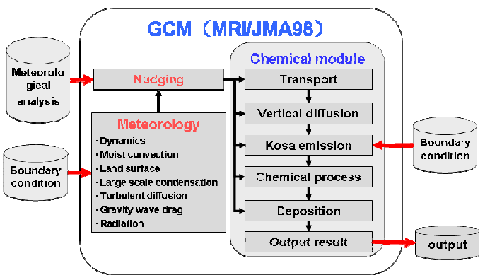
Introduction and Motivation
CTM structure:
Notes:
In most cases, the coupling between the clouds and the dynamical and hydrological processes occurs indirectly as a result of radiatively-induced changes in the large-scale thermal state of the atmosphere. Nevertheless, studies of the climatic or long-term effects of clouds have shown that a model’s simulation of the general circulation is significantly sensitive to the specification of cloudiness. Recent studies of satellite data in conjunction with model results also suggest that the cloud longwave forcing for the troposphere may be as substantial as the latent heating in deep convective systems such as the Indian summer monsoon.

Slide 4
Three major types of cloud parameterizations:
Diagnostic cloud schemes : a function of relative humidity and some other parameters
Statistical schemes : based on assumed probability distributions for the subgrid variability of the thermodynamical properties
Prognostic cloud schemes : the liquid/ice water and the cloud fraction can be determined prognostically.

Slide 5
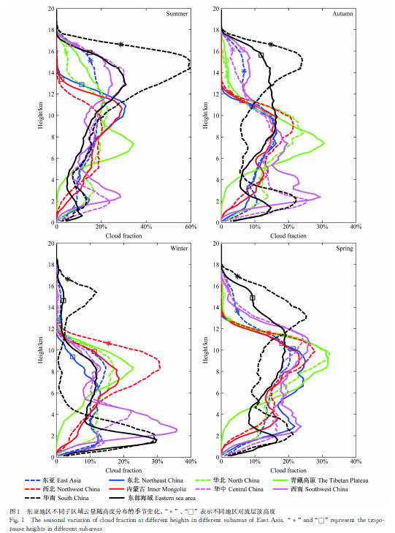
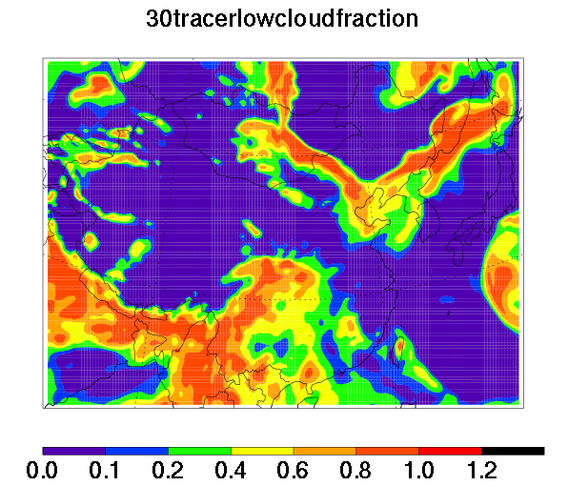

Slide 6
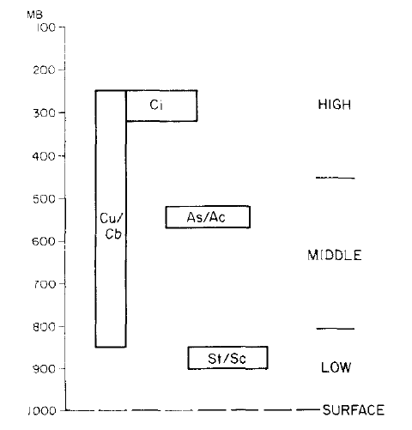
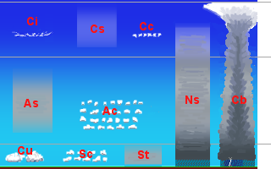
Application
Cirrus
Altocumulus/Altostratus
Cumulus/Cumulonimbus
Stratus/
Stratocumulus

Slide 7
Cirrus associated with outflow from deep convection
Cirrus associated with frontal disturbances
associated with extratropical fronts and tropical disturbances
Occur in relatively quiescent conditions and are directly associated with the boundary layer

Slide 8
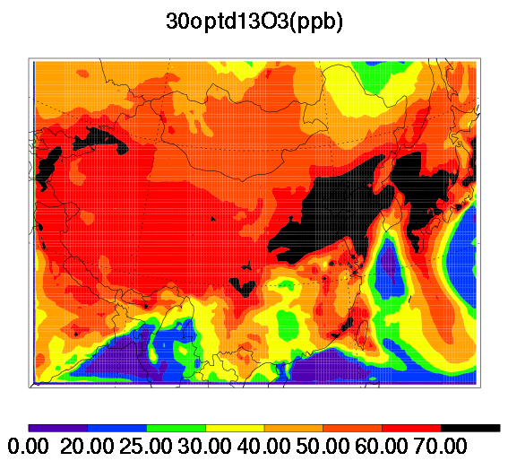
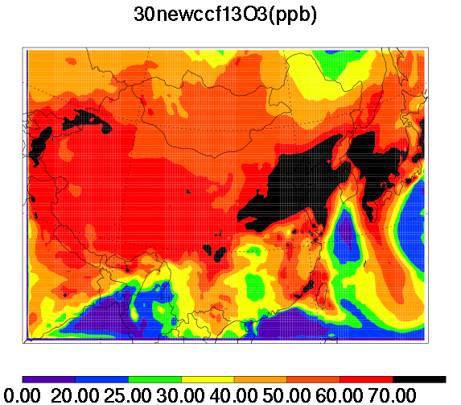
Results and Discussion

Slide 9
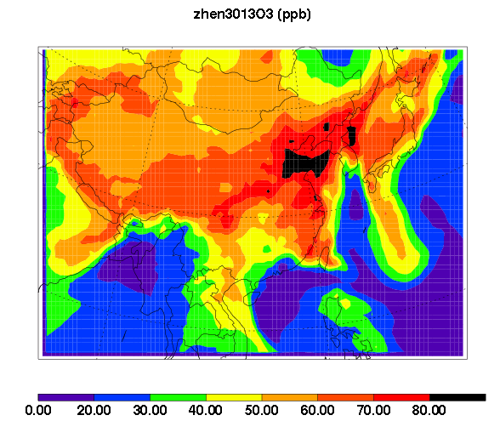
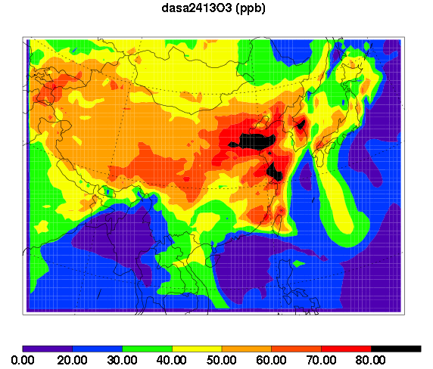

Slide 10
Cirrus associated with outflow from deep convection
Cirrus associated with frontal disturbances
associated with extratropical fronts and tropical disturbances
Occur in relatively quiescent conditions and are directly associated with the boundary layer

Slide 11
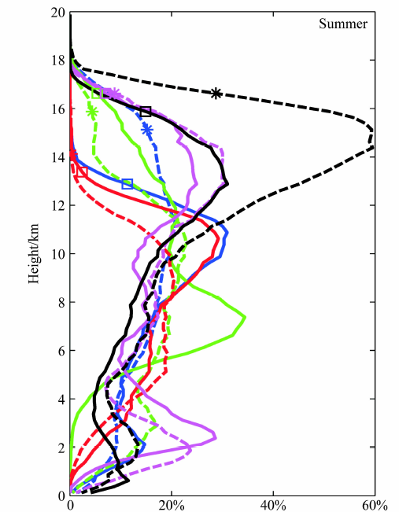

Slide 12
Reference
J.O. TEIXEIRA et al., 2002, Boundary Layer Clouds in Global Atmospheric Model: Simple Cloud Cove Parameterizations, Journal of Climate, 1261-1274.
Slingo, J. M., 1987: The development and verification of a cloud prediction scheme in the ECMWF model. Quart. J. Roy. Meteor.Soc., 113, 899–927.
Smith, R. N. B., 1990: A scheme for predicting layer clouds and their water content in a general circulation model. Quart. J. Roy. Meteor. Soc., 116, 435–460.
Li Jiming et al., 2009, Analysis of vertical distribution of cloud in East Asia by space-based lidar data, Chinese Journal of Atmospheric Sciences, 33, 698-707

Slide 13
Questions?

