Slide 1
Wildfires and Climate
---Interactions and Variations
Yufei Zou, Ziming Ke
04/16/2014

Slide 2
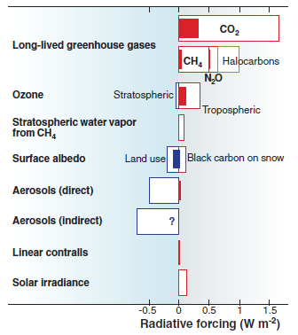
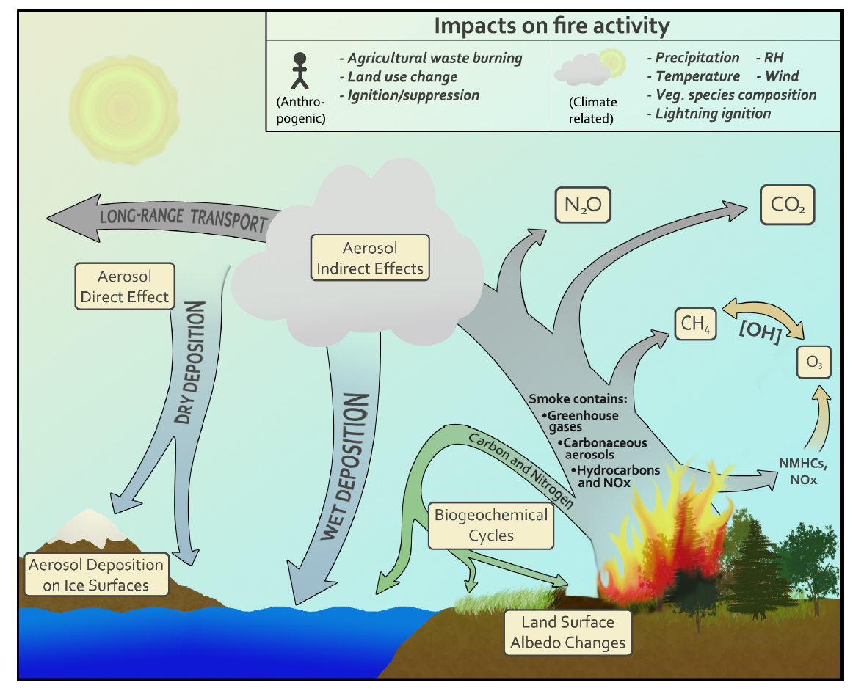
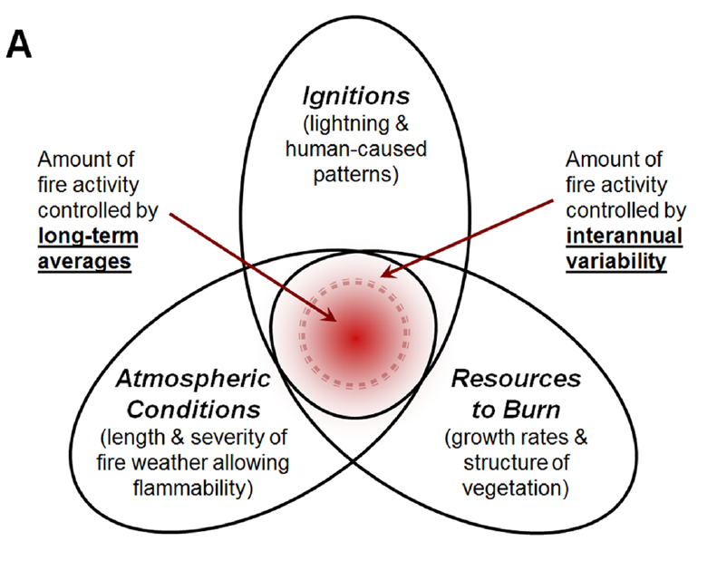
Interactions between Wildfire & Climate
Three dominant factors of fire
Deforestation fire contributions
(Moritz et al., 2012)
Understanding the linkages between natural variability, drivers of change, responses and feedbacks in the fire-climate system
(Ward et al., 2012)

Slide 3
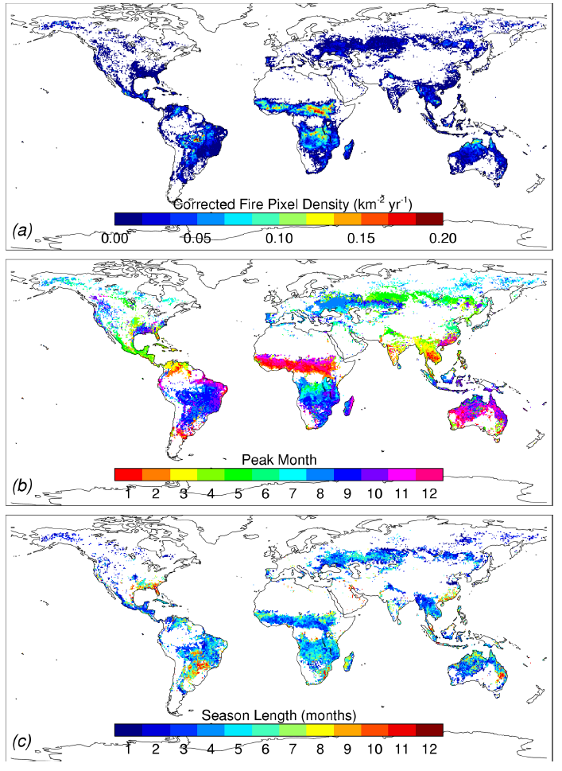
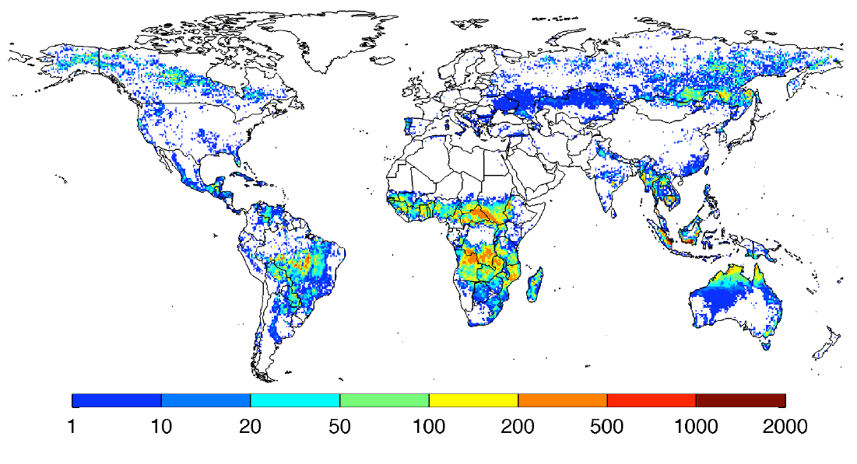
Global fire activities
Climatological fire density from MODIS
Carbon emissions from fire activities
Fire carbon emissions (gC/m²/yr)
Peak month of global fire
Biomass-limited vs. drought limited
Season length of global fire
(Werf et al., 2010)
(Giglio et al., 2006)

Slide 4
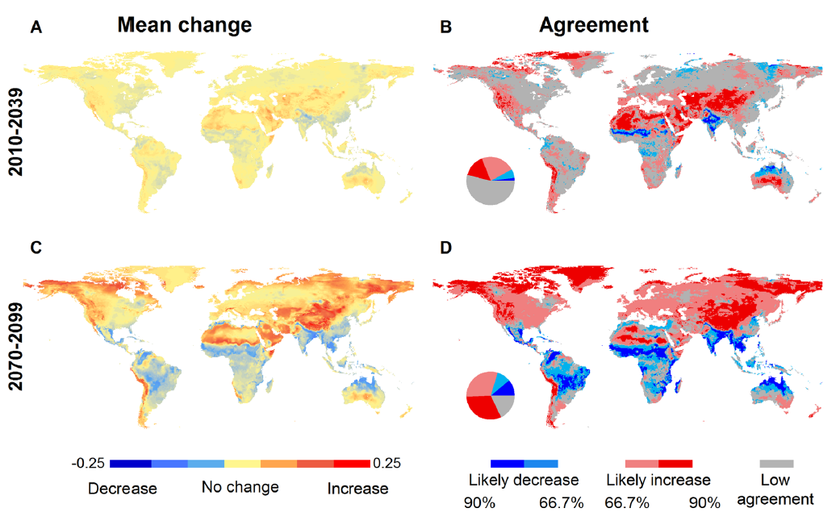
Driving forces of global wildfire
Fire in the past
Fire in the future
Predicted fire probability among 16 GCMs
Changes in global precipitation played a major role in the preindustrial period;
A stronger influence from direct anthropogenic activities following the Industrial Revolution;
An impending shift to a temperature-driven global fire regime in the 21st century;
Moritz, et al., 2012
(Pechony and Shindell, 2010)

Slide 5
Fire in the US
Less moisture-more fires
Large wildfire trends from remote sensing data
Driving forces in the US: precipitation/humidity vs. temperature
More humid and rainy in the East and drier in the West
(Running, 2006)
Early snowmelt-more fires
Declined fire activities in the East and enhanced fire in the West
(Dennison et al, 2014)
(Westerling et al., 2006)
(Pechony and Shindell, 2010)

Slide 6
Fire in Canada
Highest expected ignition densities along the south boarder regions with higher population densities;
A slight decrease in anthropogenic wildfire ignitions vs. neutral fluctuations in lightning ignitions;
Negative trend in high density regions vs. Positive trend in low density regions;
(Gralewicz et al., 2012)

Slide 7
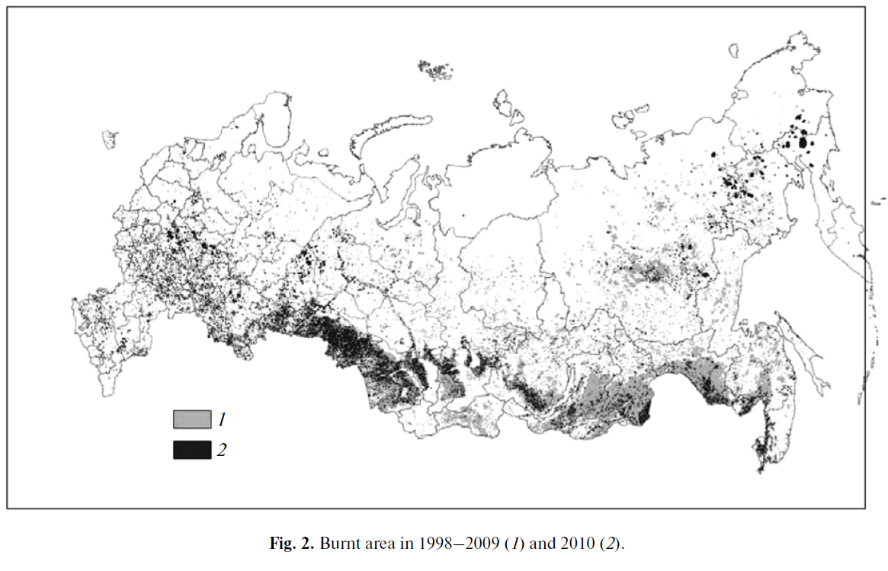
Fire in Russia
Burned Area in Russia
Forest | Damaged forests | Prescribed | Grass /shrub | wetland
59.3% | 5.8% | 18.9% | 8.7% | 7.3%
1998-2009
2010
A weak trend of increasing burned area that is not statistically significant;
Spring fires after snow melting vs. late summer fires due to abnormally dry seasons
(Shvidenko et al., 2011)

Slide 8
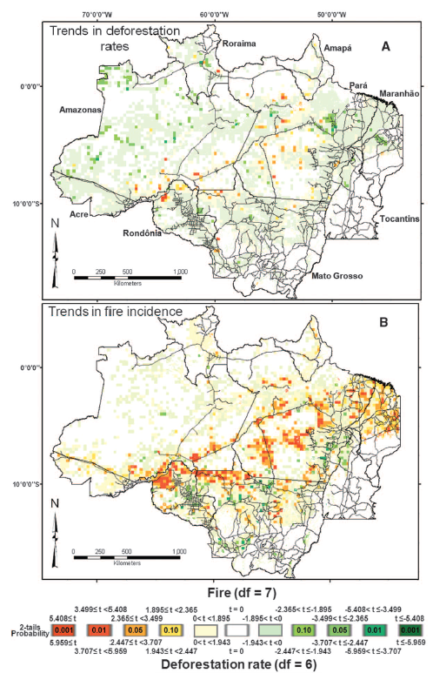
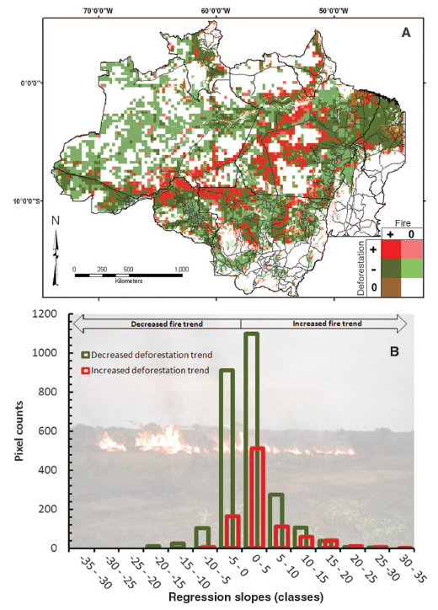
Fire in the Amazon
A widespread pattern of decreased deforestation rates from 2000 to 2007 (54% negative vs. 17% positive);
Fire occurrence has increased in 59% of the area that has experienced reduced deforestation rates;
2000-2007
Skewed to right in both cases!
(Aragao et al., 2010)

Slide 9

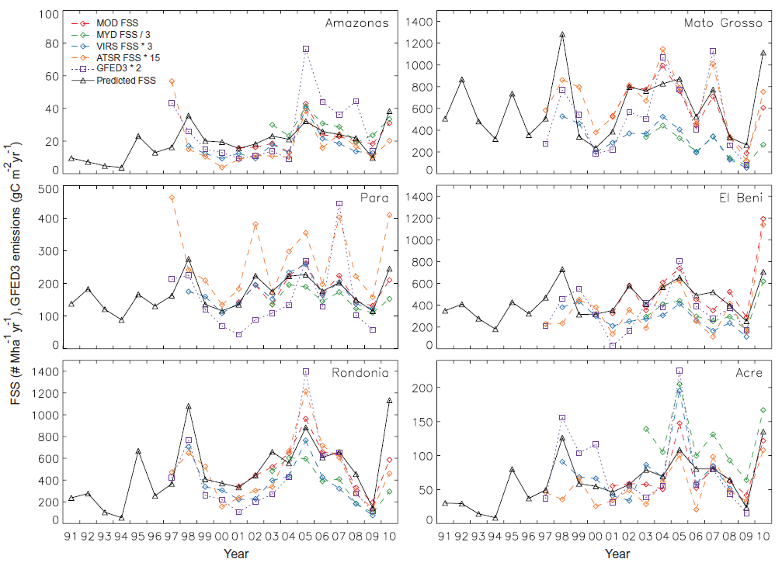
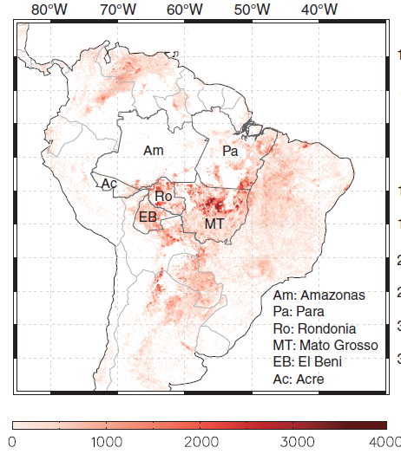
Fire in the Amazon
The Ocean Nino Index (ONI) was correlated with interannual fire activity in the eastern Amazon;
The Atlantic Multidecadal Oscillation index (AMO) was more closely linked with fires in the southern and southwestern Amazon;
Empirical predictive model of Fire Season Severity (FSS) with lead time of 3-5 months
(Chen et al., 2011)

Slide 10
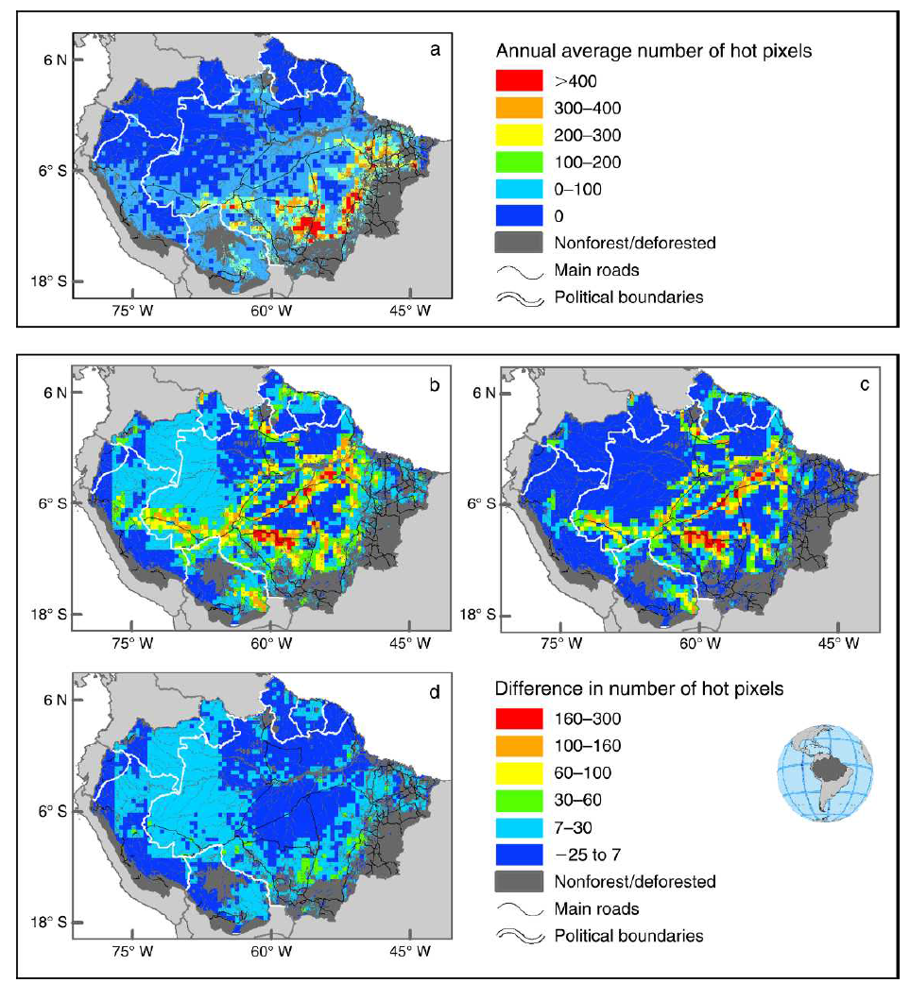
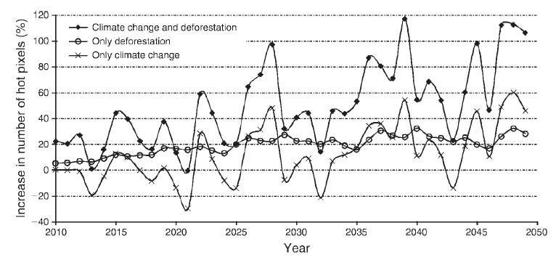
Fire in the Amazon
Current climate + land use
a probabilistic model with anthropogenic factors and climatic conditions (vapor pressure deficit);
IPCC’s A2 scenario + BAU deforestation (2050)
BAU deforestation
Forest fire occurrence may double in years of extreme drought;
More widespread fires along the highways and in the agricultural zones;
Climate change alone may spread fire activity into the northwestern Amazon;
IPCC’s A2 scenario
(Silvestrini et al., 2011)

Slide 11
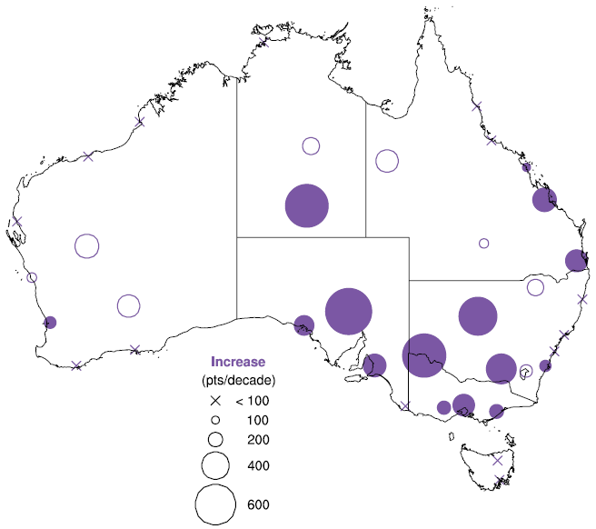
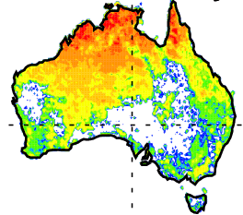
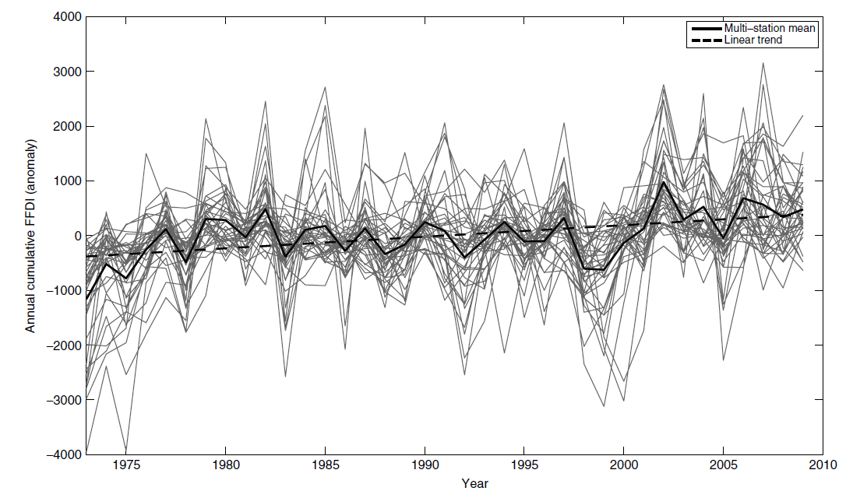

Fire in Australia
A significant increase in annual cumulative FFDI towards the southeast of the continent;
The largest increases in seasonal FFDI occurred during spring and autumn, while summer recorded the fewest significant trends;
Annual cumulative FFDI trend
Time series of annual cumulative FFDI anomaly
Forest Fire Danger Index (FFDI)
DF: drought factor; T: temperature;
H: relative humidity; V: wind speed;
(Clarke et al., 2013)

Slide 12
Summary
Fire severity are dominated by multiple factors including climate variability and anthropogenic activities;
Distinct variations in specific regions at present day;
Generally increasing fire probabilities at mid- to high-latitudes vs. decreasing probabilities in the tropics in long-term prediction ;

Slide 13
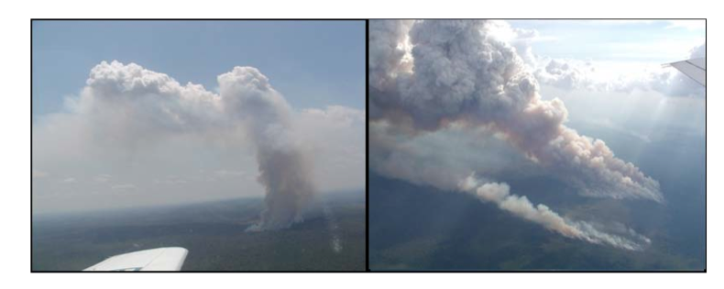
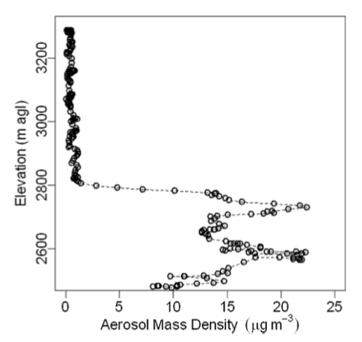
Fire Plume
Downwind Aerosol Mass Density
(Freitas et al., 2010)
(Urbanski et al., 2010)
Notes:
1, after discussed the emission trends around the world, here we focus on the transport of emissions and the impacts of emissions on weather and climate
2, one important feature is plume height or injection height, which is characterized as the maximum height a smoke plume can reach vertically in the atmosphere. For a well-developed plume, it is measured at the point where a smoke plume bends from vertical rising to horizontal transport, like the left panel. Most emissions are injected into atmosphere at this level.
3, It is needed to mention that one plume could have several fire cores.
4, a measurements ~10km downwind of the Kooternai Creak Fire, showing the emissions are concentrated in a narrow vertical bend.
5, Fire emissions injected at higher elevations are likely to be transported out of the local burn site and may affect air quality in downwind locations.

Slide 14
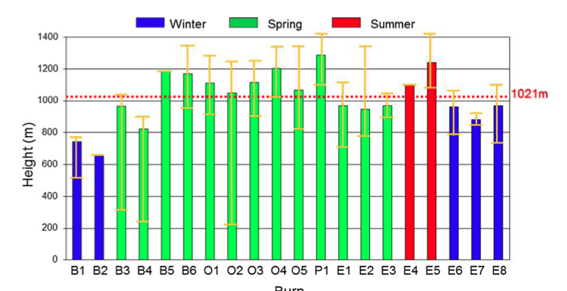
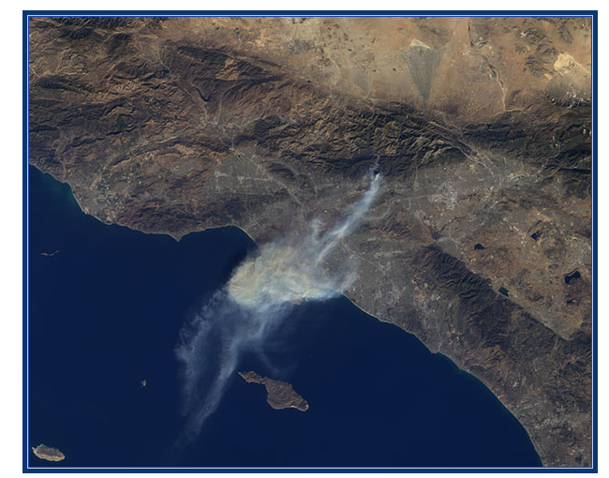
Plume Height Measurements
Satellite-based: MISR, CALIPSO
Ground-based: LIDAR system
Notes:
1, left is the MISR picture about California fire Jan, 18th, 2014
2, right is the ground ceilometer measurements for 20 prescribed burns in the southeastern US

Slide 15
Plume Height simulation
Empirical model: Fire Emission Production Simulator (FEPS) derived from the Briggs scheme.
Dynamical models: Freitas et al. (2006) and Kiefer et al. (2011) model
Hybrid model: DAYSMOKE( Achtemeier et al, 2011)

Slide 16
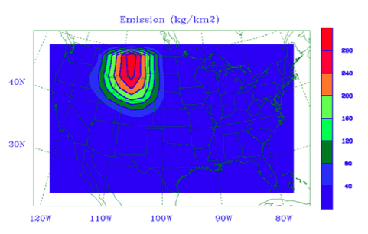
Impact on Climate: 1988 northern U.S. fire
Location: Northern Rocky mountains
Model: NCAR RegCM
Emissions of smoke particles E=ASL
Optical depth:
Smoke distribute evenly: 0~2500m
Emission 300kg km⁻², DRF up to -9 Wm⁻²
Evaluate the impact of absorbing aerosol.
(Liu., 2005)
Notes:
1, A, burned area; L fuel loading factor; S emission factor
2, DRF: direct radiative forcing, measured at the top of the model level
3, figure is 1988 observation of precipitation in mm

Slide 17
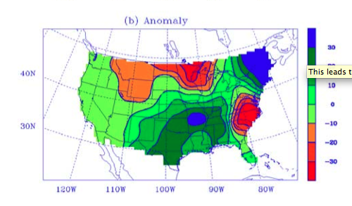
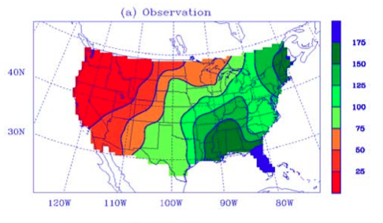
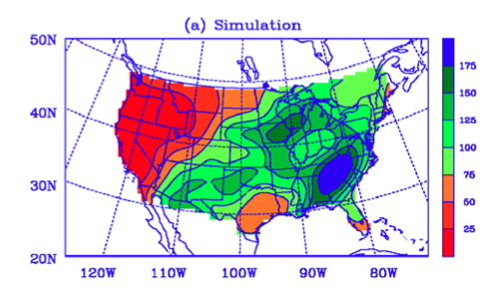
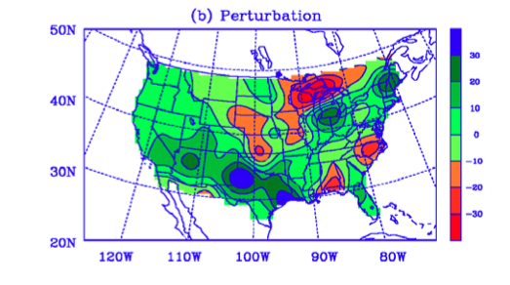
(Liu 2005)
Notes:
1, simulated geographic pattern of of precipitation, error: rainfall in southeast and midwest
2, perturbation capture the drought in northeast, and more rain in southwest.
3, increase the smoke amount, increase the intensity of drought over great lakes
4, increase the smoke injection height, the drought increase
5, remove the emission to the downwind area, the drought also increase.

Slide 18
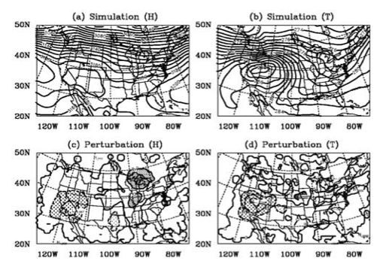
Geopotential height (in m) and temperature (in K) on 700 hPa
(Liu 2005)
Notes:
1, ridge and trough in (a), a tropical easterly trough over Mexican coast
2, absorption of solar radiation by smoke particles releases heat in upper smoke layer, → warm air downwind → weaken the trough → cloud and rainfall are reduced
3, absorption of solar radiation by smoke particles releases heat in upper smoke layer → weak north-south temperature gradient → weaken the high over the southwestern West → increase the rainfall and cloud

Slide 19
Case Summary
Absorption of solar radiation by smoke particles weakens the North America trough in the middle latitudes ,which is a major generator of precipitation in the Midwest.

Slide 20
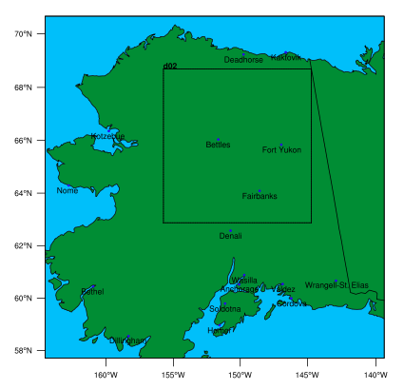
Impact on weather: 2004 Alaska Fire simulation
In summer 2004, 701 wildfires burned 6.6 million acres, largest since 1957 (Alaska Interagency Coordination Center)
WRF model with WRF-Chem and fire module
Nesting grid, resolution: 10km for big domain, 2km for small one (cloud resolved).
Investigate the interaction of aerosols with radiation and cloud microphysics.
(Grell et al., 2011)

Slide 21
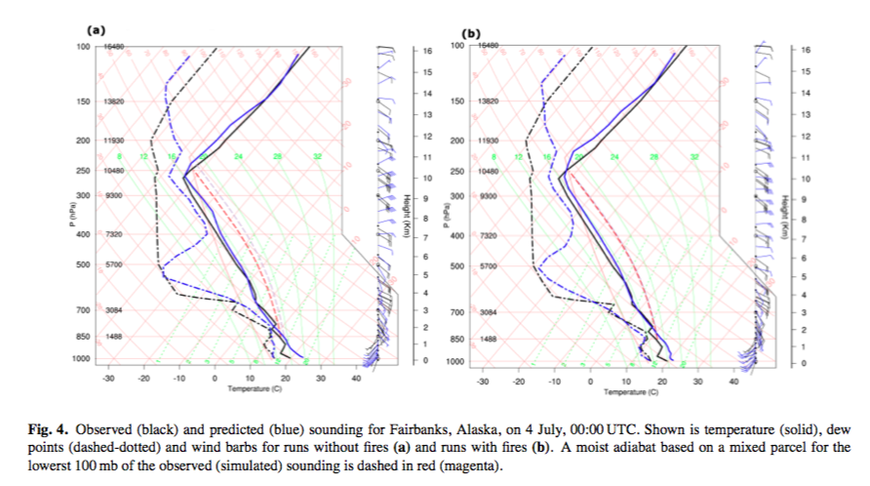
Without Fire
With Fire
(Grell et al., 2011)

Slide 22
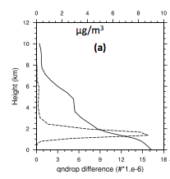
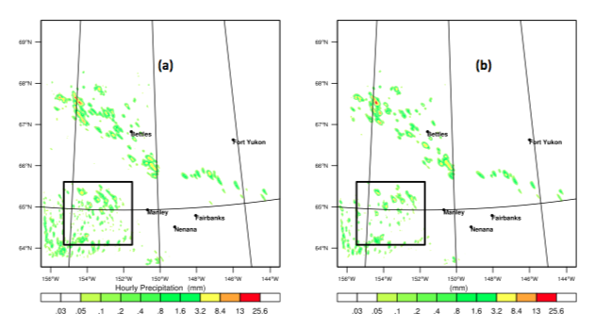
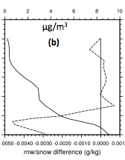
July 3rd, 12:00 UTC(local night time)
Precipitation suppressed by emissions: non-convection cloud
Droplet number density
Without Fire
With Fire
Rain water mixing ratio
Dashed line: With fire – Without Fire
Solid line: PM2.5 concentration
(Grell et al., 2011)

Slide 23
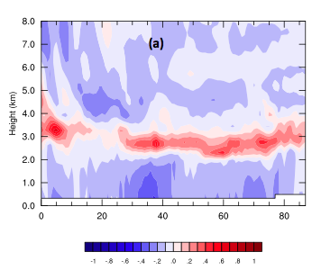
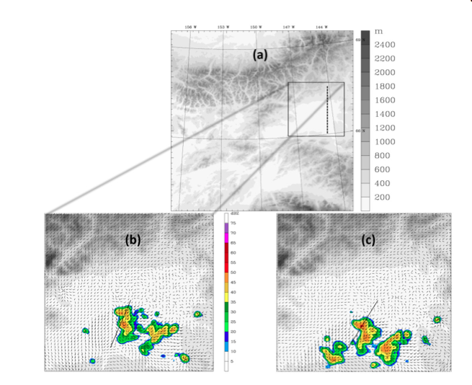
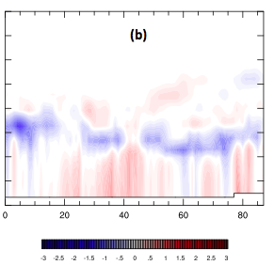
Temperature difference
July 4th, 02:00 UTC(local day time)
Precipitation enhanced by emissions: cloud free
(Grell et al., 2011)
Water vapor mixing ratio difference
Without Fire
With Fire

Slide 24
Case Summary
Interaction of aerosols with the atmospheric radiation led to slightly increase of CAPE in cloud-free areas, and resulting in more precipitation in the afternoon.
When cloud is present, the emissions result in large numbers of CCN and suppress the precipitation.

Slide 25
Reference
Freitas, S. R., K. M. Longo, R. Chatfield, D. Latham, M. A. F. Silva Dias, M. O. Andreae, E. Prins, J. C. Santos, R. Gielow, and J. A. Carvalho Jr. "Including the sub-grid scale plume rise of vegetation fires in low resolution atmospheric transport models." Atmospheric Chemistry and Physics 7, no. 13 (2007): 3385-3398.
Grell, G., S. R. Freitas, Martin Stuefer, and J. Fast. "Inclusion of biomass burning in WRF-Chem: impact of wildfires on weather forecasts." Atmospheric Chemistry & Physics 11, no. 11 (2011).
Heilman, Warren, Yongqiang Liu, Shawn Urbanskic, V. Kovalevd, and R. Micklere. "Wildland fire emissions, carbon, and climate: Plume rise, atmospheric transport, and chemistry processes." Forest Ecology and Management 317 (2014): 70-79.
Liu, Yongqiang. "Enhancement of the 1988 northern US drought due to wildfires." Geophysical research letters 32, no. 10 (2005).

