Slide 1
Bacteria CCN activity: Parametrization application for cloud droplet formation including adsorption activation and considering insoluble CCNs
Arnaldo Negron Marty; April 24, 2014

Slide 2
Objectives
Use Köhler and Frenkel-Halsey-Hill (FHH) theory to analyze the contact angles and average experimental critical supersaturations obtained for bacteria.
Understand the behavior of bacteria as CCN and estimate a range of supersaturations for the radius ranges of bacteria.

Slide 3
Bacteria as CCN
Act as CNN and different factors play key role in the nucleation as:
Hygroscopicity: (contact angle)
Supersaturation
Surface of the particle
wettable & insoluble
wettable & soluble
insoluble & absorbs water

Slide 4
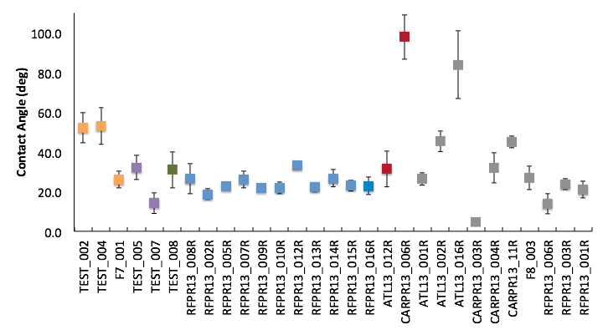
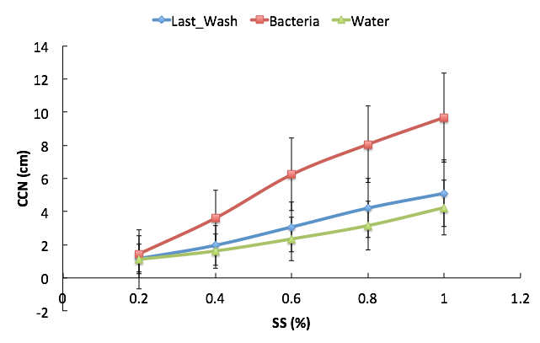
Bacteria as CCN
Contact Angles
CCN concentration vs. supersaturation%
Critical Supersaturation
Hydrophobic
In Between
Hydrophilic
Pseudomonas sp.
Unidentified
Bacillus sp.
Erwinia sp.
Curtobacterium sp.
Staphylococcus sp.

Slide 5
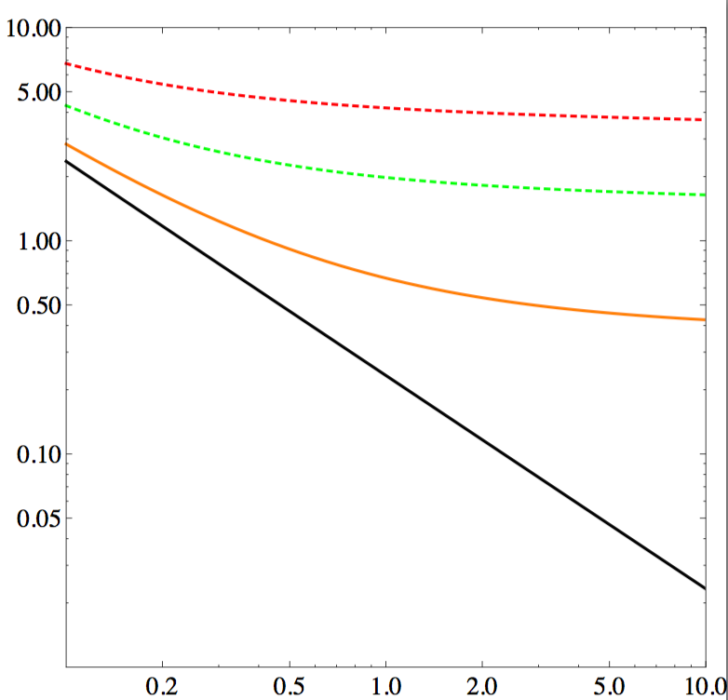
Nucleation of Drops on Water-Insoluble CCN (Mc Donald,1964)
Critical supersaturation is calculated given the following equations:
ø=12º
ø=8º
1
ø=4º
ss(%)
Kelvin function, insoluble particle
2
ø=0º
3
Contact angle (ø)
Dry particle radius (sphere)
dry diameter(µm)
Chart 1: Critical supersaturation for water nucleation
on a spherical, water-insoluble substrate particle of radius rN as
function of contact angle ø
*Combination of Eq. 1,2,3 is used to plot Chart 1.

Slide 6
Nucleation of Drops on Water-Insoluble CCN considering adsorption
Frenkel-Halsey-Hill (FHH) multilayer physical adsorption model
The following equations are used to find the supersaturation(%) as function of particle dry diameter:
3
;
4
Using Critical
diameter
*A range of dry diameters is used to determine critical diameter with Eq. 4
5
*The set of critical diameters and dry diameter is used to calculate the critical supersaturation with Eq. 5

Slide 7
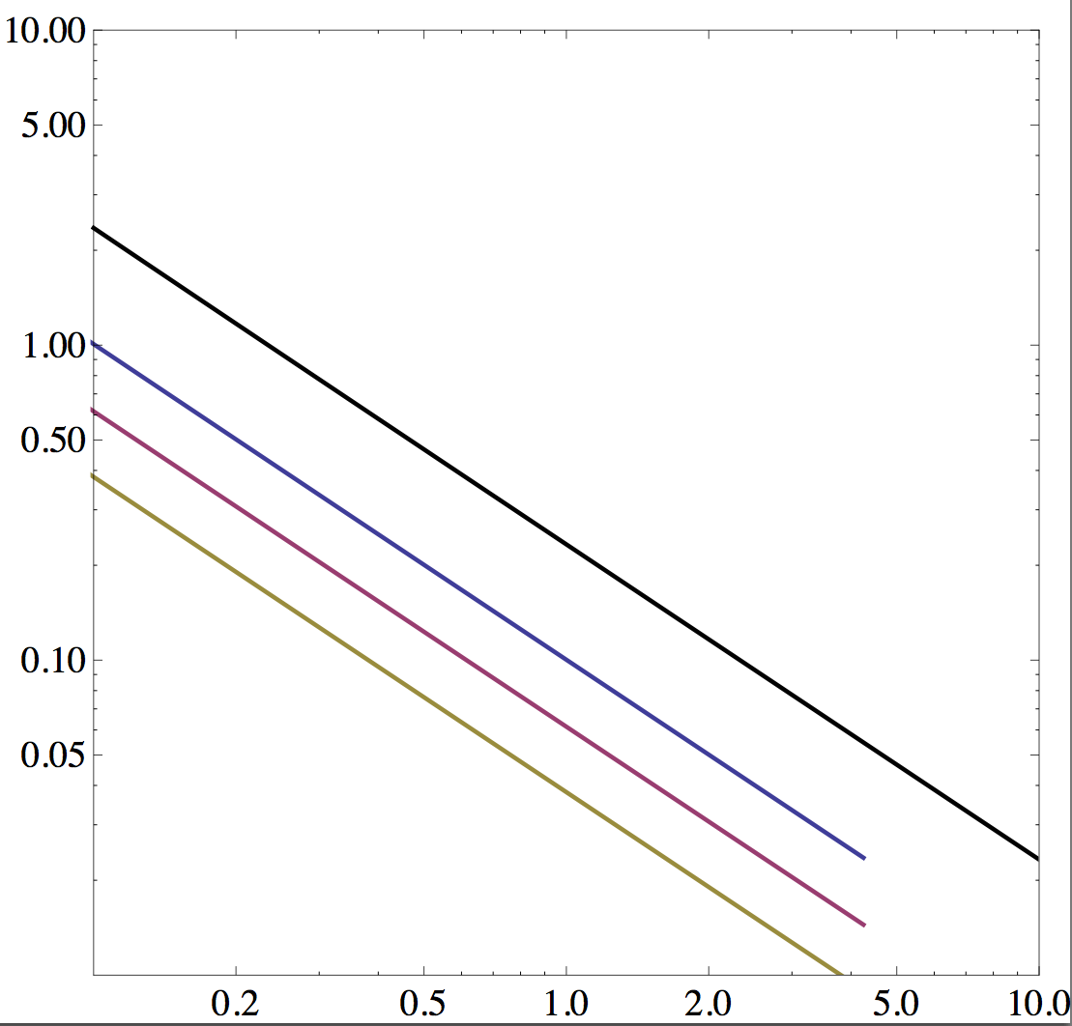
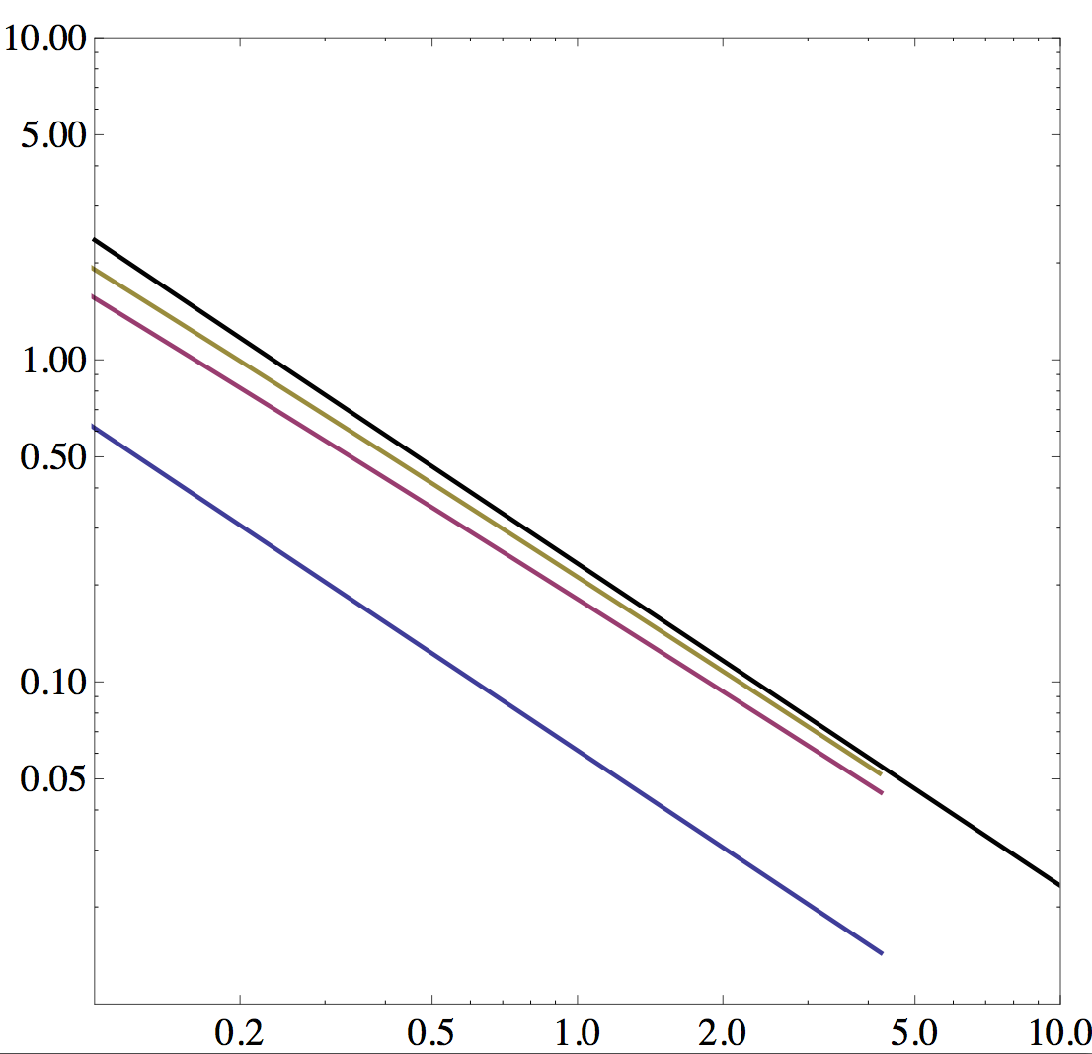
FHH adsorption model
AFHH variation
BFHH variation
BFHH =2.0
BFHH =1.5
ss(%)
ss(%)
Kelvin function, insoluble particle
AFHH =1.0
Kelvin function, insoluble particle
AFHH =1.5
BFHH =1.0
AFHH =2.0
dry diameter(µm)
dry diameter(µm)
Chart 2: Critical supersaturation for water nucleation
on a spherical, water-insoluble particle, which
absorbs water (increment of AFHH constant).
Chart 3: Critical supersaturation for water nucleation
on a spherical, water-insoluble particle, which
absorbs water (increment of BFHH constant).

Slide 8
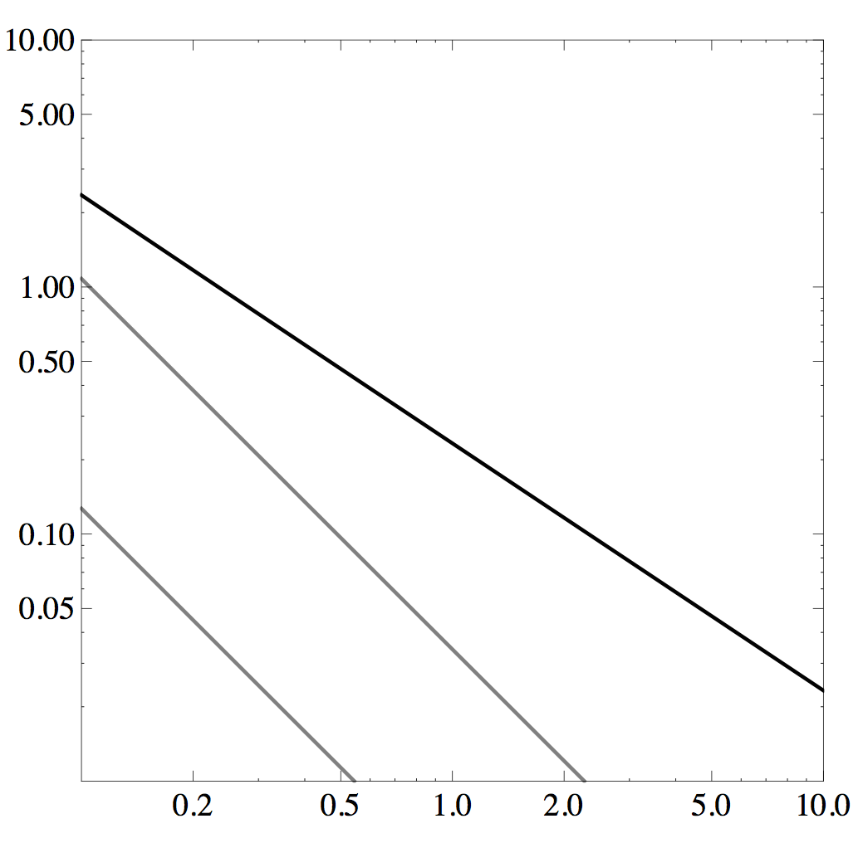
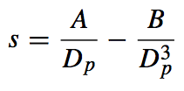
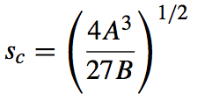
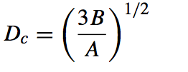
Nucleation of Drops on Water-soluble CCN (Köhler Theory)
The following equations are used to find the supersaturation(%) as function of particle dry diameter:
ss(%)
6
; where
7
&
8
Kelvin function, insoluble particle
Minimun solubility
Eq. 6 is differentiated with respect to Dc,
which is finally used to find Sc
Maximum solubility
9
10
dry diameter(µm)
critical supersaturation
Critical diameter

Slide 9
Bacteria Data: Parametrization Analysis
Experimental Supersaturation for hydrophilic (ø≈ 20º) bacteria is around 0.4% -0.5%
The range of diameters studied in these experiments are 0.7µm - 2.0µm
Supersaturations obtained don’t fit with the approach of insoluble particles. As result is hypothesized that bacteria is absorbing water or is partially soluble in water. (More research is needed in order to know the mechanism by which they nucleate)
ø=12º
ø=8º
ø=4º
ss(%)
Kelvin function, insoluble particle
ø=0º
dry diameter(µm)
Chart 4: Analysis of Critical supersaturation as function of dry diameter of a particle for bacteria.

Slide 10
Conclusions
Based on the analysis performed to the experimental data of bacteria CCN activity we can conclude that bacterias are not a complete insoluble particle and should absorb water in order to have such supersaturations at high contact angles
None of the parametrizations discussed can describe exactly what will be the critical supersaturation at a certain dry diameter for bacteria, but they can give us an approximation of what combination of the existing parametrization can be used to estimate SS% for specific dry diameters.

